Slide 1
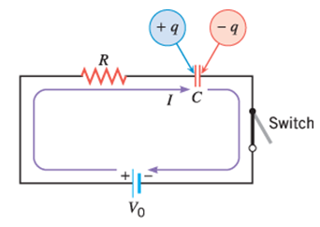
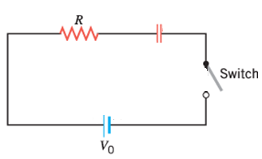
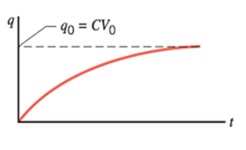
RC CIRCUITS: Charging
Time constant = τ = RC
What is the unit for RC?

Slide 2
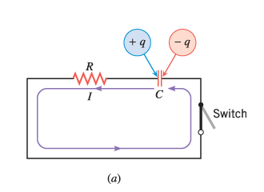
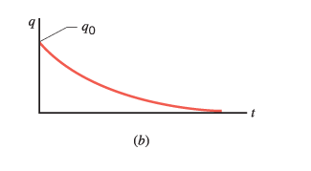
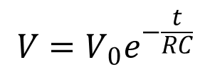
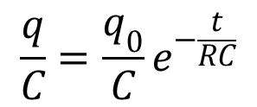
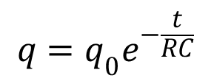
RC Circuits: Discharging
$$q=q_{0}e^{−\frac{t}{RC}}$$
Time constant = τ = RC
$$\frac{q}{C}=\frac{q_{0}}{C}e^{−\frac{t}{RC}}$$
$$V=V_{0}e^{−\frac{t}{RC}}$$

Slide 3
Problem 65, Chap 21
65. The duration of a photographic flash is related to an RC time constant, which is 0.100 μs for a certain camera. (a) If the resistance of the flash lamp is 0.0400 Ω during discharge, what is the size of the capacitor supplying its energy? (b) What is the time constant for charging the capacitor, if the charging resistance is 800 kΩ?

Slide 4
Problem 63, Chap 21
63. The timing device in an automobile’s intermittent wiper system is based on an RC time constant and utilizes a 0.500-μF capacitor and a variable resistor. Over what range must R be made to vary to achieve time constants from 2.00 to 15.0 s?

Slide 5
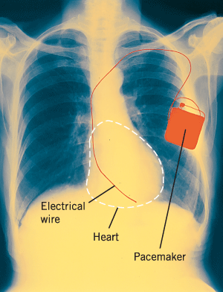
The physics of heart pacemakers
Heart pacemakers, for instance, incorporate RC circuits to control the timing of voltage pulses that are delivered to a malfunctioning heart to regulate its beating cycle.

Slide 6
Problem-69 Chap 21
69. A heart defibrillator being used on a patient has an RC time constant of 10.0 ms due to the resistance of the patient and the capacitance of the defibrillator. (a) If the defibrillator has an 8.00-μF capacitance, what is the resistance of the path through the patient? (b) If the initial voltage is 12.0 kV, how long does it take to decline to 600 V ?

