Slide 1
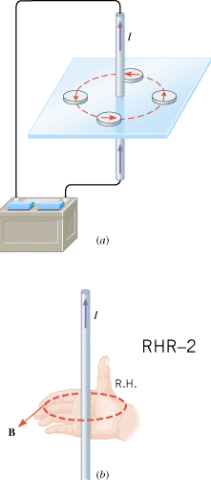
21.7. Magnetic Fields Produced by Currents
Right-Hand Rule No. 2. Curl the fingers of the right hand into the shape of a half-circle. Point the thumb in the direction of the conventional current I, and the tips of the fingers will point in the direction of the magnetic field B.

Slide 2
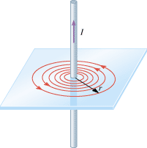
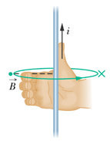
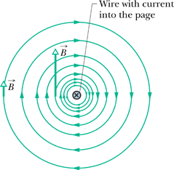
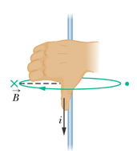
A LONG, STRAIGHT WIRE

Slide 3
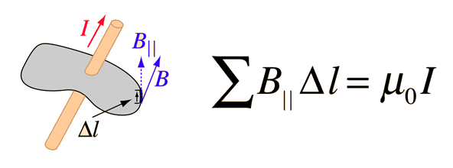
21.8 Ampère's Law
For any current geometry that produces a magnetic field that does not change in time,
A LONG, STRAIGHT WIRE

Slide 4
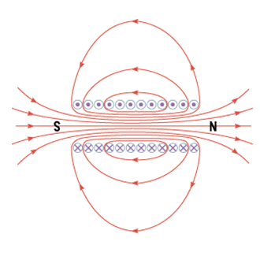
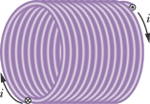
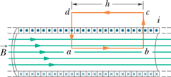
SOLENOID

Slide 5
21.9. Magnetic Materials
Magnetic field originates from the orbital and spin motions of the electron.
Most substances are nonmagnetic, the magnetism produced at the atomic level tends to cancel out.
However, there are some materials, known as ferromagnetic materials, in which the cancellation does not occur for groups of approximately 10¹⁶ – 10¹⁹ neighboring atoms, because they have electron spins that are naturally aligned parallel to each other.
This alignment results from a special type of quantum mechanical interaction between the spins. The result of the interaction is a small but highly magnetized region of about 0.01 to 0.1 mm in size, depending on the nature of the material; this region is called a magnetic domain.
Each domain behaves as a small magnet with its own north and south poles. Common ferromagnetic materials are iron, nickel, cobalt, chromium dioxide, and alnico (an aluminum-nickel-cobalt alloy).
Rare-earth magnets are strong permanent magnets made from alloys of rare earth elements. There are two types: neodymium magnets and samarium-cobalt magnets.

Slide 6
INDUCED MAGNETISM

Slide 7
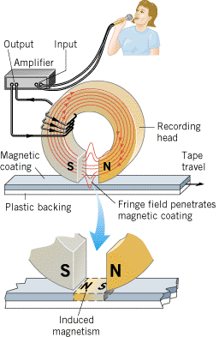
MAGNETIC TAPE RECORDING

Slide 8
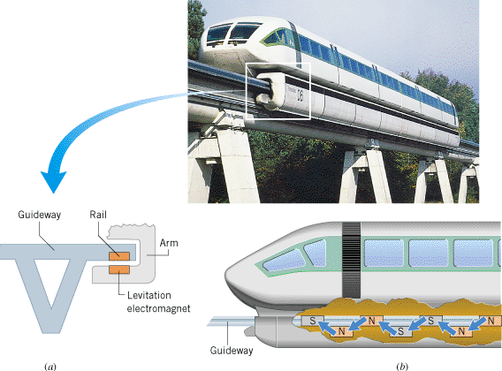
MAGLEV TRAIN magnetically levitated train

Slide 9
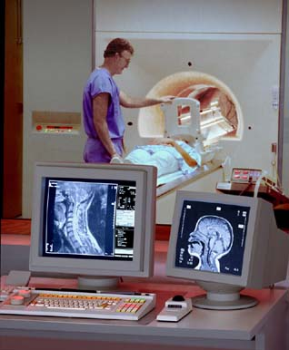
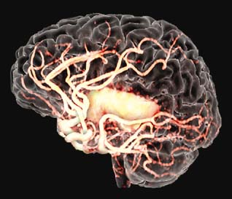
Magnetic Resonance Imaging (MRI)

Slide 10
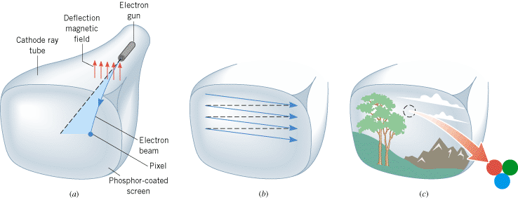
Cathode Ray Tube (CRT)

