Slide 1
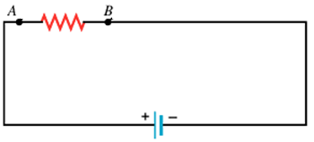
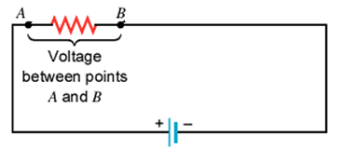
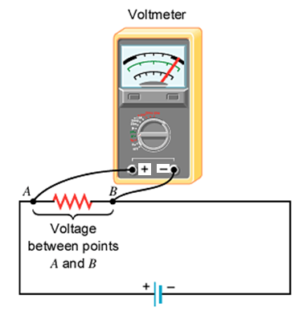
Electric Circuits Voltage Measurement

Slide 2
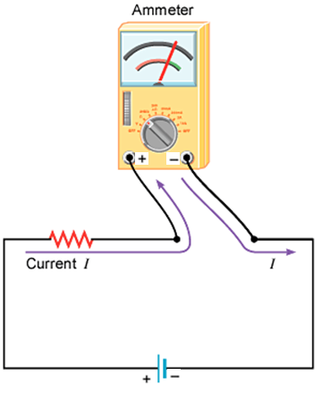
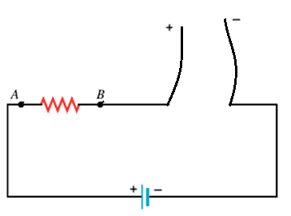
Current Measurement

Slide 3
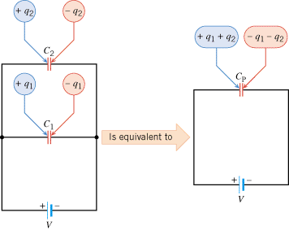
Capacitors in Parallel

Slide 4
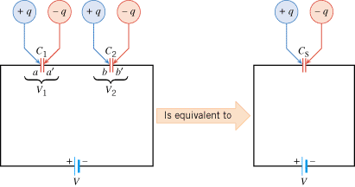
Capacitors in Series

Slide 5
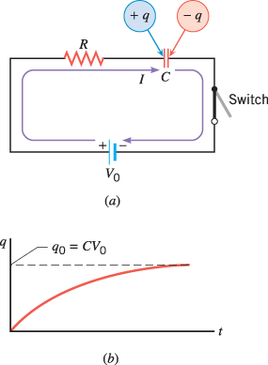
RC CIRCUITS: Charging
Time constant = τ = RC

Slide 6
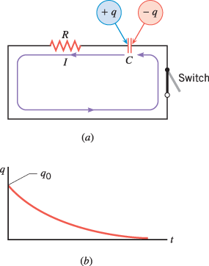
RC Circuits: Discharging
Time constant = τ = RC

Slide 7
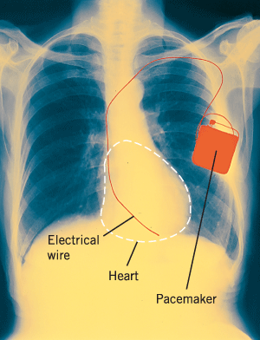
The physics of heart pacemakers
Heart pacemakers, for instance, incorporate RC circuits to control the timing of voltage pulses that are delivered to a malfunctioning heart to regulate its beating cycle.

Slide 8
P 103
In a heart pacemaker, a pulse is delivered to the heart 81 times per minute. The capacitor that controls this pulsing rate discharges through a resistance of 2.1 MΩ. One pulse is delivered every time the fully charged capacitor loses 68.0% of its original charge. What is the capacitance of the capacitor?

