Slide 1
Kirchhoff's Rules
There are two KIRCHHOFF'S RULES. 1. Junction rule 2. Loop rule
These are useful in circuit analysis.

Slide 2
Kirchhoff's Rules
Junction rule. The sum of the magnitudes of the currents directed into a junction equals the sum of the magnitudes of the currents directed out of the junction.
Loop rule. Around any closed circuit loop, the sum of the potential Rises equals the sum of the potential drops.

Slide 3
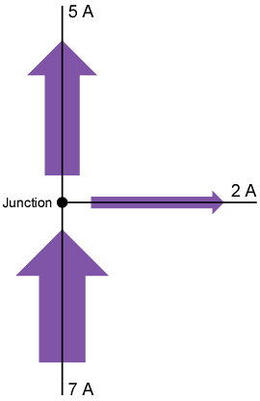
Junction Rule
Junction rule. The sum of the magnitudes of the currents directed into a junction equals the sum of the magnitudes of the currents directed out of the junction.

Slide 4
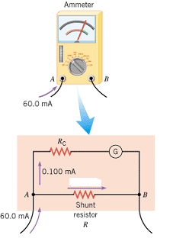
Application of Junction Rule
Q: A galvanometer with a full-scale limit of 0.100 mA is to be used to measure a current of 60.0 mA. How much current will pass through the shunt resistance R?
A: 60.0 – 0.1 = 59.9 mA

Slide 5
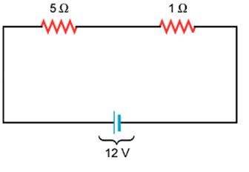
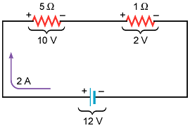
Loop Rule
Loop rule. Around any closed circuit loop, the sum of the potential drops equals the sum of the potential rises.

Slide 6
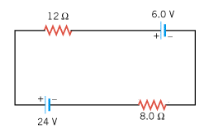
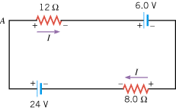
Application of Loop Rule
The circuit shown below contains two batteries and two resistors. Determine the current I in the circuit.

Slide 7
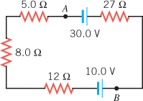
Problem
a. Fine the magnitude of the current in the circuit.
b. The magnitude of the potential difference between the points labeled A and B.
c. State which point, A or B, is at the higher potential.

Slide 8
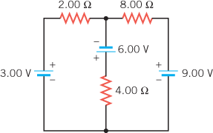
Problem
1. Assign unknown currents.
2. Identify the low and high potentials for the resistors and batteries.
3. Write down the potential differences across the resistors in terms of the assigned currents and the given resistance values.
4. Write down the junction rule equation using the assigned currents.
5. Write down the loop rule equation, for 2 different loops.
6. Solve the simultaneous equations and find the currents.

