Slide 1
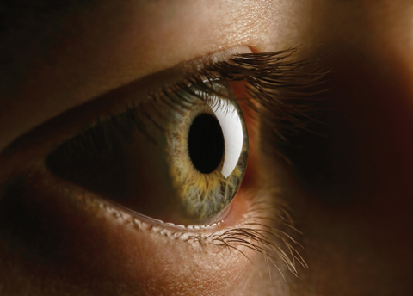
The Refraction of Light

Slide 2
The Index of Refraction
Substance | Index of Refraction, n (at λ = 589 nm )
Solids at 20 °C
Diamond | 2.419
Glass, crown | 1.523
Ice ( ) | 1.309
Sodium chloride | 1.544
Quartz
Crystalline | 1.544
Fused | 1.458
Liquids at 20 °C
Benzene | 1.501
Carbon disulfide | 1.632
Carbon tetrachloride | 1.461
Ethyl alcohol | 1.362
Water | 1.333
Gases at 0 °C, 1 atm
Air | 1.000 293
Carbon dioxide | 1.000 45
Oxygen, | 1.000 271
Hydrogen, | 1.000 139
The index of refraction n of a material is the ratio of the speed c of light in a vacuum to the speed v of light in the material:
Q: What is the speed of light in water?

Slide 3
Refraction and Speed of the Wave
Q. As light travel from one medium to another which one of the following does not change?
a. Velocity b. Wavelength c. Frequency

Slide 4
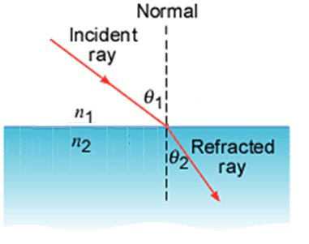
Snell's Law of Refraction
When light travels from a material with refractive index n₁ into a material with refractive index n₂ the refracted ray, the incident ray, and the normal lie in the same plane. The angle of refraction θ₂ is related to the angle of incidence θ₁ by:
n₁ sin θ₁ = n₂ sin θ₂
13. Suppose you have an unknown clear substance immersed in water, and you wish to identify it by finding its index of refraction. You arrange to have a beam of light enter it at an angle of 45.0º , and you observe the angle of refraction to be 40.3º . What is the index of refraction of the substance and its likely identity?

Slide 5
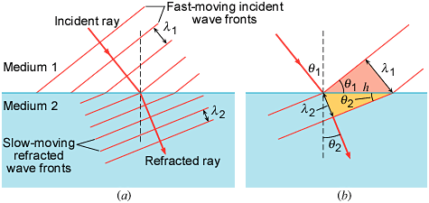
Derivation of Snell's Law

Slide 6
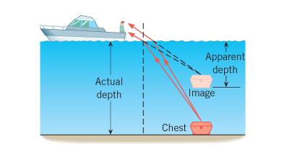
Apparent depth and Actual depth

Slide 7
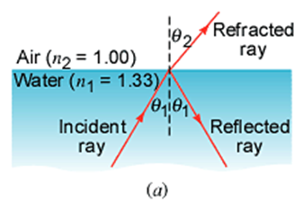
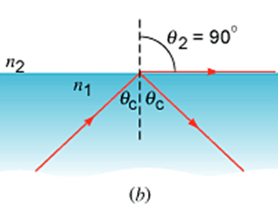
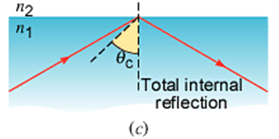
Total Internal Reflection
Critical angle, θ_{c} is given by:

Slide 8
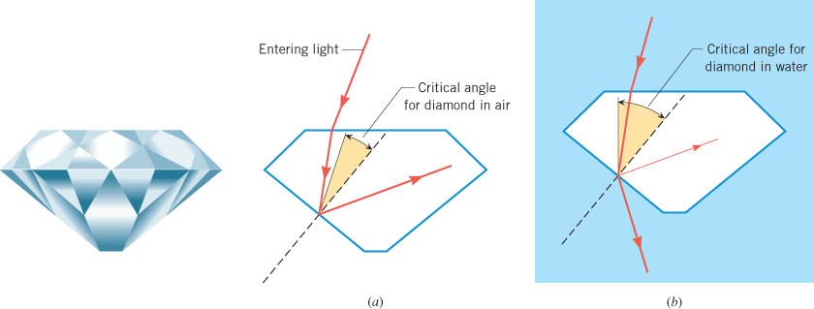
Why a diamond sparkles?
Why does a diamond exhibit such brilliance? And why does a diamond lose much of its brilliance when placed under water?
21. (a) At the end of Example 25.4, it was stated that the critical angle for light going from diamond to air is 24.4º . Verify this. (b) What is the critical angle for light going from zircon to air?

Slide 9
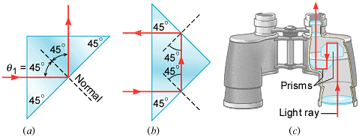
Optical Instruments
Many optical instruments, such as binoculars, periscopes, and telescopes, use glass prisms and total internal reflection to turn a beam of light through 90° or 180°.

Slide 10
Fiber Optics
Light can travel with little loss in a curved optical fiber because the light is totally reflected whenever it strikes the core-cladding interface and because the absorption of light by the core itself is small.

Slide 11
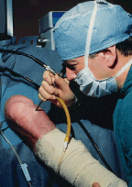
Endoscopy
In the field of medicine, optical fiber cables have had extraordinary impact. In the practice of endoscopy, for instance, a device called an endoscope is used to peer inside the body.
A bronchoscope is being used to look for signs of pulmonary disease.
Optical fibers have made arthroscopic surgery possible, such as the repair of a damaged knee shown in this photograph:

Slide 12
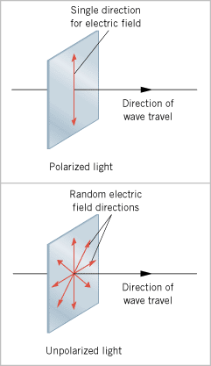
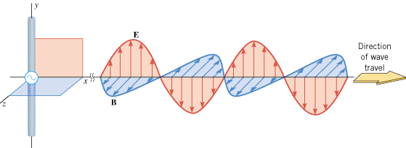
Polarization of Light
Electromagnetic Wave
Polarized and Un-polarized Light

Slide 13
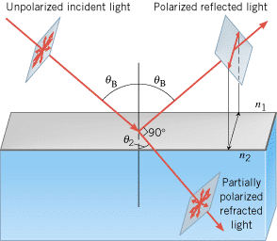
Polarization and the Reflection and Refraction of Light

Slide 14
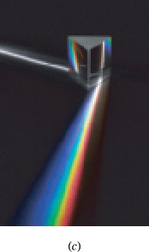
The Dispersion of Light: Prisms and Rainbows
Colorª | Vacuum Wavelength (nm) | Index of Refraction, n
Red | 660 | 1.520
Orange | 610 | 1.522
Yellow | 580 | 1.523
Green | 550 | 1.526
Blue | 470 | 1.531
Violet | 410 | 1.538

Slide 15
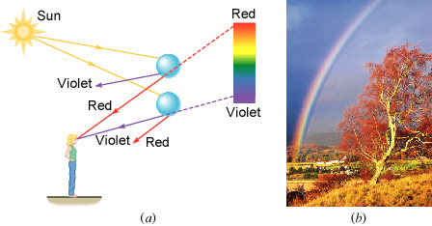
The Physics of Rainbows
When sunlight emerges from a water droplet, the light is dispersed into its constituent colors.

Slide 16
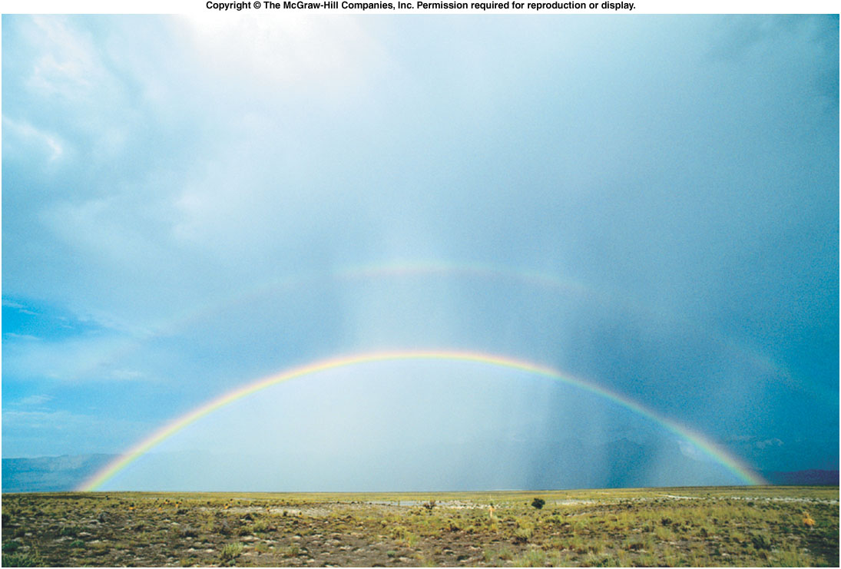
Primary & Secondary Rainbow

Slide 17
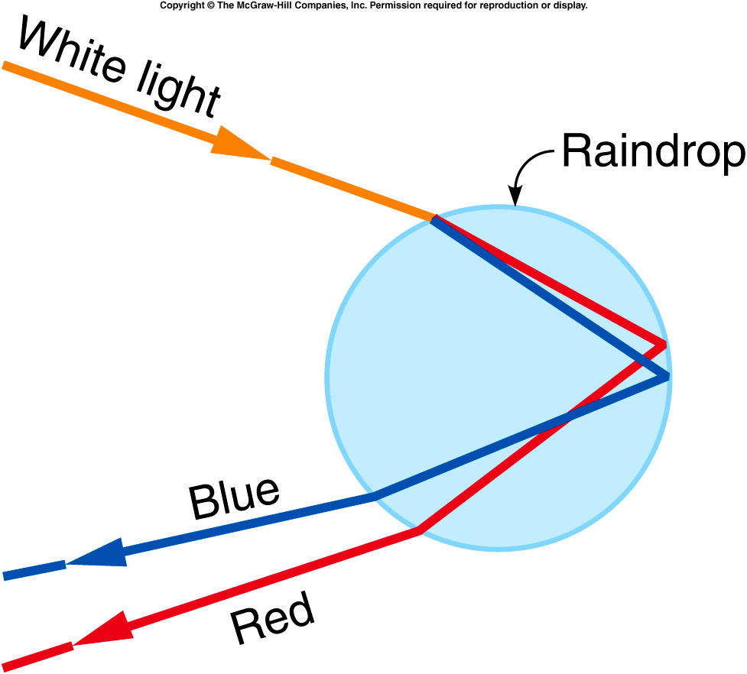
Primary Rainbow
Water droplet disperses the light into colors.

Slide 18
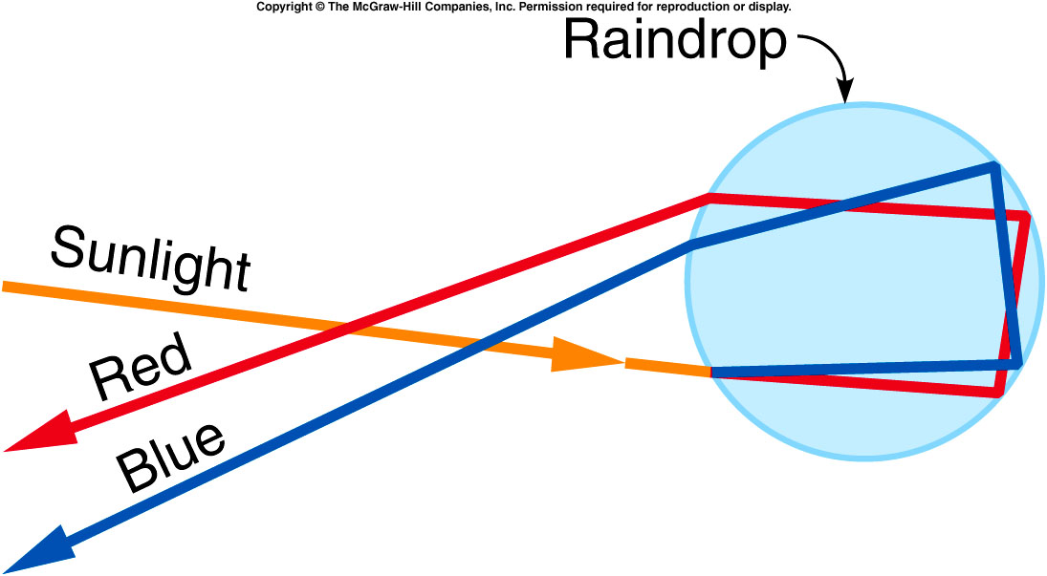
Secondary Rainbow
Colors are reversed and less intense.

Slide 19
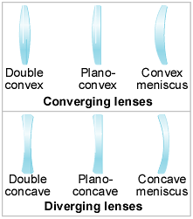
Lenses

Slide 20
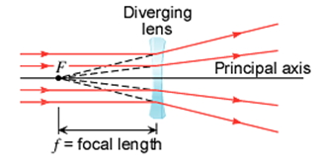
Converging Lens and Diverging Lens
Focal length of a converging lens is real and considered positive.
Focal length of a diverging lens is virtual and considered negative.

Slide 21
Sign Conventions
Focal length: f is (+) for a converging lens. f is (–) for a diverging lens.
Object & Image distances: Real (+), virtual (– ).
Magnification: m is (+) for an image that is upright with respect to the object. m is (–) for an image that is inverted with respect to the object.

Slide 22
The Thin-lens Equation and the Magnification Equation

Slide 23
Problem
An object is located 9.0 cm in front of a converging lens (f = 6.0 cm).
Using an accurately drawn ray diagram, determine where the image is located.
Calculate the image properties using the lens-equation and magnification equation.

Slide 24
Problem
A diverging lens has a focal length of –32 cm. An object is placed 19 cm in front of this lens. Calculate (a) the image distance and (b) the magnification (c) Is the image real or virtual? (d) Is the image upright or inverted? (e) Is the image enlarged or reduced in size? (f) Draw a ray diagram.

