Slide 1
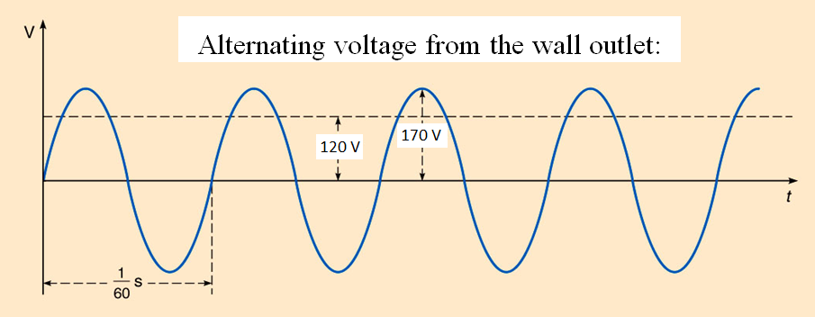





Alternating Current (ac) Voltage
$$V_{p}=170 volt$$
$$V_{rms}=120 volt$$
$$V=V_{p}\sin{ωt}$$
$$ω=2πf$$

Slide 2
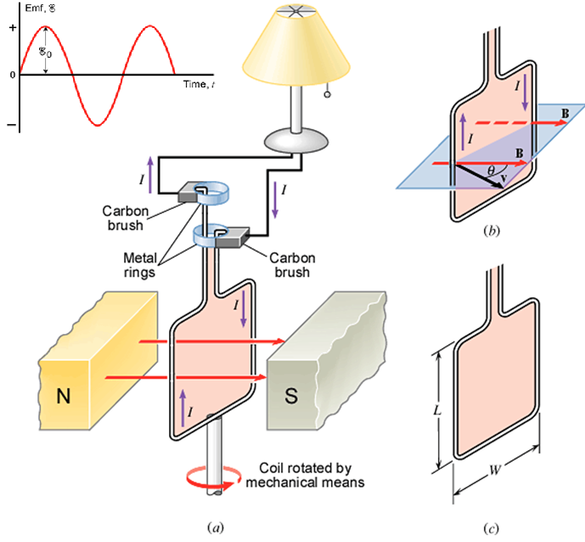

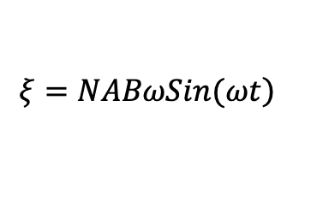
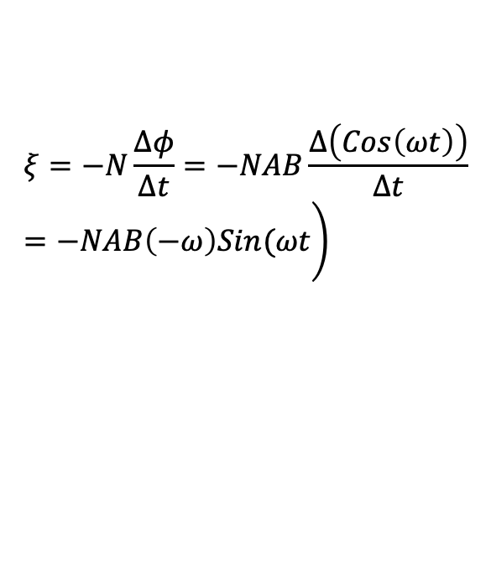
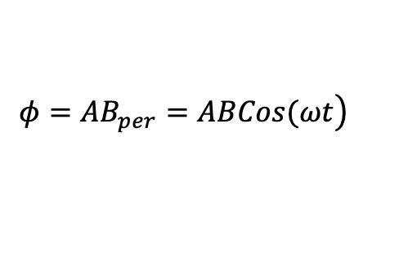
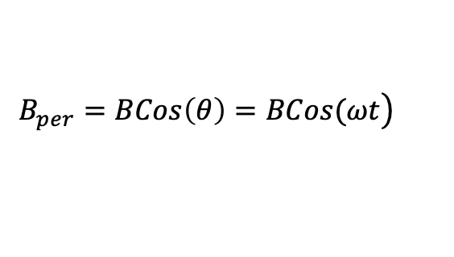

AC generator
$$\left.B_{per}=BCos\left(θ\right)=BCos(ωt\right)$$
$$\left.φ=AB_{per}=ABCos(ωt\right)$$
$$\left.ξ=−N\frac{Δφ}{Δt}=−NAB\frac{Δ\left(Cos\left(ωt\right)\right)}{Δt}=−NAB\left(−ω\right)Sin(ωt\right)$$
$$\left.ξ=NABωSin(ωt\right)$$
$$ξ_{0}=NABω$$
$$ω=2πf$$

Slide 3
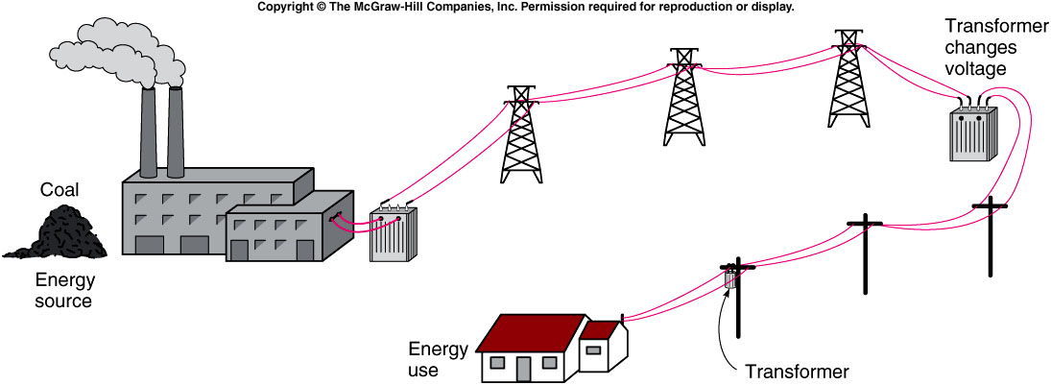
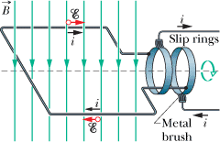
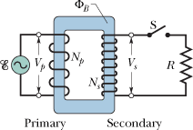
Transformers and Electricity
A transformer is a device for increasing or decreasing an ac voltage.

Slide 4
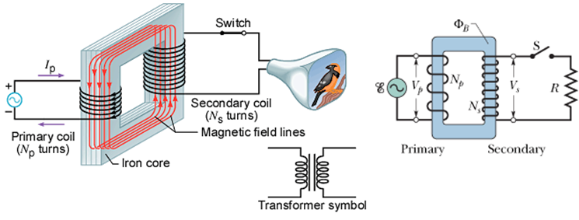
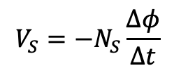
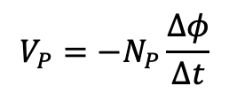



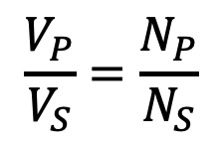
Transformers and Electricity
A transformer is a device for increasing or decreasing an ac voltage.
$$ξ=−N\frac{Δφ}{Δt}$$
$$P_{P}=P_{S}$$
$$V_{P}=−N_{P}\frac{∆φ}{∆t}$$
$$I_{P}V_{P}=I_{S}V_{S}$$
$$V_{S}=−N_{S}\frac{∆φ}{∆t}$$
$$\frac{V_{P}}{V_{S}}=\frac{N_{P}}{N_{S}}$$

Slide 5

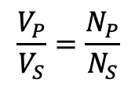
$$\frac{V_{P}}{V_{S}}=\frac{N_{P}}{N_{S}}$$
$$I_{P}V_{P}=I_{S}V_{S}$$
[CJ10-Ch22-P67] A generating station is producing 1.2 MW of power at 1200 V that is to be sent to a small town located 7.0 km away. Each of the two wires that comprise the transmission line has a resistance per kilometer of length of 0.05 Ω/km. (a) Find the power lost in heating the wires if the power is transmitted at 1200 V. (b) A 100:1 step-up transformer is used to raise the voltage before the power is transmitted. How much power is now lost in heating the wires?
,

Slide 6
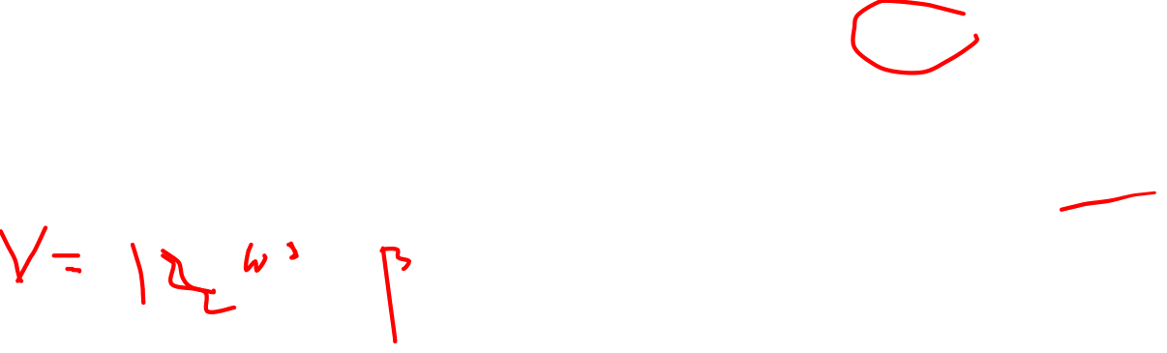
$$\frac{V_{P}}{V_{S}}=\frac{N_{P}}{N_{S}}$$
$$I_{P}V_{P}=I_{S}V_{S}$$
[CJ10-Ch22-P67] A generating power station is producing 1.2 MW of power at 1200 V that is to be sent to a small town located 7.0 km away. Each of the two wires that comprise the transmission line has a resistance per kilometer of length of 0.05 Ω/km. (a) Find the power lost in heating the wires if the power is transmitted at 1200 V.
,

Slide 7
$$\frac{V_{P}}{V_{S}}=\frac{N_{P}}{N_{S}}$$
$$I_{P}V_{P}=I_{S}V_{S}$$
[CJ10-Ch22-P67] A generating station is producing 1.2 MW of power at 1200 V that is to be sent to a small town located 7.0 km away. Each of the two wires that comprise the transmission line has a resistance per kilometer of length of 0.05 Ω/km. (a) Find the power lost in heating the wires if the power is transmitted at 1200 V. (b) A 100:1 step-up transformer is used to raise the voltage before the power is transmitted. How much power is now lost in heating the wires?
,

