Slide 1
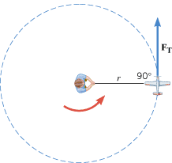
9.4. Newton’s Second Law for Rotational Motion
A model airplane on a guideline has a mass m and is flying on a circle of radius r (top view). A net tangential force F_{T} acts on the plane.

Slide 2
NEWTON’S SECOND LAW FOR A RIGID BODY ROTATING ABOUT A FIXED AXIS

Slide 3
Moment of Inertia of point masses

Slide 4
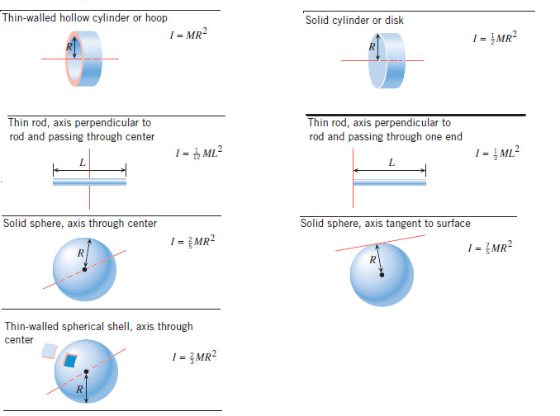
Moment of Inertia, I for Extended regular- shaped objects

Slide 5
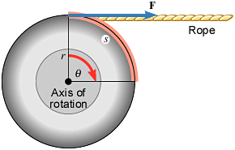
9.5 Rotational Work and Energy
Work and energy are among the most fundamental and useful concepts in physics.
The force F does work in rotating the wheel through the angle θ.

Slide 6
ROTATIONAL WORK
The rotational work W_{R} done by a constant torque τ in turning an object through an angle θ is
SI Unit of Rotational Work: joule (J)

Slide 7
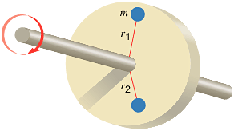
ROTATIONAL KINETIC ENERGY

Slide 8
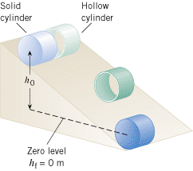
Demo on Rolling Cylinders

Slide 9
9.6 Angular Momentum
The angular momentum L of a body rotating about a fixed axis is the product of the body's moment of inertia I and its angular velocity ω with respect to that axis:
SI Unit of Angular Momentum: kg · m²/s.

Slide 10
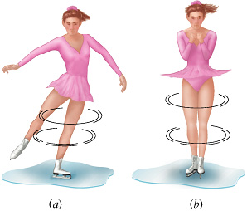
CONSERVATION OF ANGULAR MOMENTUM
The total angular momentum of a system remains constant (is conserved) if the net external torque acting on the system is zero.

Slide 11
Demonstration on Conservation of angular momentum
http://www.exploratorium.edu/snacks/momentum_machine.html

Slide 12
Problem
A woman stands at the center of a platform. The woman and the platform rotate with an angular speed of 5.00 rad/s. Friction is negligible. Her arms are outstretched, and she is holding a dumbbell in each hand. In this position the total moment of inertia of the rotating system (platform, woman, and dumbbells) is 5.40 kg·m². By pulling in her arms, she reduces the moment of inertia to 3.80 kg·m². Find her new angular speed.

