Slide 1
8.4 Angular Variables and Tangential Variables

Slide 2
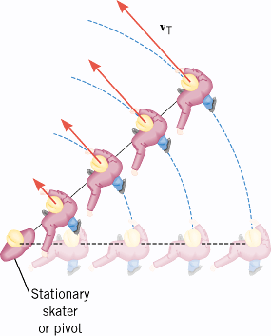
8.4 Angular Variables and Tangential Variables

Slide 3
8.4 Angular Variables and Tangential Variables
In the familiar ice-skating stunt known as “crack-the-whip,” a number of skaters attempt to maintain a straight line as they skate around the one person (the pivot) who remains in place.

Slide 4
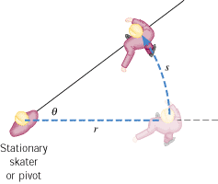
Angular Variables and Tangential Variables
During a time t, the line of skaters sweeps through an angle θ . An individual skater, located at a distance r from the stationary skater, moves through a distance s on a circular arc.

Slide 5
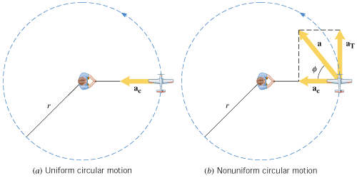
8.5 Centripetal Acceleration and Tangential Acceleration

Slide 6
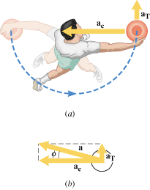
A Discus Thrower

Slide 7
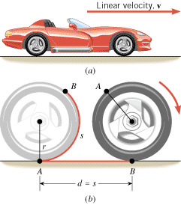
8.6 Rolling Motion

Slide 8
8.6 Rolling Motion

Slide 9

8.6 Rolling Motion

Slide 10

8.6 Rolling Motion

Slide 11
Problem-53
An Accelerating Motorcycle
A motorcycle accelerates uniformly from rest and reaches a linear speed of 22.0 m/s in a time of 9.00 s. The radius of each tire is 0.280 m. What is the magnitude of the angular acceleration of each tire?

Slide 12
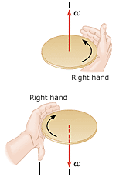
8.7 The Vector Nature of Angular Variables
Right-Hand Rule. Grasp the axis of rotation with your right hand, so that your fingers circle the axis in the same sense as the rotation. Your extended thumb points along the axis in the direction of the angular velocity vector.

