Slide 1
Chapter 8
Rotational Kinematics

Slide 2
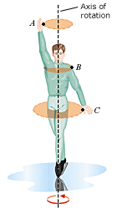
Axis of Rotation
When an object rotates, points on the object, such as A, B, or C, move on circular paths. The centers of the circles form a line that is the axis of rotation.

Slide 3
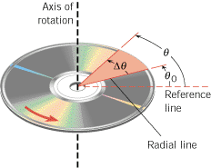
Angular Displacement
When a rigid body rotates about a fixed axis, the angular displacement is the angle Δθ swept out by a line passing through any point on the body and intersecting the axis of rotation perpendicularly.
By convention, the angular displacement is positive if it is counterclockwise and negative if it is clockwise.
SI Unit of Angular Displacement: radian (rad)

Slide 4
The angle θ
In radian measure, the angle θ is defined to be the arc length s divided by the radius r.

Slide 5
Conversion between degrees and radians
2π rad = 360⁰

Slide 6
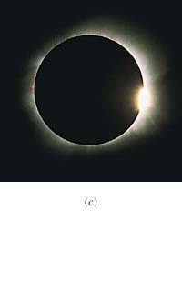
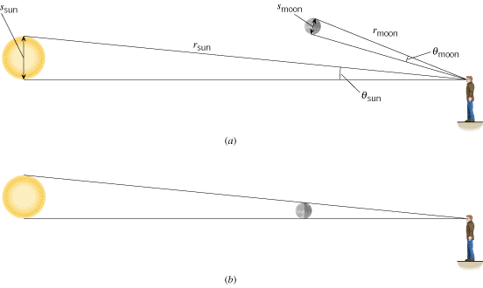
The Sun and The moon
What do you know about the Sun and the moon?

Slide 7
ANGULAR VELOCITY
To describe angular motion, we need to introduce the idea of angular velocity.
SI Unit of Angular Velocity: radian per second (rad/s)
Other unit: rpm = rev/min.

Slide 8
Example Problems
Earth rotates once every day. What is the angular velocity of the rotation of earth?
What is the angular velocity of the minute hand of a mechanical clock?

Slide 9
ANGULAR ACCELERATION
SI Unit of Average Angular Acceleration:
radian per second squared (rad/s²)

Slide 10
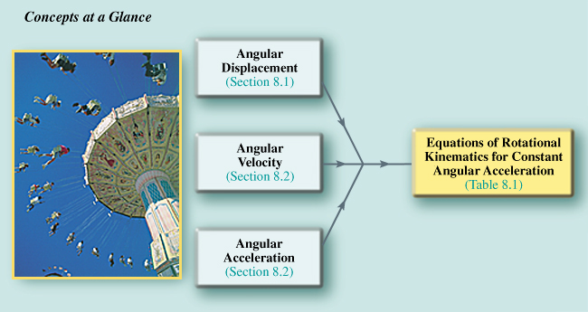
8.3 The Equations of Rotational Kinematics

Slide 11
Linear and Angular Quantities
TABLE 8.2
Symbols Used in Rotational and Linear Kinematics
Rotation Motion
Quantity
Linear Motion
θ
Displacement
x
ω₀
Initial velocity
v₀
ω
Final velocity
v
α
Acceleration
a
t
Time
t

Slide 12
Kinematic Equations
TABLE 8.1
The Equations of Kinematics for Rotational and Linear Motion
Rotation Motion (α = constant)
Linear Motion (a = constant)
ω = ω₀ + αt
(8.4)
v = v₀ + at
(2.4)
θ = (ω₀ + ω)t
(8.6)
x = (v₀ + v)t
(2.7)
θ = ω₀t + αt²
(8.7)
x = v₀t + at²
(2.8)
ω² = ω₀² + 2αθ
(8.8)
v² = v₀² + 2ax
(2.9)

Slide 13
Spin cycle of a Washing Machine: P 16
Starting from rest, the tub of a washing machine reaches an angular speed of 5.2 rad/s, with an average angular acceleration of 4.0 rad/s². How long does it take the spin cycle to come up to speed?

Slide 14
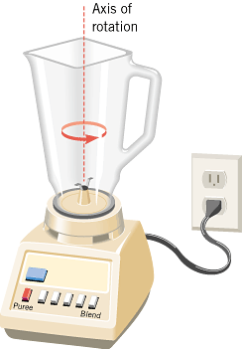
EXAMPLE 5 Blending with a Blender
The blades of an electric blender are whirling with an angular velocity of +375 rad/s while the “puree” button is pushed in, as Figure 8.11 shows. When the “blend” button is pressed, the blades accelerate and reach a greater angular velocity after the blades have rotated through an angular displacement of +44.0 rad (seven revolutions). The angular acceleration has a constant value of +1740 rad/s². Find the final angular velocity of the blades.

