Slide 1
6.7 Power
The idea of power incorporates both the concepts of work and time.
Power is work done per unit time.
Average power, P is the average rate at which work W is done, and it is obtained by dividing W by the time t required to perform the work:
Power is a scalar. Unit of power: ft.lb/s or watt = W = J/s (SI unit)

Slide 2
Force versus Distance Graph
Work = Area under the Force versus Distance graph

Slide 3
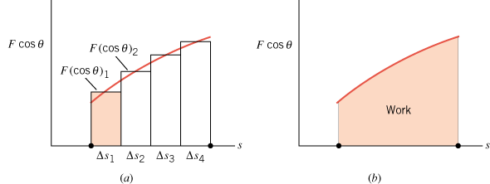
Work Done by a Variable Force
The work done by a variable force in moving an object is equal to the area under the graph of F cosθ versus s.

Slide 4
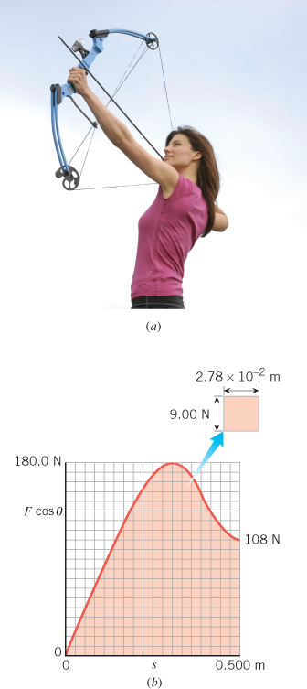
Work and the Compound Bow
Find the work that the archer must do in drawing back the string of the compound bow in Figure 6.22 from 0 to 0.500 m.

Slide 5
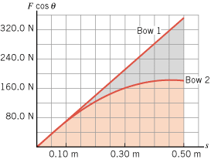
Problem 71
The drawing shows the force-versus-displacement graph for two different bows. These graphs give the force that an archer must apply to draw the bowstring. (a) For which bow is more work required to draw the bow fully from S = 0 to S = 0.5m? Give your reasoning. (b) Estimate the additional work required for the bow identified in part (a) compared to the other bow.

Slide 6
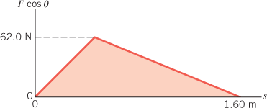
Problem 72
 | The graph shows how the force component along the displacement varies with the magnitude s of the displacement. Find the work done by the force.

