Slide 1
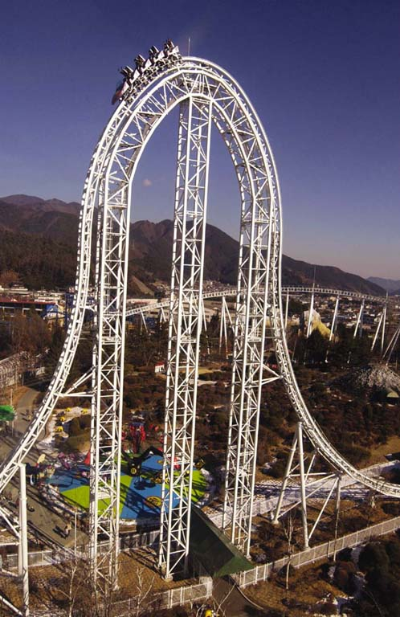
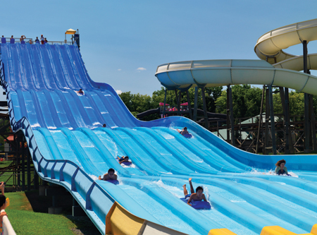
Chapter-6 Work and Energy

Slide 2
6.1. Work Done by a Constant Force
Work is done when a force F pushes a car through a displacement s.
Work = Force X Displacement.
SI Unit of Work: joule, J Work is a scalar.

Slide 3
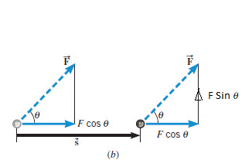
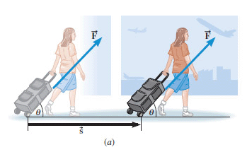
What if the force is not along the displacement?
Use the component of the force along the displacement.
What is the work done by Fsinθ?

Slide 4
Units
System | Force | Distance | Work
SI | newton (N) | meter (m) | N·m = joule (J)
CGS | dyne | cm | dyn·cm = erg
BE/USC | pound (lb) | foot (ft) | foot·pound (ft·lb)

Slide 5
Bench Pressing
During bench-pressing work is done against gravity

Slide 6
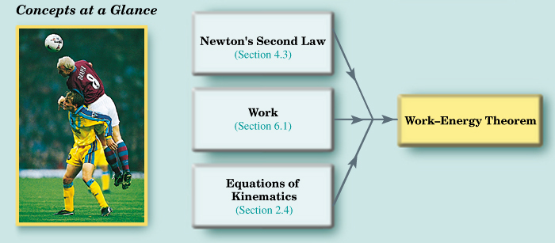
6.2 The Work-energy Theorem and Kinetic Energy

Slide 7
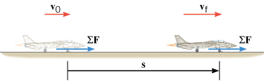
Work-Energy Theorem and Kinetic Energy
SI Unit of Kinetic Energy: joule (J)

Slide 8
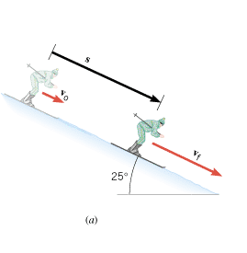
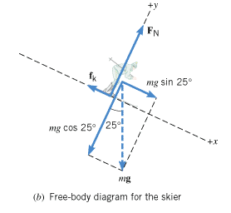
Downhill Skiing
A 58-kg skier is coasting down a 25° slope. A kinetic frictional force of magnitude 70-N opposes her motion. Near the top of the slope, the skier’s speed is 3.6 m/s. Ignoring air resistance, determine the speed v_{f} at a point that is displaced 57-m downhill.

Slide 9
6.3 Gravitational Potential Energy
The gravitational potential energy PE is the energy that an object of mass m has by virtue of its position relative to the surface of the earth. That position is measured by the height h of the object relative to an arbitrary zero level:
SI Unit of Gravitational Potential Energy: joule (J)

Slide 10
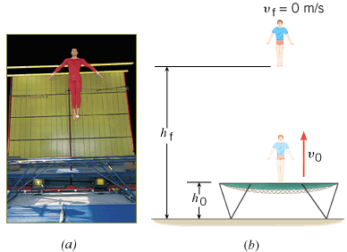
A Gymnast on a Trampoline Example 7
A gymnast springs vertically upward from a trampoline. The gymnast leaves the trampoline at a height of 1.20 m and reaches a maximum height of 4.80 m before falling back down. All heights are measured with respect to the ground. Ignoring air resistance, determine the initial speed v₀ with which the gymnast leaves the trampoline.

Slide 11
6-4: Conservative and Non-conservative Forces
A force is a conservative force if the net work it does on a particle moving around any closed path, from an initial point and then back to that point, is zero.
Equivalently, a force is conservative if the net work it does on a particle moving between two points does not depend on the path taken by the particle.
A force is non-conservative if the net work it does on a particle moving between two points does depend on the path taken by the particle.

Slide 12
Examples
Conservative Forces
Gravitational force (Ch. 4)
Elastic spring force (Ch. 10)
Electric force (Ch. 18, 19)
Nonconservative Forces
Static and kinetic frictional forces
Air resistance
Tension
Normal force
Propulsion force of a rocket

Slide 13
6.5 The Conservation of Mechanical Energy

Slide 14
THE PRINCIPLE OF CONSERVATION OF MECHANICAL ENERGY
The total mechanical energy (E = KE + PE) of an object remains constant as the object moves, provided that the net work done by external nonconservative forces is zero.

Slide 15
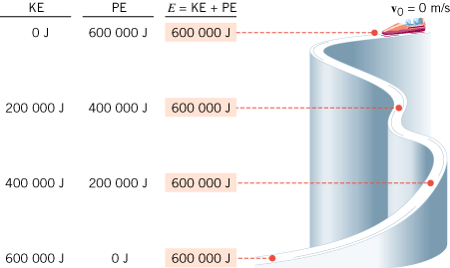
Conservation of Mechanical Energy
If friction and wind resistance are ignored, a bobsled run illustrates how kinetic and potential energy can be interconverted, while the total mechanical energy remains constant.

Slide 16
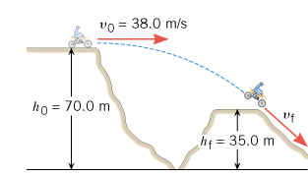
A Daredevil Motorcyclist
A motorcyclist is trying to leap across the canyon shown in Figure 6.16 by driving horizontally off the cliff at a speed of 38.0 m/s. Ignoring air resistance, find the speed with which the cycle strikes the ground on the other side.

Slide 17
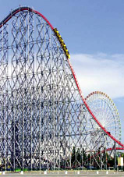
Roller Coaster (Ideal)
The ride includes a vertical drop of 93.5 m. The coaster has a speed of 3.0 m/s at the top of the drop. Neglect friction and find the speed of the riders at the bottom.

Slide 18
6.6 Nonconservative Forces and the Work–Energy Theorem
In the roller coaster example, we ignored nonconservative forces, such as friction. In reality, however, such forces are present when the roller coaster descends. The actual speed of the riders at the bottom is 41.0 m/s. Assuming again that the coaster has a speed of 3.0 m/s at the top, find the work done by nonconservative forces on a 55.0-kg rider during the descent.

