Slide 1
The Principle of Linear Superposition and Interference Phenomena
CHAPTER 17
Interference
Constructive and Destructive Interference: BEATS
Standing Waves:
Transverse-Stringed Instruments
and
Longitudinal-Wind Instruments.
Diffraction
Speakers

Slide 2
17.1 The Principle of Linear Superposition
When two or more waves are present simultaneously at the same place, the resultant disturbance is the sum of the disturbances from the individual waves.
Concept Simulation 17.1

Slide 3
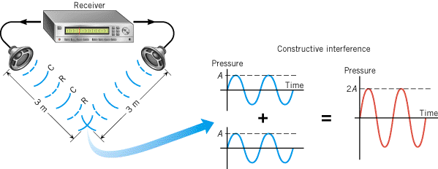
Constructive Interference of Sound Waves
Wavelength = λ = 1 m
Path difference = 0

Slide 4
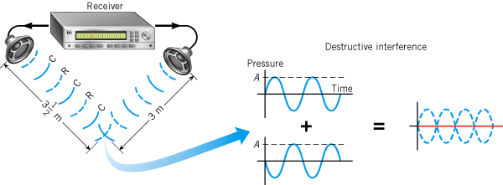
Destructive Interference
Wavelength = λ = 1 m
Path difference = λ/2= 0.5 m

Slide 5
Figure 17.5 Noise-canceling headphones utilize destructive interference

Slide 6
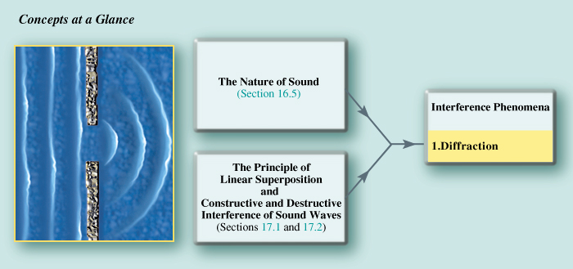
17.3 Diffraction

Slide 7
17.3 Diffraction
Diffraction is the bending of a wave around an obstacle or the edges of an opening.

Slide 8
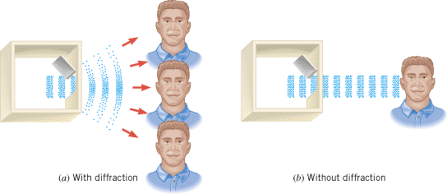
Diffraction of Sound

Slide 9
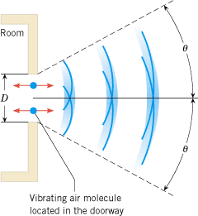
First Minimum

Slide 10
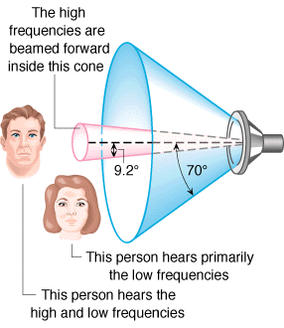

Slide 11
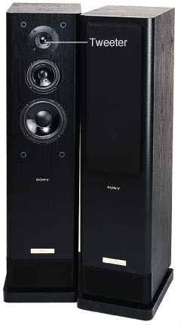
Figure 17.13 Small-diameter speakers, called tweeters, are used to produce high-frequency sound. The small diameter helps to promote a wider dispersion of the sound.

Slide 12
The bending of waves around circular opening is given below:
Explain why light waves don’t bend as much as sound waves.
2. A speaker has a diameter of 0.30 m. (a) Assuming that the speed of sound is 343 m/s, find the diffraction angle θ for a 2.0-kHz tone. (b) What speaker diameter D should be used to generate a 6.0-kHz tone whose diffraction angle is as wide as that for the 2.0-kHz tone in part (a)?

