Slide 1
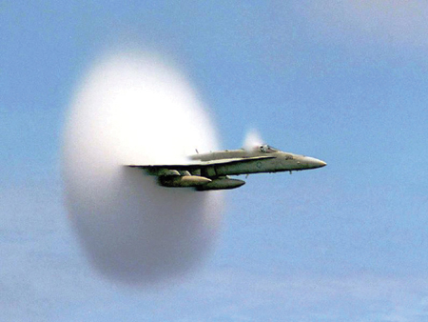
C H A P T E R 16 Waves and Sound
A fighter jet emerges from a cloud caused when it breaks through the sound barrier.

Slide 2
The Nature of Waves
Wave is a traveling disturbance.
Wave carries energy from place to place.
There are two basic types of waves:
Transverse waves and longitudinal waves.

Slide 3
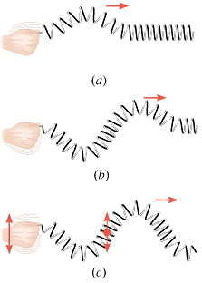
Transverse waves
A transverse wave is one in which the disturbance is perpendicular to the direction of travel of the wave.
Examples: Light wave, waves on a guitar string.

Slide 4
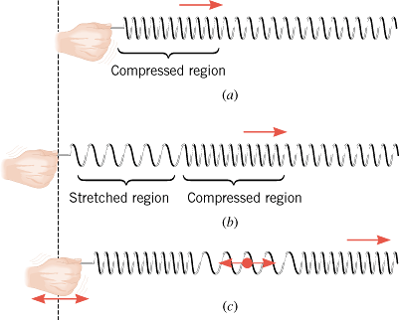
Longitudinal Waves
Longitudinal wave is one in which the disturbance is parallel to the line of travel of the wave.
Example: Sound wave in air is a longitudinal wave.

Slide 5
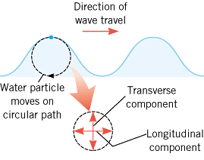
Water Waves
Water waves are partly transverse and longitudinal.

Slide 6
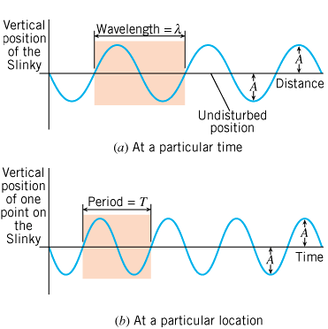
Periodic Waves
Periodic waves are waves that repeat.

Slide 7
Amplitude, Wavelength, and Period
The amplitude, A is the maximum disturbance.
The wavelength, λ is the horizontal length of one cycle of the wave.
The period, T is the time required for one complete up/down cycle of the wave.

Slide 8
Frequency
Frequency is the number of waves per unit time.

Slide 9
Wave Speed

Slide 10
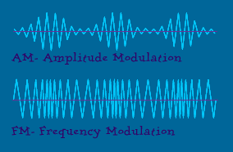
Radio Waves
FM vs AM: What's the difference?
AM: The amplitude of the signal is varied to incorporate the sound information. Frequencies are in kHz.
FM: The frequency of the carrier signal is varied to incorporate the sound information. Frequencies are in MHz.

Slide 11
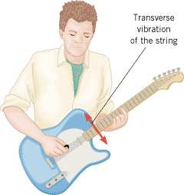
16.3. The Speed of a Wave on a String

