Slide 1
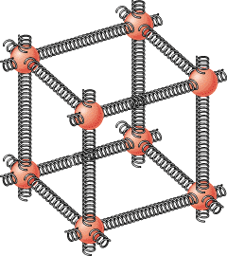
10.7 Elastic Deformation

Slide 2
Elastic Deformations
DEFORMATION |  | MODULUS
Linear | Stretching or Compression | Young (Y)
Areal or Surface | Shearing | Shear (S)
Volume | Pressurizing | Bulk (B)

Slide 3
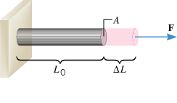
Young’s Modulus
Magnitude of the force is proportional to the fractional increase in length ΔL/L₀, and the cross-sectional area, A.

Slide 4
TABLE 10.1
Values for the Young's Modulus of Solid Materials
Material
Young's Modulus Y (N/m²)
Aluminum
6.9 × 10¹⁰
Bone
Compression
9.4 × 10⁹
Tension
1.6 × 10¹⁰
Brass
9.0 × 10¹⁰
Brick
1.4 × 10¹⁰
Copper
1.1 × 10¹¹
Mohair
2.9 × 10⁹
Nylon
3.7 × 10⁹
Pyrex glass
6.2 × 10¹⁰
Steel
2.0 × 10¹¹
Teflon
3.7 × 10⁸
Tungsten
3.6 × 10¹¹

Slide 5
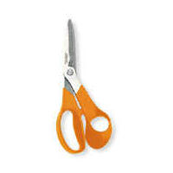
Shear Deformation
Q: Give another name for scissors?

Slide 6
Shear Deformation
Q: Give another name for scissors?
A: Shears. They cut the materials by shearing them.

Slide 7
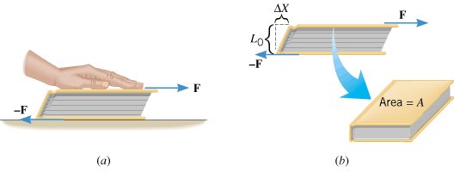
Shear Deformation and the Shear Modulus

Slide 8
TABLE 10.2
Values for the Shear Modulus of Solid Materials
Material
Shear Modulus S (N/m²)
Aluminum
2.4 × 10¹⁰
Bone
8.0 × 10¹⁰
Brass
3.5 × 10¹⁰
Copper
4.2 × 10¹⁰
Lead
5.4 × 10⁹
Nickel
7.3 × 10¹⁰
Steel
8.1 × 10¹⁰
Tungsten
1.5 × 10¹¹

Slide 9
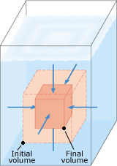
Volume Deformation And The Bulk Modulus

Slide 10
Pressure
The pressure P is the magnitude F of the force acting perpendicular to a surface divided by the area A over which the force acts:
SI Unit of Pressure: N/m² = pascal (Pa).

Slide 11
Bulk Modulus
Experiment reveals that the change ΔP in pressure needed to change the volume by an amount ΔV is directly proportional to the fractional change ΔV/V₀ in the volume:
The proportionality constant B is known as the bulk modulus. The minus sign occurs because an increase in pressure (ΔP positive) always creates a decrease in volume (ΔV negative).

Slide 12
TABLE 10.3
Values for the Bulk Modulus of Solid and Liquid
Material
Bulk Modulus B (N/m²)
Solids
Aluminum
7.1 × 10¹⁰
Brass
6.7 × 10¹⁰
Copper
1.3 × 10¹¹
Lead
4.2 × 10¹⁰
Nylon
6.1 × 10⁹
Pyrex glass
2.6 × 10¹⁰
Steel
1.4 × 10¹¹
Liquids
Ethanol
8.9 × 10⁸
Oil
1.7 × 10⁹
Water
2.2 × 10⁹

Slide 13
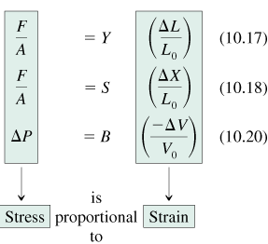
10.8 Stress, Strain, and Hooke's Law
The stress and strain are directly proportional to one another, a relationship first discovered by Robert Hooke (1635–1703) and now referred to as Hooke's law.

Slide 14
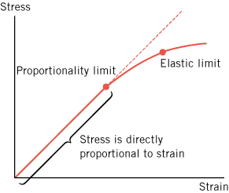
Hooke’s Law

Slide 15
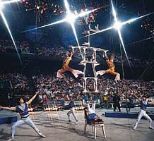
Bone Compression
In a circus act, a performer supports the combined weight (1640 N) of a number of colleagues (see Figure 10.30). Each thighbone (femur) of this performer has a length of 0.55 m and an effective cross-sectional area of 7.7 × 10^{–4} m². Determine the amount by which each thighbone compresses under the extra weight.

