Slide 1
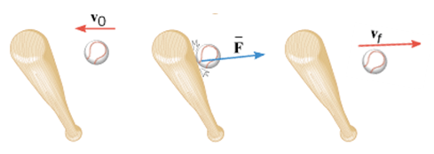
A baseball (m = 0.14 kg) has an initial velocity, magnitude 38 m/s as it approaches a bat. The bat applies an average force that is much larger than the weight of the ball, and the ball departs from the bat with a final velocity, magnitude 38 m/s, as shown below. Determine the impulse applied to the ball by the bat.

Slide 2
11. Suppose a child drives a bumper car head on into the side rail, which exerts a force of 4000 N on the car for 0.200 s. (a) What impulse is imparted by this force? (b) Find the final velocity of the bumper car if its initial velocity was 2.80 m/s and the car plus driver have a mass of 200 kg. Neglect the friction between the car and floor.

Slide 3
EXAMPLE Assembling a Freight Train
A freight train is being assembled in a switching yard, and the Figure below shows two boxcars. Car 1 has a mass of m₁ = 65×10³ kg and moves at a velocity of v₀₁ = +0.80 m/s. Car 2, with a mass of m₂ = 92×10³ kg and a velocity of v₀₂ = +1.3 m/s, overtakes car 1 and couples to it. Neglecting friction, find the common velocity v_{f} of the cars after they become coupled.

Slide 4
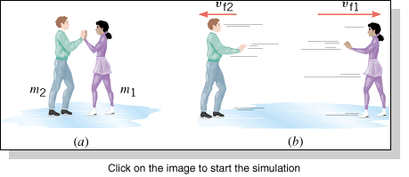
EXAMPLE: Ice Skaters
Starting from rest, two skaters “push off” against each other on smooth level ice, where friction is negligible. As the Figure shows, one is a woman (m₁ = 54 kg), and one is a man (m₂ = 88 kg). Part b of the drawing shows that the woman moves away with a velocity of v_{f1} = +2.5 m/s. Find the “recoil” velocity v_{f2} of the man.

Slide 5
Problem
A car (mass = 1100 kg) is traveling at 32 m/s and collides head-on with a sport utility vehicle (mass = 2500 kg) traveling in the opposite direction. In the collision, the two vehicles come to a halt. At what speed was the sport utility vehicle traveling?

Slide 6
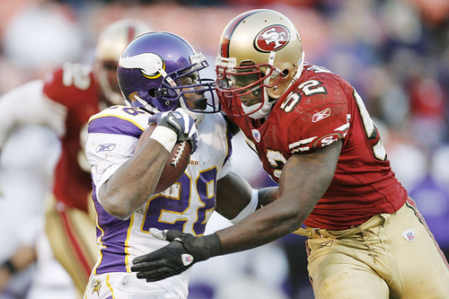
Football: 3rd Down
During a 3rd down play with less than a yard to go, a Minnesota Viking player of mass 70-kg moving at 6 m/s was tackled head-on by a San Francisco 49er of mass 90-kg moving at 5 m/s. Predict the outcome of this play?

Slide 7
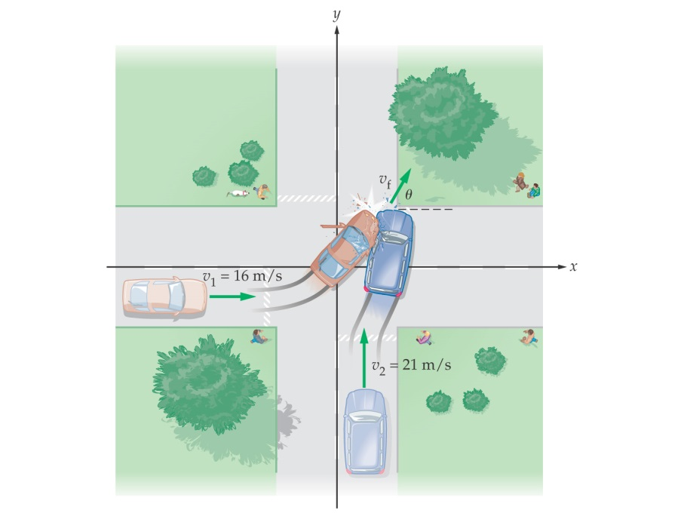
Car Collision Problem
A car with a mass of 850-kg and a speed of 16 m/s approaches an intersection as shown. A 1200-kg minivan traveling at 21 m/s is heading for the same intersection. The car and minivan collide and stick together. Find the speed (v_{f}) and direction (θ) of the wreckage just after the collision, assuming external forces can ignored.

