Slide 1
EX 7.11: What is the power output for a 60.0-kg woman who runs up a 3.00 m high flight of stairs in 3.50 s, starting from rest but having a final speed of 2.00 m/s?

Slide 2
Estimating the cost of Electricity
34. A household air conditioner may consume an average power of 8.0 kW of power. What is the cost of operating this air conditioner 8.0 h per day for 30 days if the cost of electricity is $0.11 per kW⋅h ?

Slide 3
22. A 5.00×10⁵-kg subway train is brought to a stop from a speed of 0.500 m/s in 0.400 m by a large spring bumper at the end of its track. What is the force constant (spring constant) 𝑘 of the spring?
$$EPE=\frac{1}{2}kx^{2}$$
$$KE=\frac{1}{2}mv^{2}$$

Slide 4
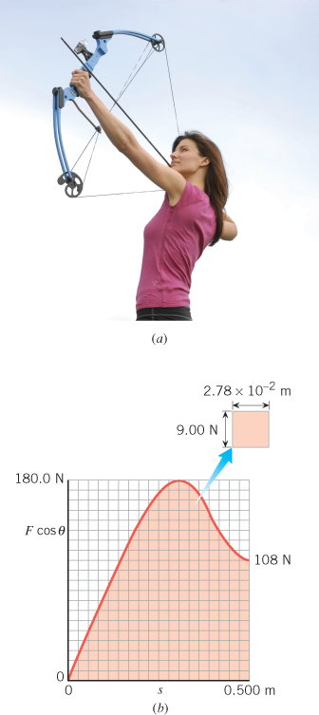
Work and the Compound Bow
Find the work that the archer must do in drawing back the string of the compound bow in the Figure from 0 to 0.500 m.

