Slide 1
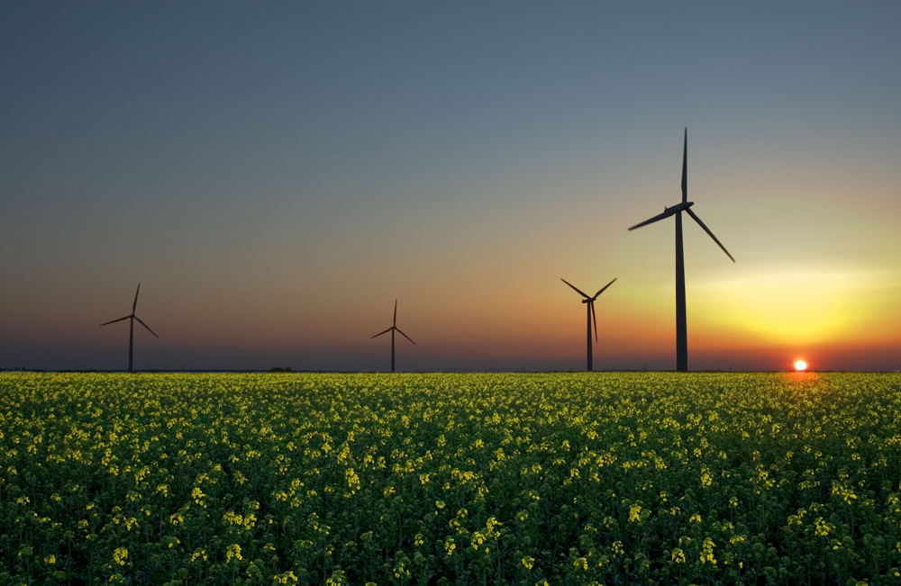
Chapter 7 WORK, ENERGY, AND ENERGY RESOURCES
How many forms of energy can you identify in this photograph of a wind farm in Iowa?

Slide 2
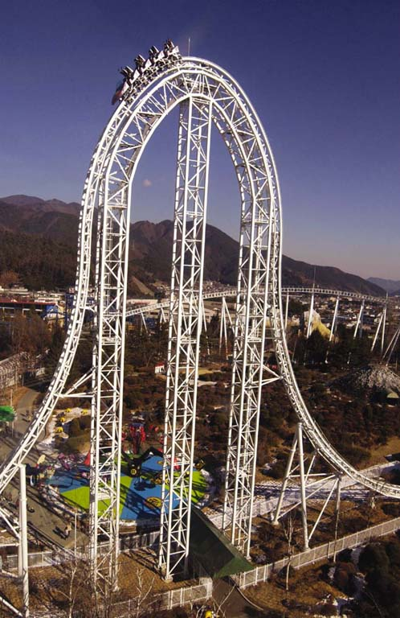
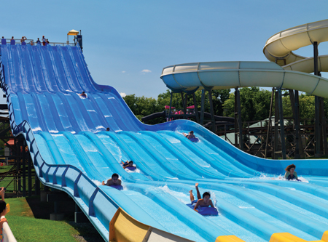
Energy Transformation

Slide 3
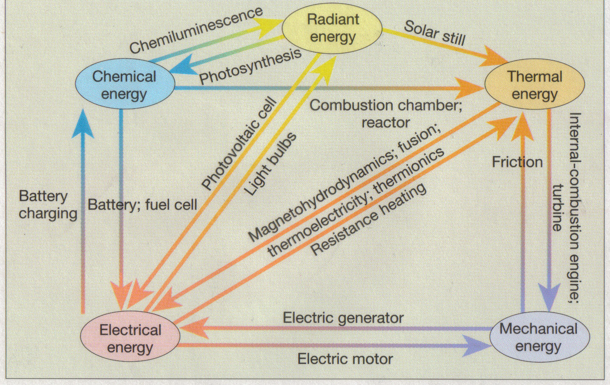
Energy: Forms and Transformations

Slide 4
Work Done by a Constant Force
Work is done when a force F pushes a car through a displacement s.
Work = Force X Displacement.
SI Unit of Work: joule, J Work is a scalar.

Slide 5
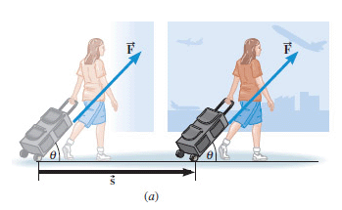
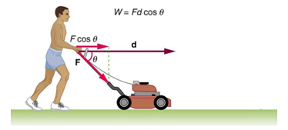
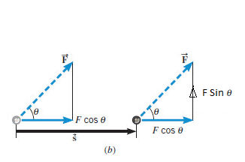
What if the force is not along the displacement?
Use the component of the force along the displacement.
What is the work done by Fsinθ?

Slide 6
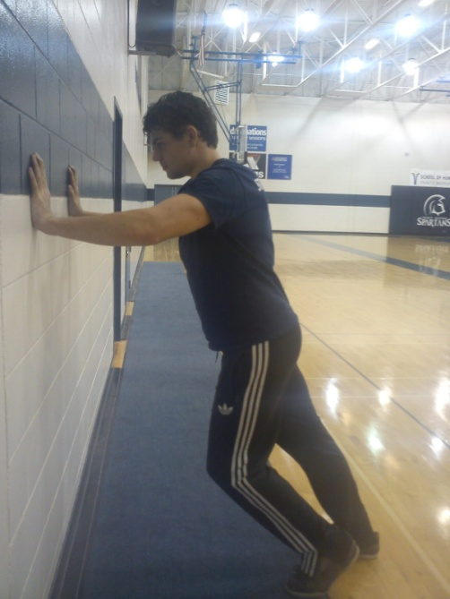
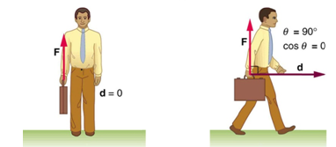
Examples of zero work

Slide 7
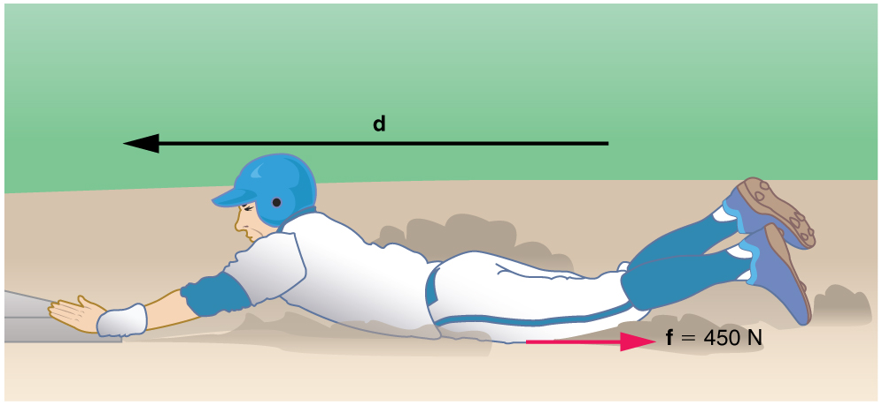
Negative Work
The baseball player slides to a stop in a distance d . In the process, friction removes the player’s kinetic energy by doing an amount of negative work fd equal to the initial kinetic energy.

Slide 8
1. Calculate the distance the 65.0-kg baseball player slides, given that his initial speed is 6.00 m/s and the force of friction against him is a constant 450 N. a) Using energy considerations b) Using kinematic equations

Slide 9
Units
System | Force | Distance | Work
SI | newton (N) | meter (m) | N·m = joule (J)
CGS | dyne | cm | dyn·cm = erg
BE/USC | pound (lb) | foot (ft) | foot·pound (ft·lb)

Slide 10
Bench Pressing
During bench-pressing work is done against gravity

Slide 11
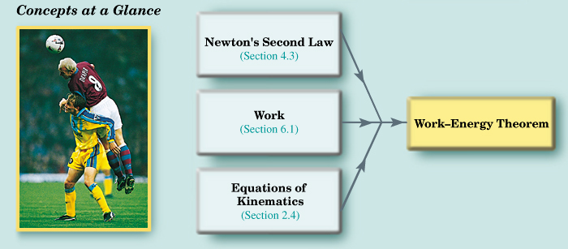
The Work-energy Theorem and Kinetic Energy

Slide 12
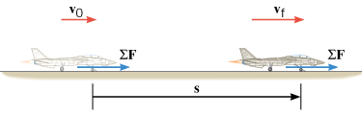
Work-Energy Theorem and Kinetic Energy
Kinetic Energy is a scalar.
SI Unit of Kinetic Energy: joule (J)

Slide 13
Gravitational Potential Energy
The gravitational potential energy PE is the energy that an object of mass m has by virtue of its position relative to the surface of the earth. That position is measured by the height h of the object relative to an arbitrary zero level:
Gravitational Potential Energy is a scalar.
SI Unit of Gravitational Potential Energy: joule (J)

Slide 14
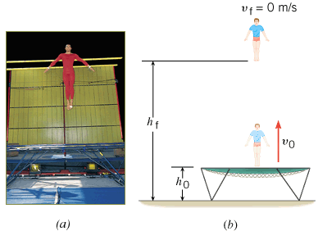
A Gymnast on a Trampoline
A gymnast springs vertically upward from a trampoline. The gymnast leaves the trampoline at a height of 1.20 m and reaches a maximum height of 4.80 m before falling back down. All heights are measured with respect to the ground. Ignoring air resistance, determine the initial speed v₀ with which the gymnast leaves the trampoline.

Slide 15
Conservative and Non-conservative Forces
A force is a conservative force if the net work it does on a particle moving around any closed path, from an initial point and then back to that point, is zero.
Equivalently, a force is conservative if the net work it does on a particle moving between two points does not depend on the path taken by the particle.
A force is non-conservative if the net work it does on a particle moving between two points does depend on the path taken by the particle.

Slide 16
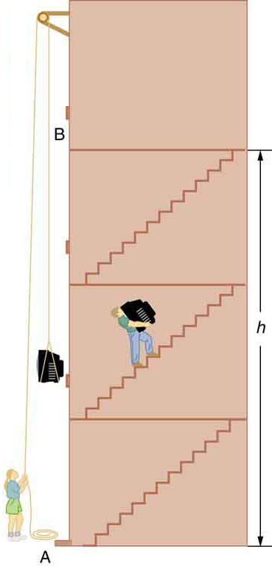
Examples
Conservative Forces
Gravitational force
Elastic spring force
Electric force
Nonconservative Forces
Static and kinetic frictional forces
Air resistance & Drag
Tension
Normal force
Propulsion force of a rocket

Slide 17
The Conservation of Mechanical Energy

Slide 18
THE PRINCIPLE OF CONSERVATION OF MECHANICAL ENERGY
The total mechanical energy (E = KE + PE) of an object remains constant as the object moves, provided that the net work done by external nonconservative forces is zero.

Slide 19
Conservation of Mechanical Energy
If friction and wind resistance are ignored, a bobsled run illustrates how kinetic and potential energy can be inter converted, while the total mechanical energy remains constant.

Slide 20
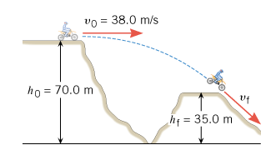
A Daredevil Motorcyclist
A motorcyclist is trying to leap across the canyon shown in Figure by driving horizontally off the cliff at a speed of 38.0 m/s. Ignoring air resistance, find the speed with which the cycle strikes the ground on the other side.

Slide 21
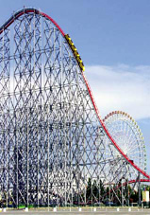
Roller Coaster (Ideal)
The ride includes a vertical drop of 93.5 m. The coaster has a speed of 3.0 m/s at the top of the drop. Neglect friction and find the speed of the riders at the bottom.

Slide 22
Nonconservative Forces and the Work–Energy Theorem
In the roller coaster example, we ignored non-conservative forces, such as friction. In reality, however, such forces are present when the roller coaster descends. The actual speed of the riders at the bottom is 41.0 m/s. Assuming again that the coaster has a speed of 3.0 m/s at the top, find the work done by non-conservative forces on a 55.0-kg rider during the descent.

