Slide 1
Example Problems
Earth rotates once every day. What is the angular velocity of the rotation of earth?
What is the angular velocity of the minute hand of a mechanical clock?

Slide 2
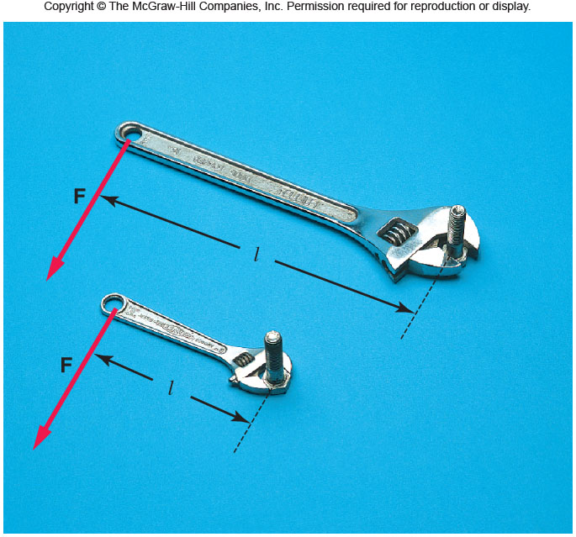
Torque, τ
Torque depends on the applied force and lever-arm.
Torque = Force x lever-arm
Torque is a vector. It comes in clockwise and counter-clock wise directions. Unit of torque = N•m
P: A force of 40 N is applied at the end of a wrench handle of length 20 cm in a direction perpendicular to the handle as shown above. What is the torque applied to the nut?

Slide 3
Application of Torque: Weighing
P. A child of mass 20 kg is located 2.5 m from the fulcrum or pivot point of a seesaw. Where must a child of mass 30 kg sit on the seesaw in order to provide balance?

Slide 4
Equations Sheet
 | MOTION
 | Linear | Rotational
Time interval | t | t
Displacement | d; (d = rθ) | θ
Velocity | v = d/t; (v = rω) | ω = θ/t
Acceleration | a = Δv/t; (a = rα) | α = Δω/t
Kinematic equations | v = v₀ + at | ω = ω₀ + αt
 | v² = v₀² + 2ad | ω² = ω₀² + 2αθ
 | d = v₀t + ½ at² | θ = ω₀t + ½ αt²
 | d = ½(v + v₀)t | θ = ½(ω + ω₀)t
To create | force = F | torque =
Inertia | Mass =m | Rotational inertia = I = Σm_{i}r_{i}²
Newton’s 2nd Law | F_{net} = ma | τ_{net} = Iα
Momentum | p = m·V | L = I·ω
Conservation of momentum | Σm_{i}v_{i} = Σm_{f}v_{f} | ΣI_{i}ω_{i} = ΣI_{f}ω_{f}
Kinetic Energy | Translational Kinetic Energy = TKE = ½ mv² | Rotational Kinetic Energy = RKE = ½ Iω²
Work | W=F·d | W=τ·θ

Slide 5
8. During a very quick stop, a car decelerates at 7.00 m/s².
(a) What is the angular acceleration of its 0.280-m-radius tires, assuming they do not slip on the pavement?
(b) How many revolutions do the tires make before coming to rest, given their initial angular velocity is 95.0 rad/s?
(c) How long does the car take to stop completely?
(d) What distance does the car travel in this time?
(e) What was the car’s initial velocity?
(f) Do the values obtained seem reasonable, considering that this stop happens very quickly?

Slide 6
Conservation of Angular momentum Problem
A woman stands at the center of a platform. The woman and the platform rotate with an angular speed of 5.00 rad/s. Friction is negligible. Her arms are outstretched, and she is holding a dumbbell in each hand. In this position the total moment of inertia of the rotating system (platform, woman, and dumbbells) is 5.40 kg·m². By pulling in her arms, she reduces the moment of inertia to 3.80 kg·m². Find her new angular speed.

