Slide 1
3.4. Relative Velocity
Escalator ride at a mall

Slide 2
Refueling of Fighter Planes
During midair refueling, the relative velocity of the two planes is zero.

Slide 3
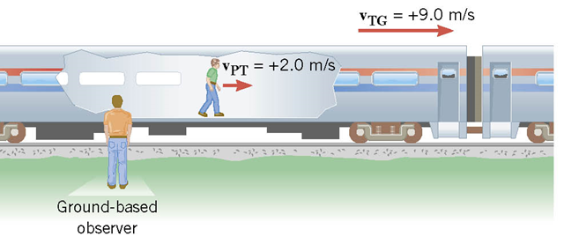
Passenger walking toward the front of a moving train

Slide 4
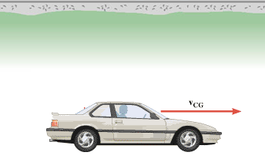
Negative of the velocity

Slide 5
Catching up a passing train
A car traveling 95 km/h overtakes a 1.10 km long train traveling in the same direction on a track parallel to the road. The velocity of the train is 75 km/h, eastward.
What is the velocity of the car relative to the train?
How long does it take the car to pass the train?
What is the velocity of the train relative to the car?

Slide 6
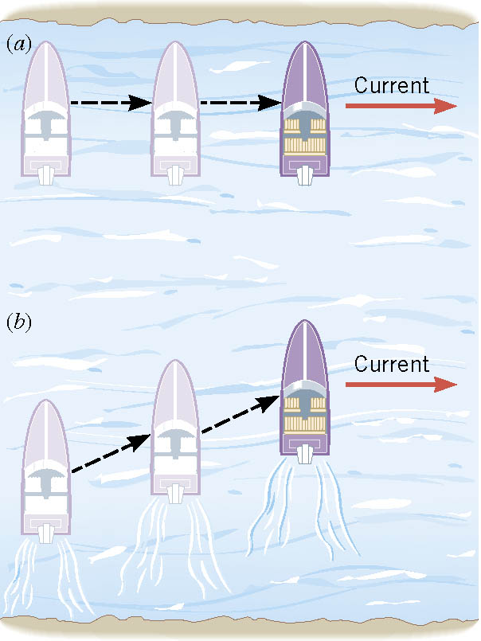
Boat Ride
A boat with its engine turned off is carried along by the current.
With the engine turned on, the boat moves across the river in a diagonal fashion.

Slide 7
Boat Ride Problem
A river is flowing to the east at 2 m/s. A boat is travelling perpendicular to the current at 4 m/s relative to water. What is the velocity of the boat as seen from the shore?

Slide 8
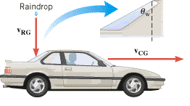
Dry rear window during rain
While driving a car, have you ever noticed that the rear window sometimes remains dry, even though rain is falling?
This phenomenon is a consequence of relative velocity.
A driver determines that he needs a minimum speed of 20 m/s to avoid wetting the rear window. If the rain is falling relative to ground at 10 m/s vertically, calculate the angle of the rear window makes with the vertical, θ_{w}.

