Slide 1
Chapter-3
Kinematics in Two Dimensions
Projectile Motion

Slide 2


Kinematics Equations in 2 dimensions
1. | 2. | 3. | 4. | 5.

Slide 3
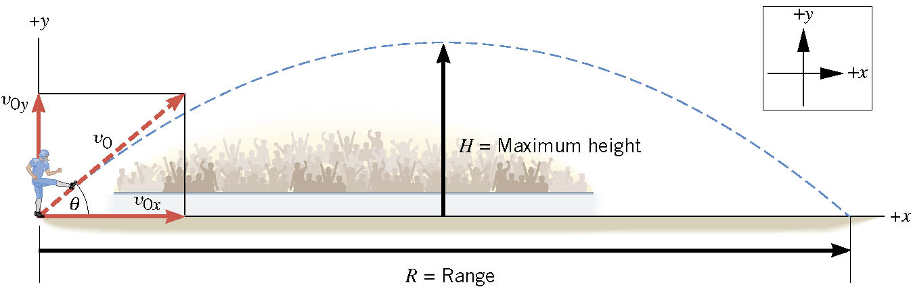
3.3 Projectile Motion
Assumptions:
1. Air resistance is neglected
2. Gravity is constant, 9.8 m/s², down.
What is the launch angle for maximum range?
http://phet.colorado.edu/simulations/sims.php?sim=Projectile_Motion

Slide 4
Velocity of a projectile and the shape of its trajectory
Trajectory is an inverted parabola.

Slide 5
Football Kickoff
A place-kicker kicks a football at an angle of 40⁰ above the horizon with a speed of 22 m/s. Find the hang time, range R, and maximum height H.

Slide 6
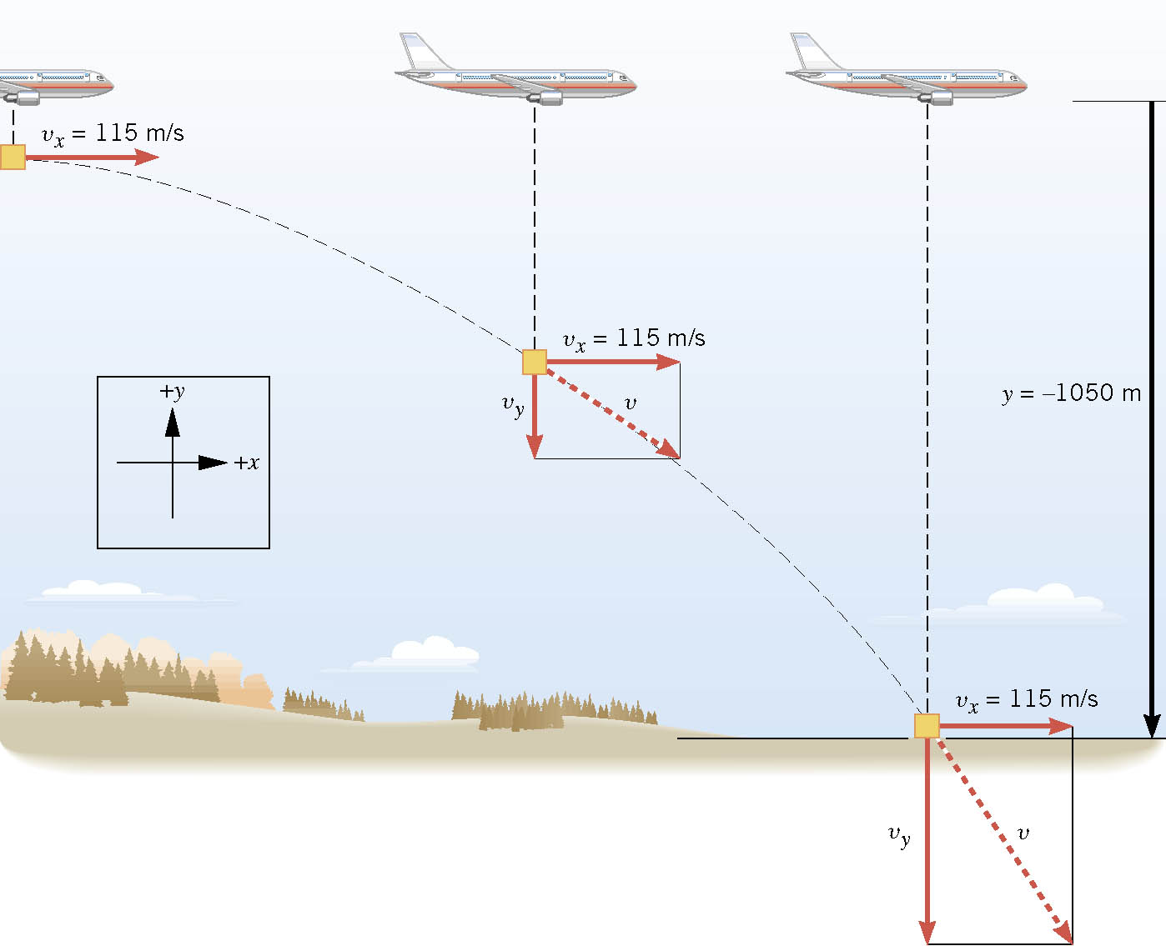
A Falling Care Package
An airplane moving horizontally with a constant velocity of +115 m/s at an altitude of 1050 m. The plane releases a “care package” that falls to the ground along a curved trajectory to reach some stranded hikers. How far horizontally ahead the package should be released?

Slide 7
Demonstration
http://www.youtube.com/watch?v=cxvsHNRXLjw

Slide 8
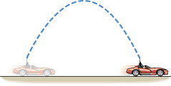
Conceptual Example
Suppose you are driving in a convertible with the top down. The car is moving to the right at a constant velocity. As Figure 3.11 illustrates, you point a rifle straight upward and fire it. In the absence of air resistance, where would the bullet land—behind you, ahead of you, or in the barrel of the rifle?

Slide 9
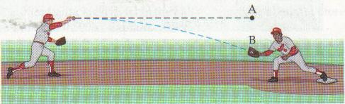
Playing Shortstop
A player picks up a ground ball and throws it horizontally with a speed of 24 m/s. It is caught after 0.42 s later at point B.
a. How far apart are the two players?
b. What is the distance of vertical drop, AB?

Slide 10
Example 3.5
A large rock is ejected from the volcano with a speed of 25.0 m/s and at an angle 35.0º above the horizontal, as shown in Figure 3.40. The rock strikes the side of the volcano at an altitude 20.0 m lower than its starting point. (a) Calculate the time it takes the rock to follow this path. (b) What are the magnitude and direction of the rock’s velocity at impact?

Slide 11
Projectile to Satellite
https://www.youtube.com/watch?v=IC1JQu9xGHQ

Slide 12
Problem 47

