Slide 1
Chapter 11 Fluids
Fluids are materials that can flow, gases and liquids.
Air is the most common gas, and moves from place to place as wind.
Water is the most familiar liquid.

Slide 2
Mass Density
The mass density ρ is the mass m of a substance divided by its volume V:
SI Unit of Mass Density: kg/m³

Slide 3
Table 10-1: Densities of common solids and liquids at 20⁰C.
Solid
Substance
Density
Liquid
Substance
Density
In g/cm³
In kg/m³
In g/cm³
In kg/m³
Ice (0⁰C)
0.92
920
Water (fresh)
1
1000
Aluminum
2.7
2700
Water (sea)
1.03
1030
Copper
8.93
8930
Gasoline
0.79
790
Glass (crown)
2.5
2500
Kerosene
0.82
820
Iron
7.8
7800
Glycerin
1.26
1260
Lead
11.3
11,300
Turpentine
0.87
870
Gold
19.3
19300
Mercury
13.6
13,600

Slide 4
Why Ice Floats on Water?
Most natural ice has a hexagonal structure, with each molecule bonding to four others. Unlike most solid forms of liquids, ice is less dense than liquid water. This is because, in ice, the hydrogen bonds hold the molecules in a lattice structure, where the distance between each molecule is greater than in liquid water. The lower density of ice means that it floats in water.

Slide 5
Specific Gravity
The specific gravity of a substance is its density divided by the density of water at 4 °C.
Being the ratio of two densities, specific gravity has no units.

Slide 6
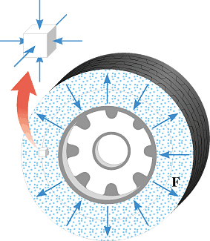
Pressure
The pressure P exerted by a fluid is defined as the magnitude F of the force acting perpendicular to a surface divided by the area A over which the force acts:
The SI unit for pressure: newton/meter² = (N/m²) = pascal (Pa).

Slide 7
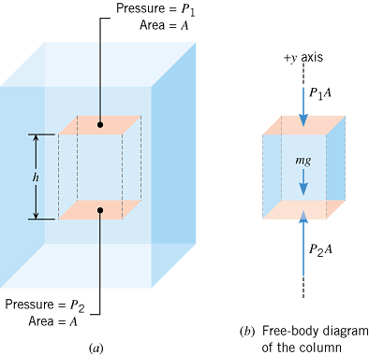
Pressure and Depth in a Static Fluid
m = ρAh
P₂A = P₁A + ρAhg

Slide 8
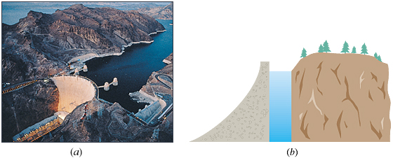
The Hoover Dam
The Hoover Dam in Nevada and Lake Mead behind it. Lake Mead is the largest wholly artificial reservoir in the United States and was formed after the completion of the Hoover Dam in 1936.

Slide 9
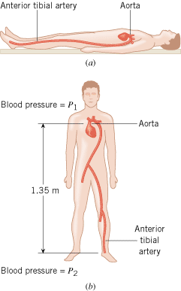
EXAMPLE 5 Blood Pressure
Blood in the arteries is flowing, but as a first approximation, the effects of this flow can be ignored and the blood can be treated as a static fluid. Estimate the amount by which the blood pressure P₂ in the anterior tibial artery at the foot exceeds the blood pressure P₁ in the aorta at the heart when a person is (a) reclining horizontally as in Figure 11.10a and (b) standing as in Figure 11.10b.

Slide 10
11.4 Pressure Gauges
Pressure gauges are used to measure pressures.

Slide 11
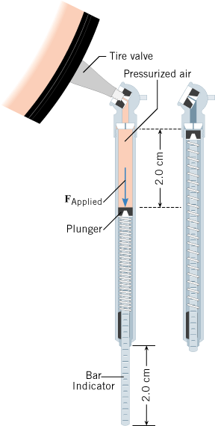
Tire pressure gauge

Slide 12
Gauge Pressure
Gauge pressure is the pressure measured by a pressure gauge.
It is the difference between the absolute pressure and atmospheric pressure.
Gauge pressure =
Absolute pressure - atmospheric pressure

Slide 13
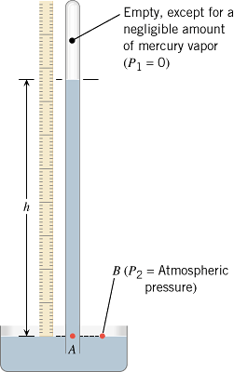
Mercury Barometer
At sea level,
Height of mercury = h = 76 cm.
Atmospheric pressure = 76 cm of Hg.
(76 cm = 760 mm = 29.9 inch)

Slide 14
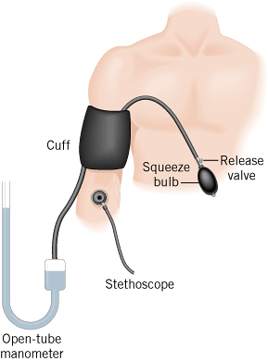
Blood pressure is measured with a sphygmomanometer.
Pressure at the peak of the beating cycle- Systolic.
Pressure at the low point of the beating cycle- Diastolic.
For a young, healthy heart:
Systolic pressure = 120 mm of Hg
Diastolic pressure = 80 mm of Hg

Slide 15
11.5 Pascal's Principle
Any change in the pressure applied to a completely enclosed fluid is transmitted undiminished to all parts of the fluid and the enclosing walls.

Slide 16
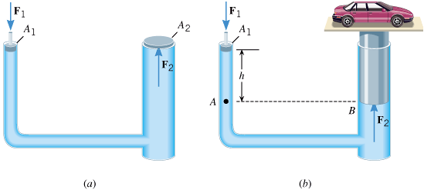
Hydraulic Car Lift

