Slide 1
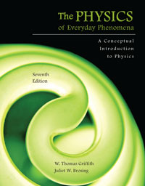
Chapter 21 Looking Deeper Into Everyday Phenomena
Lecture PowerPoint
Copyright © The McGraw-Hill Companies, Inc. Permission required for reproduction or display.

Slide 2
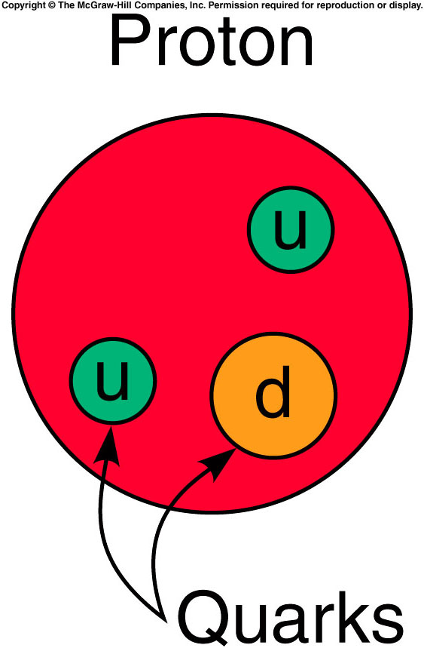
Beyond everyday phenomena: From the smallest...
What are the basic building blocks of the universe?

Slide 3
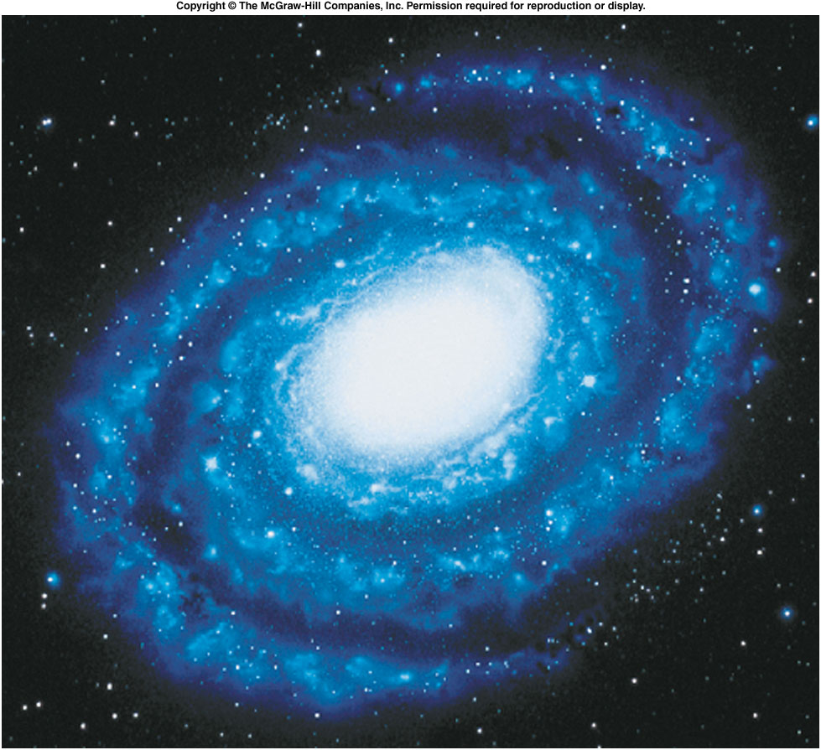
... to the largest.
How was the universe formed?
How is it changing?

Slide 4
Quarks and Other Elementary Particles
Atoms were once thought to be the basic building blocks of all matter.
We now know atoms consist of electrons, protons, and neutrons.
Neutrons and protons also have a substructure of quarks.

Slide 5
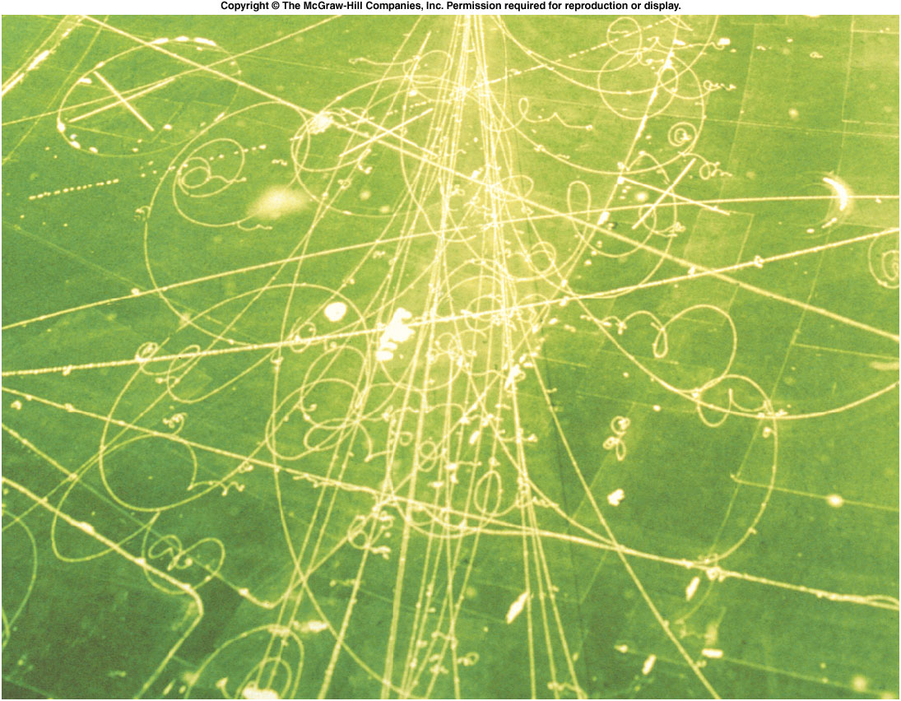
Where will this all end?
What are quarks and why do we believe they exist?
Will we someday discover that quarks also have a substructure?
Recent advances in high-energy physics have produced the standard model.
Particle accelerators like the LHC and CERN in Europe and Fermilab in the U.S. are used to bombard targets with fast-moving particles.
Particle detectors are used to study what emerges from these collisions.
For example, particle tracks in a bubble chamber provide information on the new particles produced in collisions or decays.

Slide 6
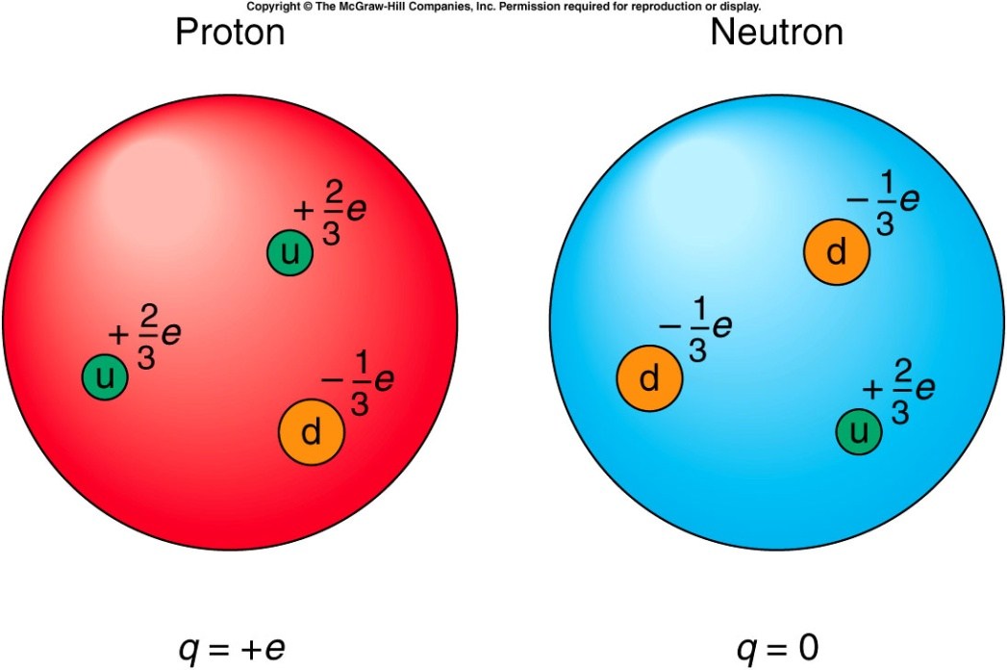
The particles are grouped into three primary groups:
Leptons are the lightest particles and include electrons, positrons, and the neutrinos that are involved in beta decay.
Mesons are intermediate in mass and include the pion and the kaon.
Baryons are the heaviest -- they include the neutron and proton as well as heavier particles.
A proton consists of two up quarks and a down quark, giving it an electric charge of +1 e.
A neutron consists of two down quarks and an up quark, for a total electric charge of zero.

Slide 7
Each particle has an antiparticle, which has the same mass but opposite charge, etc.
There are six quarks: up, down, charm, strange, top, and bottom, and they form all the hadrons (the mesons and baryons).
Mesons have zero spin and are made of two quarks.
Baryons have a spin of one-half, and consist of three quarks.
As far as we know, quarks and leptons are elementary (not made up of other particles).
A proton consists of two up quarks and a down quark, giving it an electric charge of +1 e.
A neutron consists of two down quarks and an up quark, for a total electric charge of zero.

Slide 8
Since pions are mesons, they consist of a quark and an antiquark. What is the composition of the positively charged pion (charge of +1 e)?
To get a charge of +1 e, an up quark (charge +2/3 e) is added to the antiparticle of the down quark, “down-bar”, with a charge of -(-1/3 e) = +1/3 e.
So the positive pion is composed of an up quark and a down-bar (anti-down) quark.
up + down
anti-up + anti-down
up + up
up + anti-down
anti-up + down

Slide 9
The forces in the universe have also been grouped into a few fundamental forces:
The primary force responsible for binding the quarks in neutrons, protons, and other baryons and mesons is the strong nuclear interaction.
The weak nuclear force is involved in the interactions of leptons, such as beta decay.
The electric force and magnetic force have been combined into the electromagnetic force.

Slide 10
The standard model has now unified the electromagnetic force with the weak nuclear force to form the electroweak force.
A Grand unified theory (GUT) which will unify the strong force with the electroweak force is much sought after.
This leaves only the gravitational force.
A Theory of everything (TOE) may someday unify all forces, including gravity.

Slide 11
Cosmology and the Beginning of Time
We have now looked into the extremely small:
Quarks make up protons and neutrons, which form the nucleus.
Atoms consist of the nucleus and the surrounding electrons.
Atoms make up molecules and the ordinary matter of our world.
What about the very large?
The earth is part of the solar system which includes the sun.
The sun is just one star in our galaxy, which is just one galaxy in our Local Group of galaxies.
These groups of galaxies make up larger groups, and ultimately, the universe.
What can our knowledge of atoms, nuclei, and quarks tell us about the universe?

Slide 12
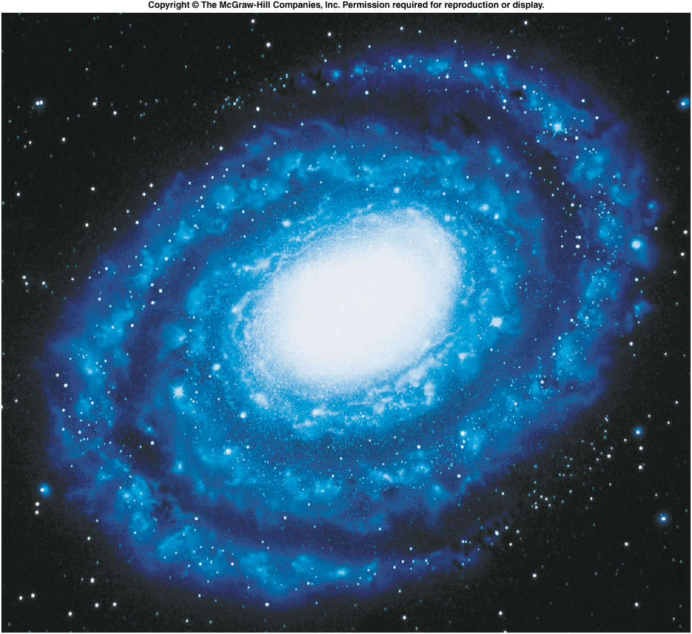
Is the universe expanding?
Collections of stars called galaxies come in various shapes and sizes.
Many have a spiral structure.

Slide 13
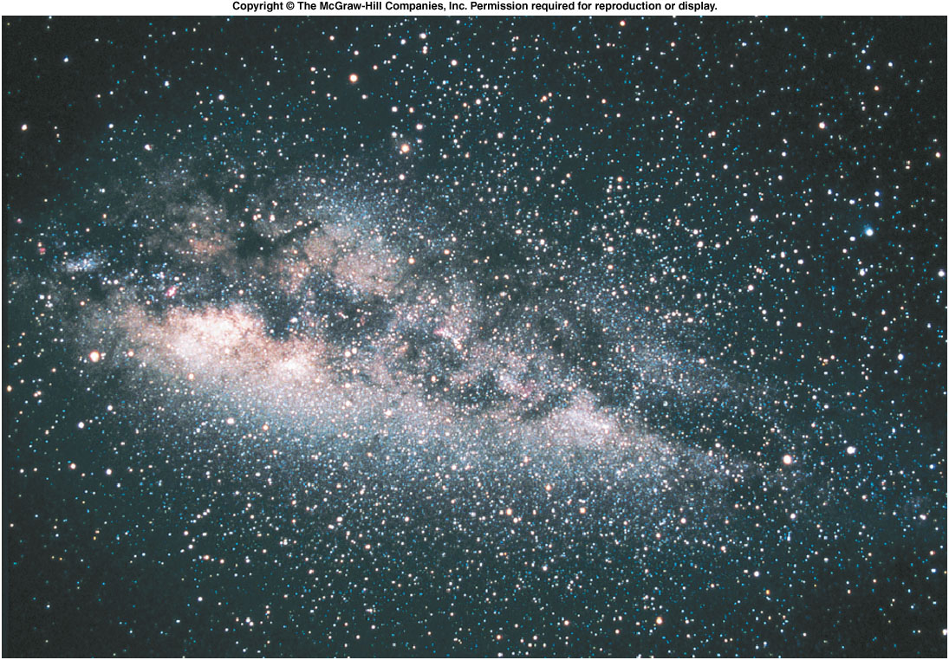
Our own Milky Way is a spiral galaxy, although from earth it appears as a band of stars across the night sky.
Our sun is one of billions of stars that make up the Milky Way galaxy.

Slide 14
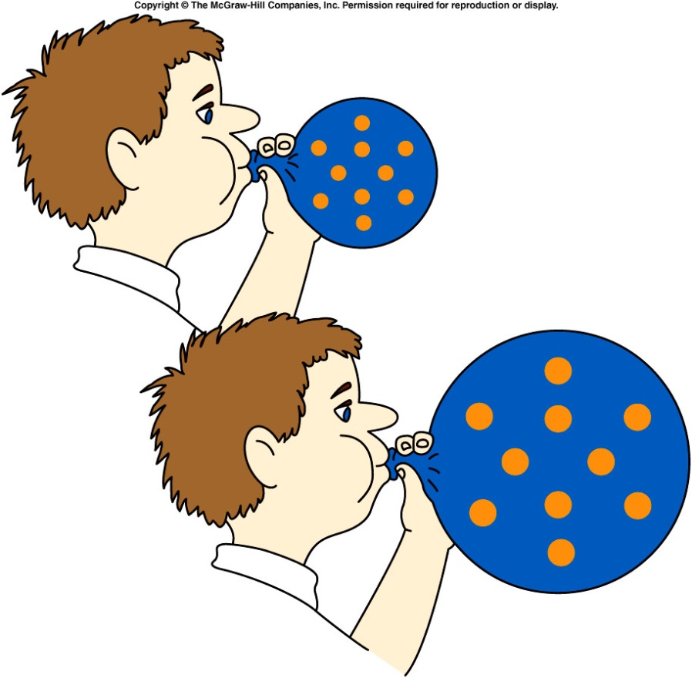
The other galaxies are receding from us -- the universe is expanding.
Hubble observed that the spectra of stars in distant galaxies were shifted in wavelength and frequency.
These stars must be moving away from us, producing a Doppler shift like what we encounter for sound waves.
This red shift is more pronounced the farther away a galaxy is.
The entire universe is expanding,
with more distant galaxies
receding faster than nearby ones.
This is analogous to spots on an
expanding balloon; according to
any spot, all the other spots
appear to recede as the balloon
expands.
Recent evidence indicates that
the rate of expansion is
accelerating.

Slide 15
If the universe is expanding, at some point in time long ago the entire mass of the universe must have been much more compressed than it is now.
The beginning of the expansion (and perhaps the beginning of time) was an explosion from which the universe has been spreading ever since.
This initial rapid expansion or explosion is called the Big Bang.
Just a microsecond or so after the beginning, all of the matter of the universe was an extremely hot sea of quarks.
As the expansion proceeded, the quarks condensed into mesons and baryons, including protons and neutrons.
About three minutes after the beginning, the protons and neutrons probably began to form nuclei.
Half a million years later, electrons began to orbit about the nuclei to form atoms.

Slide 16
The standard model of high-energy physics predicts how some of these steps could have occurred.
The model successfully predicts the ratio of helium to hydrogen in stars and galaxies.
Another confirmation is the existence and uniformity of the cosmic microwave background radiation.
Our success in describing the world of the very small plays a large role in our understanding of the universe.
There are still many unanswered questions.
We cannot describe with assurance the initial conditions of the universe.
There may be many universes, some of which may be quite different from our own.
These questions hold a tremendous fascination for physicists, astronomers, philosophers, and the general public.

Slide 17
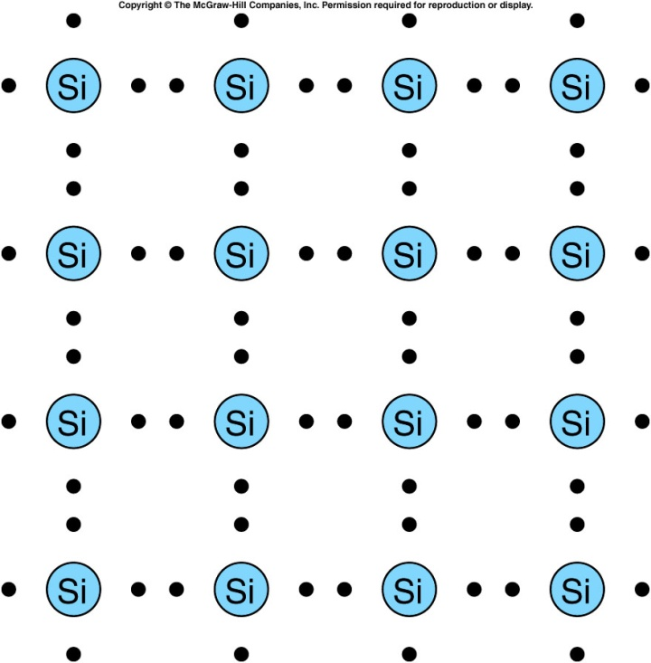
Semiconductors and Microelectronics
Calculators, microwave ovens, video recorders, home computers, television sets, digital watches, and many other items we use every day use solid-state electronics.
Semiconductors (such as carbon, germanium, and silicon) have a higher conductivity than insulators, but a lower conductivity than conductors.
These elements have four outer electrons beyond a closed shell, which are shared with neighboring atoms.
These shared electrons are more closely tied to their nuclei than in a metal, but they are freer to migrate than in a good insulator.

Slide 18
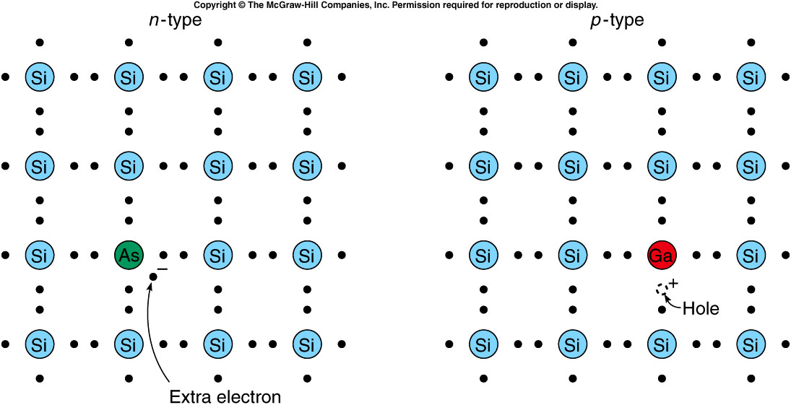
Semiconductors’ importance in electronics results from our ability to modify their conductivity by doping them with small amounts of impurity.
Doping silicon with phosphorus or arsenic provides an extra electron, making an n-type semiconductor.
Doping with boron or gallium leaves holes and produces p-type semiconductors.
A hole is the absence of an electron; a moving hole behaves as a positive charge carrier because it leaves an excess positive charge wherever it goes.

Slide 19
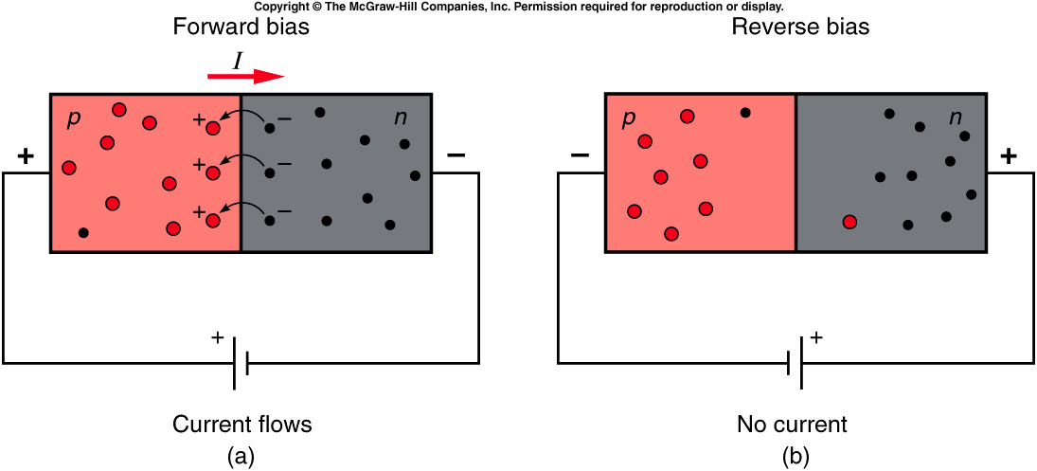
A diode allows electric current to flow in one direction but not in another.
The essential feature is the junction between the n-type and p-type materials.
When the positive terminal of a battery is connected to the p-type side and the negative terminal to the n-type side, electrons will flow to the junction and attract holes to the junction.
These holes are eliminated when electrons move across the junction to fill them, but more holes move through the p-type material from the positive terminal of the battery.
A continuous current will flow in this forward biased diode.

Slide 20
A different situation exists if we reverse the connections of the battery to the diode.
Holes are now pulled away from the junction by the negative charges from the negative terminal of the battery (now connected to the p-type side of the diode).
Electrons in the n-type material are attracted toward the positive terminal of the battery.
Since the holes and electrons are both pulled away from the junction, no recombination of holes and electrons occurs there.
There is no flow of current across the junction in reverse bias.

Slide 21
Can a diode be made from material that is doped with just one type of impurity atom?
Yes
No
Maybe
Diodes are made of two layers:
a layer of a p-type semi-conductor and a layer of an n-type semiconductor. One layer will be doped with a group III impurity and the other layer with a group V impurity.

Slide 22
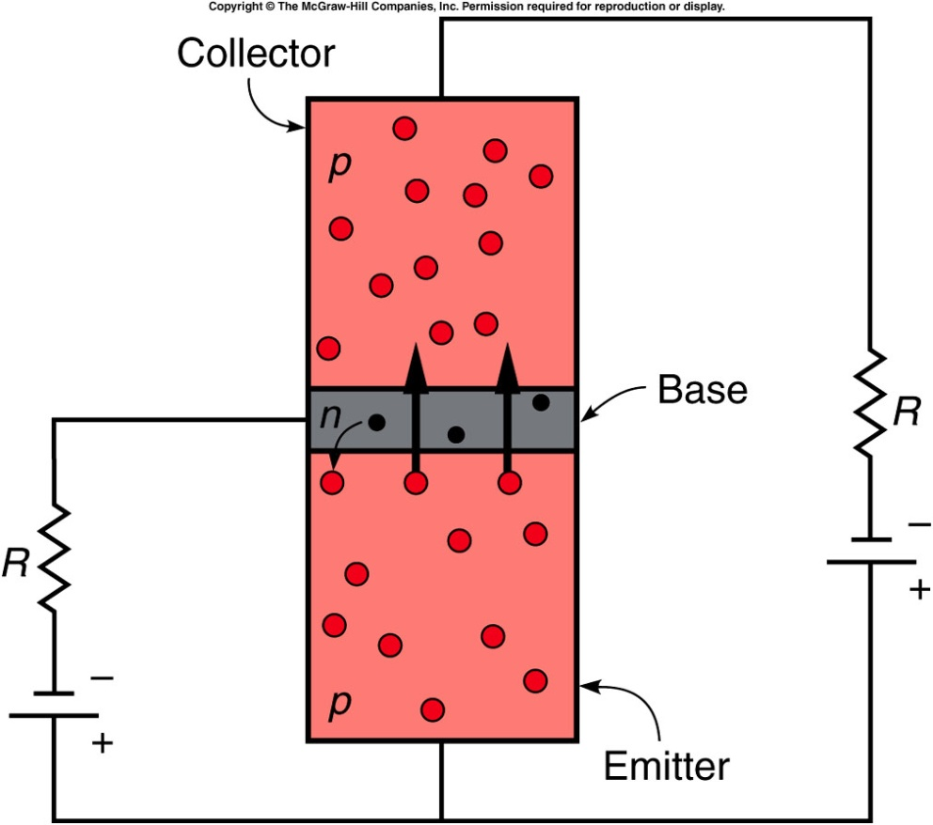
The transistor is a combination of two diodes that share the middle portion, the base of the transistor.
Holes are introduced to the emitter of the p-n-p transistor from the positive terminal of a battery.
The junction between the emitter and the base behaves as a forward-biased diode, and the holes flow into the thin base layer.
These holes can flow across the base and into the collector as long as not too many recombine with electrons in the base layer.
The number of free electrons in the base layer can be controlled by the current allowed to flow between the base and emitter.
A small change in the current from the base to the emitter can produce a large change in the current flowing between the collector and the emitter.
This allows the transmitter to serve effectively as an amplifier.
A weak signal picked up by a radio signal can be turned into a larger signal by using transistor amplifiers.

Slide 23
The transistor is a combination of two diodes that share the middle portion, the base of the transistor.
Holes are introduced to the emitter of the p-n-p transistor from the positive terminal of a battery.
The junction between the emitter and the base behaves as a forward-biased diode, and the holes flow into the thin base layer.
These holes can flow across the base and into the collector as long as not too many recombine with electrons in the base layer.
The number of free electrons in the base layer can be controlled by the current allowed to flow between the base and emitter.
Another important application is as voltage-controlled switches.
One voltage applied across the base and emitter can cause a large flow of current through the collector, while another value produces a very small flow.
The transistor is then either on or off depending on the voltage applied to the base.
This feature is useful in computers.

Slide 24
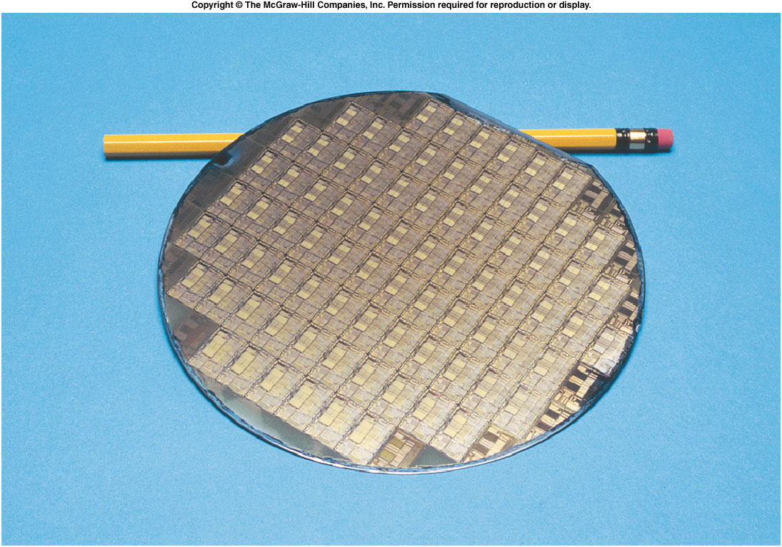
An integrated circuit consists of several transistors, diodes, resistors, and electrical connections all built into a single tiny chip of semiconductor material, usually silicon.
This allows the production of circuits much smaller than circuits made from individual transistors or vacuum tubes.
A computer that would fill a large room can now be reduced to the size of a hand-held calculator.
The starting point in producing integrated circuits is a polished wafer of single-crystal silicon.
Several identical circuits are usually imprinted on a single silicon wafer.

Slide 25
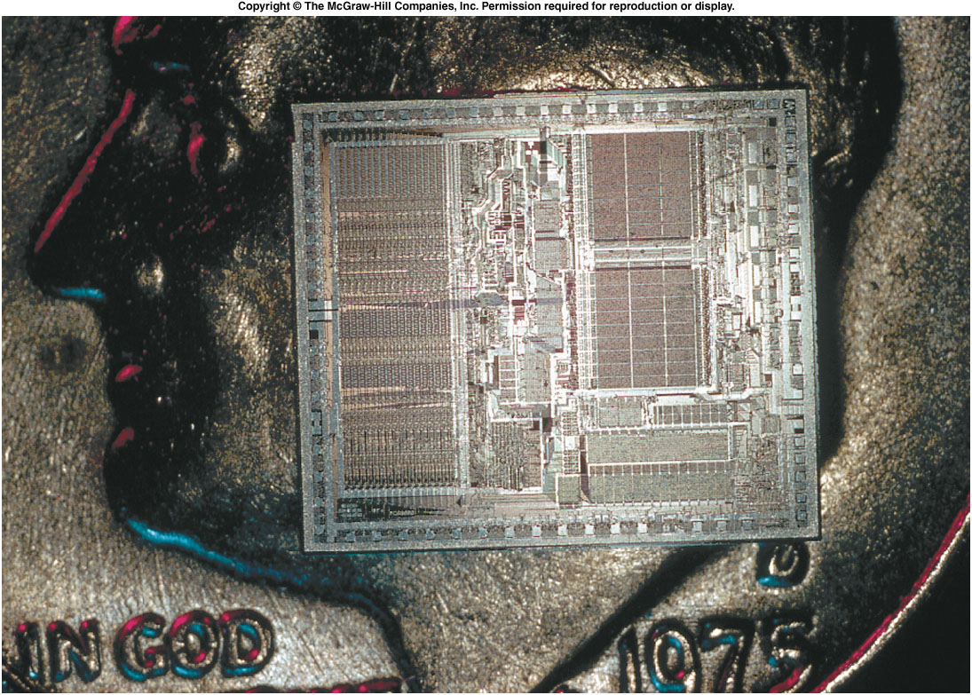
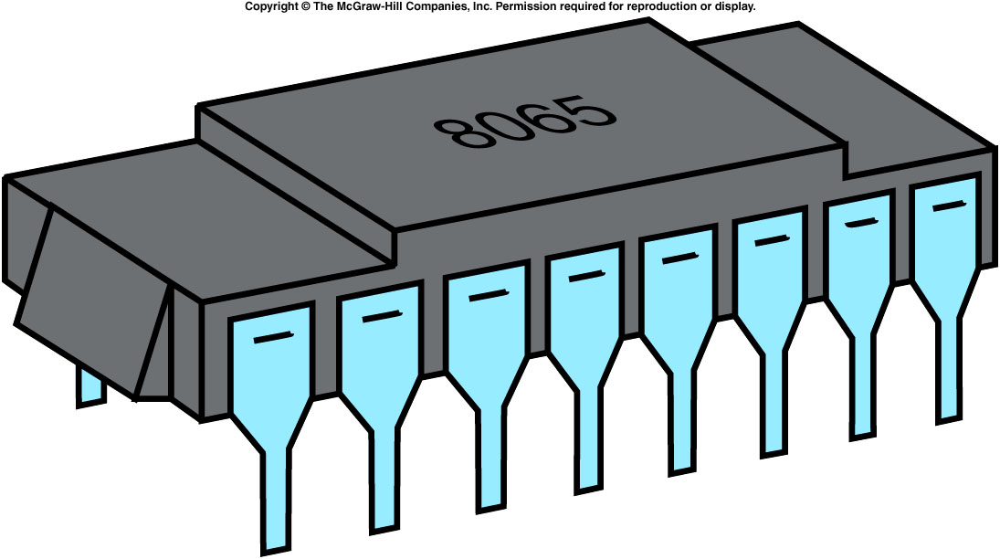
The wafer is cut into individual chips, each containing a miniature circuit.
The final steps involve making electrical connections to the chip, packaging the chip in a sealed plastic enclosure, and testing the resulting circuit.

Slide 26
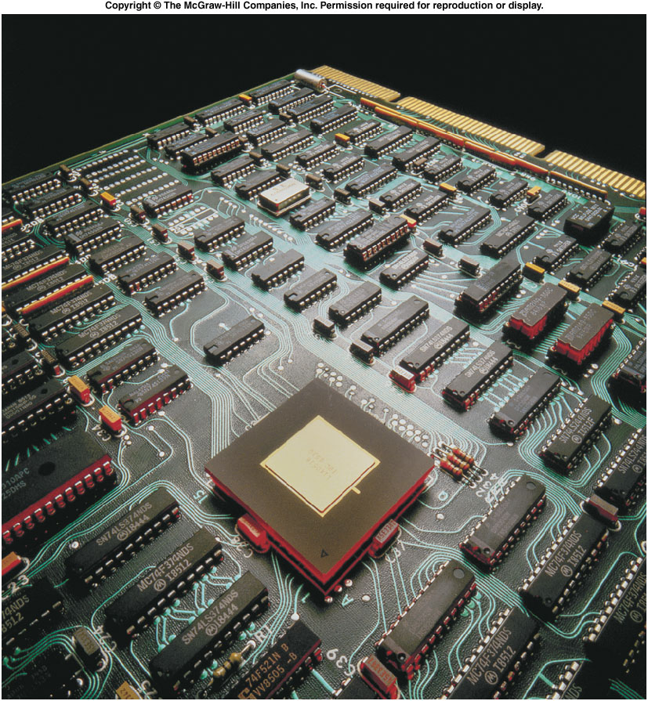
Rows of packaged microchips are used on a single circuit board of a computer.
Competition to produce ever smaller and faster circuitry continues to push the technology forward.
Research in the condensed-matter physics of semiconducting elements and compounds has become one of the most active areas in modern physics.
The revolution in electronics technology is still proceeding.

Slide 27
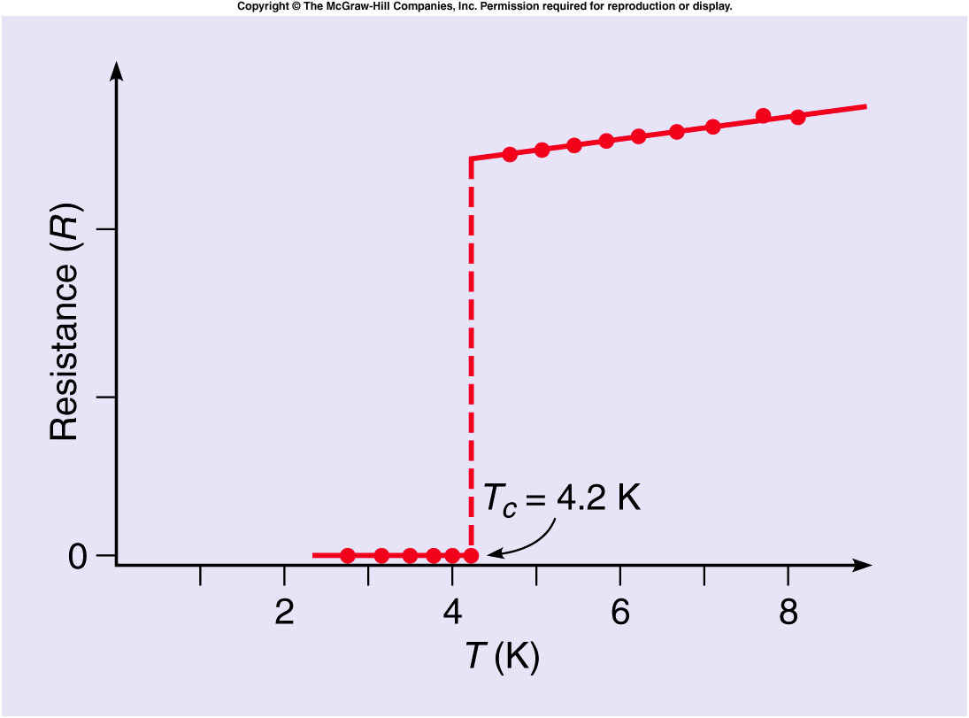
Superconductors and Other New Materials
Superconductivity is a phenomenon in which the resistance to the flow of electric current completely disappears.
The resistance of many metals drops abruptly to zero at the critical temperature T_{c}.
An electric current, once started, would flow indefinitely with no source of power.

Slide 28
A theoretical explanation applies quantum mechanics and is closely related to a theory of superfluids, a phenomenon also observed at very low temperature.
Liquid helium becomes a superfluid below a critical temperature where it loses its viscosity (resistance to flow) just as a superconductor loses its electrical resistance.
In 1986 a new type of high-temperature superconductors, made from ceramic compounds, was discovered.
Although the critical temperatures are still not what we would normally regard as high (~100 K), these temperatures can be reached using liquid nitrogen which is readily available.
Previous critical temperatures were less than 25 K, requiring special techniques that were not cost effective for most commercial uses.

Slide 29
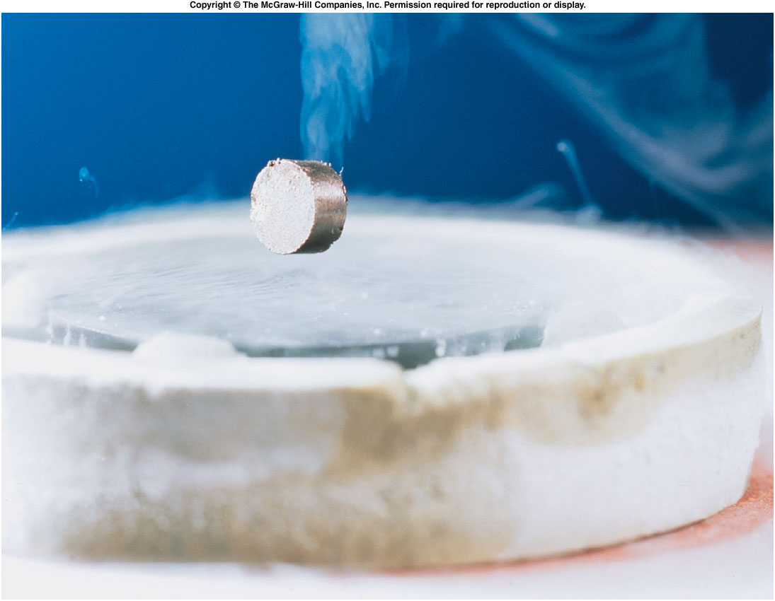
The Meissner Effect
One striking property of a superconductor is that it will completely exclude magnetic field lines produced by an external magnet or electrical current.
A magnet brought near a superconducting material will be repelled.
A small magnet can levitate above a superconducting disk cooled with liquid nitrogen.

Slide 30
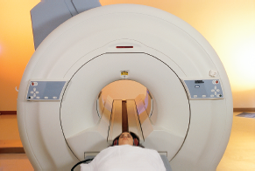
High-temperature superconductors have many potential applications, especially in the use of electromagnets.
The superconducting supercollider (SSC) would have used superconducting magnets to control particle beams.
Superconducting magnets are also used in magnetic resonance imaging (MRI), an important diagnostic tool in medicine.
Superconducting cables could be used in power transmission lines to reduce losses from electric resistance.

Slide 31
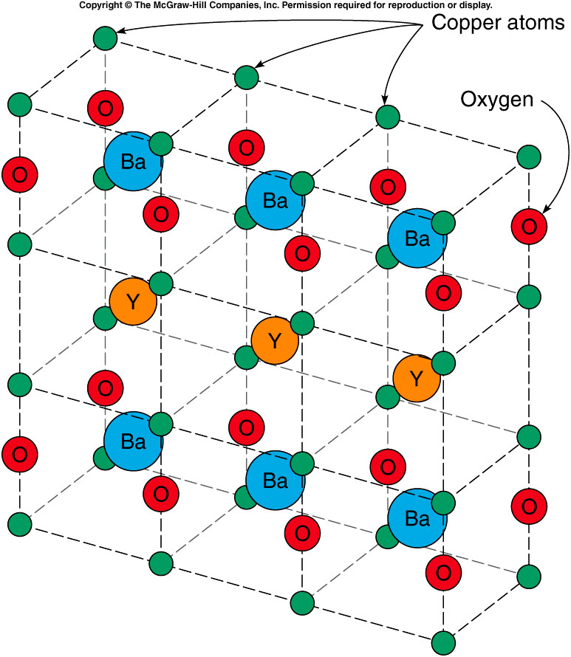
The discovery of the new superconductors was sparked by research on ceramic metal oxides already known to have interesting electrical properties.
For example, BaTiO₃ has been used to convert changes in pressure into electrical signals, or vice versa.
A crystal of barium titanate can be used as a tiny microphone or speaker.

Slide 32
The search for new materials stems from our growing knowledge of how atoms interact in the solid or liquid states.
Liquid crystals are one of the new materials that have found extensive application.
They have some properties of both liquids and solids, with a crystal-like structure in one direction but disordered and free to flow along other directions in the material.
Electric fields can affect how much light flows through the material, making them useful in display screens of hand-held calculators and in very thin, flat television screens.

Slide 33
It is hard to know just where this research will lead, but we can be sure of two things:
Some new materials will have unexpected and exciting properties.
Some of these materials will lead to new products that you will encounter in your everyday activities.

