Slide 1
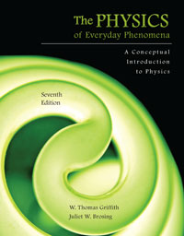
Chapter 7 Momentum and Impulse
Lecture PowerPoint
Copyright © The McGraw-Hill Companies, Inc. Permission required for reproduction or display.

Slide 2
Collisions
How can we describe the change in velocities of colliding football players, or balls colliding with bats?
How does a strong force applied for a very short time affect the motion?
Can we apply Newton’s Laws to collisions?
What exactly is momentum? How is it different from force or energy?
What does “Conservation of Momentum” mean?

Slide 3
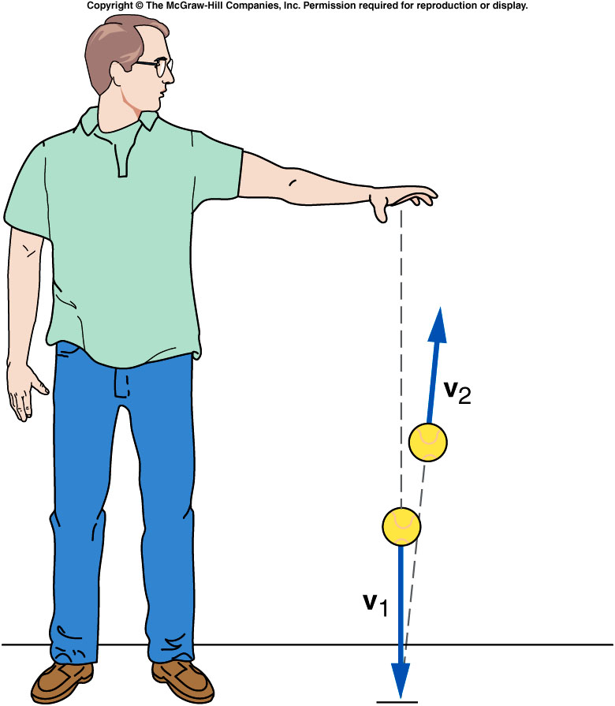
What happens when a ball bounces?
When it reaches the floor, its velocity quickly changes direction.
There must be a strong force exerted on the ball by the floor during the short time they are in contact.
This force provides the upward acceleration necessary to change the direction of the ball’s velocity.

Slide 4
What happens when a ball bounces?
Forces like this are difficult to analyze:
Strong forces that act for a very short time.
Forces that may change rapidly during the collision.
It will help to write Newton’s second law in terms of the total change in velocity over time, instead of acceleration:

Slide 5
Momentum and Impulse
Multiply both sides of Newton’s second
law by the time interval over which the
force acts:
The left side of the equation is impulse,
the (average) force acting on an object
multiplied by the time interval over which
the force acts.
How a force changes the motion of an object depends on both the size of the force and how long the force acts.
The right side of the equation is the change in the momentum of the object.
The momentum of the object is the mass of the object times its velocity.

Slide 6
Momentum and Impulse
A bowling ball and a tennis ball can have the same momentum, if the tennis ball with its smaller mass has a much larger velocity.

Slide 7
Impulse-Momentum Principle
The impulse acting on an object produces a change in momentum of the object that is equal in both magnitude and direction to the impulse.

Slide 8
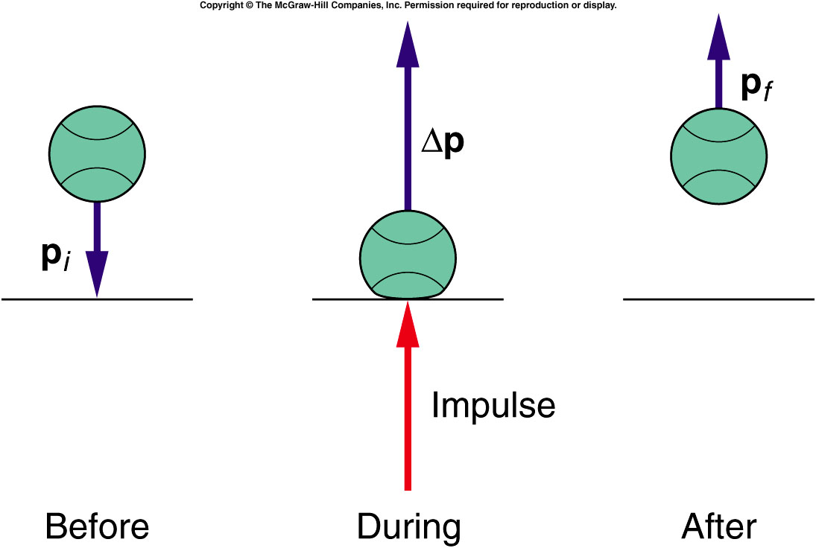
Impulse-Momentum Principle
When a ball bounces back with the same speed, the momentum changes from -mv to mv, so the change in momentum is 2mv.

Slide 9
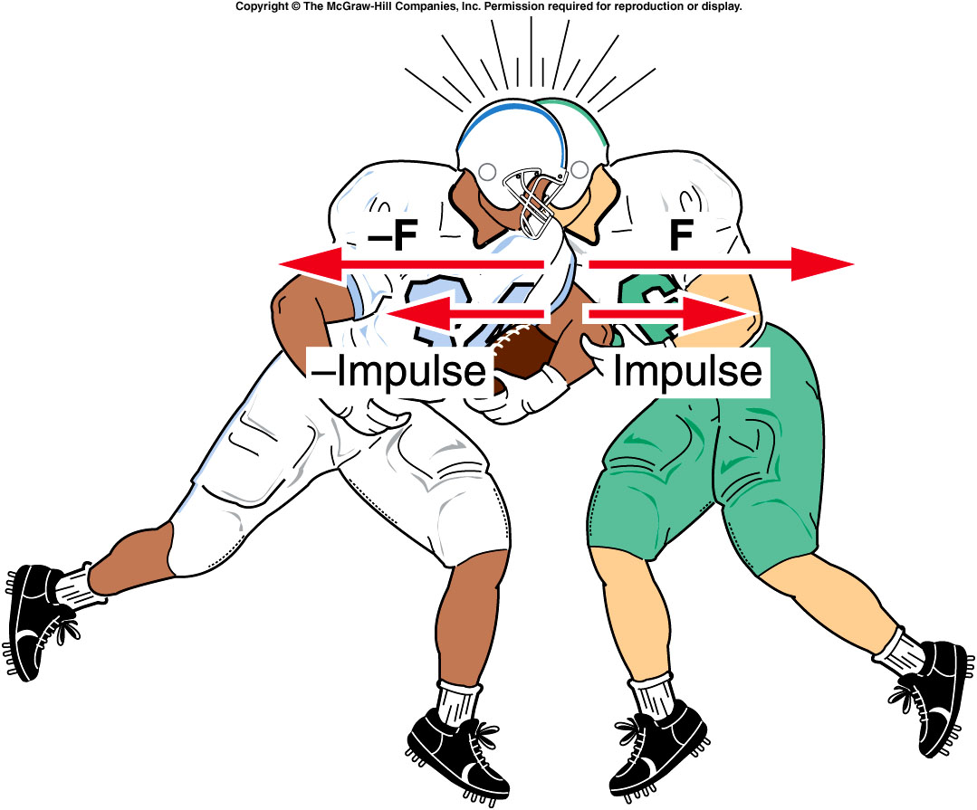
Conservation of Momentum
Does Newton’s third law still hold?
For every action, there is an equal but opposite reaction.
The defensive back exerts a force on the fullback, and the fullback exerts an equal but opposite force on the defensive back.

Slide 10
Conservation of Momentum
If the net external force acting on a system of objects is zero, the total momentum of the system is conserved.

Slide 11
Conservation of Momentum
The impulses on both are equal and opposite.
The changes in magnitude for each are equal and opposite.
The total change of the momentum for the two players is zero.

Slide 12
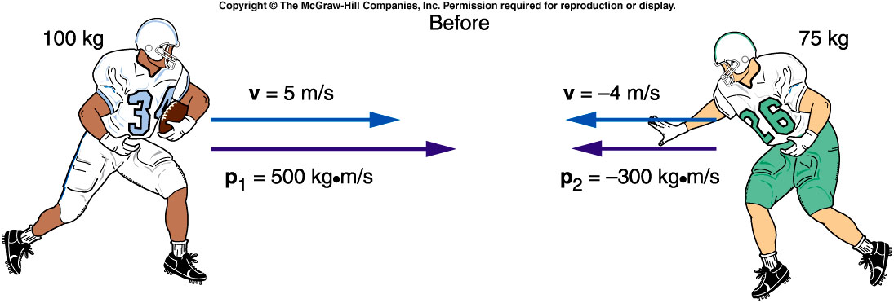
A 100-kg fullback moving straight downfield collides with a 75-kg defensive back. The defensive back hangs on to the fullback, and the two players move together after the collision. What is the initial momentum of each player?

Slide 13
What is the initial momentum of each player?
Fullback:
p = mv
= (100 kg)(5 m/s)
= 500 kg·m/s²
Defensive back:
p = mv
= (75 kg)(-4 m/s)
= -300 kg·m/s²

Slide 14
What is the total momentum of the system?
Total momentum:
p_{total} = p_{fullback} + p_{defensive back}
= 500 kg·m/s - 300 kg·m/s
= 200 kg·m/s

Slide 15
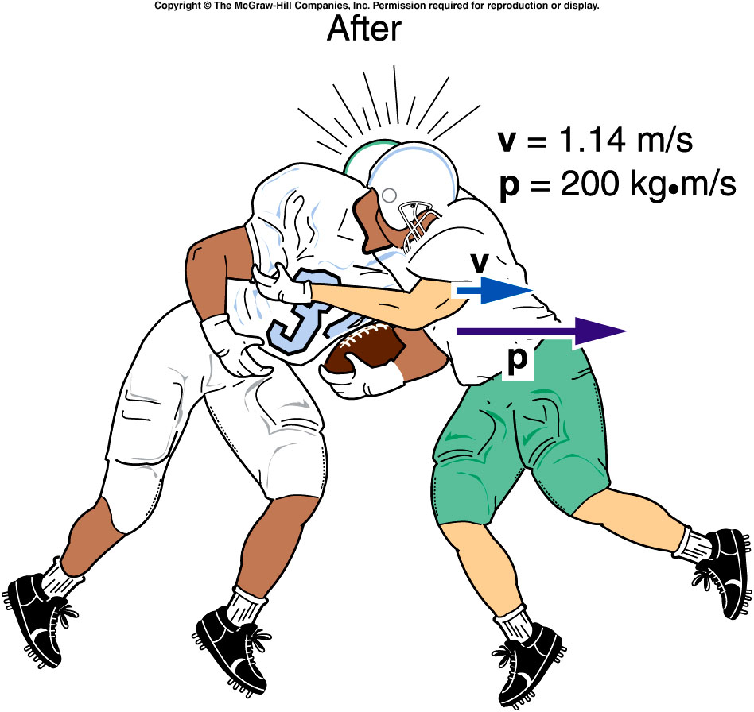
What is the velocity of the two players immediately after the collision?
Total mass:
m = 100 kg + 75 kg
= 175 kg
Velocity of both:
v = p_{total} / m
= (200 kg·m/s) / 175 kg
= 1.14 m/s

Slide 16
Recoil
Why does a shotgun slam against your shoulder when fired, sometimes painfully?
How can a rocket accelerate in empty space when there is nothing there to push against except itself?

Slide 17
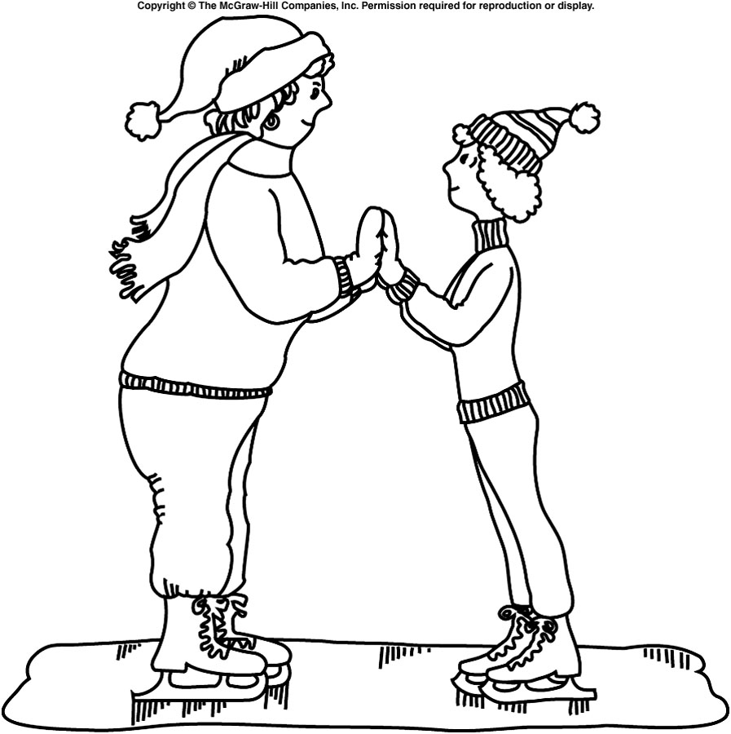
Two skaters of different masses prepare to push off against one another. Which one will gain the larger velocity?
The more massive one
The less massive one
They will each have equal but opposite velocities.
The less massive one!
The net external force acting on the system is zero, so conservation of momentum applies.
Before the push-off, the total initial momentum is zero.
The total momentum after the push-off should also be zero.

Slide 18
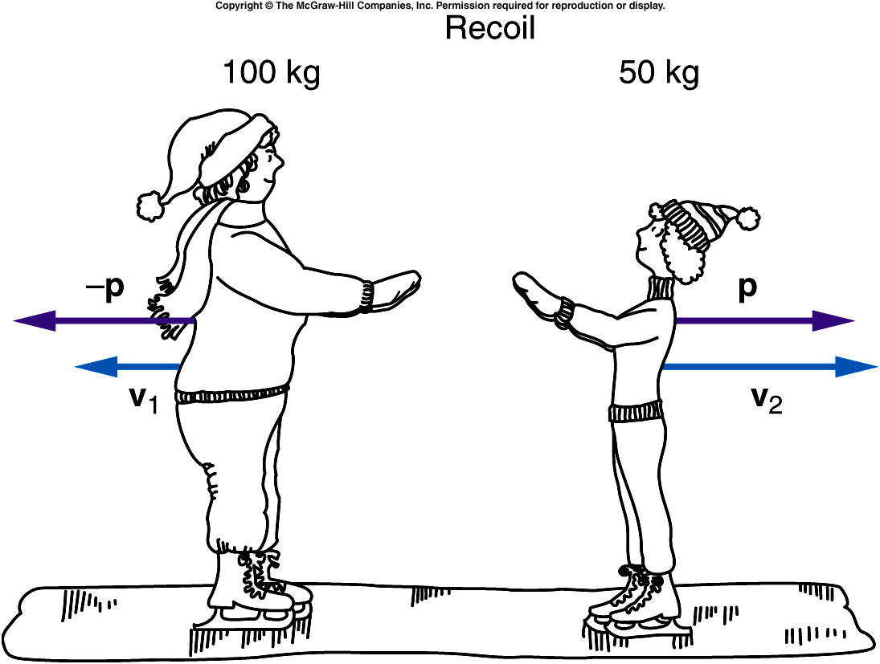
How can the total momentum be zero when at least one of the skaters is moving?
Both must move with momentum values equal in magnitude but opposite in direction: p₂ = −p₁
When added together, the total final momentum of the system is then zero.
Since momentum is mass times velocity p = mv, the skater with the smaller mass must have the larger velocity: m₁v₁ = m₂v₂

Slide 19
Recoil is what happens when a brief force between two objects causes the objects to move in opposite directions.
The lighter object attains the larger velocity to equalize the magnitudes of the momentums of the two objects.
The total momentum of the system is conserved and does not change.

Slide 20
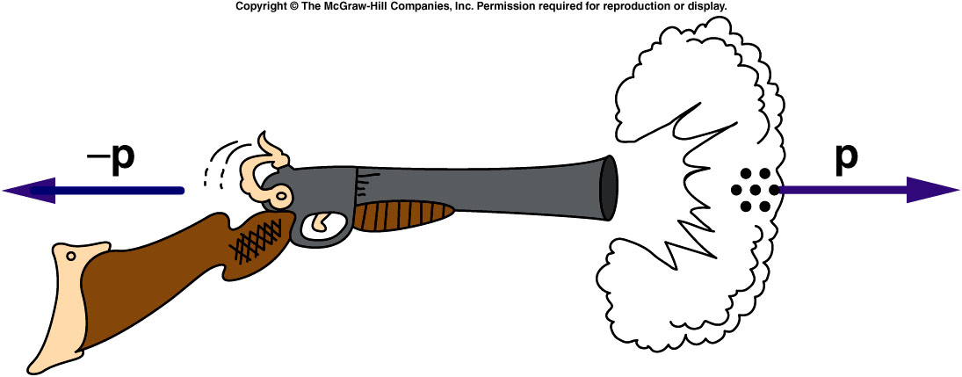
Is momentum conserved when shooting a shotgun?
The explosion of the powder causes the shot to move very rapidly forward.
If the gun is free to move, it will recoil backward with a momentum equal in magnitude to the momentum of the shot.

Slide 21
Even though the mass of the shot is small, its momentum is large due to its large velocity.
The shotgun recoils with a momentum equal in magnitude to the momentum of the shot.
The recoil velocity of the shotgun will be smaller than the shot’s velocity because the shotgun has more mass, but it can still be sizeable.

Slide 22
How can you avoid a bruised shoulder?
If the shotgun is held firmly against your shoulder, it doesn’t hurt as much.
WHY?

Slide 23
If you think of the system as just the shotgun and the pellets, then your shoulder applies a strong external force to the system.
Since conservation of momentum requires the external force to be zero, the momentum of this system is not conserved.

Slide 24
If you think of the system as including yourself with your shoulder against the shotgun, then momentum is conserved because all the forces involved are internal to this system (except possibly friction between your feet and the earth).
With your mass added to the system, the recoil velocity is smaller.

Slide 25
If you think of the system as including yourself and the earth, then momentum is conserved because all the forces involved are internal to this system.
The large mass of the earth means that the change in momentum of the earth would be imperceptible.

Slide 26
How does a rocket accelerate in empty space when there is nothing to push against?
The exhaust gases rushing out of the tail of the rocket have both mass and velocity and, therefore, momentum.
The momentum gained by the rocket in the forward direction is equal to the momentum of the exhaust gases in the opposite direction.
The rocket and the exhaust gases push against each other.
Newton’s third law applies.

Slide 27
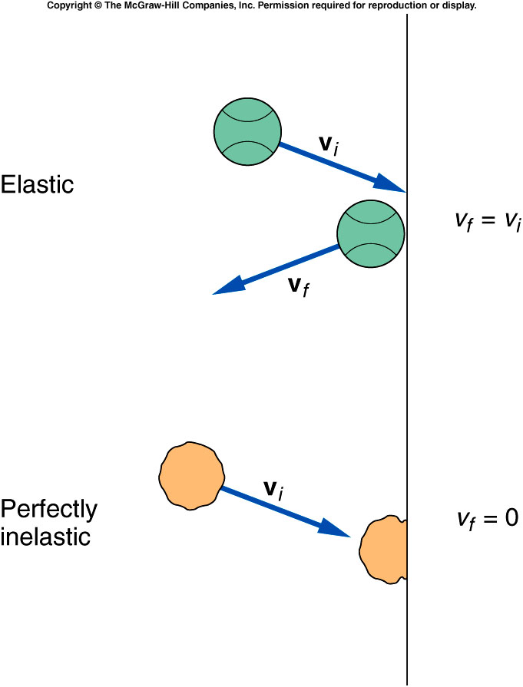
Elastic and Inelastic Collisions
Different kinds of collisions produce different results.
Sometimes the objects stick together.
Sometimes the objects bounce apart.
What is the difference between these types of collisions?
Is energy conserved as well as momentum?

Slide 28
Elastic and Inelastic Collisions
A collision in which the objects stick together after collision is called a perfectly inelastic collision.
The objects do not bounce at all.
If we know the total momentum before the collision, we can calculate the final momentum and velocity of the now-joined objects.
For example:
The football players who stay together after colliding.
Coupling railroad cars.

Slide 29
Four railroad cars, all with the same mass of 20,000 kg, sit on a track. A fifth car of identical mass approaches them with a velocity of 15 m/s. This car collides and couples with the other four cars. What is the initial momentum of the system?
m₅ = 20,000 kg
v₅ = 15 m/s
p_{initial} = m₅v₅
= (20,000 kg)(15 m/s)
= 300,000 kg·m/s
200,000 kg·m/s
300,000 kg·m/s
600,000 kg·m/s
1,200,000 kg·m/s

Slide 30
What is the velocity of the five coupled cars after the collision?
1 m/s
3 m/s
5 m/s
10 m/s
m_{total} = 100,000 kg
p_{final} = p_{initial}
v_{final} = p_{final} / m_{total}
= (300,000 kg·m/s)/(100,000 kg)
= 3 m/s

Slide 31
Is the kinetic energy after the railroad cars collide equal to the original kinetic energy of car 5?
KE_{initial} = 1/2 m₅ v₅²
= 1/2 (20,000 kg)(15 m/s)²
= 2250 kJ
KE_{final} = 1/2 m_{total} v_{final}²
= 1/2 (100,000 kg)(3 m/s)²
= 450 kJ
KE_{final} ≠ KE_{initial}
yes
no
It depends.
No, in fact it is substantially less than the initial kinetic energy!

Slide 32
Elastic and Inelastic Collisions
Energy is not conserved in a perfectly inelastic collision.
If the objects bounce apart instead of sticking together, the collision is either elastic or partially inelastic.
An elastic collision is one in which no energy is lost.
A partially inelastic collision is one in which some energy is lost, but the objects do not stick together.
The greatest portion of energy is lost in the perfectly inelastic collision, when the objects stick.

Slide 33
A ball bouncing off a floor or wall with no decrease in the magnitude of its velocity is an elastic collision.
The kinetic energy does not decrease.
No energy has been lost.
A ball sticking to the wall is a perfectly inelastic collision.
The velocity of the ball after the collision is zero.
Its kinetic energy is then zero.
All of the kinetic energy has been lost.
Most collisions involve some energy loss, even if the objects do not stick, because the collisions are not perfectly elastic.
Heat is generated, the objects may be deformed, and sound waves are created.
These would be partially inelastic collisions.

Slide 34
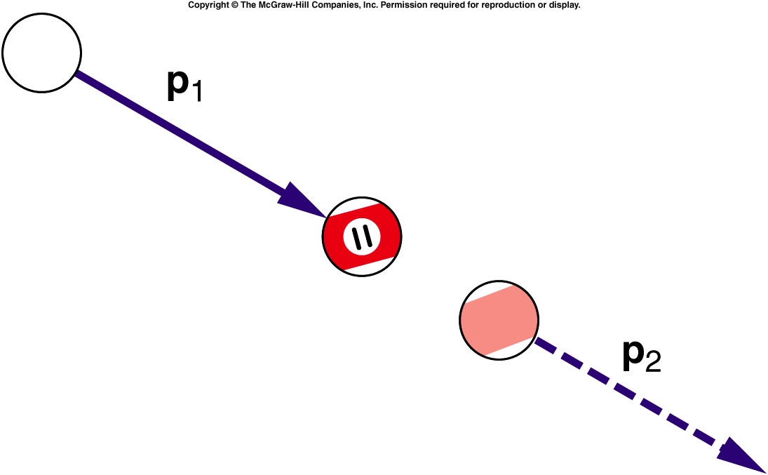
What happens when billiard balls bounce?
Simplest case: a head-on collision between the white cue ball and the eleven ball initially at rest.
If spin is not a factor, the cue ball stops and the eleven ball moves forward with a velocity equal to the initial velocity of the cue ball.
The eleven ball’s final momentum is equal to the cue ball’s initial momentum.
Momentum is conserved.
The eleven ball also has
a final kinetic energy
equal to the cue ball’s
initial kinetic energy.
Energy is conserved.

Slide 35
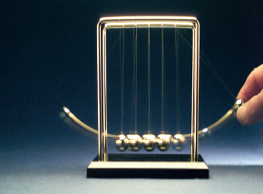
What happens when billiard balls bounce?
For equal masses, the only way for momentum and energy to both be conserved is for the cue ball to stop and the eleven ball to move forward with all the velocity.
Another example is the familiar swinging-ball toy with a row of steel balls hanging by threads from a frame.
If one ball is pulled back and released, the collision with the other balls results in a single ball from the other end flying off with the same velocity as the first ball just
before the collision.
Both momentum and kinetic
energy are conserved.
If two balls on one side are
pulled back and released, two
balls fly off from the opposite
side.
Why doesn’t one ball
fly off with twice the
velocity?

Slide 36
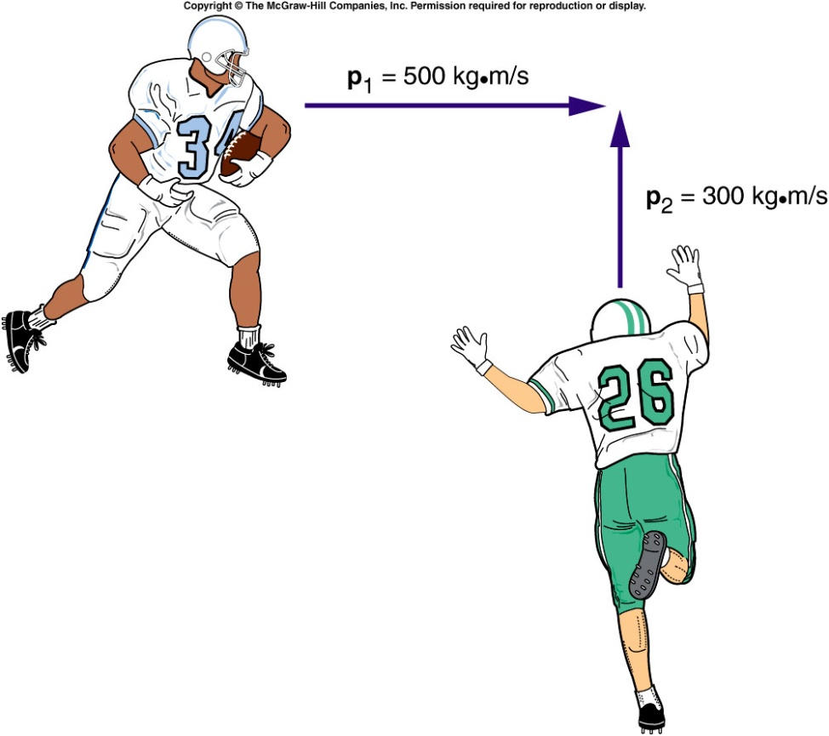
Collisions at an Angle
Two football players traveling at right angles to one another collide and stick together.
What will be their direction of motion after the collision?
Add the individual momentum vectors to get the total momentum of the system before the collision.
The final momentum of the two players stuck together is equal to the total initial momentum.

Slide 37
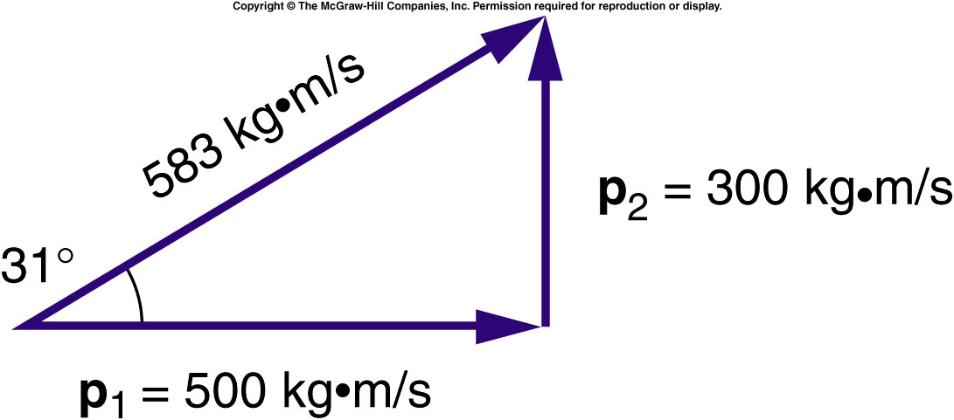
Collisions at an Angle
The total momentum of the two football players prior to the collision is the vector sum of their individual momentums.
The larger initial momentum has a larger effect on the final direction of motion.

Slide 38
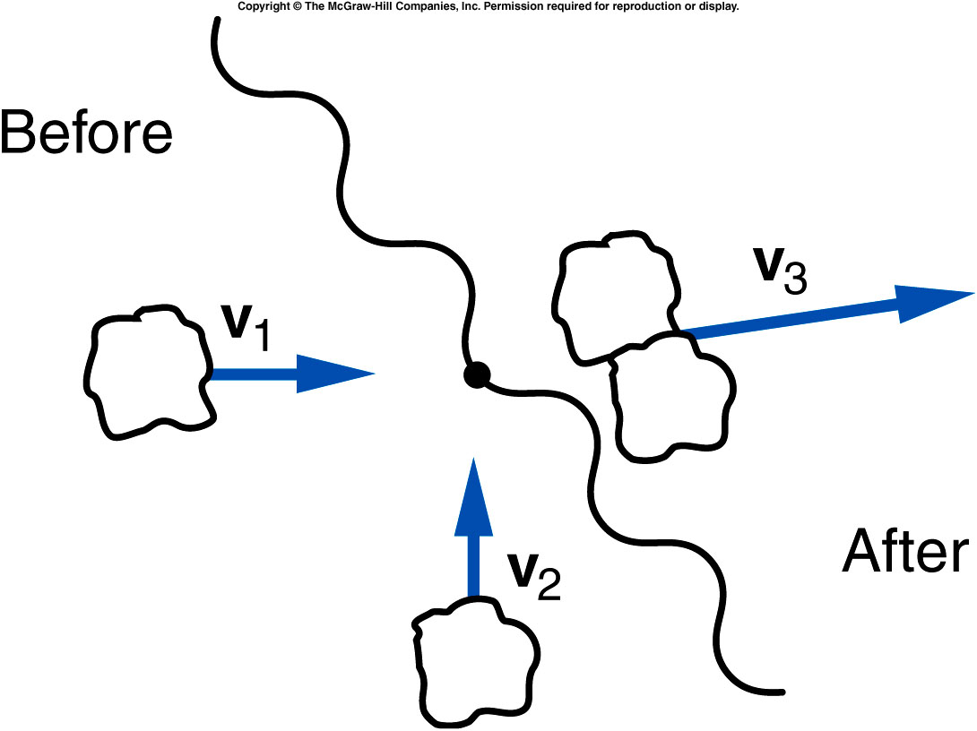
Two lumps of clay of equal mass are traveling at right angles with equal speeds as shown, when they collide and stick together. Is it possible that their final velocity vector is in the direction shown?
yes
no
unable to tell
from this graph
The final momentum will be in a direction making a 45º degree angle with respect to each of the initial momentum vectors.

Slide 39
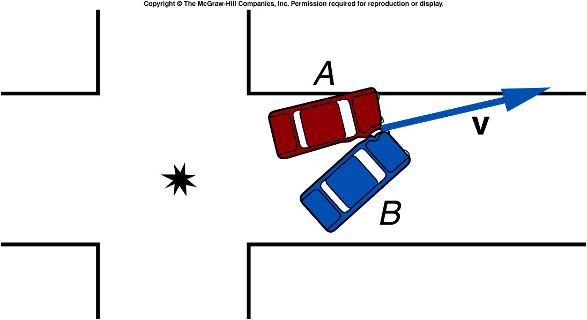
Two cars of equal mass Collide at right angles to one another in an intersection. Their direction of motion after the collision is as shown. Which car had the greater velocity before the collision?
Car A
Car B
Their velocities were equal in magnitude.
It is impossible to tell
from this graph.
Since the angle with respect to the original direction of A is smaller than 45º, car A must have had a larger momentum and thus was traveling faster.

Slide 40
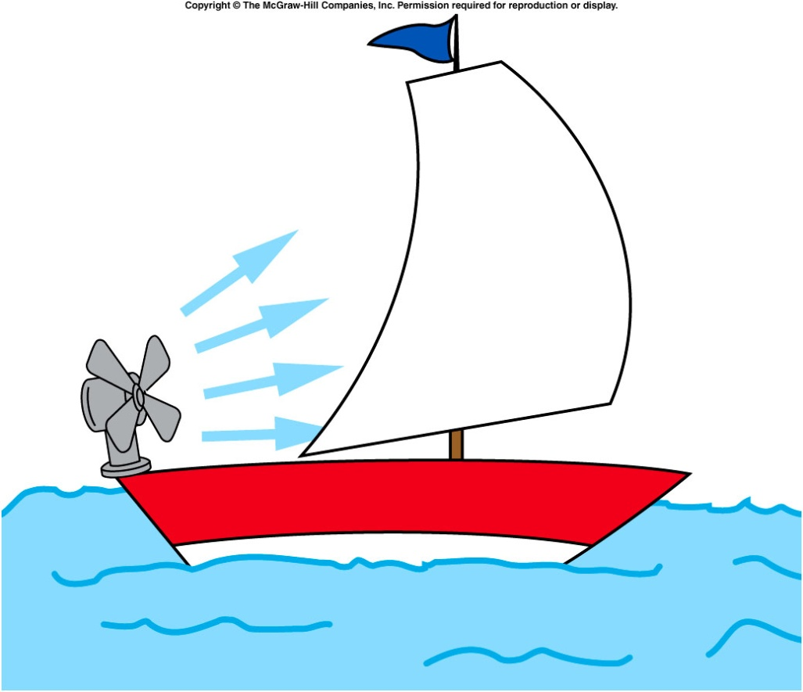
On a perfectly still day, a sailboat enthusiast brings a battery-operated fan to provide an air current for his sail. What are the directions of the change in momentum of the air at the fan and at the sail?
Fan, left; sail, right
Fan, left; sail, left
Fan, right; sail, right
Fan, right; sail, left
At the fan, the air’s change in momentum is to the right (initially zero, finally to the right). At the sail, it is to the left (initially to the right, finally zero).

Slide 41
What are the directions of the forces acting on the fan and on the sail due to these changes in momentum?
Fan, left; sail, right
Fan, left; sail, left
Fan, right; sail, right
Fan, right; sail, left
The fan pushes the air to the right, so the air pushes the fan to the left. The sail pushes the air to the left, so the air pushes the sail to the right.

Slide 42
Would the sailor be better off with the sail furled or unfurled?
Furled (sail closed)
Unfurled (sail open)
It doesn’t matter.
If he doesn't furl the sail, he won't go anywhere. The fan blowing air against the sail is an example of internal force. Internal forces do not impart acceleration to a body. With the sail furled he can move opposite the way the fan is blowing. The fan will then be blowing against an external body (the atmosphere).

