Slide 1
Waves
Waves are of three main types: 1. Mechanical waves. We encounter these almost constantly; common examples include water waves, sound waves, and seismic waves. All these waves have two central features: They are governed by Newton’s laws, and they can exist only within a material medium, such as water, air, and rock. 2. Electromagnetic waves. Examples include visible and ultraviolet light, radio and television waves, microwaves, x rays, and radar waves. These waves require no material medium to exist. Light waves from stars, for example, travel through the vacuum of space to reach us. All electromagnetic waves travel through a vacuum at the same speed . 3. Matter waves. These waves are commonly used in modern technology. These waves are associated with electrons, protons, and other fundamental particles, and even atoms and molecules.

Slide 2
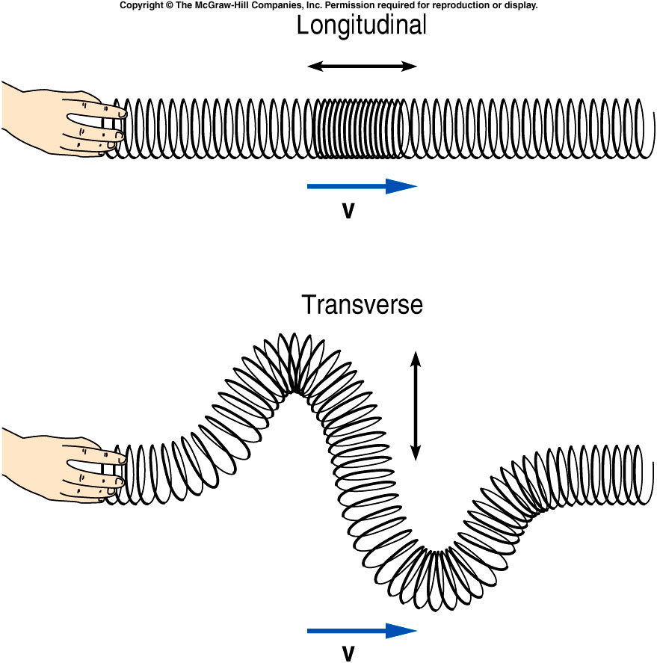
Types of waves
Longitudinal wave is one in which the disturbance is parallel to the line of travel of the wave.
Example: Sound wave in air is a longitudinal wave.
A transverse wave is one in which the disturbance is perpendicular to the direction of travel of the wave.
Examples: Light wave, waves on a guitar string.

Slide 3
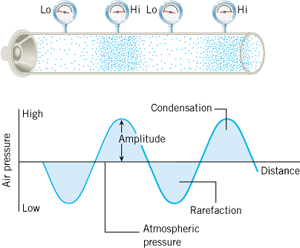
Sound Wave in Air Pictorial Representation
Sound in air is a longitudinal wave that is created by a vibrating object, such as a guitar string, the human vocal cords, or the diaphragm of a loudspeaker.

Slide 4
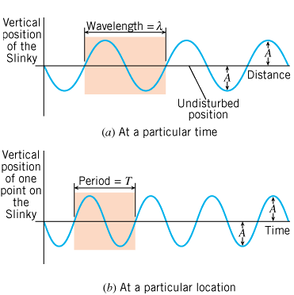
What is a periodic wave?
Periodic waves are waves that repeat.
The amplitude, A is the maximum disturbance.
The wavelength, λ is the horizontal length of one cycle of the wave.
The period, T is the time required for one complete up/down cycle of the wave.

Slide 5
The Frequency of Sound Waves
Audible Range: 20 Hz ----- 20,000 Hz.
Infrasonic waves: Sound waves with frequencies < 20 Hz.
Rhinoceroses use infrasonic frequencies as low as 5 Hz to call one another
Ultrasonic waves: Sound waves with frequencies > 20,000 Hz.
Bats use ultrasonic frequencies up to 100 kHz for locating their food sources and navigating.

Slide 6
Objective and Subjective properties of sound
Objective properties can be measured, used in physics.
Subjective properties are subjective to the person, used in music.
Objective property
Subjective quality
Frequency
Pitch
Intensity
Loudness
Waveform
Tymbre or Quality

Slide 7
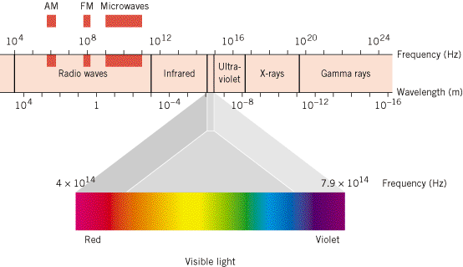
Electromagnetic Waves

Slide 8
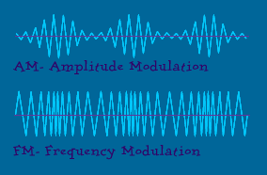
Radio Waves
FM vs AM: What's the difference?
AM: The amplitude of the signal is varied to incorporate the sound information. Frequencies are in kHz.
FM: The frequency of the carrier signal is varied to incorporate the sound information. Frequencies are in MHz.
FM signals are not affected by static.
With an FM broadcast, slight changes in amplitude don't matter -- since the audio signal is conveyed through changes in frequency, the FM receiver can just ignore changes in amplitude.
AM carrier waves have much longer wavelengths than FM carrier waves, and as a result, they can bend around obstacles like mountains and buildings better than FM waves and can travel greater distances before the signal fades.

Slide 9
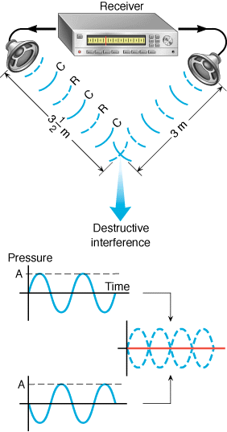
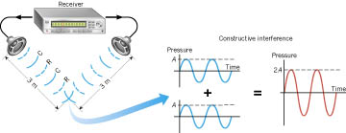
Interference of Sound Waves
http://bcs.wiley.com/he-bcs/Books?action=mininav&bcsId=3138&itemId=0471663158&assetId=92188&resourceId=7923&newwindow=true
Noise-canceling headphones utilize destructive interference

Slide 10
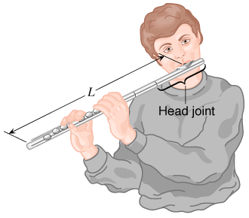
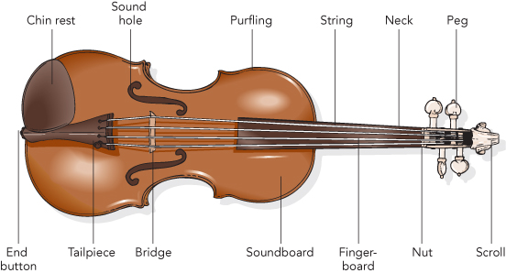
Musical Instruments
Musical instruments in the wind family depend on longitudinal standing waves in producing sound. Since wind instruments (trumpet, flute, clarinet, pipe organ, etc.) are modified tubes or columns of air, it is useful to examine the standing waves that can be set up in such tubes.

Slide 11
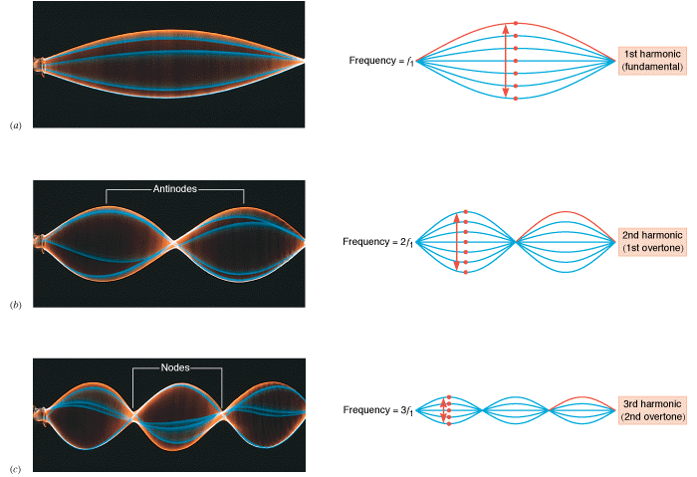
Standing wave patterns
http://bcs.wiley.com/he-bcs/Books?action=mininav&bcsId=3138&itemId=0471663158&assetId=92188&resourceId=7923&newwindow=true

Slide 12
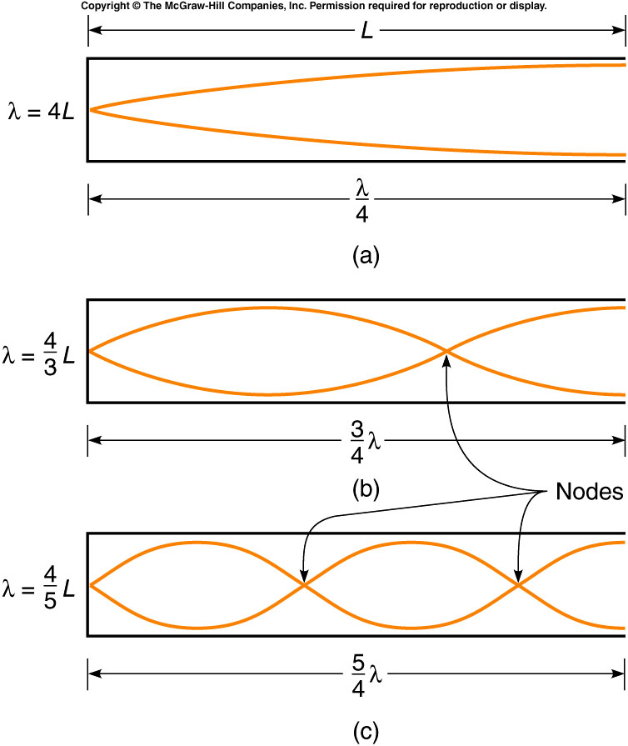
Standing waves in Wind Instruments

Slide 13
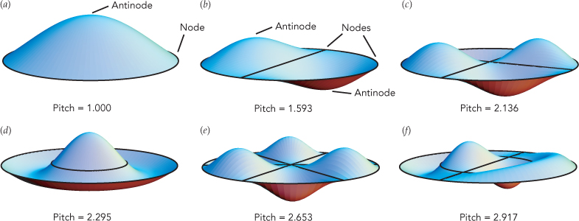
A Drum's Vibrating Surface
A drumhead is an extended object with a stable equilibrium and springlike restoring forces, its overtone vibrations have an important difference: they aren't harmonics.

Slide 14
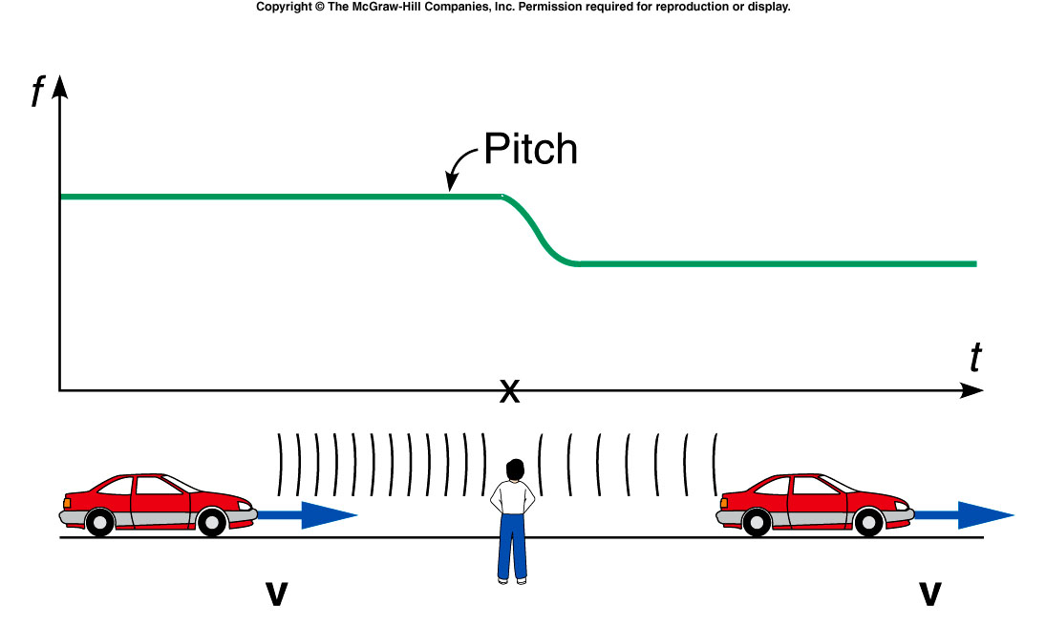
Doppler Effect

