Slide 1
Vectors
Scalars and Vectors:
Physics deals with many physical quantities, which are divided into scalars and vectors.
A scalar quantity is one that can be described by a single number (including any units) giving its size or magnitude.
Examples: Time, volume, mass, speed, distance, temperature, density, etc.
A quantity that deals with both magnitude and direction is called a vector quantity.
Examples: Force, weight, velocity, displacement, acceleration, etc.

Slide 2
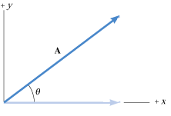
1.7. Components of a Vector
Consider the following vector, A:
How can we replace vector A by two perpendicular components?

Slide 3
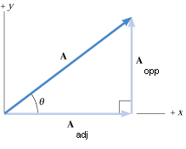
1.7. Components of a Vector
A_{adj}=A∙Cos θ and A_{opp}=A∙Sin θ

Slide 4
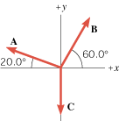
Problem
Find the resultant of the three vectors in the drawing by means of the component method. The magnitudes of the vectors are A = 100-g, B = 50-g, and C = 150-g. (http://www.1728.org/vectors.htm)

