Slide 1
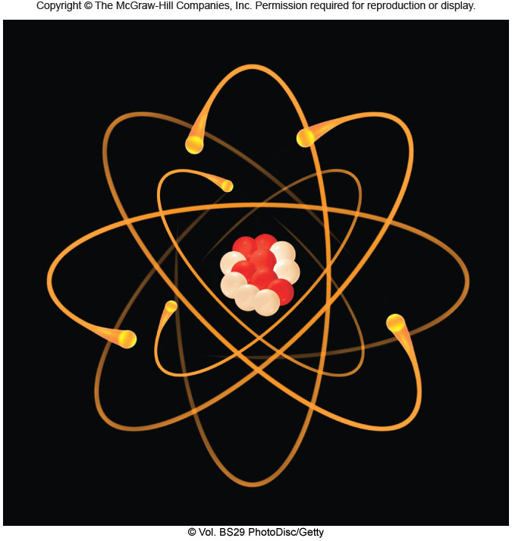
CH-19: Nucleus and Nuclear Energy
Atomic Model
Atomic Particle
Charge
Mass
Periodic Table of Elements
Electron
–1.6 × 10⁻¹⁹ C
9.11 × 10⁻³¹ Kg
CRT Demo
Proton
+1.6 × 10⁻¹⁹ C
1.673 × 10⁻²⁷ Kg
http://www.mhhe.com/physsci/chemistry/essentialchemistry/flash/ruther14.swf
Neutron
0
1.675 × 10⁻²⁷ Kg

Slide 2
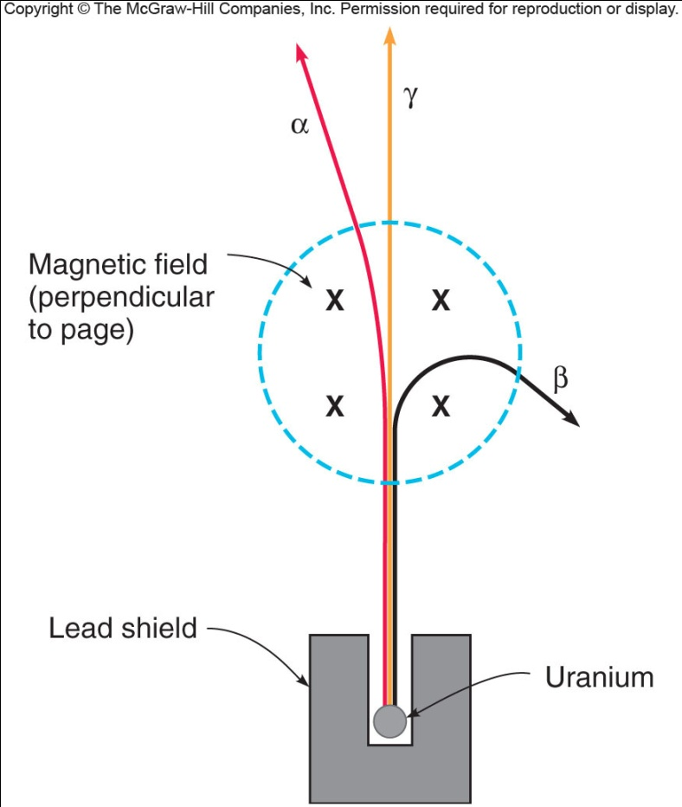
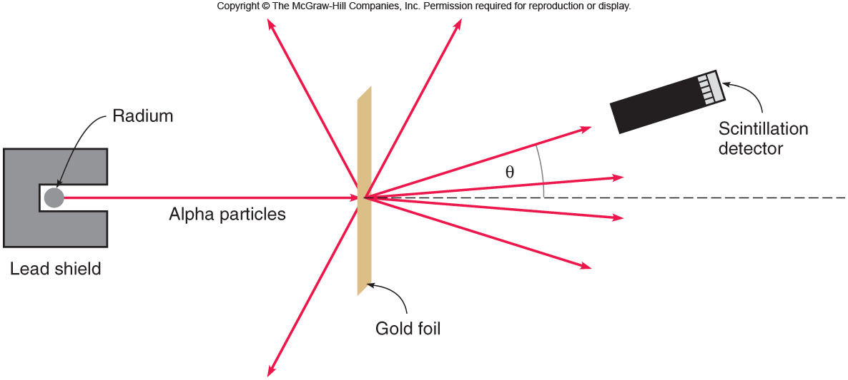
Radioactivity and Rutherford’s Experiment

Slide 3
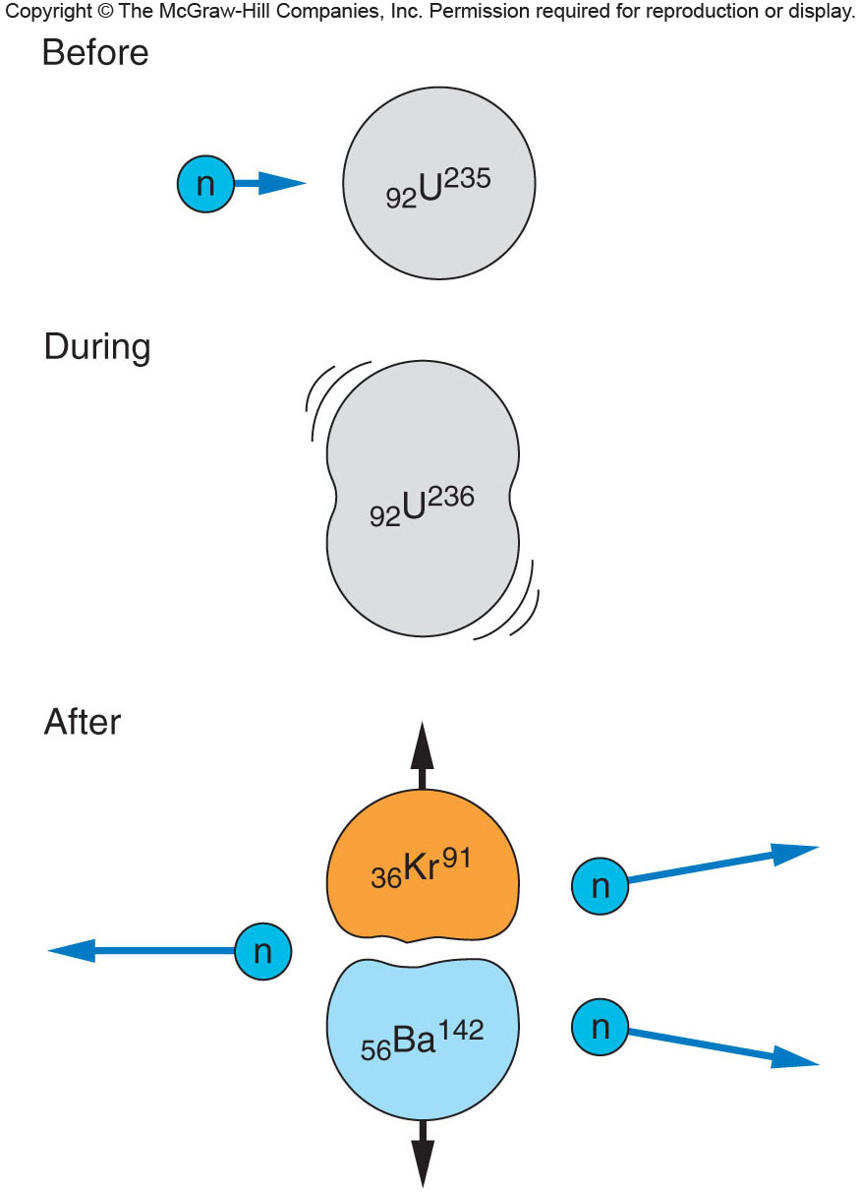
Nuclear Fission
Neutral neutron is ideal for splitting nucleus.
http://en.wikipedia.org/wiki/Uranium-235
http://www.wolframalpha.com/input/?i=krypton+91
http://www.wolframalpha.com/input/

Slide 4
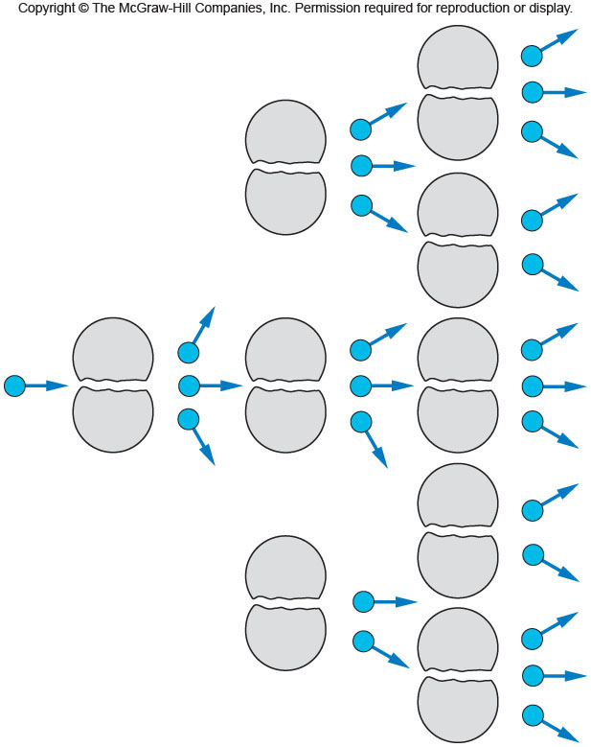
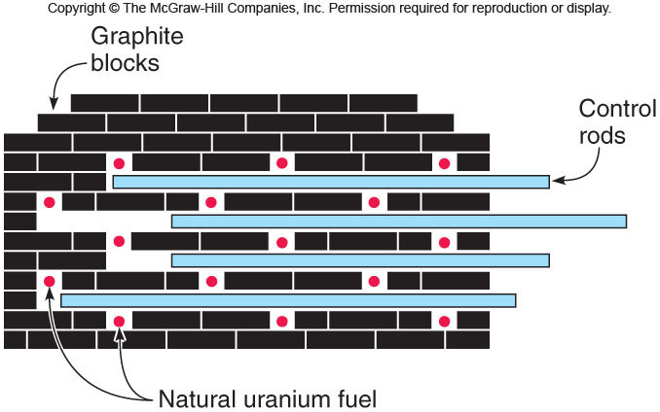
Chain Reaction
Control rods are used to regulate nuclear chain reaction.

Slide 5
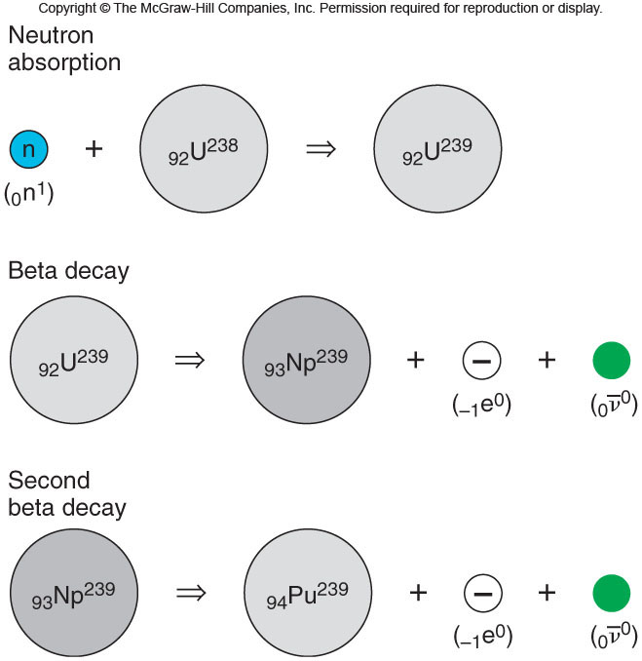
Plutonium: Primary material in fission bombs

Slide 6
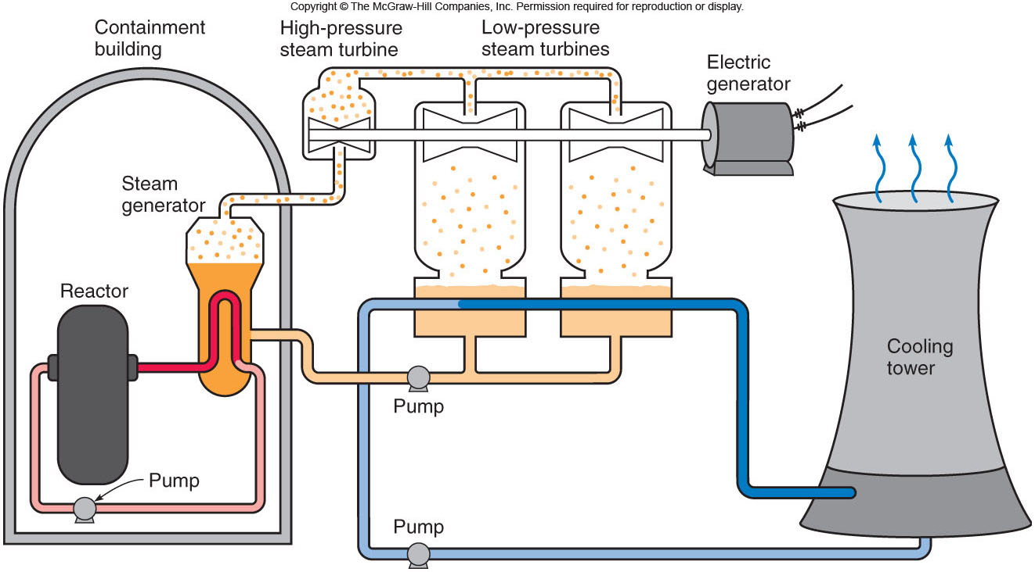
Pressurized-water nuclear Reactor

Slide 7
Useful Websites
http://www.world-nuclear.org/info/inf32.html
http://www.duke-energy.com/about-energy/generating-electricity/nuclear.asp
http://www.scientificamerican.com/article.cfm?id=how-to-cool-a-nuclear-reactor
http://library.thinkquest.org/17940/texts/nuclear_waste_types/nuclear_waste_types.html
http://www-formal.stanford.edu/pub/jmc/progress/nuclear-faq.html

Slide 8
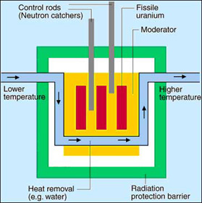
http://www.euronuclear.org/info/encyclopedia/r/reactor.htm

Slide 9
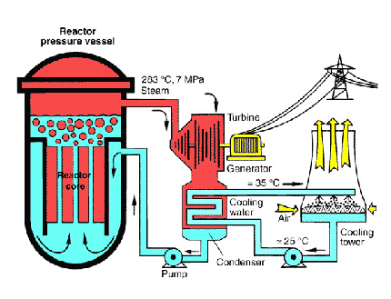
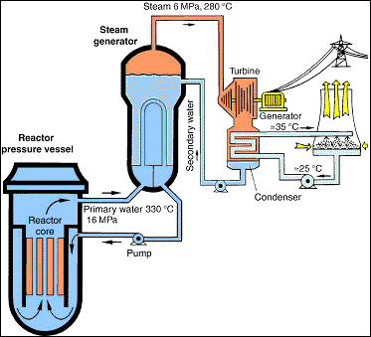
Boiling water reactor
Pressurized water reactor
http://www.euronuclear.org/info/encyclopedia/boilingwaterreactor.htm
http://www.euronuclear.org/info/encyclopedia/p/pressurized-water-reactor.htm

Slide 10
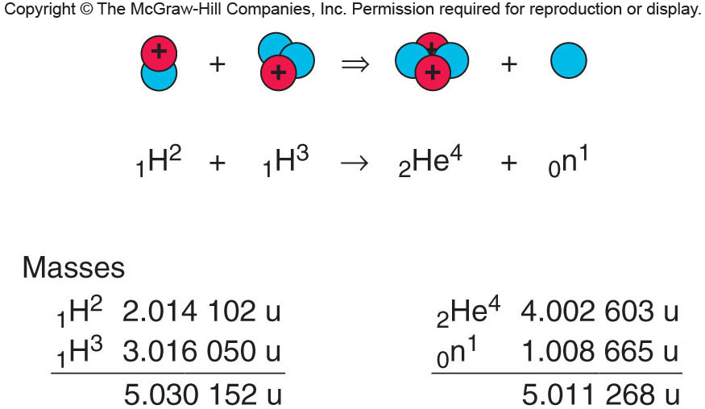
Nuclear Fusion

