Slide 1
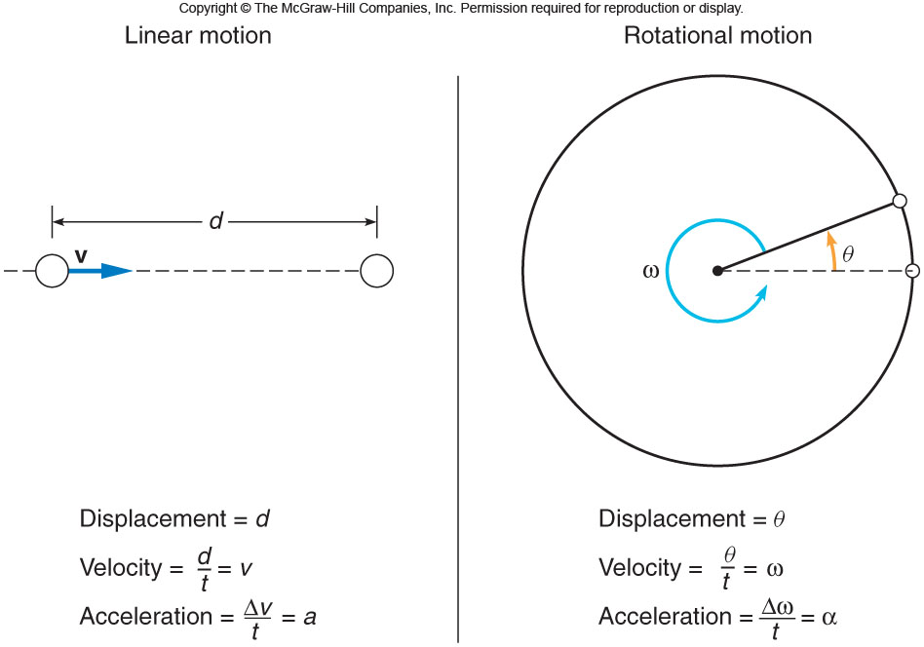
CH-8: Rotational Motion
The Earth revolves around the sun once a year and rotates about its axis once a day. What is the rotational velocity of Earth?

Slide 2
Equations Sheet
 | MOTION
 | Linear | Rotational
Time interval | t | t
Displacement | d; (d = rθ) | θ
Velocity | v = d/t; (v = rω) | ω = θ/t
Acceleration | a = Δv/t; (a = rα) | α = Δω/t
Kinematic equations | v = v₀ + at | ω = ω₀ + αt
 | v² = v₀² + 2ad | ω² = ω₀² + 2αθ
 | d = v₀t + ½ at² | θ = ω₀t + ½ αt²
 | d = ½(v + v₀)t | θ = ½(ω + ω₀)t
To create | force = F | torque =
Inertia | Mass =m | Rotational inertia = I =mr²
Newton’s 2nd Law | F_{net} = ma | τ_{net} = Iα
Momentum | p = m·V | L = I·ω
Conservation of momentum | Σm_{i}v_{i} = Σm_{f}v_{f} | ΣI_{i}ω_{i} = ΣI_{f}ω_{f}
Kinetic Energy | Translational Kinetic Energy = TKE = ½ mv² | Rotational Kinetic Energy = RKE = ½ Iω²
Work | W=F·d | W=τ·θ

Slide 3
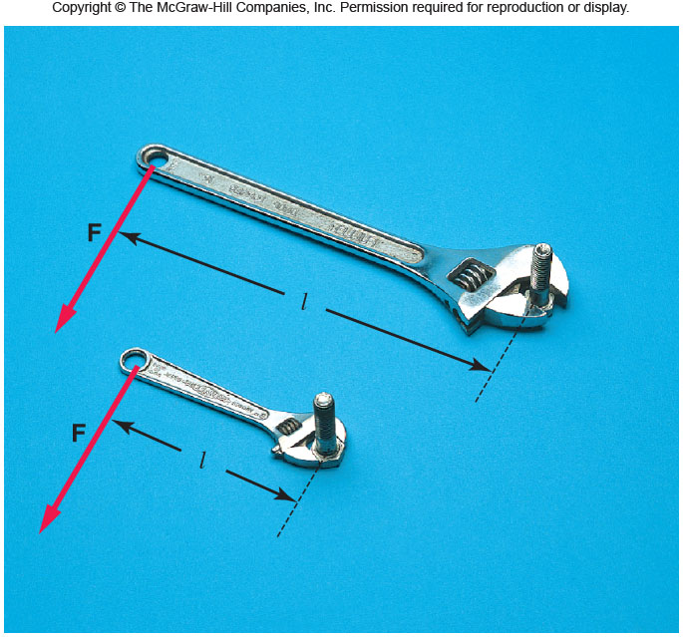
Torque, τ
Torque depends on the applied force and lever-arm.
Torque = Force x lever-arm
Torque is a vector. It comes in clockwise and counter-clock wise directions. Unit of torque = N•m
P: A force of 40 N is applied at the end of a wrench handle of length 20 cm in a direction perpendicular to the handle as shown above. What is the torque applied to the nut?

Slide 4
Application of Torque: Weighing
P. A child of mass 20 kg is located 2.5 m from the fulcrum or pivot point of a seesaw. Where must a child of mass 30 kg sit on the seesaw in order to provide balance?

Slide 5
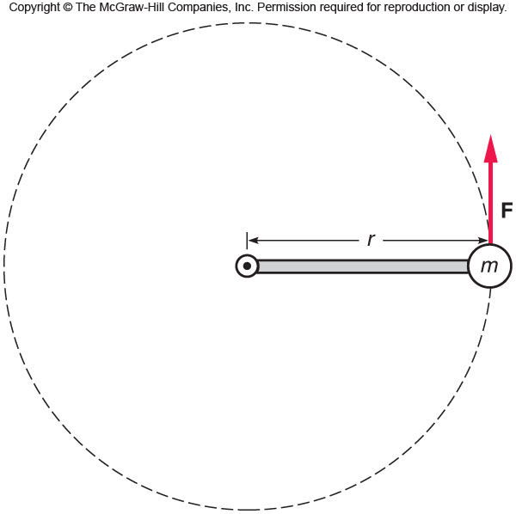
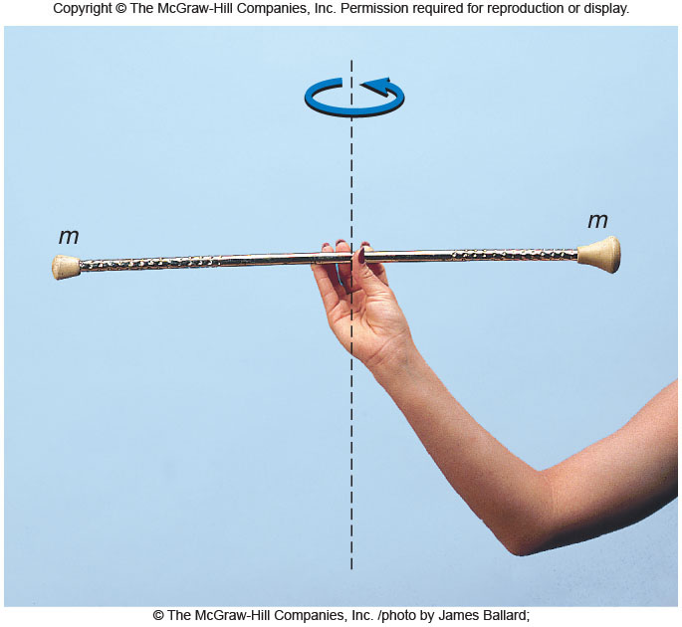
Rotational Inertia
Rotational Inertia = mass x square of distance from axis I =mr² Rotational inertia is a scalar. Unit for I = kg.m²

Slide 6
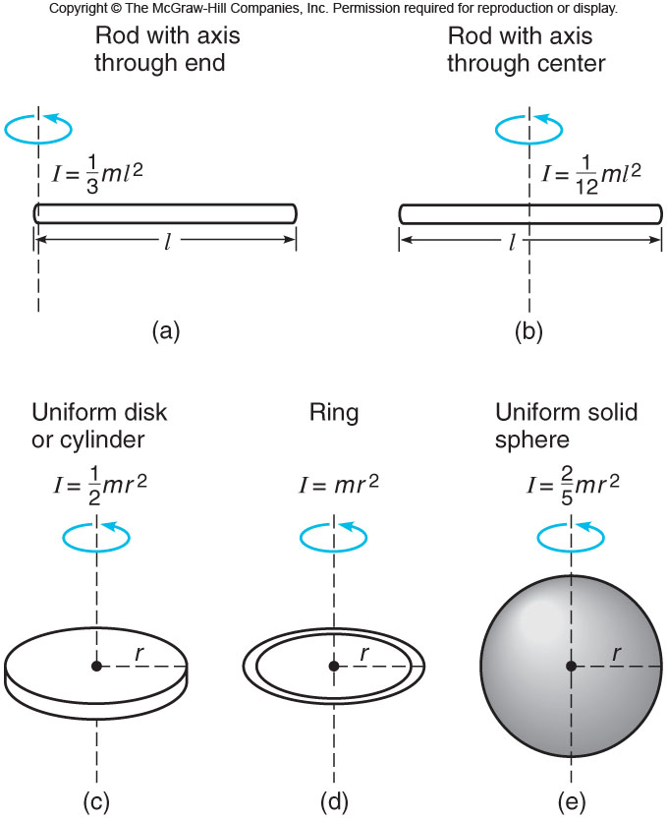
Expressions for Several objects

Slide 7
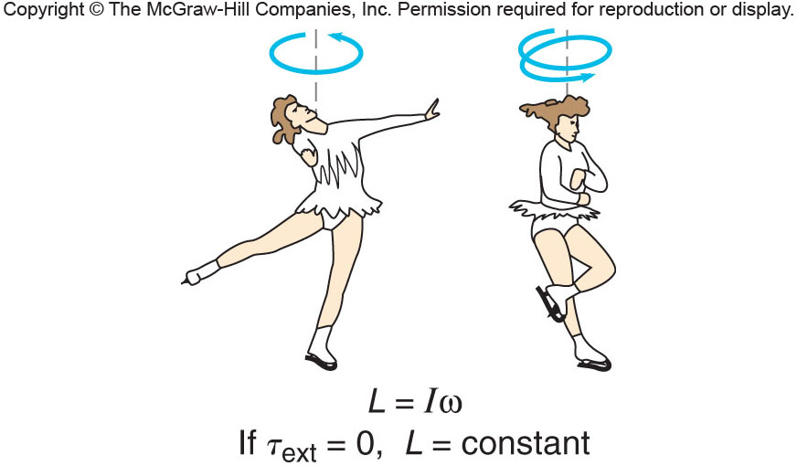
Angular Momentum or Rotational Momentum
Angular momentum is the product of the rotational inertia and rotational velocity.
L = I·ω
Conservation of Angular Momentum

Slide 8
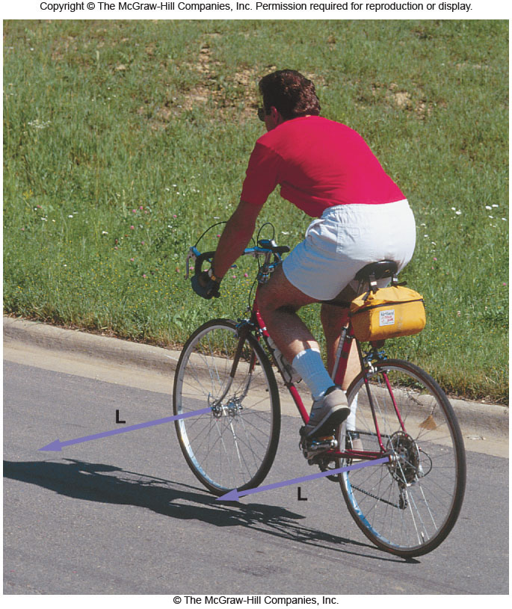
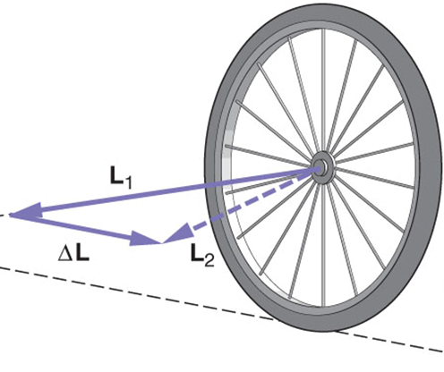
Angular momentum and Bicycles
Explain the role of angular momentum in riding a bicycle?

