Slide 1
C H A P T E R 9 Fluids
Pressure
Density
Archimedes’ Principle
Ideal gas law
Pascal’s Principle
Bernoulli’s Principle
Fluids are materials that can flow: gases and liquids.
Air is the most common gas, and moves from place to place as wind.
Water is the most familiar liquid.

Slide 2
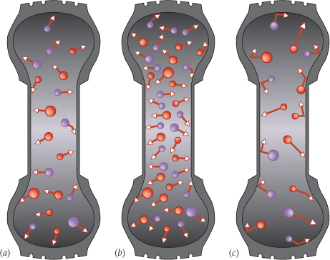
Air Pressure
People who have fixed a flat tire know something about pressure.
In colliding with the inner walls of the tire, the air molecules exert a force on every part of the wall surface.
(a) As air particles bounce off surfaces in this tire, they exert pressure on those surfaces; the amount of pressure depends on the air's temperature and on how densely its particles are packed. (b) Packing the air particles more densely increases the number of particles that hit the surfaces each second. (c) Increasing the temperature of the air increases the speed of the particles (shown by the arrows) so that they hit the tire surfaces harder and more frequently. Either change, in speed or collision frequency, increases the air's pressure.

Slide 3
Pressure
The pressure, p exerted by a fluid is defined as the magnitude F of the force acting perpendicular to a surface divided by the area A over which the force acts:
Pressure is a scalar quantity.
The SI unit for pressure: newton/meter² = (N/m²) = pascal (Pa).
Other units: PSI, pound per square inch.

Slide 4
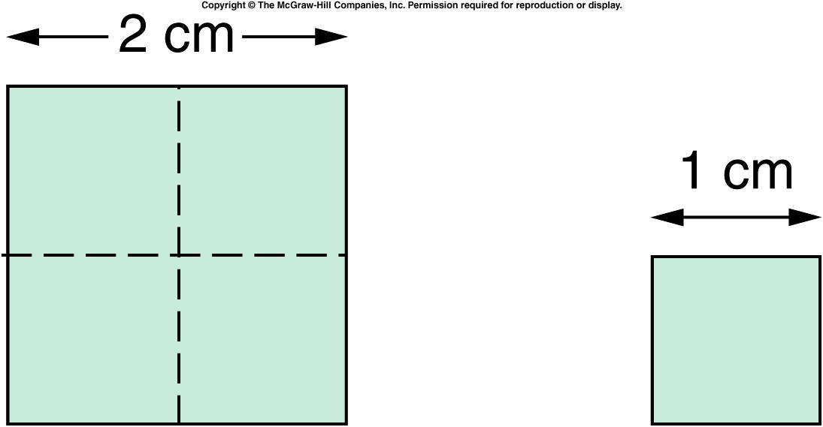
Area

Slide 5
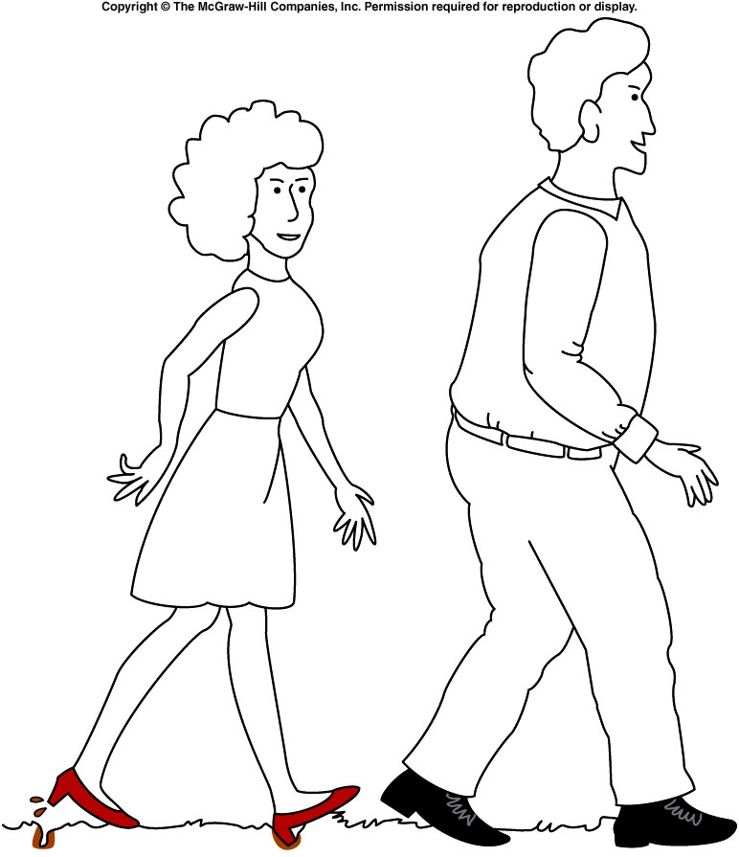
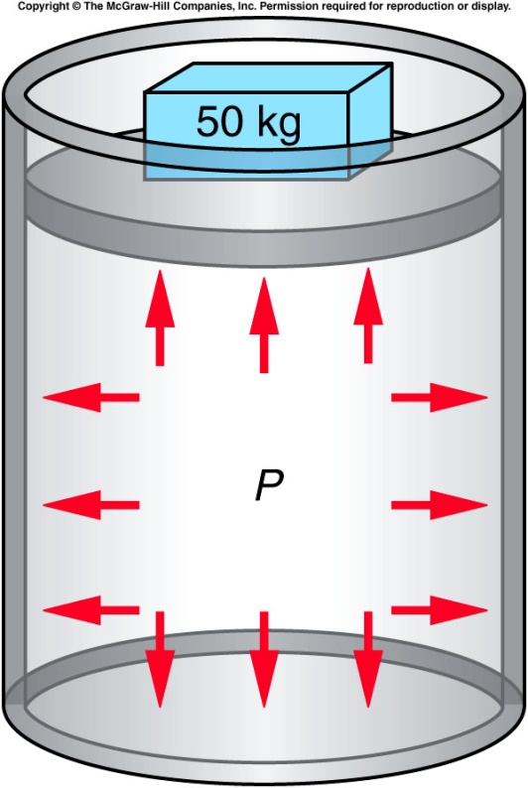
Pressure
Q1. Why the woman’s shoe makes dents whereas man’s does not?
Q2: Why does a sharp knife cuts better than a dull knife?
Pressure acts everywhere

Slide 6
Mass Density
The mass density ρ is the mass m of a substance divided by its volume V:
SI Unit of Mass Density: kg/m³

Slide 7
Table 10-1: Densities of common solids and liquids at 20⁰C.
Solid
Substance
Density
Liquid
Substance
Density
In g/cm³
In kg/m³
In g/cm³
In kg/m³
Ice (0⁰C)
0.92
920
Water (fresh)
1
1000
Aluminum
2.7
2700
Water (sea)
1.03
1030
Copper
8.93
8930
Gasoline
0.79
790
Glass (crown)
2.5
2500
Kerosene
0.82
820
Iron
7.8
7800
Glycerin
1.26
1260
Lead
11.3
11,300
Turpentine
0.87
870
Gold
19.3
19300
Mercury
13.6
13,600

Slide 8
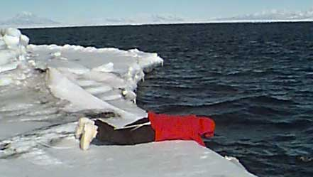
Density of Ice & Water Why Ice Floats on Water?
Most natural ice has a hexagonal structure, with each molecule bonding to four others. Unlike most solid forms of liquids, ice is less dense than liquid water. This is because, in ice, the hydrogen bonds hold the molecules in a lattice structure, where the distance between each molecule is greater than in liquid water. The lower density of ice means that it floats in water.
Q: Why Do Pipes Burst during freezing?

Slide 9
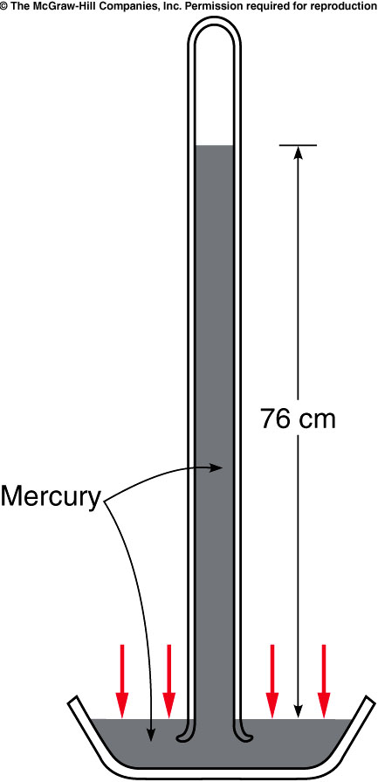
Atmospheric pressure: Mercury Barometer
At sea level,
Height of mercury = h = 76 cm.
Atmospheric pressure = 76 cm of Hg.
(76 cm = 760 mm = 29.9 inch)
Atmospheric pressure at sea level is 1.013 × 10⁵ Pa
P2. How much force is the air exerting on the front surface of your textbook?

Slide 10
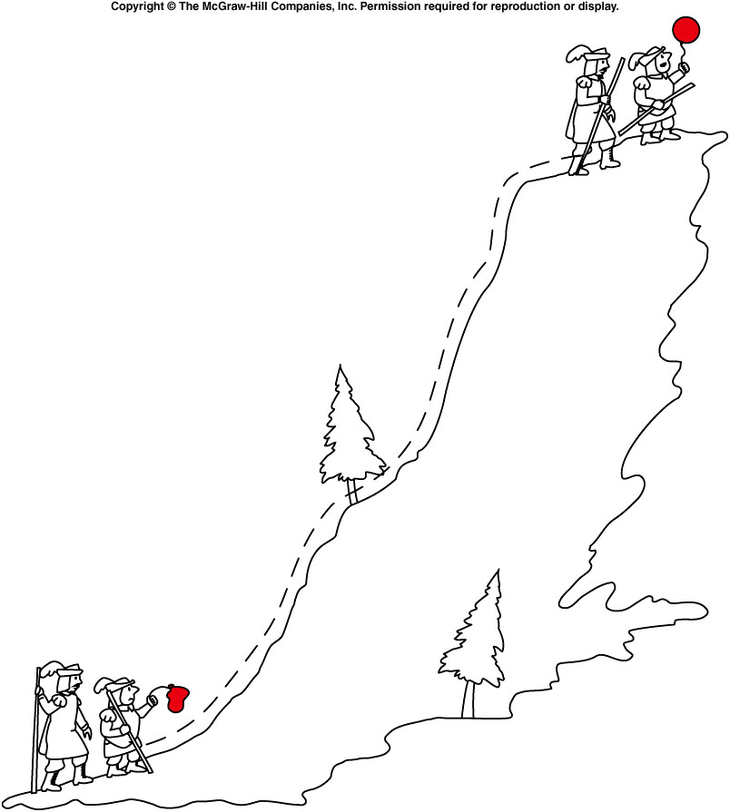
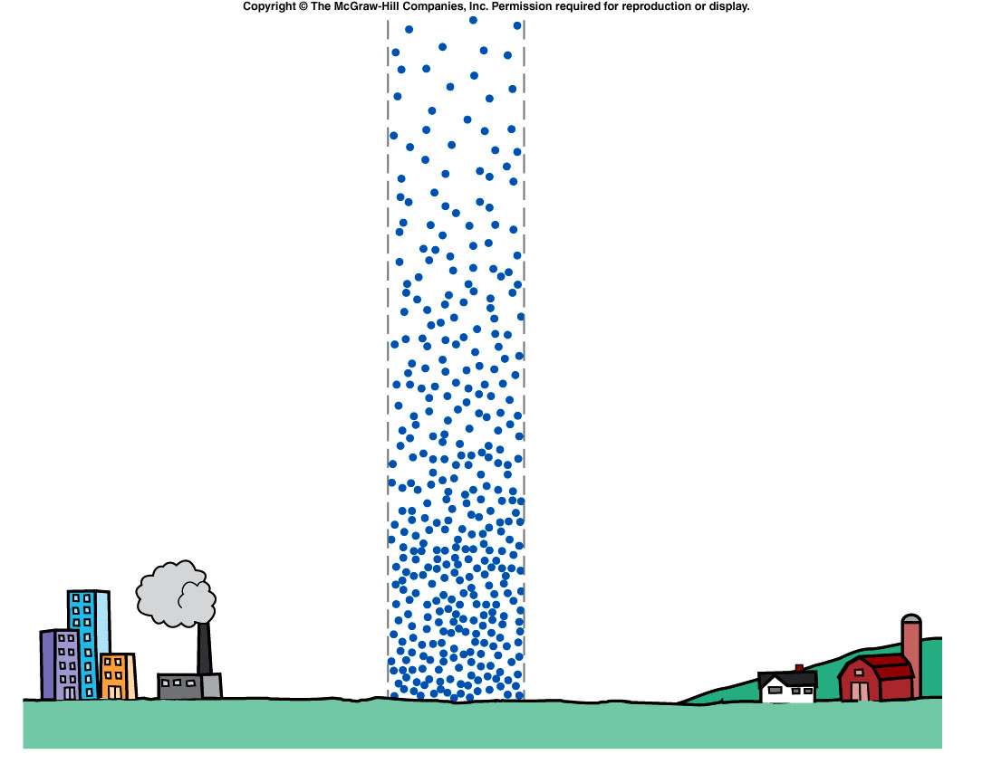
Density and Pressure of air decreases as the altitude increases

Slide 11
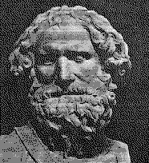
Archimedes of Syracuse (287BC-212BC)
Much of Archimedes fame comes from his relationship with Hiero, the king of Syracuse, and Gelon, Hiero's son.
At one time, the king ordered a gold crown and gave the goldsmith the exact amount of gold to make it.
When Hiero received it, the crown had the correct weight but the monarch suspected that some silver had been used instead of the gold.
Since he could not prove it, he brought the problem to Archimedes.

Slide 12
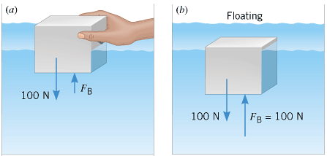
Archimedes’ Principle
One day while considering the question, "the wise one" entered his bathtub and recognized that the amount of water that overflowed the tub was proportional the amount of his body that was submerged.
This observation is now known as Archimedes' Principle and gave him the means to solve the problem.
He was so excited that he ran naked through the streets of Syracuse shouting "Eureka! eureka!" (I have found it!). The fraudulent goldsmith was brought to justice.
Archimedes’ Principle: The buoyant force acting on an object fully or partially submerged in a fluid is equal to the weight of the fluid displaced by the object.

Slide 13
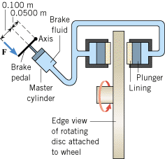
Pascal's Principle
Any change in the pressure applied to a completely enclosed fluid is transmitted undiminished to all parts of the fluid and the enclosing walls.

Slide 14
Bernoulli’s Principle
For steady flow, the speed, pressure, and elevation of an incompressible and nonviscous fluid are related by an equation discovered by Daniel Bernoulli (1700–1782).
The sum of the pressure, the kinetic energy per unit volume, and the potential energy per unit volume of a flowing fluid must remain constant.
Demonstrating Bernoulli’s Principle

Slide 15
Applications of Bernoulli's Principle
The tarpaulin that covers the cargo is flat when the truck is stationary but bulges outward when the truck is moving.
Curveball Pitch

Slide 16
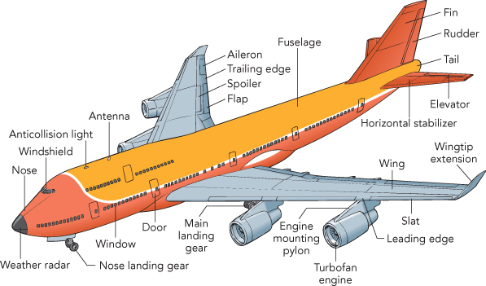
Airplane

