Slide 1
Chapter-7 Momentum and Impulse
Momentum
Impulse
3 Conservation of Momentum
4 Recoil
5 Elastic and Inelastic Collisions
6 Collisions at an Angle: An Automobile Collision

Slide 2
Momentum, p
In everyday life, the word momentum is used to describe changes in the flow of a game or leads in elections.
In physics, the momentum p of an object is the product of the object’s mass m and velocity v:
Momentum = Mass x Velocity
Momentum is a vector quantity that points in the same direction as the velocity.
SI Unit of Momentum:
kilogram · meter/second = (kg · m/s)

Slide 3
A bowling ball and a tennis ball with the same momentum
Q: If the velocity of an object is doubled, its momentum is multiplied by____________ its kinetic energy is multiplied by ___________ a.1 b. 2 c. 3 d. 4 e. 8

Slide 4
Impulse, J
The impulse J of a force is the product of the average force and the time interval Δt during which the force acts:
Impulse is a vector quantity and has the same direction as the average force.
SI Unit of Impulse: newton · second = (N · s)
Impulse = Change in momentum

Slide 5
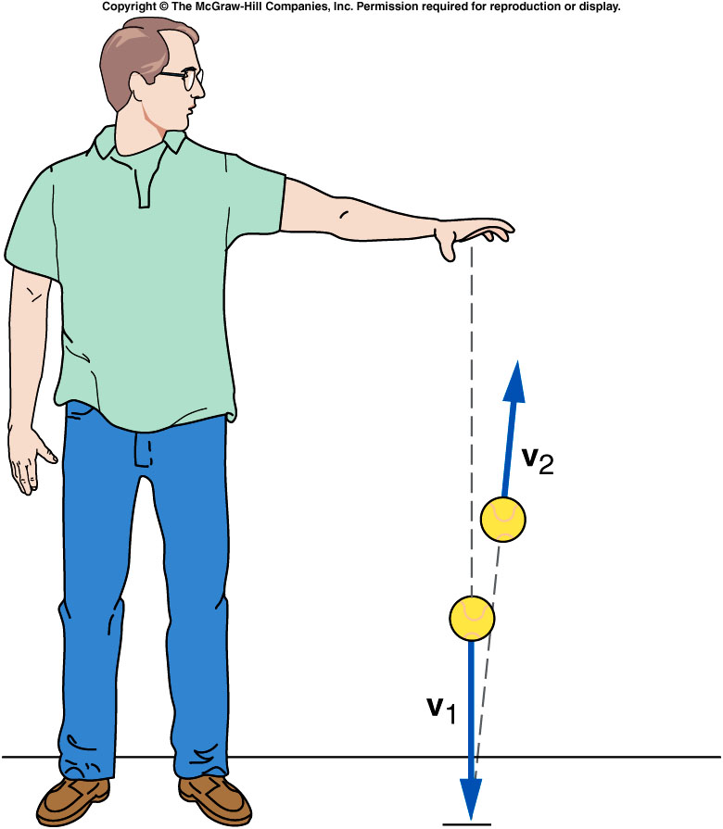
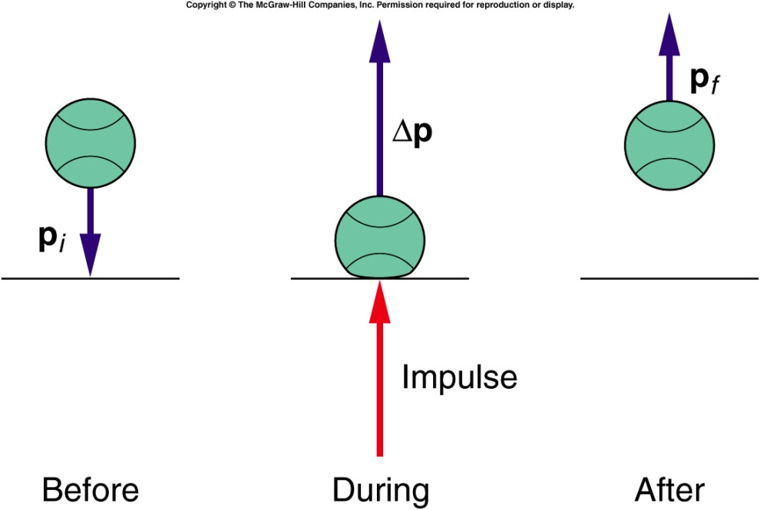
Momentum and Impulse
A tennis ball bouncing off the floor. There is a rapid change in the direction of the velocity when the ball hits the floor.
The floor delivers the impulse to the tennis ball.

Slide 6
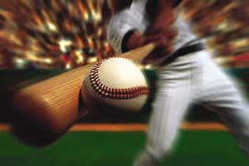
Baseball
Q: Why batters swing when they hit a ball?
A: To increase the time of contact
Catching an Egg
Q: An egg is thrown at you. How can you catch it without breaking it?

Slide 7
Conservation of Momentum
The principle of conservation of momentum helps us understand collisions such as above.
The total momentum of an isolated system remains constant (is conserved).
Isolated means there are no net external forces.
Demo:

Slide 8
Try this box 7.2

Slide 9
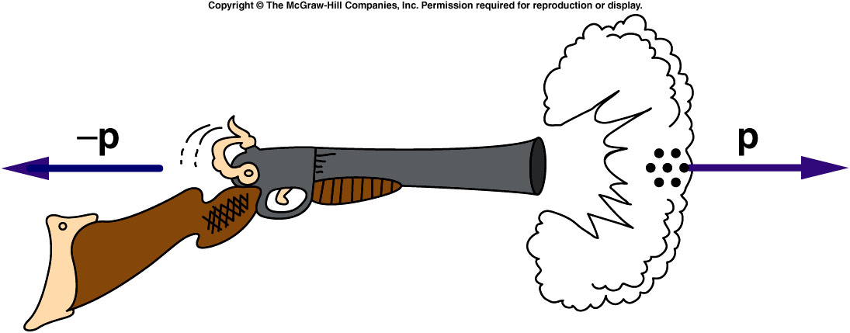
Recoil and Rocket Motion
Q: Why does a shot gun slam against your shoulder when fired?
Q: How can a rocket accelerate in empty space?

Slide 10
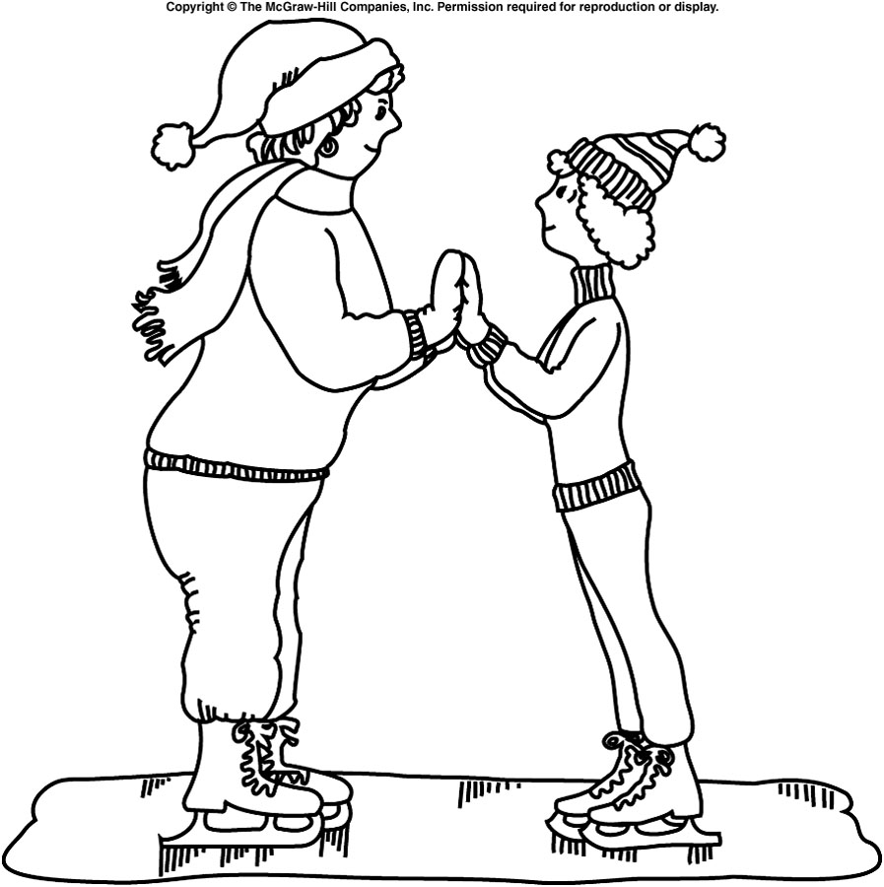
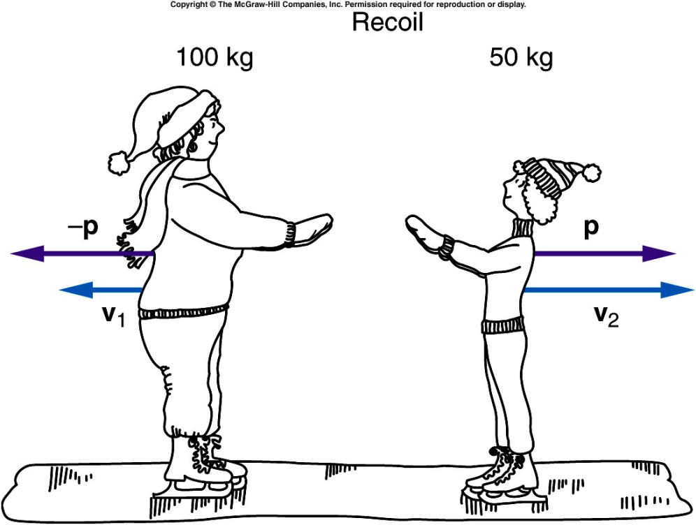
Two Skaters Push off
Starting from rest, two skaters “push off” against each other on smooth level ice, where friction is negligible. The mother’s mass is 100 kg and the child’s is 50 kg. If the mother moves away with a velocity of 2.5 m/s, west, find the “recoil” velocity of the child.

Slide 11
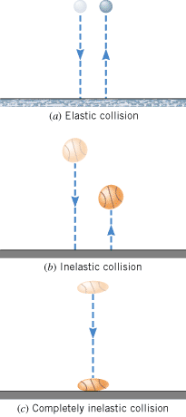
Collisions
Collisions are often classified depending on how the total kinetic energy changes during the collision:
1. Elastic collision—One in which the total kinetic energy of the system after the collision is equal to the total kinetic energy before the collision.
2. Inelastic collision—One in which the total kinetic energy of the system is not the same before and after the collision.
3. Partially inelastic collision is one in which some energy is lost, but the objects do not stick together after the collision.
4. Completely inelastic collision is one in which the objects stick together after the collision. A greatest portion of energy is lost here.

Slide 12
Collision Problems in One Dimension
1. A freight car rolling down the track at 3 m / s collides with four identical freight cars that were initially at rest. Calculate the speed of the coupled cars after the collision.
2. A 2000 kg car collides with a 1500 kg car that was initially at rest. The two cars lock together and move off after the collision at a speed of 6 m / s. Calculate the speed of the 2000 kg car before the collision.
3. A football player of mass 100 kg with a speed of 3.0 m / s collides head-on with another football player of mass 85 kg who was initially moving in the opposite direction with a speed of 5.0 m / s. The second player tackles the first and they become entangled into the equivalent of a single mass. Determine the direction and the magnitude of the velocity of the two players after the collision.

Slide 13
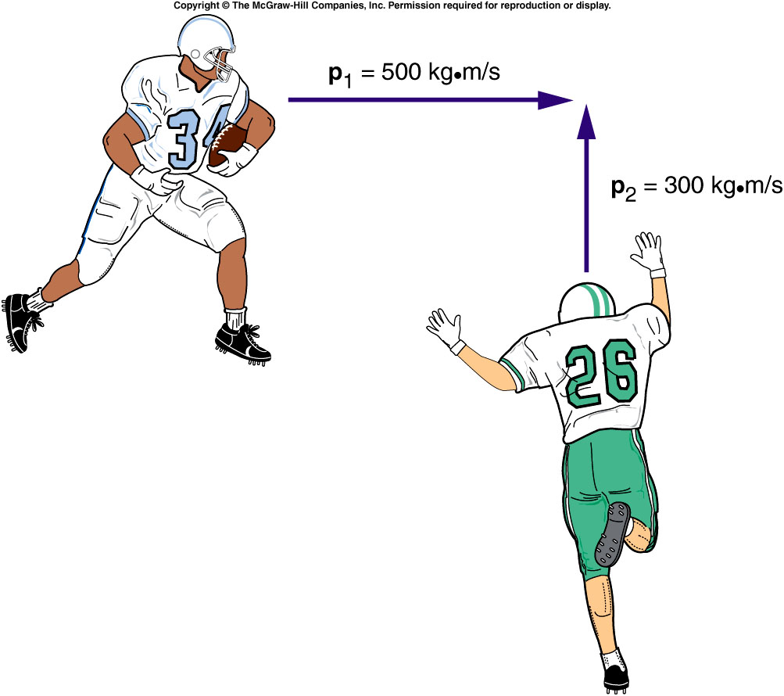
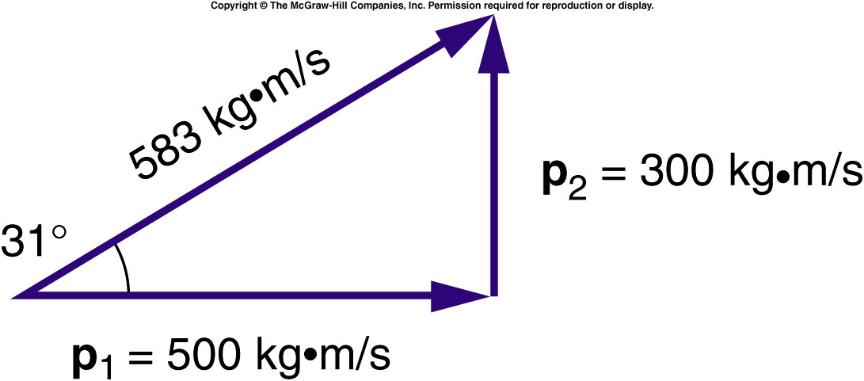
Collisions at an Angle

Slide 14
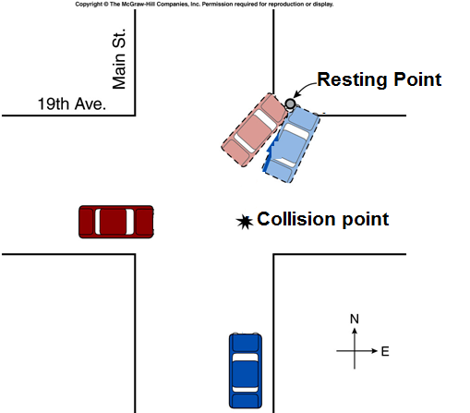
Automobile Collision: Analysis

Slide 15
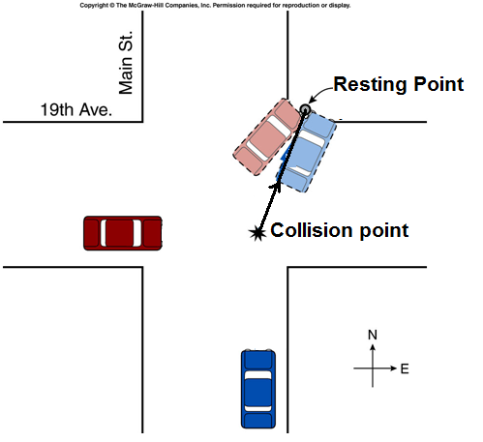
Automobile Collision: Analysis

Slide 16
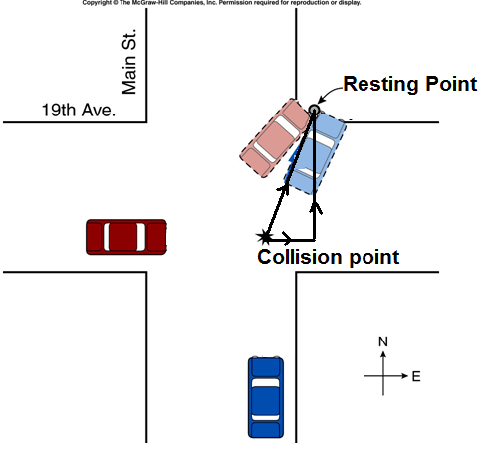
Automobile Collision: Analysis

Slide 17
Automobile Collision: Analysis

