Slide 1
Chapter-6 Energy and Oscillations
Simple Machines
Work and Power
Kinetic Energy
Potential Energy: Gravitational & Elastic
Conservation of Energy
Energy Transformations
Energy and the Pole Vault
Springs and Simple Harmonic Motion

Slide 2
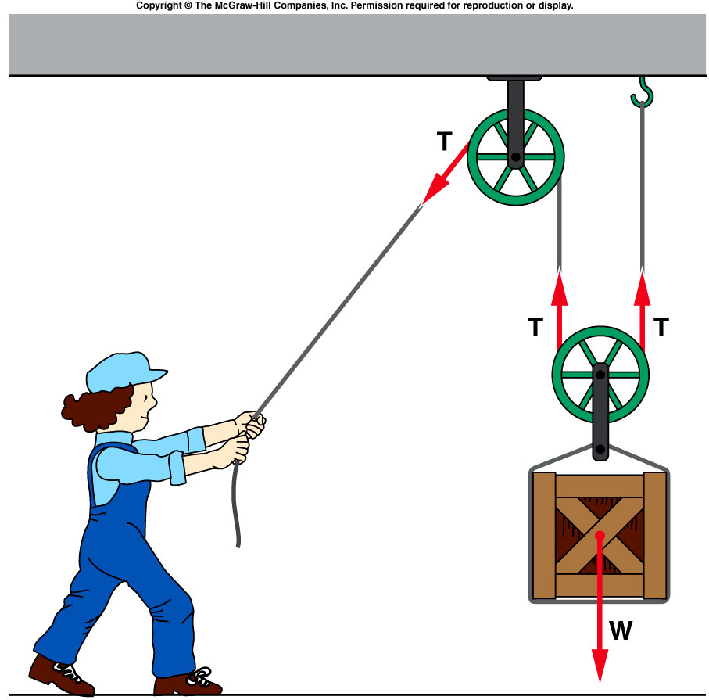
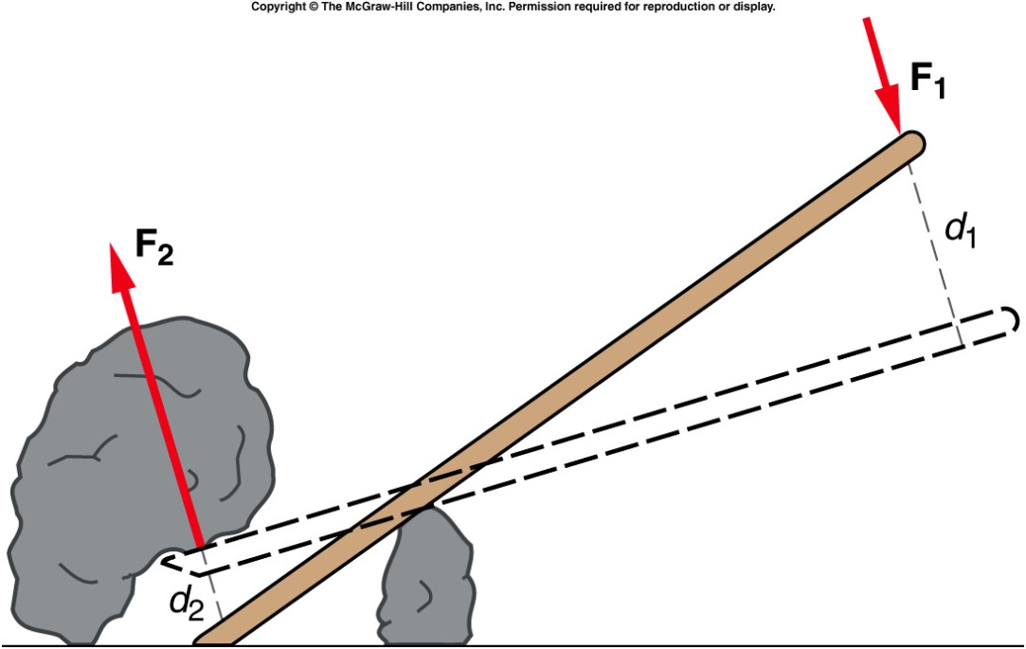
Simple Machines
A simple machine is any mechanical device that multiplies the effect of an applied force.
Pulley System
Lever

Slide 3
Work
Work done in moving an object by a force is defined as follows:
Work = Force × Distance. W = F × d.
Here the force acts along the distance.
Work is a scalar. The SI unit for work is, N.m = joule = J
Q: Ramps enable loading easy. Explain why?
(Try SP6, p123)

Slide 4
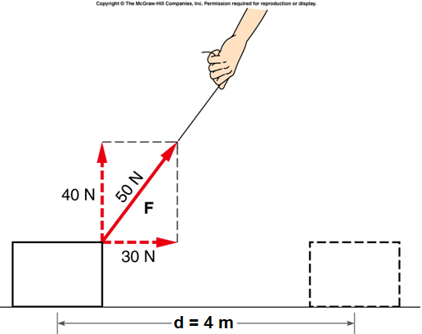
Does any force do work?
W = F × d
E5: a. Work done by the 30 N force?
b. Work done by the 40 N force?
c. Work done by the 50 N force?
Q: Work done in pushing an immobile wall?

Slide 5
Power
The rate at which work is done is called the power.
Power is a scalar quantity. The SI unit for power is Watt, W.
1 W = 1 J/s.
Before the arrival of machines horses were used to do work. With this originated the unit horsepower, hp.
1 hp = 746 W = 550 ft•lb/s.
Why mountain roads are made round and round not straight up?

Slide 6
Kinetic Energy
Kinetic energy is the energy of motion. The word “kinetic” originated from the Greek word kinetikos, meaning “motion”.
If an object of mass, m moves with a velocity v, then the kinetic energy, KE is given by the following equation,
Kinetic energy is a scalar quantity. It also has the same unit as work, joule (J).
1 J = 1 kg.m²/s².

Slide 7
W = F × d = KE_{f} − KE_{i}.
Positive work
Negative work

Slide 8
Gravitational Potential Energy
Gravitational potential energy, GPE is the energy stored in an object as a result of its height. It can be calculated using weight, which is mass times gravity, and height. It is given by the following equation,
Gravitational potential energy is a scalar quantity.
The SI unit for it is also joule, J.

Slide 9
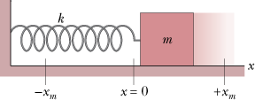
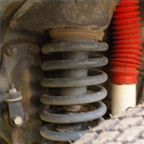
Elastic Potential energy
Elastic potential energy is the energy stored in elastic materials as the result of their stretching or compressing.
How shock absorbers work?

Slide 10
Conservation of Energy
The swing of the pendulum demonstrates the principle of conservation of energy.
Mechanical energy = KE + PE
In the absence of friction and air drag, the total mechanical energy of a system remains a constant.
http://www.youtube.com/watch?v=BVxEEn3w688

Slide 11
How is energy analysis like accounting?
Try SP5, p122.

Slide 12
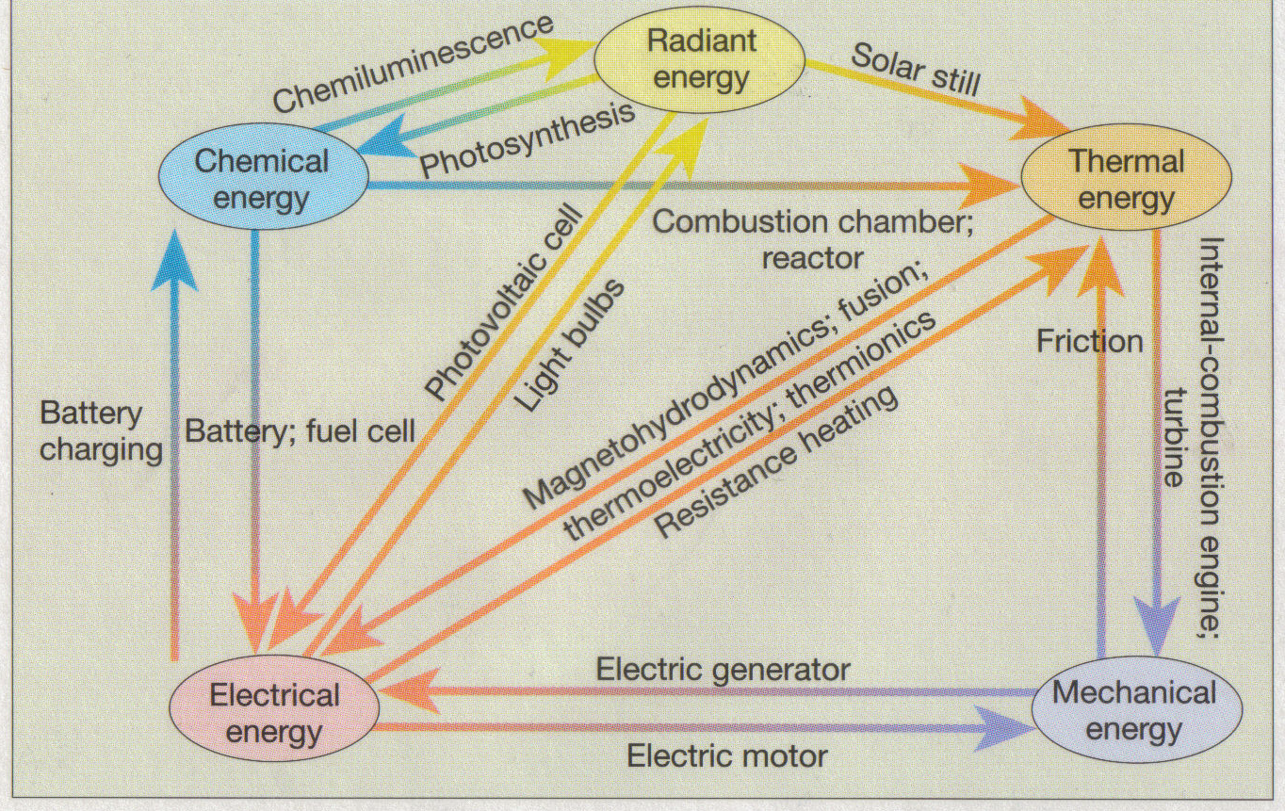
Forms of Energy and Transformations

Slide 13
Energy Transformations
Process/Device | Initial form of energy | Final form of energy
Photosynthesis
Light bulb
Electric motor
Electric generator
Solar still
Photovoltaic cell (solar cell)
During friction
Using a battery
Charging a battery
In a microphone
In a loudspeaker
In a nuclear reactor

Slide 14
Energy Transformations in Pole Vault
Forms of Energy:
Energy Transformations:

Slide 15
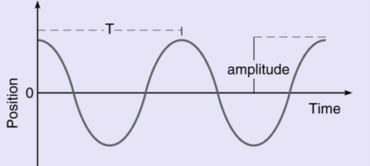
Springs and Simple Harmonic Motion
Amplitude is the maximum distance from equilibrium.
Period, T is the time taken for one complete cycle.
Frequency,f: Number of cycles per unit time.

Slide 16
A force of 70 N is applied to a crate parallel to the surface on which the crate rests. If the force moves the crate 6.0 m calculate the work done by the force.
If the force in problem 1 was applied for 8.0 seconds how much power was expended?
An object of mass 3.0 kg has a velocity of 8.0 m / s. What is the object's kinetic energy?
A monkey carries a coconut of mass 2.0 kg to a height of 10 m. Calculate the potential energy of the coconut and the work done by the monkey in getting the coconut to that height.
A pendulum of mass 2.0 kg is raised to a height of 0.4 m above the lowest point in its swing and then is released from rest. If air resistance can be ignored, how high will the pendulum swing on the other side of its motion?
For the pendulum in the previous problem, how fast will it move at the lowest point in its swing?
SP5 p122 and SP6, p123.

