Slide 1
Chapter-5: Circular Motion, the Planets, and Gravity
Circular Motion:
Centripetal acceleration
Centripetal force
Newton’s law of universal gravitation
Kepler’s laws of Planetary motion
The moon and other artificial satellites

Slide 2

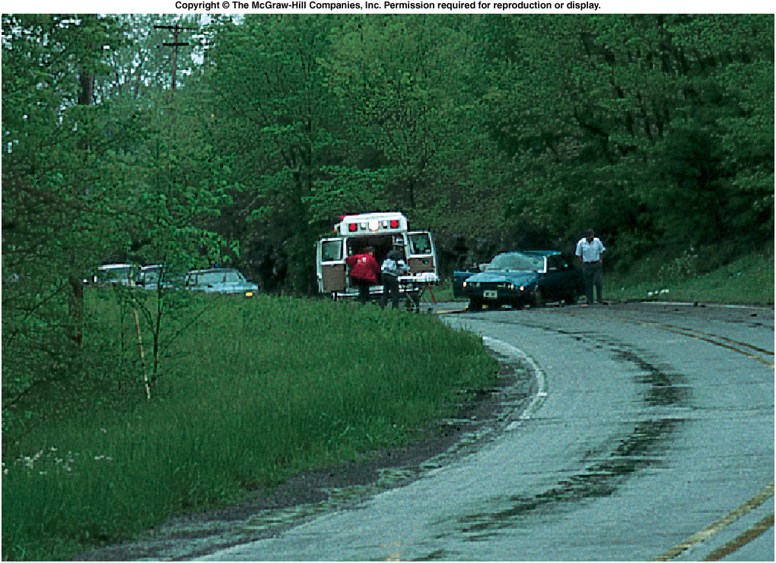

Vehicle on a Curve
The car failed to negotiate the curve. Why?
A: Not enough centripetal force.

Slide 3
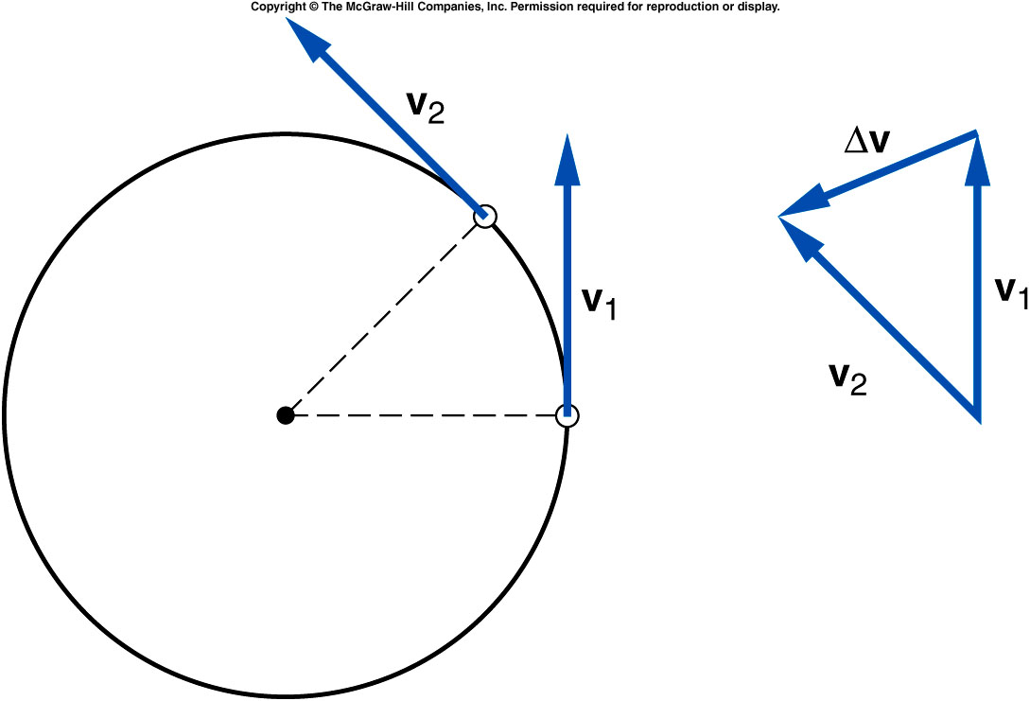
Centripetal
Acceleration (a_{c}) and Force (F_{c})
Q: Consider a ball of mass, m twirled in a horizontal circle at constant speed, v. Is there any acceleration?
A: Yes. Centripetal Acceleration
Centripetal acceleration is the rate of change in velocity of an object that is associated with the change in direction of the velocity.
It is always perpendicular to the velocity vector and points toward the center of the curve.

Slide 4
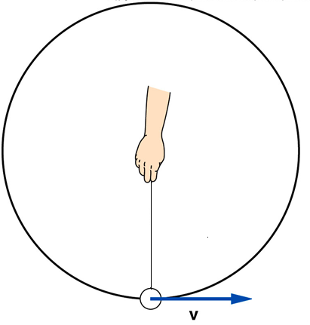
Examples
A ball of mass 0.3 kg, tied to a string is traveling at a constant speed of 2 m/s in a circle of radius 0.8 m.
a. What is the centripetal acceleration of the ball?
b. What is the tension in the string?
If the string breaks at point A, what will be the subsequent motion?

Slide 5
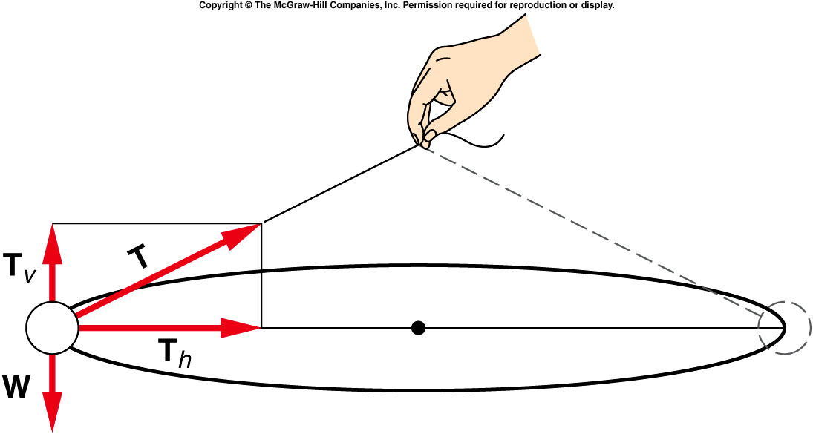
Ball twirled in a horizontal circle
Q1: What force produces the centripetal acceleration?
A1: The horizontal component of the tension in the string.
Q2: What is accomplished by the vertical component of the tension?
A2: It supports the weight of the ball.

Slide 6
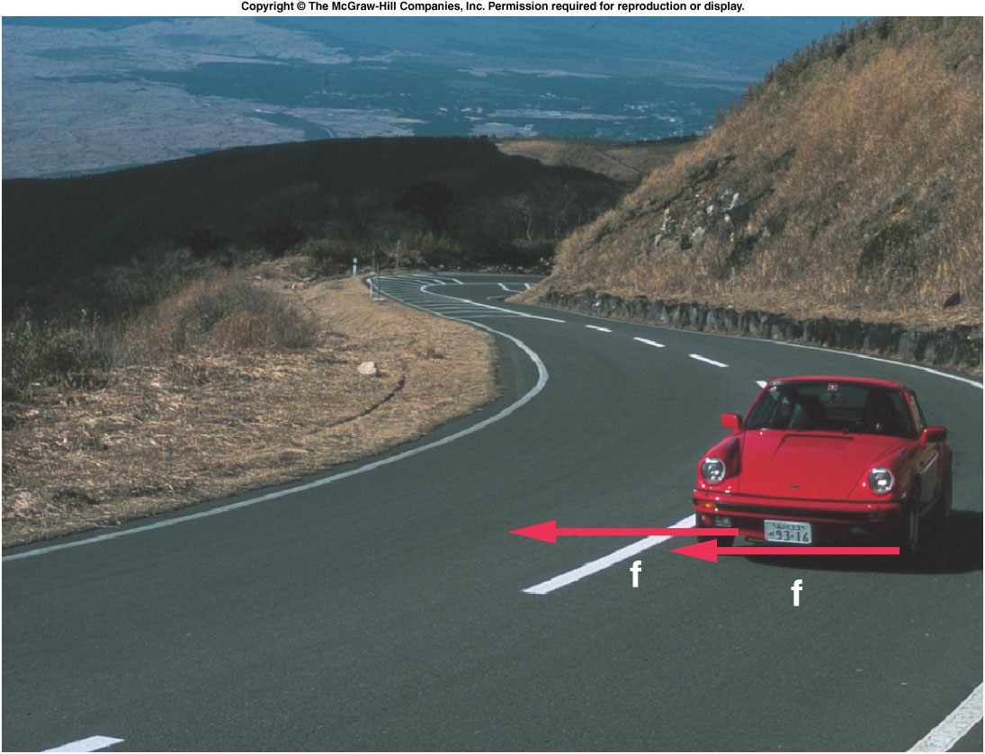
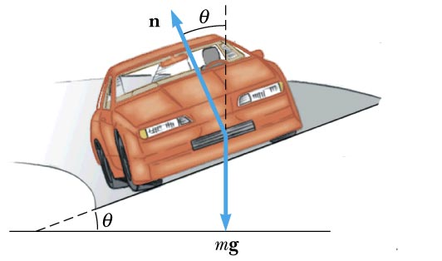
Centripetal Force
In our daily lives we come across many types of
circular motions. Centripetal force is necessary for
any of these circular motions.
Car rounding a banked-curve
Car rounding a flat-curve

Slide 7
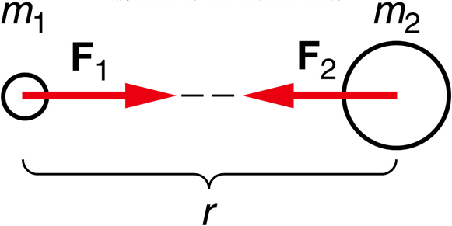
Newton’s Law of Universal Gravitation
Every body in the universe attracts every other body with a force that is directly proportional to the product of the masses of the bodies and inversely proportional to the square of the distance between the bodies.
The law of gravitation is universal and very fundamental. It can be used to understand the motions of planets and moons, determine the surface gravity of planets, and the orbital motion of artificial satellites around the Earth.

Slide 8
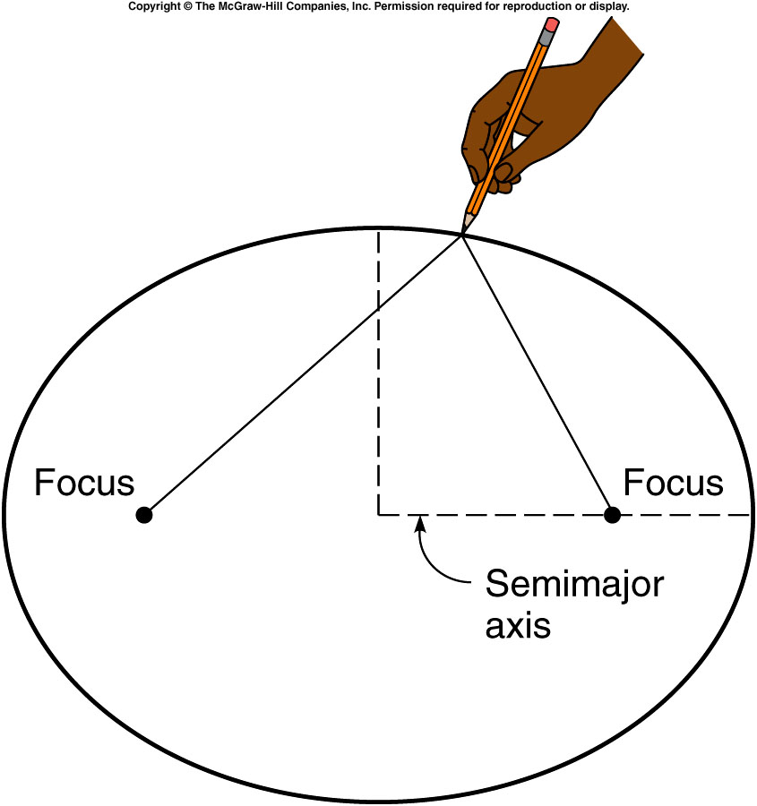
Kepler’s Laws of Planetary Motion
Kepler’s first law deals with the orbit of a planet around the sun.
It says that the planets move in elliptical orbits with the sun at one of the focal points.

Slide 9
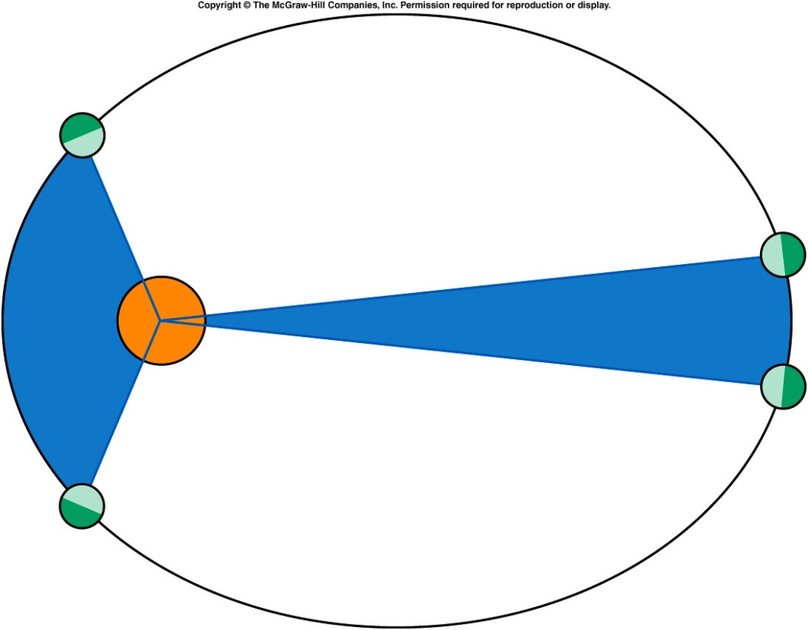
Kepler’s 2nd Law
Kepler’s second law deals with the fact that the speed of a planet changes as it orbits the Sun. When the planet is closer to the Sun it moves faster and it moves slower when it is further from the Sun.
It can be stated as follows:
The planets move along the elliptical orbit so that the line that connects the planet to the Sun sweeps equal areas during equal times.

Slide 10
Kepler’s Third Law
Kepler’s third law gives a relationship between the orbital period of a planet and the average distance of the planet from the Sun.
It can be stated as follows:
The square of the orbital period of any planet is proportional to the cube of the average distance from the planet to the Sun.
http://csep10.phys.utk.edu/astr161/lect/history/kepler.html

Slide 11
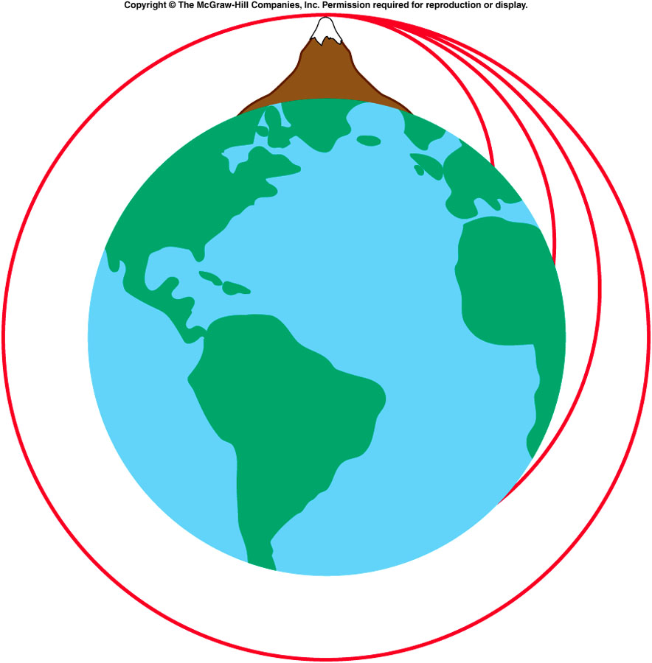
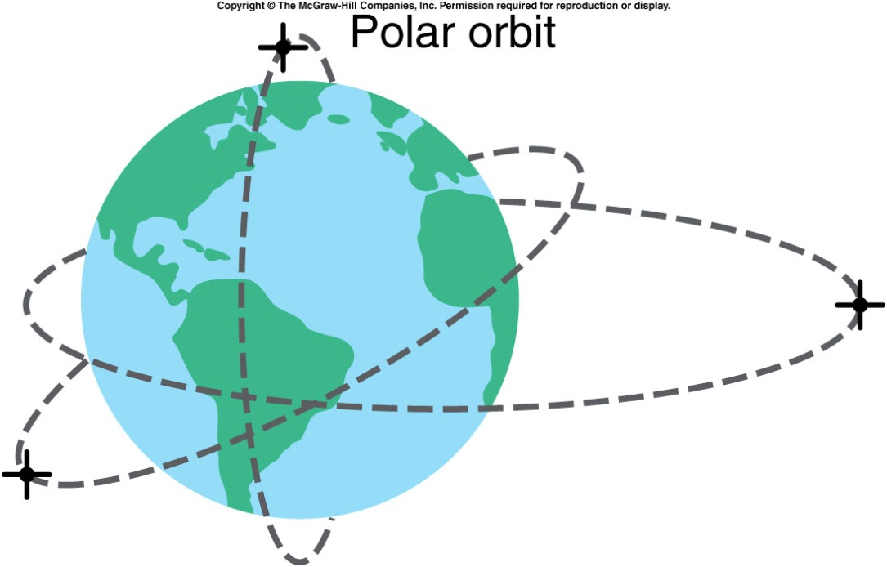
Newton’s Imagination and Artificial Satellites
http://spaceflight1.nasa.gov/realdata/tracking/index.html

Slide 12
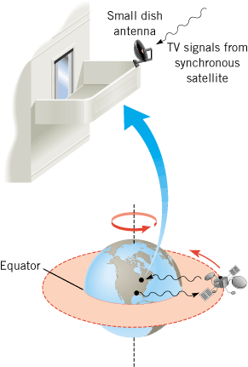
Synchronous Satellite
Synchronous satellite has a period similar to that of the rotation of earth, 24 hours. Stays at the same point above earth in the plane of the equator.
Digital satellite system uses such satellites as relay stations for TV signals that are sent up from the earth's surface and then rebroadcast down toward the dish antenna.

