Slide 1
Meeting 1, Tuesday, Jan. 14, 2020
Goals for this Meeting:
Describe general characteristics of crystalline solids, comparing and contrasting metals and ionic compounds.
Draw and understand, in detail, the four structures adopted by metals
  Important Terms: unit cell, coordination number (CN), packing density
Discussion Questions (Please come prepared):
What does it mean for a solid to be “crystalline”?
What are the defining properties of a metal? An ionic compound?
What other types of solids are there (i.e., in addition to metals and ionic compounds)? How are they similar and/or different?
What experimental technique is commonly used to determine the structure of crystalline solids? Generally, how does it work? (Hint: At least one research group in the department uses this technique.)

Slide 2
The Crystalline Solid State (Chapter 7)
1/14/20, M1
How do we describe a crystalline solid? (What does crystalline mean?)
How do we depict these species?

Slide 3
The 7 Crystal Systems
These parameters describe unit cell shapes; there are 14 different Bravais lattices that additionally depict atom/ion positions in unit cells.

Slide 4
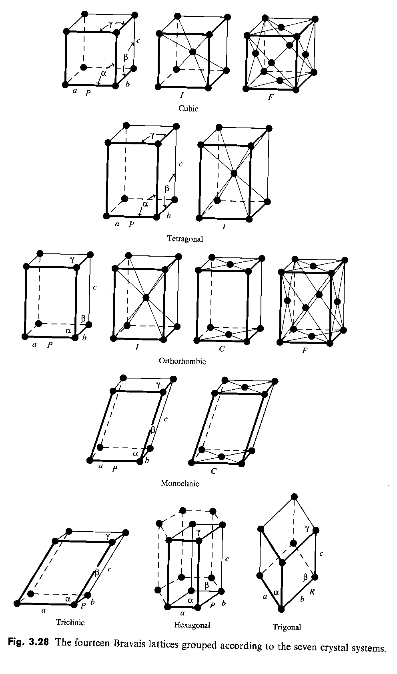
Bravais Lattices
From Miessler et al.
Fig. 7-1, p. 216
Classifications: Primitive (P), Body-Centered (I), Face-Centered (F),
Face-centered in one set of faces (C), or Rhombohedral (R)

Slide 5
Metals and Ionic Compounds
Metals:
Ionic compounds:
We will focus on 3-dimensional structures first, using both ball-and-stick and space-filling unit cell diagrams.

Slide 6
Characterizing Solid-State Lattice Structures
Experimental Determination:
Distinguishing Characteristics:
  Coordination Number (CN) –
  Packing Density – Count number of atoms contained within each unit cell. For cubic unit cells (use wooden cubes to visualize):
    Atoms wholly within the cell:
    Atoms on cell faces:
    Atoms on cell edges:
    Atoms on cell corners:

Slide 7
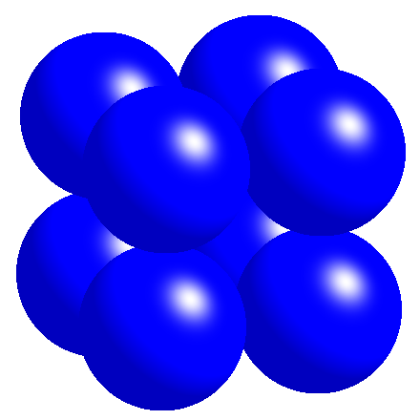
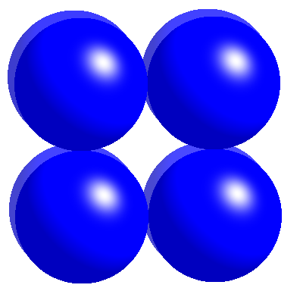
Packing Arrangements in Metals: Primitive Cubic (pc)
Primitive cubic (pc)
Coordination Number (CN) =
Atoms touch:
Atoms per unit cell =

Slide 8
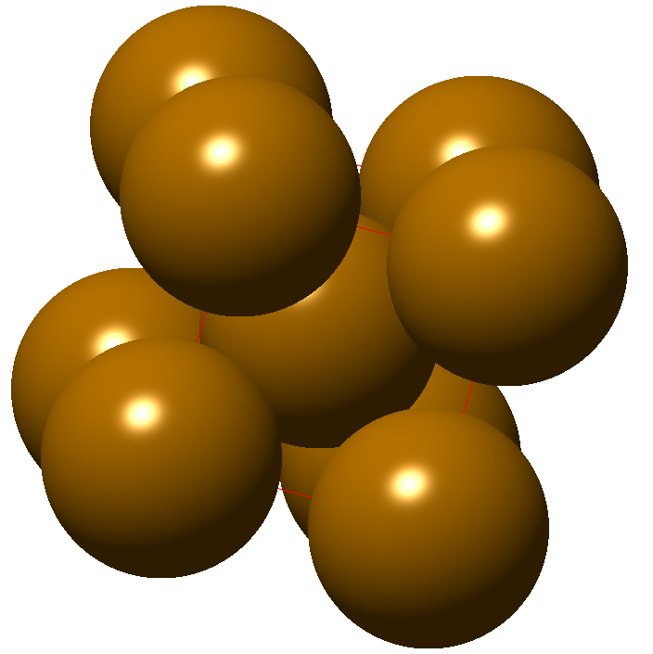
Packing Arrangements in Metals: Body-centered Cubic (bcc)
Body-centered cubic (bcc)
Coordination Number (CN) =
Atoms touch:
Atoms per unit cell:

Slide 9
Body-Centered Cubic, continued – relating L and r
Suppose that X-ray diffraction results suggest that a particular metal adopts a bcc structure. How is the edge length (L) determined from XRD related to the atomic radius (r)?
B = 4r

Slide 10
Closest Packed Structures
(Investigate with your spheres.)
Make one close-packed layer. How many neighbors does an atom touch?
Place a second layer over the first. Describe where the atoms go.
There are two different types of holes between these two close-packed layers. Can you find and describe them?

Slide 11
Closest Packed Structures, continued
There are two different ways to place the third close-packed layer. What are they?
The coordination number is the same in each case. What is it?:

Slide 12
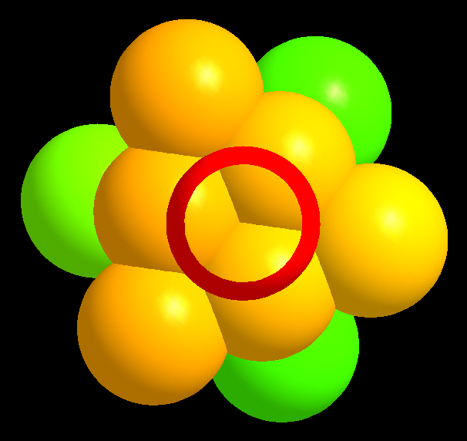
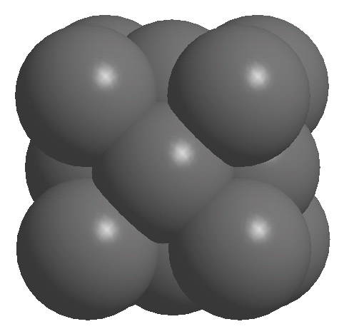
Packing Arrangements in Metals: Face-centered Cubic (fcc)
Cubic closest packed = Face-centered cubic (ccp = fcc)
Coordination # (CN) =
Atoms per unit cell =
12

Slide 13
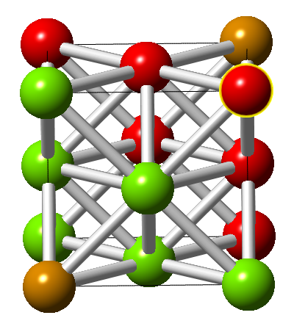
Face-Centered Cubic (fcc/ccp), continued – relating L and r
Suppose that X-ray diffraction results suggest that a particular metal adopts an fcc (or ccp) structure. How is the edge length (L) determined from XRD related to the atomic radius (r)?
Can you “see” the CN of 12 here?

Slide 14
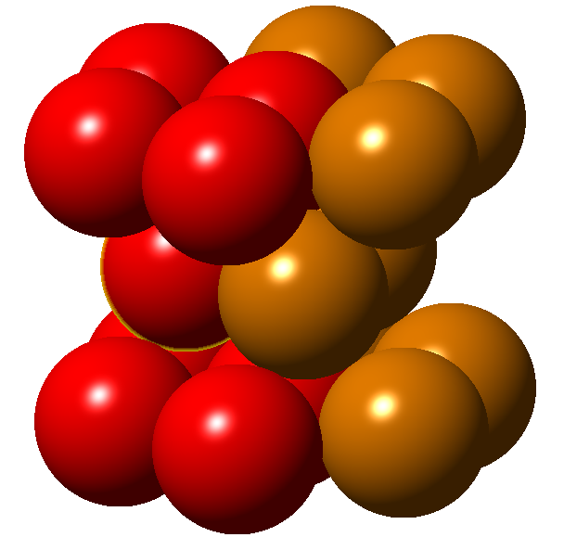
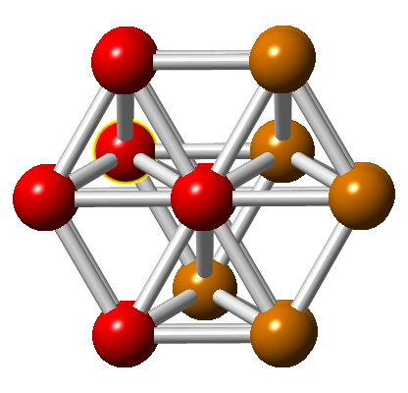
Metal Packing Arr. (Review): Hexagonal Closest Packing
The unit cell (shown in red) is a portion of the hexagonal prism.
The four atoms in each base of the parallelogram touch.
Atoms per unit cell:
Top view:
A
A
B
A
A
A
B
B
A
A
Note that ‘B’ atoms lie over alternating holes in the lower ‘A’ layer.

Slide 15
Packing Arrangements, Polymorphism and Metal Properties
Metals are distributed ~evenly between bcc, hcp and ccp packing arrangements (only Po has pc packing).
Most metals are polymorphic – their 3-D structures vary depending on temperature and pressure.
  Phase diagrams can be used to predict the form under particular conditions.
Qualitative Fe Phase Diagram
Metals’ properties depend partly on their packing arrangements:
T (K)
liquid
2000
1400
fcc
hcp
800
bcc
200
1 10 100 1000
P (bar)

