Slide 1
PROPERTIES OF COLUTIONS 1: AQUEOUS SOLUTIONS
6.1 Aqueous Solutions
6.2 Solution Properties
6.3 Net Ionic Reactions
6.4 Solubility
6.5 Mathematics of Solutions: Concentration Calculations
6.6 Acid Chemistry
6.7 Base Chemistry
6.8 Neutralization Reactions
6.9 The pH Scale and Buffers
6.10 Mathematics of Solutions: Calculating pH

Slide 2
6.1 AQUEOUS SOLUTIONS
If water is the solvent we say it is an aqueous solution.
A solution consists of a solvent, the dissolving medium, and the solute, the material (s, l, or g) being dissolved.
solute is the one present in smaller amount
Solvent is the larger amount
Dissolution: Opposites attract, like dissolves like
Electrolytes: polar molecules (permanent or regional charge); conducts electricity
NaCl(s) + water → NaCl(aq)
Nonelectrolytes: organic molecules (oils, lotions); does not conduct electricity
Rate of dissolution – increases with ⇑ surface area (powdered sugar vs granular), temp., concentration

Slide 3
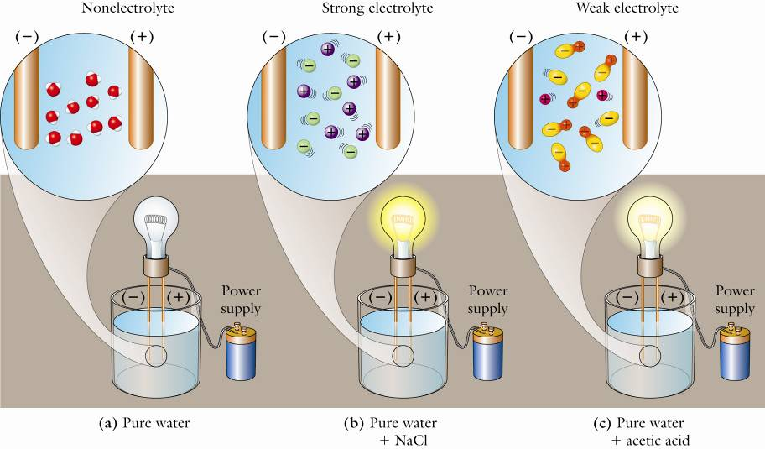
Aqueous Solution Properties
Electrolyte:
Ionic compound, and will dissolve in water
Strong acids, strong bases, and soluble salts are strong electrolytes. Weak acids and weak bases are weak electrolytes. Sugars and alcohols are nonelectrolytes. Gatorade ingredients
How do you know if it will dissolve?
Solubility rules

Slide 4
SOLUTION PROPERTIES - electrolytes
Sugars and alcohols are examples of compounds that are nonelelctrolytes because they form no ions in solution.
A compound that conducts electricity in aqueous solution is called an electrolyte.
Weak electrolytes form few ions in aqueous solution.
Strong electrolytes are compounds that are fully dissociated into ions in water solutions.
Which are electrolytes? N₂O, Fe(NO₃)₂, C₃H₈

Slide 5
SOLUBILITY Rules
Rules for Soluble Compounds
1. All compounds containing Group 1 or ammonium ions (NH₄⁺) are soluble.
2. All compounds containing acetate ions (C₂H₃O₂¹⁻) and nitrate ions (NO₃¹⁻) are soluble.
3. Most compounds containing chloride (Cl⁻), bromide (Br⁻), or iodide (I⁻) ions are soluble, but not with these cations: Ag⁺, Hg₂²⁺, or Pb²⁺.
4. Most compounds containing sulfate ions (SO₄²⁻) are soluble, but not with these cations: Ca²⁺, Ba²⁺, Sr²⁺, or Pb²⁺.
Rules for Insoluble Compounds
1. Most carbonate (CO₃²⁻), phosphate (PO₄³⁻), and chromate (CrO₄²⁻) compounds are insoluble except those containing Group 1 or ammonium ions.
2. Most sulfide (S²⁻) compounds are insoluble except those containing these ions: Group 1, ammonium, Ca²⁺, Sr²⁺, or Ba²⁺.

Slide 6
SAMPLE QUESTIONS
Which of these is insoluble?
A. KBr B. Ca(NO₃)₂ C. AgI
Solution: A. K compounds are all soluble. It comes from Group I.
B. All nitrates are soluble.
C. Insoluble. Most I⁻ compounds are soluble except AgI, PbI₂ and Hg₂I₂.

Slide 7
SAMPLE QUESTIONS
Which of these salts are insoluble?
A. BaSO₄ B. NaC₂H₃O₂ C. AgCl
A. Insoluble B. Soluble C. Insoluble
Solution: A. Most sulfates are soluble, but not those of calcium, strontium, barium, and lead(II). B. All Na and all acetate compounds are soluble.
C. Most chlorides, bromides & Iodides are soluble, but not those of silver, lead(II), and mercury(I).

Slide 8
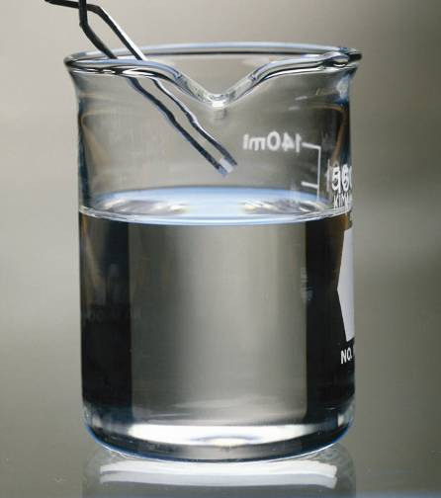
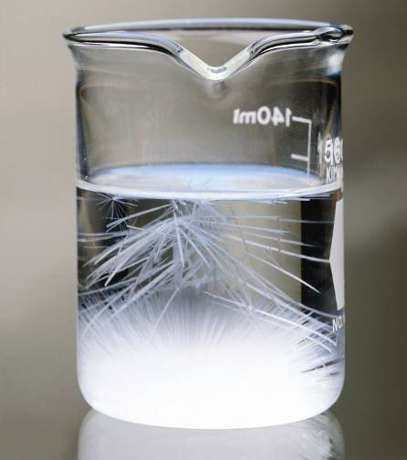
A tiny crystal of the dissolved solid is about to be added to a supersaturated solution prepared by heating and then slowly cooling without disturbing the solution.
Figure 6.3, pg. 175
Investigating Chemistry, 2nd Edition
© 2009 W.H. Freeman & Company
Notes:
8

Slide 9
SOLUBILITY
Saturated solutions are those that contain the maximum amount of solute that is stable at that temperature. These often have some visible solid in the bottom of the container as evidence.
Unsaturated solutions contain less than required to saturate the solvent.
Supersaturated solutions are not stable because they temporarily contain too much solute. These metastable solutions readily precipitate the excess solute and form a more stable saturated solution.
By analogy a cone balanced on its tip is at meta-stable equilibrium. On it’s side it is more stable.

Slide 10
Aqueous Solution Properties
How much dissolved?
Solubility = _ g/mL saturated
Solubility > _ g/mL supersaturated
Solubility < _ g/mL unsaturated

Slide 11
Solubility questions
(34/38-2nd E) The solubility of cadmium cyanide is 1.70g/100mL (0.017g/mL). Determine whether the following solutions are saturated, unsaturated, or supersaturated.
5.661 g of Cd(CN)₂ in 330.0 mL H₂O
348.5 g of Cd(CN)₂ in 20.5 L H₂O
3.40g of Cd(CN)₂ in 250.0 mL H₂O

Slide 12
Solubility questions
How many grams of potassium cyanide would be needed to make a saturated solution? KCN solubility is 50.0g/100mL.
3.4L
175mL
1.80mL

Slide 13
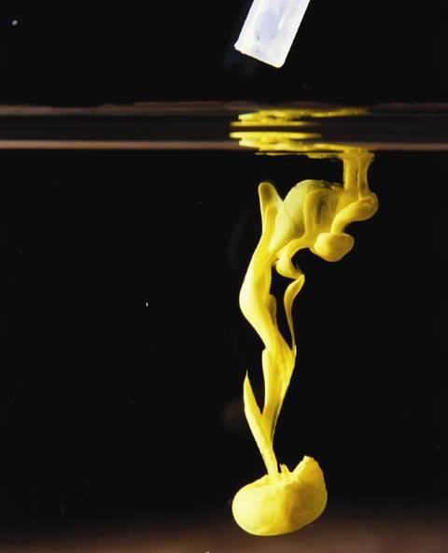
Pb(NO₃)₂ solution added to NaI solution gives the insoluble precipitate, PbI₂, lead(II) iodide, even though most iodides are soluble.
Pb(NO₃)₂ + 2KI → PbI₂(s) + 2KNO₃(aq)
Notes:
13

Slide 14
NET IONIC EQUATIONS
Reactions in solution can be written three ways:
1. The Formula Unit Equation:
Pb(NO₃)₂(aq) + 2 KI(aq) → PbI₂(s) + 2KNO₃(aq)
2. As a Total Ionic Equation, showing the dissociation of the soluble species:
Pb²⁺ + 2NO₃¹⁻ + 2K⁺ + 2I¹⁻ → PbI₂(s) + 2K⁺ + 2NO₃¹⁻
Products with (s), (l), or (g) designations must never be dissociated.
3. To obtain the Net Ionic Equation, find the species that are the same on both sides (spectator ions) and delete them.

Slide 15
NET IONIC EQUATIONS
2. Again, the Total Ionic Equation is:
Pb²⁺ + 2NO₃¹⁻ + 2K⁺ + 2I¹⁻ → PbI₂(s) + 2K⁺ + 2NO₃¹⁻
3. Below is the Net Ionic Equation (without spectator ions):
Pb²⁺ + 2I¹⁻ → PbI₂(s)
Alternatively, you can deduce the net ionic equation by working backwards from the insoluble product. ? + ? → PbI₂(s)

Slide 16
THE MATH OF SOLUTIONS: CONCENTRATION CALCULATIONS
The concentration of a solution tells us how much solute we have in a given volume of solution or solvent.
It can be expressed in terms of grams per 100 mL of solution, but more commonly it is the number of moles in one liter of solution, the molarity, M.
Molarity = no. of moles of solute = n/V
no. of liters of solution
Because it is L of solution, not solvent, we use a volumetric flask, not a grad. cylinder.

Slide 17
SAMPLE MOLARITY PROBLEM
Find the molarity of a solution if 500 mL of it contains 15.2 g of KCl.
Answer: Begin with the definition of molarity, M = n/V (in liters)
Change grams to moles.
15.2g KCl x (1 mol KCl/74.6 g KCl) = 0.204 mol KCl
Next change the volume to liters (L).

Slide 18
SAMPLE MOLARITY PROBLEM
500 mL x (1L/1000mL) = 0.500 L
Apply the definition M = n/V (in L)
M = 0.204 mol KCl / 0.500 L =?
Answer: 0.408 M KCl
This means that if we had one liter, it would contain 0.408 of a mole of KCl.
It takes practice to gain confidence.

Slide 19
DILUTION CALCULATIONS
Quite often in the lab, we have an existing “stock solution” of known concentration that we can use to prepare a more dilute one. Dissolving crystals can be more time consuming.
The dilution equation: M₁V₁ = M₂V₂
M₁ is the concentration of the stock solution.
V₁ is the volume of stock solution to be measured out.
M₂ is the concentration of the desired dilute solution.
V₂ is the volume of dilute solution needed. It is the total final volume we end up with.

Slide 20
SAMPLE DILUTION PROBLEM
How much 6.0 M HCl solution would be needed in order to prepare 2.00 L of a 1.5 M HCl solution?
Answer: Assign a symbol to each no. in the problem. 6.0 M = M₁ and 1.5 M = M₂, while 2.00L = V₂. Find V₁.
M₁ V₁ = M₂ V₂
(6.0 M) x V₁ = 1.5 M x 2.00 L

Slide 21
SAMPLE DILUTION PROBLEM
(6.0 M) x V₁ = 1.5 M x 2.00 L
So V₁ = (1.5 x 2.00)/6.0 = 0.50 L
That was through algebra.
A more common sense method can be used instead in this case.
Multiply the volume by a ratio that reduces the volume since only a smaller amount of “stock solution” is ever needed in a dilution.

Slide 22
6.6 ACID CHEMISTRY
An acid is a substance that can release hydrogen ions (H+) into an aqueous solution.
Strong acids are fully dissociated:
HCl → H⁺ + Cl¹⁻ (100%)
Weak Acids are only partly dissociated:
HCN = H⁺ + CN¹⁻ (3-5%)

Slide 23
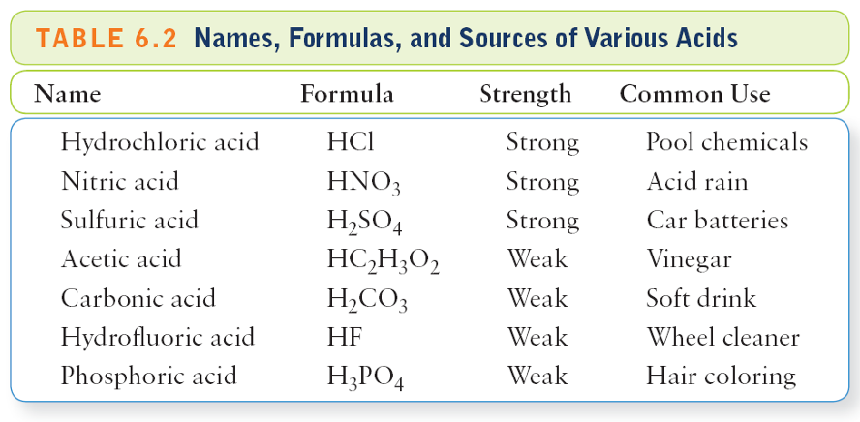
Keep in mind that HF is a weak acid, but inhalation can be fatal. A strong acid like HNO₃ may be concentrated or dilute (less dangerous).
Table 6.2, pg. 180
Investigating Chemistry, 2nd Edition
© 2009 W.H. Freeman & Company

Slide 24
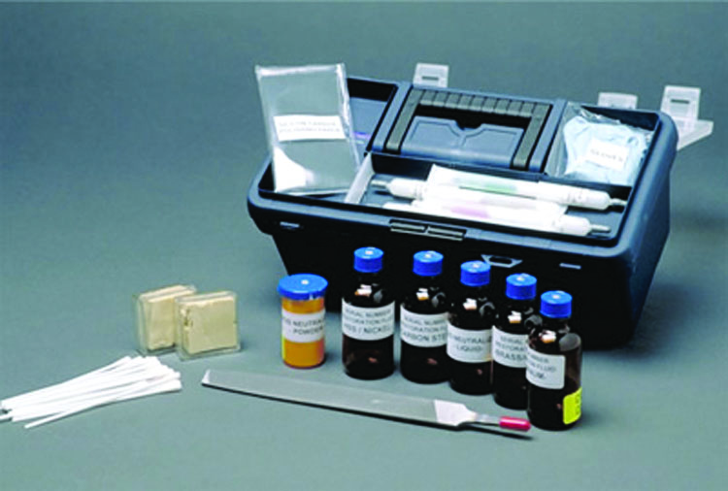
A serial no. registration kit uses acids to restore the S/N etchings.
Figure 6.4, pg. 181
Investigating Chemistry, 2nd Edition
© 2009 W.H. Freeman & Company

Slide 25
6.7 BASE CHEMISTRY
A base is a compound that produces hydroxide ions (OH¹⁻) in aqueous solution.
Terms such as alkali, alkaline, and caustic are used for bases. Acids are said to be corrosive.
Strong bases are strong electrolytes because they are fully dissociated in solution. NaOH → Na¹⁺ + OH¹⁻ (100%)

Slide 26
6.7 BASE CHEMISTRY
Weak bases are only partly dissociated or react incompletely with water.
NH₃(g) + H₂O(l) → NH₄OH(aq) (~5%)
Lye (NaOH) reacts with animal fats (lard or tallow) to yield soap and glycerin. This soap making process is called saponification. Soap is the sodium or potassium salt of a fatty acid, and is water soluble.

Slide 27
Weak bases, like weak acids, exist mainly as molecules and not ions. NH₃ + H₂O = NH₄⁺ + OH¹⁻ (~5%)
Table 6.3, pg. 181
Investigating Chemistry, 2nd Edition
© 2009 W.H. Freeman & Company

Slide 28
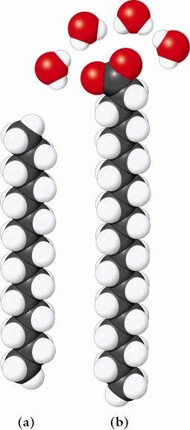
The molecule on the left, C₁₅H₃₂, is a nonpolar hydrocarbon that has no affinity for water. It is hydrophobic.
Figure 6.5. 183
Investigating Chemistry, 2nd Edition
© 2009 W.H. Freeman & Company

Slide 29
The molecule on the right, a soap, has a polar end that has much affinity for water (polar). The end is hydrophilic.
Figure 6.5. 183
Investigating Chemistry, 2nd Edition
© 2009 W.H. Freeman & Company

Slide 30
6.8 NEUTRALIZATION REACTIONS
Acids and bases will undergo neutralization reactions upon mixing to produce a salt and water.
HCl + NaOH → NaCl + H₂O(l)
acid + base yield a salt water
HBr(aq) + KOH(aq) → KBr(aq) + H₂O(l)
The net ionic equation in both examples above is: H⁺(aq) + OH⁻(aq) → H₂O(l)

Slide 31
6.8 NEUTRALIZATION REACTIONS
Neutralization reactions can be monitored by the addition of an indicator.
An indicator is a compound that will change colors depending on the amount of acid or base present in solution.
Litmus is Blue in Base, Red in Acid.
Phenolphthalein is red in base and colorless in acid.
An indicator, HIn, is a weak organic acid whose conjugate base (In¹⁻) has a different color.

Slide 32
6.9 THE pH SCALE AND BUFFERS
The pH scale tells how acidic or alkaline a water solution is. The acidic range is from ~0 to 6.999 for solutions and from 7.001 to ~14 for basic ones.
7.00 is a neutral solution.
The pH is defined as the negative logarithm of the H⁺ concentration.
pH = - log[H⁺]

Slide 33
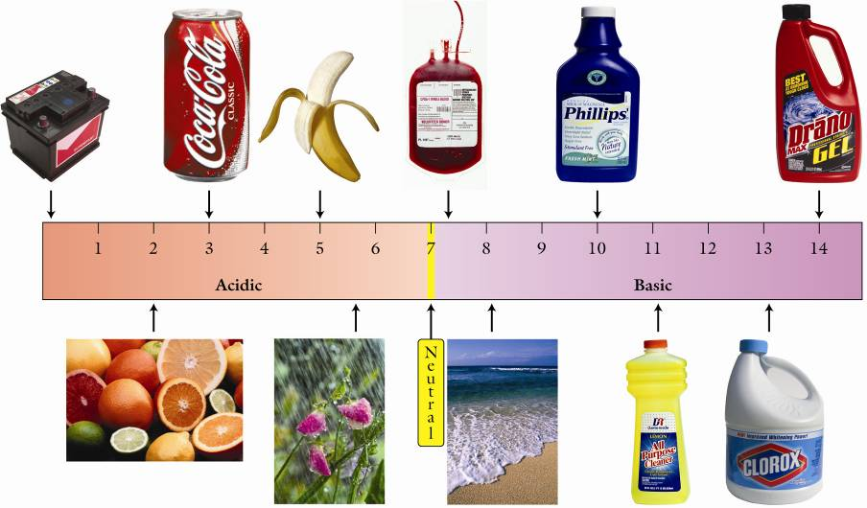
Battery cola fruit blood “M.O.M.” Drano gel ************************************* Citrus rain ocean NH₃ bleach
Figure 6.8, pg. 187
Investigating Chemistry, 2nd Edition
© 2009 W.H. Freeman & Company

Slide 34
THE pH SCALE
[H⁺] = 10⁻¹ M 10⁻² M 10⁻⁷ M 10⁻⁹ M 10⁻¹² M
pH = 1.00 2.00 7.00 9.00 12.00
The above comparison is to show that a change of one unit on the pH scale corresponds to a ten-fold change in the hydrogen ion concentration in moles per liter, [H⁺].
A change of two units is a 100-fold change in [H⁺].
And a change of three units is a 1000-fold change.

Slide 35
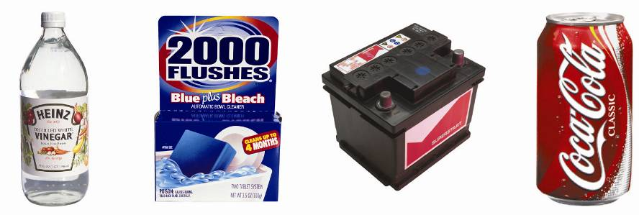
Some household substances are acidic. They have a low pH.
Unnumbered Figure, pg. 195
Investigating Chemistry, 2nd Edition
© 2009 W.H. Freeman & Company

Slide 36
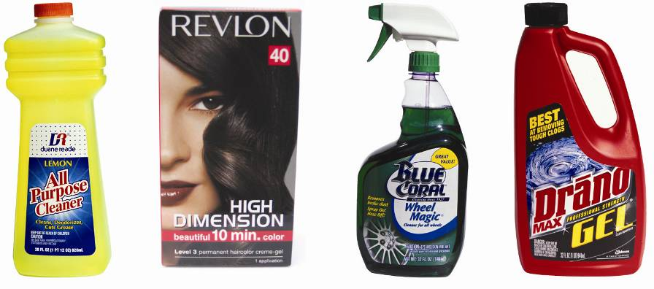
Other products have a higher pH than 7. They are basic or alkaline.
Unnumbered Figure, pg. 195
Investigating Chemistry, 2nd Edition
© 2009 W.H. Freeman & Company

Slide 37
6.10 THE MATH OF SOLUTIONS: CALCULATING pH
What is the pH of a 0.010 M HCl solution? (0.010 M = 1.0 x 10⁻² M)
Answer: Since for strong acids the concentration of H⁺ ions is the same as the strong acid, [H⁺] = 0.010 M
But the pH is defined as –log[H⁺].
So the pH = -log(10⁻²) = -(-2) = 2.00
The significant figures are in yellow.

Slide 38
0.1 M HCl has a pH of 1. 0.01 M HCl has a pH of 2.
Unnumbered Figures, pg. 191
Investigating Chemistry, 2nd Edition
© 2009 W.H. Freeman & Company

Slide 39
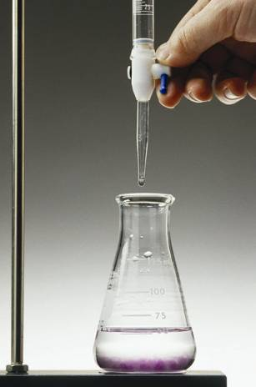
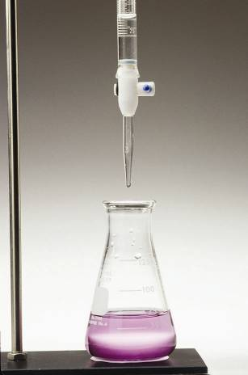
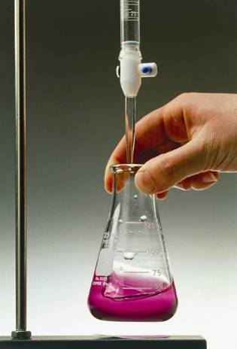
Adding NaOH from the buret in a titration of acid.
Figure 6.6, pg. 184
Investigating Chemistry, 2nd Edition
© 2009 W.H. Freeman & Company

Slide 40
BUFFERED SOLUTIONS
In chemistry, a buffer is a substance or a mixture of substances that is put into a solution to help maintain a constant pH. A buffer solution resists a change in pH.
A typical buffer contains both a weak acid and its salt, which acts as a weak base. The weak acid consumes any strong base that is added, and the basic salt reacts with any strong acid that is added.

Slide 41
BUFFERED SOLUTIONS
In blood, the plasma is buffered with carbonic acid, H₂CO₃ and NaHCO₃, the salt of the weak acid, which is mildly alkaline.
Along with another buffer (NaH₂PO₄ and Na₂HPO₄), the blood is kept in the pH range 7.35-7.45. Lower values result in acidosis. Higher values produce alkalosis.
Both conditions are very dangerous.
http://scifun.chem.wisc.edu/CHEMWEEK/BioBuff/BioBuffers.html

Slide 42
Ch4 revisited
Stoichiometry calculations
Always compare moles only
the theoretical yield
Actual yield
Types of reactions.
Test1, problem 52 – A is correct

Slide 43
STOICHIOMETRY CALCULATIONS
Always start with a balanced reaction
NEVER COMPARE masses (grams), convert to moles

Slide 44
STOICHIOMETRY
CH₄ + 2O₂ → CO₂ + 2H₂O
1 mol 2 mol → 1 mol 2 mol
16.0 g + 64.0 g = 44.0 g + 36.0 g
80.0 grams of reactants must yield 80.0 grams of products. It’s the law!
The law of the conservation of matter applies.

Slide 45
87.How much NaBr is needed to react completely with 100.0 g of AgNO₃, according to the equation:
NaBr + AgNO₃ → AgBr + NaNO₃ ?
A)30.7 g
B)122.6 g
C)61.3 g
D)100.0 g

Slide 46
85.When O₂ reacts with C₂H₆, according to the equation:
2 C₂H₆ + 7 O₂ → 4 CO₂ + 6 H₂O
How much CO₂ is produced from 60.0 g of C₂H₆?
A)60.0 g B)44.0 g C)88.0 g D)176 g

Slide 47
Wednesday, Oct 28
Owens 107 on Friday
Quiz
Additional quiz questions
Presentation
Ch5 (V1) or Ch6 (V2)

Slide 48
Additional quiz questions
21.If HI reacts completely in the reaction:
KOH + HI → H₂O + KI
how much KOH is needed to react with 128 g of HI?
A)112 g B)56.0 g C)128 g D)256 g
22.In the reaction
2 Na + Cl₂ → 2 NaCl
How much sodium chloride can be produced from 235.0 g of Cl₂ ?
A)235.0 g B)193.3 g C)387.3 g D)96.8 g

Slide 49
TYPES OF REACTIONS
Precipitation reactions yield an insoluble solid as a product.
NaCl(aq) + AgNO₃(aq) → AgCl(s) + NaNO₃(aq)
Combustion reactions unite organic compounds with oxygen to yield carbon dioxide and water.
C₃H₈ + 5O₂ → 3CO₂ + 4H₂O + heat
Neutralization reactions (Acid-base) react an acid with a base to give a salt and water.
HBr + KOH → KBr + H₂O(l) + heat
Oxidation-reduction Oxidation-Reduction or Redox Reactions involve the transfer of electrons.
O.I.L. – R.I.G. is a way to keep it straight.
Oxidation is loss of electrons. Na → Na⁺ +1e⁻
Reduction is gain of electrons. Br +1e⁻ → Br¹⁻
Mnemonic: When electrons are on the left it is a reduction.

Slide 50
4.9 TYPES OF REACTIONS
A Redox Reaction often involves at least one uncombined element, but a more reliable indicator is a change in oxidation state.
H₂SO₄ + Zn(s) → ZnSO₄ + H₂(gas)
Since the sulfate ion has a -2 charge, each H must have a +1 ox. no. But the H₂ being an uncombined element has a zero ox. no.

