Slide 1
CHAPTER 5: CHEMISTRY OF BONDING: STRUCTURE AND FUNCTION OF DRUG MOLECULES CHEMISTRY OF ADDICTION
Nature of Covalent Bonds
Lewis Structures of Ionic Compounds
Lewis Structures of Covalent Compounds
Electron dot structures
Resonance Structures
VSEPR Theory
Polarity of Bonds and Molecules

Slide 2
47. What kind of bond connects the carbon atom and oxygen atom in carbon monoxide?
A) A single bond
B) A double bond
C) A triple bond
D) Two single bond
Valence electrons C-4 + O- 6 = 10 total, to ensure each element has an octet, a triple bond is required.
:C≡O:

Slide 3
5.1 NATURE OF COVALENT BONDS
The Valence Bond (VB) theory explains bonding in covalent compounds, but is not entirely adequate in predicting shapes of molecules.
According to the VB theory, a covalent bond is formed between two atoms when their orbitals overlap.
The Lewis theory of bonding will enable us to predict the number of bonds formed by each atom, but not the bond angles.
The valence shell electron-pair repulsion (VSEPR) theory will allow us to predict the actual molecular geometries based on the local geometries of individual atoms.

Slide 4
1. How does a covalent bond form?
a. Through electron localization and orbital matching between electrons.
b. Through electron sharing and orbital overlap between bonding electrons.
c. By way of orbital mismatches aligning and electrons overlapping.
d. By way of electron localization and orbital aligning for non-bonding electrons.
Answer: B
2. What kind of bond forms when the relative difference in electronegativities is great enough that one atom removes electrons from the other?
a. An ionic bond.
b. A covalent bond.
c. A metallic bond.
d. A polar bond.
Answer: A

Slide 5
3. What does the Lewis theory state about electron configurations in atoms?
a. That electrons will shift between atoms to form stable octet configurations.
b. That atoms will share electrons when possible to form covalent bonds.
c. That electrons will form covalent bonds to achieve an octet.
d. That atoms gain or lose electrons to attain a configuration like that of the closest noble gas.
Answer: D
4. What does a Lewis dot structure show for an element?
a. The total electrons of an atom.
b. The valence electrons of an element.
c. The valence electrons, properly paired or unpaired in the element’s outer electron shell(s).
d. The valence electrons, properly paired in the element’s outer shell(s).
Answer: C

Slide 6
Questions
5. What is represented in a double bond?
a. Four electrons that are shared between two atoms.
b. Four electrons that are shared between two carbon atoms.
c. Four electrons, two shared, and two unshared, between two atoms.
d. Four electrons, two shared, and two unshared, between two carbon atoms.
Answer: A
6. In what type of molecule is a resonance structure needed?
a. Whenever a double bond can be positioned twice between two atoms with different electronegativities.
b. Whenever a double bond can be positioned between two atoms with the same electronegativity.
c. Whenever placement of a single bond can be in two positions that result in equivalent Lewis structures.
d. Whenever placement of a double bond can be in two positions that result in equivalent Lewis structures.
Answer: D

Slide 7
7. VSEPR theory takes into account what two factors when determining molecular geometry?
a. The location of lone pair valence electrons, plus the number of bonds.
b. The size and location of lone pair valence electrons, plus the location of bonds.
c. The location of lone pair valence electrons, and the location and number of bonds.
d. The location of lone pair valence electrons, and the length of single and double bonds.
Answer: C
8. When a bond is considered polar covalent, what must it possess?
a. A large difference in electronegativities between the two atoms that form it.
b. Essentially no difference in electronegativities between the two atoms that form it.
c. A minimum of two shared electrons.
d. A metal and a non-metal in the bond that forms it.
Answer: A

Slide 8
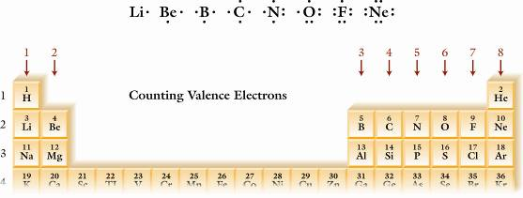
This chart shows in red the number of outermost or valence electrons for 8 families. Also note the Lewis symbols for elements 3-10.

Slide 9
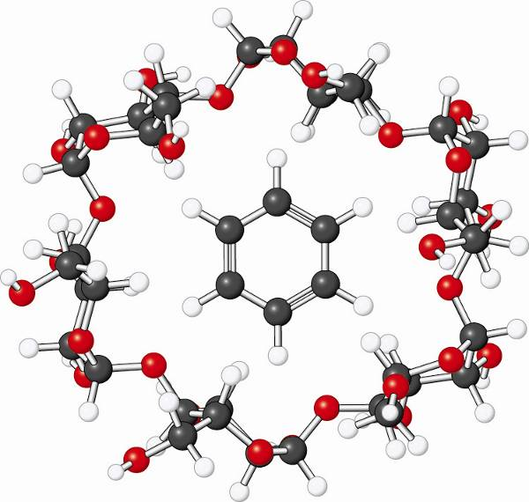
Benzene (the target) is able to bind to cyclodextrin (the receptor) mainly due to their compatible 3D geometries.
Figure 5.1, pg. 139
Investigating Chemistry, 2nd Edition
© 2009 W.H. Freeman & Company

Slide 10
5.2 LEWIS STRUCTURES OF COMPOUNDS
Single bonds share two electrons between the two atoms.
Double bonds share four electrons (2 pairs).
Triple bonds share six electrons (3 pairs).
The higher the bond order, the shorter and the stronger the bond is.
N₂ has a triple bond, which is shorter and stronger than the N=N bond, which is shorter and stronger than the N-N bond.

Slide 11
DRAWING LEWIS STRUCTURES OF COVALENT COMPOUNDS AND IONS
1. Count all the valence electrons for all the atoms. Subtract one electron for each positive charge. Add one electron for each negative charge.
2. Arrange the atoms with the unique one in the center and connect them to the central atom by one pair of electrons each. Symmetry is a useful guide: O-S-O and not S-O-O.
3. Complete the octets of all the noncentral atoms (except H). Count the number of electrons used so far and then subtract from the original total.
4. If there are surplus electrons, place them in pairs on the central atom. These are lone pairs.
If and only if the central atom (other than Be, B or Al) does not have an octet, borrow 1 or more pairs of electrons from one or more noncentral atoms to share with the central atom.
Consider the sulfate ion, SO₄²⁻. How many valence e’s are there?

Slide 12
EXAMPLE: THE SULFATE ION, SO₄²⁻
1. S has 6 valence e’s. So does each O atom. Add two for the -2 charge:
6 + 4(6) + 2 = 32 valence electrons
2. Put the four O atoms around the S.
3. Complete the octet for each O atom.
4. Do we have any leftover e’s? No! 32 total – (4x8 = 32) used = 0 left
So there are no lone pairs on the central atom, S, but each O has three lone pairs.
5. There are no multiple bonds to the S atom because it had 8 electrons in the four bonds to four O atoms.

Slide 13
These covalent bonds are formed as atoms share electrons to achieve an octet in their outermost or valence shell. How many electrons are shared by the two O atoms in the last structure? Please note that the actual O₂ molecule has unpaired electrons and a bond order of two.

Slide 14
EXAMPLE PROBLEM: Are there any errors in these Lewis structures?
:O=S=O: Hint: Count valence electrons first.
Yes. S does have an octet, but not O, and there should be a total of 3 x 6 = 18 valence electrons placed. We see just 12. Each line is 2 electrons.
? :O=N=O: Note the triple bonds between N & O.
Wrong structure again. This time the O atoms have octets, but the N atom has 12 e’s. We see 16 valence electrons placed, but we need 17. One double bond (O=N) and one single bond (N-O) are needed. The odd electron goes on N.
The odd electron on N represents an exception to the octet rule. Here as in NO, nitric oxide, also, N has 7 electrons.
Question: Does N have just 7 electrons in N₂O?

Slide 15
Nitrogen dioxide, NO₂, tends to dimerize to form dinitrogen tetroxide, N₂O₄, due to its unpaired electron.
Since the odd electron on N represents a highly reactive species (a free radical), it explains why two NO₂ molecules readily form N₂O₄:
O₂N. + .NO₂ → O₂N:NO₂ (a stable molecule)
Recall that H. combines with itself to form H₂ molecules because the unpaired electron is so reactive. [BrINClHOF are the diatomic elements.]
Can you write the Lewis structure for NO?
Use only 11 valence electrons and :N=O:.

Slide 16
5.4 RESONANCE STRUCTURES
Benzene, an aromatic hydrocarbon, has two resonance structures (Lewis structures), but the real structure has six identical bonds, not three C=C’s and three C-C, which are longer and weaker than the double bonds.
The realistic structure is called the resonance hybrid and can be described in terms of the resonance structures.
Each C atom has a p orbital with one electron in it. The orbitals overlap side-to-side to form a continuous electron cloud above and below the ring.

Slide 17
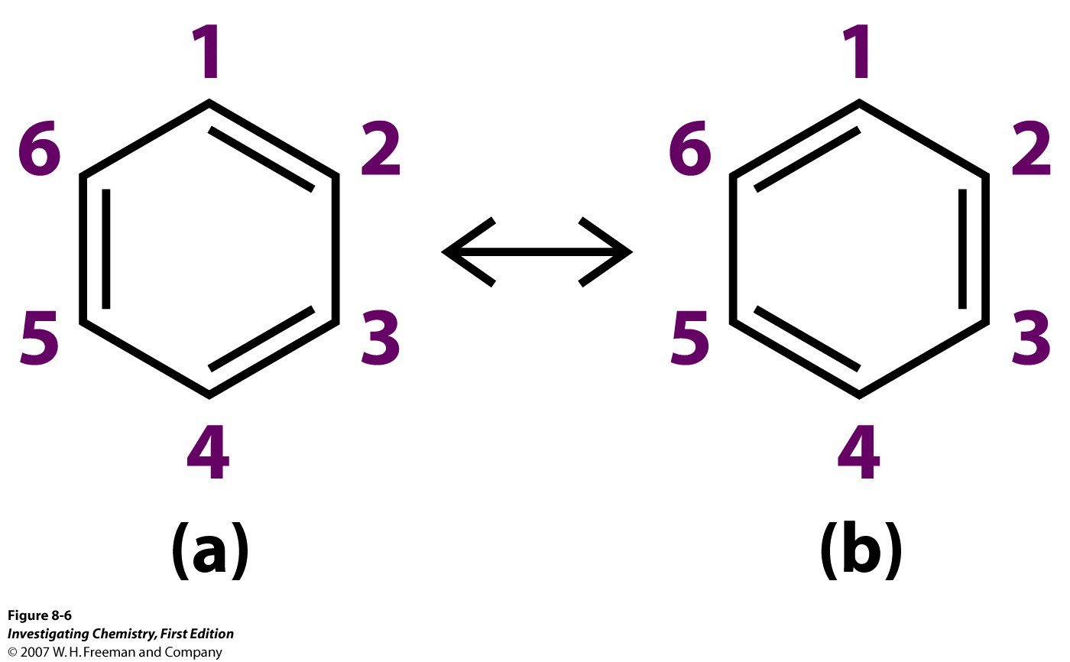
Neither of these two Lewis structures adequately explains why all the C-C bonds are equal in the actual molecule. When two or more Lewis structures can be drawn, we observe resonance, an enhanced stability.

Slide 18
Benzene, C₆H₆, is best represented by a composite of the two structures below called the resonance hybrid. It is not flipping back and forth between these two structures any more than a mule changes between a horse and donkey. A mule is a biological hybrid.

Slide 19
8.5 VSEPR THEORY and Geometry
The valence shell electron-pair repulsion theory is based on the idea that both bond pairs and lone pairs of electrons move as far apart as possible around an atom due to their like charges repelling each other.
We need to distinguish between the electronic geometry and the molecular geometry (shape of the molecule).
Question: If the central atom has a lone pair can the electronic and molecular geometries be the same?

Slide 20
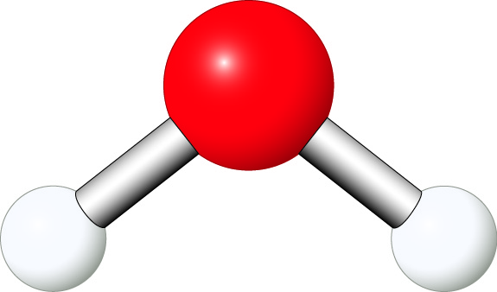
Why isn’t water a linear molecule? Drawing the Lewis structure shows us that the O atom has two bond pairs of electrons and two lone pairs. That makes the electronic geometry tetrahedral and the molecular geometry bent.

Slide 21
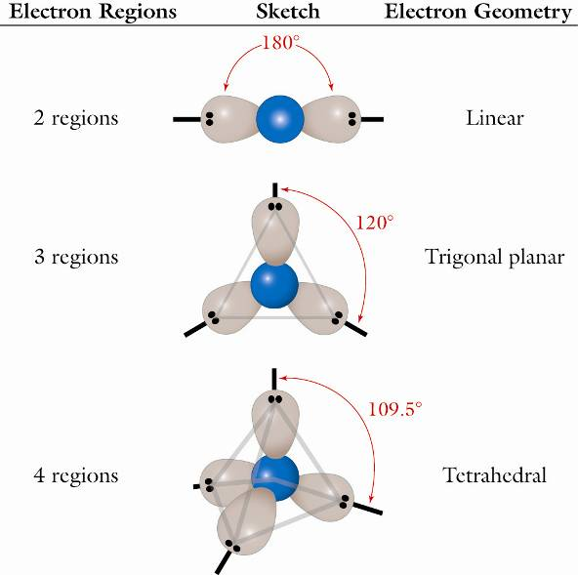
Once we determine the correct Lewis structure based on the total number of valence electrons, we can apply the VSEPR theory to predict the electron geometry, and thence the molecular geometry (if different).
Figure 5.8, pg. 149
Investigating Chemistry, 2nd Edition
© 2009 W.H. Freeman & Company

Slide 22
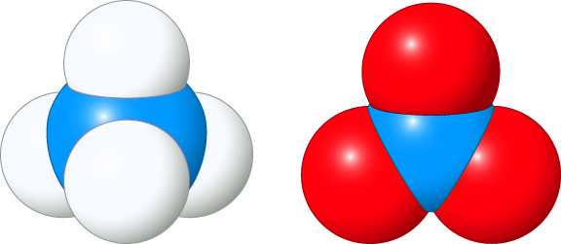
The NH₄⁺ ion, like methane, CH₄ , is tetrahedral. The NO₃⁻ ion resembles BF₃, and is trigonal planar. Ammonium nitrate, NH₄NO₃ is a fertilizer, but has been used by foreign and domestic terrorists as an explosive.
Unnumbered Figure, pg. 149
Investigating Chemistry, 2nd Edition
© 2009 W.H. Freeman & Company

Slide 23
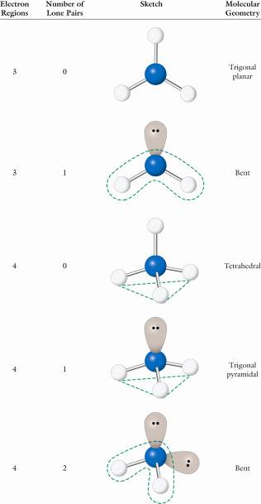
WHEN MOLECULAR GEOMETRY DIFFERS FROM ELECTRON GEOMETRY
When the central atom has no lone pairs, the two geometries coincide.
CO₂, 0=C=O, is linear since the C has no lone pairs.
SO₂ is bent since the S has a lone pair giving it three RHED’s, making its electron geometry trigonal planar.
BF₃ has trigonal planar molecular geometry, but SnCl₂ is bent. CH₄ is tetrahedral, but :NH₃ is pyramidal.

Slide 24
5.6 POLARITY OF BONDS & MOLECULES
The physical and chemical properties of any molecule are strongly affected by whether it is polar or not.
Having polar bonds depends on there being a difference in electronegativities between the bonded atoms.
The larger the difference, the greater the polarity of the bond.
When there is no difference in electronegatitivites, the bond is nonpolar. Ex: H-H, Cl-Cl or even F-F.
When there is an extreme difference (>2.0), the bond is considered “ionic” . KF, NaBr, CsI or LiCl.

Slide 25
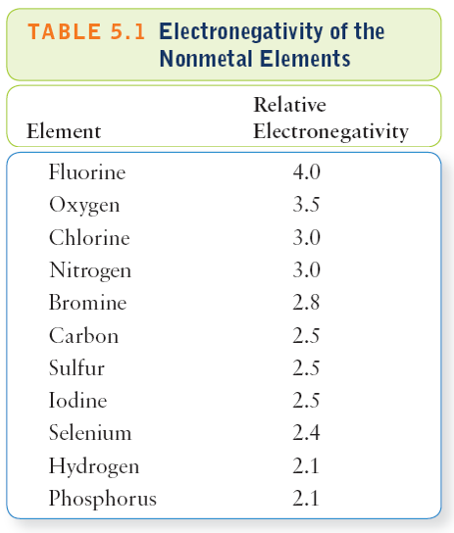
These nonmetals lie close to F on the periodic table. So they have relatively large electronegativity values.
Table 5.1, pg. 152
Investigating Chemistry, 2nd Edition
© 2009 W.H. Freeman & Company

Slide 26
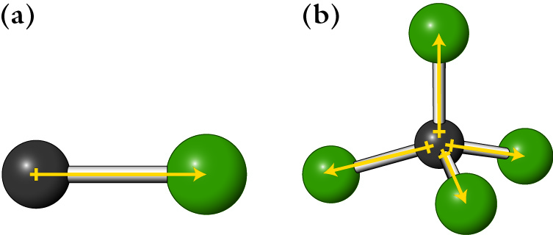
The C-Cl bond is polar, but due to its high degree of symmetry and the mutual cancellation of effects, CCl₄ is nonpolar!
Figure 5.10, pg. 153
Investigating Chemistry, 2nd Edition
© 2009 W.H. Freeman & Company

Slide 27
How can nonpolar molecules have polar covalent bonds?
Ammonia, NH₃, is a polar molecule with polar covalent bonds, but BF₃ is a nonpolar molecule with even more polar bonds.
Why is this true?
Since BF₃ is flat with no lone pairs on the B atom, the three B-F bonds cancel each other’s effects due to symmetry considerations.
With :NH₃, that can’t happen. The lone pair on N disrupts the symmetry.

Slide 28
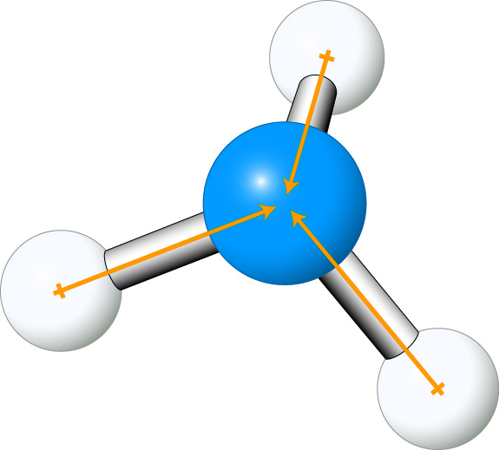
Why isn’t NH₃ flat just as BH₃ is? The Lewis structure shows a lone pair on the N atom. So it has tetrahedral electronic geometry resulting in a trigonal pyramidal molecular geometry.
Unnumbered Figure, pg. 154
Investigating Chemistry, 2nd Edition
© 2009 W.H. Freeman & Company

Slide 29
Question: As the polarity of the molecules increases, what happens to the solubility in water?
Table 5.2, pg. 154
Investigating Chemistry, 2nd Edition
© 2009 W.H. Freeman & Company

Slide 30
5.7 MOLECULAR GEOMETRY OF DRUGS
The precise shapes of both legal and illegal drug molecules helps explain how they work in the body.
In the body, proteins such as enzymes and antibodies act as a sort of key to another molecule’s lock.
These key-type molecules are so precisely designed that even the mirror image molecule (stereoisomer) will not serve as a lock that binds with them.

Slide 31
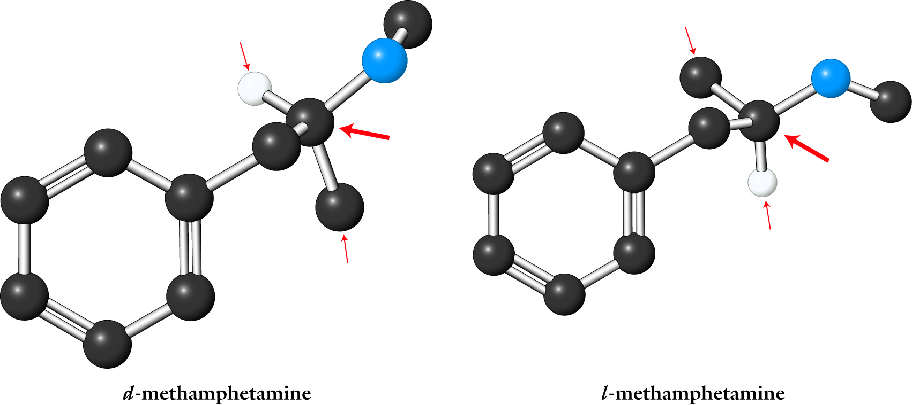
Stereoisomers have not only the same molecular formula but even the same connectivity (sequence of atoms). The only difference between them is the way the atoms are arranged in space. Only one is physiologically active.
Figure 5.11, pg. 155
Investigating Chemistry, 2nd Edition
© 2009 W.H. Freeman & Company

Slide 32
5.8 DRUG RECEPTORS & BRAIN CHEMISTRY
Certain drugs compete very successfully with the body’s neuro- transmitters in the pleasure-sensing region of the brain.
Thus they are able to block the uptake of the normal neurotransmitter molecules and produce an artificial state of euphoria as the body tries to compensate by flooding the gap between the neurons with excess neurotransmitter molecules.

Slide 33
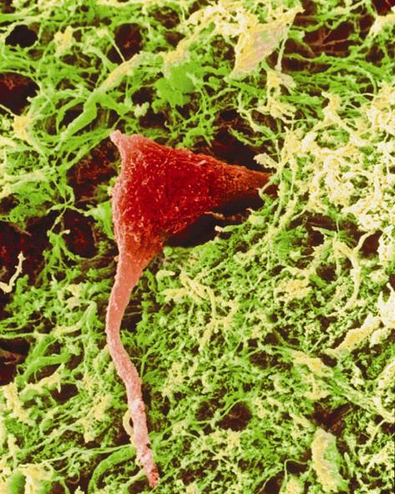
A scanning electron microscope (SEM) image of a (red) neuron or nerve cell, composed of an axon and one or more dendrites.
Unnumbered Figure, pg. 158
Investigating Chemistry, 2nd Edition
© 2009 W.H. Freeman & Company

Slide 34
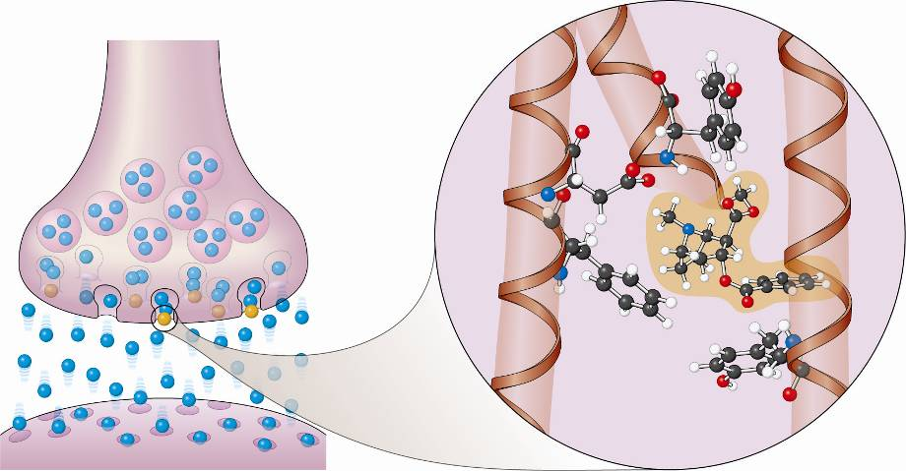
HOW A SYNAPSE WORKS The blue neurotransmitters carry an electrical signal called an action potential from one neuron to the next. Cocaine (yellow) blocks the signal causing amplification which results in damage. Because of its precise size, shape, and polarity, the cocaine molecule is able to very effectively block the normal uptake of neurotransmitters.

