Slide 1
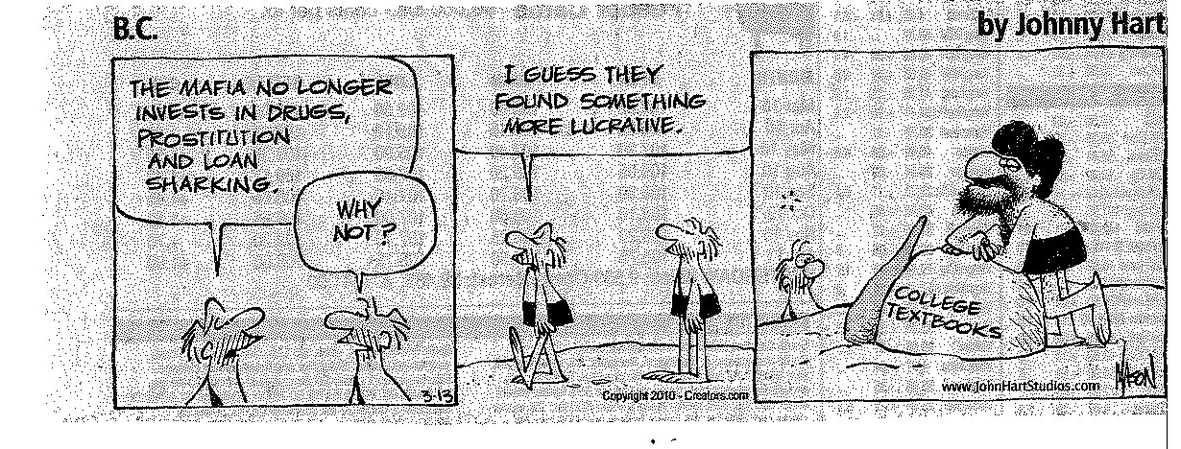

Slide 2
Welcome to the Online Learning at Winthrop Page
Winthrop University is transitioning from WebCT to Blackboard 9.1. Fall 2010 courses will still be using WebCT. Click on the link for WebCT to access WebCT courses. Beginning with the Spring 2011 semester, certain courses will be using Blackboard. Click on the link for Blackboard to access Blackboard courses. If you have any questions on which system your course is using, please check with your instructor. By Fall 2011, all courses will be using Blackboard and WebCT will no longer be available. If you have any questions regarding this transition, please feel free to email Kimarie Whetstone, Online Learning Coordinator, at whetstonek@winthrop.edu.
Old WebCT (content that hasn't been migrated to the new system) New Blackboard (content that has been migrated to the new system)

Slide 3
Welcome to WebCT August 24, 2010
Log in to myWebCT

Slide 4
Course Updates
Login to WebCT Entry Page
WebCT ID: wu_kullk
Password: ****************
Log in

