Slide 1


Slide 2
Method Parameters

Slide 3
Data acquisition parameters
Ion Mode: positive, negative
Instrument Mode: linear, reflector
Instrument range: mass range
Low mass gate: on/off, cutoff mass
Total scans: no. of laser shots averaged
Accelerating voltage: 20-25 kV
Delay time: time between laser flash and ion extraction Grid voltage: expressed as a % of Accel. Voltage
Guide wire voltage: ditto
Parameters that require optimization in linear/reflector:

Slide 4
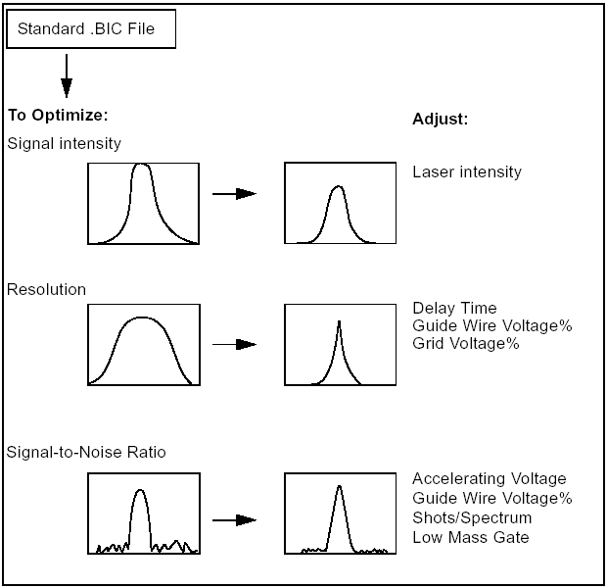
Optimization Strategy

Slide 5
Laser Power
Affects S/N and Resolution
A different power setting will be needed for 3 vs 20 Hz acquisition rate
A different setting is needed for different matrices and sample types
Excessive laser power will result in saturated peaks with poor resolution and high sample consumption

Slide 6
Bin Size
(Data Collection Interval)
Determines the time interval between subsequent acquired data points. Increasing the number of data points by sampling more frequently can increase resolution for a given mass range but also increases the size of the data file.
Baseline resolution between adjacent peaks.
Data collected at 1 ns intervals
Incomplete resolution between same peaks
Data collected at 4 ns intervals

Slide 7
Guide Wire and Accelerating voltages
Sample
plate
Reflector
Linear
Variable
voltage
Laser
Attenuator
detector
detector
grid
Reflector
Laser
Beam guide wire
Ground grid

Slide 8
Accelerating Voltage
Increasing can improve sensitivity for higher mass compounds (>25-20 kDa). Typical 20 or 25 kV.
Accelerating Voltage
Linear
Decreasing can improve resolution on compounds <2 kDa.
Increasing can improve sensitivity
Max: 25 kV
Reflector
The accelerating voltage determines the kinetic energy of the ions when they reach the detector. Efficiency of detection increases somewhat with higher ion energy.
A lower accelerating voltage provides more data points across a peak (ions move slower) for better resolution.

Slide 9
Guide wire voltage
Decreasing can improve resolution
Increasing can improve sensitivity for higher masses
Guide wire voltage %
To obtain maximum resolution in reflector mode, set the guide wire to 0%. This can then be adjusted up to 0.02%.
In linear mode <2 kDa, a setting of 0.05-0.1% is adequate.
In linear mode >20 kDa, start with 0.3% and decrease as needed.
Note: New DE STR instruments have a lens in place of the guide wire, so no adjustment is necessary.

Slide 10
Delayed Extraction
When ions are formed in MALDI they have a range of translational kinetic energies due to the ionization process. This leads to peak broadening. By forming ions in a weak electric field, then applying a high voltage extracting field only after a time delay, the effect of this energy spread can be minimized when used in conjunction with an appropriate potential gradient.
Field gradients are formed and controlled in the ionization region by the voltages applied to the sample plate and the variable voltage grid.
Ref: W.C. Wiley and I.H. McLaren, Rev. Sci. Instrum. (1953) 26, 1150-1157.

Slide 11
Extraction Voltages
Sample plate at accelerating voltage
Variable voltage at a % of the accelerating voltage
Ground grid
+20 kV
+18 kV (90%)
Potential
Gradient
to Flight Tube
Ionization Region
The variable voltage works together with the accelerating voltage to create a potential gradient in the ionization region near the target. It and the delay time must be adjusted to obtain optimum resolution for a given mass range.
Notes:
The 4700 software automatically adjusts the gradient and delay time based on the desired Focus Mass

Slide 12
Pulse Delay Time with Delayed Extraction Technology
Accelerating Voltage
Laser pulse
kV
Variable Voltage
time
Extraction delay time (25-1000 ns)

Slide 13
Ion Extraction
The problem: Peaks are broad in MALDI-TOF spectra with continuous extraction (=poor resolution).
The cause: Ions of the same mass coming from the target have different Kinetic Energy (velocity) due to the ionization process.
Sample+matrix on target
+
Ions of same mass but different velocities (KE)
+
+

Slide 14
Ion Extraction
The result: Ions of the same mass extracted immediately out of the source with a uniform accelerating voltage will have a broad spread of arrival times at the detector resulting in a broad peak with poor resolution.
Detector
+
+
+

Slide 15
Delayed Extraction (DE)
The solution: Delayed Extraction (DE)
Ions are allowed to spread out away from the plate during an appropriate time delay prior to applying the accelerating voltage
+
Ions of same mass but different velocities (KE)
+
+
The position of an ion in the source after the pulse delay will be correlated with its initial velocity or kinetic energy

Slide 16
Velocity Focusing with DE
Ions of same mass, different velocities
0 V
+
Detector
+
+
1: No electric field. Ions spread out during delay time.
+
+20 kV
+
+
+18 kV
2: Field applied. Gradient accelerates slow ions more than fast ones.
+
0 V
+
+
3: Slow ions catch up with faster ones at the detector.
Sample Plate
Variable Voltage Grid
Notes:
This is known as Velocity Focusing

Slide 17

Delayed Extraction:
Resolution Improvements circa 1996
Linear mode
Reflector mode
delayed
extraction
R=1,100
continuous
extraction
R=125
delayed
extraction
R=11,000
continuous
extraction
R=650
10600
10800
11000
11200
11400
11600
6130
6140
6150
6160
6170
m/z
m/z
Sample: mixed base DNA 36-mer
Sample: mixed base DNA 20-mer

Slide 18
Optimizing grid voltage % and delay time
Grid Voltage % and Delay time are interactive parameters.
For each grid voltage % there is an optimal delay time.
The general trends are shown in the table above.
Increments of 0.3% in grid % or 50 ns in delay may give significantly different performance.

Slide 19
Typical curves of optimum delay time as
a function of grid voltage in linear mode
2000
600
5000
15000
25000
m/z=50000
400
Pulse Delay (ns)
200
1000
0
87
88
89
90
91
92
93
94
95
96
Grid Voltage (%)

Slide 20
Voyager DE/RP/PRO/STR Delay Time and Grid Voltage %

Slide 21
Optimizing a Delayed Extraction Method
1. Start with a standard method on a known sample.
2. Find an adequate laser setting that gives good peak intensity without saturation.
3. Set the guide wire voltage for best sensitivity (peak intensity and/or S/N). Use lowest practical guide setting.
4. Optimize the grid voltage or the delay time, leaving the other unchanged. These parameters are interactive, so each must be optimized separately. Optimize for highest resolution.
5. Recheck 3-4, see if you get same results.

Slide 22
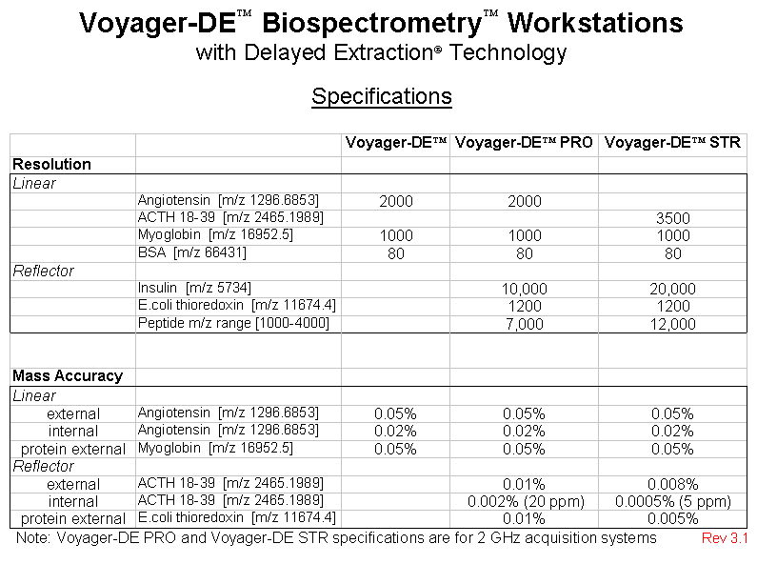

Slide 23
Calibration
Voyager Training Class

Slide 24
Calibration Equations
T = t_{o} + A √m/z + ( higher order terms)
Where
t_{o} = difference in time between the start of analysis and the time of ion extraction.
A = effective length (mm) m_{o}
Where m_{o} = 1 dalton mass in SI units
e = charge of electron in SI units
Effective length = length of flight tube corrected for ion acceleration
x
X 10 ⁹
√ Accelerating Voltage (kV)
e

Slide 25
Initial Velocity Correction
Initial velocity is the average speed at which matrix ions desorb.
The initial velocity (m/s) has been calculated for different matrices. The calibration equation can be corrected for matrix initial velocity (one of the higher order terms).
Externally calibrated samples must be in the same matrix as their calibrant.
CHCA 300 m/s
Sinapinic acid 350 m/s
DHB 500 m/s
3-HPA 550 m/s
Ref:Juhasz,P.,M.Vestal, and S.A.Martin. J.Am.Soc.Mass Spectrom.,1997,8,209-217

Slide 26
Calibration Equations
A default calibration uses a multiparameter equation that estimates values for t_{º} and A from instrument dimensions.
Default calibration is applied to the mass scale if no other calibration is specified.

Slide 27
Calibration Equations
Internal calibration uses a multiparameter equation that calculates values for t_{º} and A using the known mass of the standard(s). This corrects the mass scale.
A multi-point calibration calculates t_{º} and A by doing a least-squares fit to all of the standards.
A two point calibration calculates t_{º} and A from the standards. A one point calibration calculates A from the standard and uses t_{º} from the default calibration.

Slide 28
Internal Calibration
A one-, two- or multi-point calibration using known peak masses that are within the spectrum to be calibrated.
The standards should bracket the mass range of interest. The signal intensities of the standards should be similar to those of the samples.
The calibration equation is saved within the data file and can be exported as a *.cal file to the acquisition method or to another data file.

Slide 29
Useful Calibration Standards
Sequazyme Mass Standards Kit: P2-3143-00
Sequazyme BSA Test Standard: 2-2158-00
Voyager IgG1 Mass Standard: GEN 602151
Other useful high mass calibrants:
Cytochrome C: 12,231
Bovine Trypsin: 23,291
Carbonic Anhydrase: 29,024
Bakers Yeast Enolase: 46,672

Slide 30
Two point Internal Calibration
15000
1821.9344
1412.8272
1875.9875
10000
1789.8437
1840.928
1
1068.6892
5000
807.438
3
893.5128
1627.9507
1948.0391
2471.2187
2583.3076
756.4732
2124.0419
2441.1330
3490.7970
944.4889
1471.7961
2039.1459
2349.1390
2973.4467
3178.6034
3187.7327
0
1000
2000
3000
MALDI TOF mass spectrum of the
tryptic
digest of yeast
enolase
(in
α
-
cyano
-4-
hydroxy cinnamic
acid matrix) acquired in reflector mode. Peaks at m/z 756.47 and
3187.73 were used as internal
calibrants
.

Slide 31
High Mass Accuracy Achieved with a Two Point Internal Calibration
Enolase
AVSKVYARSVYDSRGNPTVEVELTTEKGVFRSIVPSGASTGVHEALEMR
D
GDKSKWMGKGVLHAVKNVNDVIAPAFVK
ANIDVKDQKAVDDFLISLDGTANKSKLGANAILGVSLAASR
AAAAEKNVPLYKHLADL
SKSKTSPYVLPVPFLNVLNGGS
HAGGALALQEFMIAPTGAKTFAEALRIGSEVYHNLKSLTKKRYGASAGNVGDEGGVAPNIQTAEEALDLIVDAIKAAGHD
GKV
KIGLDCASSEFFKDGKYDLDFKNPNSDKSKWLTGPQLADLYHSLMKRYPIVSIEDPFAEDDWEAWSHFFKTAGIQIV
ADDLTVTNPKRIATAIEK
KAADALLLKVNQIGTLSESIKAAQDSFAAGWGVMVSHRSGETEDTFIADLVVGLRTGQIKTG
APARSERLAKLNQLLRIEEELGDNAVFAGENFHHGDKL
m/z
MH+
Delta(
ppm
)
Start/end
Peptide Sequence
756.4732
756.4732
0.0028
415-420
(K)LNQLLR(I)
807.4382
807.4365
2.1327
180-187
(K)TFAEALR(I)
893.5131
893.5209
-8.7031
1-8
(-)AVSKVYAR(S)
944.4884
944.4914
-3.1415
403-411
(K)TGAPARSER(L)
1068.6889
1068.6893
-0.4105
412-420
(R)LAKLNQLLR(I)
1412.8272
1412.8225
3.2999
106-120
(K)LGANAILGVSLAASR(A)
1471.8047
1471.7981
4.4748
398-411
(R)TGQIKTGAPARSER(L)
1627.9507
1627.9495
0.7191
104-120
(K)SKLGANAILGVSLAASR(A)
1789.8439
1789.8444
-0.2862
363-380
(K)AAQDSFAAGWGVMVSHR(S)
1821.9345
1821.9234
6.0739
381-397
(R)SGETEDTFIADLVVGLR(T)
1840.9284
1840.9227
3.0842
32-49
(R)SIVPSGASTGVHEALEMR(D)
1875.9879
1875.9816
3.3490
15-31
(R)GNPTVEVELTTEKGVFR(S)
1948.0390
1948.0292
5.0121
180-197
(K)TFAEALRIGSEVYHNLK(S)
2039.1460
2039.1290
8.3612
121-140
(R)AAAAEKNVPLYKHLADLSK(S)
2124.0417
2124.0461
-2.0566
9-27
(R)SVYDSRGNPTVEVELTTEK(G)
2441.1344
2441.1373
-1.2055
421-444
(R)IEEELGDNAVFAGENFHHGDKL(-)
2471.1987
2471.2200
-8.6300
32-55
(R)SIVPSGASTGVHEALEMRDGDKSK(W)
2583.3073
2583.3055
0.7080
9-31
(R)SVYDSRGNPTVEVELTTEKGVFR(S)
2973.4477
2973.4563
-2.8758
32-59
(R)SIVPSGASTGVHEALEMRDGDKSKWMGK(G)
3178.6048
3178.5922
3.9794
415-444
(K)LNQLLRIEEELGDNAVFAGENFHHGDKL(-)
3187.7327
3187.7327
0.0103
89-120
(K)AVDDFLISLDGTANKSKLGANAILGVSLAASR(A)
3490.8160
3190.8083
2.2081
412-444
(R)LAKLNQLLRIEEELGDNAVFAGENFHHGDKL(-)
Fig. 2
Summary of
enolase
peptides identified by MALDI TOF. Upper : expected sequence with confirmed
sequences underlined. Lower : detailed mass data for matched peptides.

Slide 32
External Calibration
Calibration from one standard applied to another nearby sample. The closer the standard is to the sample spot, the better the calibration, but not as good as internal calibration.
Central External Standard
Close External Standard
Sample wells

Slide 33
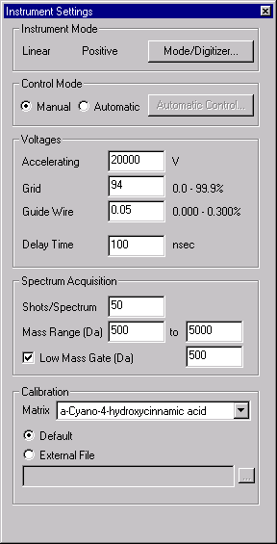
Using an external calibration file in the ICP
If you specify an external calibration file in the ICP, all data files will have that calibration applied automatically as they are acquired
Specify the External Calibration file here

Slide 34
Voyager
Instrument Control Panel
Voyager Training Class

Slide 35
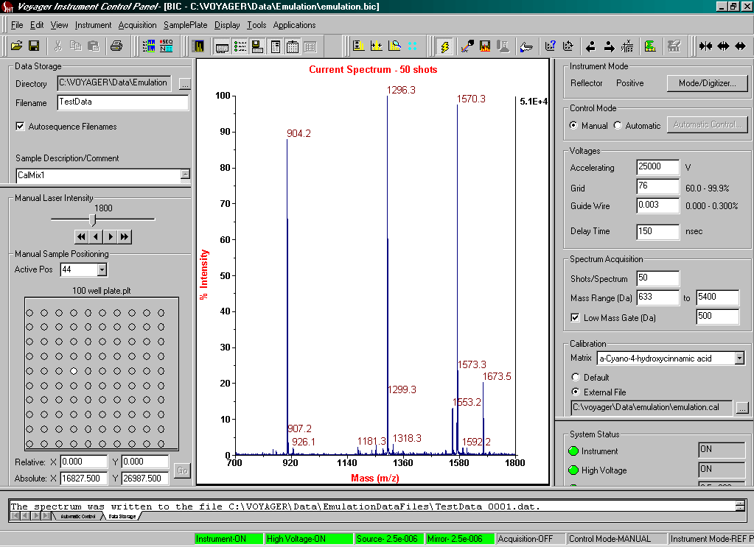
Elements of the Control Panel
Toolbar
Spectrum view
Instrument Mode
Data storage
page
Control Mode
Instrument
settings page
Laser Step Control
Calibration file
Sample plate
page
Instrument
status page
Output
window
Status bar

Slide 36
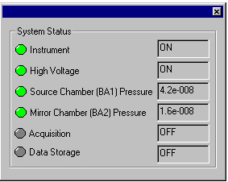
System Status Display
Status Window
Status Bar
Green = OK/ON
Yellow = Fault
Gray = Off

Slide 37
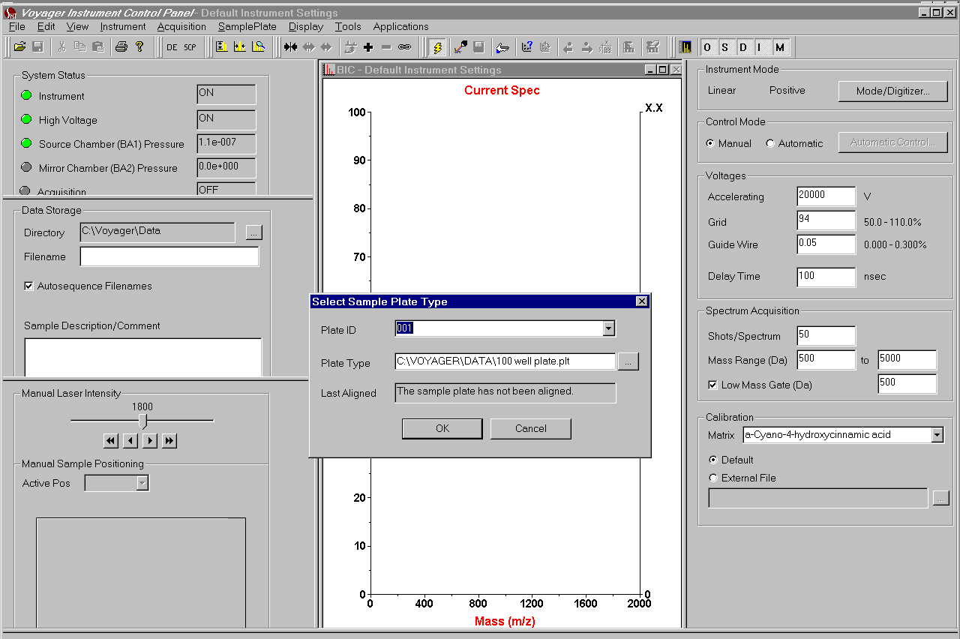
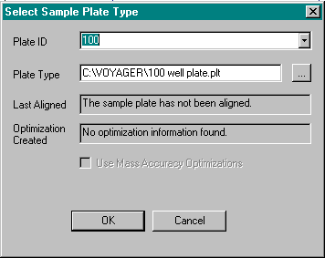
Selecting the Sample Plate Type

Slide 38
Selecting the sample plate type
Select the plate ID, or input a new name
Select the *.plt file
Date when (if) a plate optimization file was created
Date when (if) the plate was last aligned

Slide 39
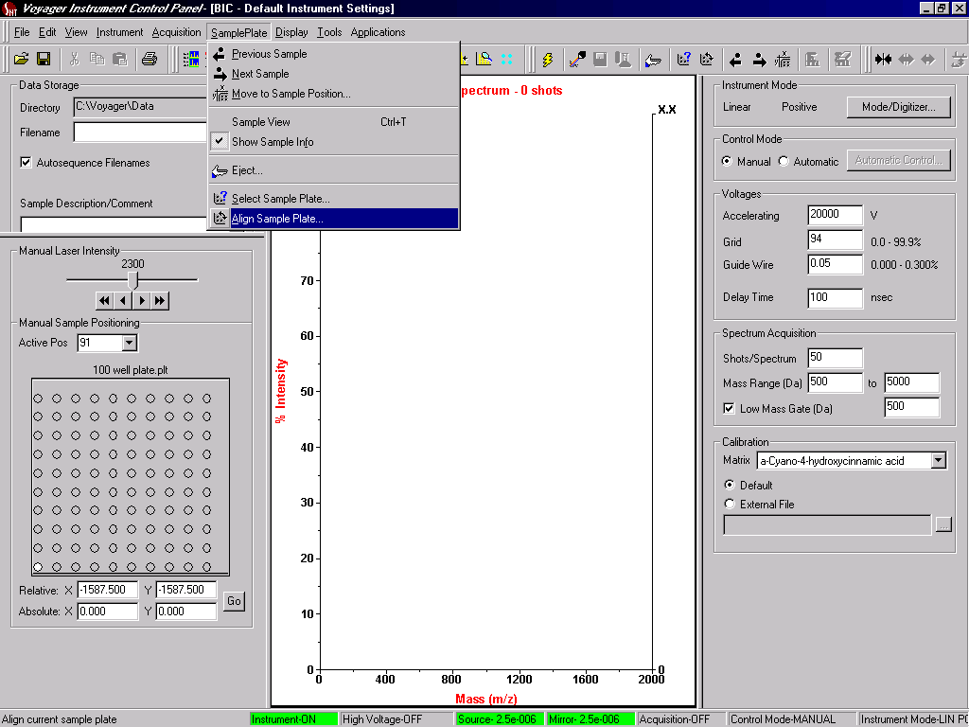
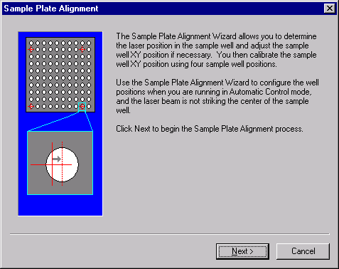
Sample Plate Alignment

Slide 40
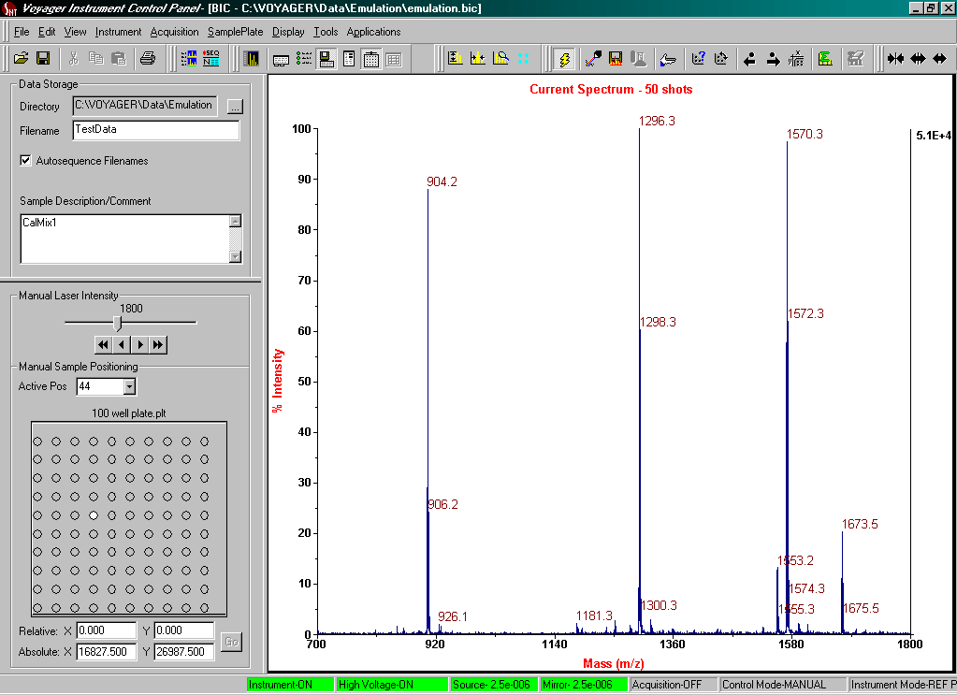
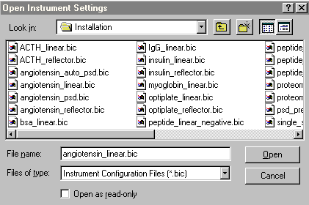
Simple Acquisition
Step 1: Open acquisition method
Step 2: Specify data file name
Step 3: Move to sample position
Step 4: Acquire/view data

Slide 41
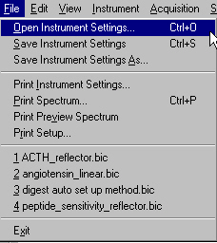
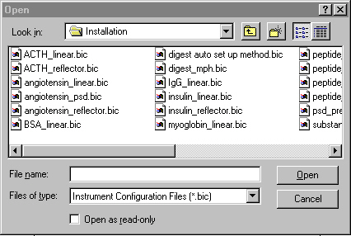
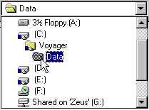
Opening Instrument Setting
(Method Files)*.BIC

Slide 42
Standard Linear Methods
Angiotensin_linear.bic 500-2500
ACTH_linear.bic 500-5,000
Insulin_linear.bic 1000-10,000
Myoglobin_linear.bic 1,000-25,000
BSA_linear.bic 2,000-100,000
IgG_linear.bic 10,000-200,000

Slide 43
Standard Reflector Methods
Angiotensin_reflector.bic 500-2,500
ACTH _reflector.bic 1,000-4,000
Insulin _reflector.bic 2,500-7,000
Thioredoxin _reflector.bic 1,000-15,000
psd_precursor.bic variable
Angiotensin_psd.bic 1,296.7
Angiotensin_auto psd.bic 1,296.7

Slide 44
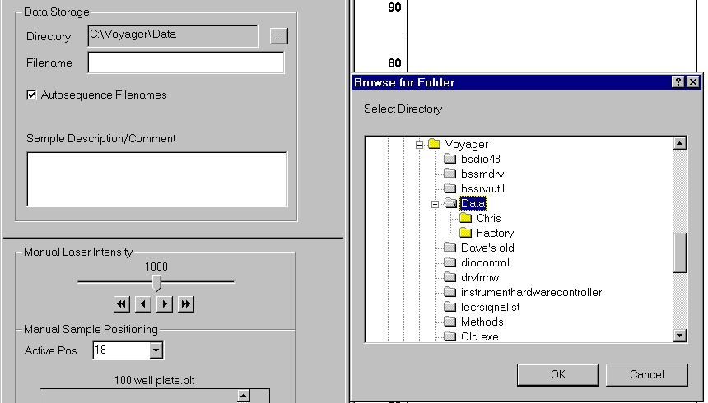
Data storage
Specify data directory here or create a new directory under the File menu
Enter a Root filename
Enter a sample description

Slide 45
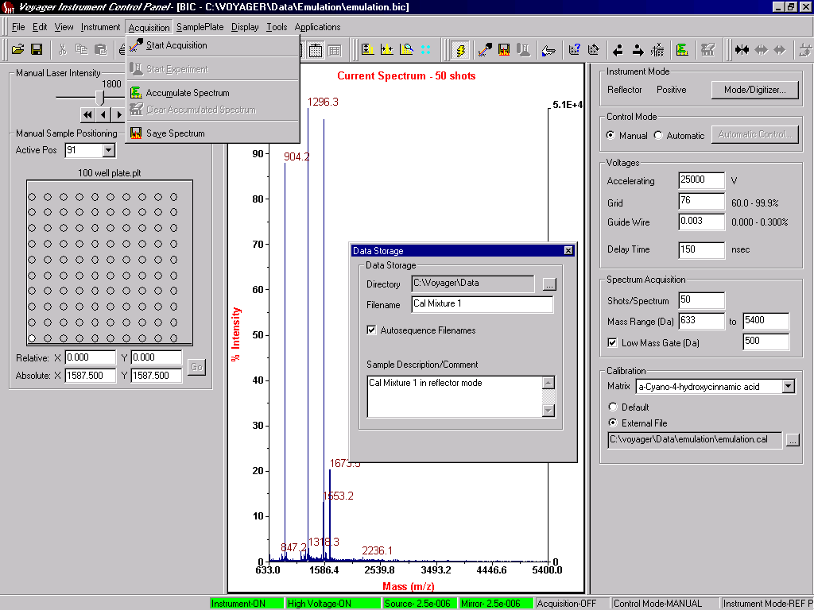
To save Data

Slide 46
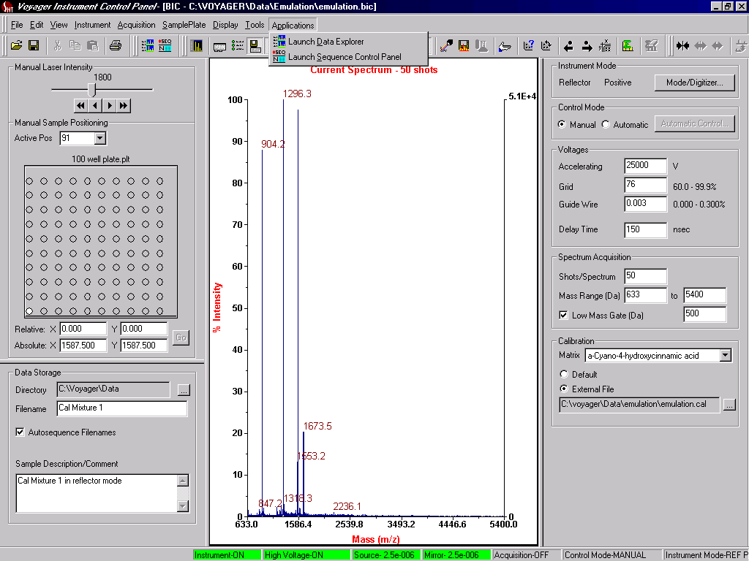
To go to Data Explorer and open the Saved Data File

Slide 47
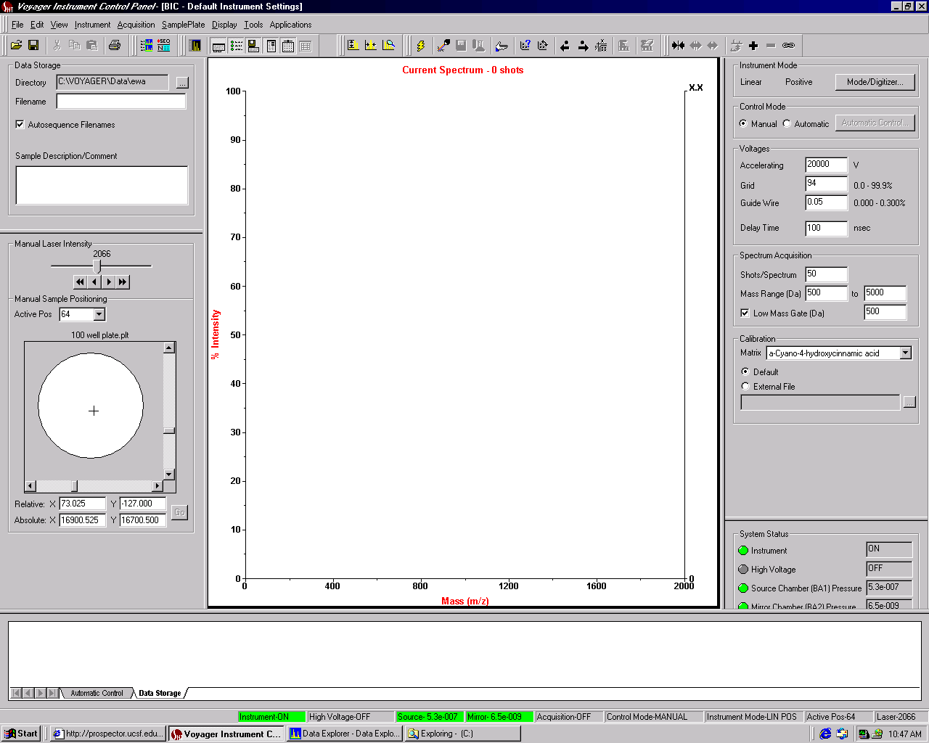
Sample position control
Laser power
setting
Right mouse click toggles between normal and expanded views

Slide 48
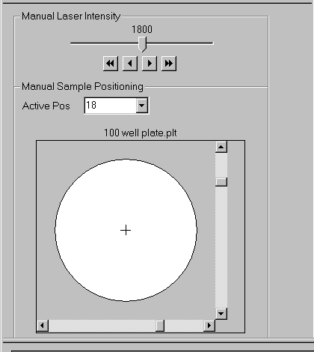
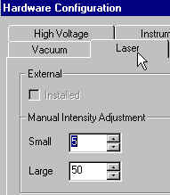
Sample View (con’t)
Laser Intensity Controls
Slider laser control
Instrument
Coarse laser control
Fine laser control
Point and Click with the mouse to move to new x,y coordinates or use Joystick
Fine and Coarse step sizes are set up in Hardware Config. / Laser

Slide 49

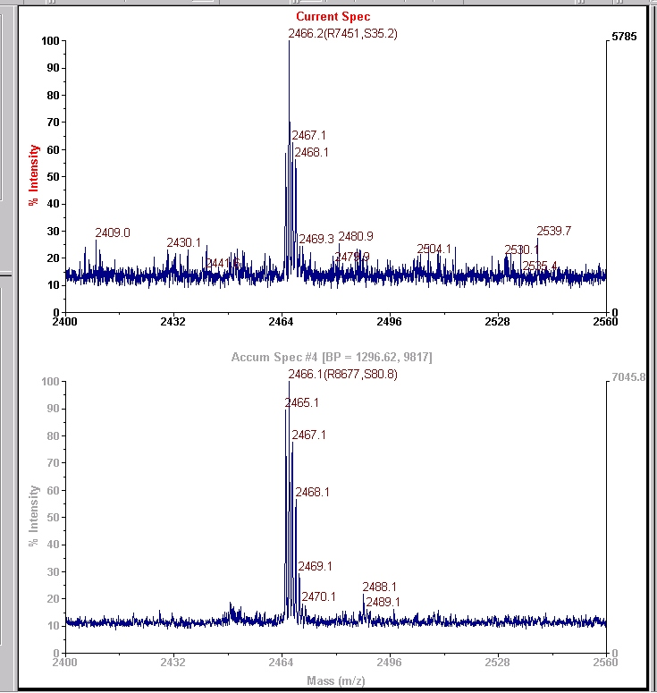
Spectrum Accumulation in Manual Mode
Q: When to use?
A: When the user cannot afford “bad” scans
Step 1: Acquire “a few” laser shots
Step 2: Inspect Current Spectrum
Step 3: Optionally use the calculators
Step 4: If spectrum is satisfactory
add to the accumulation
buffer.

Slide 50
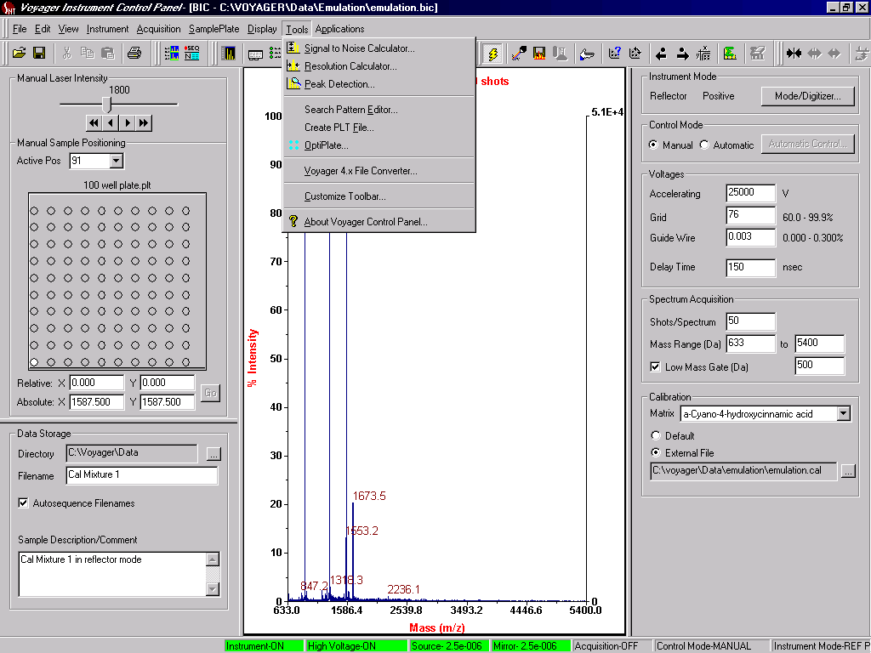
Resolution and Signal to Noise Calculators

Slide 51
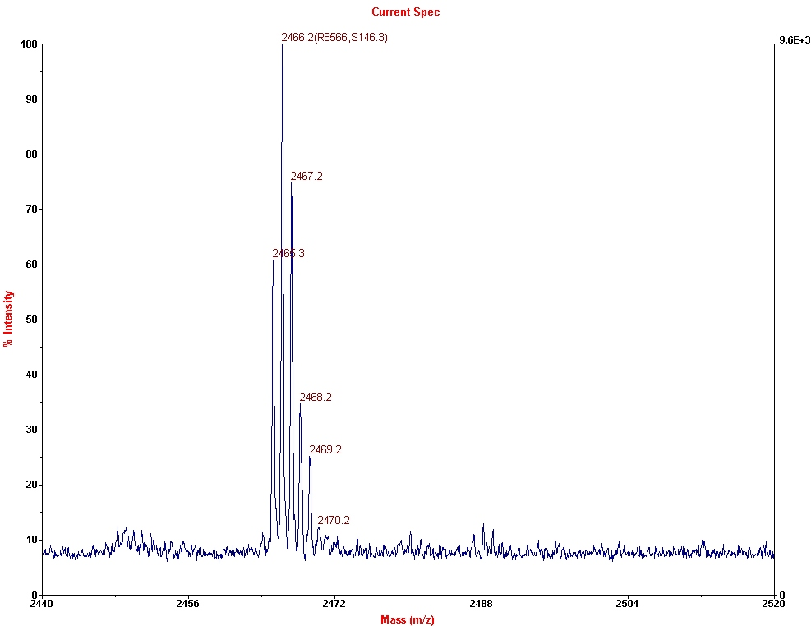
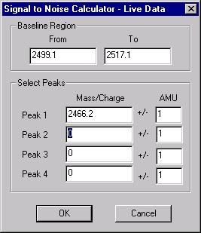
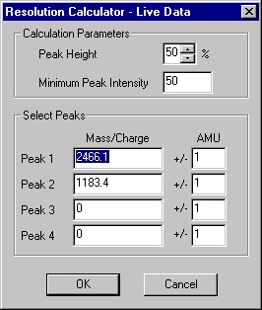
Resolution and S/N calculators during acquisition
Tools
Tools
2466.2 (R8566, S146.3)

Slide 52
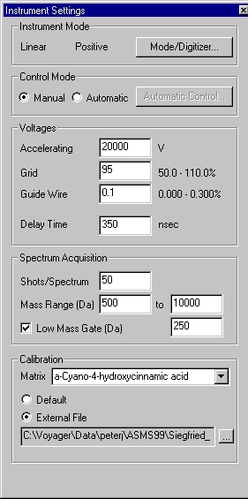
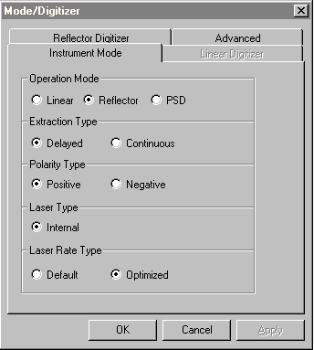
Instrument Settings / Mode
Instrument Modes
Acquisition control mode
Instrument
mode tab
Digitizer
tabs
TIS / Reflector
Tune Ratio
Voltage settings
Mass range settings
Calibration mode

Slide 53
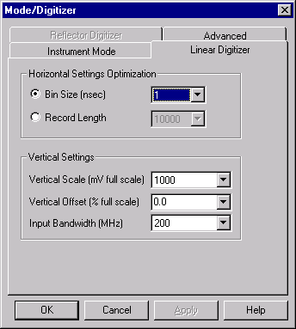
Mode / Digitizer Setup

Slide 54
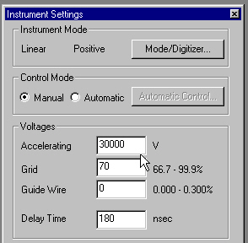
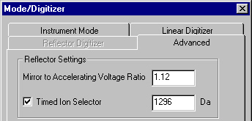
Advanced Tab from Instrument Setting

Slide 55
Standard Voyager Acquisition Methods
The following pages contain details of the standard methods (*.bic files) for Voyager DE, DE-PRO and DE-STR. These files are usually found in the C drive of the Voyager computer in Voyager/Data/Installation. The instrument settings shown in these tables are only starting points and may be different than the actual settings required to achieve a given specification. The Grid
Voltage % and Guide Wire % settings are the most critical for method optimization.
The settings required to optimize any method varies from one instrument to the next, thus a .bic file copied from another instrument will not necessarily work well on yours without additional fine-tuning.
Keep at least one copy of your optimized .bic files in a write-protected folder. Create a working copy of these files for daily use.

