Slide 1
Winthrop Chemistry Freshman Orientation
Welcome to Winthrop!
Please have the survey that I emailed you completed and emailed back to me by the end of the day TODAY
This survey will be used to assign you an academic advisor
Three rules:
Nothing is permanent
Stay calm, refer to Rule 1
Your college career is YOUR college career.
Whatever you get out of the coming experience will depend upon what you put in

Slide 2
Winthrop Freshman Orientation
The chemistry degree is the hardest degree to earn on campus, but all of the effort you put in will pay off with better opportunities at jobs, graduate/medical/pharmacy schools
You will have to work hard for this degree
You will fail some tests and quizzes, but remember the first to rules and everything will be OK
Failing is not bad if you take the opportunity to learn from the experience
Faculty are here to help, but we are not psychic.
If you have a problem, you must speak with us (see the third rule)

Slide 3
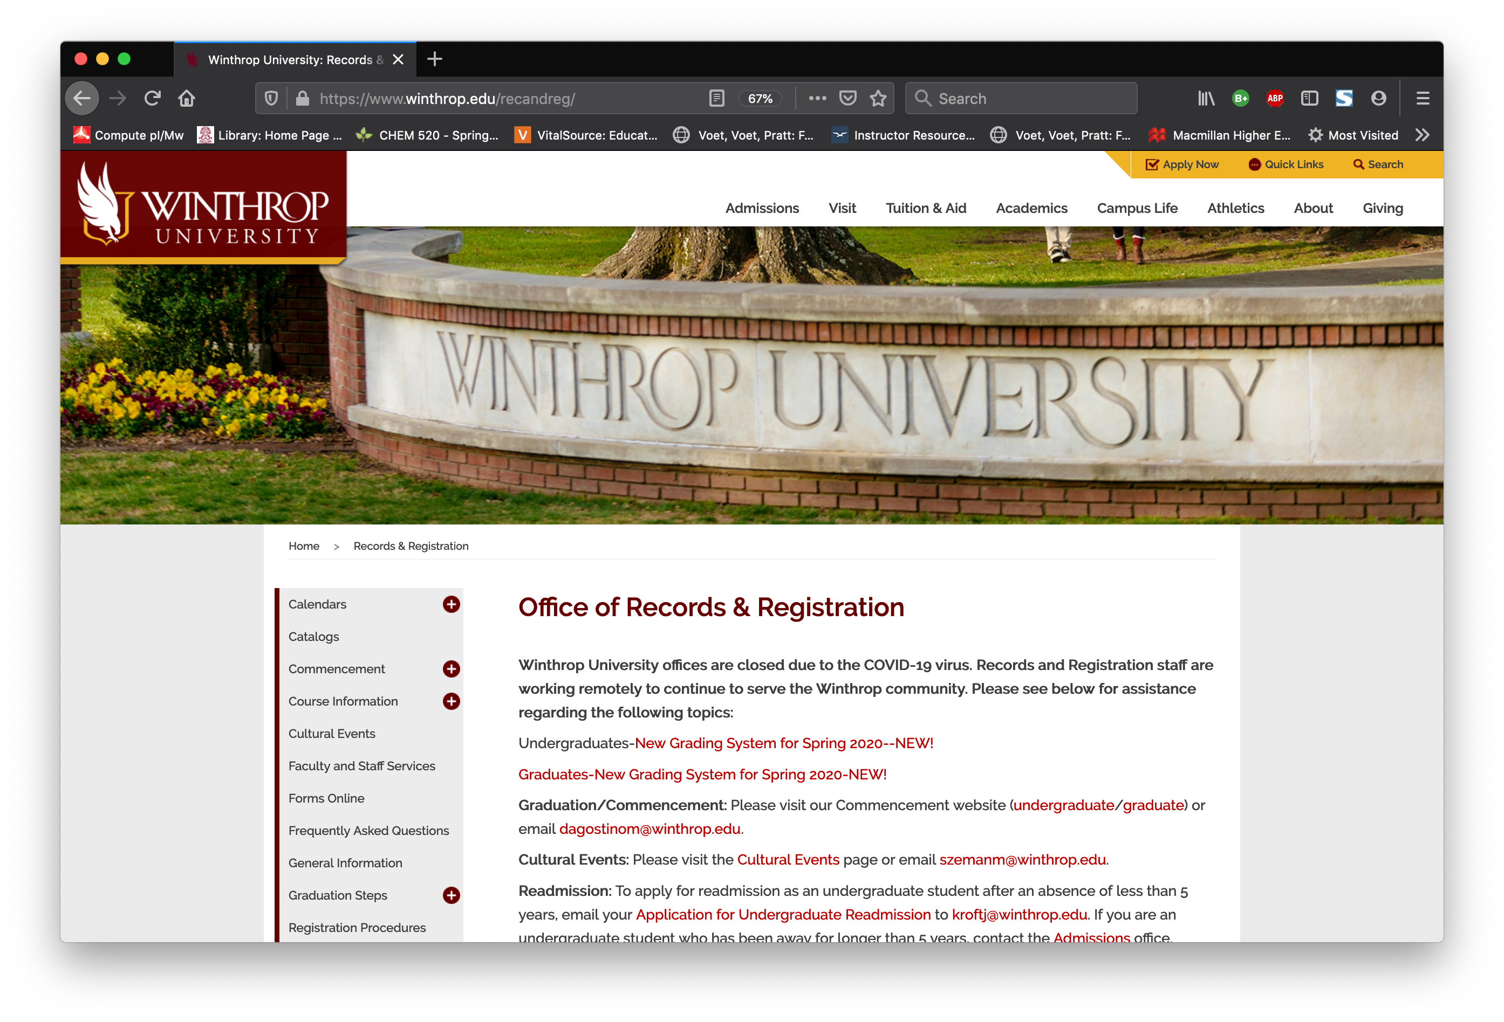
Winthrop University Important Websites
First website you should know is the Office of Records and Registration website:
www.winthrop.edu/recandreg
This website has a lot of information you will refer to throughout your career

Slide 4
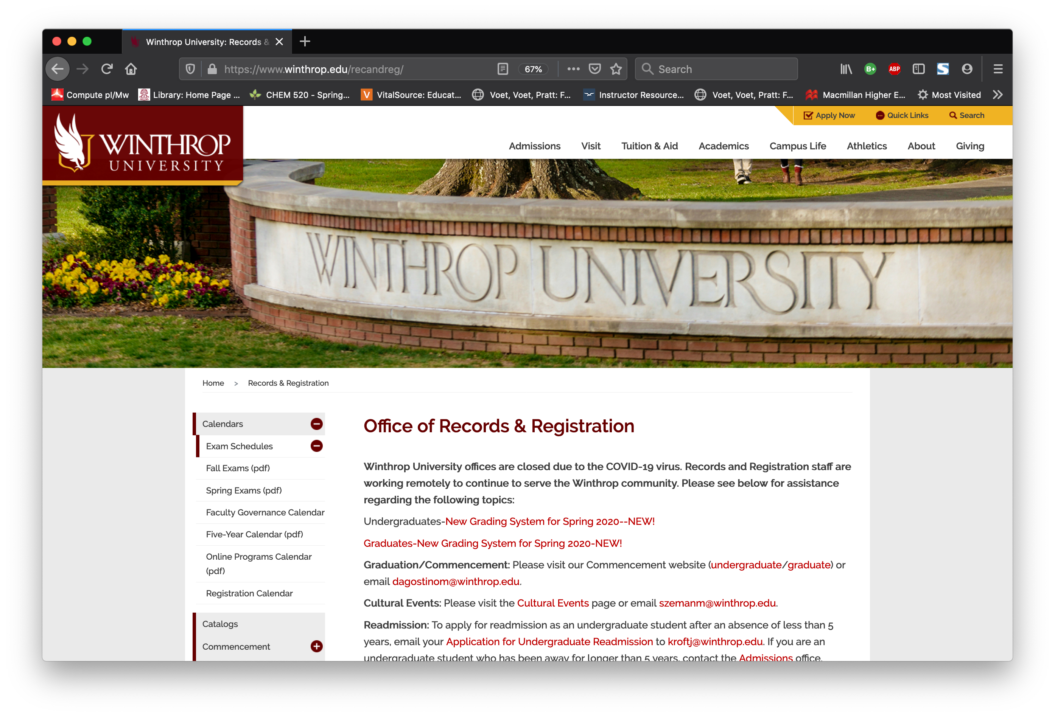
Winthrop University Important Websites
The academic and final exam calendars are found on the “Calendars” link

Slide 5
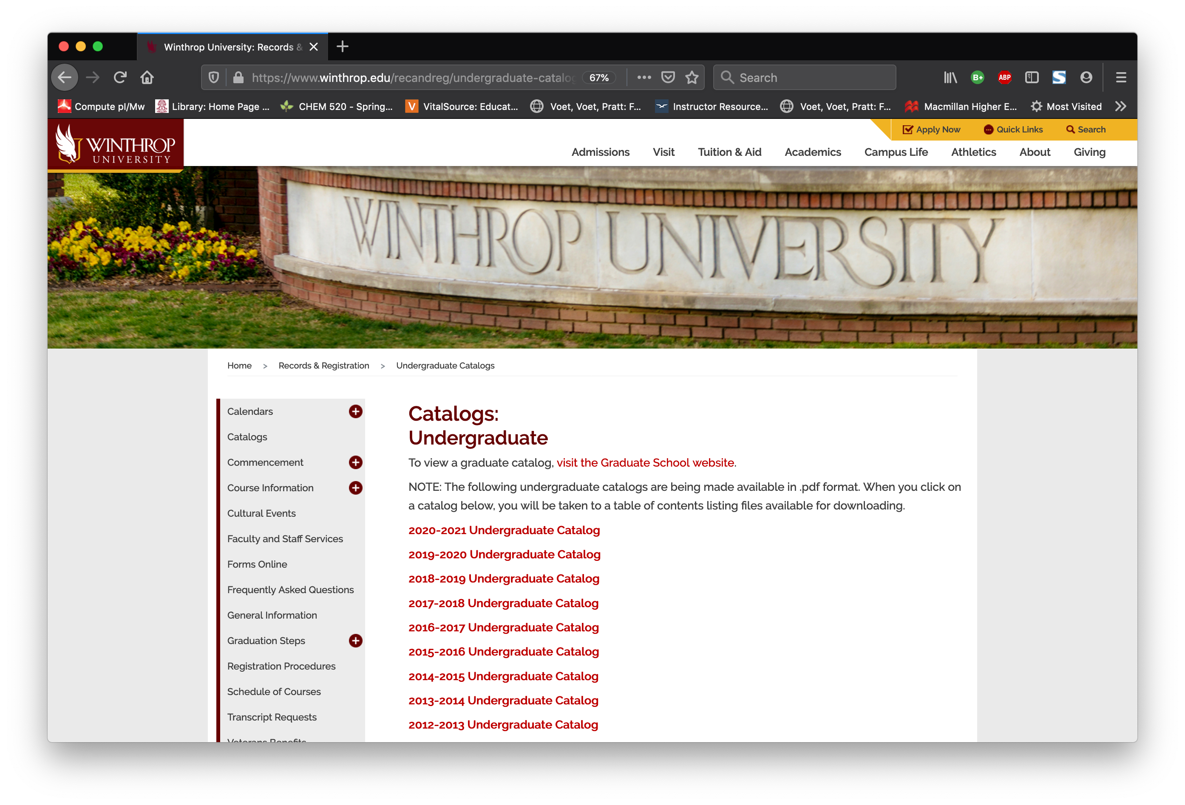
Winthrop University Important Websites
Online catalogs are in the “Catalogs” link
These are the rules you are bound by with respect to classes you need to take and the number of courses you must take to earn your degree

Slide 6
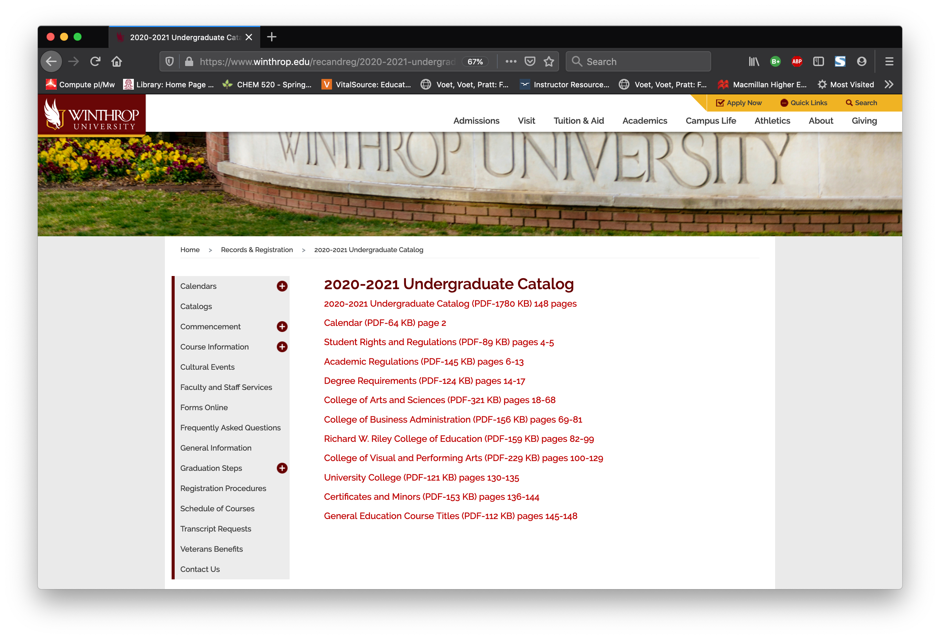
Winthrop University Important Websites
Online catalogs are in the “Catalogs” link
Click on the 2020-21 Undergraduate Catalog Link
We want to bookmark the “Degree Requirements” link and will refer to it in a moment

Slide 7
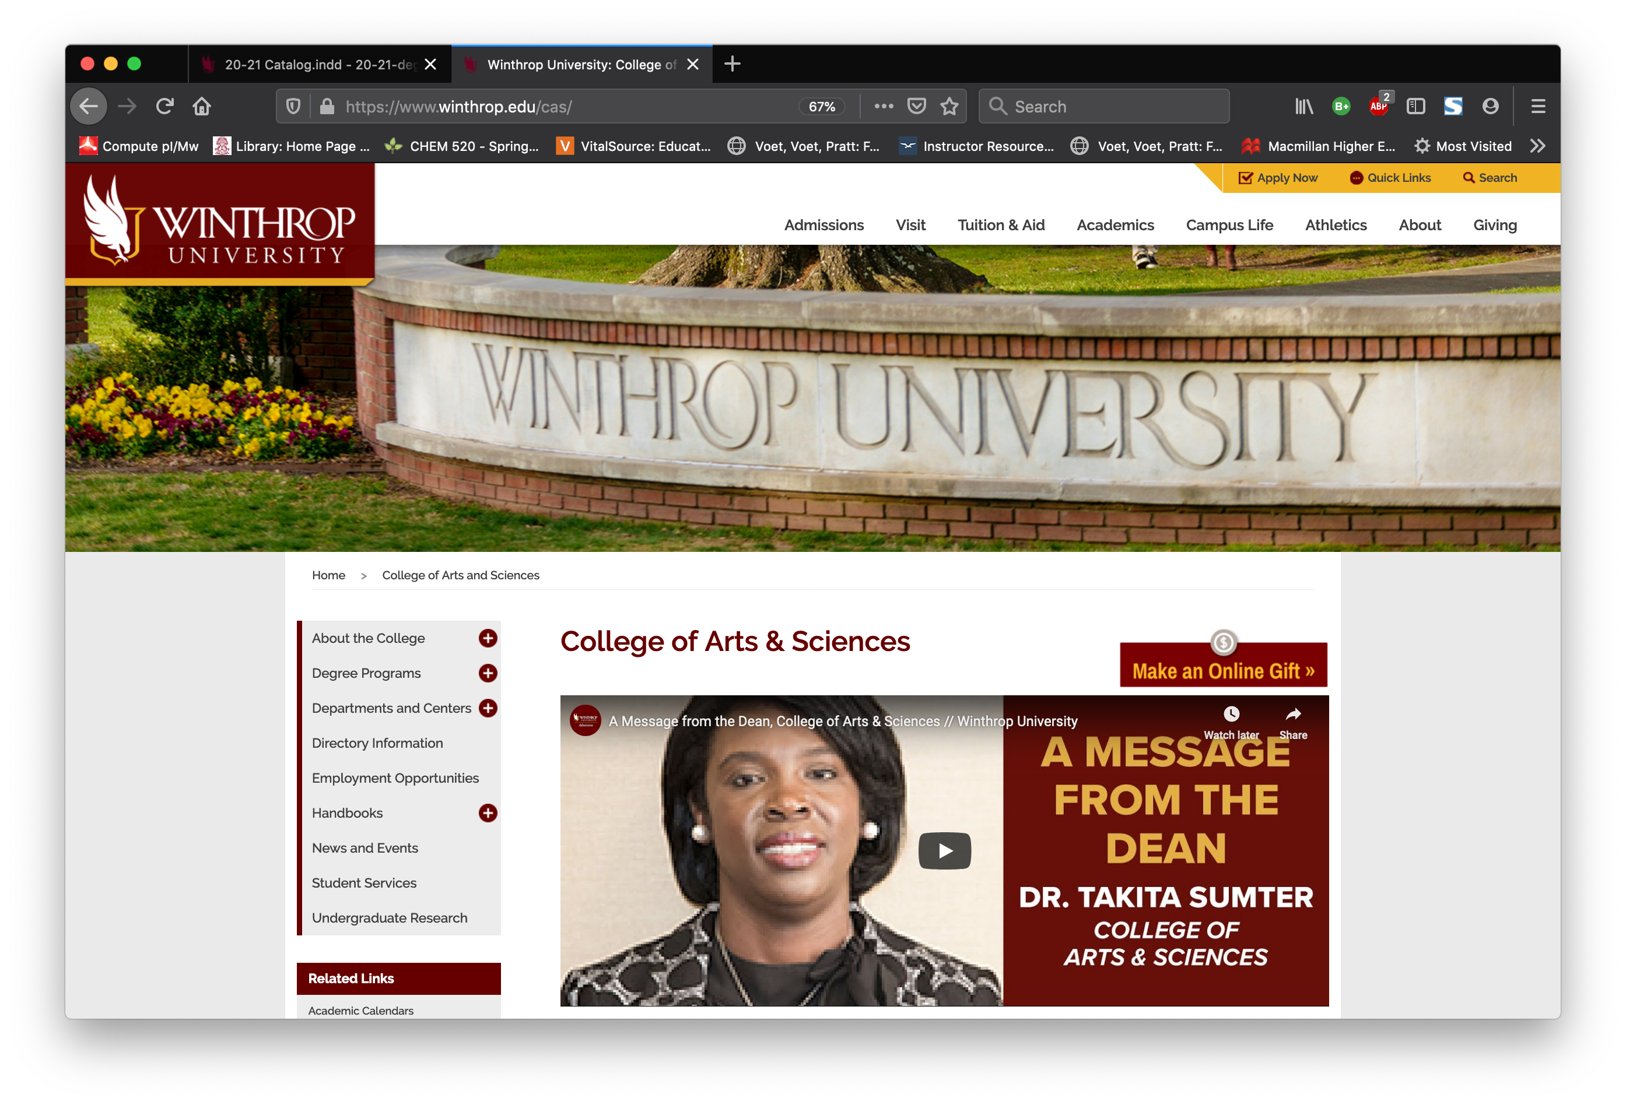
Winthrop University Important Websites
The next website is the website for the College of Arts and Sciences
www.winthrop.edu/cas
We want to look at the Degree Programs link, then look at the ”Degree Checklists”

Slide 8
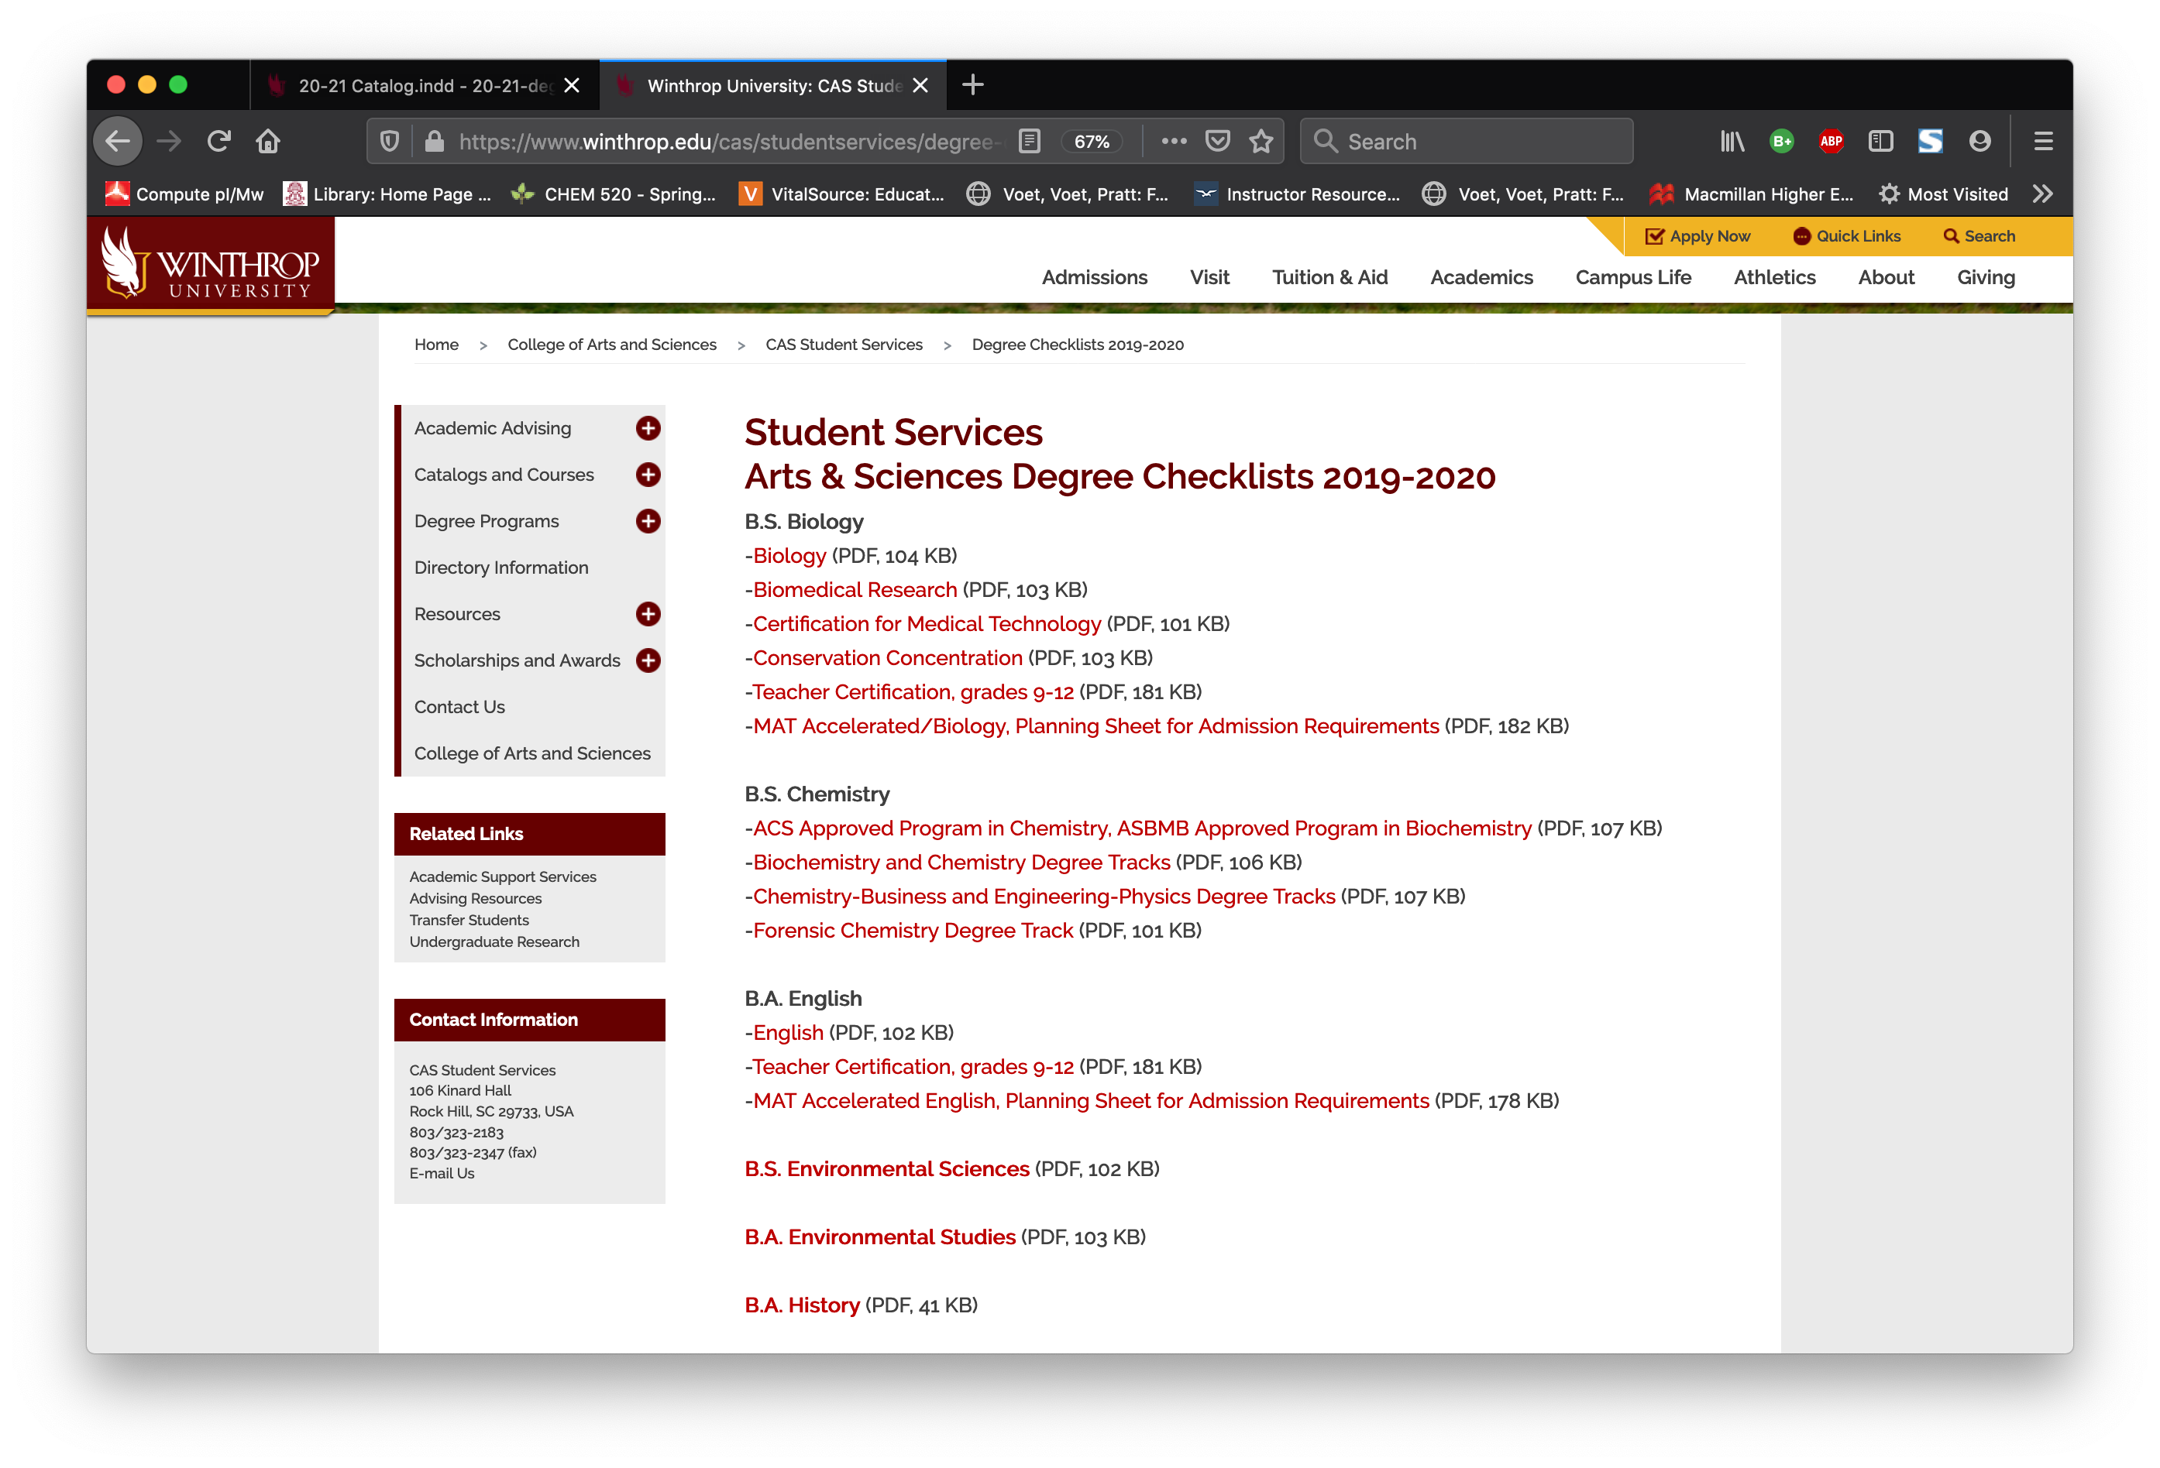
Winthrop University Important Websites
The Chemistry department has a lot of degree tracks, depending on your career goals.
The key differences between the tracks only really matter during your junior and senior years, all chemistry majors take the same initial set of classes

Slide 9
What’s the difference between degree tracks?
ACS Approved and ASBMB-certified degrees are back by two leading professional societies: American Chemical Society and the American Society of Biochemistry and Molecular Biology
This means that your degree was as rigorous as an ACS-certified or ASBMB-certified degree from Clemson or Harvard

Slide 10
Winthrop University Important Websites
Let’s use the Biochemistry and Chemistry Degree tracks as a general example

Slide 11
On the left side of the PDF sheet are your General Education classes
Everyone in every degree program at Winthrop has to take these courses

Slide 12
The courses that can be taken to fill out each slot in the General Education section can be found in the Catalog link we looked at earlier

Slide 13
Courses from the list in the Undergraduate Catalog can be selected to complete the requirements on the right
Classes are broken down into “Designators” and “Numbers”
For example WRIT101 has a WRIT designator and a Course number of 101

Slide 14
Courses from the list in the Undergraduate Catalog can be selected to complete the requirements on the right
Classes are broken down into “Designators” and “Numbers”
During a given semester there will be multiple sections of WRIT101, so each unique section has a specific CRN (course reference number)

Slide 15
You will take GenEd courses nearly every semester of your undergraduate career, so find some you are interested in and SPEAK TO YOUR ADVISOR ABOUT YOUR PLANS

Slide 16
So what about the courses on the right side of the checklist?
These are major and track specific and usually must be taken in a specific order.

Slide 17
Courses and Prerequisites
Many courses in STEM fields build upon previous courses, so there is a progression to the courses you will take.
First thing about the chemistry degree: IT IS MATH INTENSIVE
If you have struggled with math in the past, you may find many courses in the chemistry major challenging
YOU MUST HAVE COMPLETED CALCULUS 1 (MATH201) BY THE END OF SUMMER 2021 TO REMAIN ON A VIABLE 4 YEAR GRADUATION DATE

Slide 18
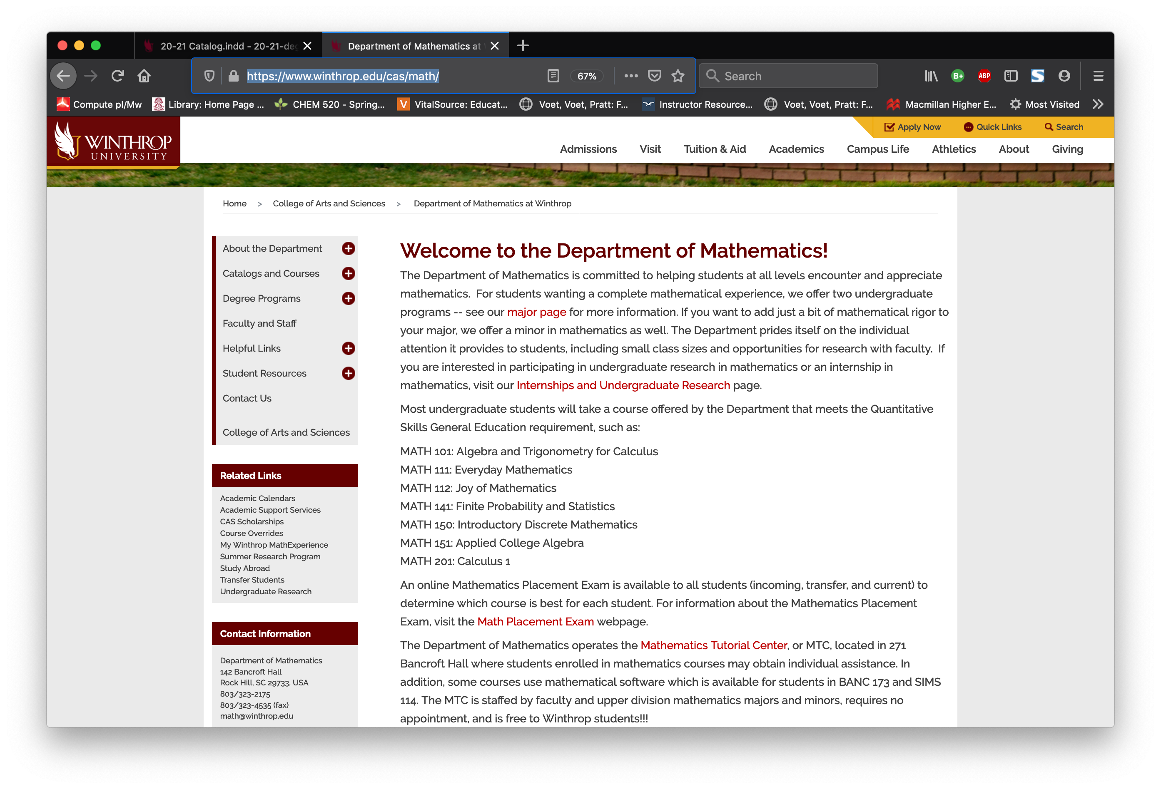
Courses and Prerequisites
Some of you may have taken the Winthrop Math Placement exam and been assigned a MATH course
If you haven’t, go to: https://www.winthrop.edu/cas/math/ and scroll down the page until you see the link to the Math Placement Exam

Slide 19
Courses and Prerequisites
Some of you may have taken the Winthrop Math Placement exam and been assigned a MATH course
If you haven’t, go to: https://www.winthrop.edu/cas/math/ and scroll down the page until you see the link to the Math Placement Exam
If you have taken the AP exam or Dual enrollment credit, the scores may not have transferred yet, only the Registrar knows what has come in yet, so check with them

Slide 20
Courses and Prerequisites
Based upon your MATH scores in high school or on the standardized tests you may have taken, you have been assigned to a specific Chemistry and Math course combination:
Group 1: CHEM104
CHEM104 (3 cr)
MATH101 (3 cr)
ACAD101 (1 cr)
WRIT101 (3 cr)
BIOL220 (3 cr)
BIOL222 (1 cr)
PESH### (1 cr)
15 cr total
Group 2: CHEM105
CHEM105 (4 cr)
MATH101/201 (3or4 cr)
ACAD101 (1 cr)
WRIT101 (3 cr)
BIOL220 (3 cr)
BIOL222 (1 cr)
15 or 16 cr total
Group 3: MATH151
MATH151 (3 cr)
ACAD101 (1 cr)
WRIT101 (3 cr)
BIOL220 (3 cr)
BIOL222 (1 cr)
PESH### (1 cr)
CSCI101A (1.5 cr)
CSCI101B-N (3 at 0.5 cr each)
15 cr total

Slide 21
Courses and Prerequisites
Group 1: CHEM104
CHEM104 (3 cr)
MATH101 (3 cr)
ACAD101 (1 cr)
WRIT101 (3 cr)
BIOL220 (3 cr)
BIOL222 (1 cr)
PESH### (1 cr)
15 cr total
Group 2: CHEM105
CHEM105 (4 cr)
MATH101/201 (3or4 cr)
ACAD101 (1 cr)
WRIT101 (3 cr)
BIOL220 (3 cr)
BIOL222 (1 cr)
15 or 16 cr total
Group 3: MATH151
MATH151 (3 cr)
ACAD101 (1 cr)
WRIT101 (3 cr)
BIOL220 (3 cr)
BIOL222 (1 cr)
PESH### (1 cr)
CSCI101A (1.5 cr)
CSCI101B-N (3 at 0.5 cr each)
15 cr total
These assignments are not punitive, one is not more important than the other nor are they in any way a negative reflection of your potential
You have been assigned to a group based upon your math and chemistry experiences in high school and are meant to help you maximize your success.

Slide 22
Courses and Prerequisites
Group 1: CHEM104
CHEM104 (3 cr)
MATH151/101 (3 cr)
ACAD101 (1 cr)
WRIT101 (3 cr)
BIOL220 (3 cr)
BIOL222 (1 cr)
PESH### (1 cr)
15 cr total
Group 2: CHEM105
CHEM105 (4 cr)
MATH101/201 (3or4 cr)
ACAD101 (1 cr)
WRIT101 (3 cr)
BIOL220 (3 cr)
BIOL222 (1 cr)
15 or 16 cr total
Group 3: MATH151
MATH151 (3 cr)
ACAD101 (1 cr)
WRIT101 (3 cr)
BIOL220 (3 cr)
BIOL222 (1 cr)
PESH### (1 cr)
CSCI101A (1.5 cr)
CSCI101B-N (3 at 0.5 cr each)
15 cr total
Groups 1 and 3: You will likely have to take the equivalent of Calculus 1 (MATH201) at a technical school during the summer of 2021 to stay on track:
MATH151 -> MATH101 -> MATH201 -> MATH202

Slide 23
Why?
The short answer: Prerequisites
Winthrop only offers PHYS211 (Physics with Calculus 1) every fall semester NOT during the spring
A prerequisite for PHYS211 is a grade of “C” or higher in MATH201
Now see why completing MATH201 before fall 2021 is so important?
Completing PHYS211 is important because CHEM313 (Quantitative Analysis) is required for the Chemistry degree, but it is only offered during spring semesters
CHEM313 has prerequisites of a grade of “C” or higher in MATH201, PHYS211 and CHEM301 (Organic Chemistry 1)

Slide 24
It may seem confusing, but…
It really is. That’s why you have an academic advisor within the department.
That’s why completing AND returning the survey to me is so important!
Let’s look at a typical freshman year for a Group 1 student:
Fall Freshman Year
CHEM104 (3 cr)
MATH151/101 (3 cr)
ACAD101 (1 cr)
WRIT101 (3 cr)
BIOL220 (3 cr)
BIOL222 (1 cr)
PESH### (1 cr)
15 cr total
Spring Freshman Year
CHEM105 (4 cr)
MATH101/201 (3 or 4 cr)
HMXP102 (3 cr)
BIOL221 (3 cr)
BIOL223 (1 cr)
Gen Ed Elective (If MATH101) (3 cr)
15 or 17 cr total
Summer Freshman Year
MATH201 (if needed) (4 cr)

Slide 25
What about (insert your specific exception here)?
Remember the rules?
If you have AP or Dual enrollment credit coming, Great!
But we don’t need to worry about that now
Everything will be fluid your first semester, we just want to get you registered and then you can meet with your advisor to hammer out a specific track.
Don’t worry! We are here to help.
Once everyone completes freshman year and gets through MATH201, things stabilize a bit…

Slide 26
Back to the ideal situation…
Let’s look at the sophomore year for that same Group 1 student:
Fall Sophomore Year
CHEM301 (4 cr)
MATH202 (4 cr)
MAED200 (1 cr)
PHYS211 (4 cr)
Gen Ed Elective (3 cr)
16 cr total
Spring Sophomore Year
CHEM302 (3 cr)
CHEM304 (1 cr)
CHEM312 (1 cr)
CHEM313 (3 cr)
CHEM314 (1 cr)
PHYS212 (4 cr)
Gen Ed Elective (3 cr) 16 cr total

Slide 27
That’s the first 2 years of being a Chemistry major
At this point, you have a good understanding of basic chemical concepts and are ready for Upper Division courses in Chemistry, Math or Biology
This is where communicating with your advisor really matters!
Research is something you may want to consider, ask a faculty member!
Internships are available, ask your advisor!
Summer research programs at Winthrop or universities across the country are available, ask your advisor!
Really, just ASK YOUR ADVISOR!

