Slide 1
Protein Presentation
Katie Bolling

Slide 2
Acetyl-CoA Synthetase (Salmonella enterica)
Gulick, A. & Starai, V. (2003). The 1.75 A⁰ Crystal Structure of Acetyl-CoA Synthestase Bound to Adenosine-5’-propyolphosphate and Coenzyme A. Biochemistry. 42, 2866-2873.

Slide 3
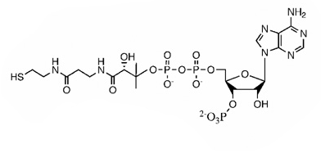
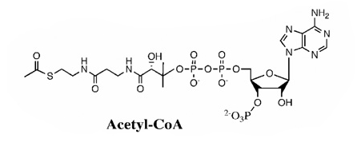
Acetyl-CoA Synthetase
Enzyme Class: ligase
Mechanism: catalyzes the formation of acetyl CoA from acetate and CoA
Key role in central metabolism
+
Acetate
Coenzyme A
Acetyl-CoA

Slide 4
Structural Framework
Homodimer
Length: 652 aa
Weight: 72kDa
Secondary Structure:
32% alpha helices
24% beta sheets
A
B

Slide 5
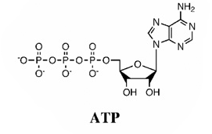
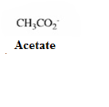
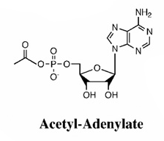
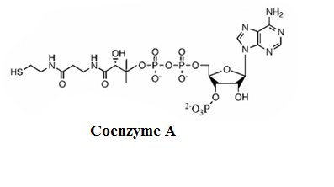
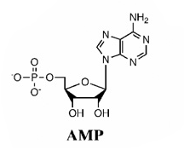
Mechanism
First Step:
Second Step:

Slide 6
Conserved Regions
C-terminus Domain
Asp517- hinge residue
N-terminus Domain
ATP binding sites:
(S/T)(S/T/G)G(S/T)(S/T)GXPKG
WWQTE-ATP binding site
C-Terminus
Asp517
N-Terminus
Notes:
The active site is located in the interface between these two domains. The N terminal domain is composed of the first 517 residues. Aspartate which is labeled 517 in the diagram is the conserved hinge residue. WWQTE is found at the ATP binding pocket. Although the glycine and Ser/Thr rich sequence is not a Walker P-loop motif, it does orient the three phophates of ATP in a similar manner. The C-terminal is around 130 residues in length and contains three anti-parallel strands surrounded on both sides by two alpha helices. Asp517 is the hinge residue that is the pivot point for both reactions to occurThe The C-terminal of the enzyme rotates 140 degrees after the adenylate forming half reaction which allows the second reaction to occur.

Slide 7
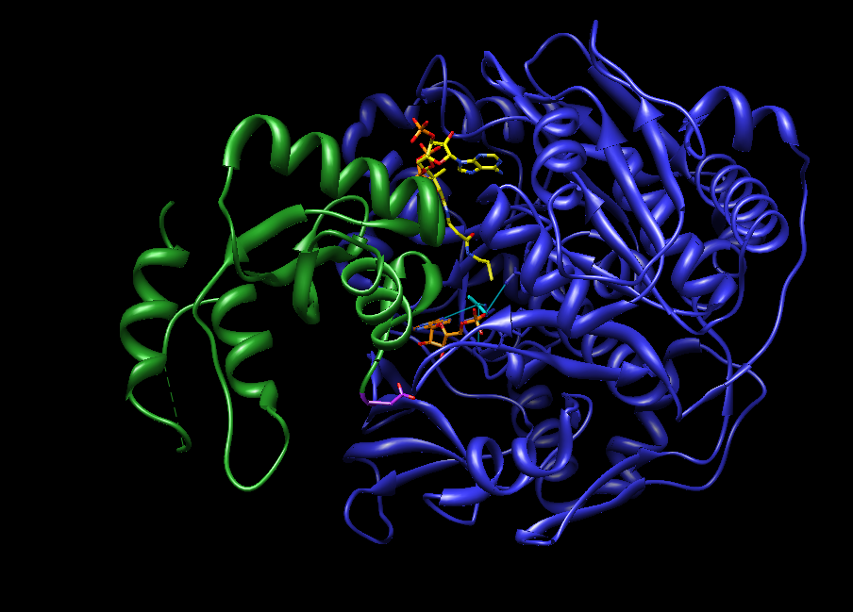
Co-A
CoA
Acetate
ACT
AMP
AMP
Notes:
The active site is located between the interface of the two domains. The binding sites for AMP and acetate are completely buried. The nicotinamide ring in CoA is bound on the surface of the protein while thiol portion of CoA is directed in the active site in close proximity to acetate.

Slide 8
AMP Active Site
Asp-500
Arg 515
Gln 415
Val 310
Arg-515
Asp 500
AMP
Acetate
Trp 413
Trp 414
Ile 512
Val 386
Notes:
The binding site for AMP and acetate is almost completely buried. The adenine ring lies in a hydrophobic pocket formed by Trp413 and Ile512. The 2’ hydroxyl of AMP interacts with Asp500, while the 3’ hydroxyl interacts with Gln415 and Arg515. The acetate binding pocket is formed by Val310, Val386, and Trp414

Slide 9
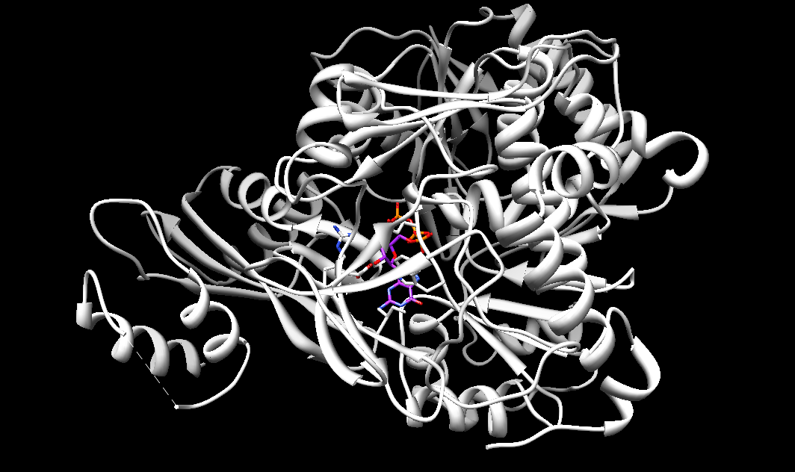
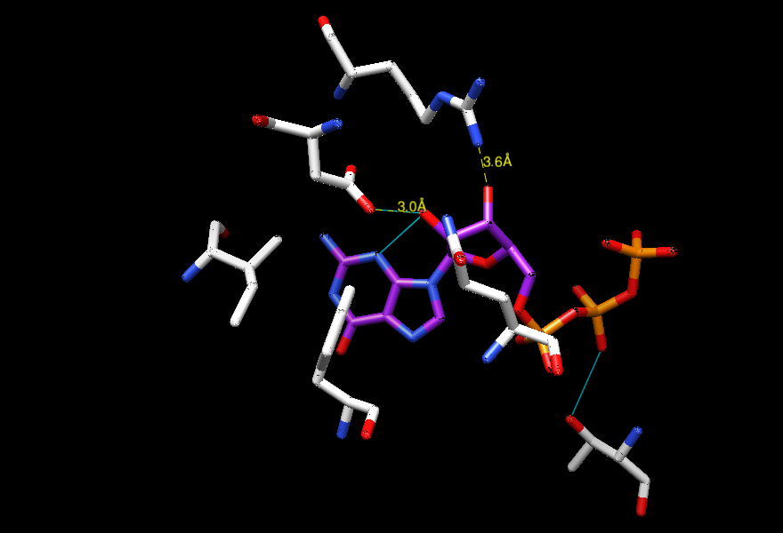
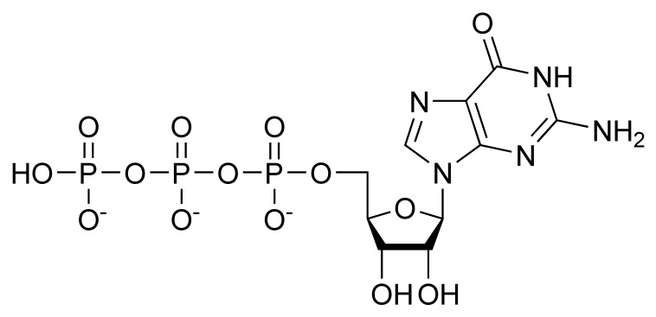
GTP
Asp-500
Ile-512
Gln-415
Guanosine triphosphate
Adenosine triphosphate
Trp-413
Thr-311
Notes:
Guanine attached to a ribose sugar with three phosphates. ATP – adenine attached to a ribose with three phosphates. Major differences between the structures is that GTP has an additional carbonyl side chain, and the amine side chains have different positions in the side chains

Slide 10
CoA Active Site
Ile 196
Arg 191
Arg 194
Phe 163
Arg 584
CoA
Ser-523
Notes:
The adenine ring of CoA sits in a hydrophobic pocket formed by Phe163 and Ile196. The phosphates of CoA interacts with Arg584, Arg194, and Arg191. The sulfur atom of CoA interacts with Thr311. Again, this nucleotide portion of CoA is bound on the surface of the protein

Slide 11
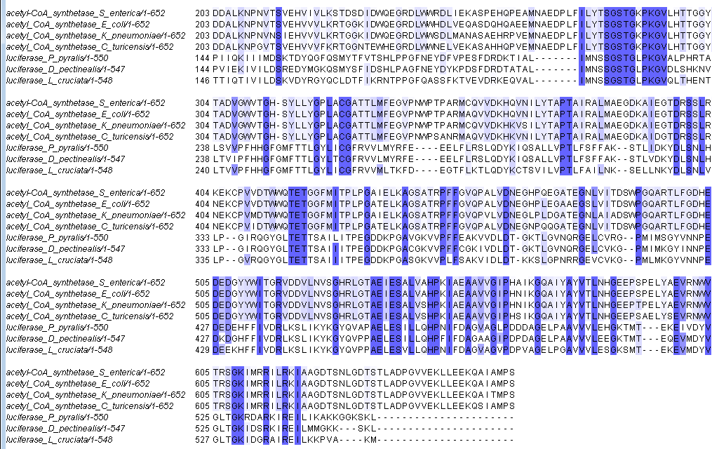
Sequence Alignment
Orients the phosphates of ATP
Hinge residue
Adenylate-forming half reaction
Notes:
In the firefly luciferase, ATP and molecular oxygen are used to produce oxyluciferin, a highly unstable, compound that decomposes to emit light. The formation of oxyluciferin is produced by adenylation of luciferin. the adenylate reacts in an oxidative decarboxylation to yield an activated carbonyl that decomposes to emit light. The conserved residue needed for the adenylate forming half reaction is PXXXXGK. The SGSTGXPKG is needed to orient the three phosphates of ATP prior to the first half reaction. Asp517 is the conserved hinge residue. However, this residue is only conserved in the acyl-coa synthetases because the luciferase does not undergo the second step of the mechanism. Besides the conserved regions, the primary sequences for the luciferase family and the acetyl-CoA family are fairly different suggesting divergent evolution.

Slide 12
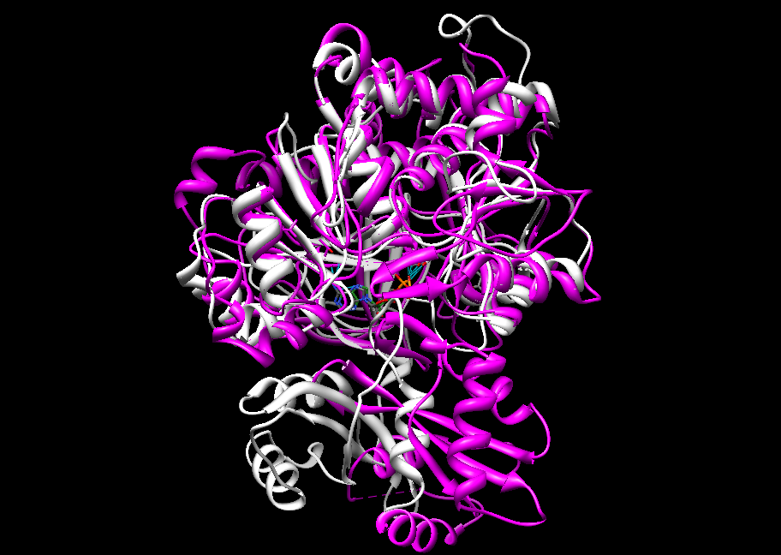
Structural Alignment
Notes:
Luciferase is shown in purple while acetyl-coA synthetase is shown in white. The structures are similar especially at near the alpha helices. Since the structures are similar, they evolved from a common ancestral protein. Luciferase and Acetyl CoA developed different mechanisms, so they have different substrate specificities.

Slide 13
ATP Active Site

Slide 14
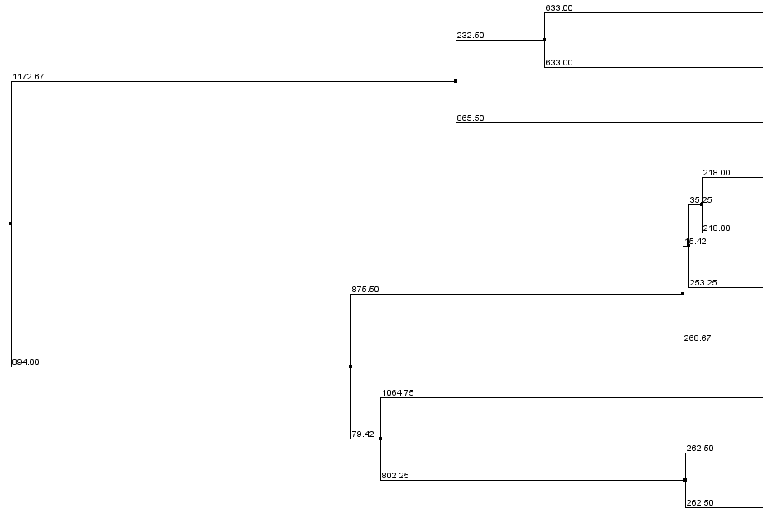
Phylogenetic Tree
Luciferase-
Photinus pyralis
Luciferase- Diaphanes pectinealis
Luciferase-
Luciola cruciata
Acs –
Salmonella enterica
Acs –
Escherichia coli
Acs – Klebsiella
pneumoniae
Acs-
Cronobacter turicensis
Acs-Drosophila
melanogaster
Acs-
Rattus norvegicus
Acs-Homo sapiens
Gram negative, anaerobic
Notes:
Luciferase is part of the adenylate family. After adenylation, the enzyme performs an oxidative decarboxylation to yield an activated carbonyl that decomposes to emit light. Salmonella enterica is an aerobic, gram-negative bacterium that infects food. Klebsiella pneumoniae, Escherichia Coli, and Cronobacter are all gram-negative, anaerobic bacterium. Drosophila melanogaster is a fruit fly. Photinus pyralis is an eastern firefly. Diaphanes pectinealis is a firefly, and luciola cruciata is a Japenese aquatic firefly. The top three are luciferase enzymes that produce, the middle four are gramnegative, anaerobic, and the bottom two are mammals.

Slide 15
Glucose-6-Phosphate Isomerase (Thermotoga maritima)
Chou, C., Sun, Y., Meng, M., & Hsiao, C. D. (2000). The Crystal Structure of Phosphoglucose Isomerase/Autocrine Motility Factor/Neuroleukin Complexed with Its Carbohydrate Phosphate Inhibitors Suggests Its Substrate/Receptor Recognition. J. Biol. Chem. 275, 23154-23160.
Notes:
Thermotoga maritima grows at an optimal temperature around 80 degrees celcius so it is a thermophile. It lives in hot springs and in marine hydrothermal vents

Slide 16
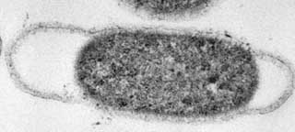
Thermotoga Maritima
Thermophile
Grows at an optimal temperature around 80⁰ C
Found in hot springs and marine hydrothermal vents
Rod-shaped bacterium
Metabolizes simple and complex carbohydrates

Slide 17
Glucose-6-Phosphate Isomerase
Enzyme Class: isomerase
Role: converts glucose-6-phosphate to fructose-6-phosphate
Central role in glycolysis and gluconeogenisis
Fructose-6-phosphate
Glucose-6-phosphate
Notes:
Thermotogoa maritimia is a bacterium that has an optimal growth temperature of 80 degrees Celsius. Glucose-6-Phosphate isomerase, also known as phosphoglucose isomerase abbreviated GP6, is another important enzyme in cellular metabolism. GP6 catalyzes the second step of glycolysis, the conversion of glucose-6-phosphate to fructose-6-phosphate.

Slide 18
Structural Framework
Dimer of trimers
Length: 460 aa
Secondary Structure:
47% alpha helices
13% beta sheets
B
C
A

Slide 19
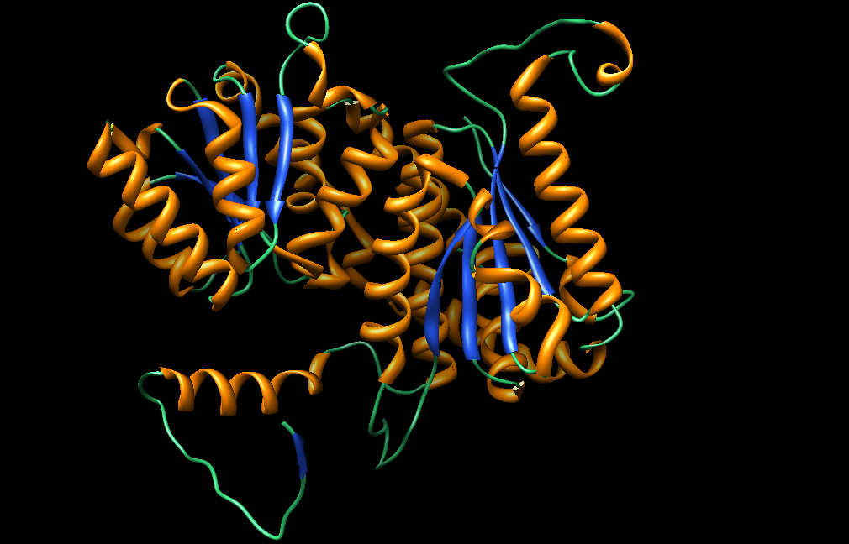
Conserved Regions –
Large domain
c
d
b
a
e
1
2
Small Domain
5
4
3
C-terminal tail
Notes:
The small domain contains a 5-stranded parallel b-sheet (marked 1-5) surrounded on both sides by a helices. The small domain also contains an “arm like” C terminal tail. The tail wraps around the other monomer increasing the stability of the enzyme. The large domain has a 5-stranded mixed parallel/antiparallel b-sheet (marked a-d) surrounded on both sides by a-helices.

Slide 20
Sequence Alignment
PGI –H. sapiens
PGI- T.maritima
PGI-H.sapiens
PGI-T.maritima
PGI-H.sapiens
PGI-T.maritima
PGI-H.sapiens
PGI-T.maritimas
PGI-H..sapiens
PGI-T.maritimas

Slide 21
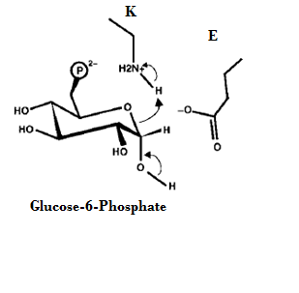
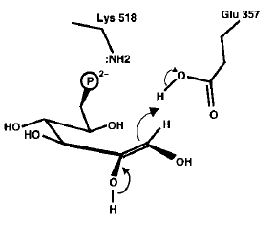
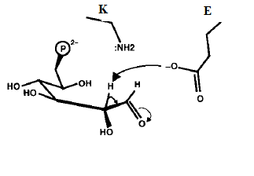
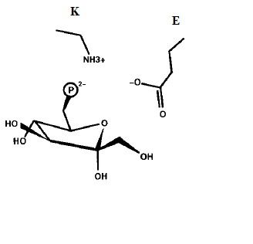
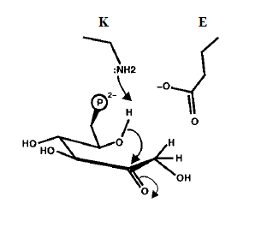
Mechanism
K
E
Notes:
The scientific journal describing the mechanism of PGI in Thermotoga maritima PGI has yet to be published. Assuming the catalytic mechanism is conserved in all organisms, this is the proposed reaction mechanism for PGI. After glucose-6-phosphate binds to the enzyme, Lys protonates the ring oxygen, allowing the ring to open. This causes the C1 hydroxyl to form a carbonyl. The next step is enolization initiated by glutamate. Glutamate abstracts a proton from the C2 position of the sugar, allowing for the formation of a cis-enediol intermediate. In the final step, Lys deprotonates the sugar ring oxygen leading to ring closure and formation of fructose-6-phosphate.

Slide 22
Inhibitor – PAB
Phosphoarabinonate (PAB)
Mimics the cis-enediol intermediate of the reaction
Completive inhibitor of PGI
Phosphate residue forms hydrogen bonds with the side chain residues of Thr-211, Thr-214, Ser-209 and Ser-159
Hydroxyl oxygen stabilized by side chain of Lys-518
Notes:
The active site is located in the cleft between the large and small domain and is close to the subunit boundary. 5-phosphoarabinonate looks similar to the non-cyclic form of glucose-6-phosphate, and even forms a cis-enediol intermediate. As a result, F-phosphoarabinate acts as a comepetive inhibitor.

Slide 23
5PA with PGI (Homo Sapiens)
Notes:
Lys-518 is the residue responsible for the ring opening of glucose-6-phosphate by functioning as a base. Glu 357 acts as a general acid and donates a proton to the carbonyl oxygen. Phosphate group is stabilized by several threoning and Serine residues through hydrogen-binding interactions

Slide 24
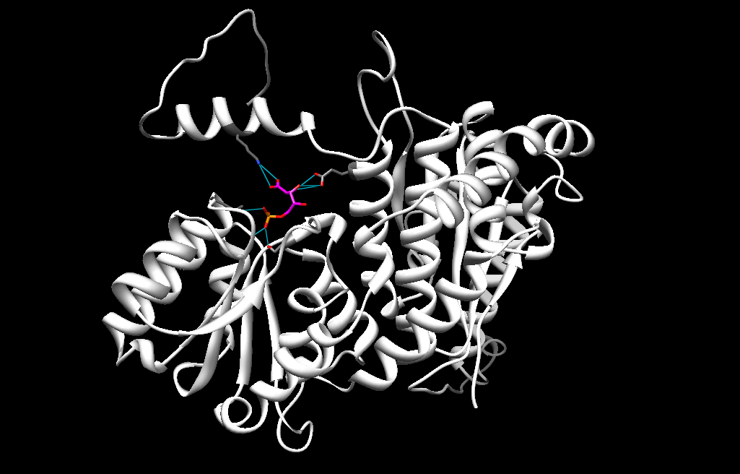
5PA with PGI (Thermotoga maritima)
Lys-422
Glu-281
Thr-141
Ser-77
Notes:
The Delta G value for the docked structure was -3.5.

Slide 25
Phylogenetic Tree
PGI – Leishmania mexicana
PGI-Thermotoga maritima
PGI-Fervidobacterium nodosum
thermophiles
PGI-Chloroflexus aggregans
PGI – Desulfobacca acetoxidans
PGI-Oceanithermus profundus
PGI-Haloferax volchanii
PGI-Paenibacillus polymyxa
PGI-Mitsuokella multacida
Notes:
Leishmania mexicano is a parasite that occurs when an individual is bitten by an infected sand fly. Thermotogoa maritimia is a gram-negative, anaerobic, rod shaped bacterium that has an optimal growth temperature of 80 degrees Celsius. Mitsuokella multacida. Desulfobassa acetoxidans is a gram-neg. mesophile (grows best at moderate temperatures). Chloroflexus aggregans is a photosynthetic thermophile. Haloferaz volchonii exists in extreme saline enviornments and also grows best in moderate temperature enviornments

Slide 26
Transglutaminase 3 (Homo sapiens)
Ahvazi, B. , Kim, H., Kee, S., Nemes, Z. & Steinert, P. M. (2002). Three-dimensional structure of the human transglutaminase 3 enzyme: binding of calcium ions changes structure for activation. EMBO. 21 2055-2067.

Slide 27
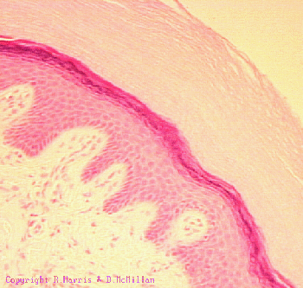
Transglutaminase 3
Enzyme Class: transferase
Mechanism: Cross-linking by ε-(c-glutamyl)lysine bonds
Important for the formation of the cornified cell envelope in the epidermis
High levels are linked to cancer
Notes:
This image is of stratified squamous epithelial tissue in the skin. The bottom left region are the dermis cells while the remaining portions are the epidermis cells. The outer, pale color is known as the epidermal barrier, or cornified cell envelope. These proteins strengthen the cornified cell envelope by covalently cross-linking glutamine and lysine residues. The intermolecular bond that is formed is highly resistant to proteolysis. As a result, transgulatminase help strengthen and support the skin. This is similar to how pectin provides structure to the cell wall of plants. Recent research indicates that cancer patients may have unusually high levels of the enzyme. This could be from the peripheral layer having too many cross-links that would inhibit nutrients from passing into and out of the cell. This enzyme can be inhibited by monitoring the extracellular Ca+2 levels.

Slide 28
Structural Framework
Homodimer
Length: 692 aa
Weight: 76kDa
Secondary Structure:
16% alpha helices
40% beta sheets
Vital Ca⁺² ions
A
B

Slide 29
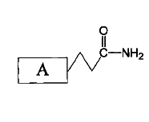
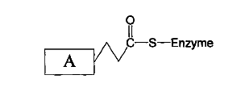
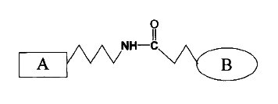
Mechanism
Step 1:
Ca⁺²
+
Step 2:
+
Notes:
Ping pong mechanism because residue A has to be bound to the active site before residue B. The thiol side chain in the cysteine residue performs a nucleophiic attack on the amide carbon forming a thiol-acyl intermediate. The amine on a protein bound lysine residue initiates a nucleophilic attack on the thiol-acyl intermediate. This forms an isopeptide bond, which is resistant to proteolytic degredation. Thiol attacks the amide after activation by a ca ion to make a thiol ester. And the thiol ester reacts with an amine to produce an iso-peptide. Like the catalytic triad, the histidine nitrogen accepts the hydrogen from the cysteine thiol group, thus coordinating the attack of the peptide bond. The carboxyl group on the aspartic acid in turn hydrogen bonds with the histidine.

Slide 30
Zymogen
β Barrel 2
β Barrel 1
Amino-terminal
Catalytic Core
Cleavage at Ser469

Slide 31
Amino-terminal Domain
1
3
2
9
7
6
8
4
5
Notes:
The amino-terminal domain consists of nine-strands of B-sheets (numbered 1-9) interspersed with an alpha helix. The beta strands are arranged in two antiparalled beta sheets to form a distorted B-barrel

Slide 32
β barrel Domain 1
2
5
3
4
6
1
7
Notes:
The B-barrel Domain 1 is composed of 7 beta strands arranged in barrel-like conformations

Slide 33
β barrel Domain 2
5
2
4
1
3
7
6
Notes:
The B-barrel Domain 2 is also composed of 7 beta strands arranged in barrel-like conformations

Slide 34
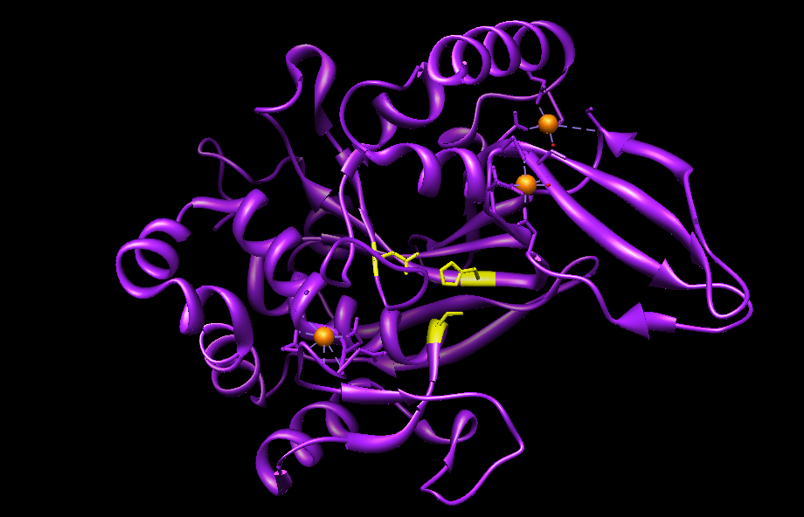
Catalytic Core Domain
Notes:
Both monomers have missing denisty for a flexible loop between residues 461-479. The catalytic core is composed of 15 beta sheets and 15 alpha helices arranged in an alpha/beta manner. The catalytic triad is located in the catalytic core domain Cys272 is located on one of the alpha helices, while His330 and Asp353 are located on adjacent B-strands.

Slide 35
Active Site
Cys272
Site 1
His330
Asp353
Site 3
Site 2
Notes:
During proteolysis, the cleaved enzyme acquires two additional Ca+2 ions to occupy sites two and three. Each Ca+2 is hepta coordinated, so it forms direct contacts with seven atoms. In this figure, Mg occupies site 3. When Mg is replaced with Ca at site three the enzyme inactive because the Mg+2 has octahedral geometry. Mg+2 prefers six coordinations because it has a smaller size than Ca+2. When Ca+2 is present, the ion forms an additional contact to Asp-324, producing a conformational shift that opens the active site

Slide 36
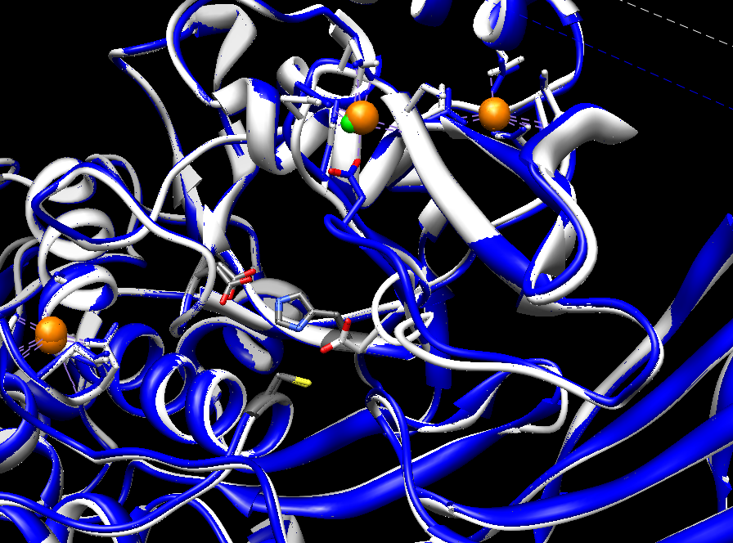
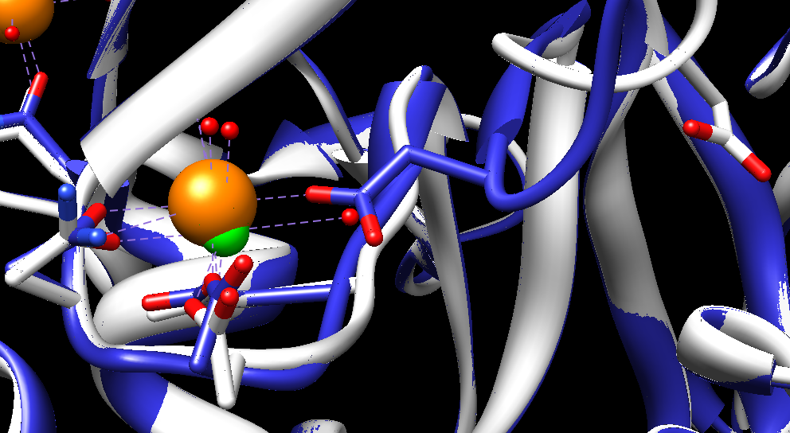
Asp-324 (Active)
Asp-324

Slide 38
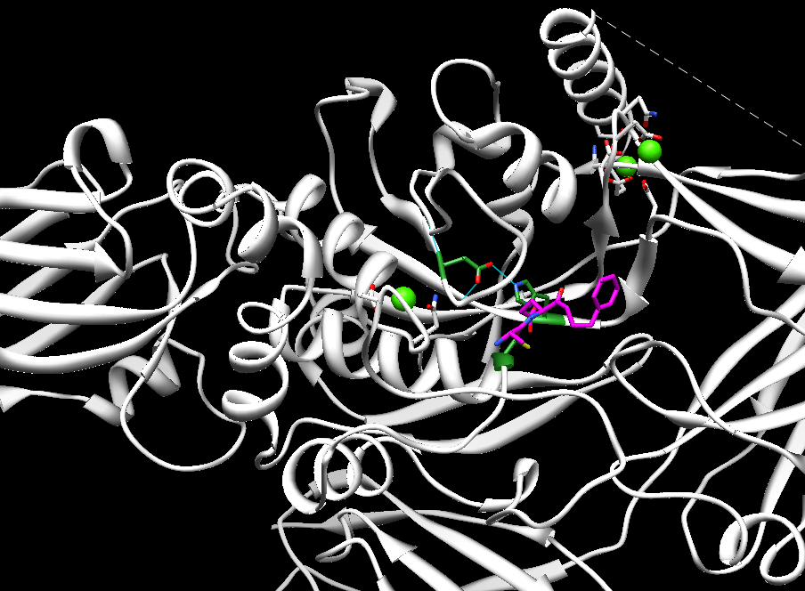
Molecular Docking: Glutamate Substrate

Slide 39
Cys-272

Slide 40
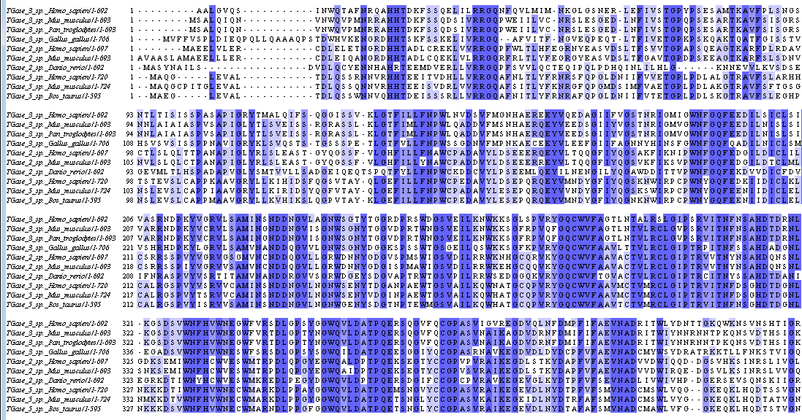
Multiple Sequence Alignment
Notes:
The cysteine residue is not conserved within all the organisms. A couple of the transglutaminase 3 enzymes have a serine residue instead. This shows that cysteine may not be A sequence Alignment was constructed between members of the transglutaminase family. The alignment is shaded base on the sequences percent identity. Overall, the sequences shared similar residues with each other.
Tgase 2 bonds and hydrolyzes GTP to GDP

Slide 41
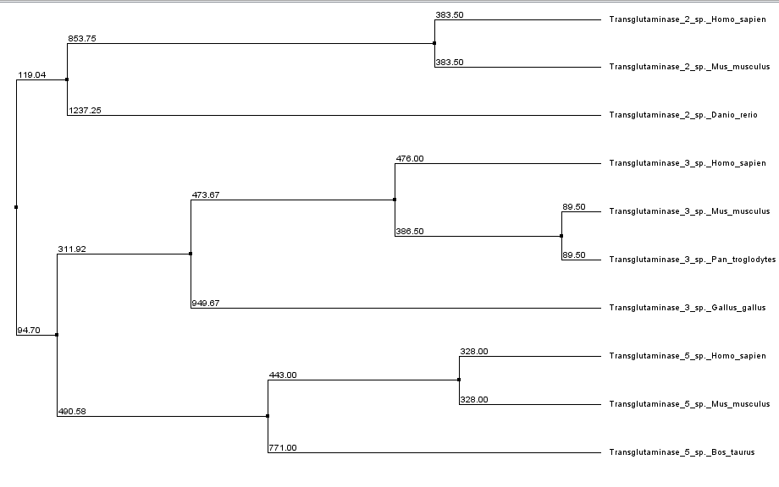
Phylogenetic Tree
Transglutaminase 2-
Homo sapiens
Transglutaminase 2 –
Mus musculus
Transglutaminase 2-
Danio rerio
Transglutaminase 3-
Homo sapiens
Transglutaminase 3-
Mus musculus
Transglutaminase 3-
Pan troglodytes
Transglutaminase 3-
Gallus gallus
Transglutaminase 5-
Homo sapiens
Transglutaminase 5-
Mus musculus
Transglutaminase 5-
Bos Taurus
Notes:
I compared Translutaminase 3 in humans to other mammals as well to different TransglHomo sapiens were the most closely related to the mouse, Mus Musculus. In addition, Transglutaminase 2 diverged the earliest. Pan troglodytes – Chimpanzee, Gallus-gallus-chicken, Danio-rerio-tropical fresh-water fish, Bos tuarus – cow. Transglutaminase is not a zymogen. Instead the Beta-domain number 2 is activated by the hydrolysis of GTP to GDP.

Slide 42
Cathepsin H (Sus Scrofa)
Jenko, S., Dolenc, I. & Guncar, G. (2003). Crystal Structure of Stefin A in Complex with Cathepsin H: N-terminal Residues of Inhibitors can Adapt to the Active Sites of Endo- and Exopeptidases. J. Mol. Biol. 326, 875-885. Jenko,S., Dolenc, I. & Guncar, G. (2003). Crystal Structure of Stefin A in Complex with Cathepsin H: N-terminal Residues of Inhibitors can Adapt to the Active Sites of Endo- and Exopeptidases. J. Mol. Biol. 326, 875-885.

Slide 43
Cathepsin H
Enzyme Class: Hydrolase
Super family: cysteine proteinase
Mechanism: cleaves a single amino acid residue from the N terminus of a peptidyl substrate
Can be harmful to environment
Liked to Cancer and Alzheimer’s Disease
Notes:
Aminopeptidase so it’s an exopeptidase enzyme, lysosomal degredation of proteins. Increased interest for developing inhibitors since over-expression of the enzyme is linked to Cancer and Alzeimer’s Disease. cysteine proteinases have the same catalytic triad: a cysteine, Asn, and His. The mechanism, as you will soon see, begins with a nucleophilic attack by the cysteine thiol.

Slide 44
Structural Framework
L-Domain
Monomer
Length: 220aa
Secondary Structure:
30% alpha helices
23% beta sheets
R-Domain
Notes:
Cathepsin H contains two domains, the L-Domain and the R-domain. The L-domain contains a 30 residue alpha helix and Ser-24, which performs a nucleophilic attack in the first step of the mechanism. Active site is in the open cleft between these two alpha helices. The R-domain contains a beta barrel. His-159 is located near the end of the beta barrel

Slide 45
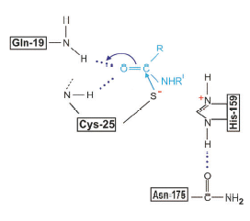
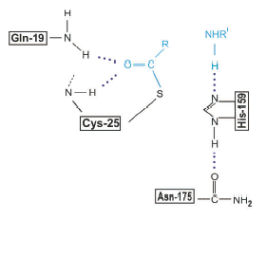
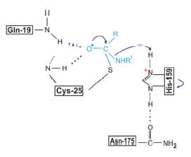
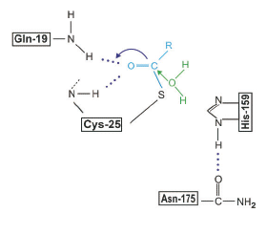
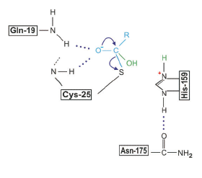
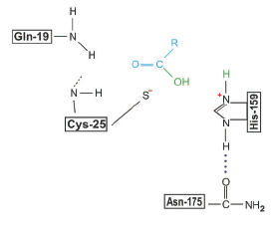
Mechanism
Notes:
Substrate needs to have an amide bond. First, the thiol is deprotonated by His-159, this allows the thiol group of Cys-25 to perform a nucleophilic attack on the carbonyl carbon of the substrate molecule, pushing the pie electrons to the oxygen. This forms a tetrahedral intermediate before the lone pair kick back down displacing the amine group of the substrate. The remaining steps involves a hydrolysis reaction in which. Thiolate attacking the carbonyl of an amide. This pops open the pie bond. This is promoted by one of the hydrogens on the amine of a gln residue. The nitrogen picks up a hydrogen from his which allows it to be a much better leaving group

Slide 46
Active Site
Asn-175
Cys-25
His-159

Slide 47
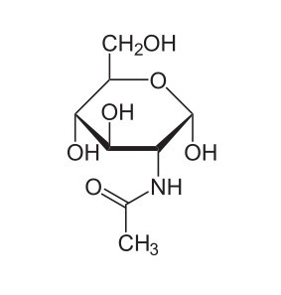
Substrate: N-acetyl-D-glucosamine
Notes:
Monosaccharide derivative of glucose

Slide 48
Cys-25 Mutation
Notes:
Mutate His-159 to an alanine, to see change in specificity!

Slide 49
Stefin A
Cathepsin H inhibitor:
Controls enzymatic activity of lysosomal proteases
Intracellular inhibitor
Structure:
Length: 98 residues
Weight: 1.1 kDa
Notes:
Stefin A is a 98 residue protein comprised of a 5-stranded anti-parallel beta sheet and an alpha helix.

Slide 50
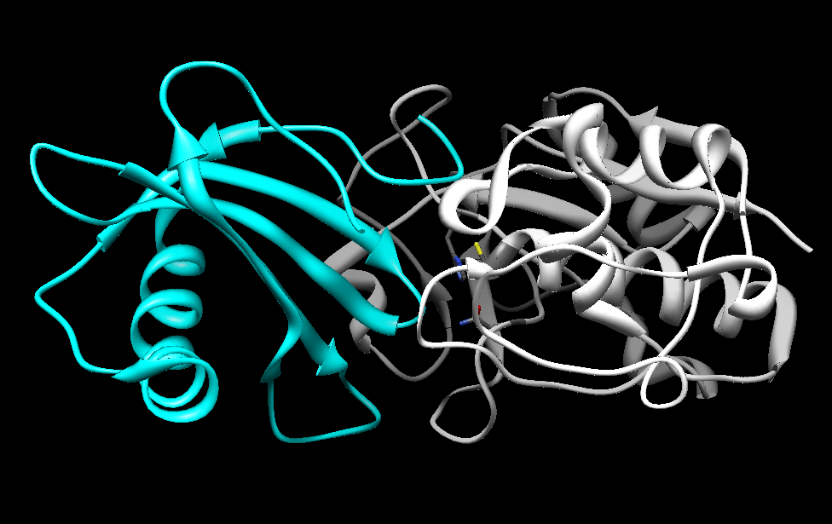
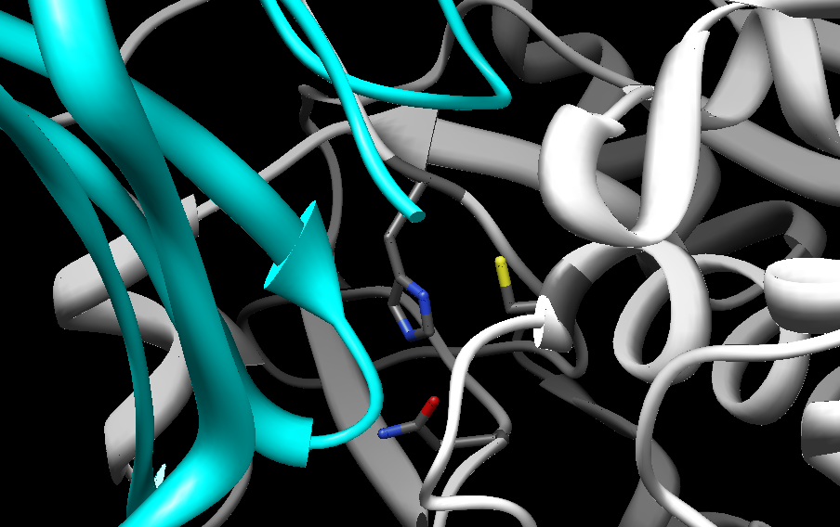
Notes:
Stefin is a powerful inhibitor because it docks into the active site cleft of cathepsin H. Stefin a has two hairpin loops that are oriented near the active site of cathepsin H, preventing substrate-binding. Stabilized by salt bridges

Slide 51
Sequence Alignment

Slide 52
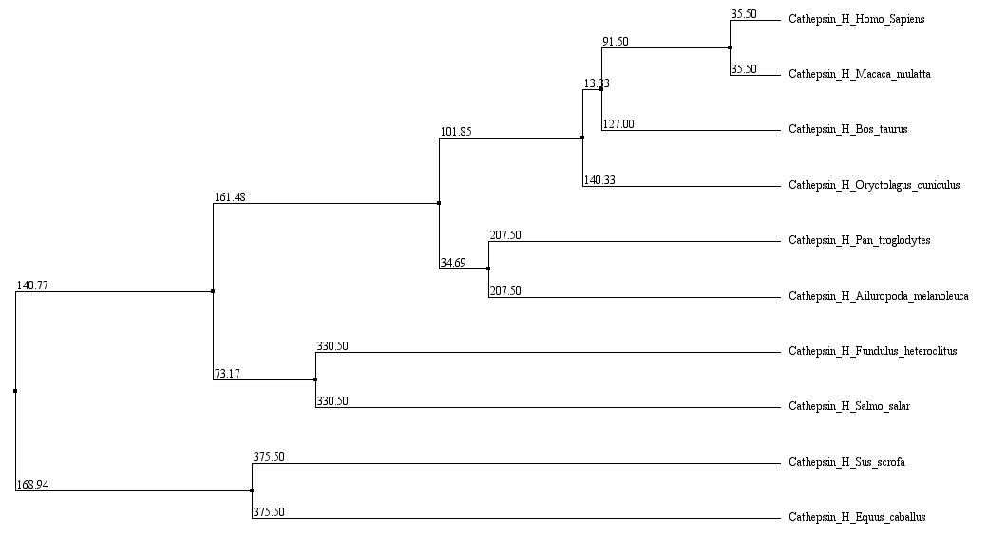
Phylogenetic Tree
Notes:
Sus scrofa – pig. Salmo salar – atlantic salmon. Eqqus caballus – horse. Macaca mulatta-monkey. Bos taurus-cow. Oryctolagus-rabbit. Pan troglodytes –chimpanzee. Ailuropoda melanoleuca-panda bear

