Slide 1
Enzyme Presentation II Petal Death Protein - Dianthus caryophyllus Alanine Racemase - Bacillus anthracis Glycogen Phosphorylase - Oryctolagus cuniculus Thrombin-Activatable Fibrinolysis Inhibitor - Homo sapiens
Amy Deng
CHEM 524-001
Dr. Jason Hurlbert
April 21st, 2011

Slide 2
Enzyme and Host Organism
Petal Death Protein (AltName: Citramalate Lyase or PSR 132) from Dianthus caryophyllus (carnation, clove pink)
- Teplyakov et. al. (2005). Crystal Structure of the Petal Death Protein from Carnation Flower. Biochemistry: 44, 16377-16384.
- Lu et. al. (2005). Diversity of Function in the Isocitrate Lyase Enzyme Superfamily: The Dianthus caryophyllus Petal Death Protein Cleaves α-Keto and α-Hydroxycarboxylic Acids. Biochemistry, 44:16365-16367
- NCBI Accession Number: Q05957.1
PDB ID: 1ZLP

Slide 3
Petal Death Protein (PDP)
Lyase (EC 4.1.3); Dimer-of-Dimer
Induced in response to ethylene production associated with petal senescence
Catalyzes the cleavage of the C(2)-C(3) bond in (2R)-alkyl malate derivatives
Malate Derivatives
α-ketocarboxylate (pyruvate derivatives)
Alkyl Carboxylate (acetate derivatives)
R1 – CH₃, CH₂CH₃, or CH₂CH₂CH₃
R2 – H or CH₃
Notes:
Talk about petal senescence, how this protein acts as a scavenger protein that collects products of plant metabolism and converts them into smaller metabolites that feed into the glyoxylate cycle (carbon recycling) – making sugars for exportation during senescence. 4.1.3 – Oxo-acid-lyase

Slide 4
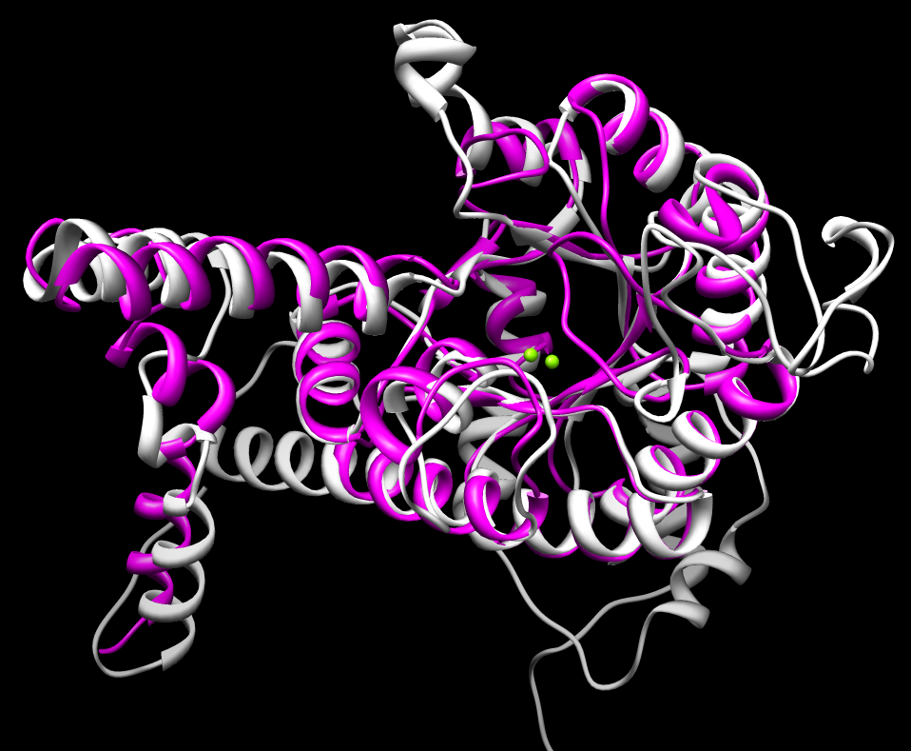
ICL/PEPM Superfamily
Isocitrate Lyase (ICL), Phosphoenolpyruvate Mutase (PEPM), 3-methyl-2-oxobutanoate hydroxymethyltransferase (MOBL), Petal Death Protein (PDP), etc.
Stabilization of an oxyanion intermediate
Require metal cofactor (Mg²⁺, etc)
TIM-barrel C-terminal edge forms the catalytic scaffold
Core residues are stringently conserved among family members yet active sites and reaction types are diversified
Notes:
Show a picture of all four of them showing similarity in 3D structures. Briefly talk about what each of them does and point out that they are different proteins catalyzing different reactions – but they have similar fold

Slide 5
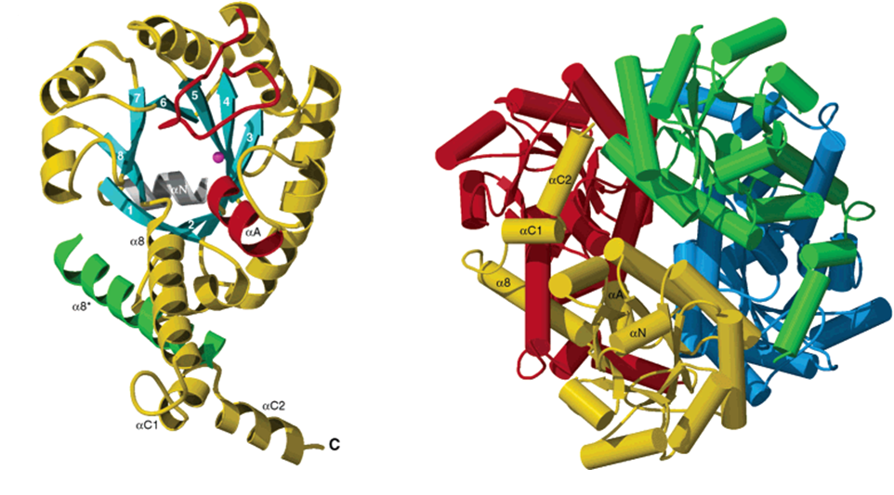
D. Caryophyllus PDP Structure
318 amino acids/monomer (tetramer); ~34 kD
13 helices (45%), 10 β-strands (13%)
(α/β)₈ barrel (TIM-barrel) topology, with the swapping of the eighth helix between the two monomer
Two monomers are tightly associated, with an interface area of 3500 Ǻ².
Mg²⁺ coordinates three residues and the substrate at the catalytic site of each monomer
Catalytic residue (Cys144) locates on a flexible loop (138 – 153) that allows “open” and “closed” conformations
Notes:
The swapping helix is a characteristic that distinguishes the ICL-PEPM family. 25% of the monomer surface interacting with another subunit. The dimers obey exact crystallographic symmetry, whereas their association in the tetramer is pseudosymmetrical. In the PDP structure, the conformation is closed. Green helix is from another monomer. N-terminal alpha helix is labeled alpha-N. Red helix is the substrate binding site. The active site gating loop is colored red.

Slide 7
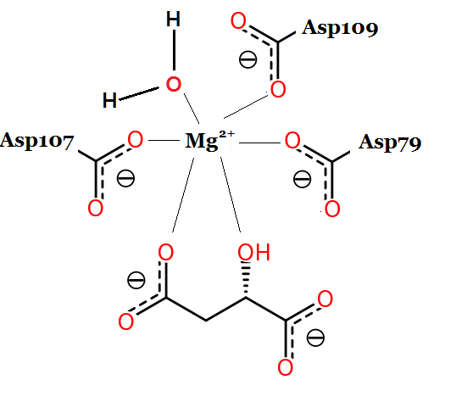
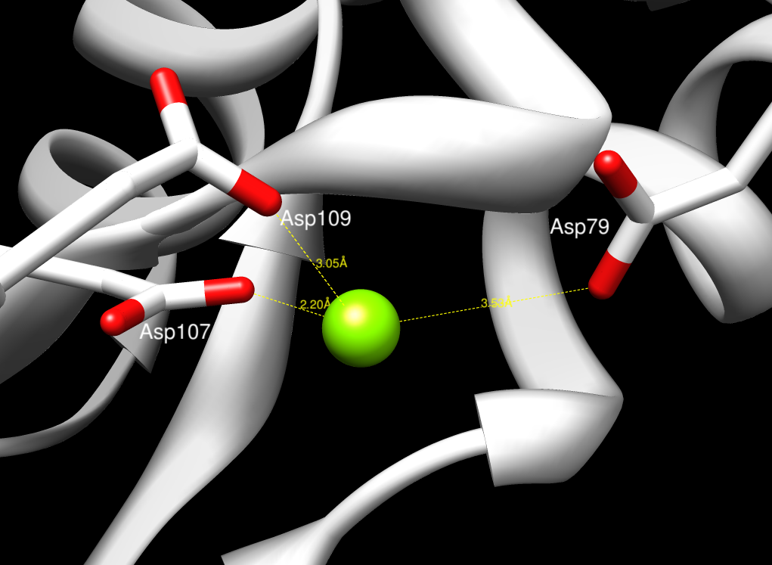
Metal Coordination
A Mg²⁺ cofactor assumes an octahedral geometry coordination of the following through ion-dipole interaction:
- Amino acid Asp107
- Amino acid Asp109
- Amino acid Asp79
- A catalytic water
- The hydroxyl group on C2 of the malate derivative
- The carbonyl group on C3 of the malate derivative
Notes:
Like I said before, metal coordination is very important in the ICL/PEPM superfamily. It not only coordinates important catalytic residues of the protein in the catalytic site but also coordinates catalytic waters that may involve in the catalysis process, which I will show you later.

Slide 8
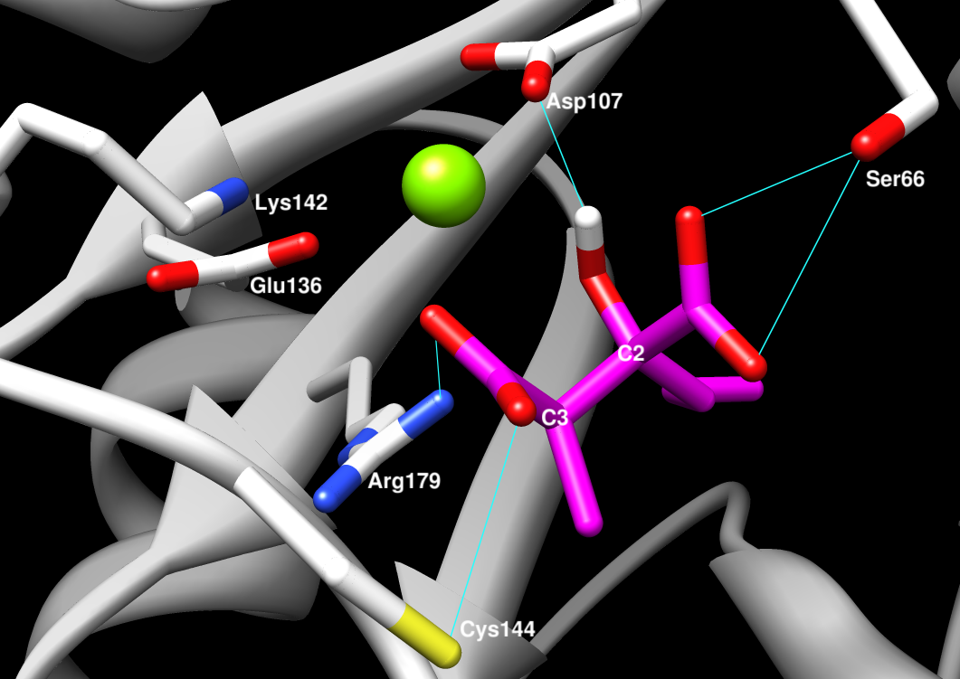
Catalytic Residues
Two catalytically important residues:
- Cys144: the proton source for the acidcarboxylate anion leaving group
- Glu136: the nucleophile that attacks the catalytic water
Catalytic water:
- Once activated by Glu136, it attacks the hydroxyl hydrogen on C2 of the malate derivative

Slide 9
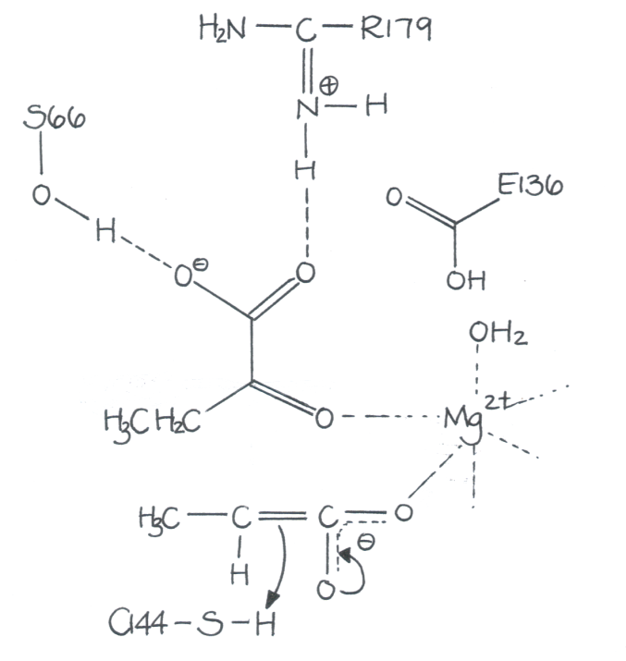
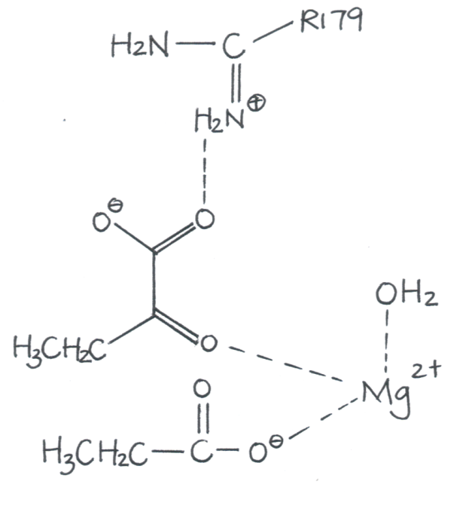
Proposed Reaction Mechanism

Slide 10
Substrate Specificity
Hydrophobic “Specificity Triad” residues locate on segments 6 and 7 and consist of Phe207, Ala255, and Ser257.
Not conserved among superfamily members.
Groups (methyl, ethyl, propyl) on C2 can be accommodated in this hydrophobic pocket, but not to the same extent.
ethylmethylmalate – k_{cat}/K_{m} = 2 x10⁴ M⁻¹ s⁻¹
dimethylmalate – k_{cat}/K_{m} = 2 x10³ M⁻¹ s⁻¹
methylpropylmalate – k_{cat}/K_{m} = 2 x10³ M⁻¹ s⁻¹
PDP has the largest hydrophobic pocket in the superfamily due to residues Phe64 and Phe134.
Notes:
Backbone of the substrate binds to the hydrophobic pocket of the protein. For PDP, the specificity triad consists of “Phe207, Ala225, and Ser257”. Also, PDP’s hydrophobic pocket is the largest in the superfamily – which makes sense because of its promiscuity (ethyl group can fit it, methyl and propyl can also fit too but less optimal). Phe64 and Phe134. They replace Tyr134/His113 in E. coli MICL and Tyr90/His218 in M. tuberculosis ICL.

Slide 11
Notes:
Looking down at the hydrophobic pocket

Slide 12
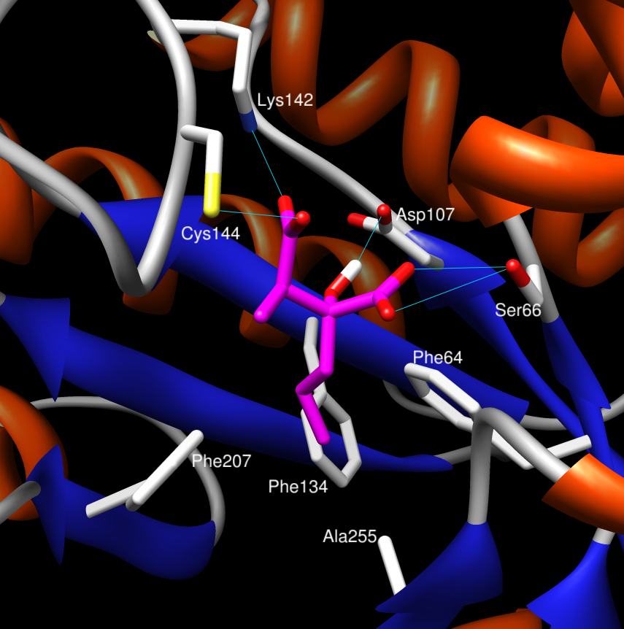
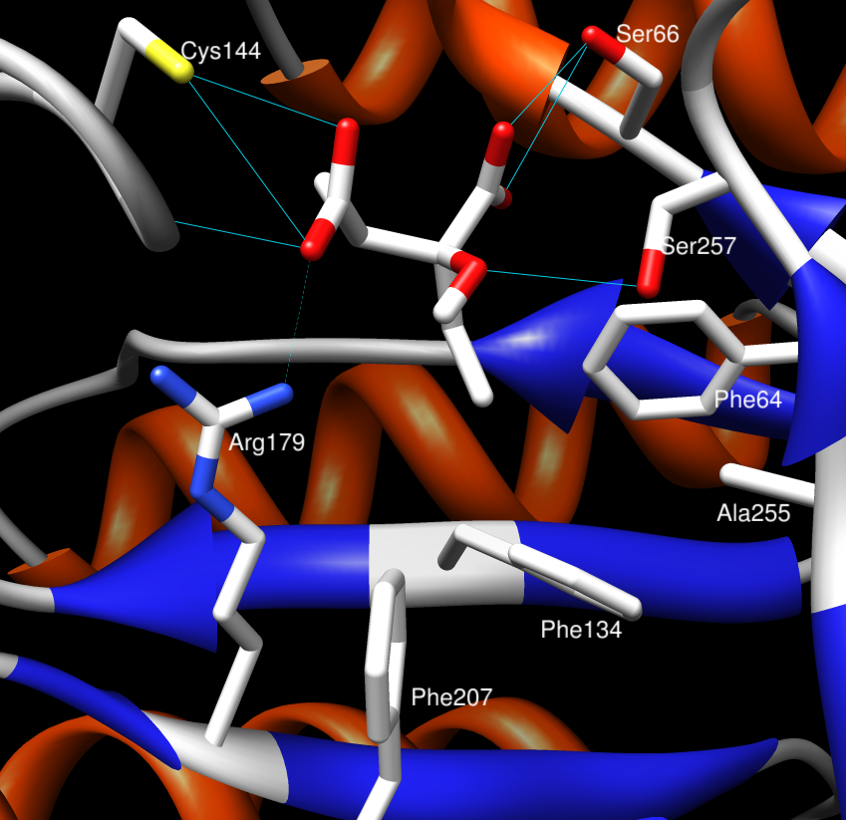

Slide 14
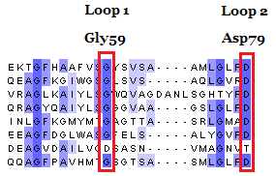
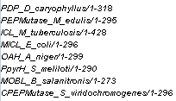
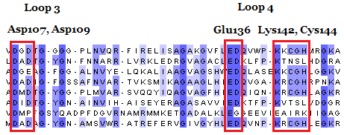
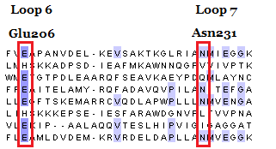
Notes:
Loop 7, Loop 8 and Loop 9 show very low level of conservation because it is the region responsible for substrate specificity

Slide 15
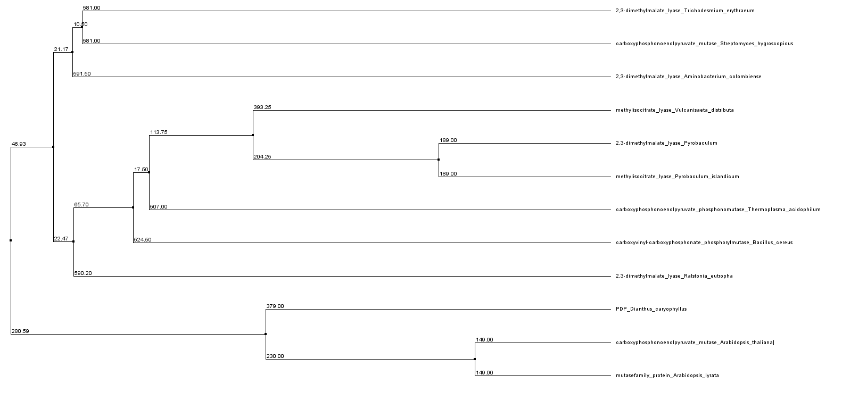
Notes:
Green – other two flower species in the mustard/cabbage family; Yellow – bacteria; Blue – Achaea bacteria

Slide 16
Petal Death Protein
Scavenger protein for glyoxylate cycle
Can bind a variety of substrates – promiscuity
Big hydrophobic pocket
ICL/PEPM Superfamily (TIM Barrel)

Slide 17
Petal Death Protein – Dianthus caryophyllus
Alanine Racemase – Bacillus anthracis
Glycogen phosphorylase – Oryctolagus cuniculus
Thrombin-Activatable Fibrinolysis Inhibitor – Homo sapiens

Slide 18
Enzyme and Host Organism
Alanine Racemase from Bacillus anthracis
- Counago, R.M., Davlieva, M., et. al. (2009) Biochemical and structural characterization of alanine racemase from Bacillus anthacis (Ames). BMC Structural Biology, 9:53.
- Read, T.D., Peterson, S.N., et. al. (2003) The genome sequence of Bacillus anthracis Ames and comparison to closely related bacteria. Nature, 423 (6935):81-86.
NCBI Accession Number: YP_018721
PDB ID: 3HA1

Slide 19
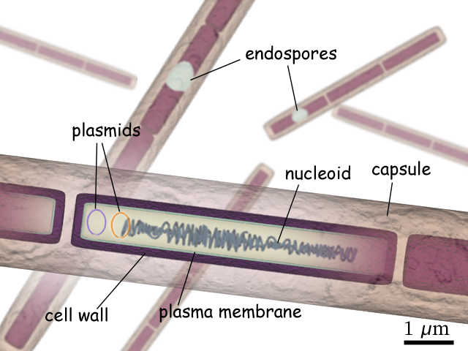
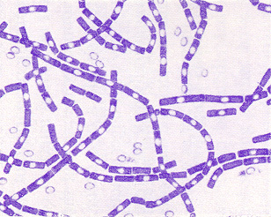
Bacillus anthracis (Ames)
The causative agent of anthrax
Soil-dwelling, spore-forming, Gram-positive bacterium
The only known bacterium that synthesizes a protein capsule (D-glutamate)
B. anthracis spores are highly resilient, surviving extremes of temperature and harsh chemical treatment for decades or centuries
The Ames strain is a monomorphic disease, mutating slowly if at all – “gold standard “ for vaccine development
Notes:
Most bacteria has a capsule made of polysaccharides. B. anthracis has a capsule that is a polymer of D-glutamate amino acids for protection and virulence. Because the fact htat the spores of B. anthracis is hard to destroy and decomtaminate, it is a significant threat to public health.

Slide 20
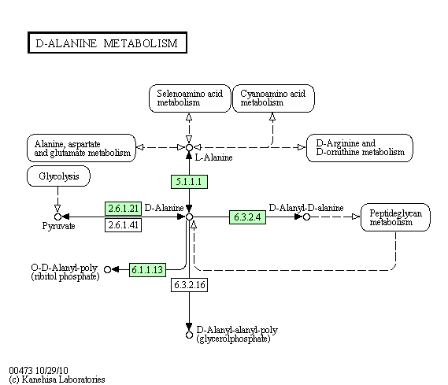
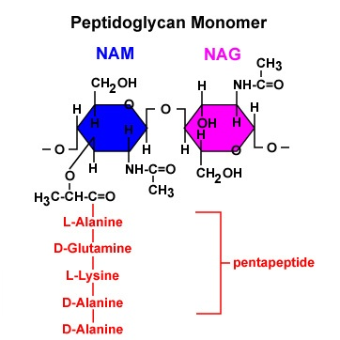
Alanine Racemase
Isomerase (EC 5.1.1.1); Homodimer
An essential enzyme in prokaryotes that is responsible for the racemization of L-alanine to D-alanine, a key component of the peptidoglycan of bacterial cell wall
Notes:
EC 5.1.1 – Acting on amino acid and derivatives (for alanine is 5.1.1.1). The dal1 gene is one of the four genes up-regulated during sporulation, which is the spore formation (chiefly among bacilli and spirilli). Because alanine racemase is absent in virtually all eukaryotes, it has often been proposed as an ideal drug target for the development of new antibiotics.

Slide 21
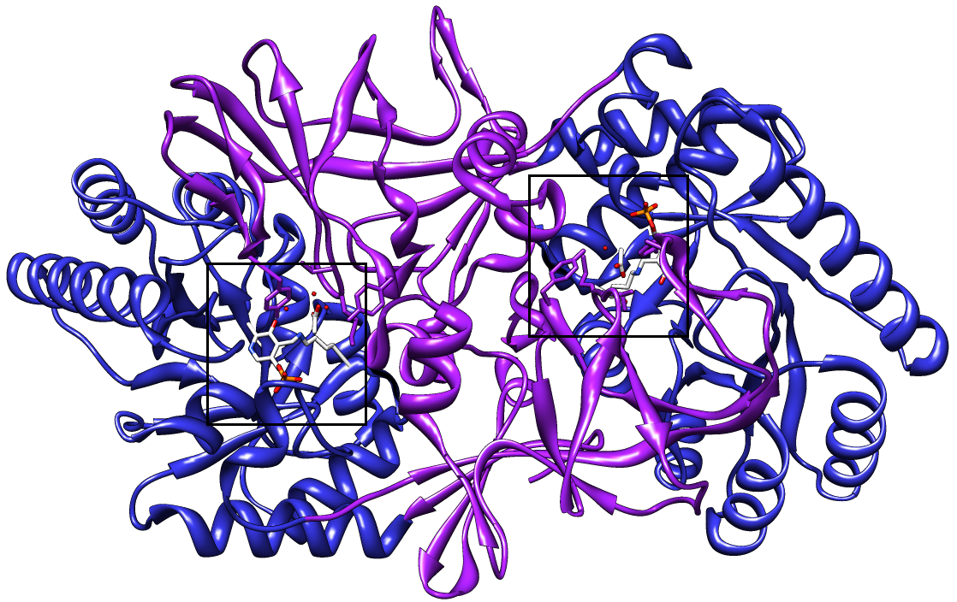
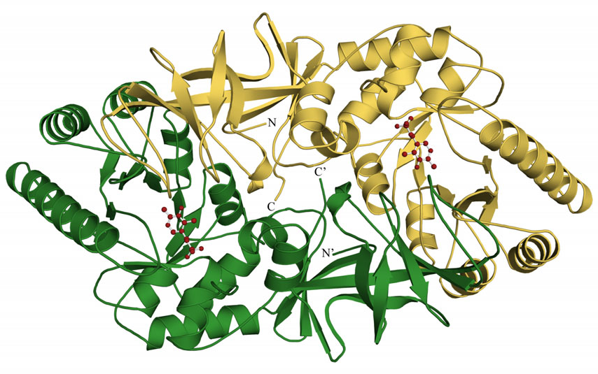
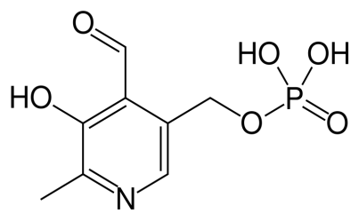
B. anthracis Alanine Racemase
Encoded by the dal1 gene
391 amino acids/monomer (dimer); ~ 44 kDa
Two identified domains:
N-terminal Domain (16-245)
C-terminal Domain (1-15, 246-389)
The active site is formed by N-terminus residues from one monomer and C-terminus residues from the other monomer (Lys41 and Tyr270) and located at the interface of the two domains
Requires a cofactor pyridoxal 5’-phosphate (PLP) for catalysis
Notes:
The homodimer displays two active sites. Only the dimeric form of the enzyme is catalytically active. Therefore, interface residues are critical in forming a functional active site. Certainly the interface functions to correctly position the second catalytic tyrosine residue from the opposite monomer on top of the active site. In addition, both monomers contribute to the overall composition of the alanine entryway and binding pocket.

Slide 22
N-terminal Domain (16-245)
- (α/β)₈ barrel
- Lys41 is covalently linked to a PLP molecule and pointing toward the center of the barrel
- important for catalysis
C-terminal Domain (1-15, 246-391)
- mainly antiparallel β-strands
- Tyr270, Tyr289, and Thr316 covers over the active site formed with the other monomer and forms extensive H-bond network with PLP
Notes:
Residues located outside of the core show greater structural variations. Head-to-tail position of the two monomers.

Slide 23
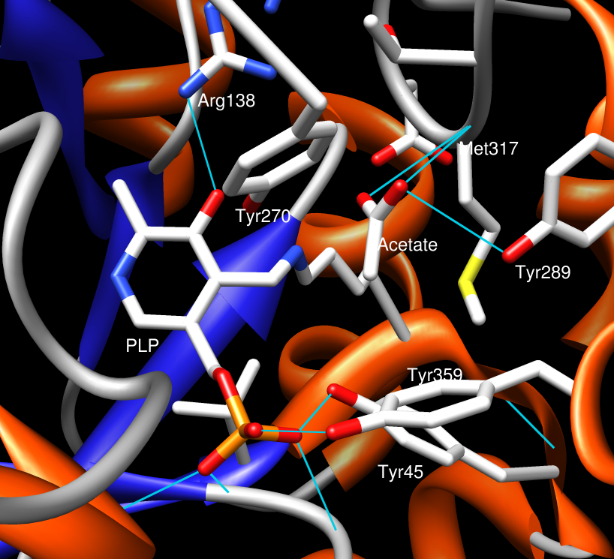
The Active Site
Pyridoxal-5’-phosphate is coordinated by 9 hydrogen bonds from close-by amino acid side-chains and the protein backbone
- Tyr359, Tyr45, Arg138, Ser209
The substrate (L-Alanine) is coordinated by residues in close proximity to the PLP molecule
- Tyr289, Met317 (holds the carbonyl group)
- Tyr270 (hydrogen bond with the –NH₃⁺ group)

Slide 25
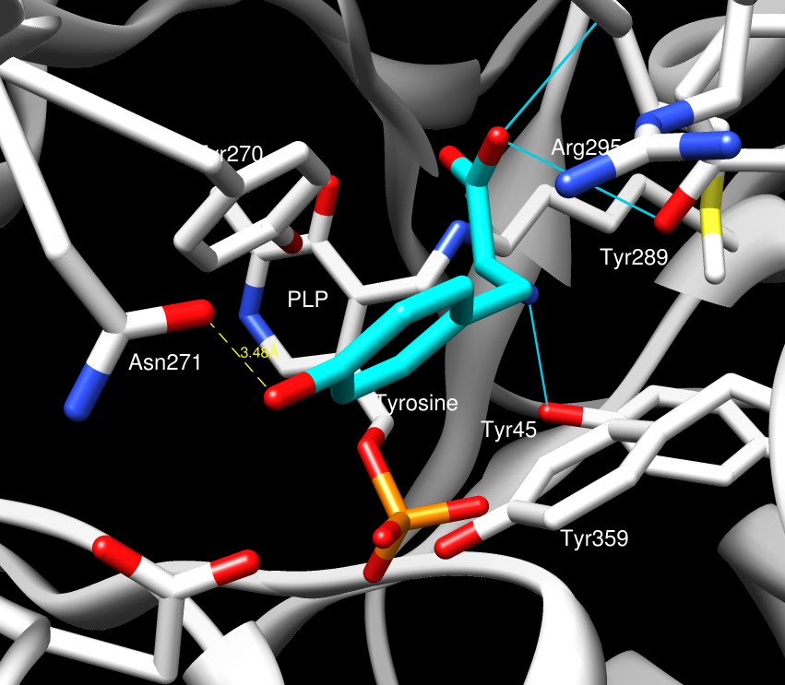

Slide 26
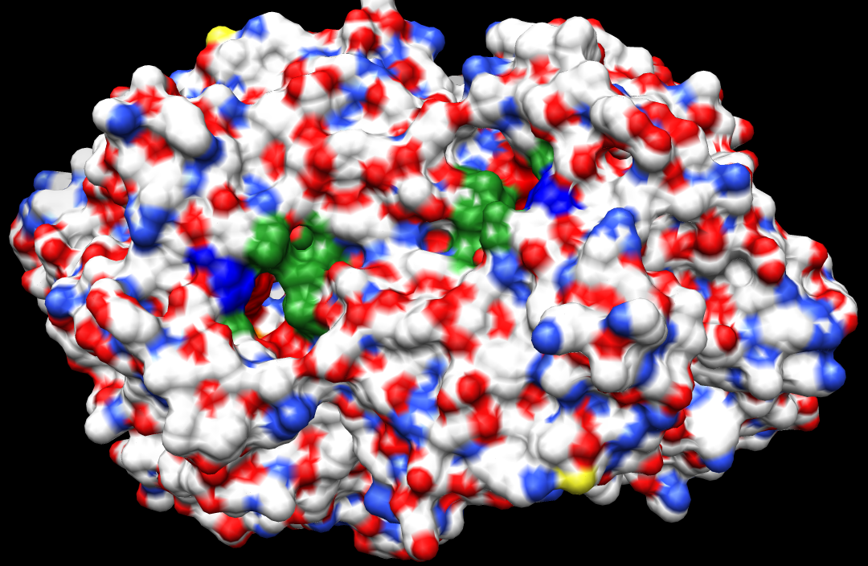
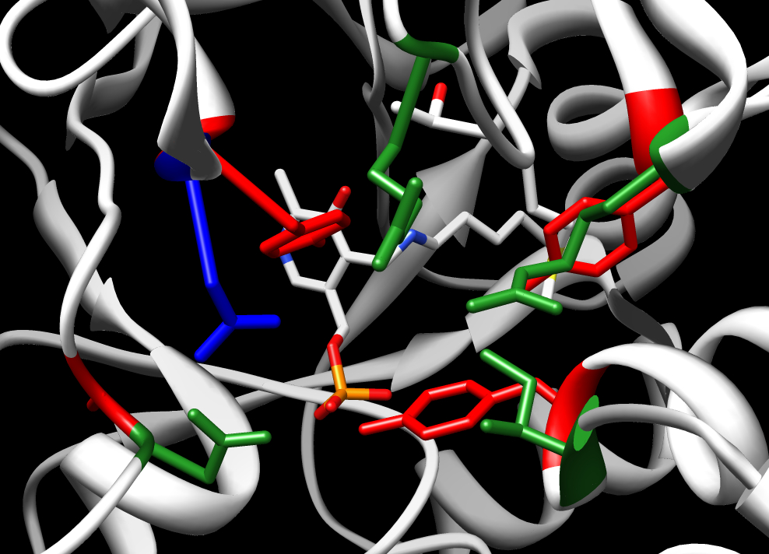
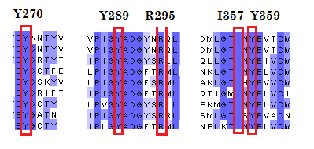
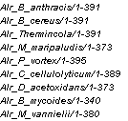
The Active Site Entryway
Loops from the N-terminal domain of one monomer and C-terminal domain of the other monomer
Inner layer: Tyr270, Tyr359, Tyr 289, and Ala 172
Middle layer: Arg314, Ile357, Arg295, and Asp173
Outer layer: less conserved, more restricted entryway due to a the presence of Asn271 instead of glycines
Notes:
The active site entryway of Alr has been previously divided in inner, middle and outer layers, starting from the PLP binding pocket and moving towards the protein surface. Residues from the inner and middle layers whose strong conservation among various Alr. After doing a BLAST search, I picked a variety of alanine racemase from different species and they all showed that these entryway guarding residues are highly conserved among them, especially the inner and middle layer residues.

Slide 27
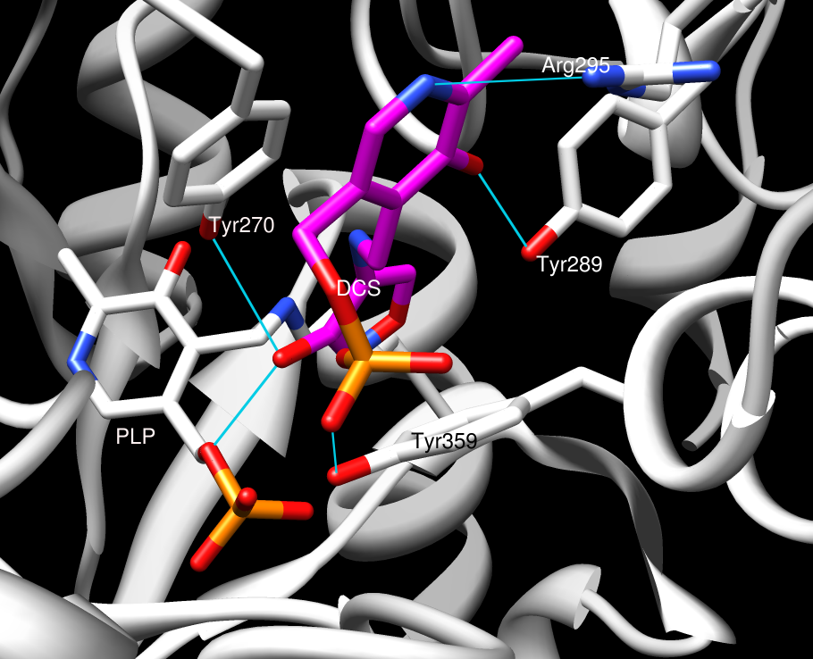
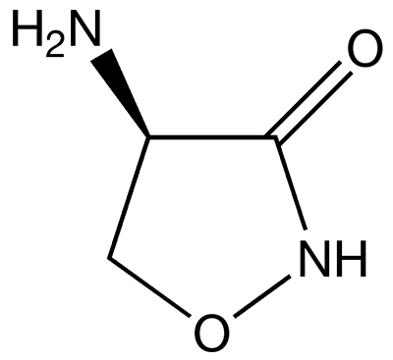
D-Cycloserine
Antibiotics for treating Mycobacterium tuberculosis
Can competitively inhibit both Alanine Racemase or D-Alanine Ligase
Prevents the proper construction of cell wall
D-Cycloserine

Slide 28
Proposed Alr Mechanism

Slide 29
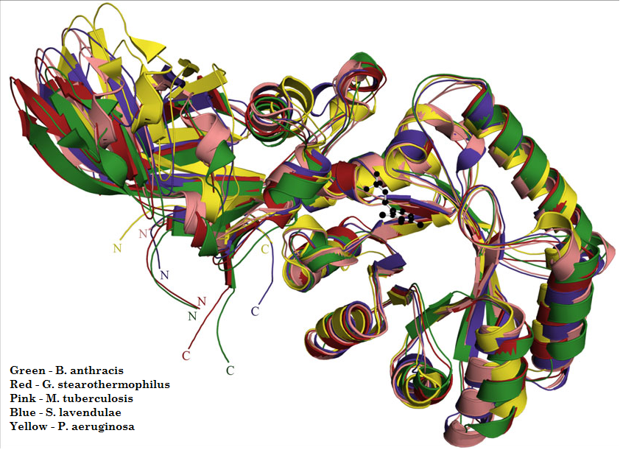
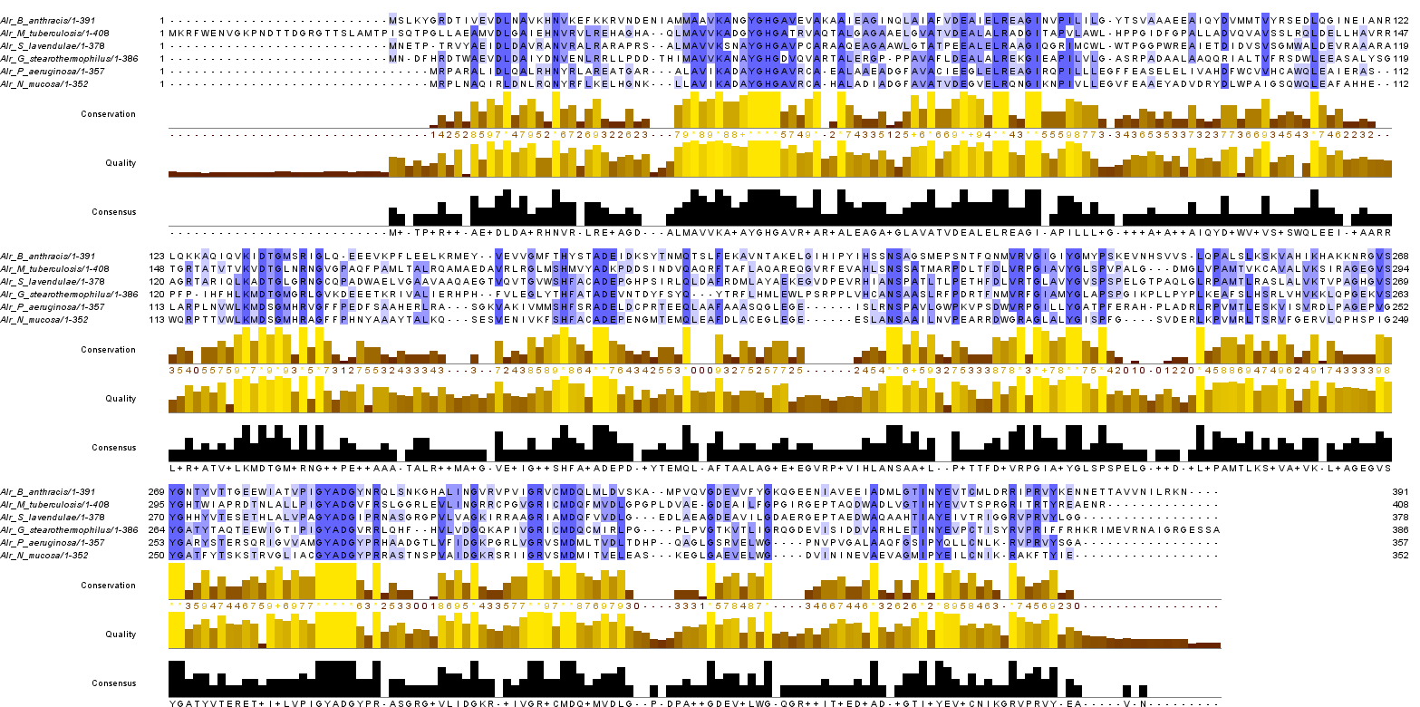

Slide 30
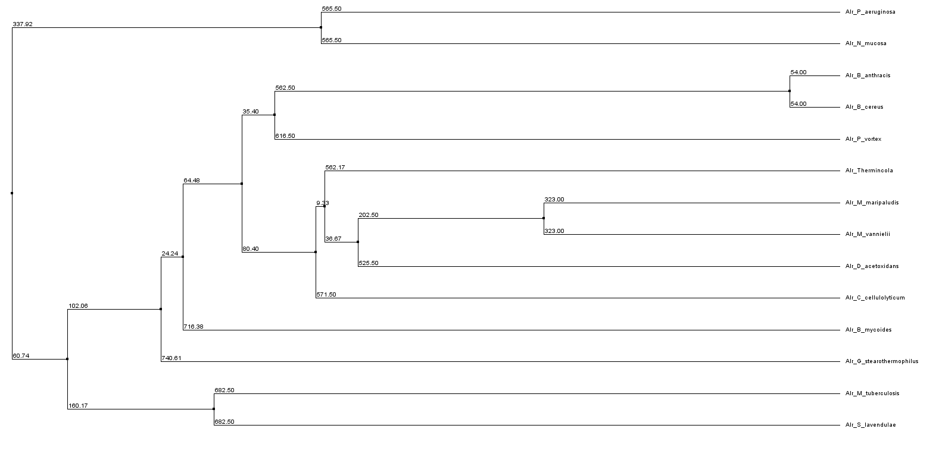
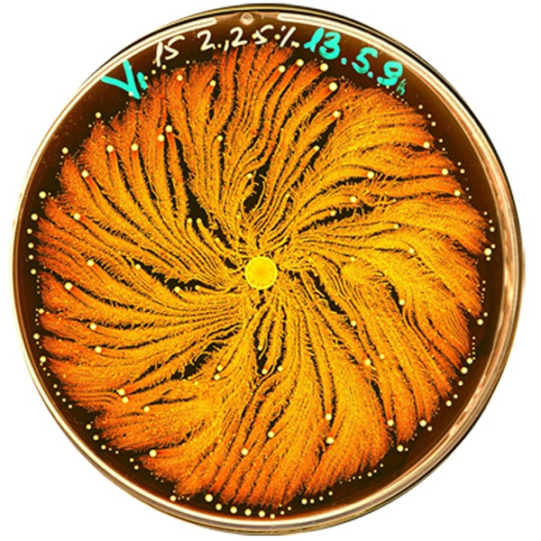
Notes:
Green – Gram (+), Blue – Gram (-); Yellow – Achaea bacteria

Slide 31
Alanine Racemase
L-alanine to D-alanine
Target of antibiotics
Pyridoxal-5’-phosphate cofactor
Highly conserved

Slide 32
Petal Death Protein – Dianthus caryophyllus
Alanine Racemase – Bacillus anthracis
Glycogen phosphorylase – Oryctolagus cuniculus
Thrombin-Activatable Fibrinolysis Inhibitor – Homo sapiens

Slide 33
Enzyme and Host Organism
Glycogen Phosphorylase from Oryctolagus cuniculus (European rabbit)
- Sprang, S.R., Acharya, K.R. et. al. (1988). Structural changes in glycogen phosphorylase induced by phosphorylation. Nature, 336(17): 215 - 221
- Leonidas, D.D., Oikonomakos, N.G. et. al. (1992). Control of phosphorylase b conformation by a modified cofactor. Protein Science, 1: 1112 – 1122.
NCBI Accession Number: NP_001075653
PDB ID: 1GPA & 3GPB

Slide 34
Glycogen phosphorylase (GP)
Transferase (EC 2.4.1.1); Homotetramer
Catalyzes the initial and rate-limiting step in the degradation of glycogen by releasing glucose-1-phosphate from the terminal α-1,4-glycosidic bond.
Can only act on linear chains of glycogen
Controlled by conformational states and allostery
Notes:
Glycogen phosphorylase breaks up glycogen into glucose subunits. Glycogen is left with one fewer glucose molecule, and the free glucose molecule is in the form of glucose-1-phosphate. In order to be used for metabolism, it must be converted to glucose-6-phosphate by the enzyme phosphoglucomutase. This happens in tissue with high energy demands, such as the liver and muscle tissues. EC 2.4.1.1 – transferase of phosphate groups, work on 6-member ring sugars

Slide 35
O. cuniculus Glycogen phosphorylase
842 amino acids/monomer; exists as tetramer but dissociates to form dimers upon binding to glycogen
GPa – active form, phosphorylated at Ser14, mostly in R-state conformation; GPb – inactive form, nonphosphorylated, predominantly in T-state
R-state promoters: Glycogen, AMP, and G-1-P
T-state promoters: Glucose, ATP, and G-6-P
Two identified domains:
N-terminal domain (1-490): allosteric control
C-terminal domain (491-842): catalysis
Catalysis is dependent on the cofactor pyridoxal-5’-phosphate (PLP)
Notes:
Positive effectors can shift the equilibrium between R and T state toward the R state, thereby making the protein more functional; Negative effectors, however, shift the equilibrium toward the T-state, thereby making the protein more inactive. The activity of mammalian glycogen phosphorylase is controlled by both covalent modification and noncovalent allosteric interactions. However, not all R-state-stabilizing compounds are activators of the enzyme, since ligands that bind to the C site and stabilize the R-state may also compete with substrate for binding

Slide 36
Notes:
Solvent inaccessbility, interface between two subunits buried a lot of surface area and these interface areas are often the allosteric regulation site or catalytic site.

Slide 37
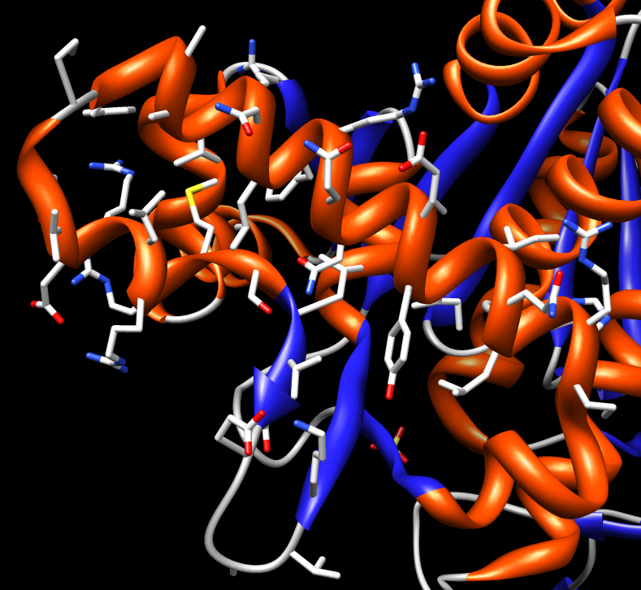
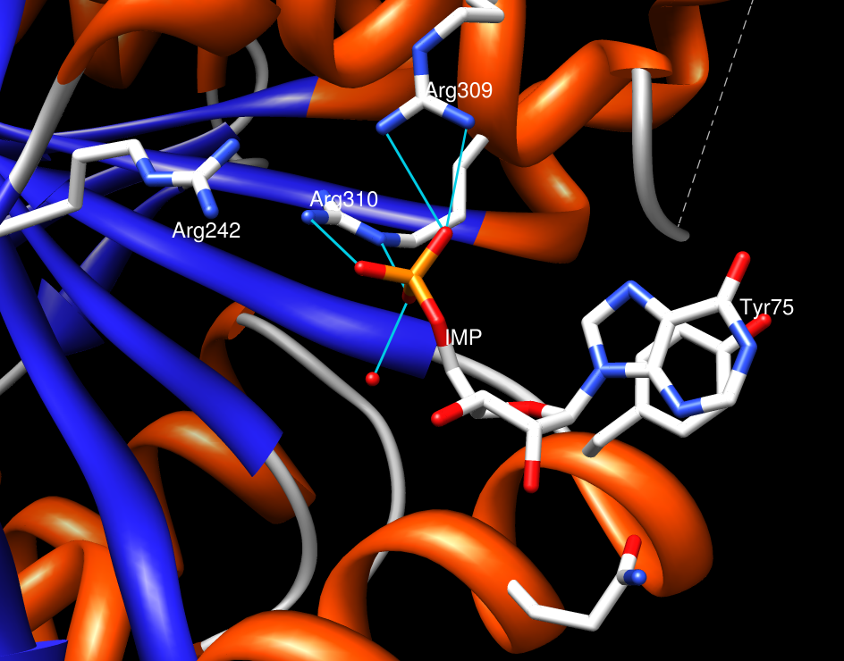
N-terminal Allosteric Domain
Residues 1-490:
- α/β sandwich with Rossmann-fold topology
- Ser14 phosphorylation site at the N-terminus
- AMP/ATP allosteric regulation site at 289-314 (Arg309, Arg310, Arg242)
- Glycogen storage site at 397-437 (helix with mainly charged residues to form H-bond with glycogen)
- The “280s loop” (281-288) is sensitive to the phosphorylation at Ser14 and allosteric regulators and blocks the access to the catalytic site in the T-state
Notes:
N-terminal tail lies along the dimer interface and contains the locus of covalent modification.

Slide 38
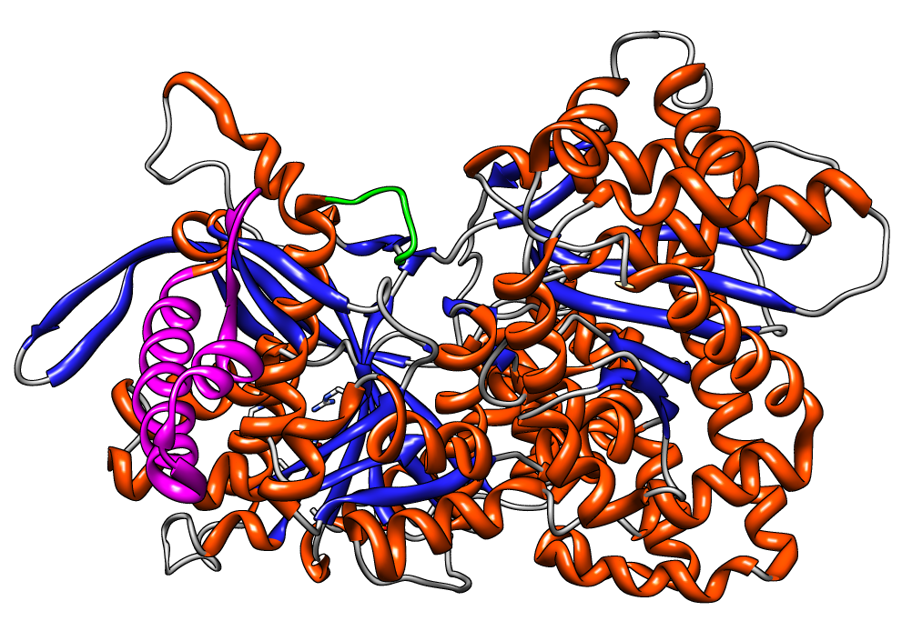

Slide 39
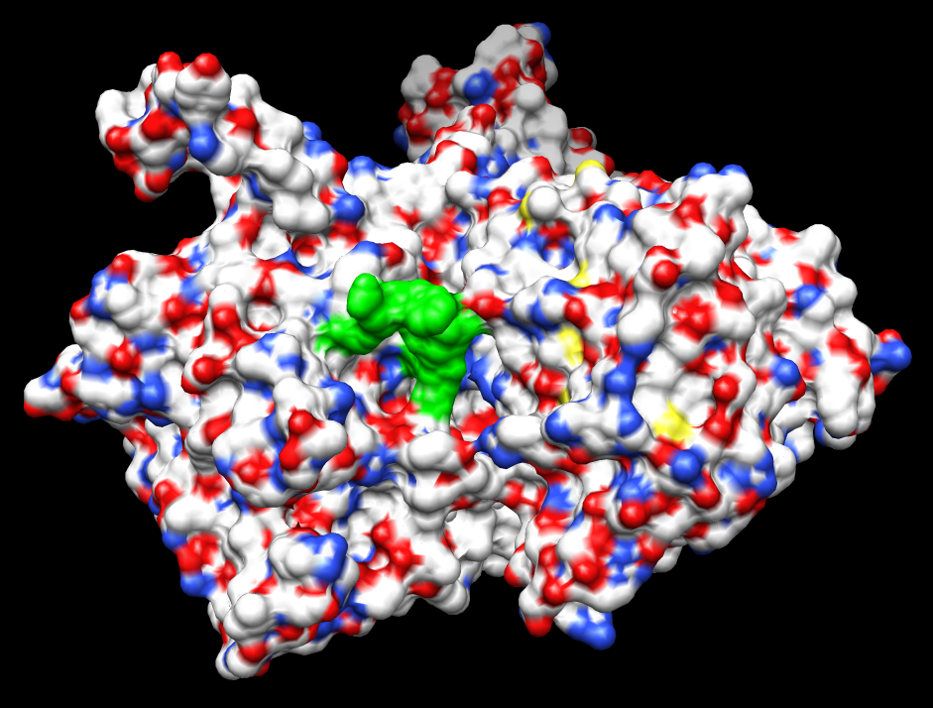

Slide 40
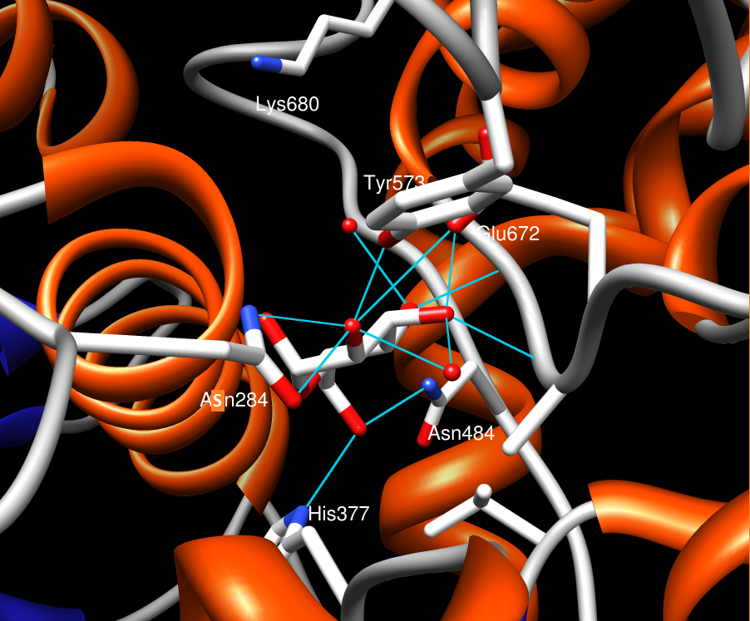
C-terminal Catalytic Domain
Residue (491-842):
- α/β sandwich with Rossmann-fold topology
- Lys680 is covalently linked to the pyridoxal-5’-phosphate (PLP) cofactor
- Residues surrounding the catalytic site (H377, Q284, Q484, D672, and Y573) anchor the substrate through H-bonds
Catalytic site is formed by the cleft between two domains and is blocked by the 280-loop in the T-state
Competitive inhibitor can bind at the substrate anchoring site and thus prevents catalysis.
Notes:
IMP (inosine monophosphate) is formed by the deamination of AMP. Rossmann-fold topology, as I have previously talked about in my first presentation, is discovered by Dr. Michael Rossmann in Purdue and is usually involved in nucleotide binding (NAD or ATP/AMP). Second picture glucose

Slide 41
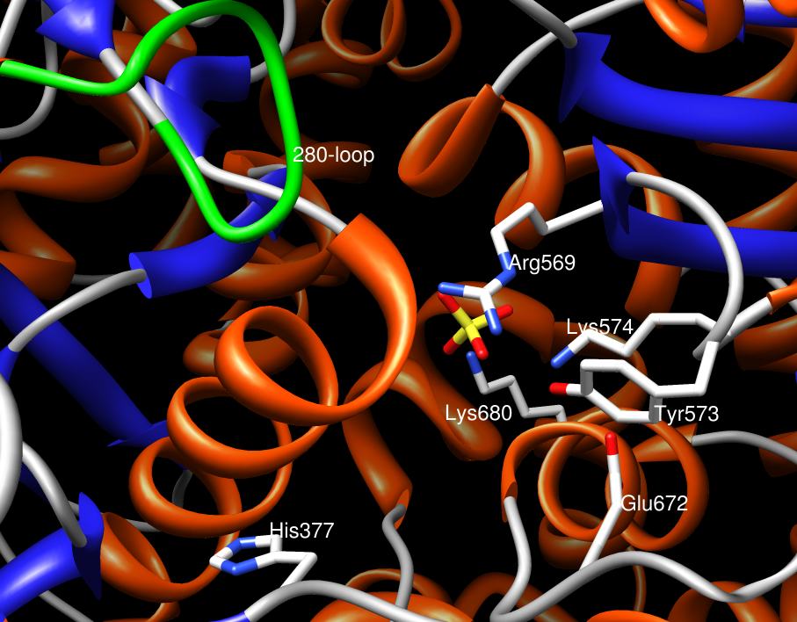

Slide 42
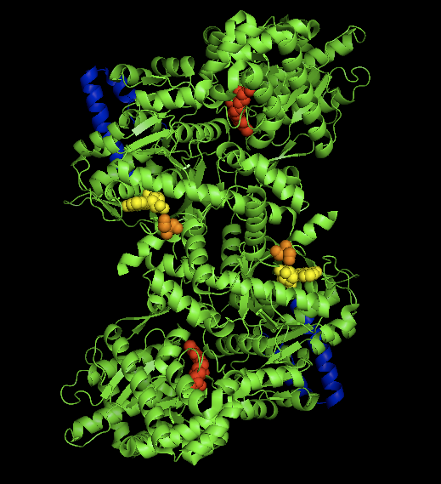
Notes:
This figure shows us the surface of glycogen phosphorylase. The green patch we see here is the 280-loop that I have previously showed you. As we can see here, the loop covers the active site. Blue – glycogen binding; orange – phosphorylation; red – PLP; yellow – AMP/ATP binding site

Slide 43
GP Mechanism

Slide 44
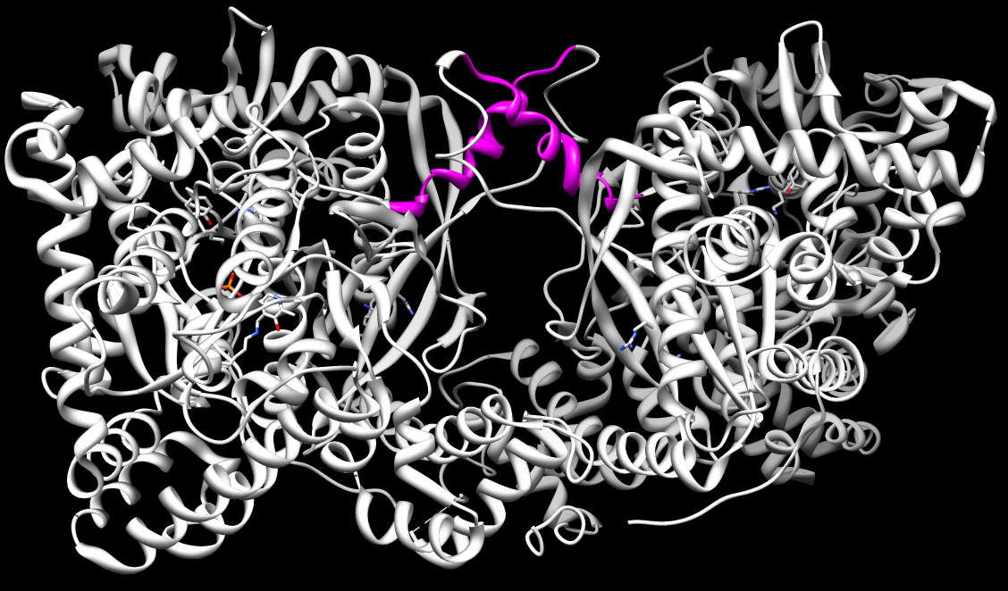
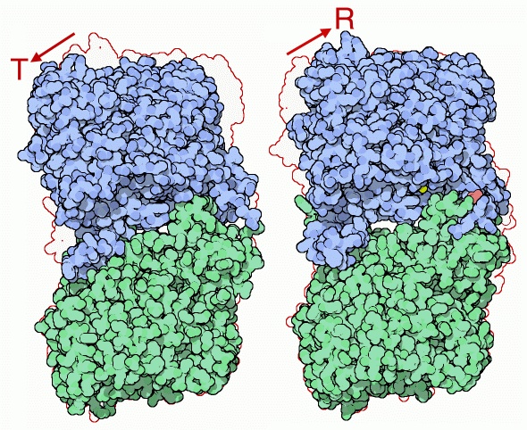
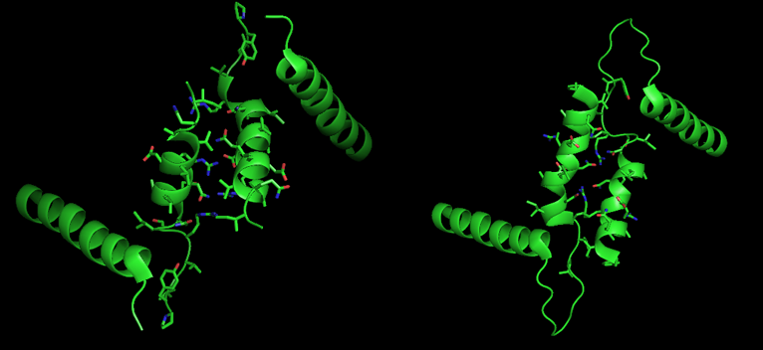
R-state and T-state
R-state
T-state
Notes:
AMP binding rotates the tower helices (residues 262-278) of the two subunits 50˚ relative to one another through greater organization and intersubunit interactions. This rotation of the tower helices leads to a rotation of the two subunits by 10˚ relative to one another, and more importantly disorders residues 282-286 (the 280s loop) that block access to the catalytic site in the T state but do not in the R state.

Slide 45
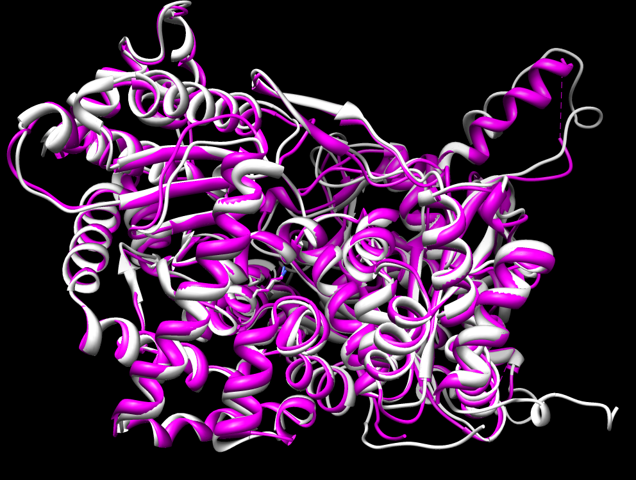
Residues Conserved?
Notes:
White- rabbit; Purple-human

Slide 46
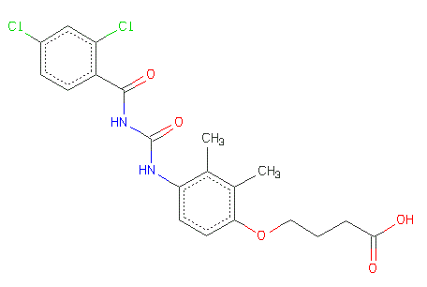
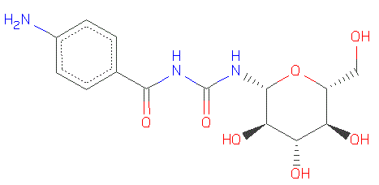
Inhibitors (Vina Docking)
Glycogen phosphorylase is a validated target for treating type II diabetes
Inhibitors can compete with AMP/P_{i} at the N-terminus allosteric site or block the entry way to catalytic site.
Current research has shown that acyl urea derivatives show inhibitory activity toward GP by binding to the AMP/ATP allosteric site (ex. Inhibitor 1) or occupying the catalytic site (ex. Inhibitor 2).
Inhibitor 1
Inhibitor 2
Notes:
Because inhibiting glycogen phosphorylase can lead to the attenuation of hyperglycemia associated with type II diabetes. If the inhibitor can bind to the allosteric site, it can promote the protein toward its T-state and inactivate glycogen phosphorylase.

Slide 47
Inhibitor 1 Docking
4-[4-[(2,4-dichlorophenyl)carbonylcarbamoylamino]-2,3-dimethyl-phenoxy]butanoic acid

Slide 48
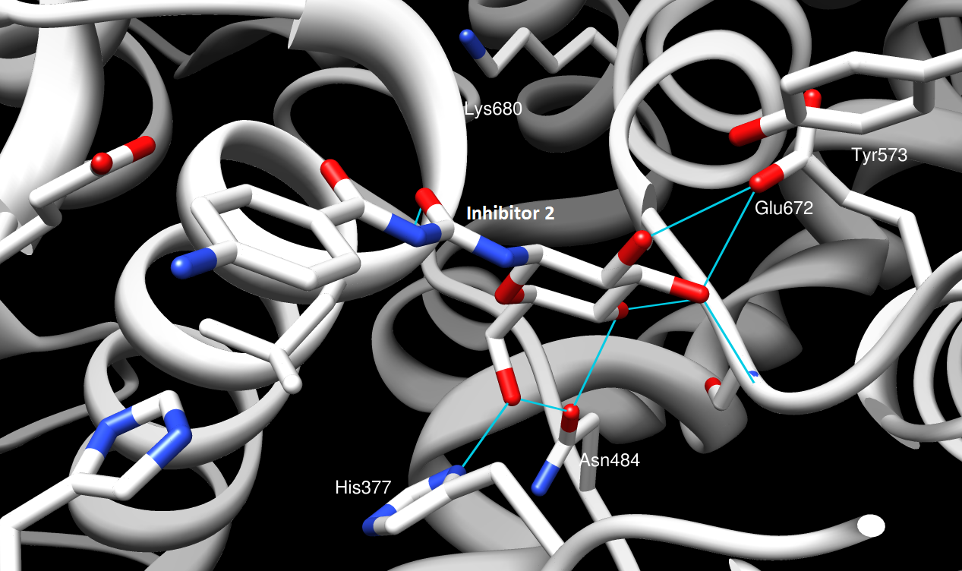
Inhibitor 2 Docking
N-{[(4-aminophenyl)carbonyl]carbamoyl}-beta-D-glucopyranosylamine

Slide 49
Notes:
Green – (up to down)bats, rabbits, rats and mouse; Yellow – primates, (up to down)galago, baboon, human, titi monkey in africa, new world monkey in brazil; Blue – other mammals (up to down)horse, cattle, sheep, wild boar, and giant panda

Slide 50
Glycogen Phosphorylase
Conformational changes and allosteric control
Glycogen storage site
Pyridoxal-5’-phosphate cofactor
High conservation – cellular importance
Good target for treating Type II diabetes

Slide 51
Petal Death Protein – Dianthus caryophyllus
Alanine Racemase – Bacillus anthracis
Glycogen phosphorylase – Oryctolagus cuniculus
Thrombin-Activatable Fibrinolysis Inhibitor – Homo sapiens

Slide 52
Enzyme and Host Organism
Thrombin-activatable Fibrinolysis Inhibitor (Carboxypeptidase B2) from Homo sapiens
- Bouma, B.N., Marx, P.F., et. al. (2001). Thrombin-Activatable Fibrinolysis Inhibitor (TAFI). Thrombosis Research, 101: 329-354.
- Valnickova, Z., Christensen, T., et. al. (2005). Post-translational Modifications of Human TAFI: Evidence for a Large Shift in the Isoelectric Point and Reduced Solubility upon Activation. Biochemistry, 45: 1525 – 1535.
NCBI Accession Number: Q96IY4
PDB ID: 3LMS

Slide 53
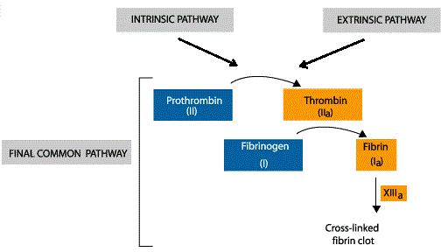
Coagulation and Fibrinolysis
Coagulation – a complex process by which blood forms clots; requires platelet and coagulation factor (fibrinogen)
Fibrinolysis – blood clots are reorganized and resorbed; the enzyme plasmin is primarily responsible.
Notes:
Primary homeostasis – platelets immediately form a plug; secondary homeostasis occurs as clotting factors respond in a complex cascade to form fibrin strans, which strengthen the plug. In order to effectively form clots at the injury site, fibrinolysis must be inhibited. This protein, TAFI, is performing this role.

Slide 54
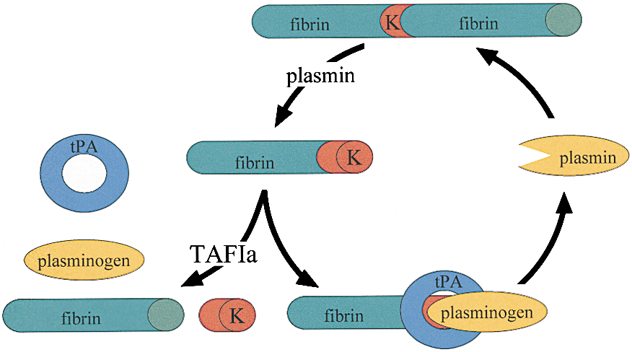
Essentially, TAFI links the coagulation and fibrinolytic systems by down-regulating fibrinolysis and stabilizing the fibrin clots
Notes:
Essentially, TAFI links the coagulation and fibrinolytic systems by downregulating fibrinolysis and stabilizing the fibrin clot.

Slide 55
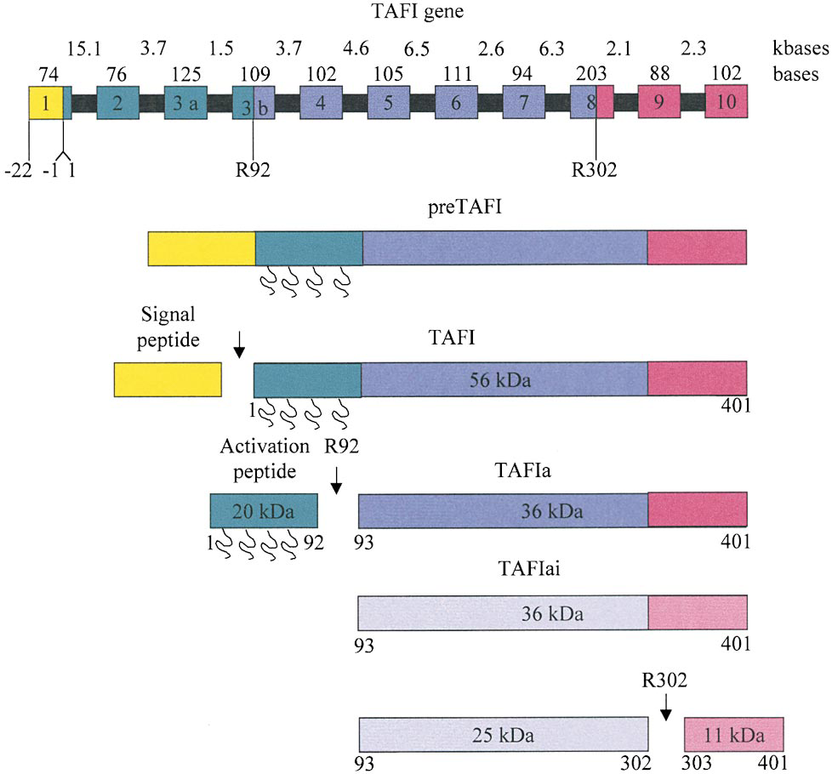
Thrombin-Activatable Fibrinolysis Inhibitor (TAFI)
Synthesized in the liver and secreted in its zymogen form (inactive)
Circulates in plasma in its inactive form of 4-15 µg/mL and is present in several tissues such as pancreas
Can be activated by trypsin, plasmin, thrombin, or thrombin-thrombomodulin complex.
Glycoprotein (zymogen) – 20% of its total mass is made of carbohydrates
Belongs to the family of metallocarboxypeptidases, which carry a zinc atom that is important for catalysis
Conformational change - Inactivation
Notes:
The family of carboxypeptidases consists of serine carboxypeptidases, cysteine carboxypeptidases, and metallocarboxypeptidases. One thing to note that the activation of TAFI releases the activation peptide containing the majority of the attached glycans, thereby reducing the solubility of TAFI and shortening its half-life from several hours to few minutes. 423 – 401 - 309

Slide 56
Human TAFIa
Hydrolase (EC 3.4.17.20); Monomer; 309 amino acids
Catalyzes the hydrolysis of peptide bond of C-terminal lysine or arginine residues (R > K)
Activated by a single cleaved at Arg-92, removing the activation peptide that shielded the active site
Notes:
3.4.17.20 – hydrolase acting on peptide bonds, requires metal, specifically releases terminal lysine or arginine residue

Slide 57
Zinc Ion Coordination
Zinc ion is coordinated by three amino acid residues: Histidine67, Glutamate70, Histidine196
Zinc also coordinates:
- the catalytic water
- the oxyanion intermediate

Slide 58
Substrate Binding and Specificity
Asparagine142, Arginine143, and Tyrosine249
- Form extensive H-bond network with substrate backbone and side-chains
Aspartate256 confers substrate specificity
- Helps recognize the lysine/arginine residue at the carboxy end of peptide chain
- Binds to lysine/arginine through H-bond

Slide 59
Catalytic Residues
Arginine125 and Glutamate271
- Glutamate acts as a proton extractor from a water molecule
- Both residues help anchoring the oxyanion intermediate formed by hydrogen bonding

Slide 60
Notes:
Alpha-beta-alpha sandwich, Glutamate270 and Arginine124 for Catalysis; Asparagine144, Arginine145, Tyrosine248 for substrate binding; Histidine 69, Glutamate72, and Histidine196 for zinc ion binding. Asparate 256 for substrate specificity

Slide 62
Carboxypeptidase A vs. TAFI
Magenta – TAFI; White – Human Carboxypeptidase A
Notes:
Carboxypeptidase A4 – cleaves C-terminal of aromatic residues (contain a isoleucine residue instead of aspartate)

Slide 64
TAFI
Coagulation and Fibrinolysis
Zymogen
Arginine or Lysine
Metal coordination
Divergent evolution

Slide 65
Something to think about…
Did the petal death protein evolve to obtain its promiscuity? Or was it built like that?
You saw two proteins (which two?) with TIM-barrel topology today and each has a different function? What does it tell you about TIM-barrels?
Why does glycogen phosphorylase dissociate to form dimers upon catalysis?
What ways do you think that TAFI can be inhibited? (other than degradation).
Where did babies come from?

Slide 66
Questions?

