Slide 1
Understanding the complexity of Protein Function
Jarod Fincher
Biochemistry II
Instructor: Dr. Jason Hurlbert “a.k.a House”

Slide 2
Pantothenate Synthetase Mycobacterium tuberculosis
PDB: 3IMG
Wang, Shuishu. Crystal Structure of Pantothenate Synthetase from Mycobacterium tuberculosis, Snapshots of the Enzyme in Action. Biochemistry. 2006. 45. 1554-1561.

Slide 3
Background Information
Was discovered by German Physician Dr. Robert Koch. Awarded the Nobel Prize in 1905 and is referred to as “The Father of Bacteriology”
Mycobacterium Tuberculosis (TB) primarily affects the lungs
There are two forms:
TB Infection
TB Disease
TB kills over 2 million people a year. Very prone in HIV patients

Slide 4
So what is Pantothenate Synthetase (PS)?
Enzyme class: Ligase
Method: X-Ray Diffraction
Pantothenate Synthetase catalzyes the ATP-dependent condensation of pantoate and β-alanine to form pantothenate (Vitamin B₅)
Active site is located on the N-terminal domain, partially covered by the C-terminal domain
Flexible wall at active site cavity in a conformation incapable of binding pantoate
Precursor for the biosynthesis of CoA and acyl carrier proteins, both playing roles in metabolism
Notes:
Pantothenate Synthestase is a precursor for the biosynthesis of coenzymeA(CoA) and acyl carrier proteins(ACP). Both play critical roles in many cellular processes such as energy metabolism and fatty acid metabolism.

Slide 5
Mycobacterium Tuberculosis Pantothenate Synthetase
N-terminal
dimeric protein

Slide 6
Two Step Mechanism
Figure taken from Organic and Biomolecular Chemistry

Slide 7
Pantoyl adenylate (key intermediate)
ASP 161
Notes:
Binding of B-alanine can only occur after formation of of the Pantoyl adenylate adenylate

Slide 8
B-Alanine and Pantoyl Adenylate
Wang, Shuishu. Crystal Structure of Pantothenate Synthetase. Biochemistry. 2006. 45. 1554-1561.
Notes:
Superposition of the active site residues ofsubunit A between the â-alanine complex and the pantoyl adenylatecomplex (PDB entry 1N2I). The active site residues align well withan rmsd for CR atoms of less than 0.15 Å. The protein structure isfrom the â-alanine complex, as in panel A, except that Tyr82 andthe water molecules are not shown. The pantoyl adenylate moleculecolored cyan is from the pantoyl adenylate complex. A hydrogen
bond from the carboxylate group of â-alanine to the Gln72 sidechain is shown as a cyan dashed line. The distance between theamino group of â-alanine and the phosphate oxygen of pantoyladenylate is 2.8 Å, suggesting a potential hydrogen bond (shownas a magenta dashed line) for initial binding of â-alanine. In thisbinding position, the nitrogen atom of â-alanine is 3.38 Å fromthe carbonyl carbon of the pantoyl group. This figure was prepared

Slide 9
Sequence Alignment

Slide 10
Phylogenetic Tree
thermophilic
Gram negative

Slide 11
Prostaglandin I2 Synthase Danio rerio
PDB: 3B98
Li, Yi-Ching. Structures of Prostacyclin Synthase and Its Complexes with Substrate Analog and Inhibitor Reveal a Ligand-specific Heme Conformation Change. Journal of Biological Chemistry. 2008. 5. 2917-2926

Slide 12
Background Information
Discovered over 20 years ago
Enzyme Class: Isomerase
Is a member of the cytochrome P450 enzyme family
P450s belong to a large family of proteins containing a heme cofactor
P450 enzymes have been identified in all domains of life
Prostaglandins are derivative of Arachidonic acid and produced by Cox-1 and Cox-2 (cyclooxygenase)
Notes:
CYP enzymes have been identified in all domains of life, i.e., in animals, plants, fungi, protists, bacteria, archaea, and even viruses. Cytochrome P450 enzymes are present in most tissues of the body, and play important roles in hormone synthesis and breakdown (including estrogen and testosterone synthesis and metabolism), cholesterol synthesis, and vitamin D metabolism. PGIS is unusual in that it catalyzes an isomerization rather than a monooxygenation, which is typical of P-450 enzymes.

Slide 13
Prostaglandin I2 Synthase Function
Catalyzes production of prostacyclin from prostaglandin H₂
Protaglandin I2 is a potent inhibitor of vasoconstriction, platelet activation, and aggregation
Widely known for its vasoprotective activity
PGIS and Thromboxane synthase are the only two P450 enzymes that metabolize an endoperoxide moiety as their physiological substrate
Favors homolytic cleavage of peroxide bond from fatty acid peroxides
Unusual in that is catalyzes an isomerization rather than a monooxygenation (typical of P450)
Notes:
PGIS is unusual in that it catalyzes an isomerization rather than a monooxygenation(insertion of one atom of oxygen into an organic substrate (RH) while the other oxygen atom is reduced to water), which is typical of P450 enzymes. The function of most CYP enzymes is to catalyze the oxidation of organic substances.

Slide 14
Danio rerio Prostaglandin I2 Synthase

Slide 15
Prostaglandin I2 Mechanism
Notes:
Isomerization reaction is triggered by a sterospecific binding of C-11 oxygen of PGH2 to the heme-iron of PGIS. Following initial substrate binding, a one-electron transfer from Fe(III) to an O-O bond induces a homolytic cleavage of the endoperoxide, leading to the formation of Fe(IV)-porphyrin and alkoxy radical. Cyclization between the radical and the alkene C-6 takes place to produce a five-member ring and the C-5 radical. The change in the electronic state of the active site favors the transfer of an electron from NAD(P)H via cytochrome P450 reductase or another associated reductase^{[9]} This takes place by way of the electron transfer chain, as described above, reducing the ferric heme iron to the ferrous state.

Slide 16
F(G/S)XGX(H/R)XCXG Motif found in P450s
In PI2 the sequence varies WGTEDNLGPG
HEME group is selected in cyan blue
Classic example of divergent evolution
Cysteine ligand loop
Cys
Notes:
Highly conserved cysteine ligand loop present in all P450 enzymes. However, in PS the 10 aa sequence differs but still serves the same function. Here is a classic example of divergent evolution. Loops of both proteins are shaped via a hydrogen bond between backbone of carbonyl tryptophan and the backbone amide of the invariant cysteine.

Slide 17
Sequence Alignment of Cytochrome P-450s

Slide 18
Phylogenetic Tree
amphibians
mammals

Slide 19
Glycerol-3-Phospate dehydrogenase Escherichia coli
PDB: 2QCU
Yeh, Joanne. Structure of glycerol-3-phosphate dehydrogenase, an essential monotopic membrane enzyme involved in respiration and metabolism. PNAS. 2008. 105. 3280-3285.

Slide 20
Glycerol-3-Phosphate Dehydrogenase
Enzyme class: Oxidoreductase
Purified in 1972 by Weiner JH
Method: X-Ray Diffraction
Exhibits membrane-dependency for activity
Is one of the key flavin-linked dehydrogenases in the electron transport chain

Slide 21
G-3-P dehydrogenase function
Catalyzes the oxidation of G-3-P to dihydroxyacetone phosphate (DHAP)
Reduction of FAD to FADH₂
Channels electrons into respiratory chain by reducing UQ (ubiquinone)
Originally thought to be a metalloenzyme but is actually inhibited by metals.

Slide 22
Glycerol metabolic pathway in E. coli
Notes:
Fig. 1. Schematic of the glycerol metabolic pathway in E. coli. Protein members of the glycerol metabolic pathway includes glycerol facilitator (GlpF/AQP), a member of the aquaporin family of major intrinsic proteins. The soluble glycerol kinase (GK) phosphorylates glycerol to G3P. Another membrane protein constituent of this pathway is the transporter for the uptake of G3P (GlpT) with concomitant exit of Pi. Oxidation of G3P to DHAP is catalyzed by the monotopic membrane enzyme, glycerol-3-phosphate dehydrogenase (GlpD), a primary dehydrogenase. Concurrent with oxidation of G3P is reduction of flavin adenine dinucleotide (FAD) to FADH2, which passes on electrons to ubiquinone (UQ) forming the reduced form (UQH2) and ultimately shuttling electrons to oxygen or nitrate.

Slide 23
Escherichia coli Glycerol-3-Phosphate Dehydrogenase
Dimeric Protein

Slide 24
GlpD has two major domains
“cap”
N-terminal FAD-binding domain
“Switch point”
Notes:
The cap domain exhibits highly negatively electrostatic potential. Highly positive patches at located at the base region of the enzyme, indicating that these regions are likely involved with the negatively charged membrane phospholipid head groups. There is large hydrostatic patches between these two regions. “Switch point” is where UQ(ubiquinone) docking site is located. Structural evidence that this region is the UQ docking site is that a number of Beta-strands are found here, presenting a planar lipophilic surface. Both strands are adjacent parallel. An interesting fact is that several different mitochondrial GlpD require exogenous phospholipids or nondenaturing detergents for electron-transfer activity.

Slide 25
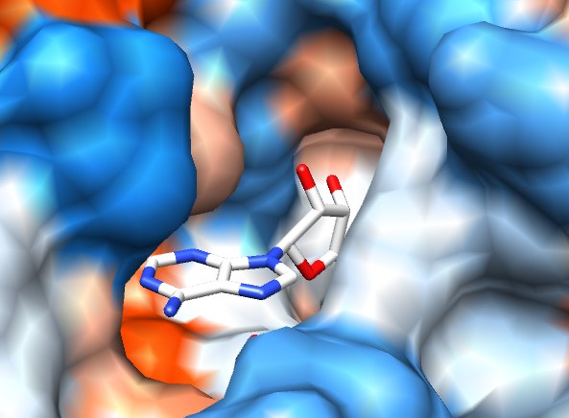
Surface Interactions
Ubiquinone
Notes:
The cap domain exhibits highly negatively electrostatic potential. Highly positive patches at located at the base region of the enzyme, indicating that these regions are likely involved with the negatively charged membrane nnnnphospholipid head groups. There is large hydrostatic patches between these two regions. Another striking freature of the cap domain is the overall negative electrostatic surace, which may aid in susubstrate recognition. The positive electrostatic potential of the base of the FAD-domain delineates the regions that interacts with the negative phospholipid head groups of the membrane bilayer. The distinct electrostatic ”polarity” of the distal membrane bilayer. These results help indicate the membrane-interacting regions.

Slide 26
Mechanism
Anchor point
Hydride transfer of G3P to FAD results in dihydroflavin anion state
stabilizer
Notes:
The catalytic center is shielded from solvent providing an apolar microenviroment required for catalysis that has been observed in other flavoenzymes. The isoalloxazine ring forms numerous interactions with the protein polpeptide on the si-side; residues in proximity of 3.4A are Ser-46, Leu48, His50, Leu355 and Thr356. The binding interactions with the phosphate group of the subof the substates are conserved in all of the structures, possible serving as the initial anchor-point that aligns the substrate for dehydrogenation. At the active site, Arg317 is in proximity to the hydroxyl group of C2. Arg 317 acts tas the base first deprotonating the hydroxyl group O2 of C2 in G3P to initiate the dehydrogenation. Hydride transfer from C2 of G3P to N5 of FAD results in the dihydroflavin anion state. The reduced flavin is stabilized by Lys354. Lack of additional cofactors suggests that electron transfer from FADH2 to UQ may be mediated through protein residues or that a ping-pong type mechanism may function whereby the product, DHAP, first exits the cleft, permitting UQ access to FADH2 for reduction.

Slide 27
Residues that interact with isoalloxazine ring
Notes:
These residues form intimate interactions with FAD so substrates can only bind at the re-face of the isoalloxazine ring.

Slide 28
Sequence Alignment

Slide 29
Phylogenetic Tree
Gram negative bacteria

Slide 30
Pectate Lyase C Erwinia chrysanthemi
PDB: 1AIR
Scavetta, Robert. Structure of a Plant Cell Wall Fragment Complexed to Pectate Lyase C. The Plant Cell. 1999. 11. 1081-1092

Slide 31
Erwinia chrysanthemi Pectate Lyase C
Enzyme class: Lyase
Pectate Lyases occur in 5 of the 21 families polysaccharide lyases
PLs are depolymerizing enzymes that degrade plant cell walls
Catalyze cleavage of pectate, the major component that maintains the structural integrity of a plant cell’s wall

Slide 32
Erwinia chrysanthemi Pectate Lyase C

Slide 33
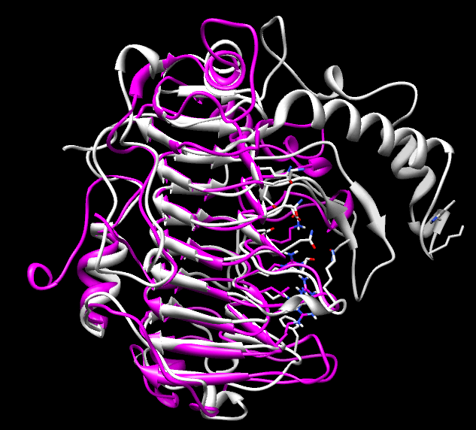
Structural Comparison of Bacillus subtillis and E. chrysthemi
All PLs share an unusual structural motif termed the parallel β-helix
Notes:
Pectate Lyase from Bacillus subtilis is shown in gray and structurally aligned with Pectate Lyase C from Erwinia chrysathemi. The beta-strands are folded into a large, right handed coil. The protruding loops on one side of the parallel B-helix form the petolytic active site.

Slide 34
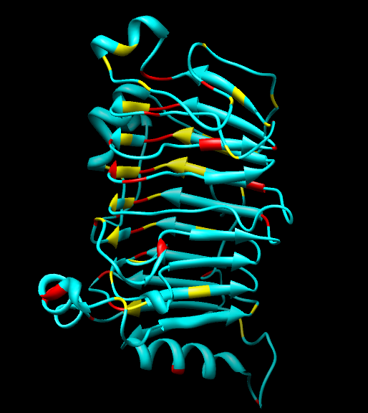
Stacking of the B-strand
Asn (red)
Aromatic (yellow)

Slide 35
Mechanism

Slide 36
Tetragalacturonic acid bound in active site

Slide 37
So can any sugar bind? Like glucose?

Slide 38
Tetragalacturonic Acid bound without Ca²⁺
TetraGalpA
Notes:
TetragalpA(tetra-GALACTOPYRANURONIC ACID) bound to the active site. Here we see from docking that TetraGalpA is still able to bind with a negative free energy without the metal Ca2+. Ca2+ is required for proteolytic activity and cross link the uronic acid moieties of neighboring antiparrallel chains of PGA together. “Egg box” model

Slide 39
Sequence Alignment

Slide 40
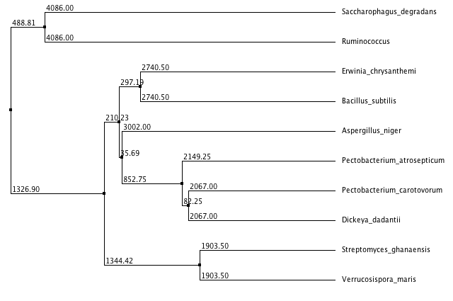
Phylogenetic Tree

Slide 41
The End!!!
Questions?

