Slide 1
The Central Dogma
The flow of genetic information is generally from DNA to RNA to proteins, a scheme called the central dogma.

Slide 2
Section 4.1 A Nucleic Acid Consists of Four Kinds of Bases Linked to a Sugar­­–Phosphate Backbone
Nucleic acids are long, linear polymers constructed from four types of monomers.
Each monomer consists of a sugar, a phosphate, and a nitrogenous base.
The sequence of the bases is the information content of the nucleic acid.

Slide 3
Polymeric Structure of Nucleic Acids
Notes:
FIGURE 4.1 Polymeric structure of nucleic acids.

Slide 4
DNA and RNA Differ in the Sugar Component and One of the Bases
The sugar component of deoxyribonucleic acid (DNA) is deoxyribose, a ribose in which the 2’-hydroxyl is replaced with a hydrogen.
Ribonucleic acid (RNA) contains the sugar ribose.
The backbones of DNA and RNA consist of sugars linked by phosphodiester bridges between the 3’-hydroxyl of one sugar and the 5’-hydroxyl of an adjacent sugar.
Bases are attached to carbon atom 1’ in the sugar.
Two of the bases are purines (adenine and guanine), and two are pyrimidines [cytosine and thymine (DNA) or uracil (RNA)].

Slide 5
Ribose and Deoxyribose
Notes:
FIGURE 4.2 Ribose and deoxyribose. Atoms in sugar units are numbered with primes to distinguish them from atoms in bases (see Figure 4.4).

Slide 6
Backbones of DNA and RNA
Notes:
FIGURE 4.3 Backbones of DNA and RNA. The backbones of these nucleic acids are formed by 3′-to-5′ phosphodiester linkages. A sugar unit is highlighted in red and a phosphate group in blue.

Slide 7
Purines and Pyrimidines
Notes:
FIGURE 4.4 Purines and pyrimidines. Atoms within bases are numbered without primes. Uracil instead of thymine is present in RNA.

Slide 8
Nucleotides are the Monomeric Units of Nucleic Acids
A nitrogenous base bound to a sugar is called a nucleoside. The nucleosides of DNA are deoxyadenosine, deoxyguanosine, deoxycytidine, and deoxythymidine. By convention, deoxythymidine, which rarely occurs in RNA, is simply called thymidine.
The nucleosides of RNA are adenosine, guanosine, cytidine, and uridine.
The C-1’ of the sugar is attached to the N-9 of the purine or the N-1 of the pyrimidine by a β-glycosidic bond.
A nucleotide is a nucleoside with one or more phosphoryl groups.
Nucleoside triphosphates are the building blocks of DNA and RNA.

Slide 9
β-Glycosidic Linkage in a Nucleoside
Notes:
FIGURE 4.5 β-Glycosidic linkage in a nucleoside.

Slide 10
Examples of Nucleotides
Notes:
FIGURE 4.6 Nucleotides adenosine 5′-triphosphate (5′-ATP) and deoxyguanosine 3′-monophosphate (3′-dGMP).

Slide 11
Nucleic Acid Conventions
Nucleic acid chains are represented by abbreviations such as pApGpCpT, pAGCT, or more simply AGCT.
Nucleic acid chains have directionality since the two ends are different. One end has a phosphoryl group attached to the 5’ carbon atom of the sugar, and one end has a free hydroxyl attached to the 3’ carbon of the sugar.
By convention, nucleic acid sequences are typically written from left to right in the 5’-to-3’ direction.

Slide 12
A Stylized Structure of a DNA Chain
Notes:
FIGURE 4.7 Structure of a DNA chain. The chain has a 5′ end, which is usually attached to a phosphoryl group, and a 3′ end, which is usually a free hydroxyl group.

Slide 13
Section 4.2 A Pair of Nucleic Acid Strands with Complementary Sequences Can Form a Double-Helical Structure
The double helix is stabilized by hydrogen bonds and van der Waals interactions.
Because of the base pairing rules (A-T and G-C), the sequence of one strand determines the sequence of the partner strand.
The two strands can be separated and complementary sequences synthesized to generate two identical daughter strands.

Slide 14
X-ray Diffraction Photograph of a Hydrated DNA fiber
Notes:
FIGURE 4.10 X-ray diffraction photograph of a hydrated DNA fiber. When crystals of a biomolecule are irradiated with x-rays, the x-rays are diffracted and these diffracted x-rays are seen as a series of spots, called reflections, on a screen behind the crystal. The structure of the molecule can be determined by the pattern of the reflections (Section 3.5). In regard to DNA crystals, the central cross is diagnostic of a helical structure. The strong arcs on the meridian arise from the stack of nucleotide bases, which are 3.4 Å apart. [Science Photo Library.]

Slide 15
X-Ray Diffraction Image of B-form DNA
The X-pattern in the middle shows that the molecule is helical
The regularity of the spot spacings shows that the structure is regular and repeating
The spacing between the bars is indicative of the helical turn distance (34 Å is the height of one turn)

Slide 16
X-Ray Diffraction Image of B-form DNA
The distance from the middle to the top or bottom bar is the distance b/w the base pair stacks (3.4 Å)
The height of each turn (34Å) and the distance between the stacked base pairs (3.4Å) told Watson and Crick that there were 10 base pairs per turn!

Slide 17
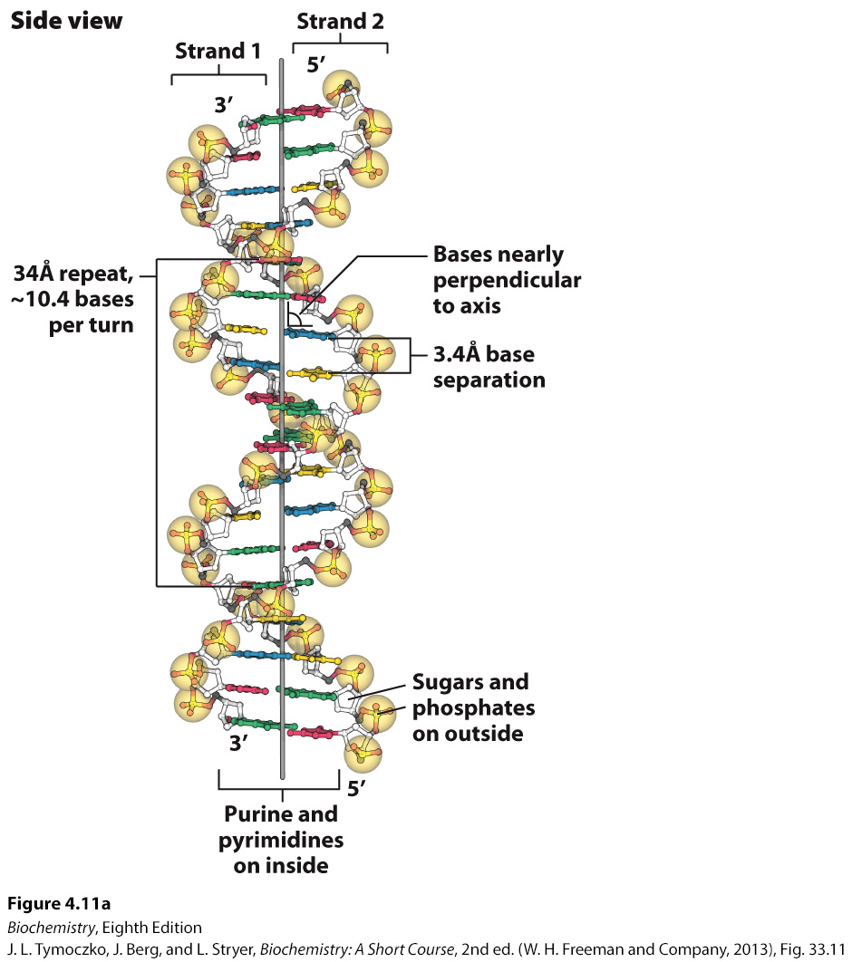
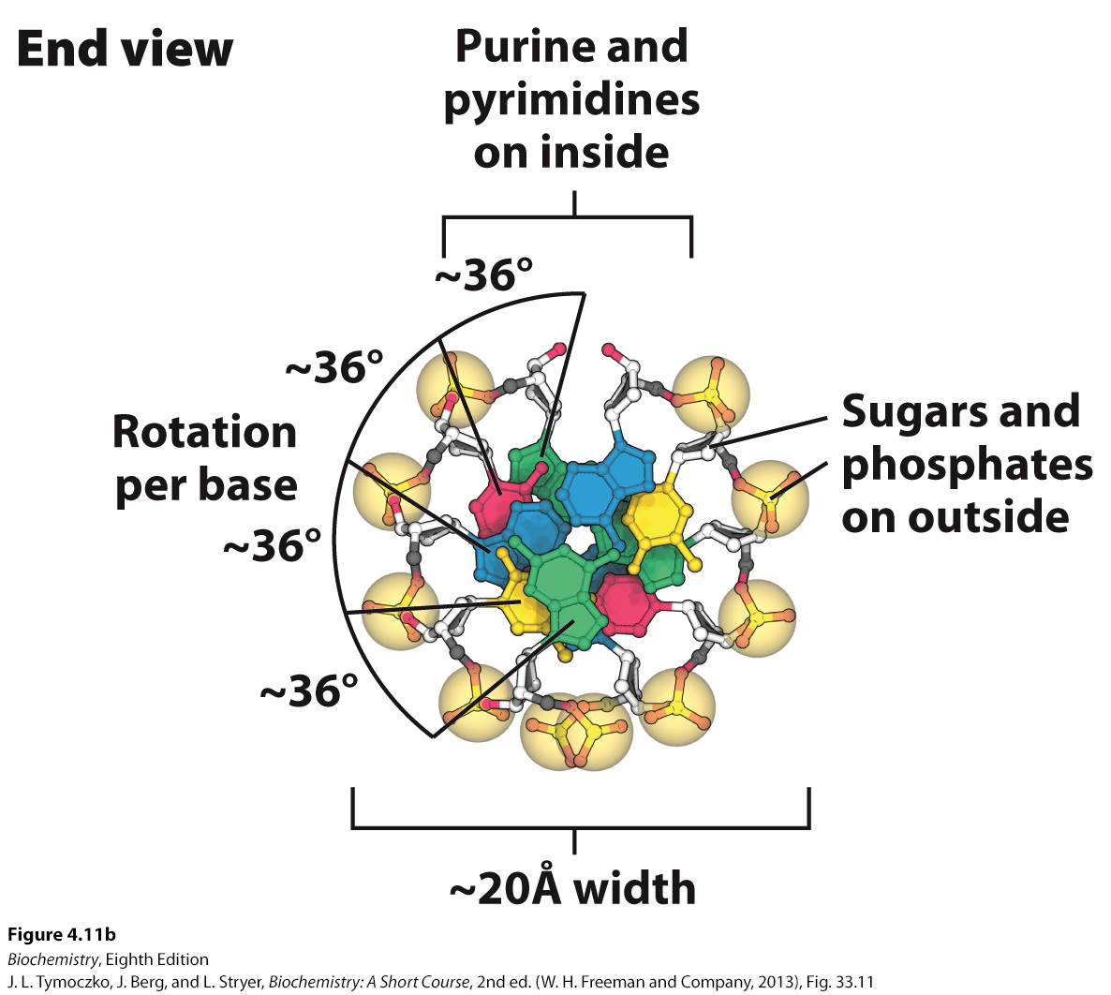
Watson–Crick Model of Double-helical DNA
Notes:
FIGURE 4.11 Watson–Crick model of double-helical DNA. (A) Side view. Adjacent bases are separated by 3.4 Å. The structure repeats along the helical axis (vertical) at intervals of 34 Å, which corresponds to approximately 10 nucleotides on each chain. (B) Axial view, looking down the helix axis, reveals a rotation of 36° per base and shows that the bases are stacked on top of one another [Source: J. L. Tymoczko, J. Berg, and L. Stryer, Biochemistry: A Short Course, 2nd ed. (W. H. Freeman and Company, 2013), Fig. 33.11.]

Slide 18
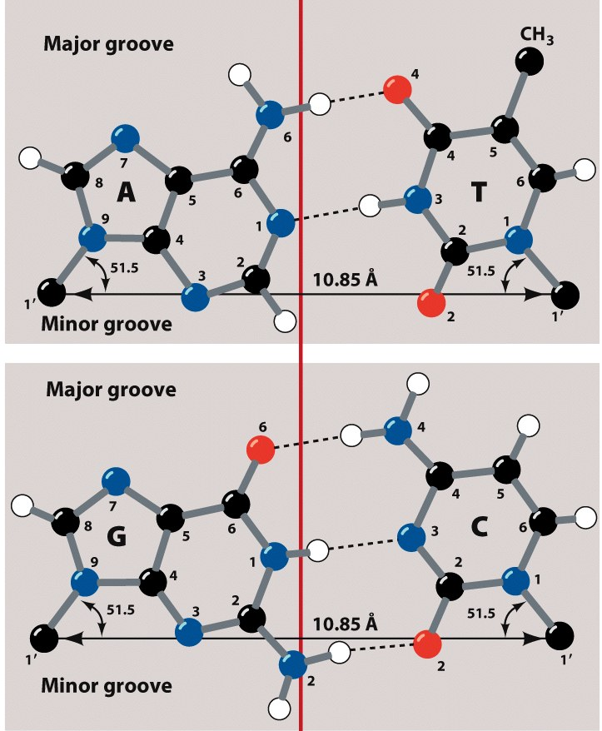
Structures of the Base Pairs Proposed by Watson and Crick
The Watson-Crick base pairing keep the helix from distorting
Perfect example of form and function
Notes:
FIGURE 4.12 Structures of the base pairs proposed by Watson and Crick.

Slide 19
Implications on DNA – Protein Interactions
On the major and minor grooves of DNA, chemical moieties on the nitrogenous bases are available to interact with amino acid side chains of proteins
Most frequent amino acid side chains found to interact with DNA are:
Asn, Gln, Glu, Lys and Arg
There is much greater variation in the Major groove (one more position), so proteins have more chances at selectivity

Slide 20
Features of the Watson–Crick Model of DNA Deduced from the Diffraction Patterns
Two helical, antiparallel polynucleotide strands are coiled around a common axis in a right-handed helix.
The sugar–phosphate backbones are on the outside and the purine and pyrimidine bases lie on the inside of the helix.
The bases are nearly perpendicular to the helix axis.
The various measurements in Angstroms of the helix could be determined.

Slide 21
Base Compositions Experimentally Determined for a Variety of Organisms
In 1950–before the three-dimensional structure of DNA was established–Erwin Chargaff observed that the adenine:thymine and guanine:cytosine ratios were each nearly 1:1 in a variety of organisms while the adenine:guanine ratio varied

Slide 22
A Side View of DNA
The van der Waals interactions that help to stabilize DNA are sometimes referred to as “base stacking” interactions.
Notes:
FIGURE 4.13 A side view of DNA. Base pairs are stacked nearly one on top of another in the double helix. The stacked bases interact with van der Waals forces. Such stacking forces help stabilize the double helix. [Source: J. L. Tymoczko, J. Berg, and L. Stryer, Biochemistry: A Short Course, 2nd ed. (W. H. Freeman and Company, 2013), Fig. 33.13.]

Slide 23
DNA can Assume a Variety of Structural Forms
In the cell, the most commonly seen form of the DNA double helix is called the B form or the Watson–Crick helix.
The double helix can also exist in an A form, which is shorter and wider than the B form with the bases at an angle rather than perpendicular to the helix axis. In the A forms, the sugar is in the C-3’-endo conformation, while the sugar is in C-2’-endo configuration in the B form.
The A form is seen in RNA double helices and in RNA–DNA hybrid helices, structures observed in transcription and RNA processing.

Slide 24
B-form and A-form DNA
Notes:
FIGURE 4.14 B-form and A-form DNA. Space-filling models of 10 base pairs of B-form and A-form DNA depict their right-handed helical structures. Notice that the B-form helix is longer and narrower than the A-form helix. The carbon atoms of the backbone are shown in white. [Drawn from 1BNA.pdb and 1DNZ.pdb.]

Slide 25
Some DNA Molecules are Circular and Supercoiled
To fit inside a cell, the DNA molecule must be compacted. In E. coli, the DNA double helix is a circular molecule that is twisted into a superhelix by the process of supercoiling.
The relaxed circular DNA and the superhelix form are topological isomers of each other.
Notes:
FIGURE 4.17 Electron micrographs of circular DNA from mitochondria. (A) Relaxed form. (B) Supercoiled form. [Courtesy of Dr. David Clayton.]

Slide 26
Single-stranded Nucleic Acids can Adopt Elaborate Structures
A common structural motif seen in nucleic acids, most notably RNA, is the stem-loop, which occurs when complementary sequences in the same strand form a double helix.
Non-Watson-Crick base pairs occur frequently in RNA.
More elaborate structures may form, often stabilized by Mg²⁺ ions.

Slide 27
Stem-loop Structures
Notes:
FIGURE 4.18 Stem-loop structures. Stem-loop structures can be formed from single-stranded DNA and RNA molecules.

Slide 28
Complex Structure of an RNA Molecule
Notes:
FIGURE 4.19 Complex structure of an RNA molecule. A single-stranded RNA molecule can fold back on itself to form a complex structure. (A) The nucleotide sequence showing Watson–Crick base pairs and other nonstandard base pairings in stem-loop structures. (B) The three-dimensional structure and one important long-range interaction between three bases. In the three-dimensional structure at the left, cytidine nucleotides are shown in blue, adenosine in red, guanosine in black, and uridine in green. In the detailed projection, hydrogen bonds within the Watson–Crick base pair are shown as dashed black lines; additional hydrogen bonds are shown as dashed green lines.

Slide 29
Section 4.3 The Double Helix Facilitates the Accurate Transmission of Hereditary Information
Because of the base-pairing rules, the sequence of one strand determines the sequence of the partner strand.
The two strands can be separated and complementary sequences synthesized to generate two identical daughter strands.
Because the two daughter helices have one parent strand and one newly synthesized strand, the replication process is called semiconservative replication.

Slide 30
Differences in DNA Density Established the Validity of the Semiconservative Replication Hypothesis
Meselson and Stahl elegantly demonstrated that replication is semiconservative by growing bacteria in growth media supplemented with ¹⁵N.
The bacteria were then shifted to growth media with ¹⁴N as the nitrogen source.
Density gradient centrifugation established that upon the shift to ¹⁴N medium, newly synthesized DNA consisted of DNA with equal parts ¹⁵N-DNA and ¹⁴N-DNA, a result consistent with semiconservative replication.

Slide 31
Resolution of ¹⁴N DNA and ¹⁵N DNA by Density-gradient Centrifugation
The ¹⁵N isotope is heavier than the ¹⁴N isotope.
Density-gradient centrifugation can be used to distinguish between DNA that contains ¹⁵N and DNA that contains ¹⁴N.
Notes:
FIGURE 4.20 Resolution of ¹⁴N DNA and ¹⁵N DNA by density-gradient centrifugation. (A) Ultraviolet-absorption photograph of a centrifuged cell showing the two distinct bands of DNA. (B) Densitometric tracing of the absorption photograph. [Data from M. Meselson and F. W. Stahl. Proc. Natl. Acad. Sci. U.S.A. 44:671–682, 1958.]

Slide 32
Detection of Semiconservative Replication of E. coli DNA by Density-gradient Centrifugation
Notes:
FIGURE 4.21 Detection of semiconservative replication of E. coli DNA by density-gradient centrifugation. The position of a band of DNA depends on its content of ¹⁴N and ¹⁵N. After 1.0 generation, all of the DNA molecules were hybrids containing equal amounts of ¹⁴N and ¹⁵N. [Data from M. Meselson and F. W. Stahl. Proc. Natl. Acad. Sci. U.S.A. 44:671–682, 1958.]

Slide 33
Semiconservative Replication
Notes:
FIGURE 4.22 Diagram of semiconservative replication. Parental DNA is shown in blue and newly synthesized DNA in red. [Information from M. Meselson and F. W. Stahl. Proc. Natl. Acad. Sci. U.S.A. 44:671–682, 1958.]

Slide 34
The Double Helix can be Reversibly Melted
During replication or transcription, the two strands of the DNA double helix must be separated.
In the laboratory, DNA strands can be separated by heating a solution of DNA, a process called denaturation or melting. The temperature at which half of the DNA molecules are denatured is called the melting temperature (T_{m}).
Melting can be observed because bases stacked in a double helix absorb less ultraviolet light than bases in a single-stranded molecule, a phenomenon called hypochromism.
Upon cooling, the two strands can bind to each other to reform the double helix, a process called reannealing.

Slide 35
Hypochromism
The absorbance of a solution of DNA in the UV range increases by ~40% when it denatures.
Why might this be?
Notes:
FIGURE 4.23 Hypochromism. (A) Single-stranded DNA absorbs light more effectively than does double-helical DNA. (B) The absorbance of a DNA solution at a wavelength of 260 nm increases when the double helix is melted into single strands.

Slide 36
Section 4.4 DNA Is Replicated by Polymerases That Take Instructions from Templates
DNA polymerase catalyzes phosphodiester-bridge formation.
The reaction catalyzed by DNA polymerase is

Slide 37
Key Characteristics of DNA Synthesis
Four deoxynucleoside triphosphates (activated precursors) and Mg²⁺ are required.
A template strand is used to direct DNA synthesis.
A primer from which the new strand grows must be present.
An enzyme called Primase drops down little (~50-75 base) pieces of RNA hydrogen bonded to the DNA
Many DNA polymerases have nuclease activity that allows for the removal of mismatched bases.

Slide 38
Overall Requirements of DNA Replication
Forms of DNA Helices
All the background experiments helped give a set of rules for DNA replication
DNA replication is semi-conservative
DNA replication begins and proceeds Bidirectionally
DNA synthesis proceeds in a 5’→3’ direction and is semidiscontinuous
If replication is bidirectional (see #2) and always happens in a 5’→3’ direction, how is this possible?
One strand is synthesized in short pieces called Okazaki fragments
Leading strand: Continuous 5’→3’ synthesis
Lagging strand: Opposite direction of replication fork, where Okazaki fragments are found
4) DNA is synthesized by DNA polymerases

Slide 39
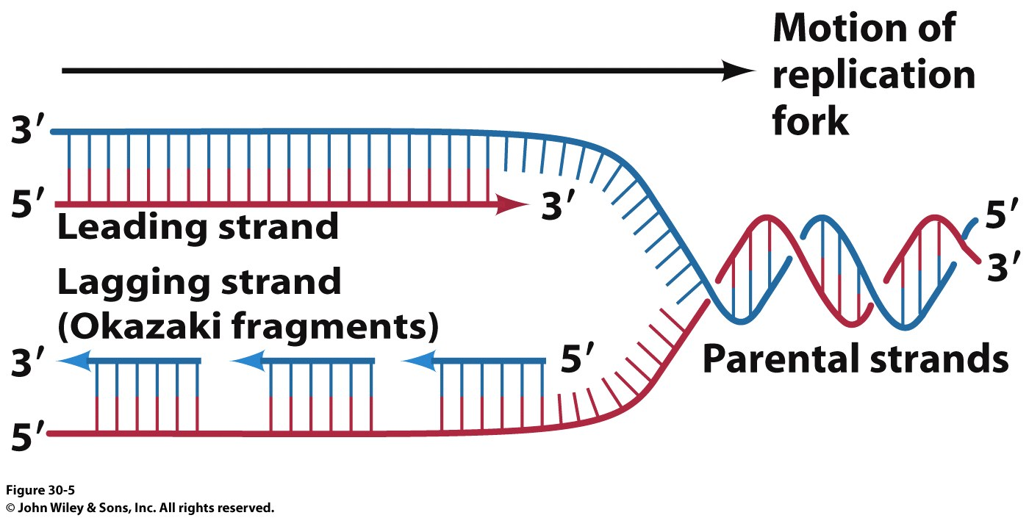
Semi-discontinuous Replication
Forms of DNA Helices
DNA’s 2 strands are replicated at the same time
DNA Polymerase synthesizes DNA in the
5’ → 3’ direction
5’
3’
5’
So how does the other strand elongate?
The ‘Lagging Strand’ is synthesized as small fragments (1000 – 2000 nuclotides in bacteria or 100-200 nt in eukaryotes) called Okazaki fragments.
Okazaki fragments are combined by a DNA Ligase after the RNA primers are cut out by the 5’-3’ exonuclease activity of DNA PolI

Slide 40
Adding Bases to the Growing Strand
Forms of DNA Helices
Same general chemistry for all polymerases
DNA Pol I

Slide 41
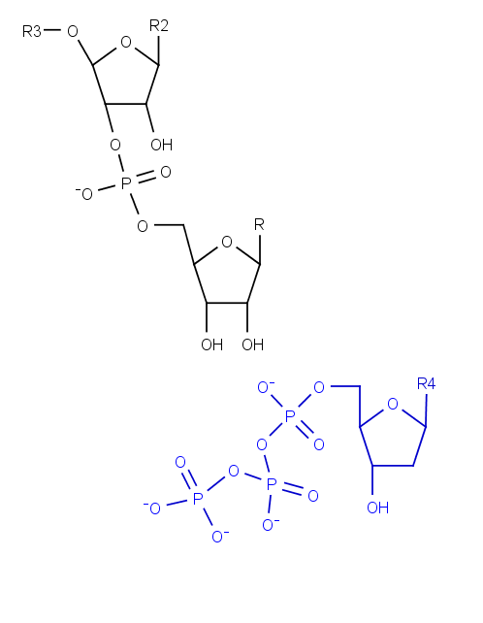
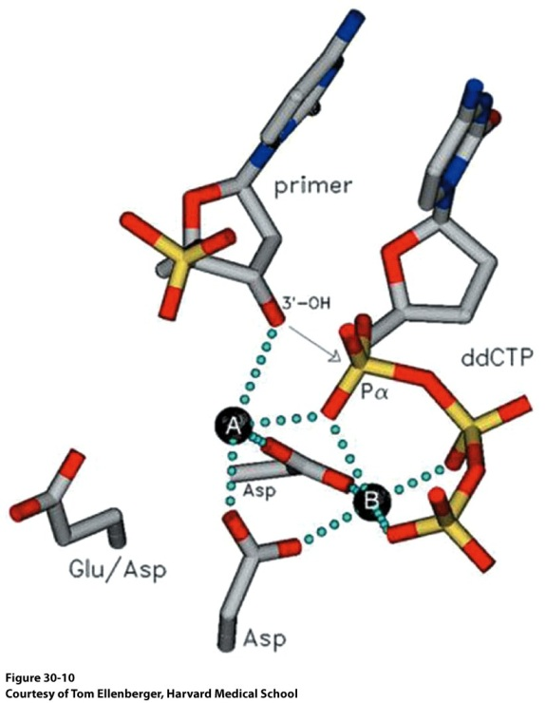
Adding Bases to the Growing Strand
Forms of DNA Helices
How will a dNTP be added to the existing chain?
How might the reaction be activated?
Metal ions! (A and B below)

Slide 42
Requirement for Priming
Forms of DNA Helices
This model of DNA replication requires a 3’ OH for strand elongation
5’
3’
5’
Analysis of Okazaki fragments indicated that the 5’ end was always composed of RNA 1→60 nucleotides in length
These will have to be replaced at some point
Nucleophile

Slide 43
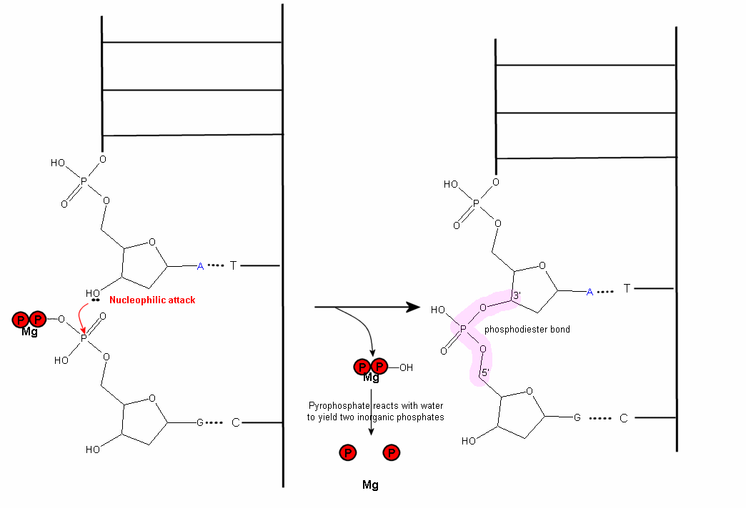
Polymerization Reaction
Forms of DNA Helices
http://wiki.cstl.semo.edu/agathman/GetFile.aspx?File=DNA%20polymerase/nucleophilic.gif

Slide 44
Strand Elongation is Driven by Pyrophosphate Hydrolysis
Notes:
FIGURE 4.25 Strand-elongation reaction. DNA polymerases catalyze the formation of a phosphodiester bridge. [Source: J. L. Tymoczko, J. Berg, and L. Stryer, Biochemistry: A Short Course, 2nd ed. (W. H. Freeman and Company, 2013), Fig. 34.2.]

Slide 45
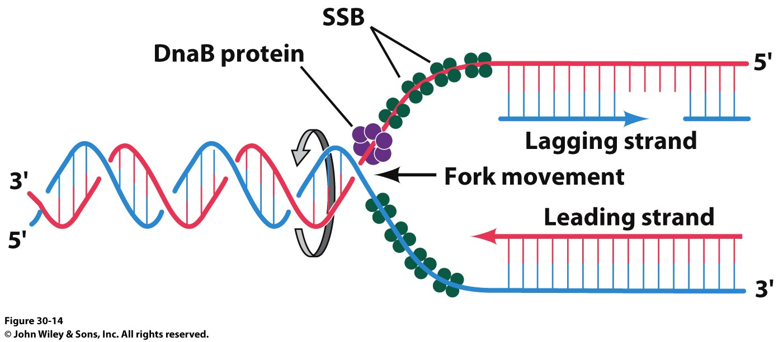
Formation of the Replication Fork
Forms of DNA Helices
DNA Gyrase (Topoisomerase II)
Crucial to deal with the supercoiling and twisting that the strands would do as they are unwound

Slide 46
Formation of the Replisome
Forms of DNA Helices

Slide 47
DNA Replication
DNA Replication is a very complex process
Must unwind helix and energy is normally required (pyrophosphatase driven)
ssDNA tends to form intra-strand base pairs that can halt the process (cruciform structures)
A single enzyme can realistically only catalyze a limited number of different types of reactions (replication complexes are typically among the most complex enzymatic associations that exist in any organism)
Safeguards have evolved to recognize and prevent errors and to repair most of those that do occur
Circularity in prokaryotes and largely linear molecules in eukaryotes in concert with the great size of the genomes of many organisms add physical constraints to replication systems
No particular mode of replication is suitable for all organisms (or viruses)
Replication is always, invariably a double-stranded event

Slide 48
What do we need in a DNA Polymerase?
Forms of DNA Helices
DNA Polymerases require a template
Template DNA binding site
Single Strand or Double Strand?
DNA Polymerases require an existing 3’-OH to join NTPs
Must have room for growing dsDNA
dNTP binding site
Mechanism to differentiate between the 4 possible dNTPs
Processivity vs Fidelity (Speed vs. Accuracy)
Self Correcting?
Viral Polymerase vs. Human Polymerase

Slide 49
What do we need in a DNA Polymerase?
Forms of DNA Helices
With respect to the template and 3’-OH requirement:
DNA Polymerases cannot simply start making new DNA strands! Why is this important?
ii) RNA polymerases don’t have the 3’-OH requirement, so they make the RNA primers that DNA Polymerases build upon
RNA Polymerases don’t have as much fidelity but it can start with just template and some nucleotides
DNA Polymerase HAS Fidelity AND Processivity
The polymerase binds to the template strand, adds nucleotides to the growing strand and proceeds
Faster polymerase have higher rates of Processivity or they add more nucleotides before they dissociate from the template strand (yes, they just fall off!)
Given the importance of DNA to the organism, it isn’t surprising that DNA polymerases must have fidelity
Your average DNA Polymerase makes a mistake every 1,000-10,000 bases added
The active site of a DNA Polymerase ensures that even though the wrong nucleotide might be added, it won’t fit into the active site and the growing strand swings down to a nuclease domain (in some polymerases)

Slide 50
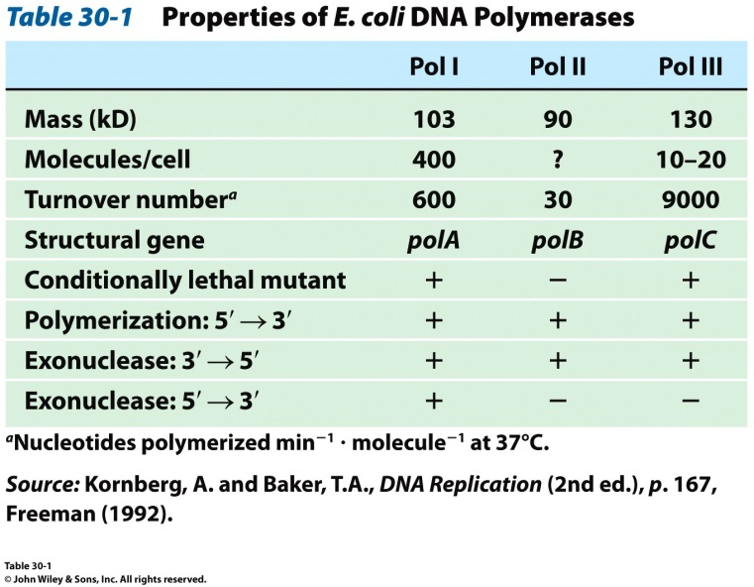
DNA Polymerases
E. coli has three major DNA polymerases
DNA Pol III is the principal replicative polymerase in E. coli. Why?

Slide 51
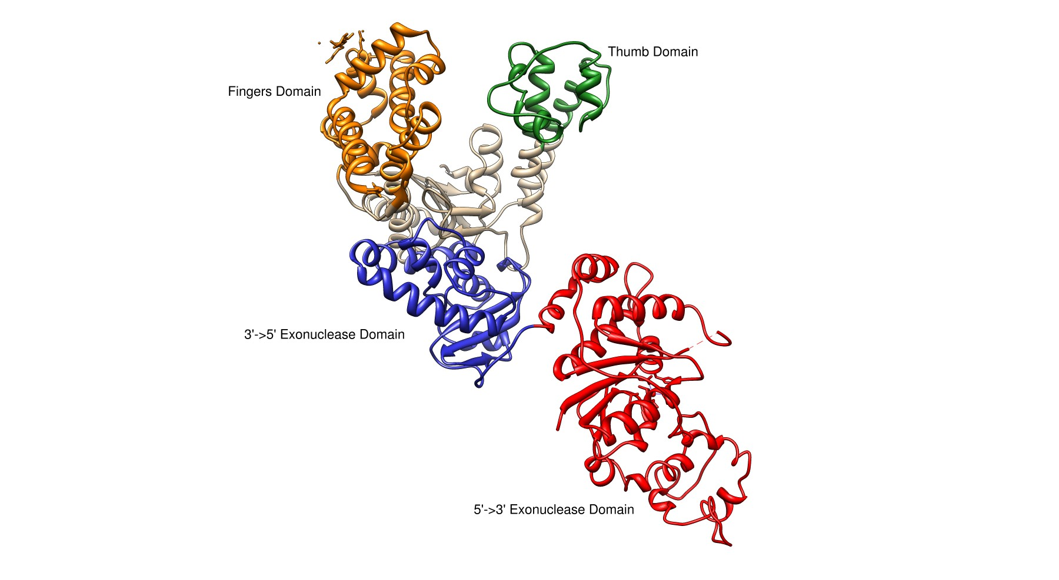
E. coli DNA Polymerase I
Forms of DNA Helices
Pol I
3’→ 5’ and 5’ → 3’ exonuclease activity
Small N-terminal domain contains the 5’→3’ exonuclease activity
Completely independent from active site or 3’ → 5 site
Thumb
Guides newly formed DNA
Responsible for processivity
Fingers
Contains dNTP binding site
Close in on dNTP/Growing Strand once successful Watson-Crick base pairing made
Palm Domain
~22 Å x 30 Å
Ideal shape to bind B-DNA
Lined with basic amino acids

Slide 52
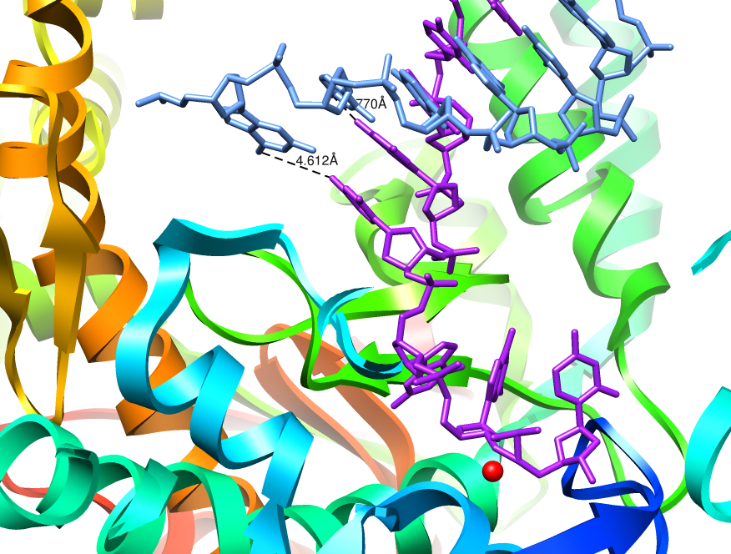
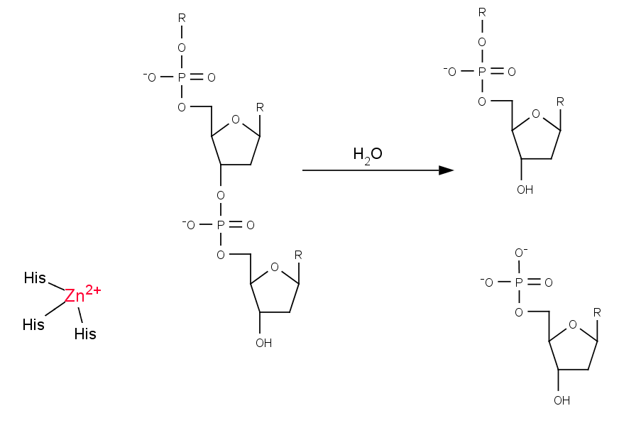
3’ → 5’ Exonuclease
Forms of DNA Helices
The structure of E. coli Pol I has been solved with DNA bound in the 3’→5’ exonuclease active site
Growing strand peels away from active site
The base pair closest to the polymerization active site is significantly weakened
Exonuclease site (Zn²⁺ activated mechanism)
Which bond will be cleaved?
NEED 3’-hydroxyl for elongation

Slide 53
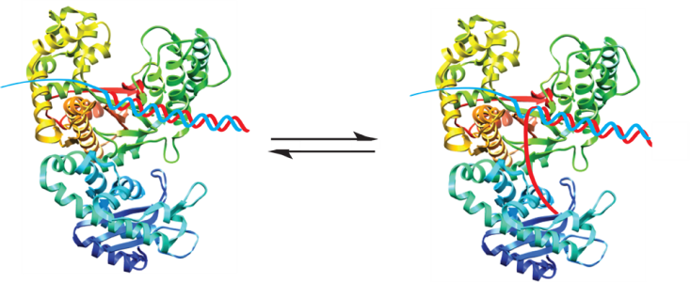
Model for Proofreading in DNA Polymerases
Forms of DNA Helices
dNTPs are in rapid equilibrium at active site
When reaction occurs, proper base pair will form a strong tight bonding pair
When an error occurs, the base pair is not as tight, resulting in increased favorability for the growing chain to be positioned at the 3’→5’ exonuclease site

Slide 54
Model for Proofreading in DNA Polymerases
Forms of DNA Helices
Incorrect pairing causes a clash and the chains separate. The growing chain swings out and into the exonuclease site

Slide 55
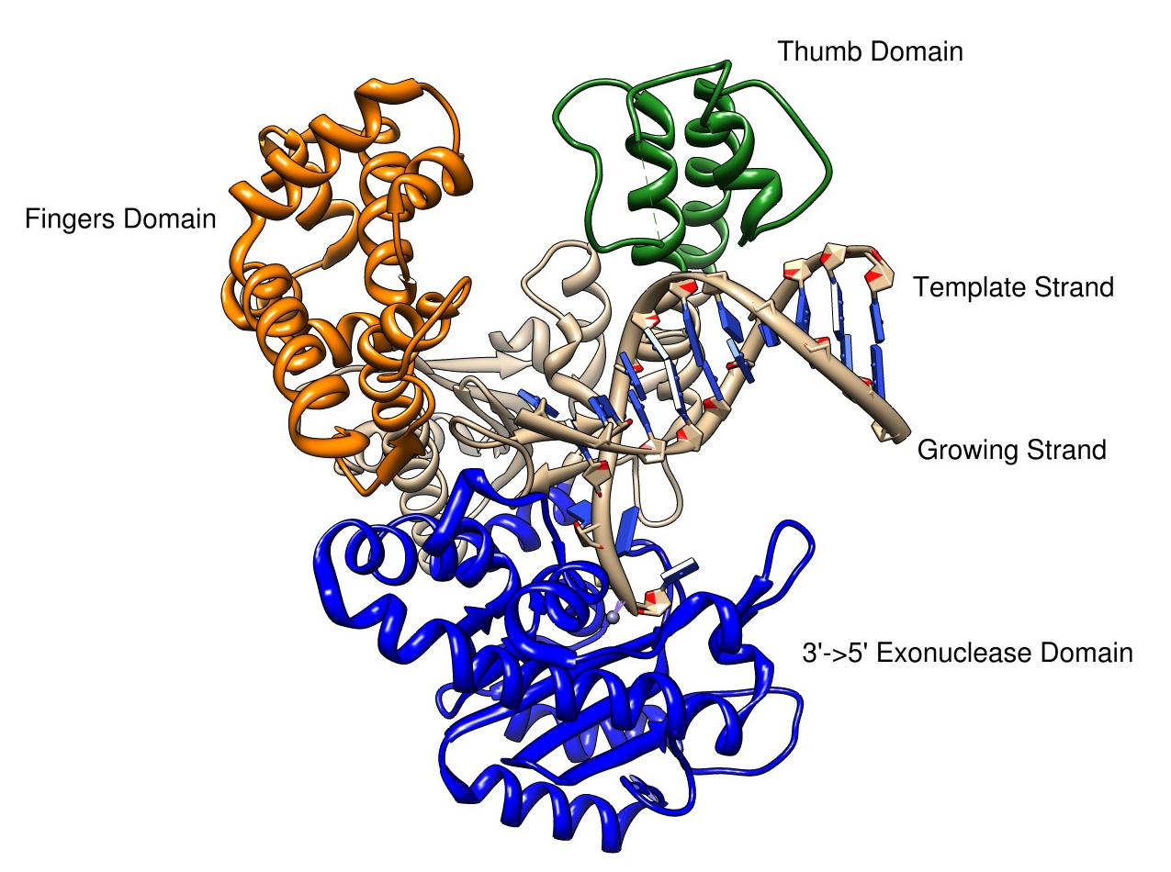
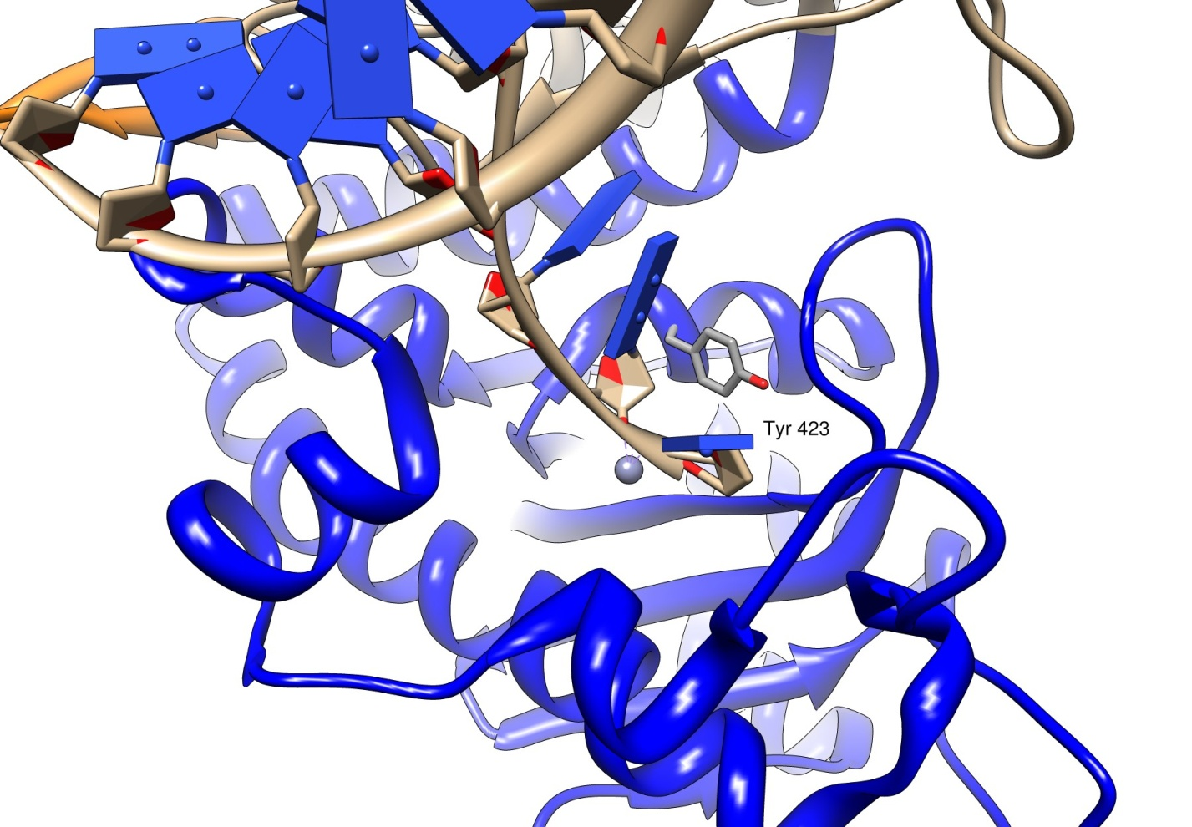
3’->5’ Exonuclease Mechanism
Forms of DNA Helices
The structure of E. coli Pol I has been solved with DNA bound in the 3’→5’ exonuclease site
Growing strand peels away from active site
Tyr 423 activates a water molecule which then serves as a nucleophile to begin the cleavage of the base from the strand

Slide 56
3’->5’ Exonuclease Mechanism
Forms of DNA Helices
Tyr 423 activates a water molecule which then serves as a nucleophile to begin the cleavage of the base from the strand
Freemont et al. (1988). Cocrystal structure of an editing complex of Klenow fragment with DNA. PNAS 85: 8924-8928.

Slide 57
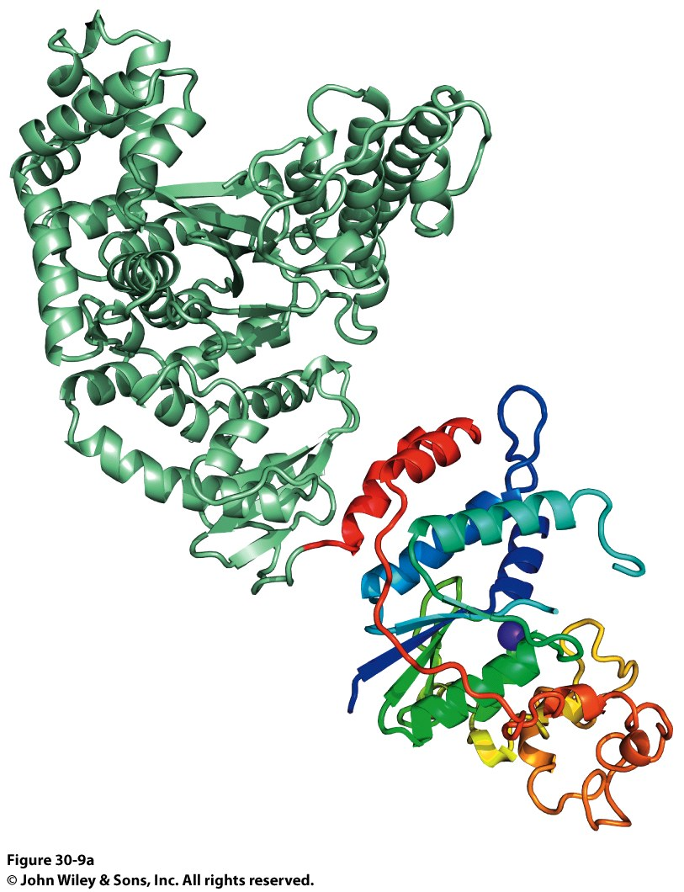
Taq DNA Polymerase
Forms of DNA Helices
Two domains were identified:
Polymerase Domain
5’→3’ Exonuclease Domain
N-terminal domain contains 5’ → 3’ exonuclease
C-terminal domain contains polymerase activity

Slide 58
Taq DNA Polymerase
Forms of DNA Helices
Notice the same Finger and Thumb domains as E. coli DNA PolI
Same function, same domains
Evidence of evolutionary conservation of function
Taq DNA Pol has no 3’->5’ exonuclease activity though…

Slide 59
E. coli and Taq DNA Polymerase Superposition
Forms of DNA Helices
Notice the same Finger and Thumb domains as E. coli DNA PolI
Same function, same domains
Evidence of evolutionary conservation of function
Taq DNA Pol has no 3’->5’ exonuclease activity though…

Slide 60
DNA Pol III
Forms of DNA Helices
Many subunits and protomers required for function

Slide 61
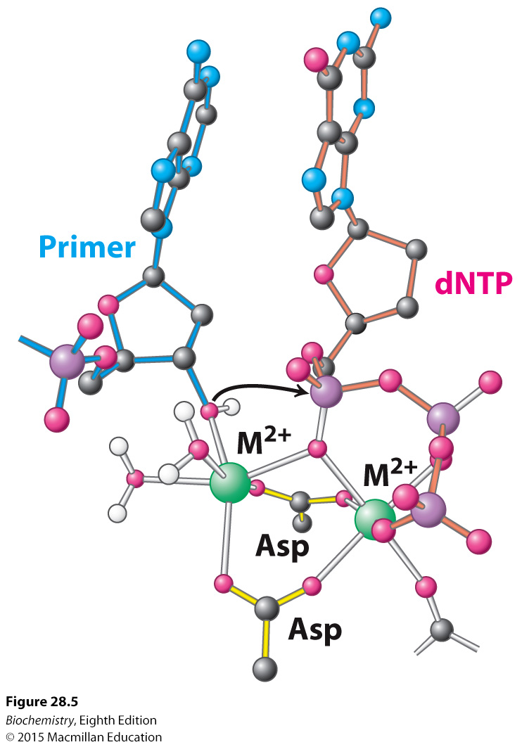
Metal Ions in Addition Reaction

Slide 62
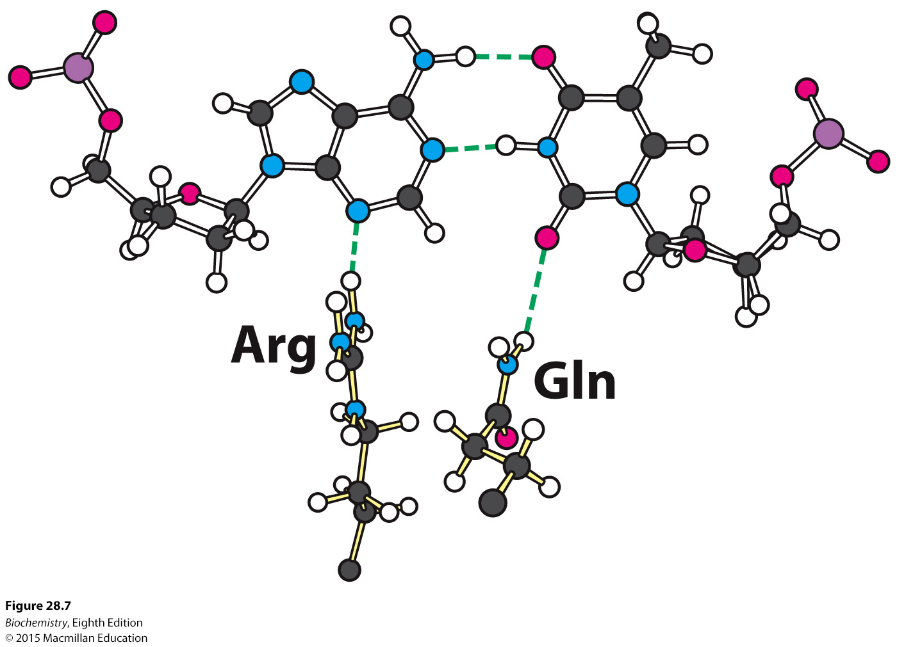
Fidelity, Minor groove hydrogen bonding

Slide 63
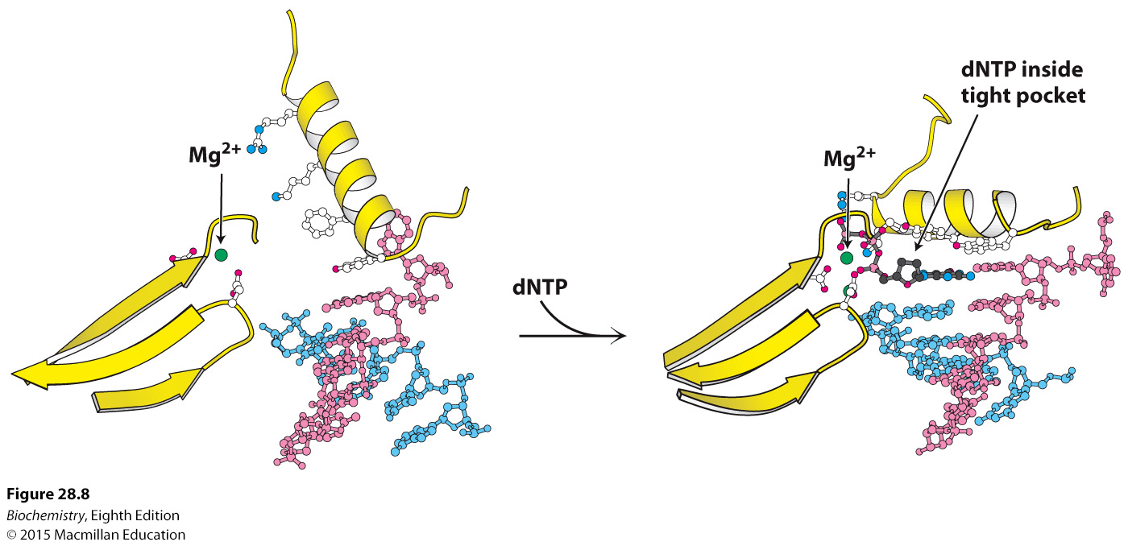
Fidelity, O-Helix

Slide 64
Fidelity, O-Helix

Slide 65
You absolutely MUST know the next slide in order to understand all subsequent slides. The next slide would make a very easy and straightforward test/final exam question All nucleic acid biosynthesis is the same chemical reaction mechanism, just different enzymatic machinery
Notes:
FIGURE 4.25 Strand-elongation reaction. DNA polymerases catalyze the formation of a phosphodiester bridge. [Source: J. L. Tymoczko, J. Berg, and L. Stryer, Biochemistry: A Short Course, 2nd ed. (W. H. Freeman and Company, 2013), Fig. 34.2.]

Slide 66
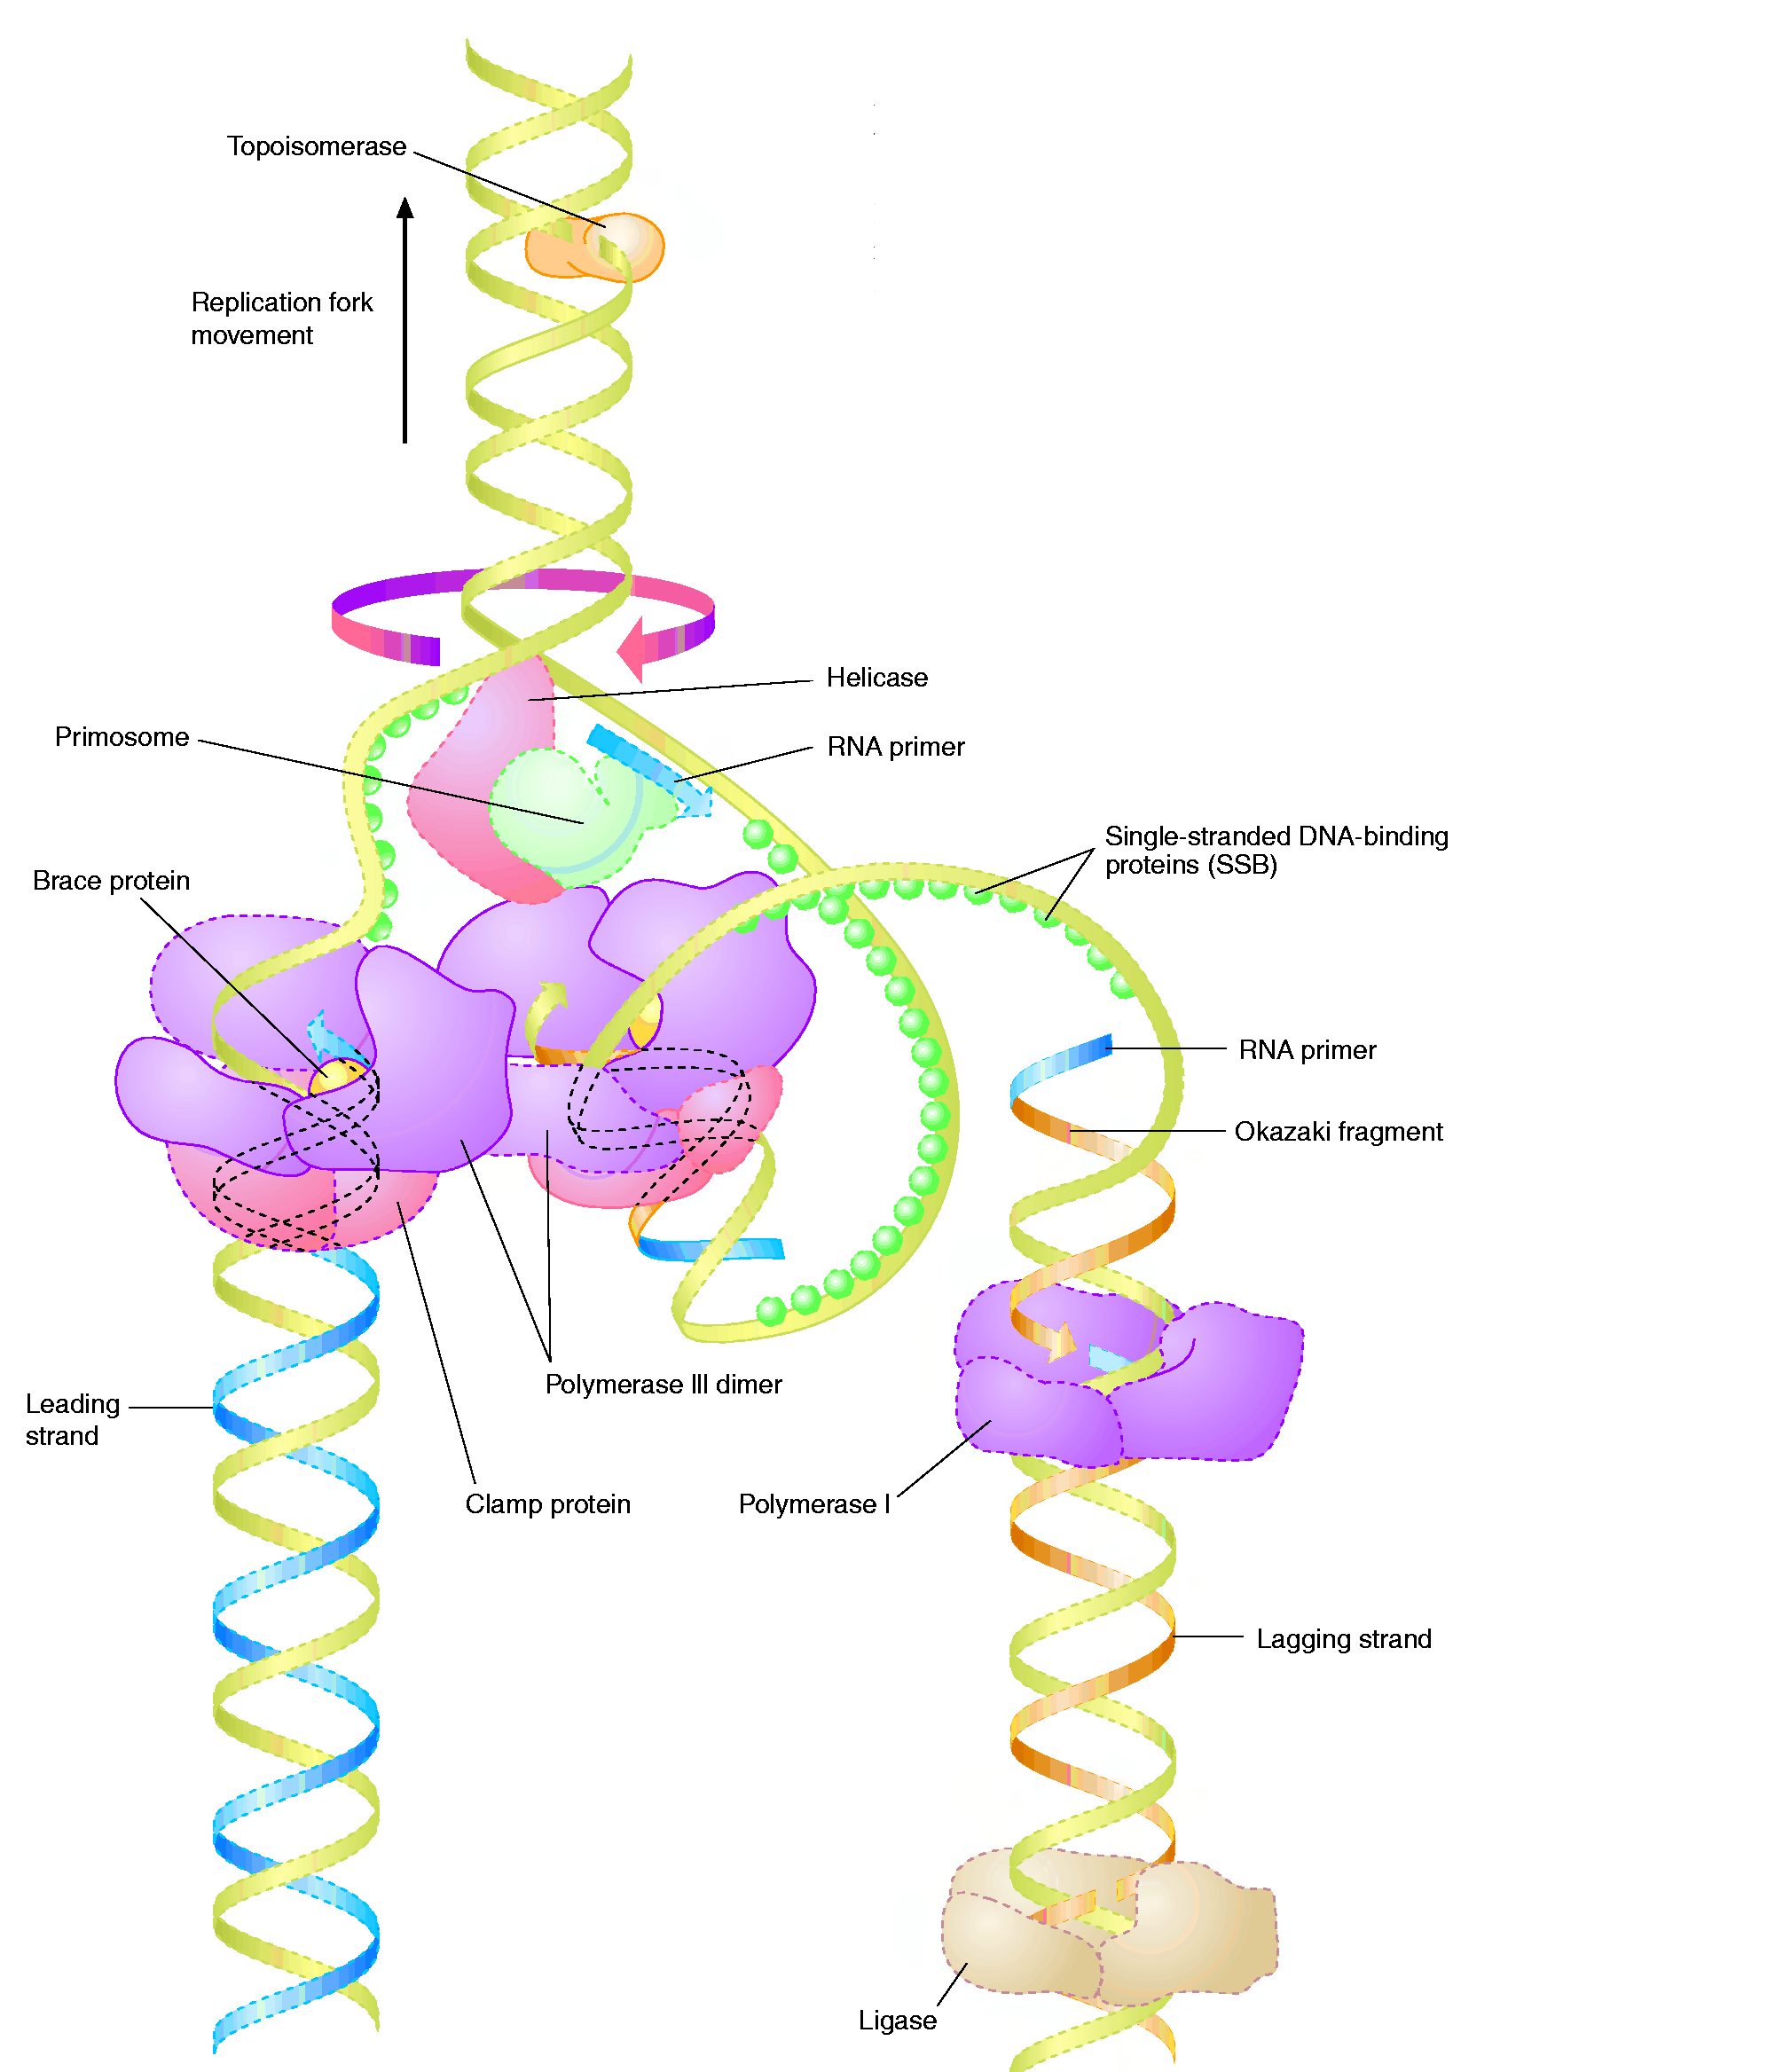
The Big Picture (in E.coli)
Forms of DNA Helices
Topoisomerase: relieves topological strain
Helicase - unwinds dsDNA at replication fork
SSB: keeps ssDNA from reannealing
Primase: synthesizes RNA primers for lagging strand
Pol III elongates lagging strand until strained. It then releases the template and rebinds at a new primed location.
DNA Polymerase III : elongate primed DNA from 5’→3’
3’→5’ exonuclease activity limits errors
Pol I: closes any gaps in lagging strand and replaces RNA primer; 5’→3’ exonuclease activity
Ligase: seals off backbone nicks

Slide 67
Formation of the Replisome
Forms of DNA Helices
It all comes down to a sequence (or a set of them!)
We call this the Origin of Replication, oriC.

Slide 68
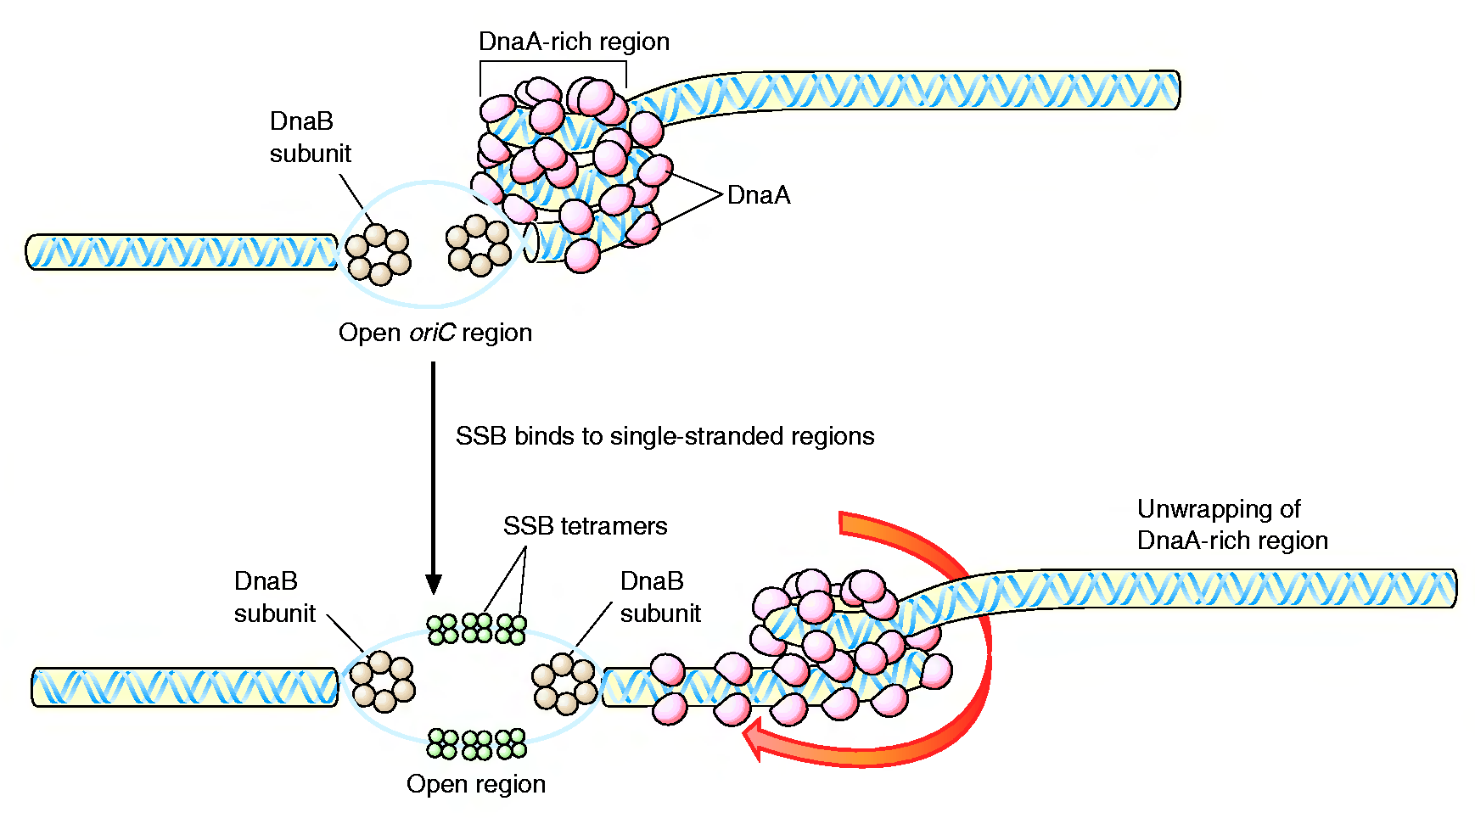
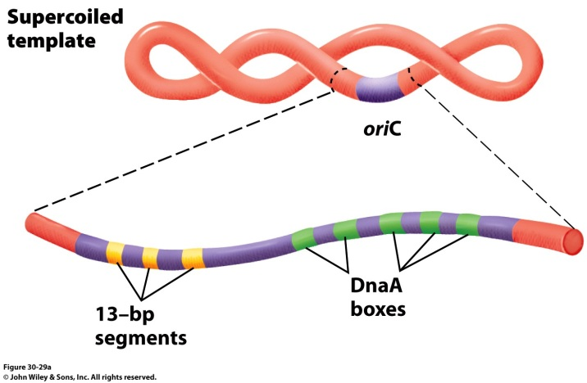
Formation of the Replication Fork
Forms of DNA Helices
4 DnaA proteins bind to the oriC region (recognizes 9 nucleotide segments)
Additional DnaA monomers bind forming a histone like complex of tightly wound DNA
Localized melting of a 13bp repeats
DnaB (6 subunit helicase) binds and unwinds the DNA
Topoisomerase functions downstream to relieve stress
Single Strand DNA binding proteins prevent the ssDNA from reannealing

Slide 69
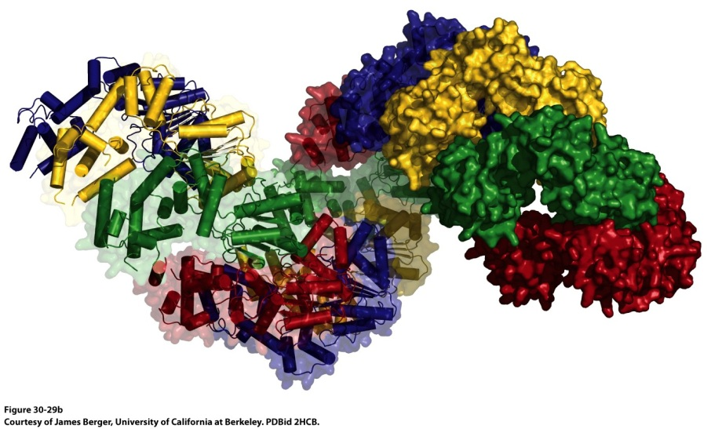
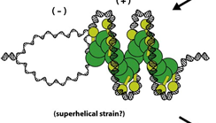
Formation of the Replication Fork
Forms of DNA Helices
178 Å
DnaA helical filament – 8 monomers per turn
ATP-bound DnaA molecules sit on 3 of the 5 DnaA boxes of the origin.
They recruit additional DnaA molecules to occupy the remaining boxes
This introduces positive supercoiling into the DNA, causing the DNA to unwind
The ATPase domain of DnaA may actively unwind DNA as a function of ATP hydrolysis
4) The oriC-DnaA complex recruits DnaB-DnaC hexamers to actively separate the DNA helix (DnaB is a helicase, DnaC is a loading protein that places DnaB onto the strand)

Slide 70
Formation of the Replication Fork
Forms of DNA Helices
DNA Gyrase (Topoisomerase II)
Crucial to deal with the supercoiling and twisting that the strands would do as they are unwound

Slide 71
Formation of the Replisome
Forms of DNA Helices

Slide 72
We’re loaded and primed, let’s replicate!
Forms of DNA Helices

Slide 73
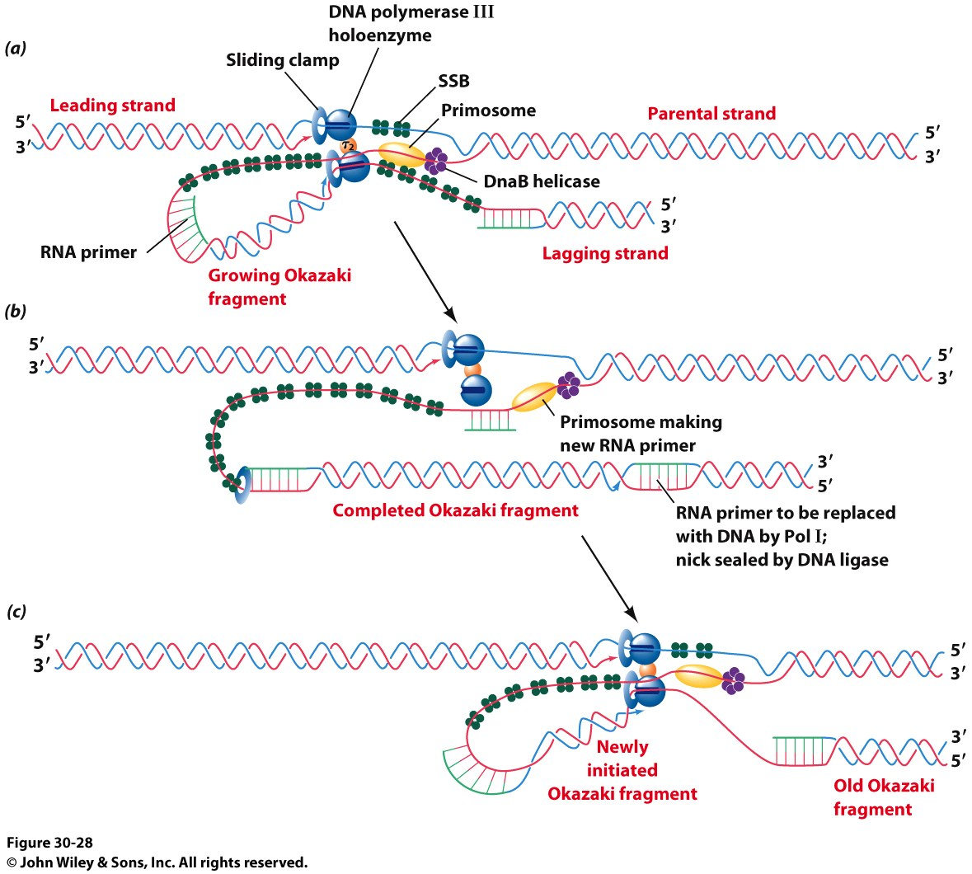
We’re loaded and primed, let’s replicate!
Forms of DNA Helices
Another look…

Slide 74
Sealing the Nicks in the Lagging Strand
Forms of DNA Helices
Reaction Catalyzed by DNA ligase

Slide 75
Finishing the Job: Termination
Forms of DNA Helices
The Ter sequences serve as binding sites for the Terminus Utilization Substance (Tus)
A Tus/Ter complex halts a polymerase in its tracks and replication stops.
No, we don’t really know how the Ter sequences are replicated!
It is assumed that some DNA polymerase finishes the job and seals the DNA strands after they split.

Slide 76
Trombone Model of DNA Replication by DNA PolIII
https://www.youtube.com/watch?v=I9ArIJWYZHI

Slide 77
Section 4.5 Gene Expression Is the Transformation of DNA Information into Functional Molecules
Many types of RNA perform a variety of functions.
However, the three most abundant classes of RNA are rRNA, tRNA, and mRNA.

Slide 78
All Cellular RNA is Synthesized by RNA Polymerases
Synthesis of RNA from a DNA template (transcription) is catalyzed by RNA polymerase, which has the following requirements:
A DNA template. The sequence of the newly synthesized RNA is complementary to the DNA template. The DNA strand that has the same sequence as the RNA product (with T instead of U) is called the coding strand.
Activated precursors in the form of the four ribonucleoside triphosphates
Divalent metal ions, usually Mg²⁺ or Mn²⁺
RNA polymerase catalyzes the following reaction:

Slide 79
RNA Polymerase
RNA polymerase initiates and elongates the RNA product, with the chain growing in the 5’-to-3’ direction.
No primer is needed. The 3’ OH of the growing chain attacks the innermost phosphoryl (α) group of the incoming ribonucleoside triphosphate.
Notes:
FIGURE 4.27 RNA Polymerase. This large enzyme comprises many subunits, including β (red) and β’ (yellow), which form a “claw” that holds the DNA to be transcribed. Notice that the active site includes a Mg²⁺ion (green) at the center of the structure. The curved tubes making up the protein in the image represent the backbone of the polypeptide chain. [Drawn from 1L9Z. pdb.]

Slide 80
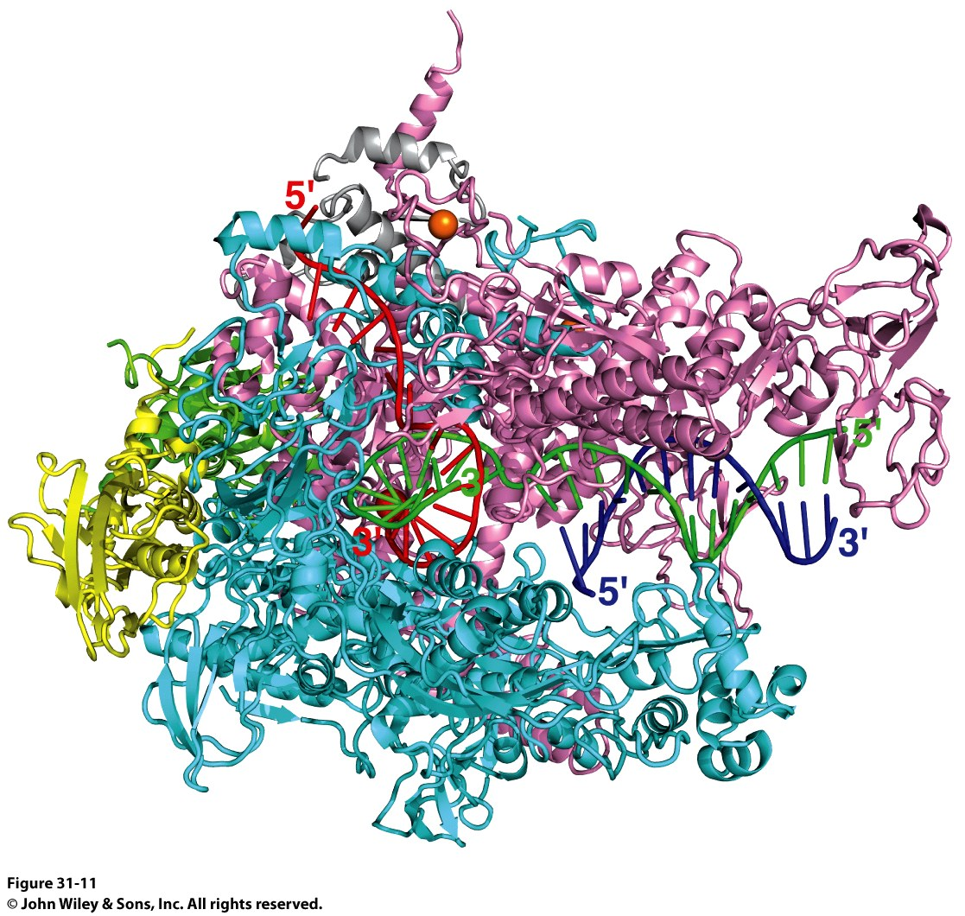
RNA Polymerase
RNA Polymerase (RNAP)
PDB ID Codes:
2O5I: Crystal structure of the Thermus thermophilus RNA polymerase elongation complex
1L9Z: Thermus aquaticus RNA Polymerase Holoenzyme/Fork-Junction Promoter DNA Complex at 6.5 A Resolution
2A69: Crystal structure of the Thermus Thermophilus RNA polymerase holoenzyme in complex with antibiotic rifapentin
2O5I

Slide 81
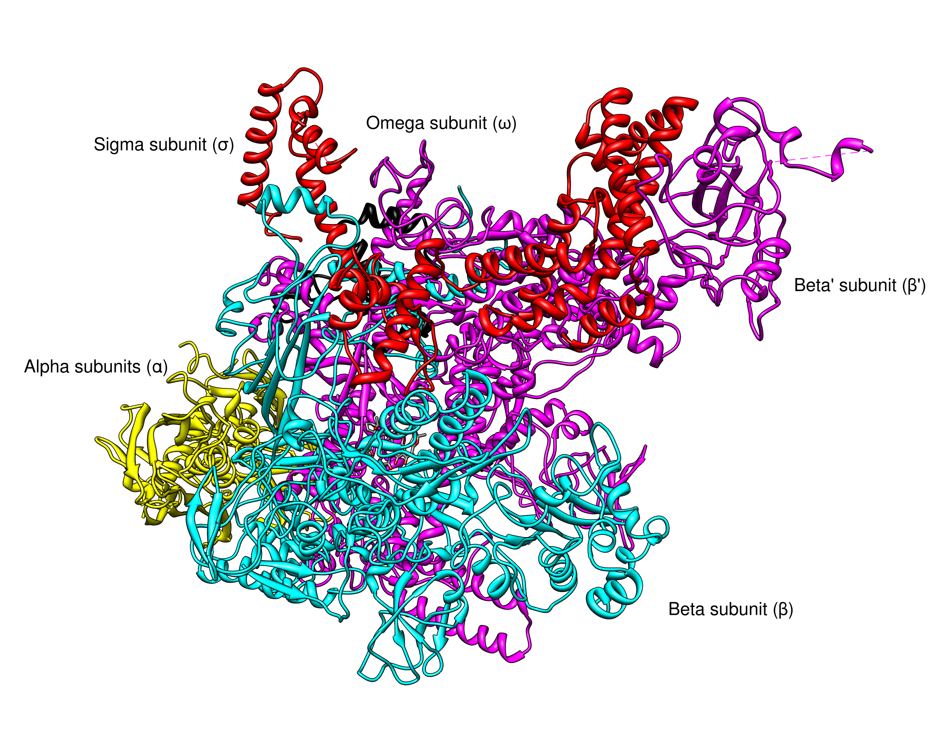
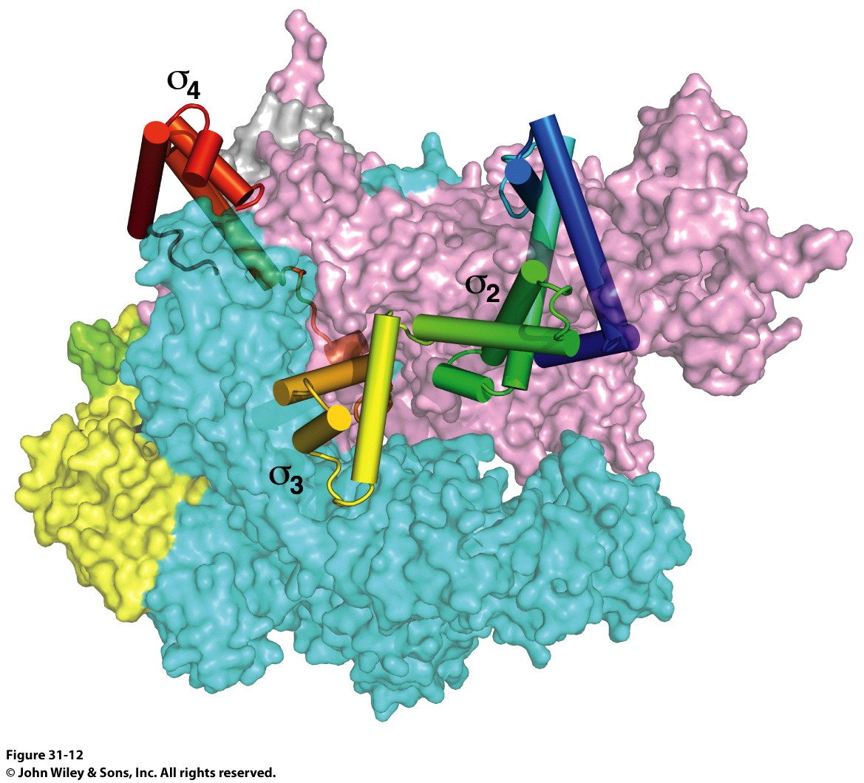
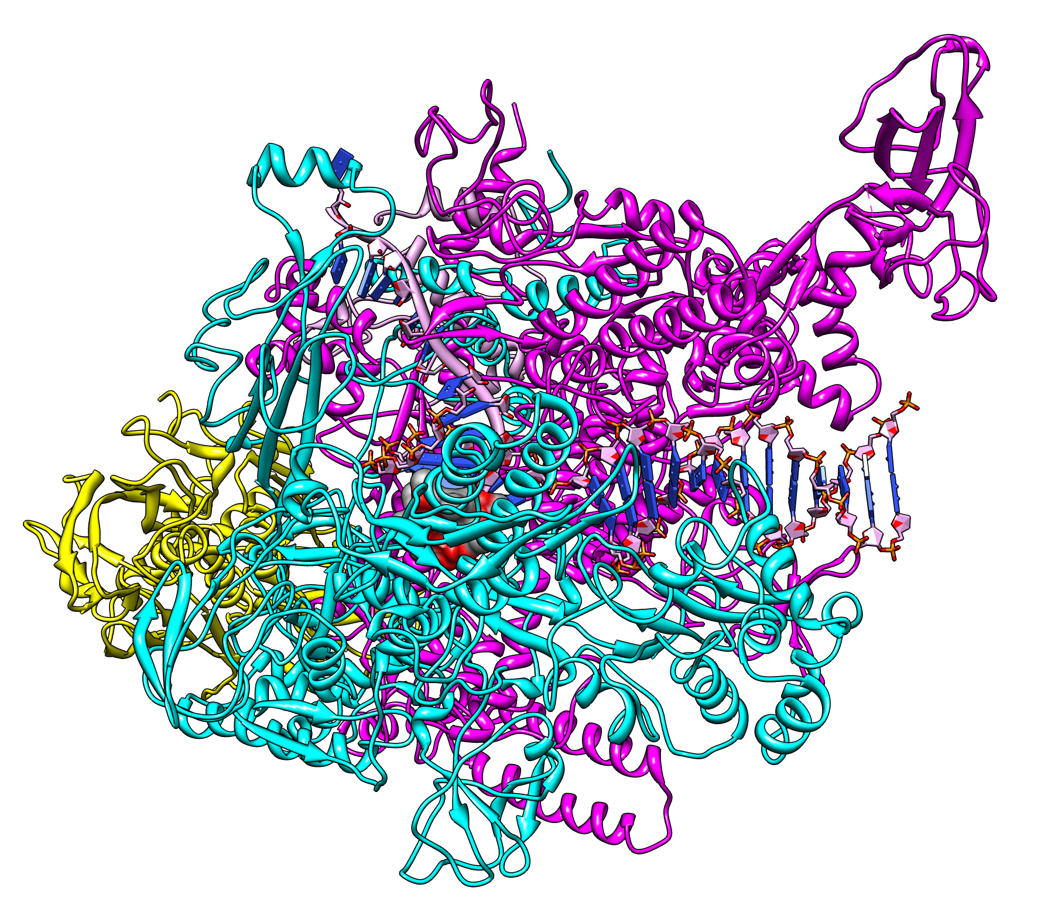
RNA Polymerase
Sigma subunits are critical to start transcription
1IW7
2A69
2O5I
The Holoenzyme (1IW7)
(The initial assembly on the promoter)
459 kDa
α₂ββ’ωσ subunits
The Core Enzyme (2A69)
(The functional assembly)
389 kDa
α₂ββ’ω subunits
Note no sigma!

Slide 82
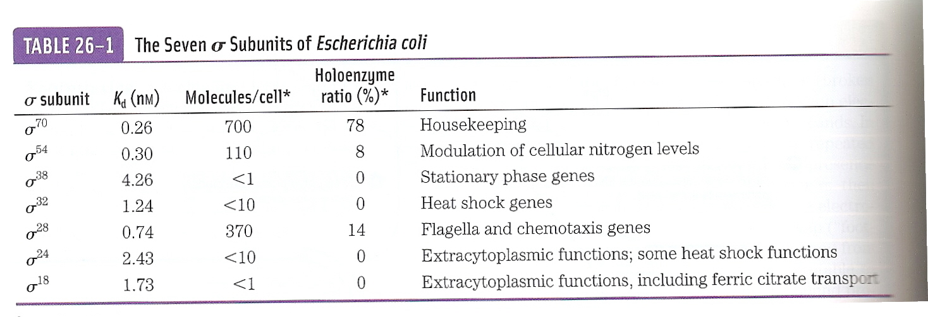
Sigma Subunits are Promoter Specific
The most prevalent is σ⁷⁰

Slide 83
Transcription Begins Near Promoter Sites and Ends at Terminator Sites
Promoters are specific DNA sequences that direct RNA polymerase to the proper initiation site.
There are often variations in the sequence of a promoter for different genes. The average of such variation is called the consensus sequence.

Slide 84
Promoter Sites for Transcription in Prokaryotes and Eukaryotes
Notes:
FIGURE 4.30 Promoter sites for transcription in (A) prokaryotes and (B) eukaryotes. Consensus sequences are shown. The first nucleotide to be transcribed is numbered +1. The adjacent nucleotide on the 5′ side is numbered −1. The sequences shown are those of the coding strand of DNA.

Slide 85
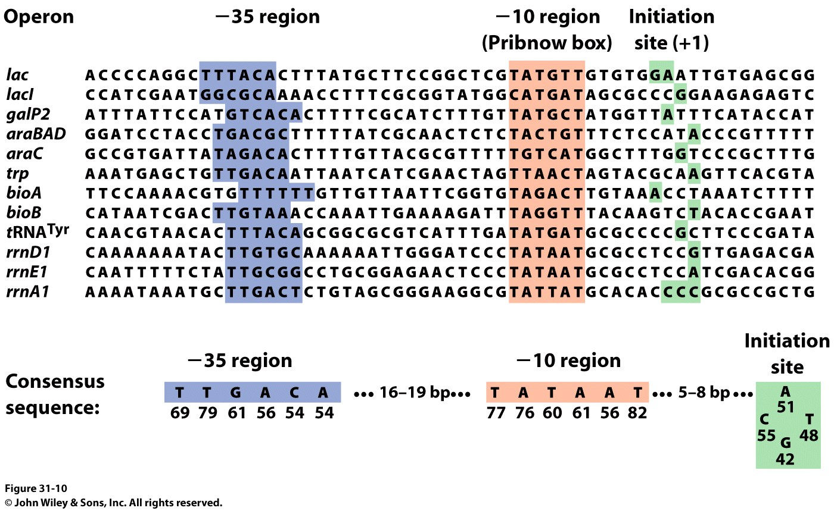
Promoters:
RNAP Binds to Specific Sites on the DNA
DNA is a duplex:
Antisense Strand: Strand that is transcribed
Sense Strand: The coding strand, has the same sequence as the transcribed mRNA

Slide 86
Promoters:
RNAP Binds to Specific Sites on the DNA
Promoters are 40bp sequences BEFORE the transcriptional start site (+1 site)
There is some variation in the -35 region, and almost none in the Pribnow box
The distance between the -35 and -10 regions is ABSOLUTELY CRITICAL
Mutation changes the affinity of RNAP for the DNA
Normally 1x10⁻¹⁴ M
Binding of RNAP to the promoter “melts” the DNA through the Pribnow box

Slide 87
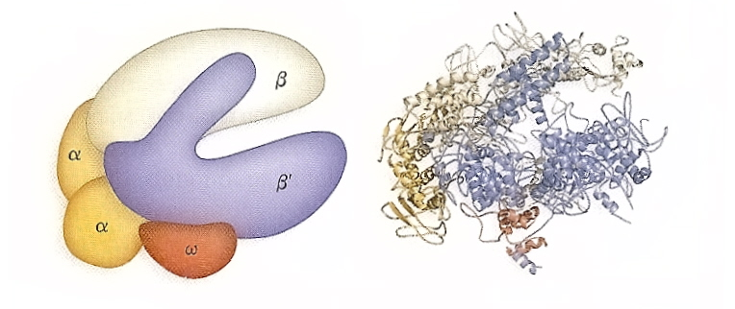
Structure of E. coli RNAP and Mechanism

Slide 88
Transcription Mechanism of the Chain-Elongation Reaction Catalyzed by RNA Polymerase
The reaction is driven thermodynamically by the hydrolysis of pyrophosphate.
Notes:
FIGURE 4.28 Transcription mechanism of the chain-elongation reaction catalyzed by RNA polymerase. [Source: J. L. Tymoczko, J. Berg, and L. Stryer, Biochemistry: A Short Course, 2nd ed. (W. H. Freeman and Company, 2013), Fig. 36.3.]

Slide 89
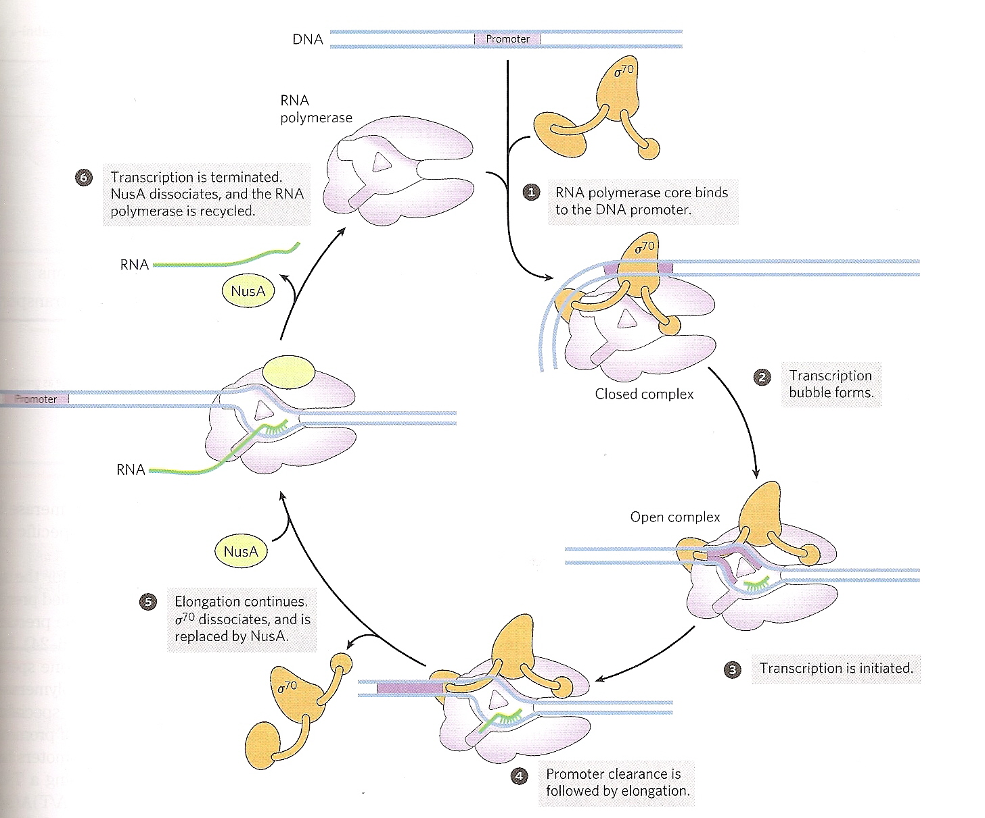
Structure of E. coli RNAP and Mode of Action
See? The sense strand going over the surface of the protein

Slide 90
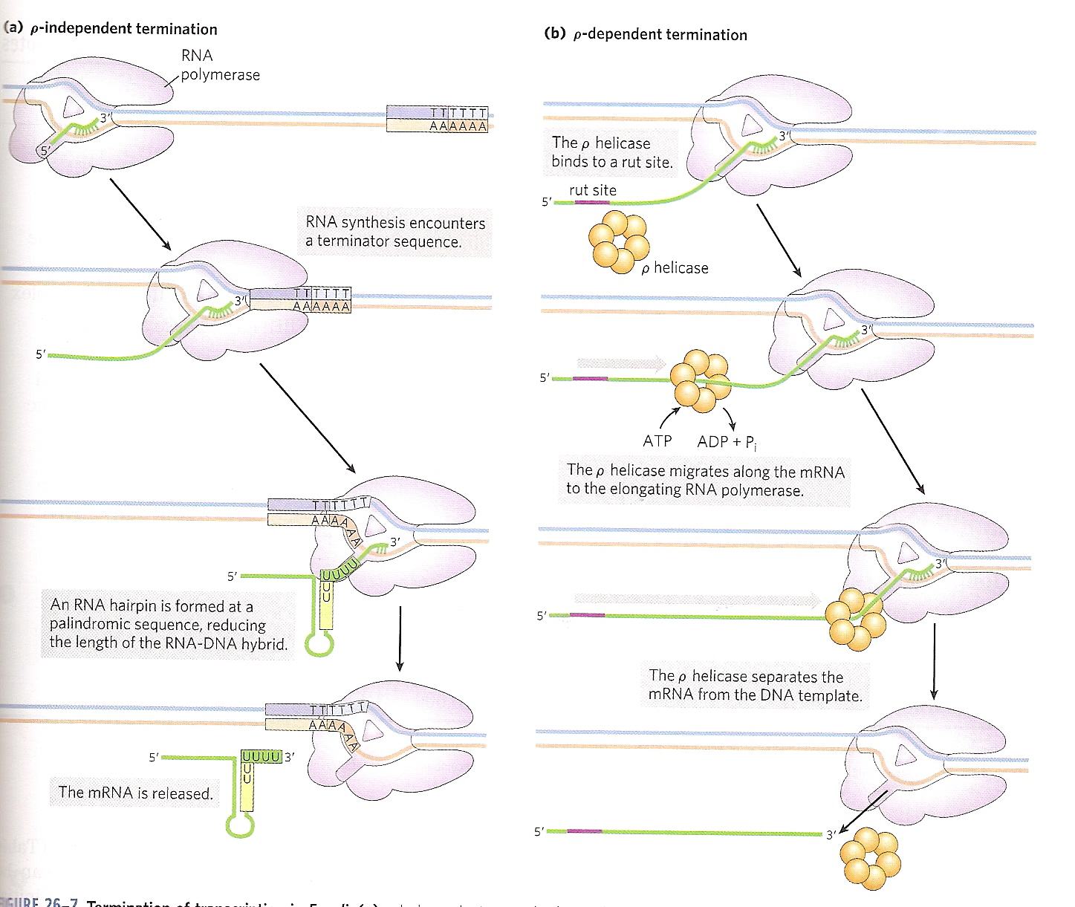
Termination of Transcription
Two methods: Rho independent and Rho-dependent

Slide 91
A Hairpin Structure at the 3’ End of an E. coli mRNA Transcript
Notes:
FIGURE 4.31 Base sequence of the 3’ end of an mRNA transcript in E. coli. A stable hairpin structure is followed by a sequence of uridine (U) residues.

Slide 92
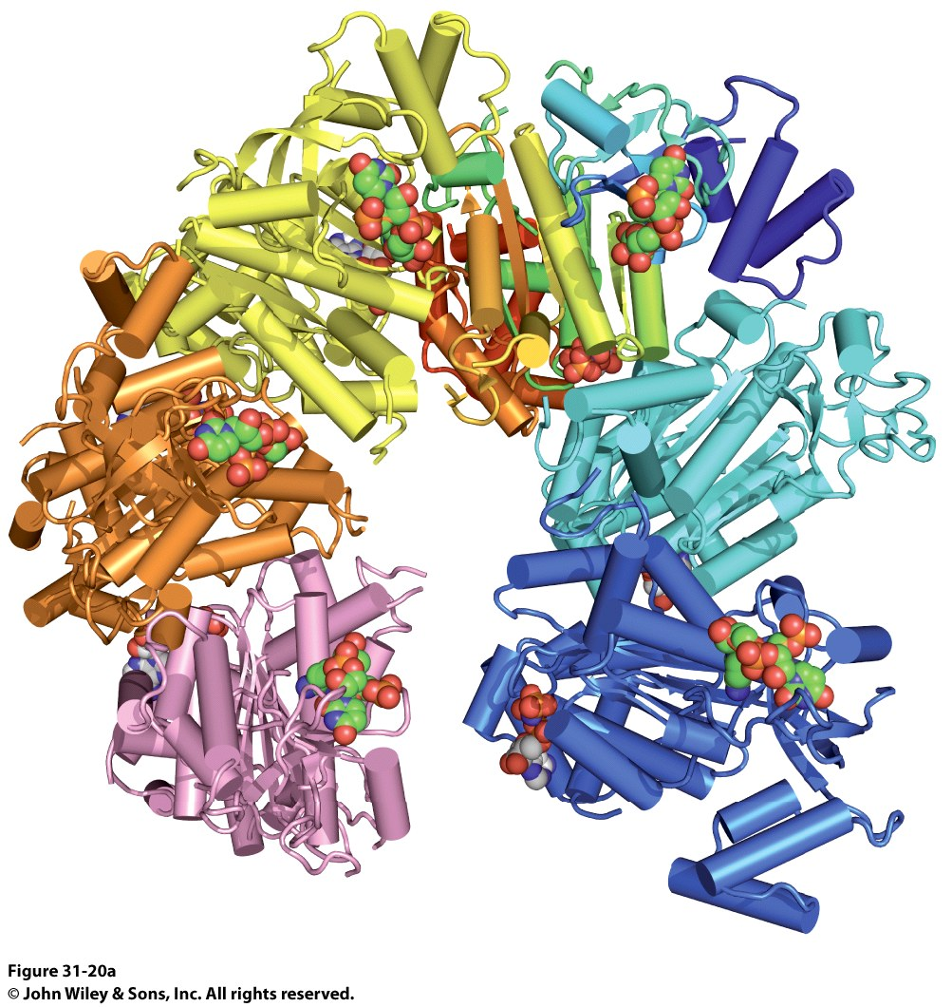
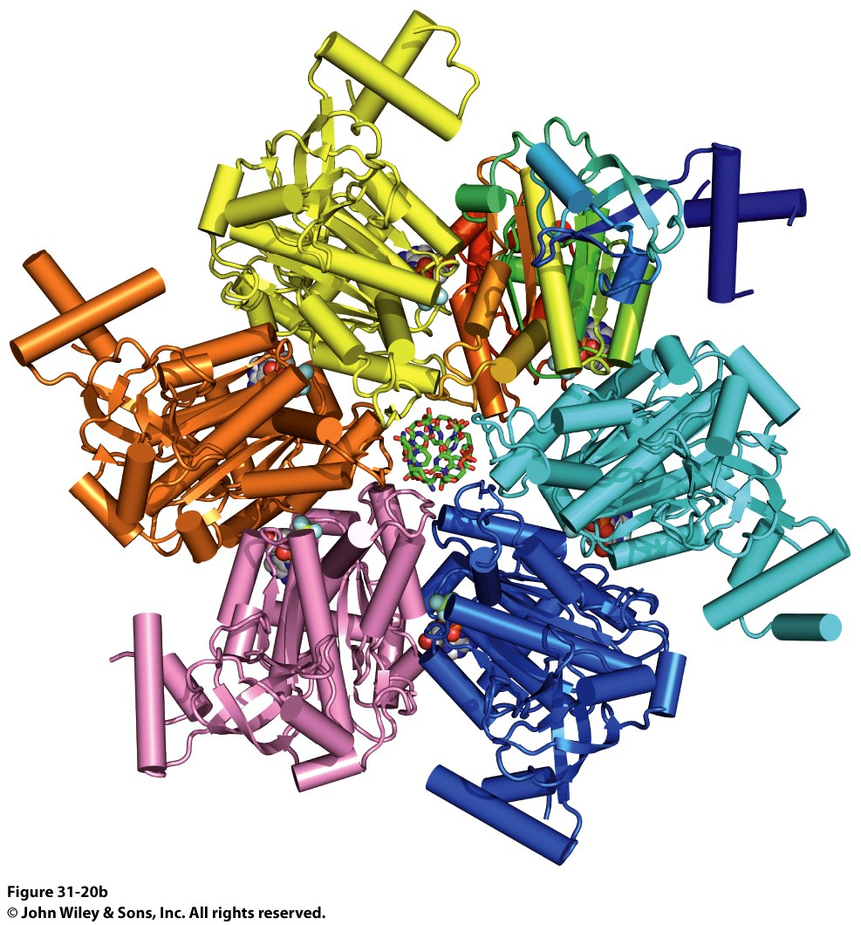
Rho-Dependent Termination of Transcription
The Rho protein is a helicase that loads onto DNA at specific sites (Rho Utilization Sites, RUT)

Slide 93
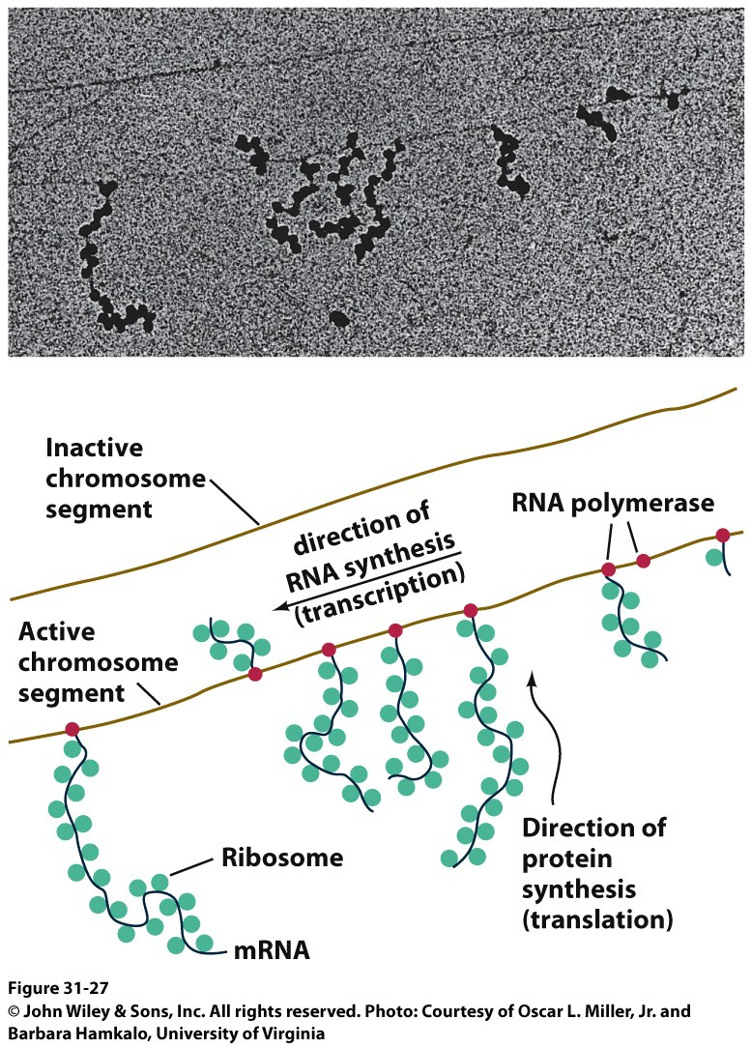
The Third Pillar of the Central Dogma
Translation / Protein Synthesis
We’ve replicated our DNA, transcribed a gene (or an operon) and now we have to make protein
In 1961 Francis Crick and Sydney ,Brenner devised the Adaptor Hypothesis

Slide 94
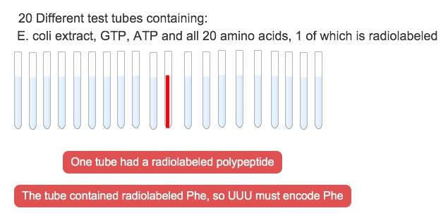
We need to review the message and Codons
5’-(UUU)_{X}-3’
mRNA is read in the 5’ → 3’ direction
The code was “cracked” by many scientists using synthetic mRNAs of a single repeating base
Nuremberg and Matthaei had the seminal experiment

Slide 95
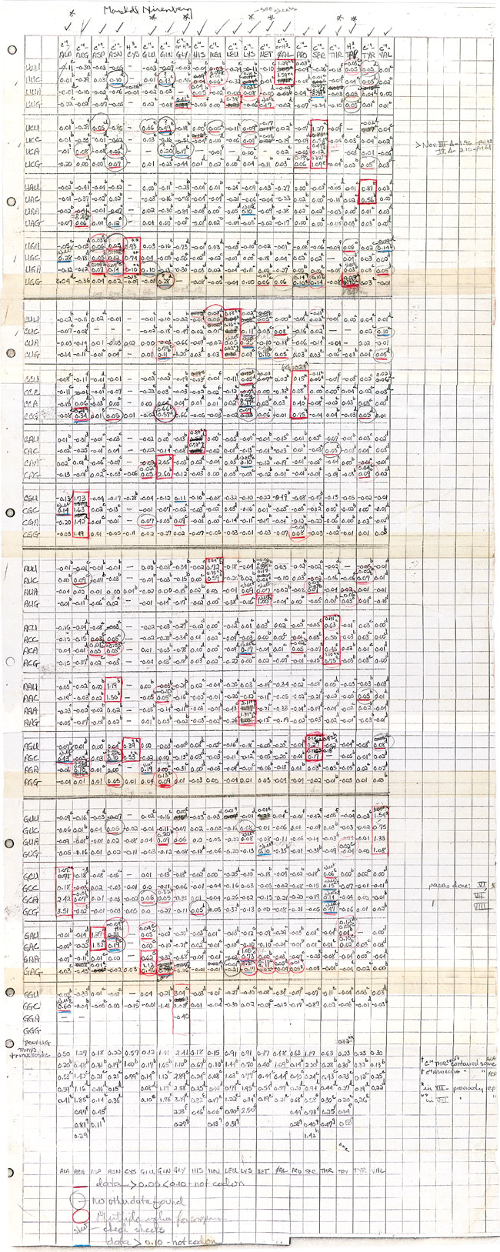
We need to review the message and Codons
They did the same thing for Poly CCC, Poly AAA and Poly GGG
They found radiolabeled polyPro, polyLys and polyGly, respectively
They also found that UAG, UAA and UGA are stop codons
They also found that AUG is the start codon (initiation codon)
This was pure luck
The ribosome will indiscriminately start translation at the high Mg²⁺ levels used in their experiment

Slide 96
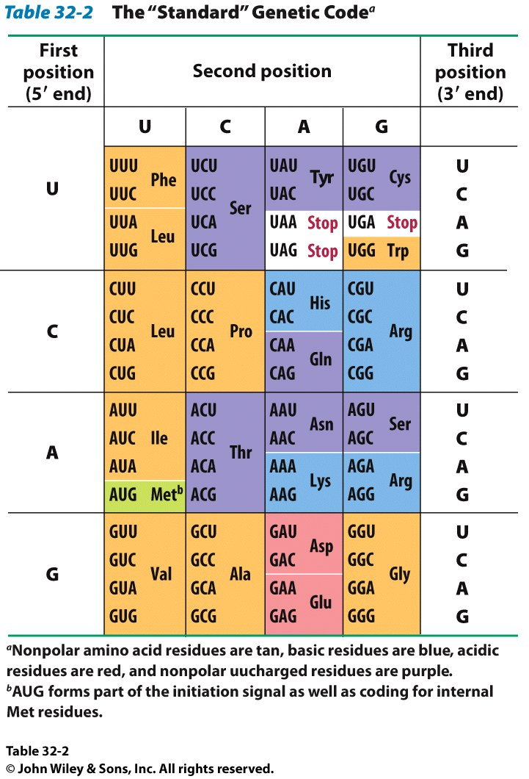
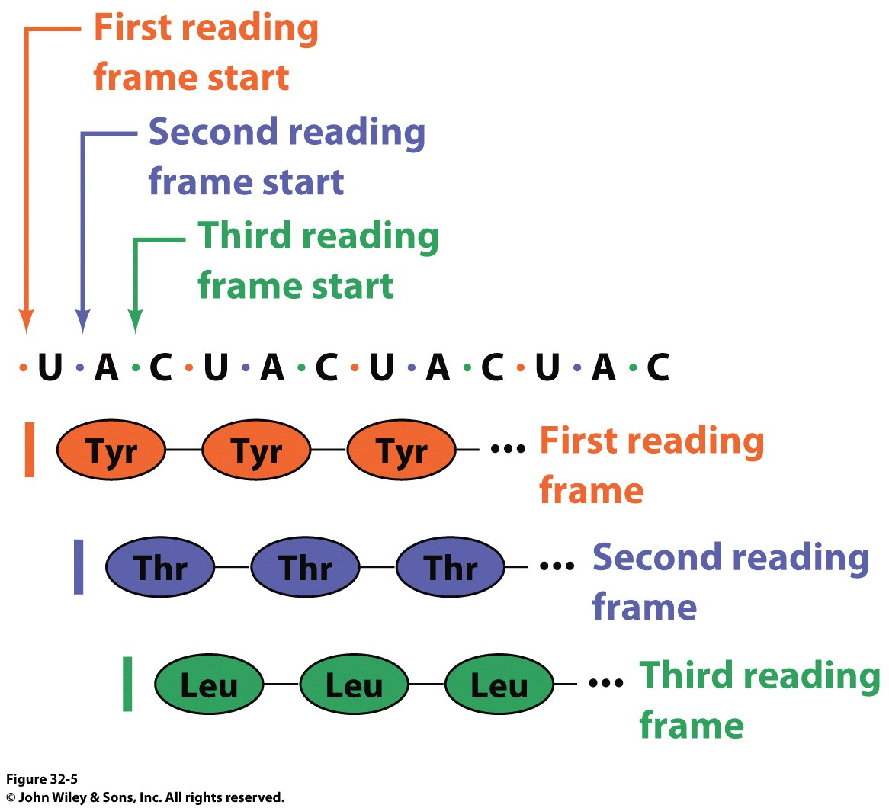
The result of many different experiments was…
The genetic code is written in 3 base codons
The genetic code is highly degenerate
Three amino acids are encoded by six codons each (R, L and S)
Codons specifying the same amino acid are called Synonyms

Slide 97
The result of many different experiments was…
The arrangement of the codon table is non-random
Most synonyms occupy the same box
The third position doesn’t seem to matter as much (“wobble”)
The degeneracy gives an organism the potential to accept point mutations without a phenotypic change

Slide 98
The result of many different experiments was…
The “wobble” actually refers to the wobbling of the anticodon loop of tRNA when pairing with mRNA
The 1st two bases of the codon form tight H-bond interactions with the second two bases of the anticodon loop

Slide 99
Characteristics of the Genetic Code
Three nucleotides, called a codon, encode an amino acid.
The code is nonoverlapping.
The code has no punctuation.
The code has directionality. It is read from the 5′ end of the mRNA to the 3′ end.
The code is degenerate in that some amino acids are encoded by more than one codon; this minimizes the deleterious effects of mutations.

Slide 100
Transfer RNAs are the Adaptor Molecules in Protein Synthesis
Transfer RNA molecules react with specific amino acids in a reaction catalyzed by aminoacyl-tRNA synthetases.
Transfer RNA molecules also contain a template recognition site, called the anticodon. The anticodon, which consists of three bases, recognizes a complementary 3-base sequence in the mRNA called the codon.

Slide 101
tRNA and aminoacyl tRNA formation
All tRNAs share the following:
5’ phosphate group
7 bp stem that includes the 5’ phosphate group. This is called the Acceptor Stem on the Amino Acid Arm
The D Arm which contains dihydrouridine
5 bp stem that contains the anticodon loop called the Anticodon Arm
5 bp stem containing the sequence TΨC where Ψ is pseudouridine

Slide 102
Attachment of an Amino Acid to a tRNA Molecule
Notes:
FIGURE 4.33 Attachment of an amino acid to a tRNA molecule. The amino acid (shown in blue) is esterified to the 3′-hydroxyl group of the terminal adenylate of tRNA. [Source: J. L. Tymoczko, J. Berg, and L. Stryer, Biochemistry: A Short Course, 2nd ed. (W. H. Freeman and Company, 2013), Fig. 39.3.]

Slide 103
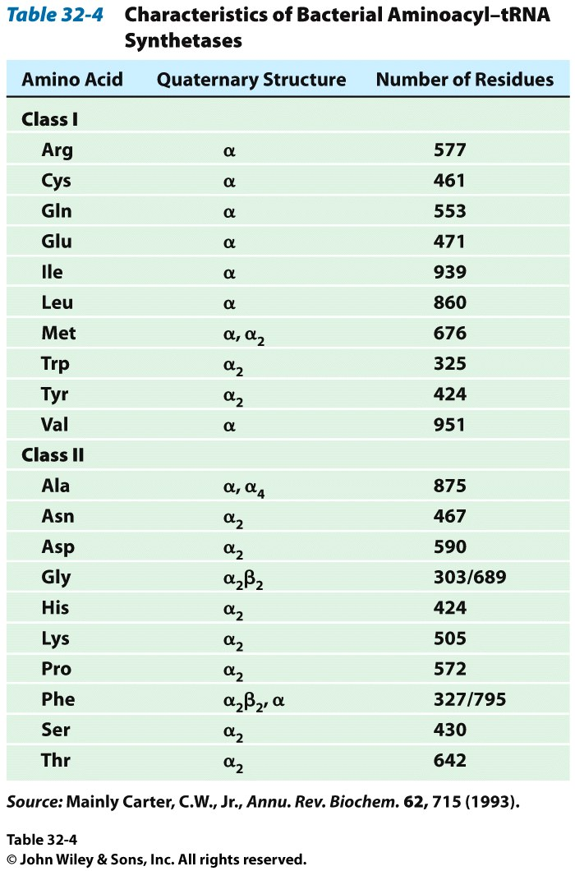
How do tRNAs get loaded?
All cells have one aminoacyl tRNA synthetase for each amino acid
They all catalyze the same base reaction, but are divided into 2 classes based upon primary and tertiary structure
There is no evidence that the classes share a common ancestor through evolution
Amino acid + tRNA + ATP → aminoacyltRNA + AMP + PPi

Slide 104
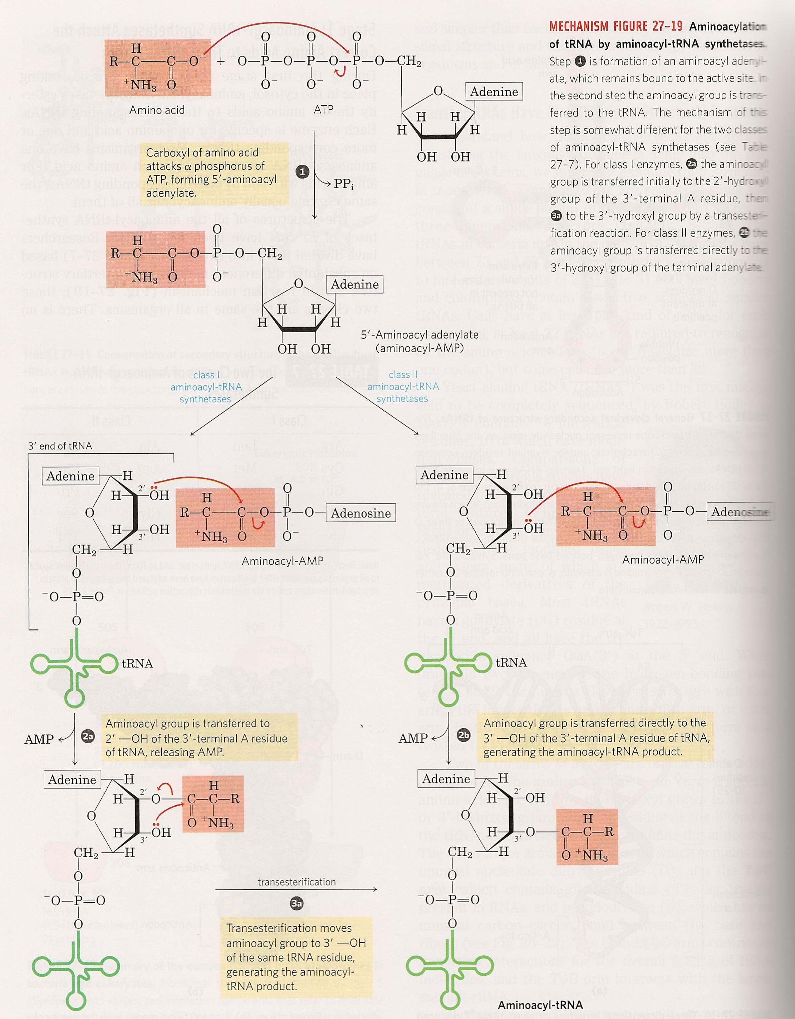
How do tRNAs get loaded?
Class II synthetases have the 3’ hydroxyl attack the amino acid carbonyl carbon directly
Class I synthetases have the 2’ hydroxyl attack the carbonyl and then transfer the amino acid to the 3’ hydroxyl

Slide 105
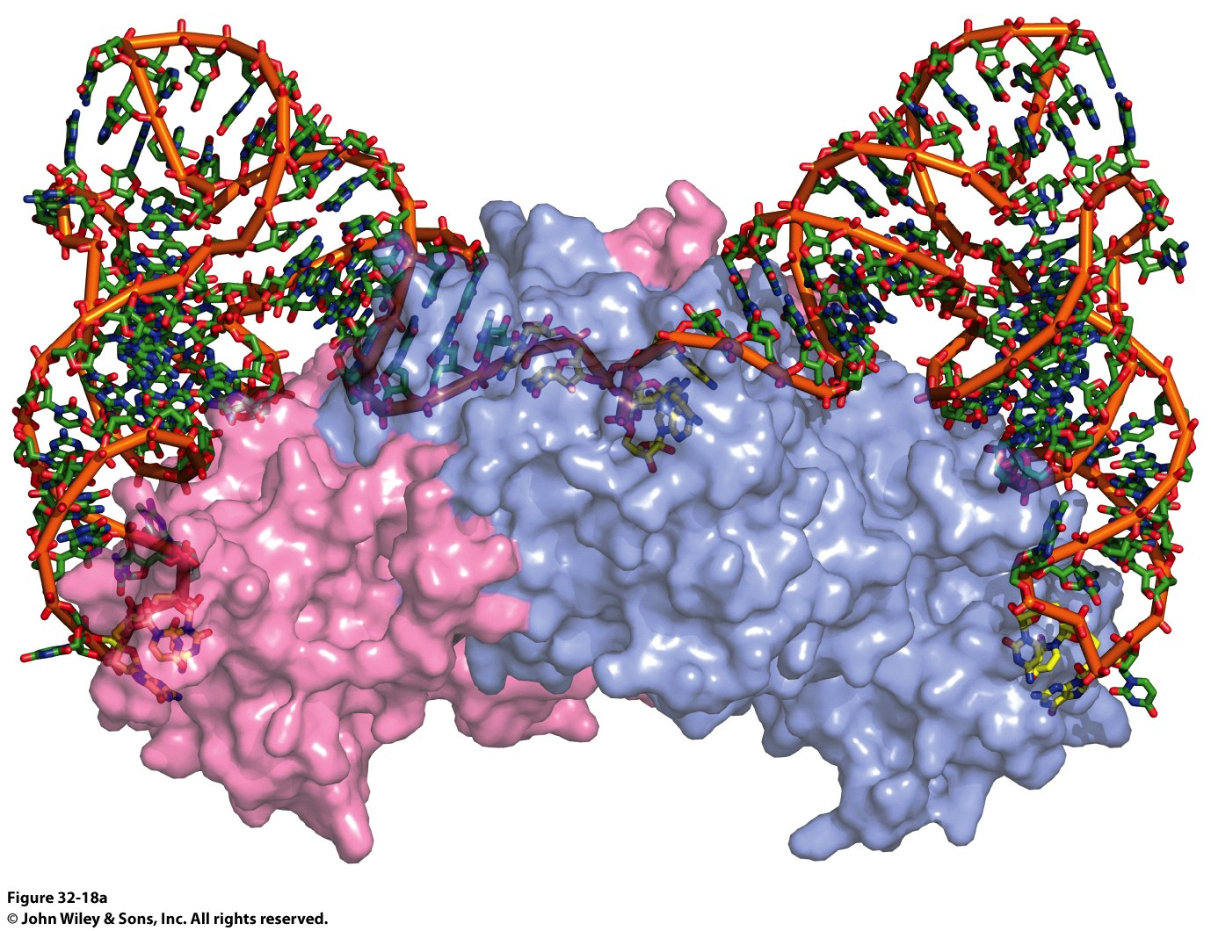
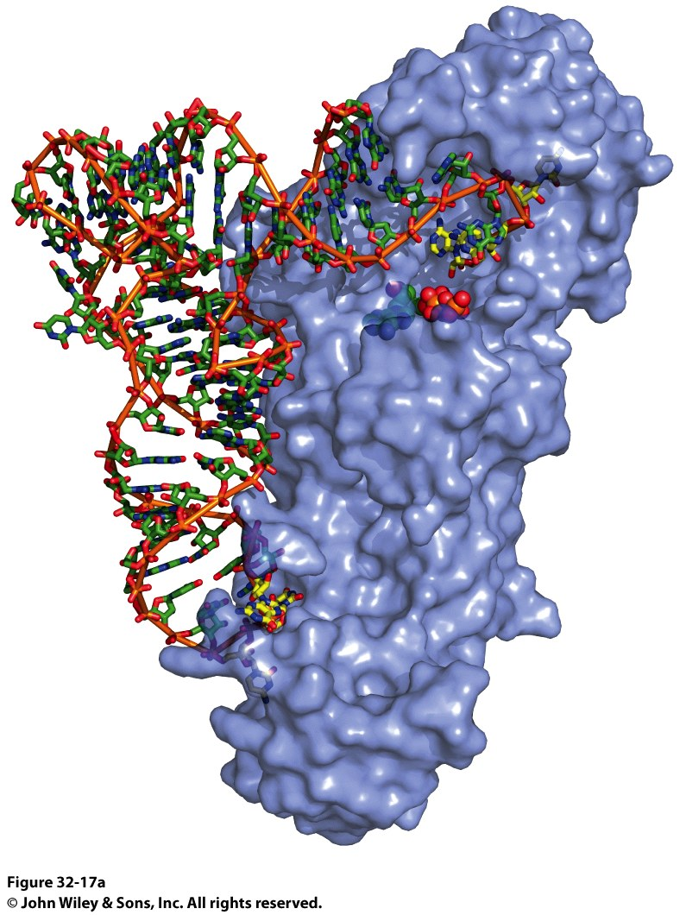
Why the Difference? Mysteries…
Class I Synthetase
Class II Synthetase

Slide 106
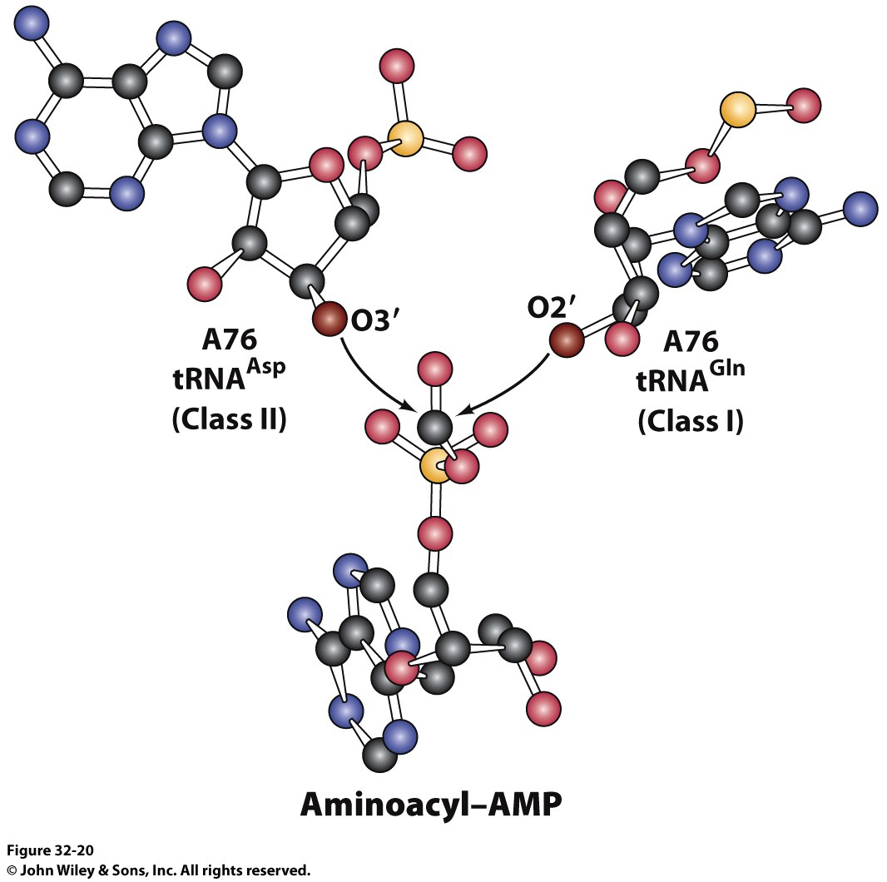
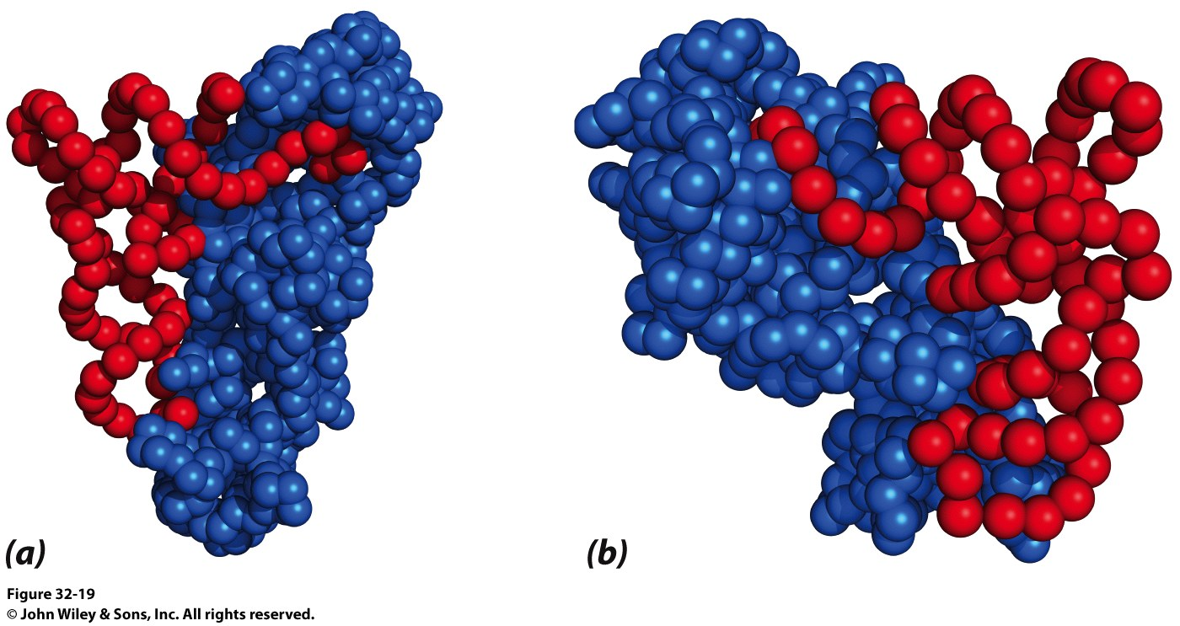
Why the Difference?

Slide 107
General Structure of an Aminoacyl-tRNA
Notes:
FIGURE 4.34 General structure of an aminoacyl-tRNA. The amino acid is attached at the 3′ end of the RNA. The anticodon is the template-recognition site. Notice that the tRNA has a cloverleaf structure with many hydrogen bonds (green dots) between bases.

Slide 108
Where are we and Where have we been?
Nucleotide structure
Chargaff’s rules for hydrogen bonding between nitrogenous bases
Role hydrogen bond acceptors, donors and methyl groups play on specificity of protein/DNA interactions
Structure of the phosphodiester backbone of DNA
Physical dimensions of B-DNA (we ignored A-form and Z-form DNA)
DNA is supercoiled in the cell (by topoisomerase)
DNA and RNA can form stem-loop structures
Messelson/Stahl experiment proved DNA replication is semiconservative
DNA can be “melted” and every sequence of DNA has a specific Tm determined by its sequence. Why?
Hypochromism. What is is and why?
DNA synthesis
Reaction mechanism for DNA PolI and DNA PolIII both require what?
What is pyrophosphate hydriolysis and why does it matter?
Formation of the replication fork requires what proteins? What does each do?

Slide 109
Where are we and Where have we been?
DNA synthesis cont’d
What proteins are in the replisome?
What do we need in a polymerase?
Requirements of DNA polymerases that RNA polymerases don’t have. Why?
Speed vs. Fidelity (relative to organisms)
How do DNA polymerases maintain fidelity?
If a mistake is made, how is it corrected?
3’->5’ exonuclease activity vs. 5’ -> 3’ exonuclease activity
Why E. coli DNA polymerases have which activity?
Why?
Mechanism of each exonuclease activity (one requires Mg2+ ions, one requires Zn2+ and a Tyr)
Slide 66. Period. Done. Know what each protein does and the role each plays in DNA replication. Know those and any specific mechanisms for selected proteins and you’re golden.

Slide 110
Where are we and Where have we been?
Mechanism of DNA Ligase (ATP vs NAD+ for eukaryotes and prokaryotes)
How does DNA replication stop?
RNA polymerase holoenzyme is different from the core enzyme?
What does that sigma subunit do? Why is it important?
Structure of a promoter.
Sequences that matter and why
Structure of the active RNAP complex with DNA
Adapter hypothesis and how it was proven by Francis Crick and Sydney Brenner
Codon table and wobble
Characteristics of genetic code

Slide 111
Where are we and Where have we been?
tRNA and aminoacyl-tRNA
tRNA Synthetases
Mechanism of loading amino acids onto tRNA
That’s pretty much it.
We’ll pick up Translation next time
Now for Test 3…

