Slide 1
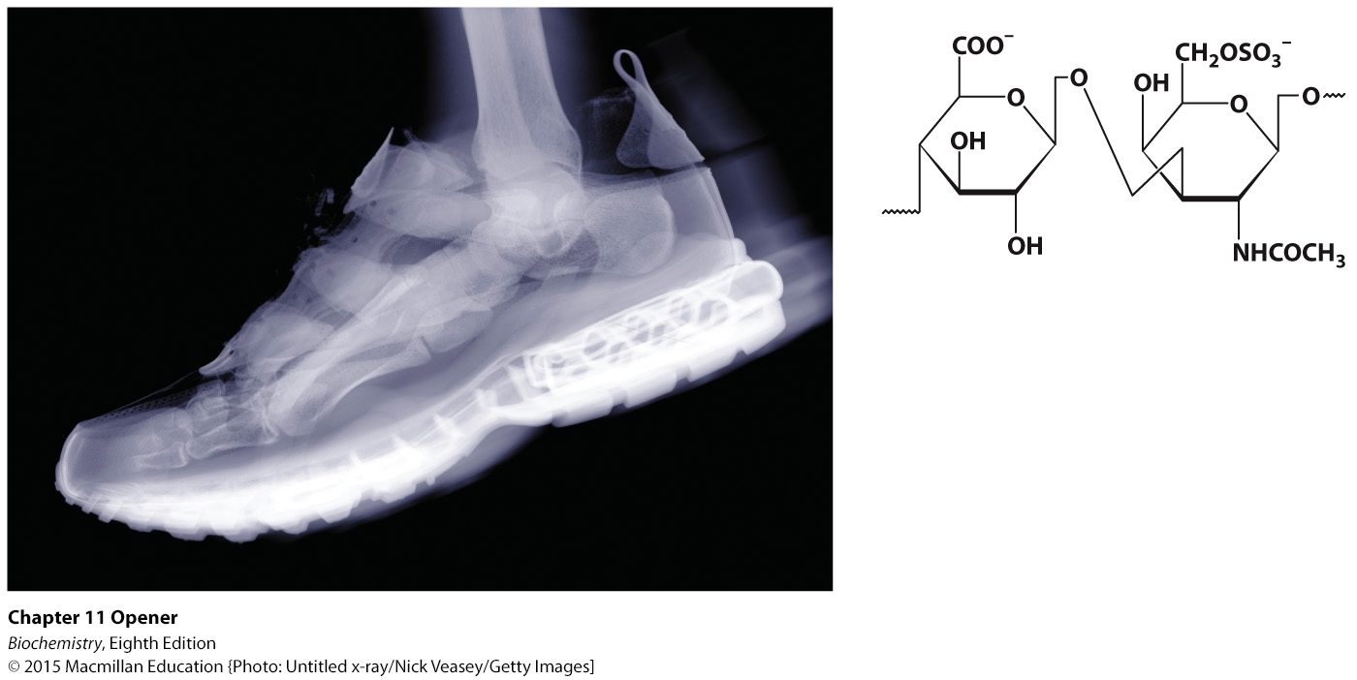
Notes:
Carbohydrates are important fuel molecules, but they play many other biochemical roles, including protection against high-impact forces. The cartilage of a runner’s foot cushions the impact of each step she takes. A key component of cartilage are molecules called glycosaminoglycans , large polymers made up of many repeats of dimers such as the pair shown at the right. [Untitled x-ray/Nick Veasey/Getty Images.]

Slide 2
Ch.11 Learning Objectives
By the end of this chapter, you should be able to:
Describe the main roles of carbohydrates in nature.
Define carbohydrate and monosaccharide.
Describe how simple carbohydrates are linked to form complex carbohydrates.
Explain how carbohydrates are linked to proteins.
Describe the three main classes of glycoproteins and explain their biochemical roles.

Slide 3
Ch.11 Outline
11.1 Monosaccharides Are the Simplest Carbohydrates
11.2 Monosaccharides Are Linked to Form Complex Carbohydrates
11.3 Carbohydrates Can Be Linked to Proteins to Form Glycoproteins
11.4 Lectins Are Specific Carbohydrate-Binding Proteins

Slide 4
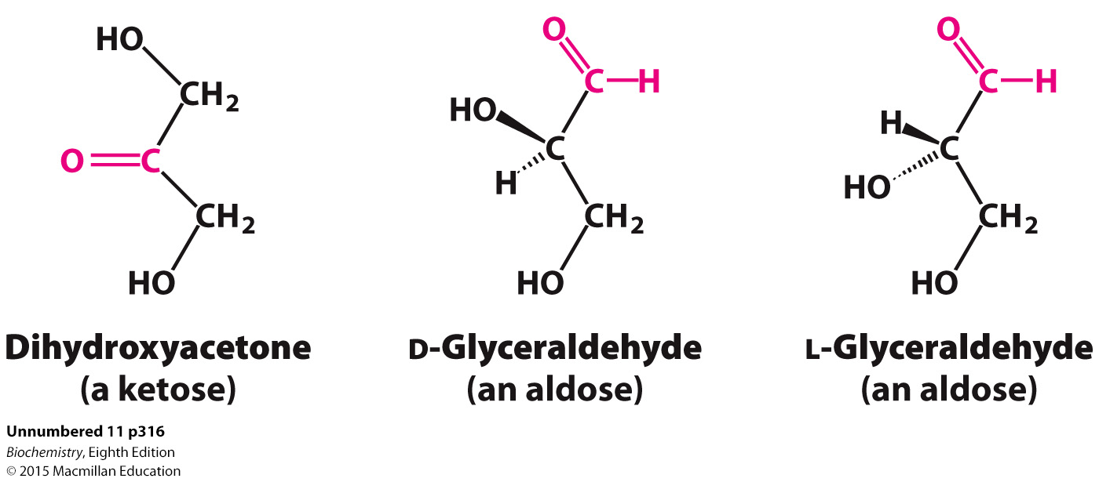
Monosaccharides are aldehydes or ketones that contain two or more hydroxyl groups.
The smallest monosaccharides are composed of three carbons.
Monosaccharides exist in many isomeric forms.

Slide 5
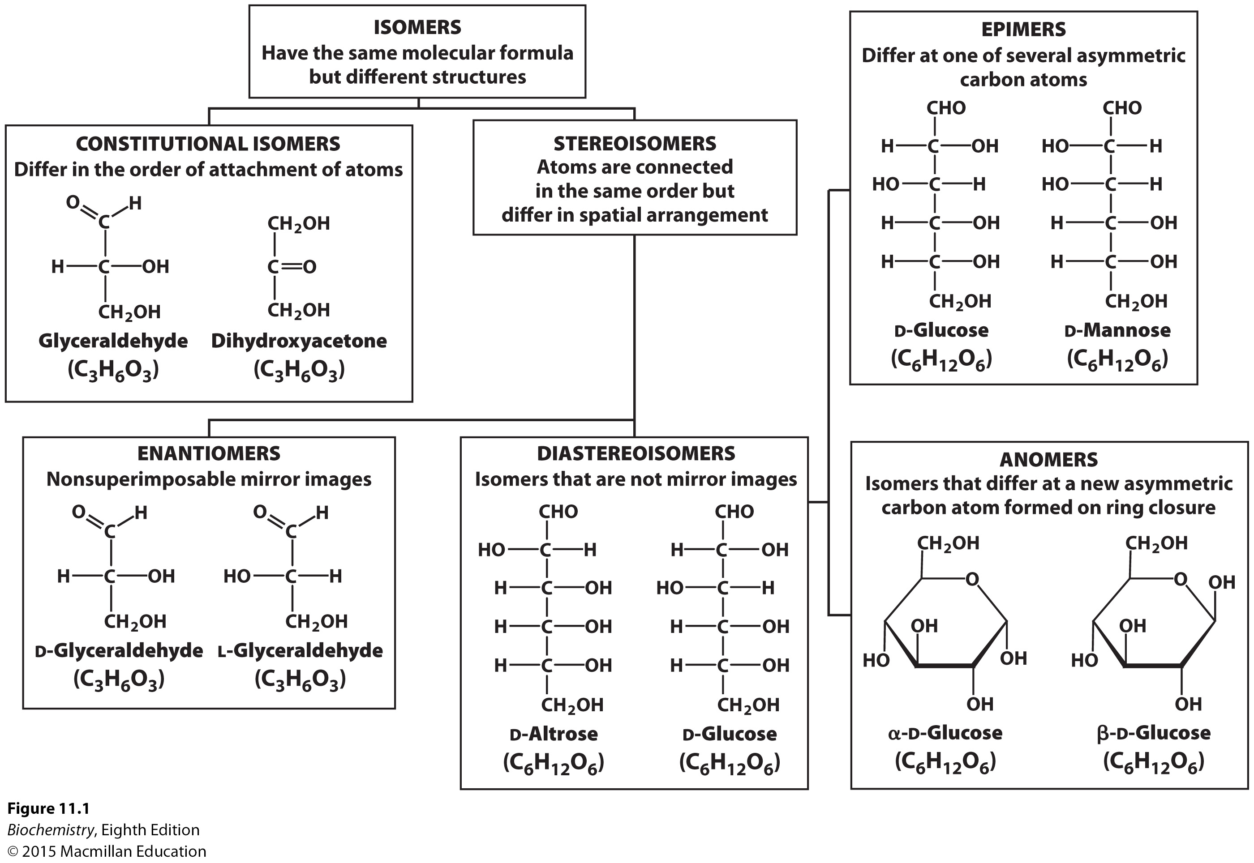
Notes:
FIGURE 11.1 Isomeric forms of carbohydrates.

Slide 6
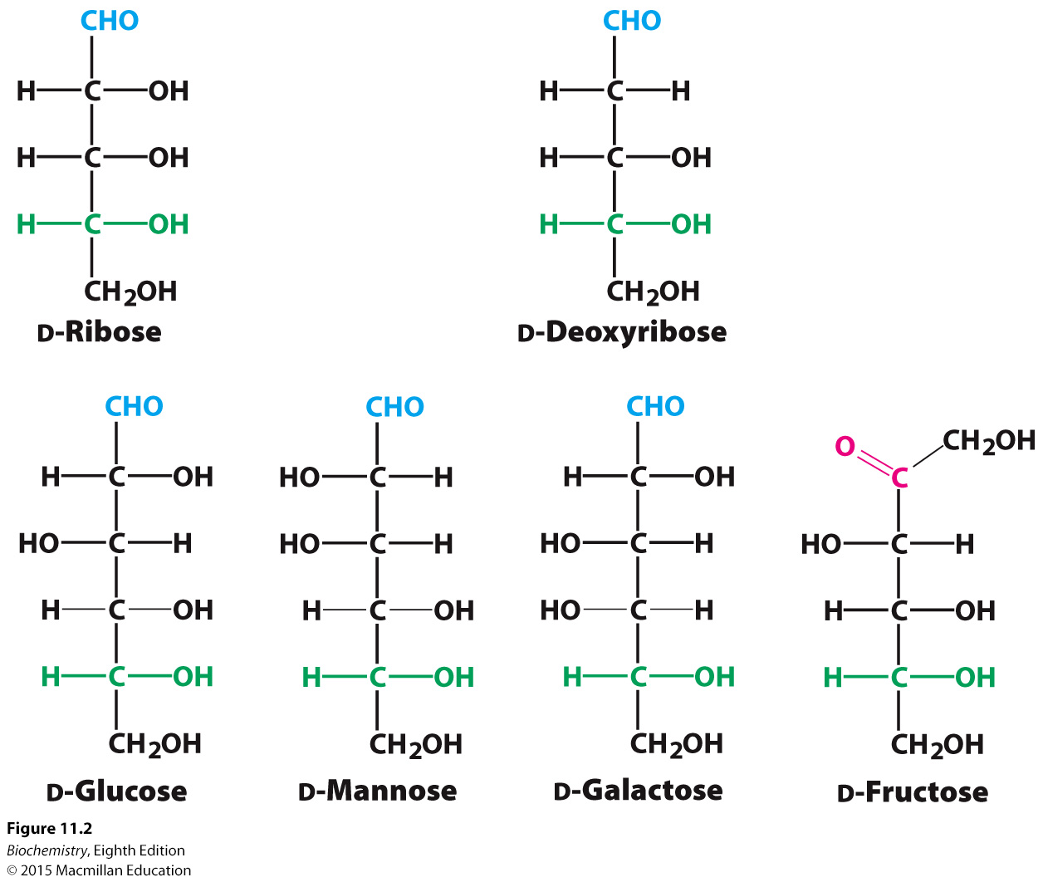
Six monosaccharides are especially common.
Notes:
FIGURE 11.2 Common monosaccharides. Aldoses contain an aldehyde (shown in blue), whereas ketoses, such as fructose, contain a ketose (shown in red). The asymmetric carbon atom farthest from the aldehyde or ketone (shown in green) designates the structures as being in the d configuration.

Slide 7
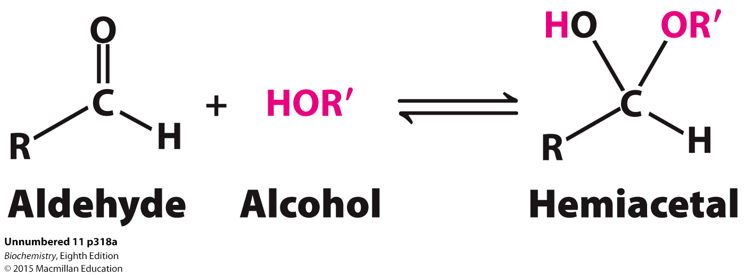
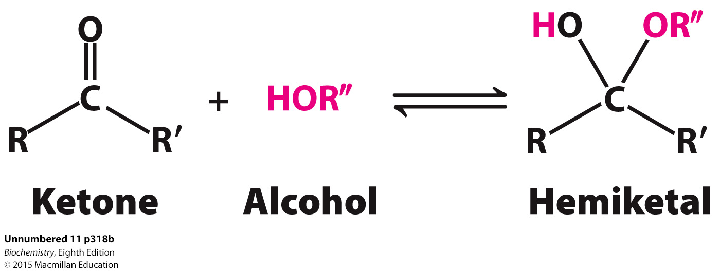
The chemical basis for ring formation is the reaction of an aldehyde with an alcohol to form a hemiacetal, whereas a ketone can react with an alcohol to form a hemiketal.

Slide 8
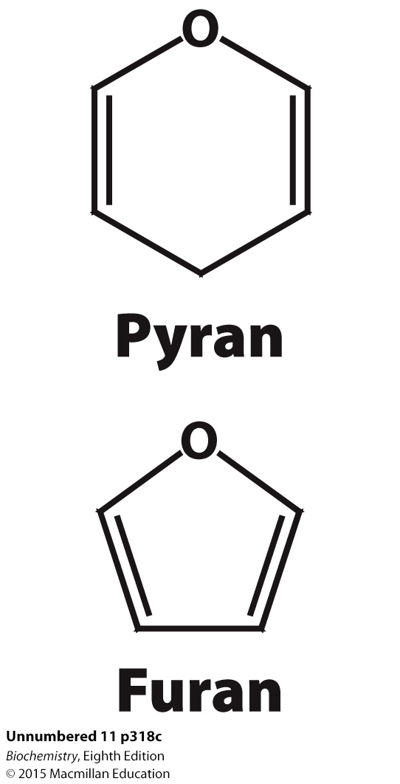
In the case of glucose, the resulting intramolecular hemiacetal, a six- carbon ring, is called a pyranose because of its resemblance to pyran.
In the case of the ketose fructose, the intramolecular hemiketal, a five-carbon ring, is called a furanose because of its resemblance to furan.

Slide 9
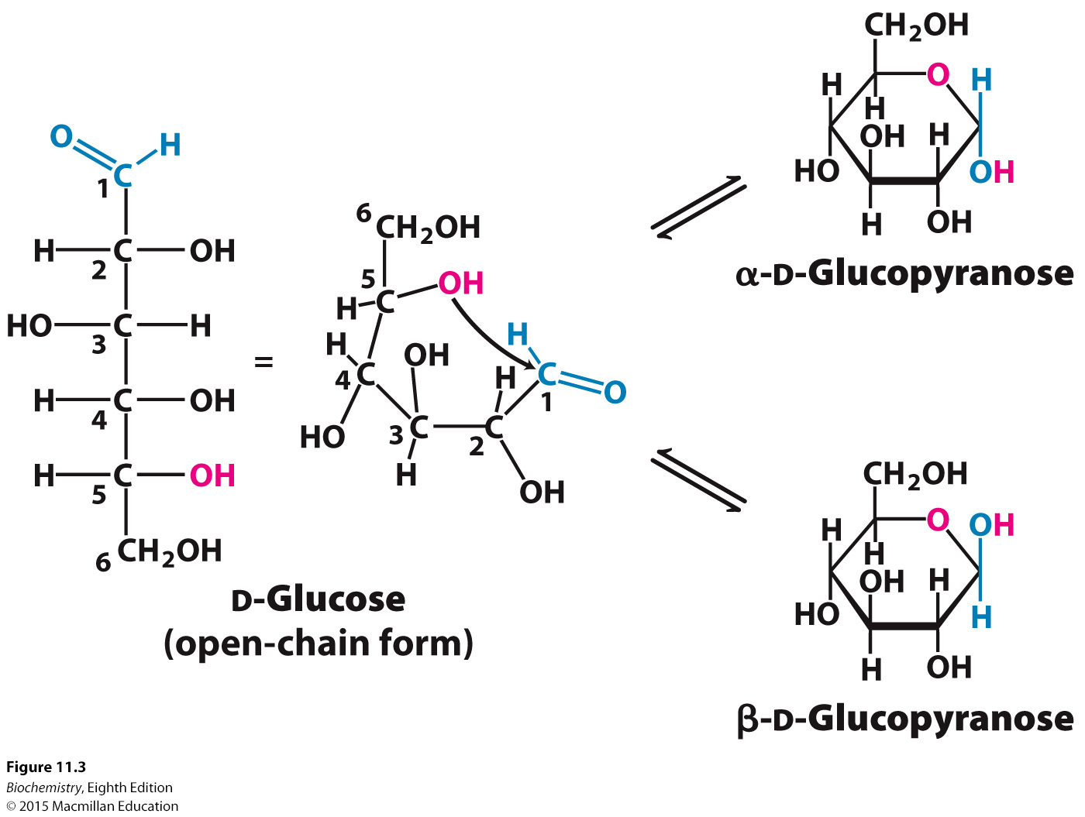
Notes:
FIGURE 11.3 Pyranose formation. The open-chain form of glucose cyclizes when the C-5 hydroxyl group attacks the oxygen atom of the C-1 aldehyde group to form an intramolecular hemiacetal. Two anomeric forms, designated α and β, can result.

Slide 10
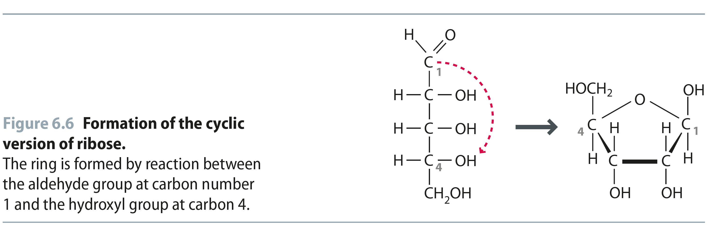
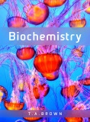
Fig 6.6
Another View of the Same Ring Closure Reaction
Reproduced from:
Biochemistry by T.A. Brown, ISBN: 9781907904288 © Scion Publishing Ltd, 2017

Slide 11
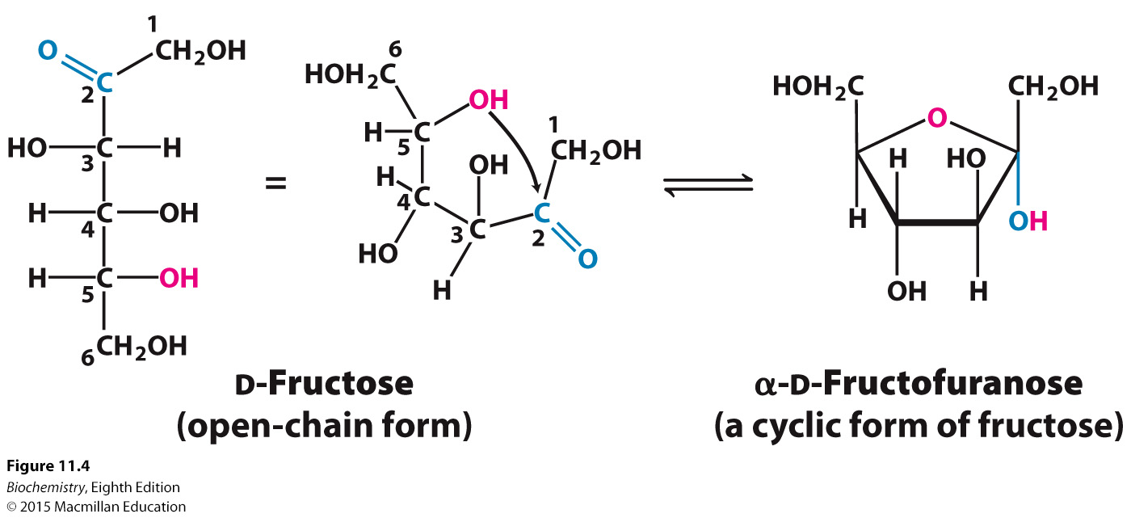
Notes:
FIGURE 11.4 Furanose formation. The open-chain form of fructose cyclizes to a five-membered ring when the C-5 hydroxyl group attacks the C-2 ketone to form an intramolecular hemiketal. Two anomers are possible, but only the α anomer is shown.

Slide 12
Formation of a cyclic hemiacetal creates another diastereoisomeric form called an anomer.
The α form means that the hydroxyl at C-1 is below the plane of the ring.
The β form means that the hydroxyl at C-1 is above the plane of the ring.
The furanose form of fructose can also exist in anomeric forms in which the α and β forms refer to the orientation of the hydroxyl at C-2.
Fructose forms both the pyranose form, which predominates when fructose is free in solution, and a furanose form, commonly seen in fructose derivatives.

Slide 13
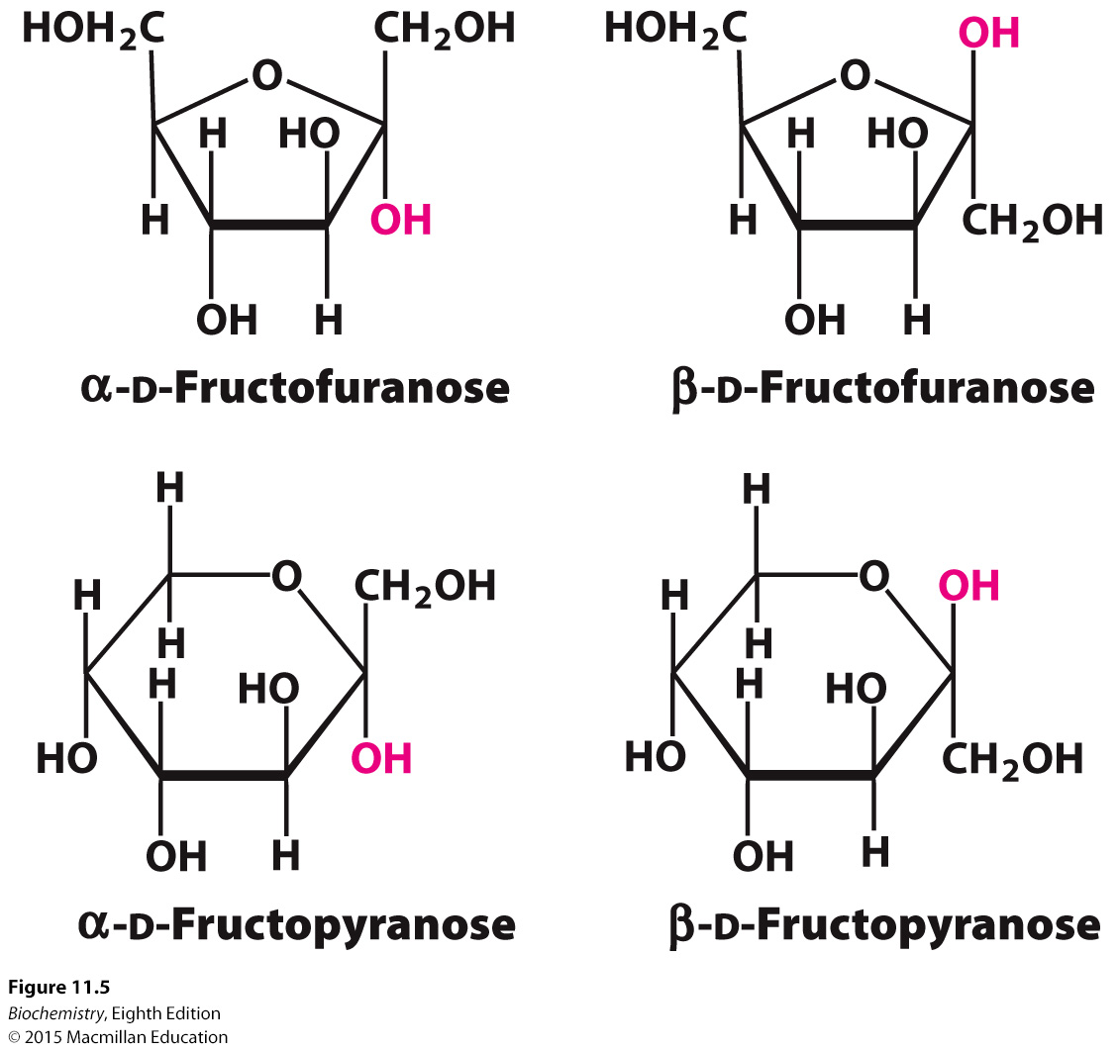
Notes:
FIGURE 11.5 Ring structures of fructose. Fructose can form both five-membered furanose (top) and six-membered pyranose (bottom) rings. In each case, both α and β anomers are possible.

Slide 14
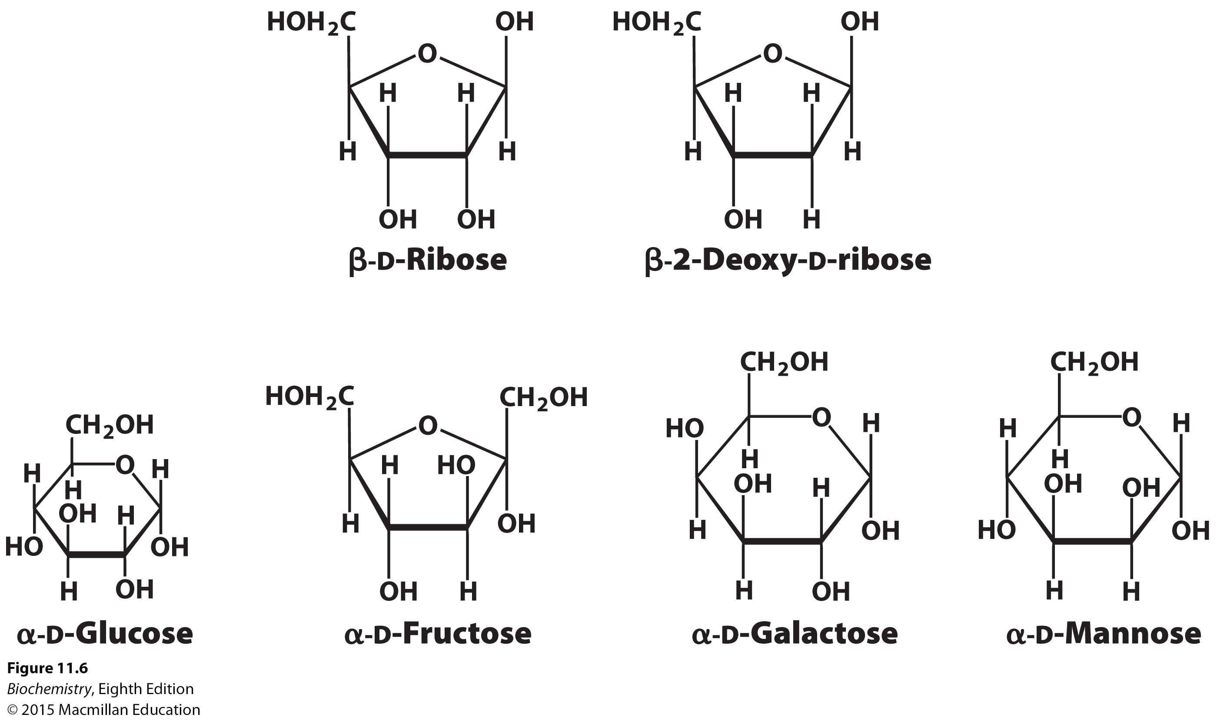
Six common monosaccharides in their ring forms.
Notes:
FIGURE 11.6 Common monosaccharides in their ring forms.

Slide 15
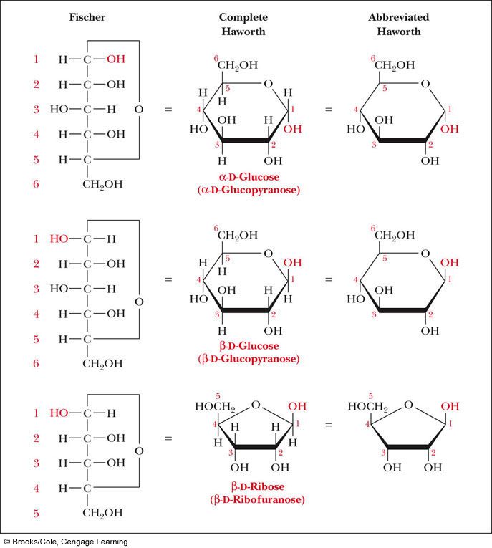
Comparison of the Fischer and Haworth Representations
Groups on the Right Side of the Fischer Representation are drawn as DOWN in the Haworth Projection
DDUDU Rule!

Slide 16
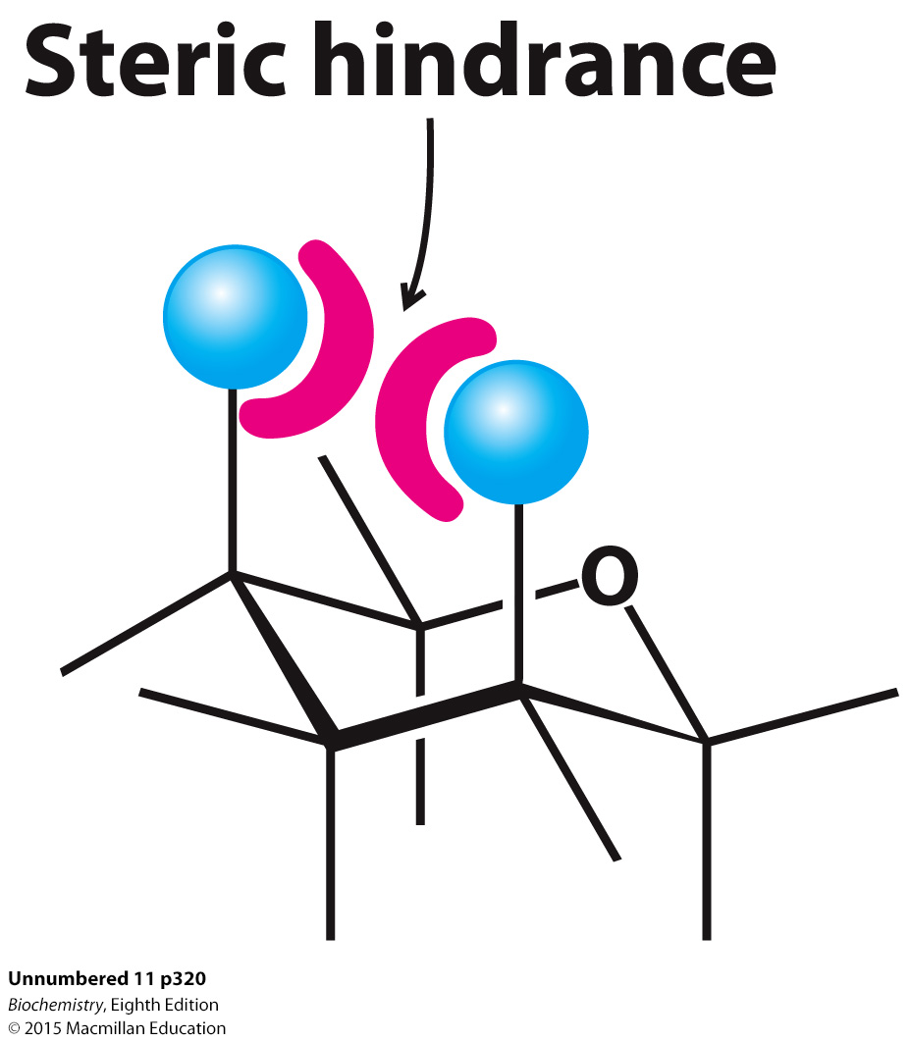
Pyranose rings can adopt two types of conformation, called boat and chair.
In the chair form, substituents on the carbon ring atoms have two orientations: axial and equatorial.
β-D-glucopyranose adopts the chair conformation because the axial positions are occupied by hydrogens, reducing steric hindrance.

Slide 17
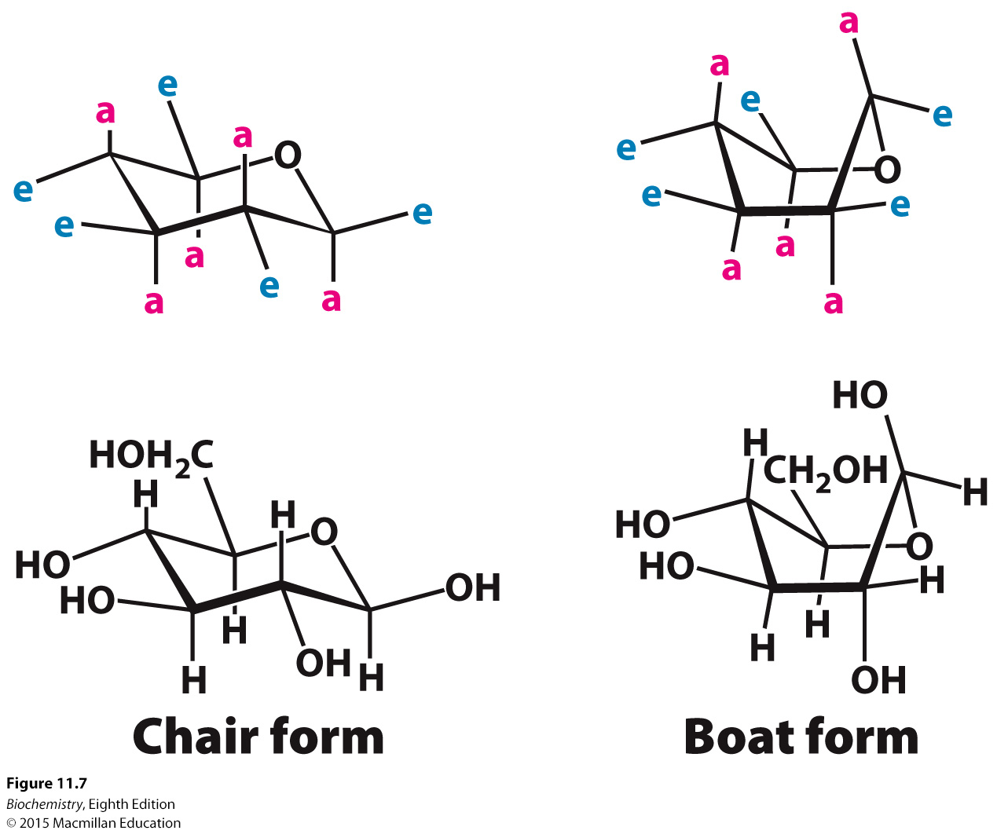
Notes:
FIGURE 11.7 Chair and boat forms of β-d-glucose. The chair form is more stable because hydrogen atoms occupy the axial positions, resulting in less steric hindrance. Abbreviations: a, axial; e, equatorial.

Slide 18

A solution of glucose contains one-third α anomer, two-thirds β anomer, and about 1% open chain.
Because the two anomeric forms are in equilibrium that passes through an open-chain form, the free open-chain form reacts with oxidizing agents.
Sugars that react with oxidizing agents are called reducing sugars, whereas those that do not are non-reducing sugars.

Slide 19
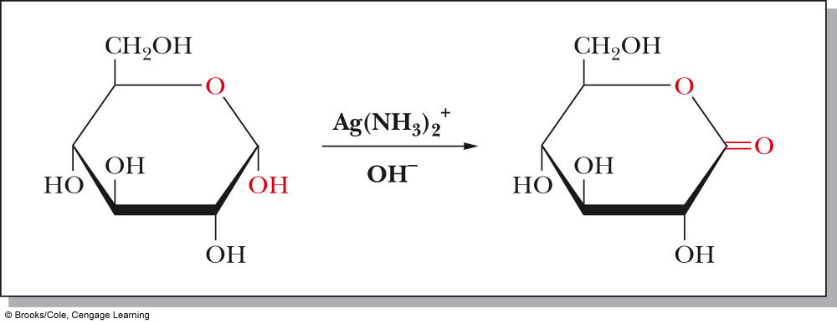
Reaction of Monosaccharides
Reducing sugar: one that reduces an oxidizing agent
  Oxidation of a cyclic hemiacetal form gives a lactone
  When the oxidizing agent is Tollens solution, silver precipitates as a silver mirror
If anomeric carbons are involved in glycosidic linkage, there will be a negative Tollens reagent test
If another anomeric carbon is not bonded and is free, there will be a positive Tollens reagent test

Slide 20
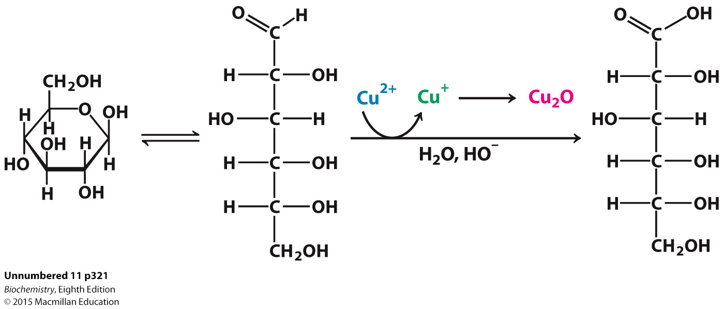

Slide 21
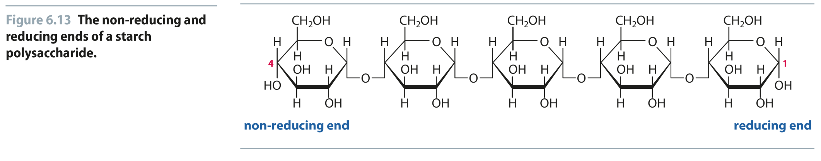
Fig 6.13
Why do reducing sugars matter?
All biological polymers, even polysaccharides, have directionality
Reproduced from:
Biochemistry by T.A. Brown, ISBN: 9781907904288 © Scion Publishing Ltd, 2017

Slide 22
As a reducing sugar, glucose can react with hemoglobin, forming glycosylated hemoglobin (hemoglobin A1c), which is fully functional.
Determining the amount of hemoglobin A1c in the blood allows one to monitor the long-term control of blood glucose levels in diabetics.
Reactions between carbohydrates and proteins often impair protein function.
Such modifications, called advanced glycation end products, have been implicated in a number of pathological conditions.

Slide 23
A bond formed between the anomeric carbon atom and an oxygen atom of an alcohol is called an O-glycosidic bond, and the product is called a glycoside.
A bond formed between the anomeric carbon atom and an amine is called an N-glycosidic bond.

Slide 24
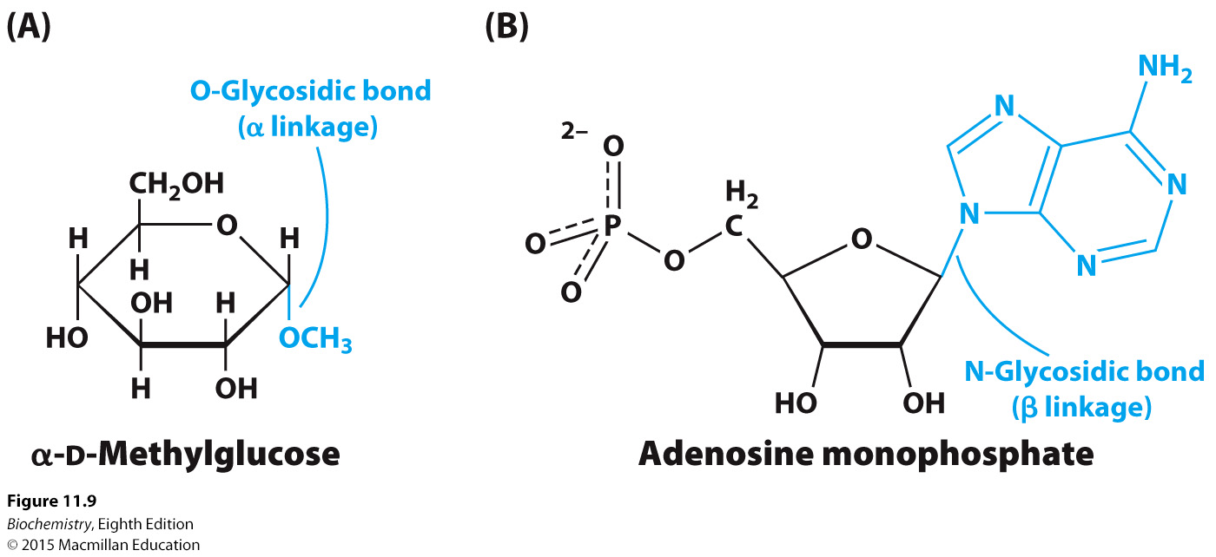
Notes:
FIGURE 11.9 O- and N-glycosidic linkages. (A) An O-glycosidic bond links glucose to a methyl group in α-d-methylglucose. (B) An N-glycosidic bond joins ribose to the base adenine in adenosine monophosphate.

Slide 25
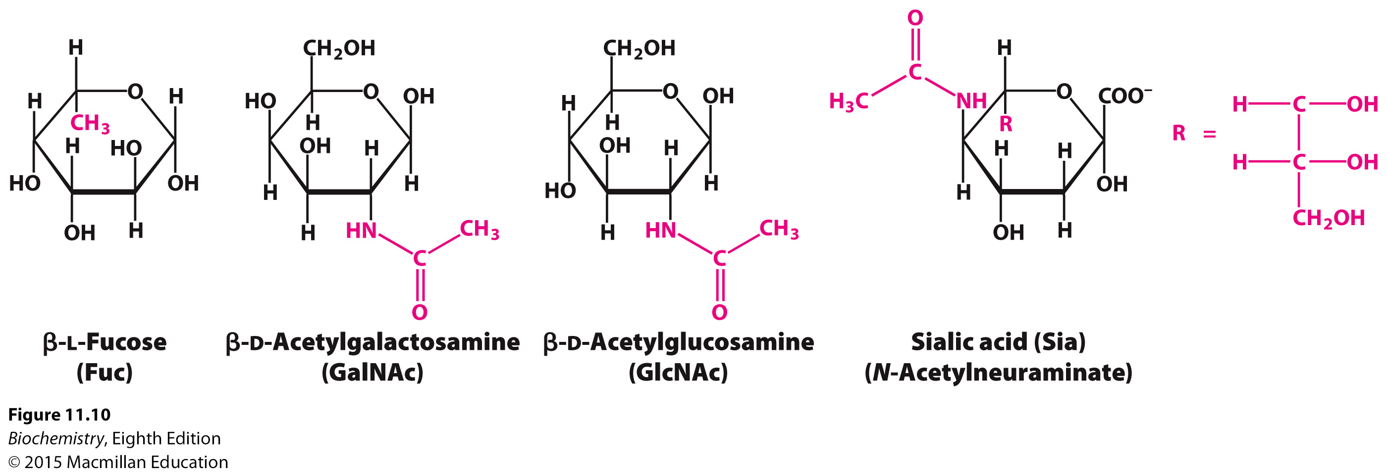
Common Modifications to Monosaccharides
Notes:
FIGURE 11.10 Modified monosaccharides. Carbohydrates can be modified by the addition of substituents (shown in red) other than hydroxyl groups. Such modified carbohydrates are often expressed on cell surfaces.

Slide 26
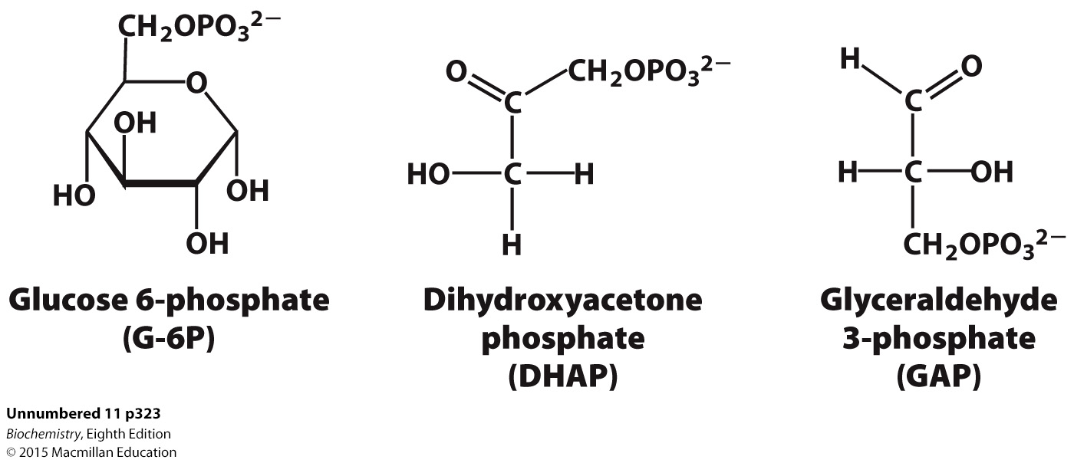
Phosphorylation is a common modification of carbohydrates.
Phosphorylation makes the sugars anionic and prevents them from leaving the cell.
Phosphorylation also facilitates the metabolism of sugars.

Slide 27

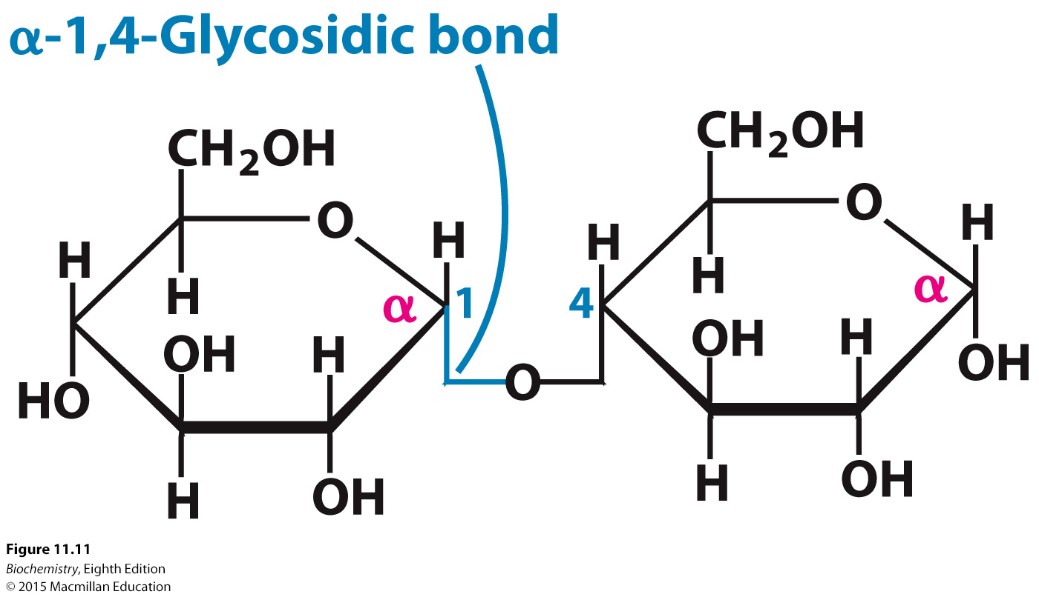
Oligosaccharides containing two or more monosaccharides are linked by O-glycosidic bonds.
Notes:
FIGURE 11.11 Maltose, a disaccharide. Two molecules of glucose are linked by an α-1,4-glycosidic bond to form the disaccharide maltose. The angles in the bonds to the central oxygen atom do not denote carbon atoms. The angles are added only for ease of illustration. The glucose molecule on the right is capable of assuming the open-chain form, which can act as a reducing agent. The glucose molecule on the left cannot assume the open-chain form, because the C-1 carbon atom is bound to another molecule.

Slide 28
Sucrose is obtained from sugar cane and sugar beets and is composed of a glucose linked to a fructose. The linkage is α for glucose and β for fructose. Sucrose is cleaved by sucrase.
Lactose is the disaccharide of milk that consists of a galactose linked to a glucose by a β-1-4-linkage. Lactase cleaves lactose.
Maltose, a degradation product of large oligosaccharides, is composed of two glucose molecules linked by an α-1-4-linkage. Maltose is hydrolyzed by maltase.

Slide 29
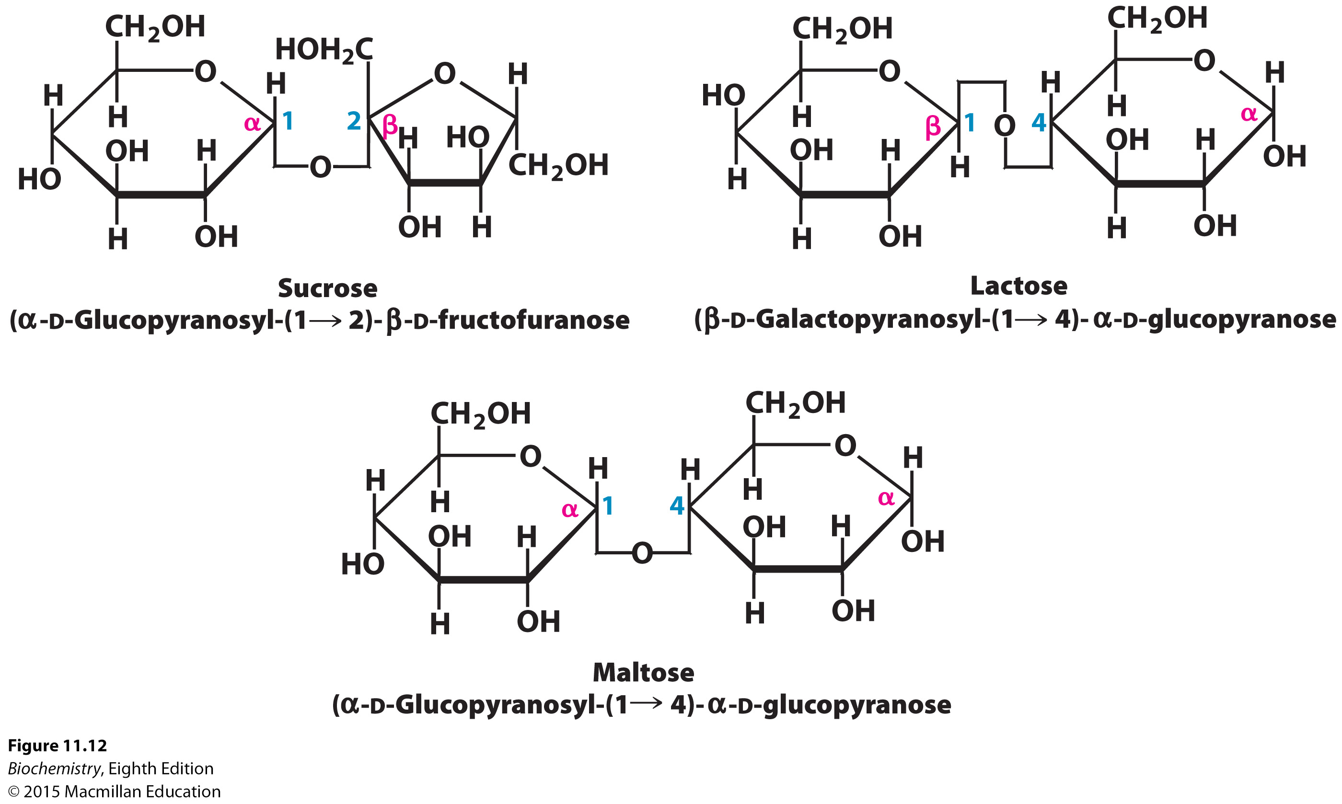
Notes:
FIGURE 11.12 Common disaccharides. Sucrose, lactose, and maltose are common dietary components. As in Figure 11.11, the angles in the bonds to the central oxygen atoms do not denote carbon atoms.

Slide 30
Large polymeric oligosaccharides are called polysaccharides. If all of the monosaccharides in the polysaccharide are the same, the polysaccharide is called a homopolymer.
The polysaccharide glycogen is the storage form of glucose in animal cells.
Most glucose units in glycogen are lined by α-1,4-glycosidic bonds, with branches formed by α-1,6-glycosidic bonds every 10 glucose units.
In plants, glucose is stored as starch, of which there are two forms.
Amylose is a linear polymer of glucose units linked by α-1,4-glycosidic bonds.
Amylopectin is a branched polymer, with an α-1,6-glycosidic bond for every 30 α-1,4-glycosidic bonds.

Slide 31
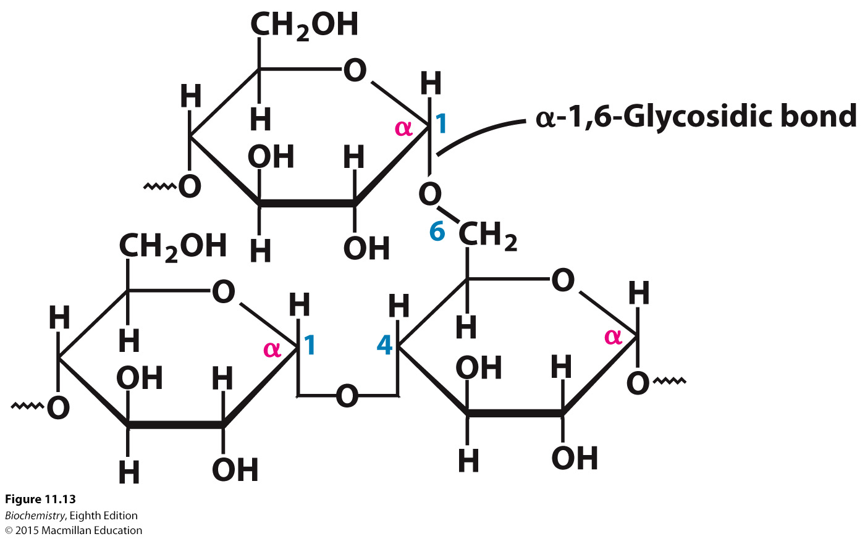
Notes:
FIGURE 11.13 Branch point in glycogen. Two chains of glucose molecules joined by α-1,4- glycosidic bonds are linked by an α-1,6-glycosidic bond to create a branch point. Such an α-1,6- glycosidic bond forms at approximately every 10 glucose units, making glycogen a highly branched molecule.

Slide 32

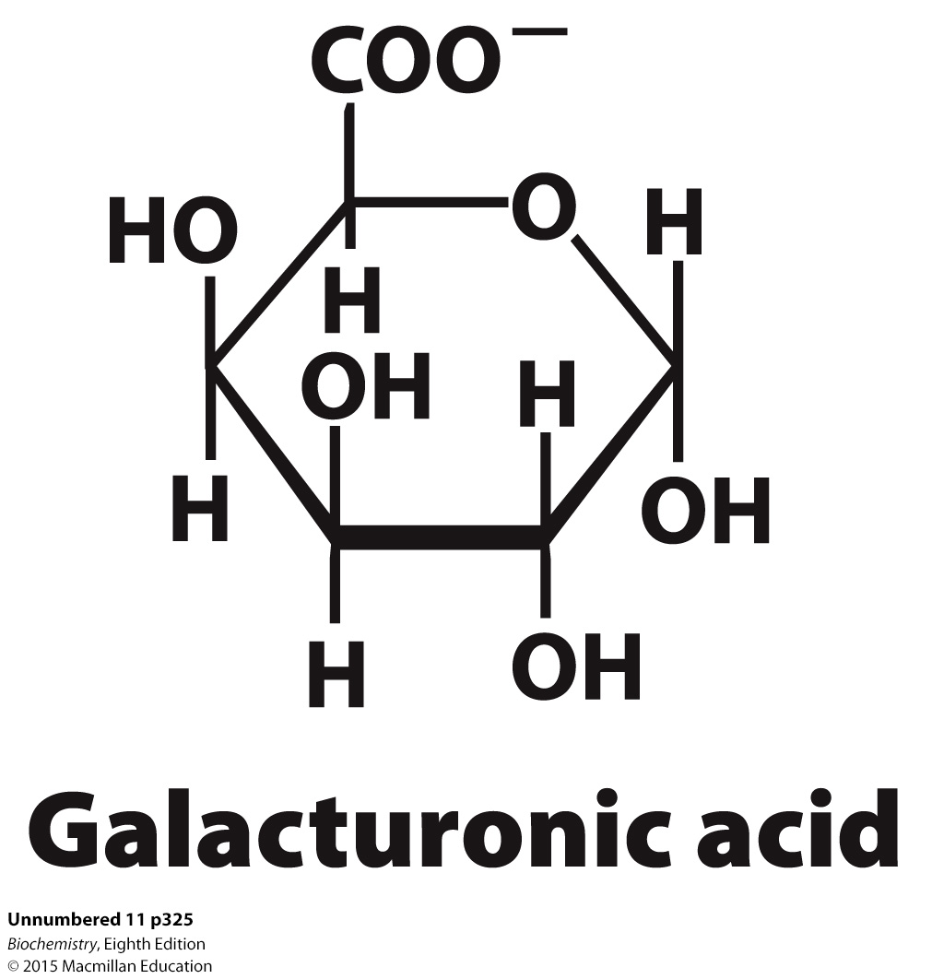
Cellulose is a homopolymer of glucose units linked by a β-1,4-glycosidic bond.
The β linkage yields a straight chain capable of interacting with other cellulose molecules to form strong fibrils.
The α linkages of starch and glycogen form compact hollow cylinders suitable for accessible storage.
Although mammals cannot digest cellulose and other plant fibers, soluble fibers, such as polygalacturonic acid, aid in digestion.

Slide 33
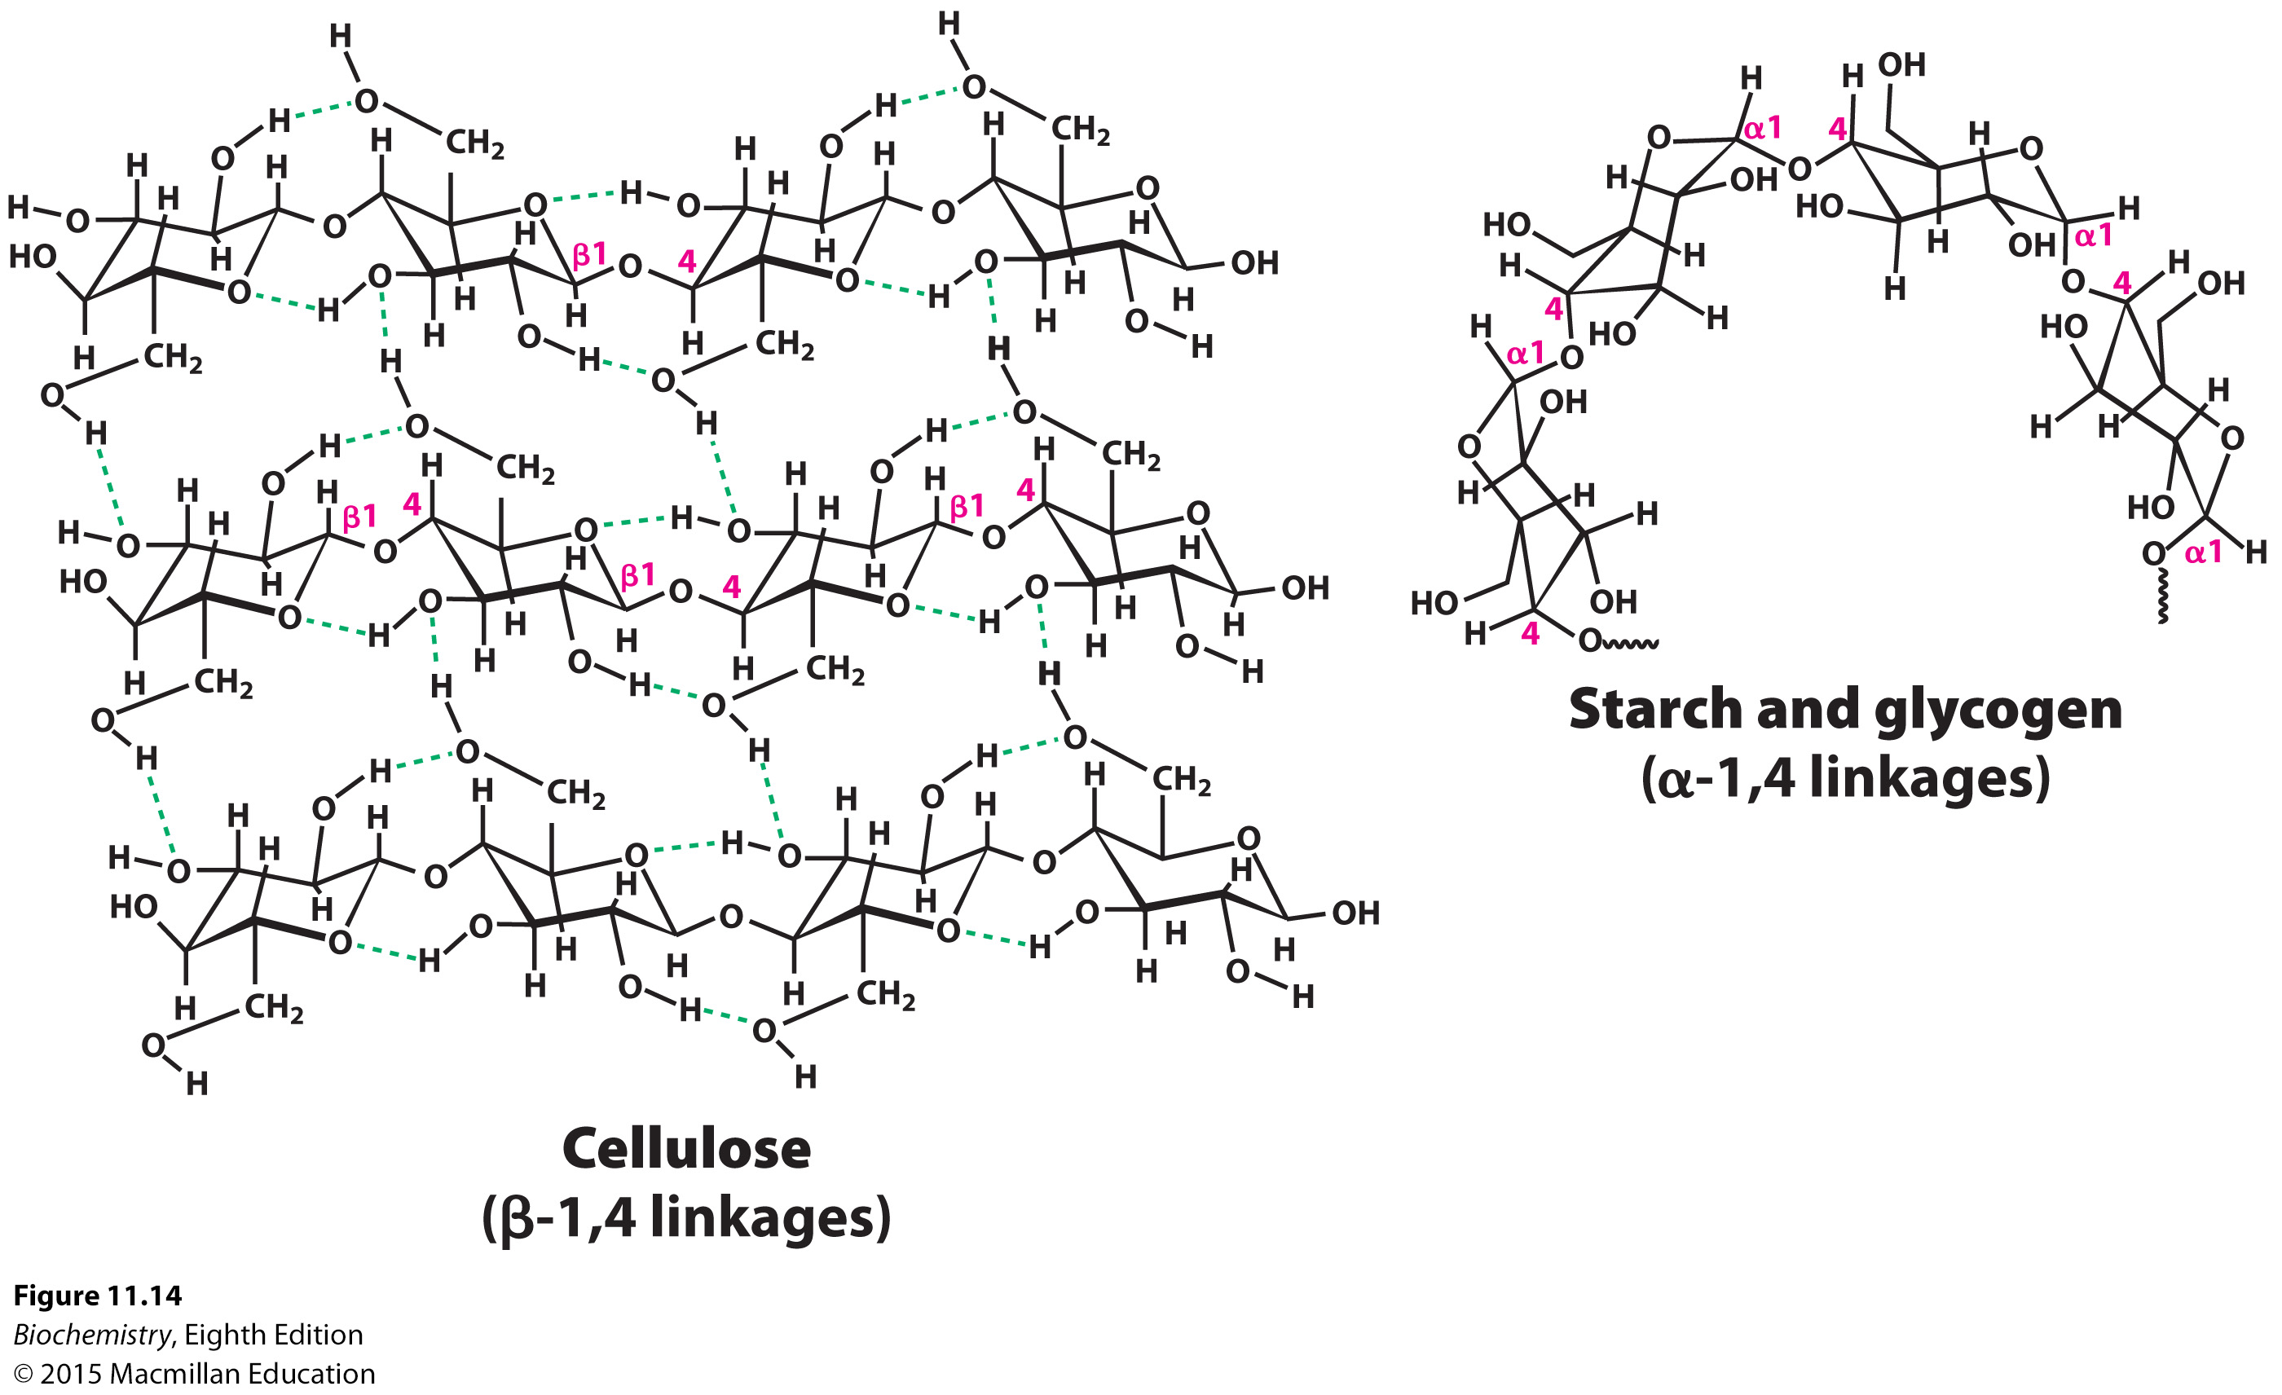
Importance of Structure on Polymer Function
Notes:
FIGURE 11.14 Glycosidic bonds determine polysaccharide structure. The β-1,4 linkages favor straight chains, which are optimal for structural purposes. The α-1,4 linkages favor bent structures, which are more suitable for storage.

Slide 34
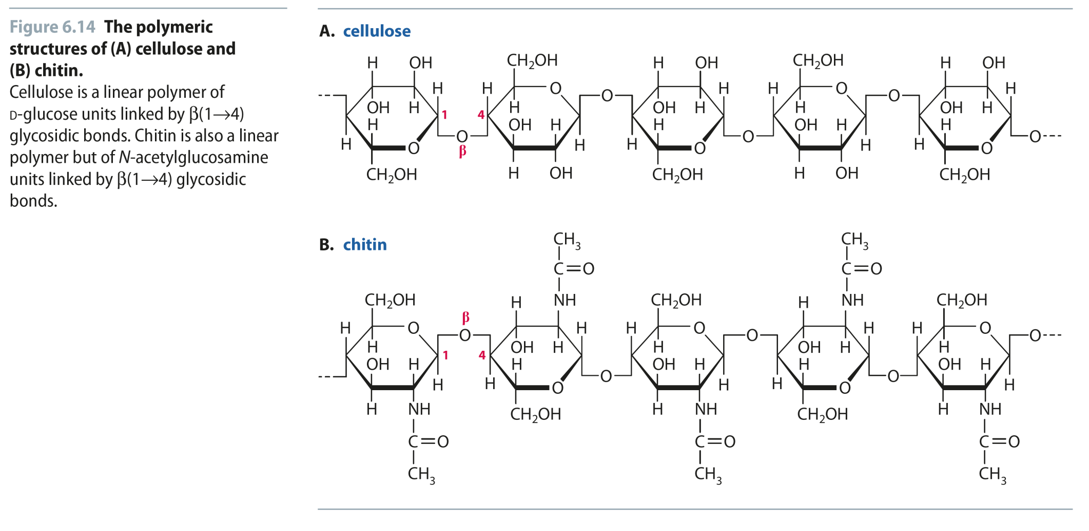
Fig 6.14
Reproduced from:
Biochemistry by T.A. Brown, ISBN: 9781907904288 © Scion Publishing Ltd, 2017

Slide 35

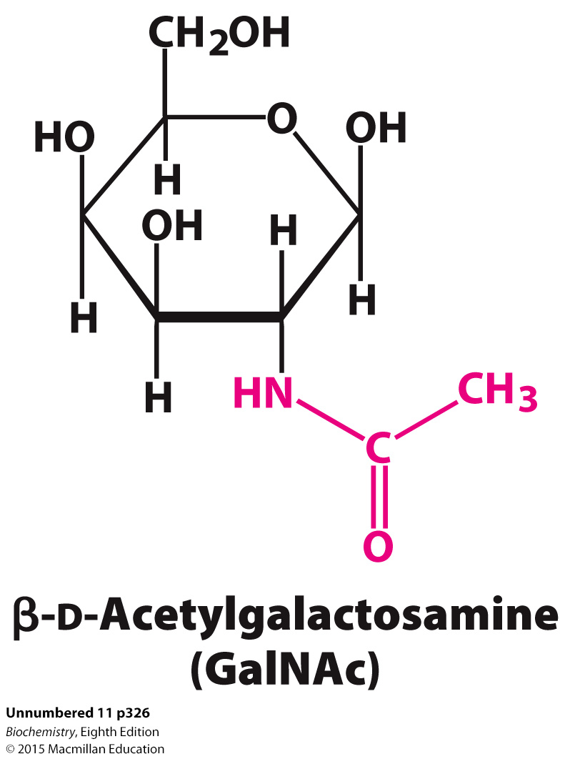
Proteins with carbohydrates attached are called glycoproteins. There are three main classes of glycoproteins:
Glycoproteins: The protein is the largest component by weight. Glycoproteins play a variety of roles, including as membrane proteins.
Proteoglycans: The protein is attached to a particular type of polysaccharide called a glycosaminoglycan. By weight, proteoglycans are mainly carbohydrate. Proteoglycans play structural roles or act as lubricants.
Mucins or mucoproteins: Like proteoglycans, mucins are predominantly carbohydrate. The protein is characteristically attached to the carbohydrate by N-acetylgalactosamine. Mucins are often lubricants.

Slide 36
In all classes of glycoproteins, carbohydrates are attached to the nitrogen atom in the side chain of asparagine (N-linkage) or to the oxygen atom of the side chain of serine or threonine (O-linkage).
All N-linked polysaccharides have a common pentasaccharide core, consisting of three mannoses and two N-acetylglucosamine units.
Additional monosaccharides may be attached to the core.

Slide 37
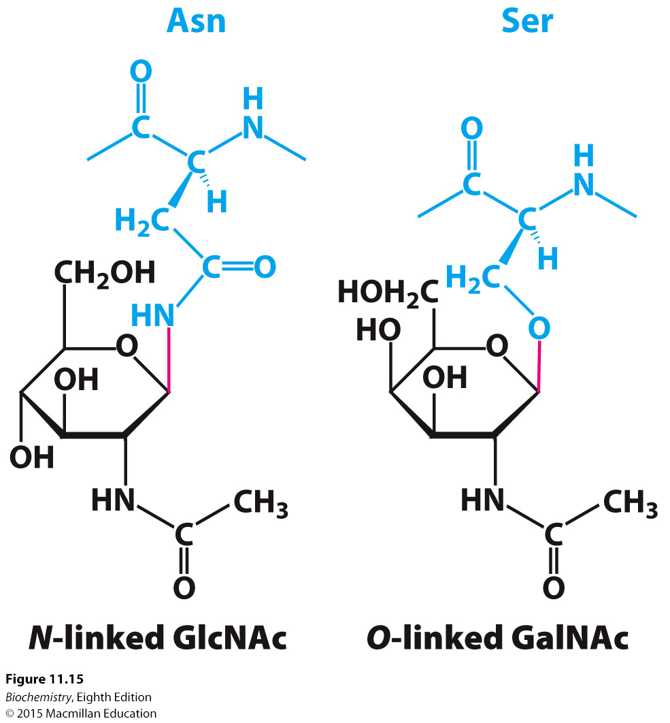
Notes:
FIGURE 11.15 Glycosidic bonds between proteins and carbohydrates. A glycosidic bond links a carbohydrate to the side chain of asparagine (N-linked) or to the side chain of serine or threonine (O-linked). The glycosidic bonds are shown in red.

Slide 38
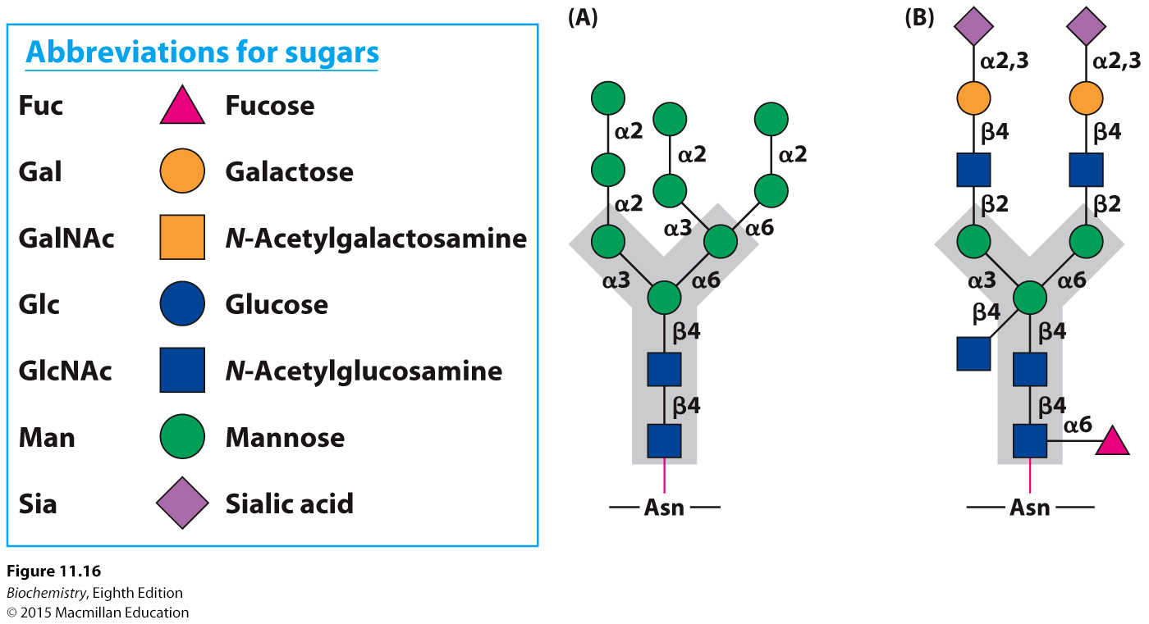
Notes:
FIGURE 11.16 N-linked oligosaccharides. A pentasaccharide core (shaded gray) is common to all N-linked oligosaccharides and serves as the foundation for a wide variety of N-linked oligosaccharides, two of which are illustrated: (A) high-mannose type; (B) complex type.

Slide 39
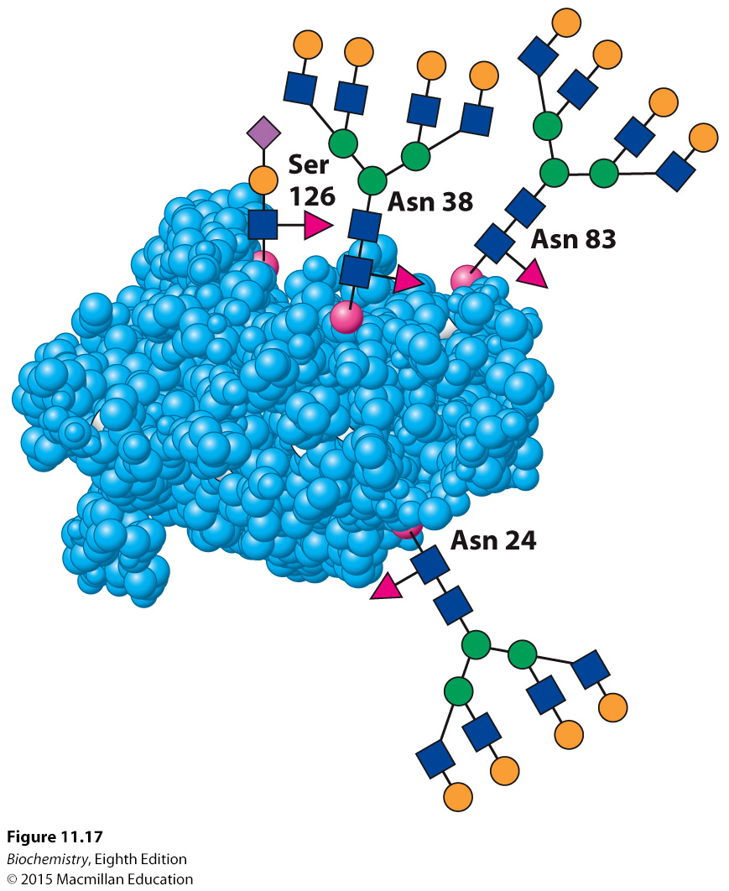
Notes:
FIGURE 11.17 Oligosaccharides attached to erythropoietin. Erythropoietin has oligosaccharides linked to three asparagine residues and one serine residue. The structures shown are approximately to scale. See Figure 11.16 for the carbohydrate key. [Drawn from 1BUY.pdf.]

Slide 40
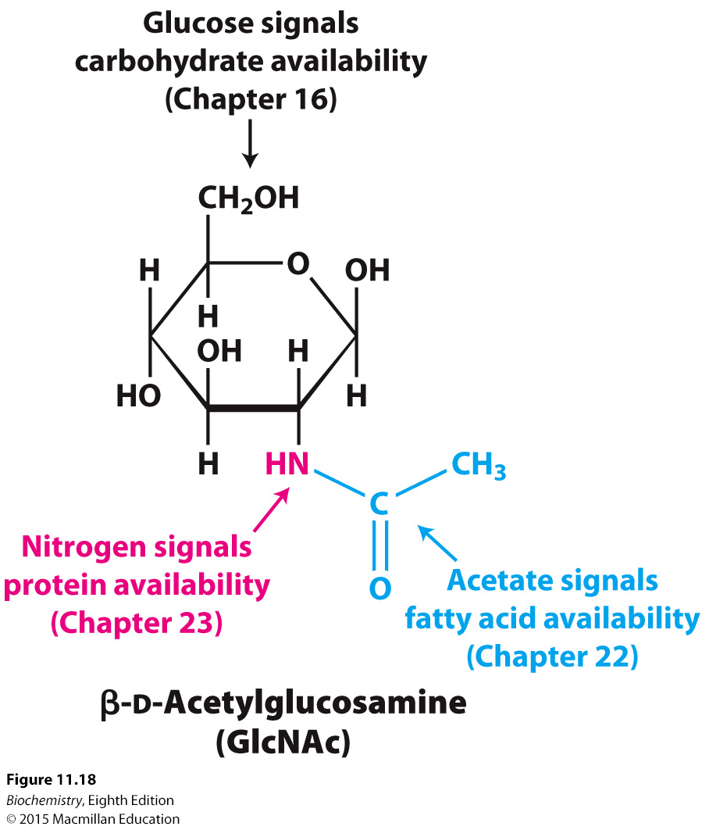
Many proteins are modified by the attachment of N-acetylglucosamine (GlcNAc) to serine or threonine residues by GlcNAc transferase. GlcNAc is attached to protein when nutrients are abundant.
The attachment is reversible, with GlcNAcase removing the carbohydrate.
Improper regulation of the transferase has been linked to a number of pathological conditions.
Notes:
FIGURE 11.18 Glycosylation as a nutrient sensor. N-acetylglucosamine is attached to proteins when nutrients are abundant.

Slide 41

Proteoglycans are proteins attached to glycosaminoglycans, which make up 95% of the proteoglycan by weight.
Glycosaminoglycans are composed of repeating units of a disaccharide, one of which is a derivative of an amino sugar and one of which carries a negative charge, either as a carboxylate or sulfate.
Proteoglycans are key components of the extracellular matrix and serve as lubricants.

Slide 42
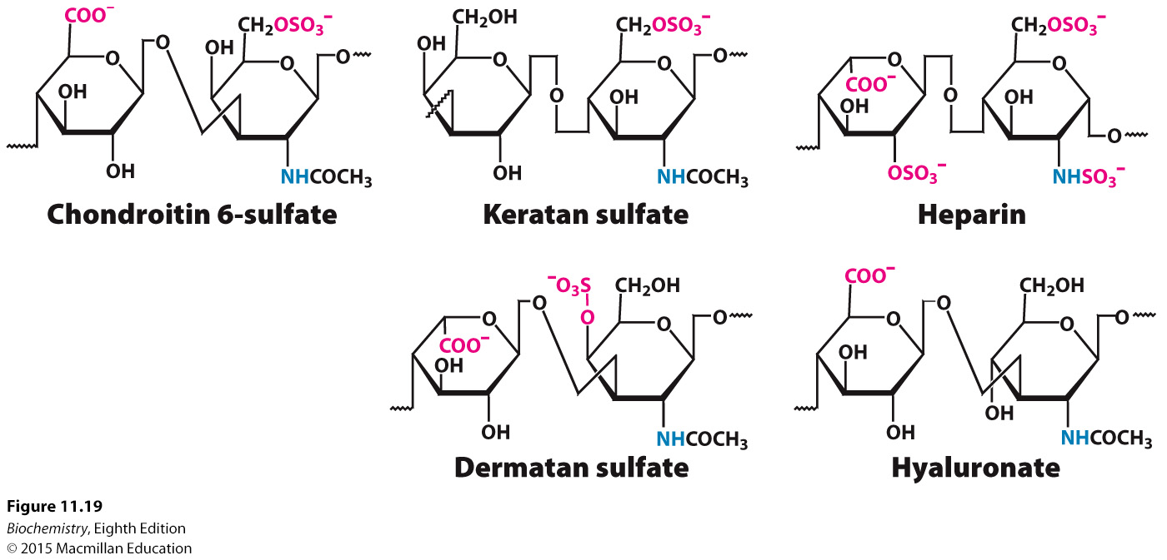
Notes:
FIGURE 11.19 Repeating units in glycosaminoglycans. Structural formulas for five repeating units of important glycosaminoglycans illustrate the variety of modifications and linkages that is possible. Amino groups are shown in blue and negatively charged groups in red. Hydrogen atoms have been omitted for clarity. The right-hand structure is a glucosamine derivative in each case.

Slide 43
Cartilage is composed, in part, of the proteoglycan aggrecan and collagen. The glycosaminoglycan component of aggrecan cushions joints by releasing water on impact, and then rebinding water.
Chitin, a glycosaminoglycan found in the exoskeleton of insects, is one of the most abundant carbohydrates in the world.

Slide 44
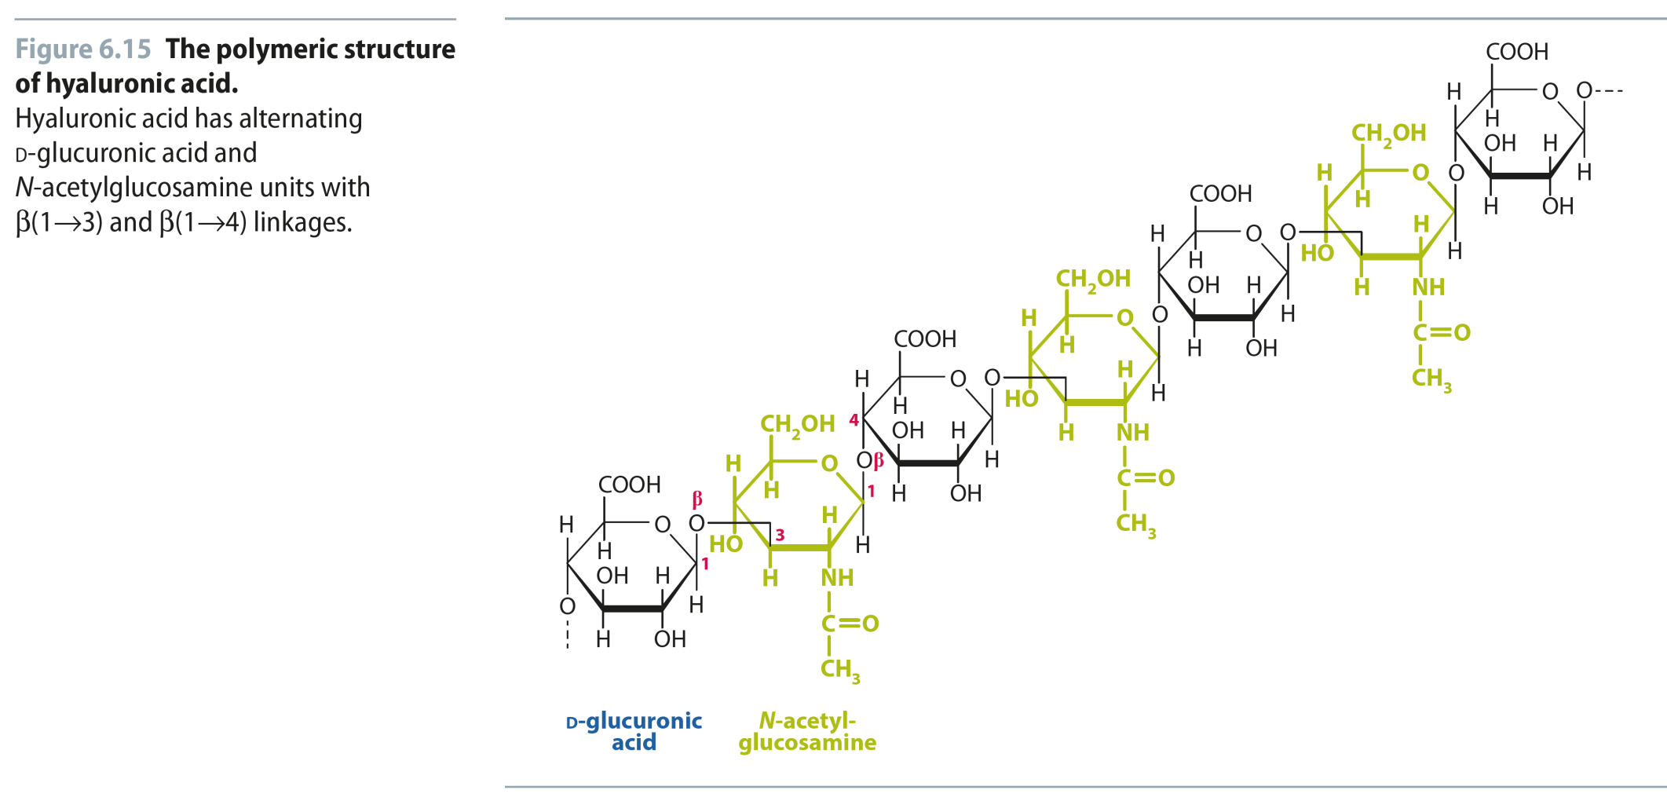
Fig 6.15
Reproduced from:
Biochemistry by T.A. Brown, ISBN: 9781907904288 © Scion Publishing Ltd, 2017

Slide 45
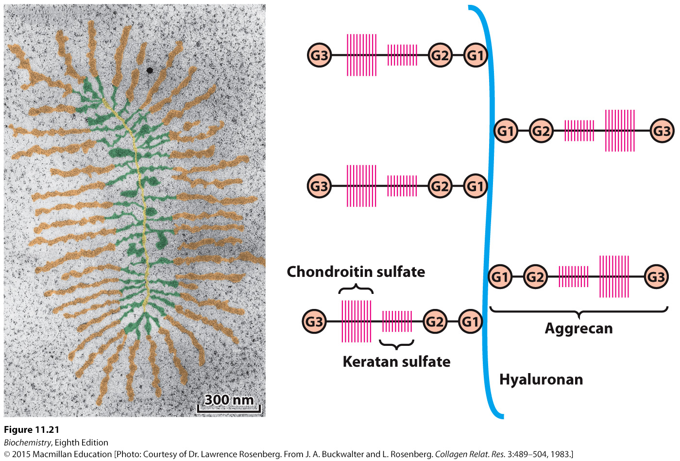
(A)
(B)
Notes:
FIGURE 11.21 Structure of proteoglycan from cartilage. (A) Electron micrograph of a proteoglycan from cartilage (with false color added). Proteoglycan monomers emerge laterally at regular intervals from opposite sides of a central filament of hyaluronate. (B) Schematic representation. G = globular domain. [(A) Courtesy of Dr. Lawrence Rosenberg. From J. A. Buckwalter and L. Rosenberg. Collagen Relat. Res. 3:489–504, 1983.]

Slide 46
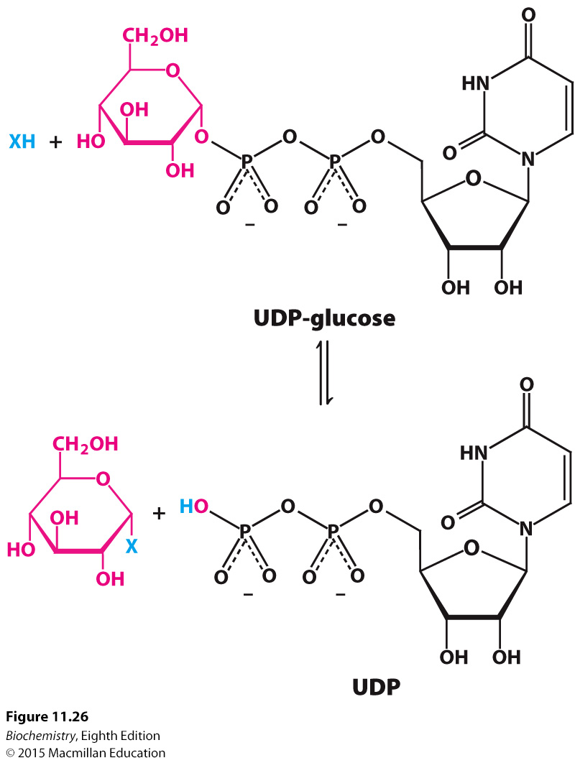
Notes:
FIGURE 11.26 General form of a glycosyltransferase reaction. The sugar to be added comes from a sugar nucleotide—in this case, UDP-glucose. The acceptor, designated X in this illustration, can be one of a variety of biomolecules, including other carbohydrates or proteins.

Slide 47
The human ABO blood groups reflect the specificity of glycosyltransferases.
All of the blood groups share the oligosaccharide foundation called O.
In A, N-acetylgalactosamine is added to the O by a specific glycosyltransferase.
In B, galactose is added by another transferase.
The blood type O, sometimes called H, lacks both the enzymes required to modify the foundation.

Slide 48
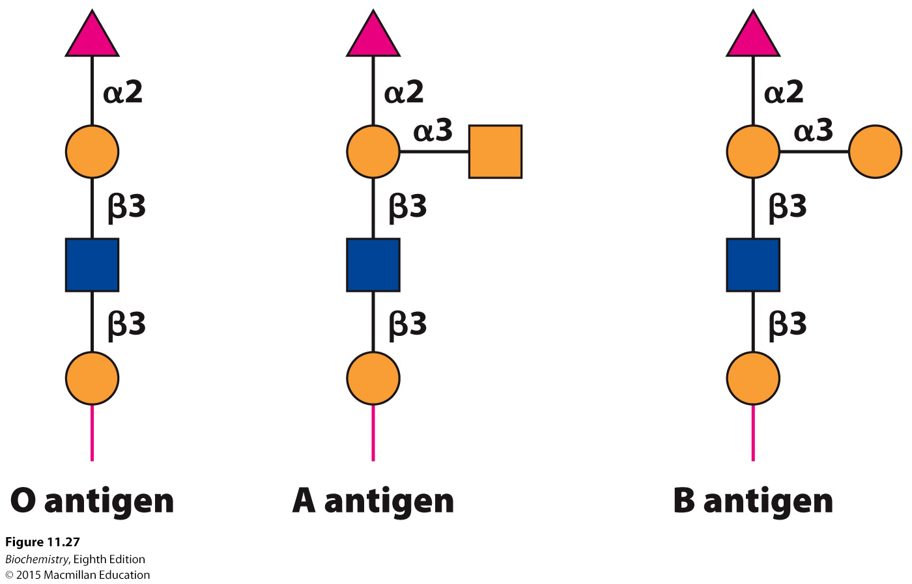
Notes:
FIGURE 11.27 Structures of A, B, and O oligosaccharide antigens. The carbohydrate structures shown are depicted symbolically by employing a scheme (see the key in Figure 11.16) that is becoming widely used.

Slide 49
Oligosaccharides can be sequenced by using enzymes that cleave specific glycosidic bonds.
MALDI-TOF is used to identify the released sugars.

Slide 50
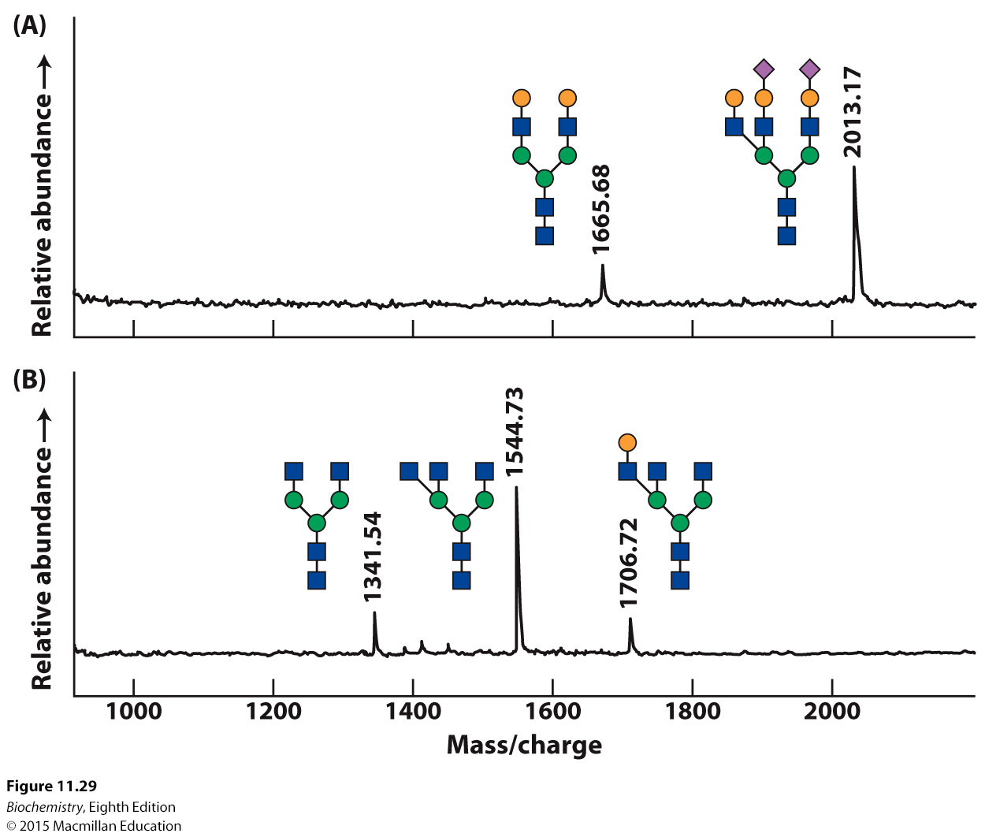
Notes:
FIGURE 11.29 Mass spectrometric “sequencing” of oligosaccharides. Carbohydrate cleaving enzymes were used to release and specifically cleave the oligosaccharide component of the glycoprotein fetuin from bovine serum. Parts A and B show the masses obtained with MALDI-TOF spectrometry as well as the corresponding structures of the oligosaccharide digestion products: (A) digestion with peptide N-glycosidase F (to release the oligosaccharide from the protein) and neuraminidase; (B) digestion with peptide N-glycosidase F, neuraminidase, and β-1,4-galactosidase. Knowledge of the enzyme specificities and the masses of the products permits the characterization of the oligosaccharide. See Figure 11.16 for the carbohydrate key. [Data from A. Varki, R. D. Cummings, J. D. Esko, H. H. Freeze, G. W. Hart, and J. Marth (Eds.), Essentials of Glycobiology (Cold Spring Harbor Laboratory Press, 1999), p. 596.]

Slide 51
Glycan-binding proteins bind to specific oligosaccharides on the cell surface.
Lectins are a particular class of glycan-binding proteins.

Slide 52
The lectins on one cell recognize and bind to carbohydrates on another cell with multiple weak interactions. Such binding facilitates cell-cell interaction.

Slide 53
In C-type lectins, a calcium ion facilitates interaction between the protein and the carbohydrate.
Selectins are a class of lectins. Some selectins bind immune cells to sites of injury.
Other selectins allow attachment of an embryo to the mother’s uterus.

Slide 54
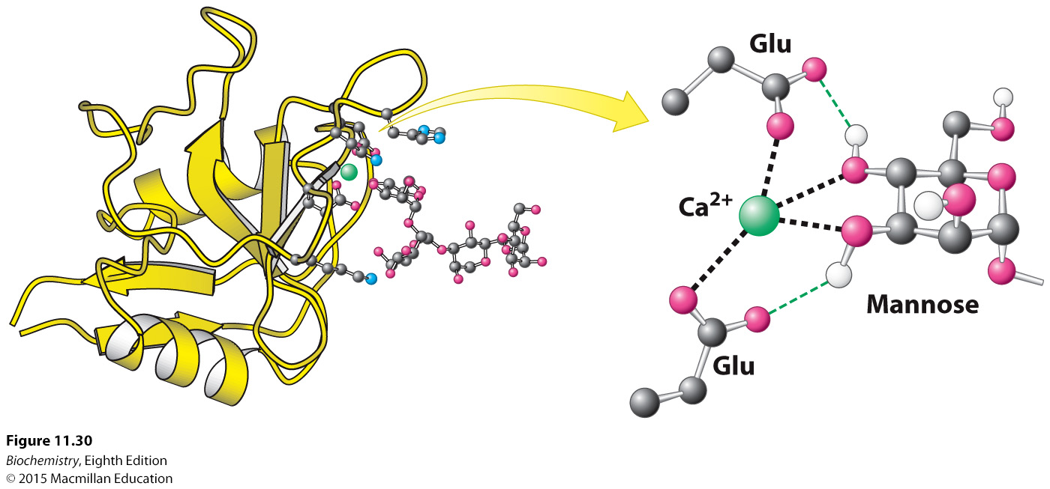
Notes:
FIGURE 11.30 Structure of a carbohydrate-binding domain of an animal C-type lectin. Notice that a calcium ion links a mannose residue to the lectin. Selected interactions are shown, with some hydrogen atoms omitted for clarity. [Drawn from 2MSC. pdb.]

Slide 55
Some viruses gain entry into cells by first binding to carbohydrates on the cell surface.
The influenza virus binds to oligosaccharides composed of sialic acid and galactose.
The viral protein hemagglutinin is responsible for carbohydrate binding.

Slide 56
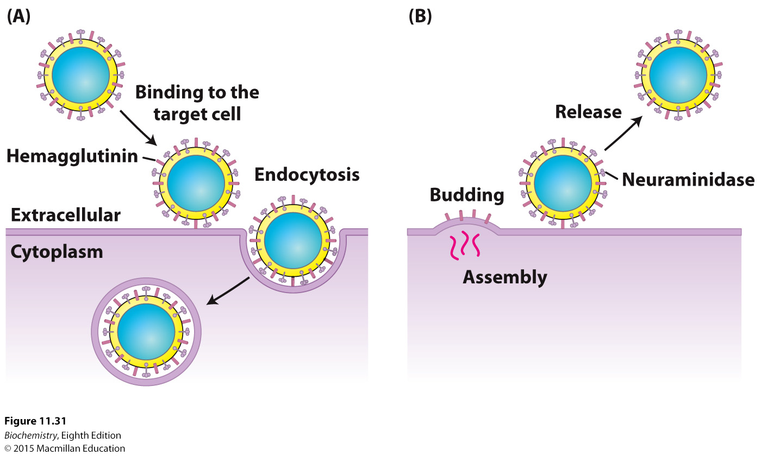
Notes:
FIGURE 11.31 Viral receptors. (A) Influenza virus targets cells by binding to sialic acid residues located at the termini of oligosaccharides present on cell-surface glycoproteins and glycolipids. These carbohydrates are bound by hemagglutinin, one of the major proteins expressed on the surface of the virus. (B) When viral replication is complete and the viral particle buds from the cell, the other major viral surface protein, neuraminidase, cleaves oligosaccharide chains to release the viral particle.

Slide 57
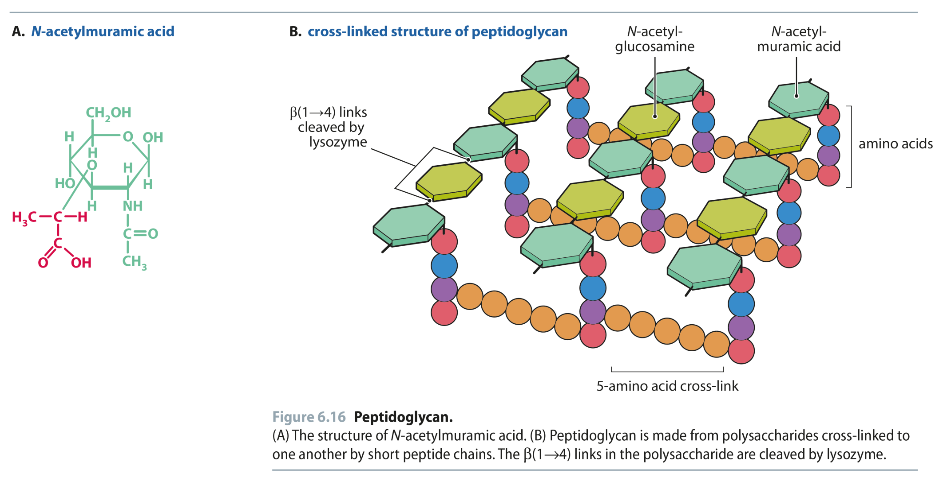
Fig 6.16
Reproduced from:
Biochemistry by T.A. Brown, ISBN: 9781907904288 © Scion Publishing Ltd, 2017

Slide 58
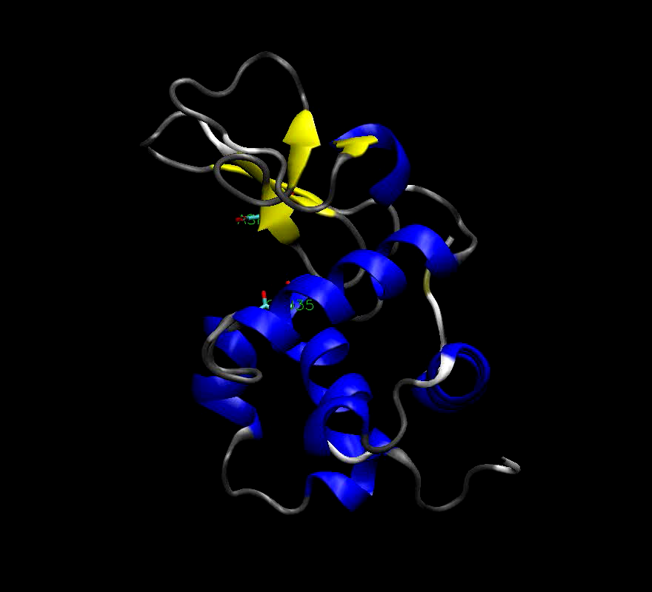
Chicken Egg White Lysozyme
Enzyme responsible for degrading bacterial cell walls
Hydrolyzes the glycosidic linkage between NAM and NAG

Slide 59
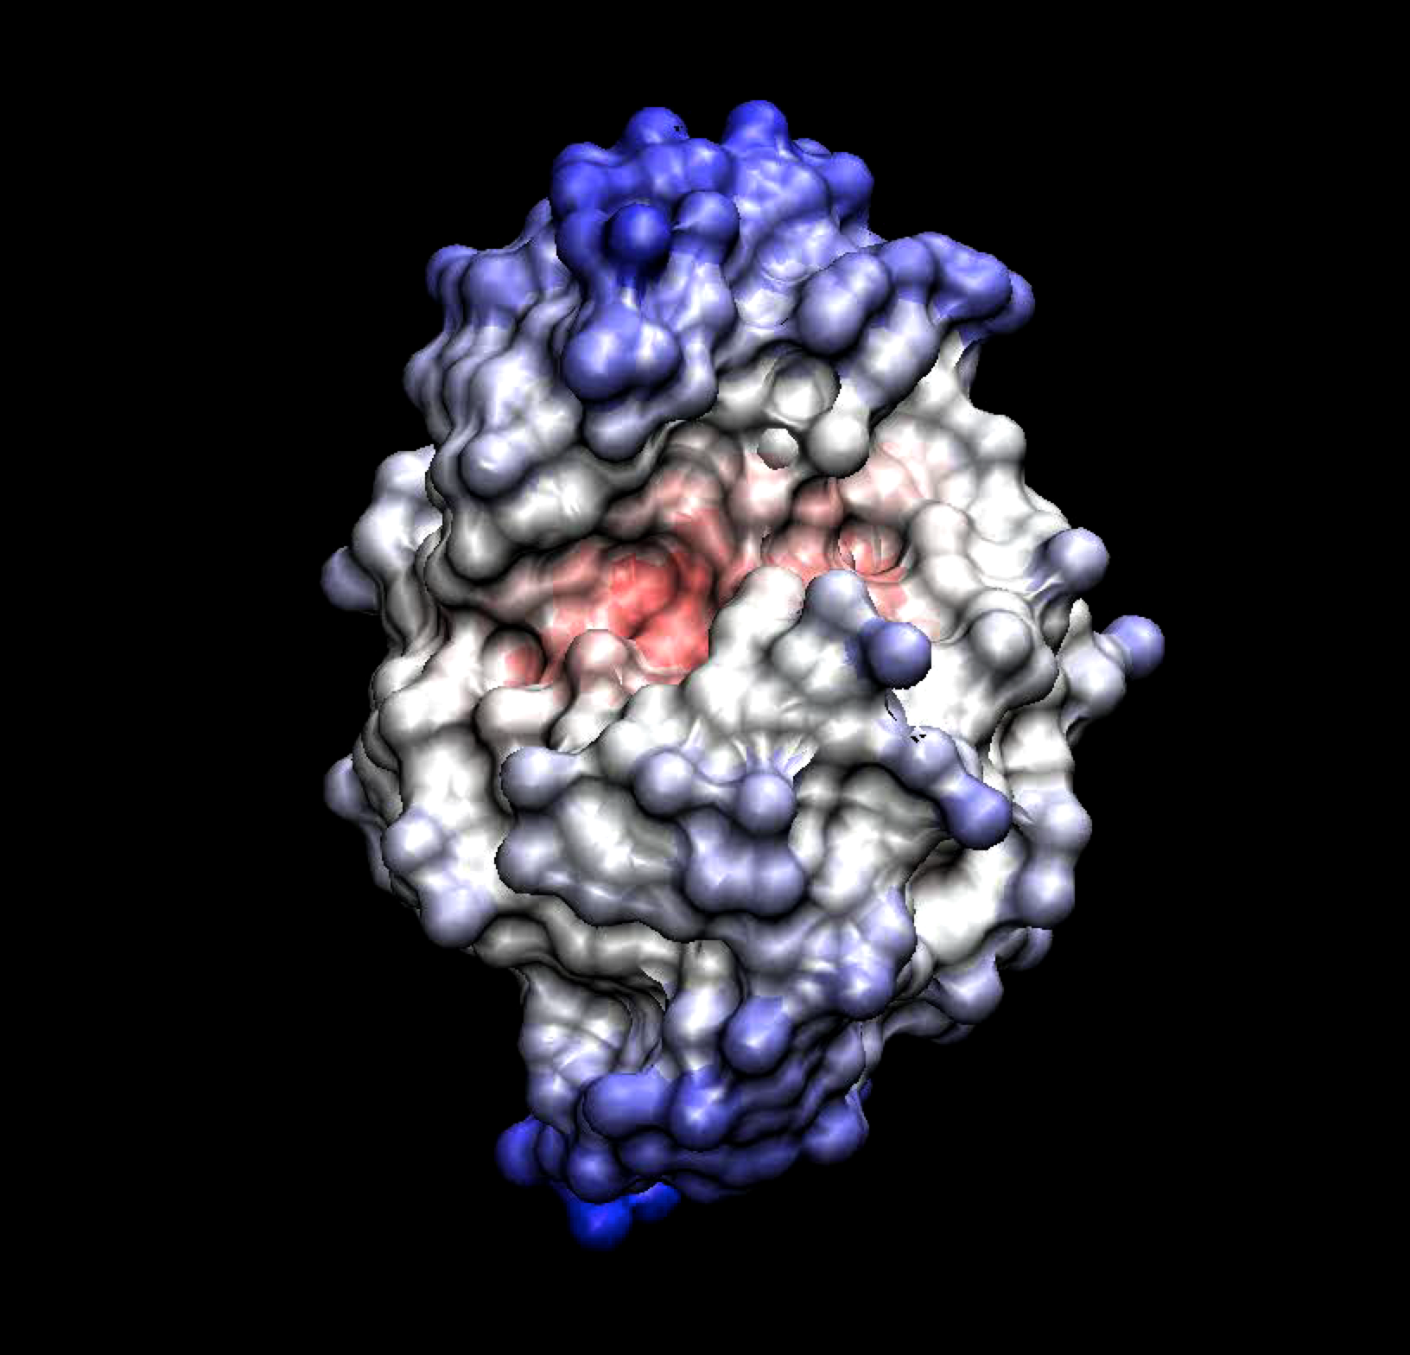
Chicken Egg White Lysozyme
Binding Site
Substrate fits in groove in enzyme

Slide 60
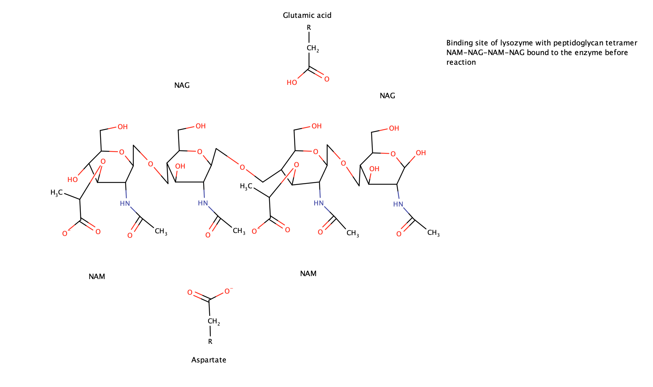
Lysozyme Mechanism

Slide 61
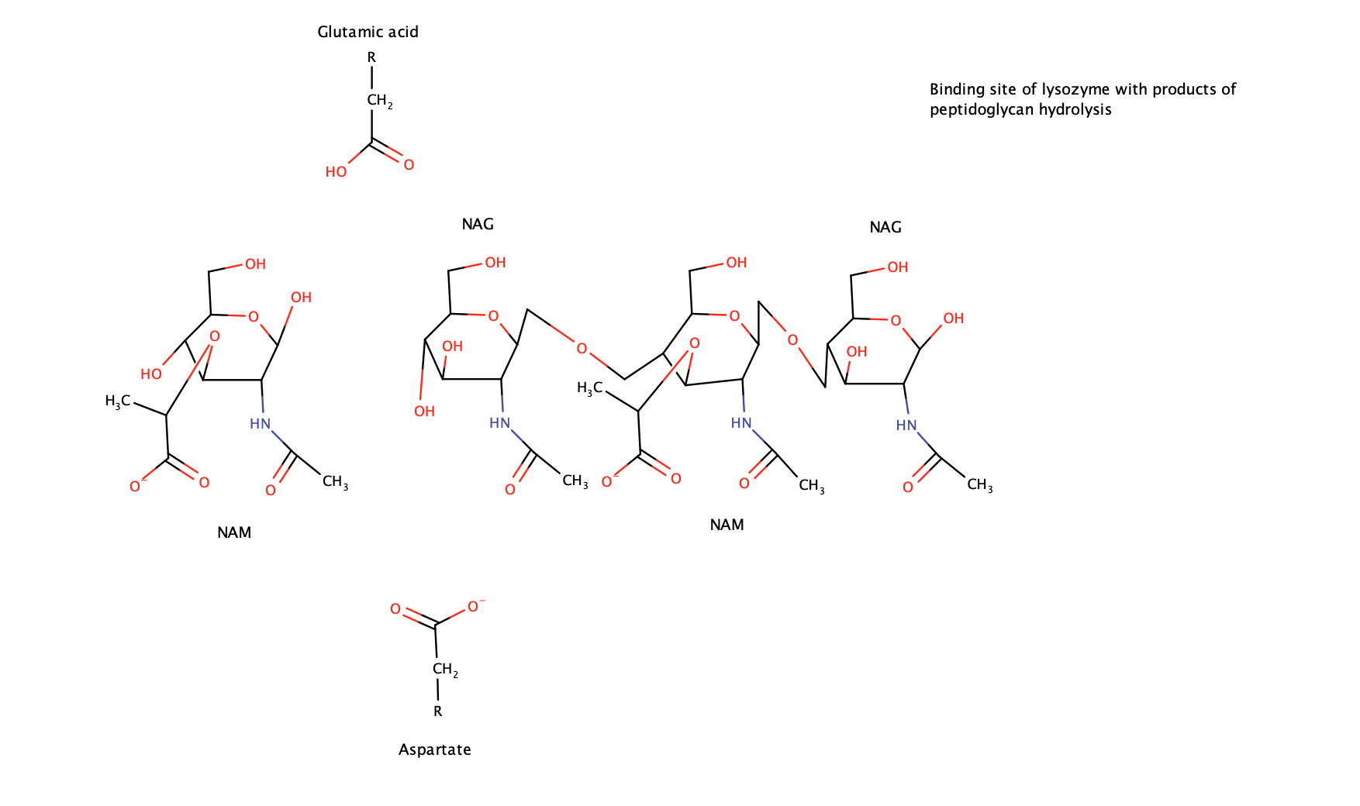
Lysozyme Mechanism

