Slide 1
The last topic of the semester:
Transcription and Transcriptional Control

Slide 2
INDUCTION of Enzyme Production using OPERONS
One way to regulate of an enzyme
If it isn’t needed, it isn’t made
Operons have: Control sites and Structural Genes in a linear array on the chromosome
The regulatory protein is encoded outside the boundaries of the operon

Slide 3
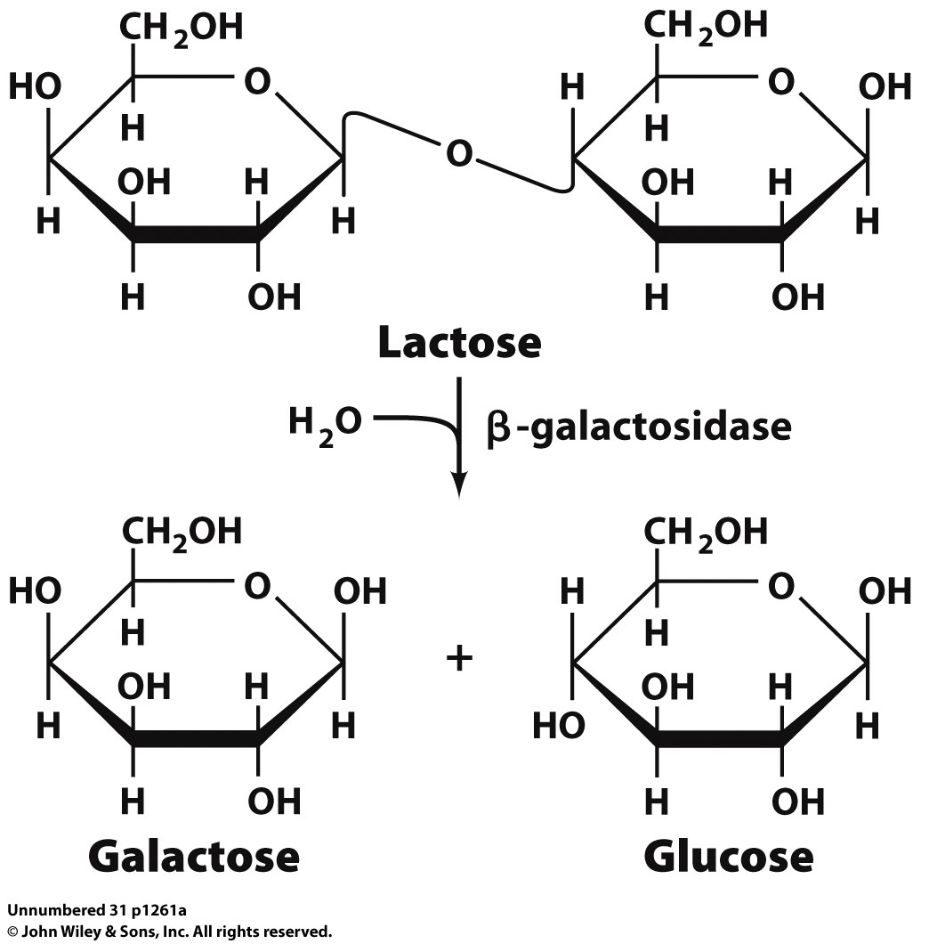
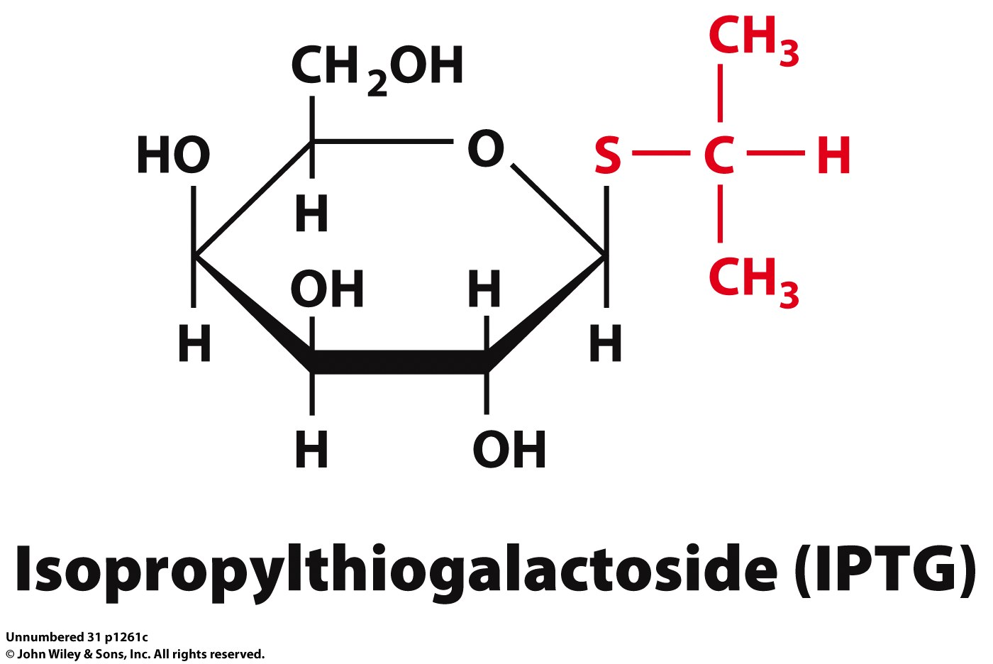
Example 1: The lac operon
The lac operon has the structural genes for three proteins:
1) lacZ: beta-galactosidase
2) lacY: galactoside permease
lacA: Thiogalactoside transacetylase
Unknown role in pathway
Transfers acetyl group to C-6 hydroxyl group on IPTG and other thiogalactosides

Slide 4
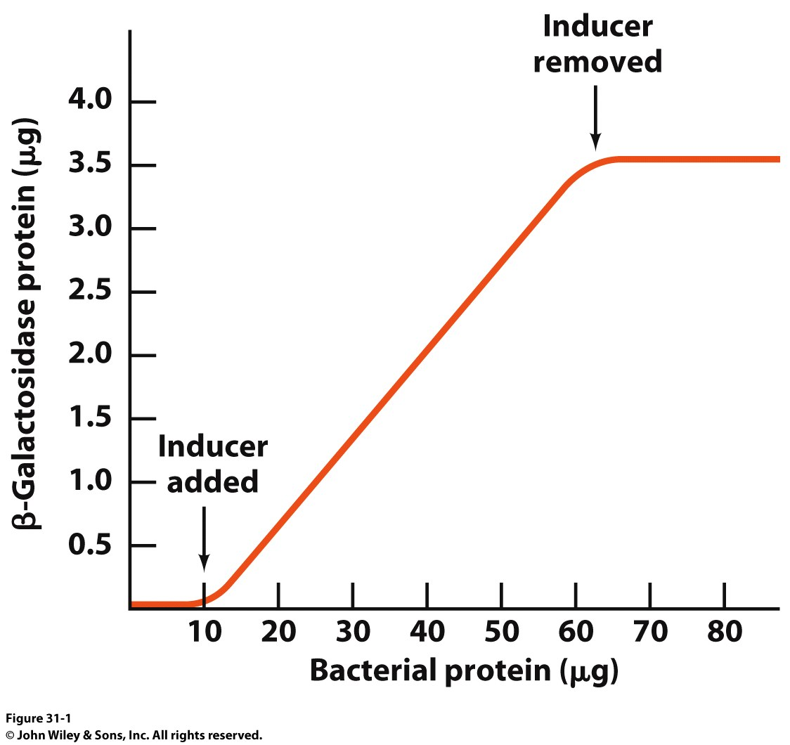
Example 1: The lac operon
Allows proteins to be made when needed and then halt production when they aren’t
Inducer

Slide 5
The lac operon led to…
Monod and Jacob postulating in 1961:
1) The structural genes on DNA are TRANSCRIBED into complementary strands of messenger RNA (mRNA)
2) mRNA must associate with ribosomes which catalyze the synthesis of polypeptides

Slide 6
Transcriptional Regulation
We have seen how DNA is synthesized and how the cell creates mRNA to convert the information stored in genes into something that can do work
How do we regulate the process of transcription?
Let’s break the problem down into key checkpoints:
We could use different sigma factors (stop RNAP from binding)
We could block access to the promoter
We could have secondary structures in the mRNA that hang up translation
We could degrade the mRNA (short lifetime = little translation)

Slide 7
Promoters and Transcription
-60 region: UP (upstream promoter) elements strongly stimulate binding of RNAP to the promoter
More than the normal affinity of 1x10⁻¹⁴ M for DNA by RNAP
Get more action from the same promoter (Nitrous Boost!)
σ32: Heat shock sigma factor. Normally present in low abundance in the cell (<10 copies per cell)
Only transcribe when you need to!

Slide 8
Promoters and Transcription
In other words:
If we decrease how often a promoter is bound by RNAP, then we also decrease how many times the genes controlled by the promoter are transcribed
Mutations in promoter sequence will affect RNAP binding
RNAP has a finite activity
Anything that will change that rate will affect the amount of transcript produced and, therefore, the amount of protein made

Slide 9
Proteins and Promoters
We can regulate the initiation of transcription with 3 different types of proteins:
Specificity factors: Alter the specificity of RNAP for a promoter (eg: sigma factors)
Repressors: Prevent RNAP from binding the promoter at all
Activators: Promote RNAP binding to the promoter

Slide 10
Repressors and Negative Regulation
Repressors bind at the OPERATOR site near the promoter
The repressor can bind to the operator in the presence of a ligand or the absence of a ligand
If the repressor binds, there is a negative effect on the expression of the operon

Slide 11
Activators and Positive Regulation
Activators bind at the promoter and ENHANCE the binding of RNAP
The activator can bind to the operator in the presence of a ligand or the absence of a ligand
If the activator binds, there is a positive effect on the expression of the operon

Slide 12
Operons
Polycistronic mRNA: Bacterial mRNAs often encode multiple genes on a single transcript
By having the transcripts of the structural genes in a single array, the cell can get a much more immediate response

Slide 13
How do Regulatory Proteins Work?
Transcriptional Regulatory Proteins must interact with DNA and with other protein molecules
These proteins have an affinity for their cognate DNA binding sequence that is 10⁴ – 10⁶ fold greater than non-specific DNA sequences
These proteins have very specific traits that allow them to do their job:
1) Specificity of DNA interaction
Specific Protein domains
Helix-Turn Helix
Zinc-finger
Homeodomain
Leucine Zipper
Helix-Loop-Helix

Slide 14
DNA – Protein Interactions
On the major and minor grooves of DNA, chemical moieties on the nitrogenous bases are available to interact with amino acid side chains of proteins
Most frequent amino acid side chains found to interact with DNA are:
Asn, Gln, Glu, Lys and Arg
There is much greater variation in the Major groove (one more position), so proteins have more chances at selectivity

Slide 15
Protein Domains that Interact with DNA
DNA binding domains tend to be small (~60-90 residues)
Tend to form dimers (and sometimes tetramers)
Each monomer recognizes a specific repeated palindromic sequence
Hence the dimerization
The monomers bind cooperatively

Slide 16
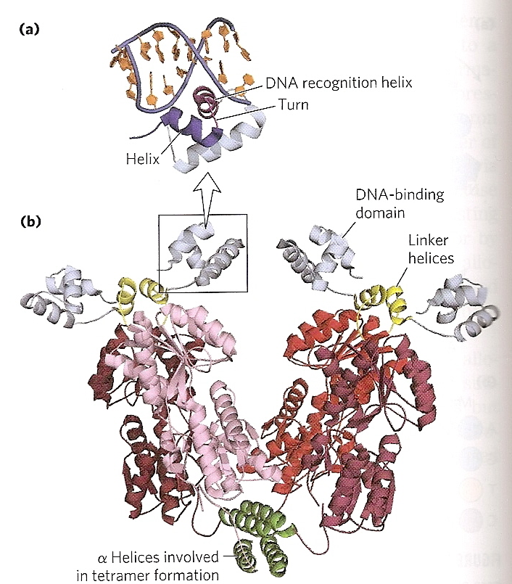
Helix-Turn-Helix Domain
20 amino acids arrayed in:
2 α-helices (7-9 amino acids long)
β-turn separates the helices
One α-helix is called the RECOGNITION HELIX
This helix interacts with a specific DNA sequence in the DNA
Fits in the major groove
(lac repressor, PDB ID: 2PE5)

Slide 17
Zinc-finger Domain
30 amino acids
Single Zn²⁺ coordinated by 4 amino acids
4 Cys or 2 Cys/ 2His
The Zn²⁺ doesn’t interact with the DNA but serves to stabilize the domain
Single interactions b/w the fingers and DNA are weak, so multiple fingers are common in proteins with these domains
Zif268 PDB ID: 1ZAA

Slide 18
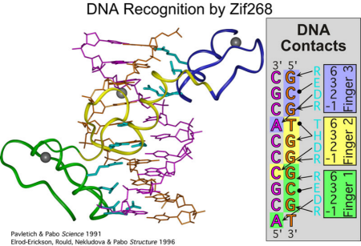
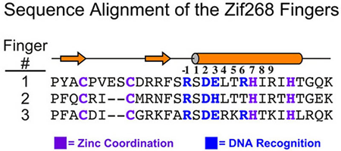
Zinc-finger Domain

Slide 19
Homeodomains
60 amino acids long
3 α-helices connected by short loops
ONLY FOUND IN EUKARYOTES
Serves to regulate genes responsible for limp patterns in development

Slide 20
Protein-Protein Interaction Domains of DNABPs
We said that DNA binding proteins tend to form dimers or tetramers
This means that not only must they interact with DNA, but with each other as well
Two primary Protein-Protein Interaction domains are found in Transcriptional Regulatory Proteins:
Leucine zippers
Basic Helix-Loop-Helix

Slide 21
Leucine Zipper
Clothespin type of helical arrangement
Clamps onto DNA
Amphipathic α-helix
One side is rich in hydrophobic residues
Every 7th residue is a Leu
When a Leucine-zipper dimerizes, these Leu residues align
Basic residues in the helix interact with DNA backbone
Very small DNA-binding surface, but you get it twice so it helps specify a target sequence

Slide 22
Basic Helix-Loop-Helix
Eukaryotic regulatory protein domain
50 amino acids
2 short, amphipathic α-helices linked by a loop of variable length
Distinct from HTH domains b/c these are Protein/Protein Interaction domains
Almost resemble a Leucine Zipper motif interrupted by a short loop
A single Leu residue (red) lies on one end of each helix

Slide 23
Transcriptional Regulation
Example 1: Remember the lac operon?
The lac operon has the structural genes for three proteins:
1) lacZ: beta-galactosidase
2) lacY: galactoside permease
lacA: Thiogalactoside transacetylase
Unknown role in pathway
Transfers acetyl group to C-6 hydroxyl group on IPTG and other thiogalactosides

Slide 24
The lac Operon
The lac operon is an example of NEGATIVE REGULATION
The repressor protein binds to the O1 sequence (Operator 1) and induces a conformational change in the DNA
The dimers of the tetramer interact via leucine zippers
DNA binding is via HTH domains
The tetramer can bind another operator region on either side of O1:
O2 (+410) or O3 (-90) to shut down transcription of the operon
When inducer molecule is added, it binds to the repressor protein and causes a conformational change that makes the repressor dissociate from the DNA
The Operon is Transcribed!!!

Slide 25
The lac Operon: Nothing is that Easy!
The lac operon is an example of POSITIVE REGULATION!! (Told you it wasn’t simple)
If glucose is present then the cell wants to use it before any other carbon source. Period.
What happens if both glucose AND lactose are present?
eg: Milk chocolate easter candy
CATABOLITE REPRESSION
RESTRICTS THE PRODUCTION OF THE ENZYMATIC MACHINERY NECESSARY TO UTILIZE OTHER SUGARS

Slide 26
Catabolite Repression
Effect is mediated by cAMP receptor protein or CRP
22 kDa homodimer
Binds to DNA and cAMP
cAMP is a signaling molecule that cells use to regulate metabolism
When glucose is present, cAMP levels are low inside the cell
CRP doesn’t bind cAMP and is in the T-state
When glucose is absent, cAMP levels rise, CRP binds cAMP then DNA and recruits RNAP to promoter

Slide 27
Catabolite Repression and the lac Operon
CRP is allosterically regulated by cAMP
Strong induction of the lac operon requires both the presence of lactose and a low [glucose]

Slide 28
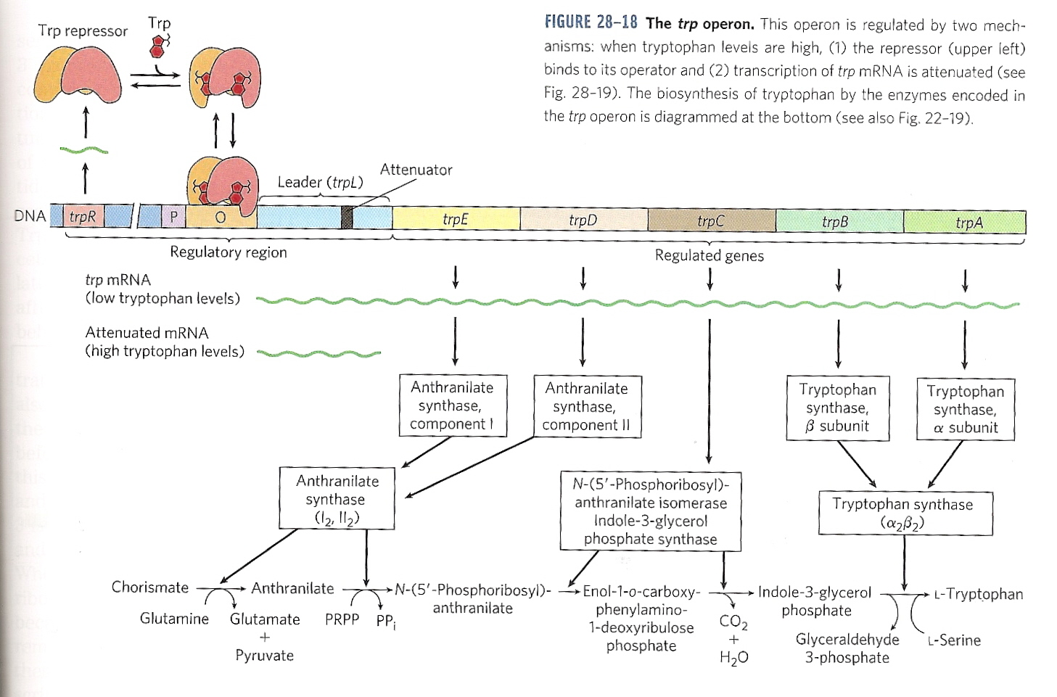
The trp Operon
E. coli cells can biosynthesize all 20 amino acids
If an amino acid is abundant in the growth medium, then the cell doesn’t need to synthesize it
5 proteins are required to synthesize tryptophan
(two enzymes catalyze more than one step in the pathway)

Slide 29
The trp Operon
The mRNA of the trp operon has a half-life of 3 min
Allowing the cell to rapidly respond to changing media conditions
The Trp repressor is a homodimer that binds tryptophan and undergoes a conformational change

Slide 30
The trp Operon
The conformational change caused by tryptophan binding converts the Trp repressor to the R-state from the T-state and it binds the operator of the trp operon
The operator overlaps the promoter, so no transcription
Straightforward, right?

Slide 31
Yeah, right. ATTENUATION!
At decreased tryptophan levels, the repressor loses its bound tryptophan ligands and dissociates from DNA
This should cause a massive increase in the production of the enzymes in the tryptophan biosynthetic pathway, yes?
Maybe…
It all depends on HOW MUCH tryptophan is around.
The cell can attenuate the signal from the transcript at the translational level.
Huh?

Slide 32
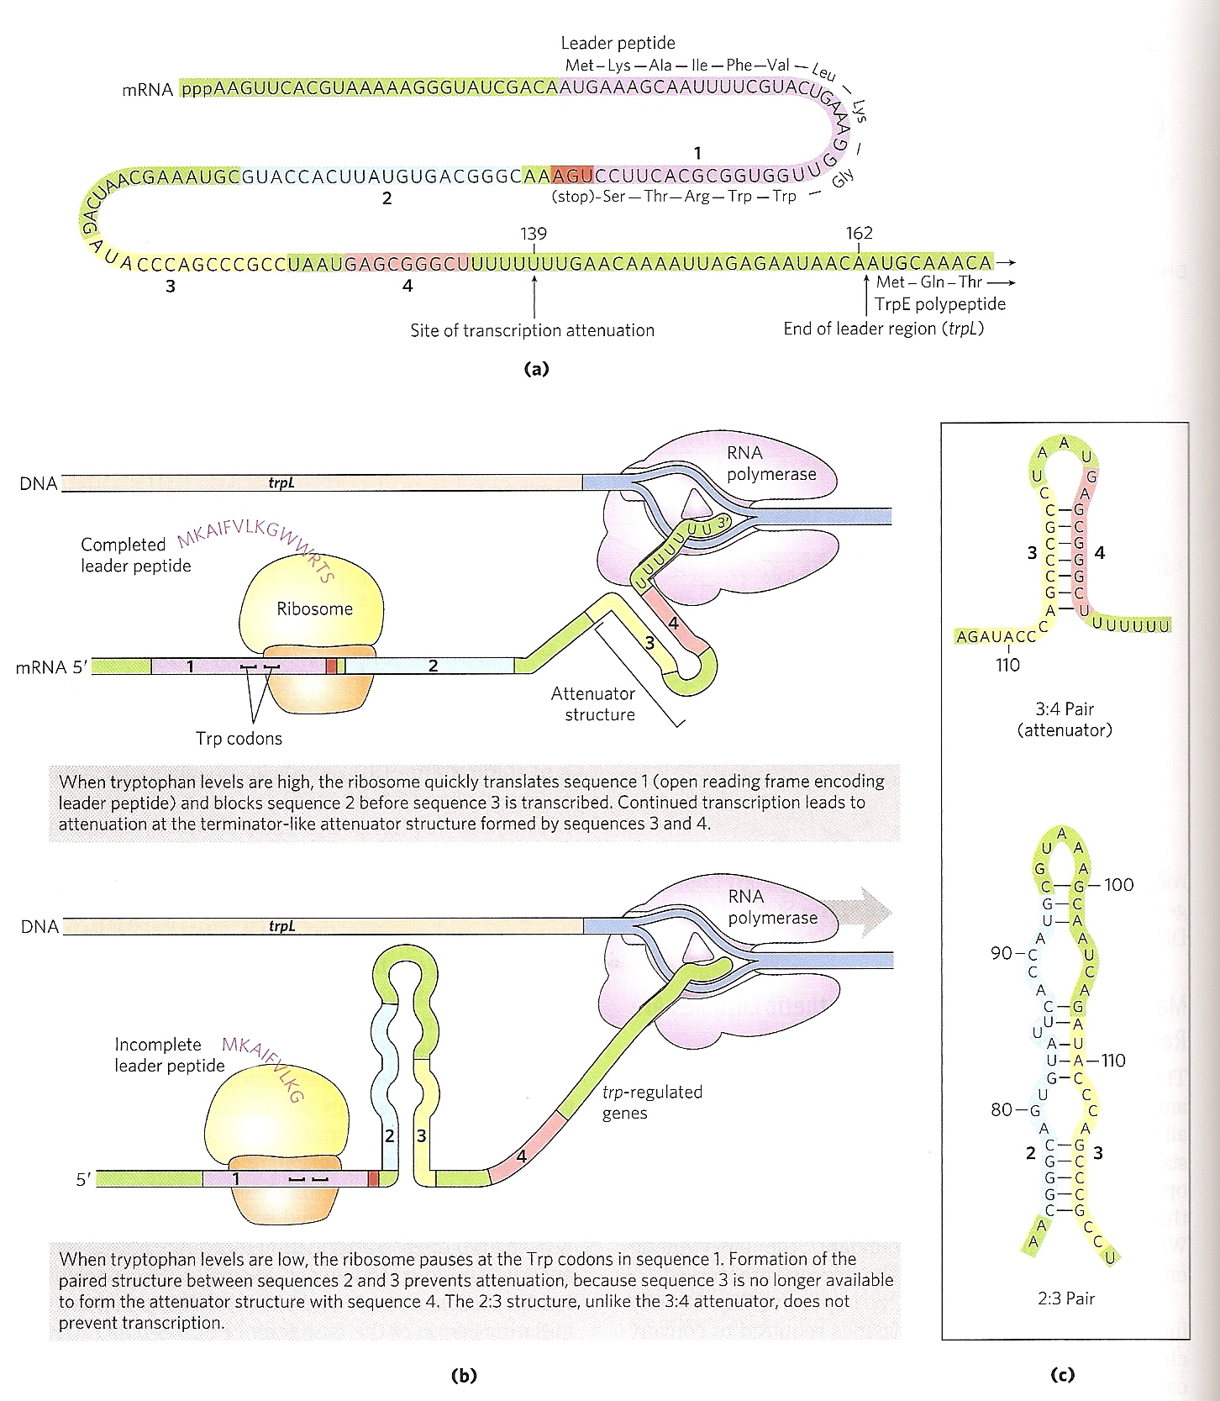
ATTENUATION
The mRNA has a 162 bp Leader Sequence that contains 4 sequences
Sequence 1 and 2: Regulatory sequences
Sequence 3 and 4: Attenuator sequence

Slide 33
ATTENUATION
Sequence 1 contains two codons for tryptophan.
If there is plenty of tryptophan in the cell, then there are plenty of tryptophan tRNA molecules so to ribosome goes right through both sequences

Slide 34
ATTENUATION
This allows Sequences 3 and 4 to form a base paired duplex called The Attenuator
This attenuator is very strong due to its size and loop structure
Transcription stops because the attentuator structure “jams up the gears” of RNAP

Slide 35
ATTENUATION
At tryptophan concentrations below the threshold, the ribosome stalls at Sequence 1
This allows a weaker pairing of Sequences 2 and 3
The ribosome can blast through the weaker 2:3 pair and make the proteins of the trp operon

