Slide 1
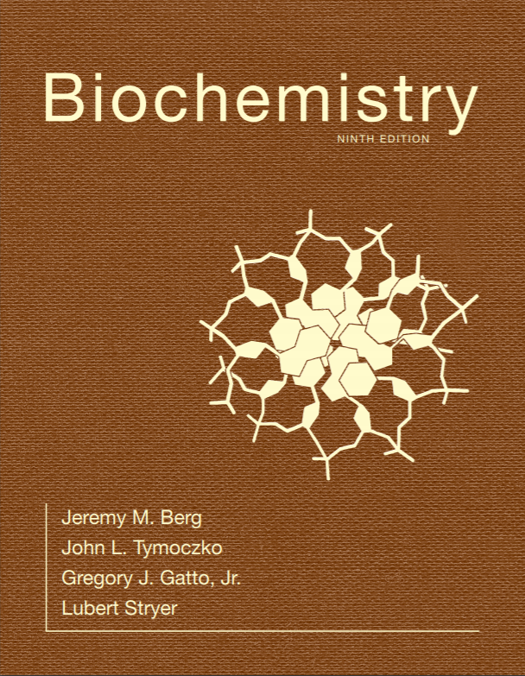
Chapter 7
Hemoglobin: Portrait of a Protein in Action
© 2019 W. H. Freeman and Company
Notes:
Corresponding Chapters: 1, 2, 8, 9, 10

Slide 2
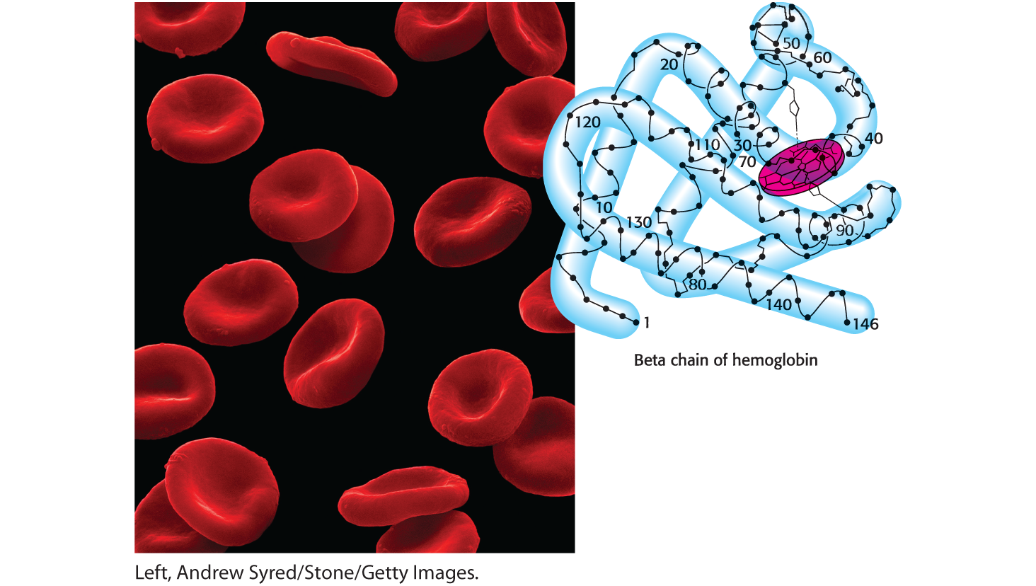
CHAPTER 7
Hemoglobin: Portrait of a Protein in Action
Notes:
In the bloodstream, red cells carry oxygen from the lungs to the tissues, where demand is high. Hemoglobin, the protein that gives blood its red color, is responsible for the transport of oxygen via its four heme-bound subunits. Hemoglobin was one of the first proteins to have its structure determined; the folding of a single subunit is shown in this hand-drawn view. [Left, Andrew Syred/Stone/Getty Images.]

Slide 3
Ch.7 Learning Objectives
By the end of this chapter, you should be able to:
Explain how the structure of myoglobin changes upon oxygen binding.
Describe the differences in the oxygen-binding properties of hemoglobin and myoglobin.
Describe how the cooperative binding of hemoglobin allows for optimal oxygen delivery.
Explain the differences between the two models for hemoglobin cooperativity.
Identify the key regulators of hemoglobin function.
Define the Bohr effect and describe how it explains maximal oxygen delivery to tissues in greatest need.

Slide 4
Ch.7 Outline
7.1 Binding of Oxygen by Heme Iron
7.2 Hemoglobin Binds Oxygen Cooperatively
7.3 Hydrogen Ions and Carbon Dioxide Promote the Release of Oxygen: The Bohr Effect

Slide 5
A Comparison of Myoglobin and Hemoglobin Illuminates Some Key Aspects of Protein Structure and Function
Hemoglobin is a red blood cell protein that transports oxygen from the lungs to the tissues.
Hemoglobin is an allosteric protein that displays cooperativity in oxygen binding and release.
Myoglobin binds oxygen in muscle cells. The binding of oxygen by myoglobin is not cooperative.
Oxygen binding is measured as a function of the partial pressure of oxygen (pO₂).

Slide 6
Section 7.1 Binding of Oxygen by Heme Iron
The ability of myoglobin and hemoglobin to bind oxygen depends on the presence of a heme group, which consists of an organic component called protoporphyrin and a central iron ion.
The iron must be in the ferrous (Fe²⁺) form, the only form that can bind oxygen.

Slide 7
The Position of the Iron Changes Depending on Whether Oxygen is Bound
The iron lies in the middle of the protoporphyrin bound to four nitrogens.
Iron can form two additional bonds, at the fifth and sixth coordination sites.
  The fifth coordination site is occupied by an imidazole ring of a histidine called the proximal histidine.
  The sixth coordination site binds oxygen. Upon oxygen binding, the iron moves into the plane of the protoporphyrin ring.

Slide 8
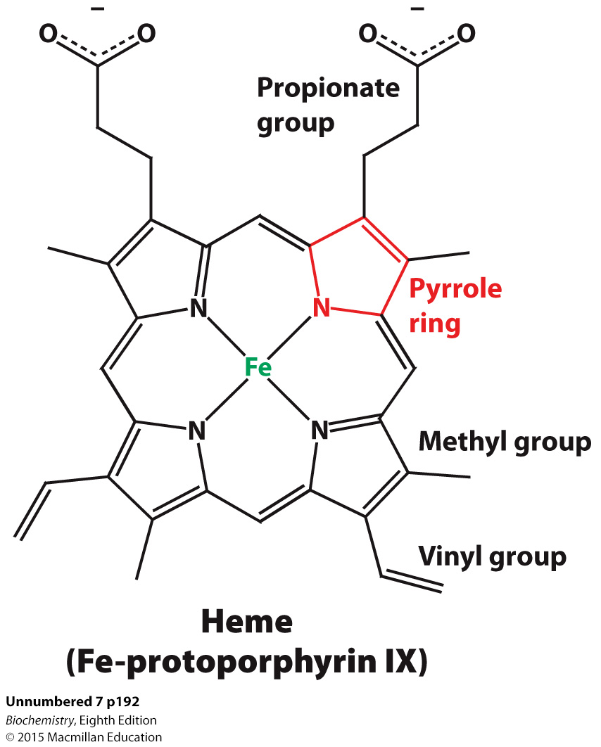

Slide 9
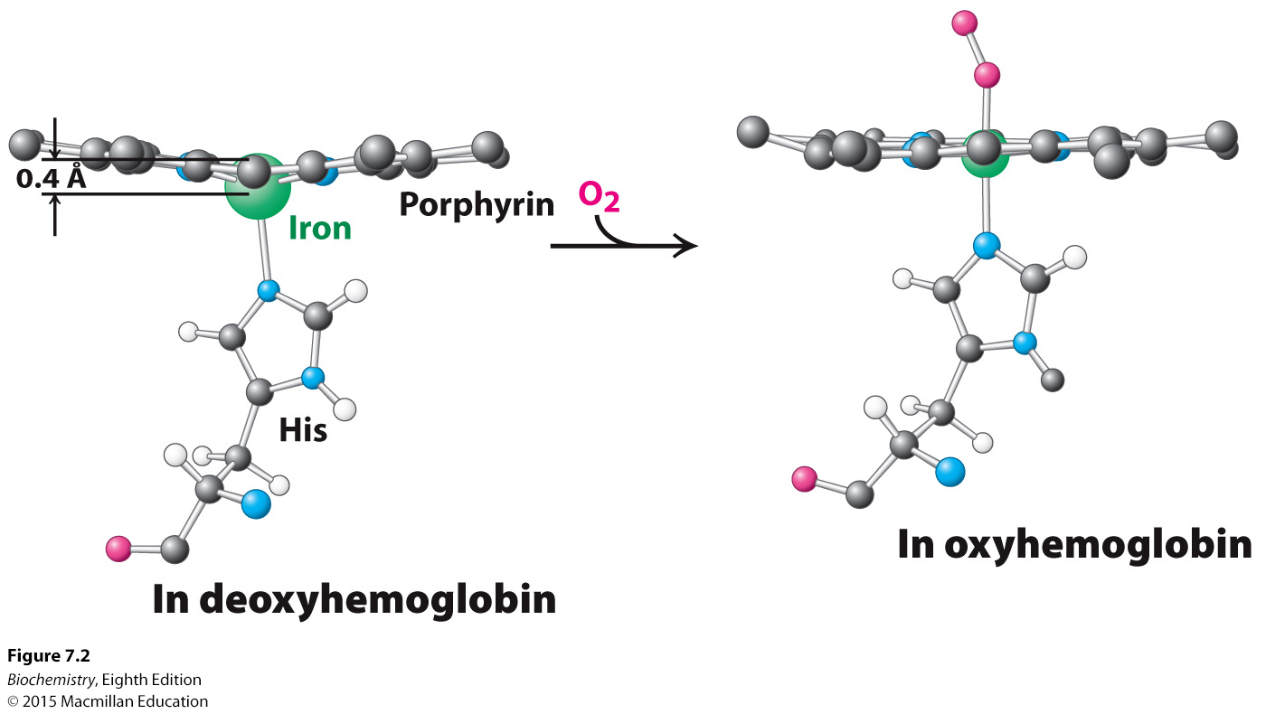
Proximal His

Slide 10
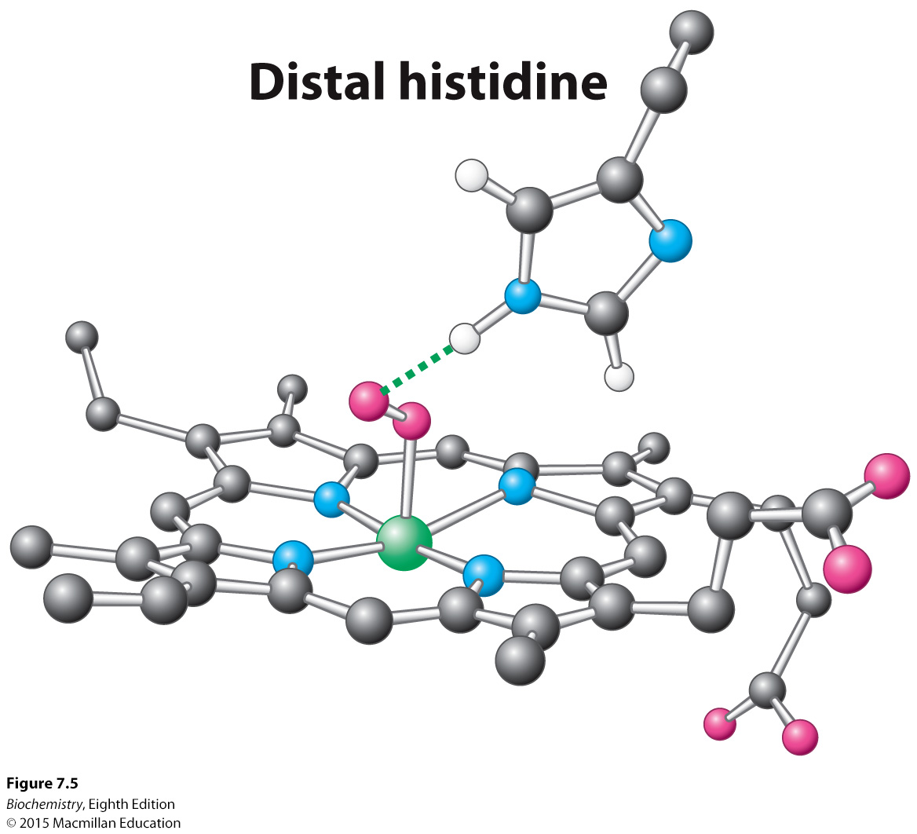

Slide 11
Myoglobin
18 kDa monomeric protein, 153 amino acids
The rate of O₂ diffusion from capillaries to tissue is slow because of the solubility of oxygen.
Myoglobin increases the solubility of oxygen by binding it and moving it form capillaries to muscle tissue.
Oxygen storage is also a function because Myoglobin concentrations are 10-30 fold greater in whales and seals than in land mammals

Slide 12
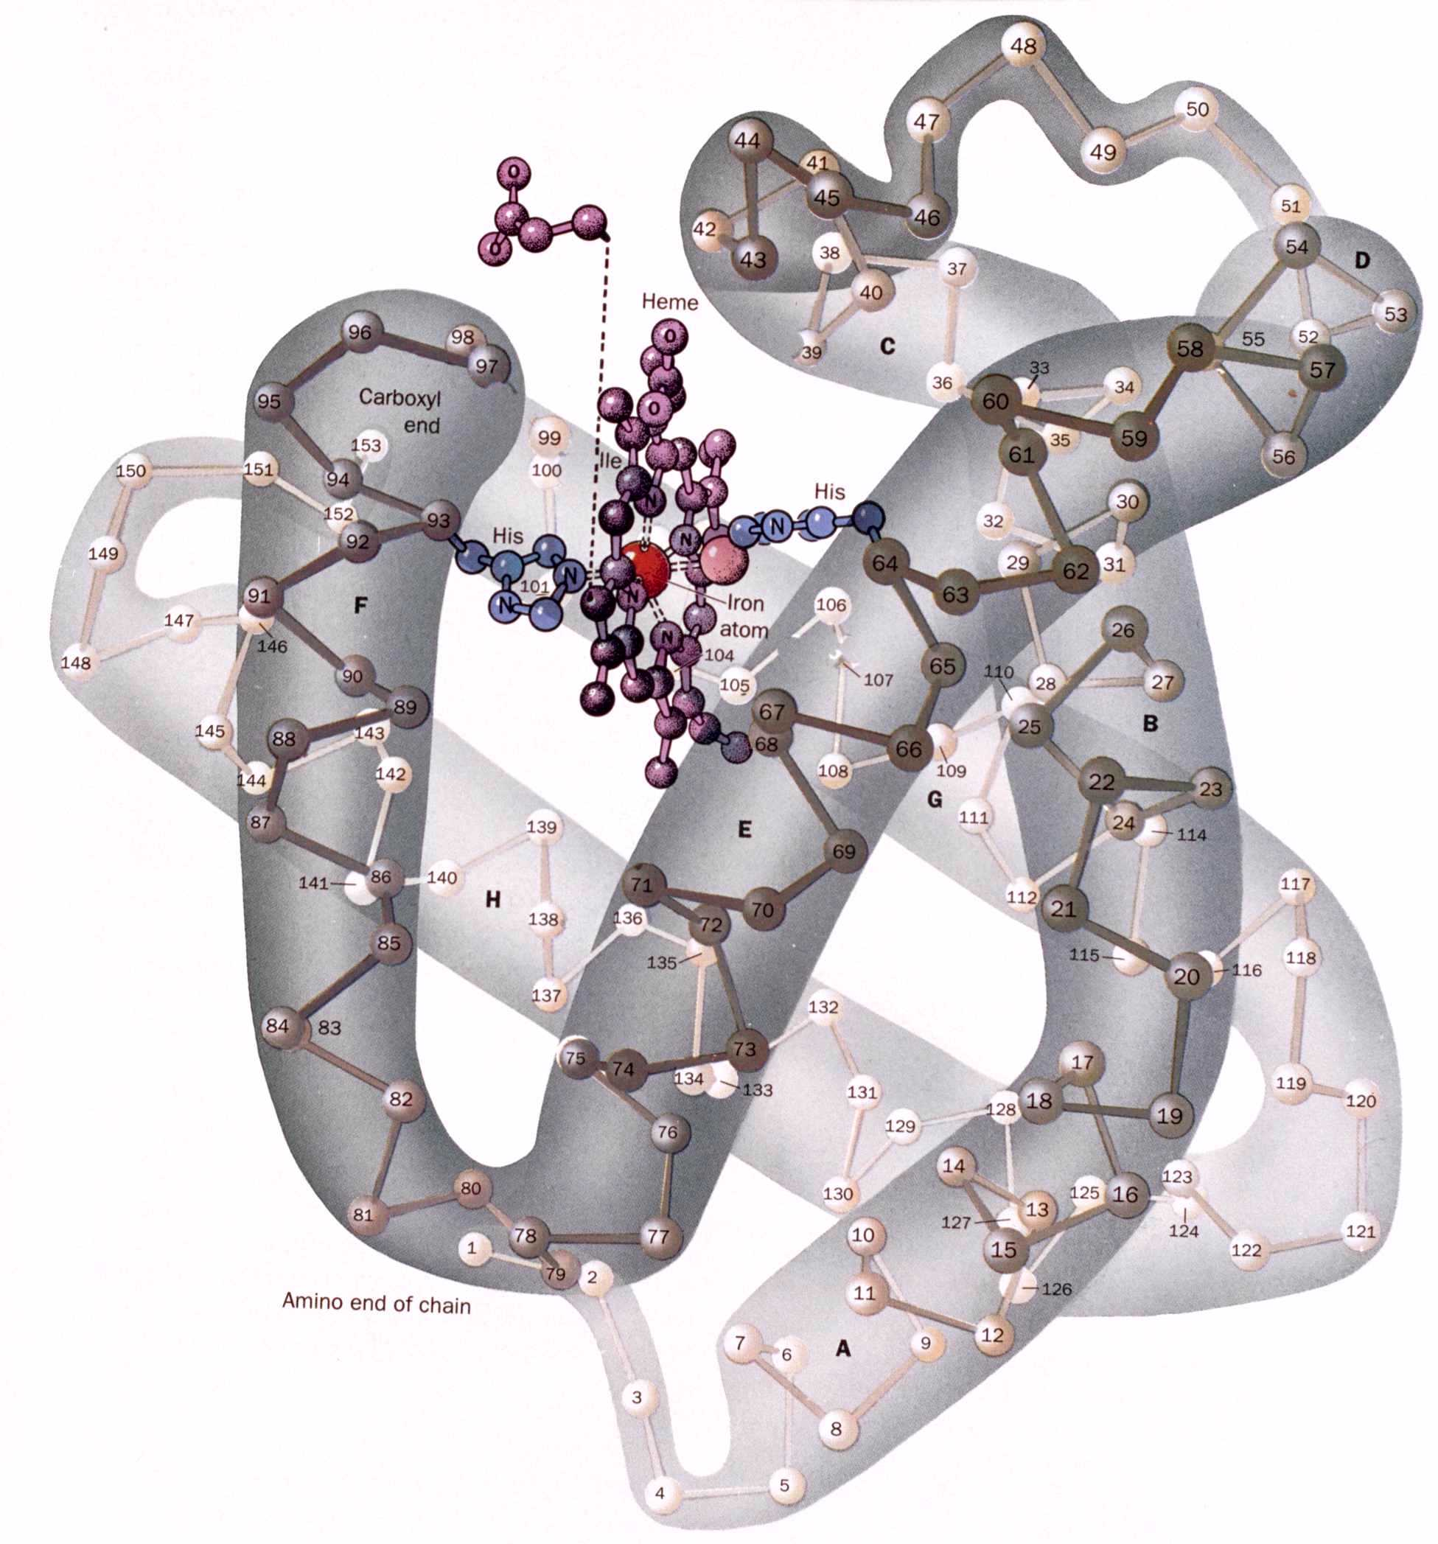
The Structure of Myoglobin
153 amino acid residues
121 residues are in an a helix. Helices are named A, B, C, …F.
Heme group is wedged in a hydrophobic pocket b/w helices E and F (~aa 58-94)
The Proximal His (His F8 or His93) is the 5th ligand coordinating the Fe(II)

Slide 13
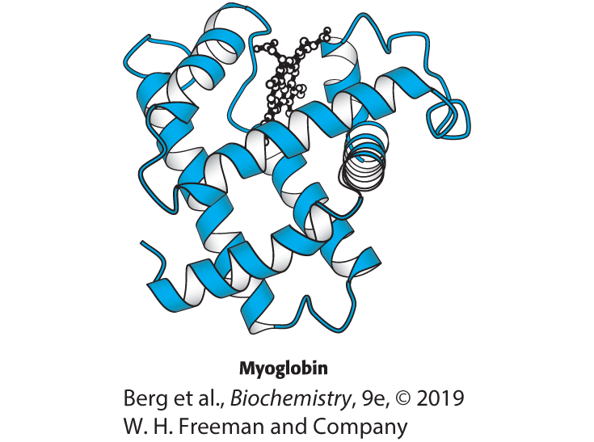
Structure of Myoglobin
Notes:
FIGURE 7.1 Structure of myoglobin. Notice that myoglobin consists of a single polypeptide chain, formed of α helices connected by turns, with one oxygen-binding site. [Drawn from 1MBD.pdb.]

Slide 14
The Structure of Myoglobin Prevents the Release of Reactive Oxygen Species
The interaction between iron and oxygen exists as resonance structures, one with Fe²⁺ and O₂ and another with Fe³⁺ and superoxide ion (O₂⁻).
There are two reasons why it is critical that oxygen be released only in the O₂ (not in the superoxide) state:
  Superoxide is very reactive and can quickly bind to and harm other cellular molecules.
  The iron ion would be left in the ferric (Fe³⁺) state, preventing it from binding additional oxygen. Myoglobin in this state is called metmyoglobin.
Features of myoglobin help to prevent superoxide release, including an additional (distal) histidine that donates a hydrogen bond to the bound oxygen molecule.

Slide 15
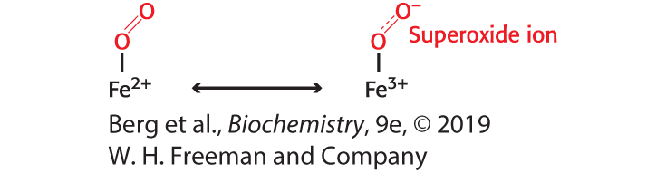
Iron–oxygen Bonding
Notes:
FIGURE 7.4 Iron–oxygen bonding. The interaction between iron and oxygen in myoglobin can be described as a combination of resonance structures, one with Fe²⁺ and dioxygen and another with Fe³⁺ and superoxide ion.

Slide 16
When Fe(II) goes to Fe(III), oxidized, it produces methemoglobin which is brown and coordinated with water in the sixth position. Dried blood and old meat have this brown color.
Butchers use ascorbic acid to reduce methemoglobin to make the meat look fresh!!
There is an enzyme methemoglobin reductase that converts methemoglobin to regular hemoglobin in the cell.

Slide 17
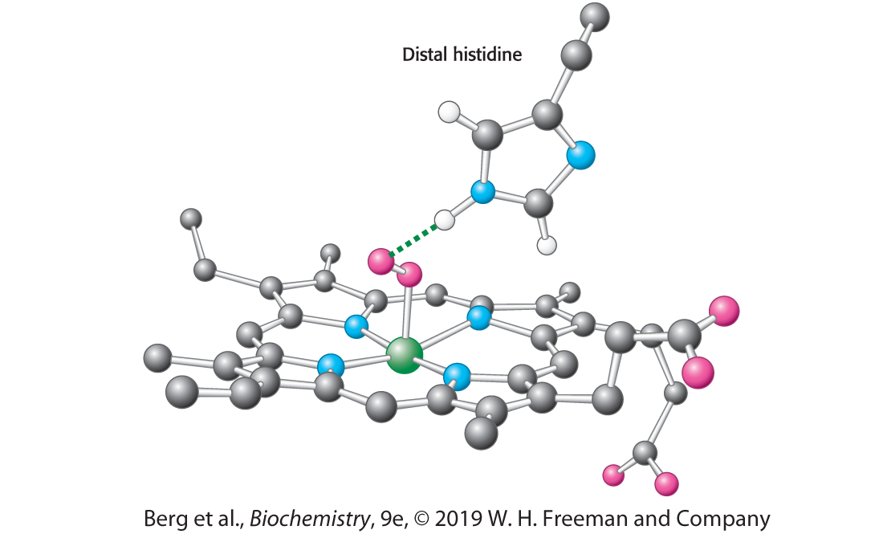
Stabilizing Bound Oxygen
H-bond
Notes:
FIGURE 7.5 Stabilizing bound oxygen. A hydrogen bond (dotted green line) donated by the distal histidine residue to the bound oxygen molecule helps stabilize oxymyoglobin.

Slide 18
Human Hemoglobin is an Assembly of Four Myoglobin-like Subunits
Hemoglobin consists of four chains: two identical α chains and two identical β chains.
Many of the helices in each subunit are arranged in a pattern also found in myoglobin, a structure called the globin fold.

Slide 19
Hemoglobin
65 kDa heterotetramer α₂,β₂ dimer
  Each subunit is structurally similar to myoglobin
Transports oxygen from lungs to tissues.
O₂ diffusion alone is too poor for transport in larger animals.
Solubility of O₂ is low in plasma i.e. 10⁻⁴ M.
But bound to hemoglobin, [O₂] = 0.01 M or nearly that of air

Slide 20
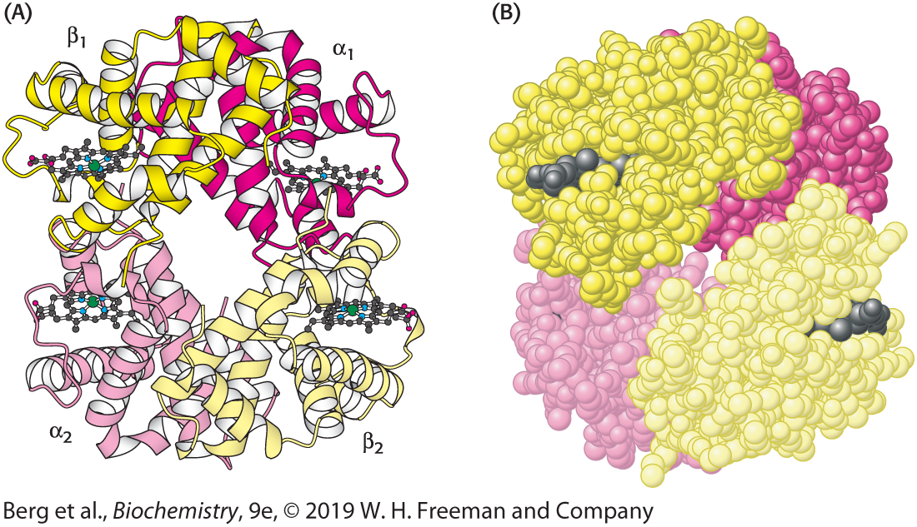
Quaternary Structure of Deoxyhemoglobin
Notes:
FIGURE 7.6 Quaternary structure of deoxyhemoglobin. Hemoglobin, which is composed of two α chains and two β chains, functions as a pair of αβ dimers. (A) A ribbon diagram. (B) A space-filling model. [Drawn from 1A3N.pdb.]

Slide 21
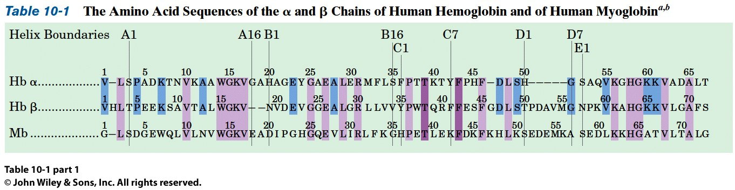
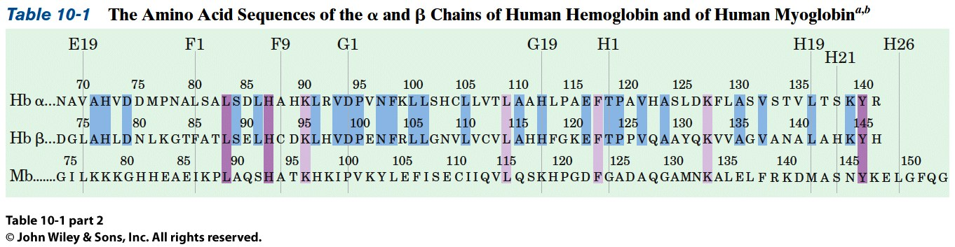
Average of <30% Sequence Identity b/w myoglobin and other proteins
Divergent or Convergent Evolution?
Why?

Slide 22
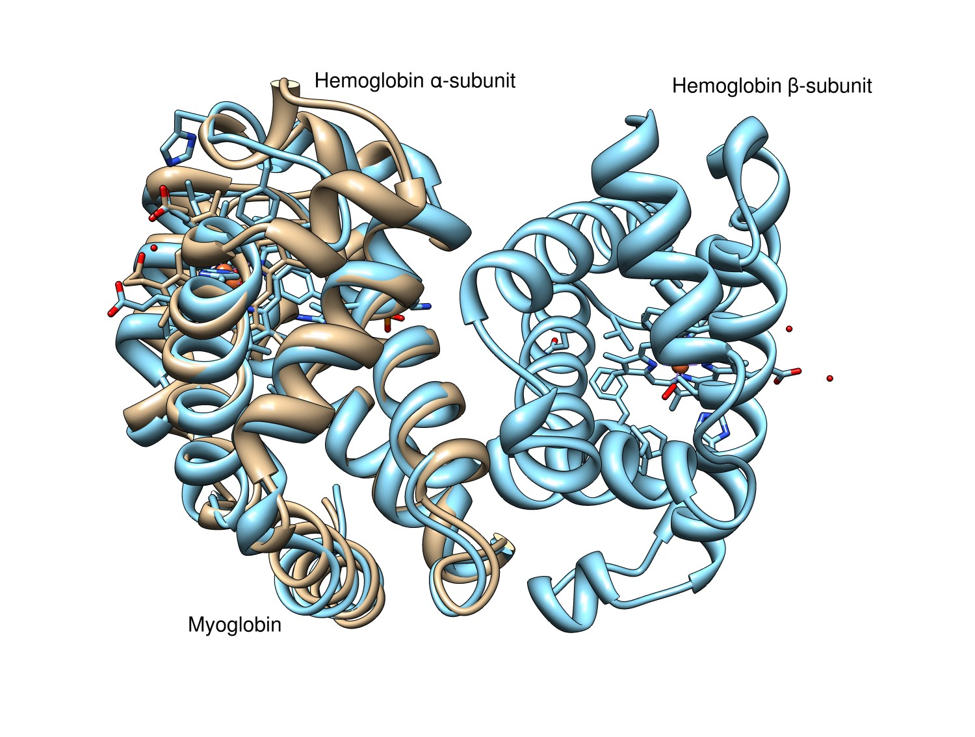
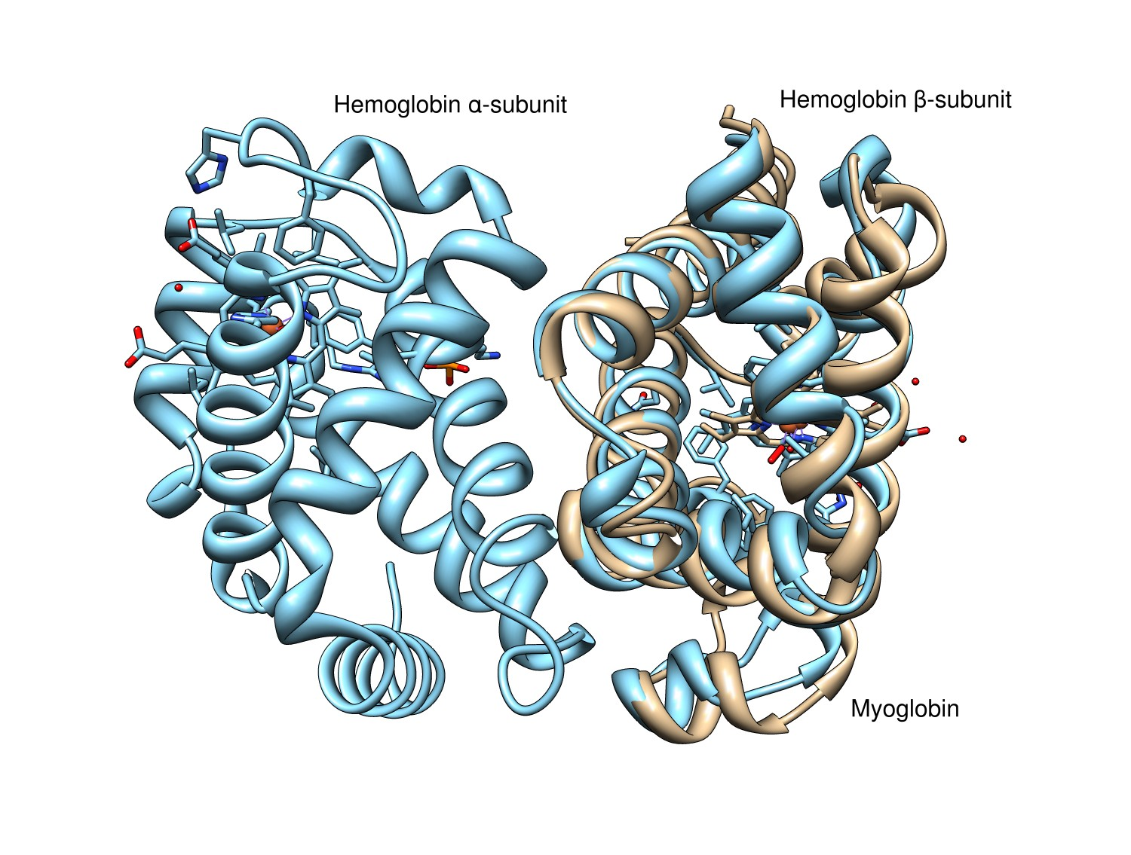
Divergent or Convergent Evolution?
Does this Help?

Slide 23
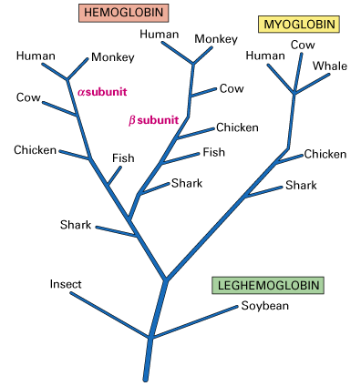
Divergent or Convergent Evolution?
How about this?
http://www.muhlenberg.edu/main/academics/biology/courses/bio152/bioinformatics_lab/beta_globin_info.html

Slide 24
Section 7.2 Hemoglobin Binds Oxygen Cooperatively
An oxygen binding curve is a plot of the fractional saturation versus the oxygen concentration, which is shown as partial pressure (in units of torr).
  Torr is a unit of pressure equal to that exerted by a column of mercury 1 mm high at 0°C and standard gravity (1 mm Hg).
Myoglobin displays a hyperbolic oxygen binding curve, while hemoglobin exhibits a sigmoid curve, indicating that O₂ binding and release is cooperative.
The cooperativity allows hemoglobin to bind oxygen in the lungs, where it is plentiful, and release oxygen at the tissues, where it is scarce.

Slide 25
O₂ binding to Myoglobin
MbO₂ <-> Mb + O₂
We can calculate the dissociation constant, K_{D}
Fractional Saturation solve for [MbO₂] and plug in

Slide 26
O₂ binding to Myoglobin
Fractional Saturation, Y_{O2}, is the fraction of the O₂ binding sites occupied

Slide 27
O₂ binding to Myoglobin
Now, we’ll define p50 as the value of p_{O2} when Y_{O2} =0.5 or when the pressure of oxygen in the blood when 50 of Mb molecules are bound with oxygen (Try setting Y_{O2} equal to 0.5 and solving for K_{D})

Slide 28
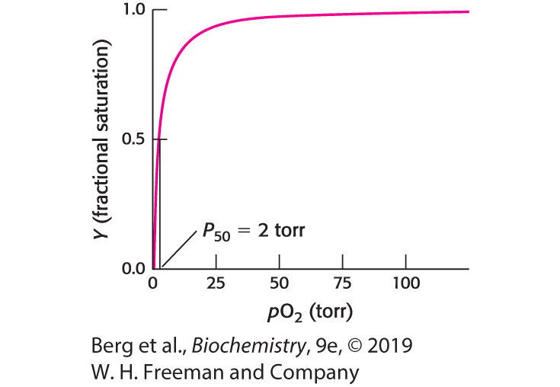
Oxygen Binding by Myoglobin
Notes:
FIGURE 7.7 Oxygen binding by myoglobin. Half the myoglobin molecules have bound oxygen when the oxygen partial pressure is 2 torr.

Slide 29
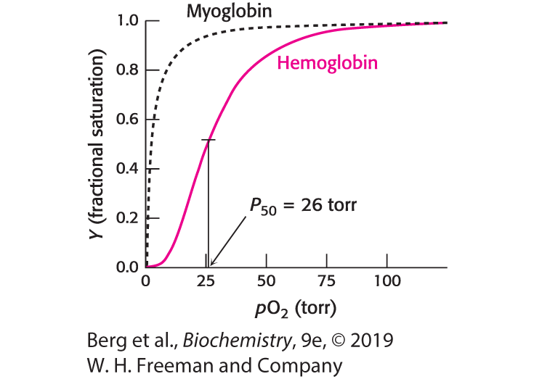
Oxygen Binding by Hemoglobin
Notes:
FIGURE 7.8 Oxygen binding by hemoglobin. This curve, obtained for hemoglobin in red blood cells, is shaped somewhat like an “S,” indicating that distinct, but interacting, oxygen-binding sites are present in each hemoglobin molecule. Half-saturation for hemoglobin is 26 torr. For comparison, the binding curve for myoglobin is shown as a dashed black curve.

Slide 30
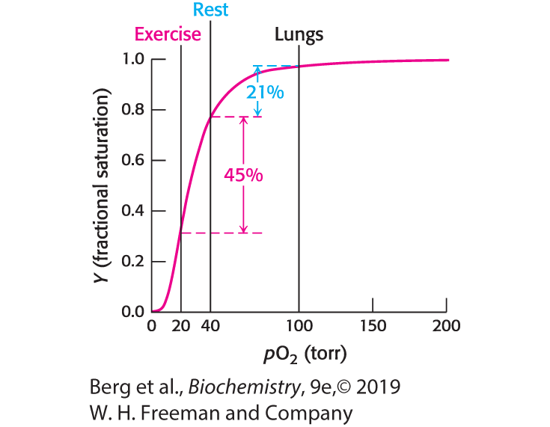
Responding to Exercise
Notes:
FIGURE 7.10 Responding to exercise. The drop in oxygen concentration from 40 torr in resting tissues to 20 torr in exercising tissues corresponds to the steepest part of the observed oxygen-binding curve. As shown here, hemoglobin is very effective in providing oxygen to exercising tissues.

Slide 31
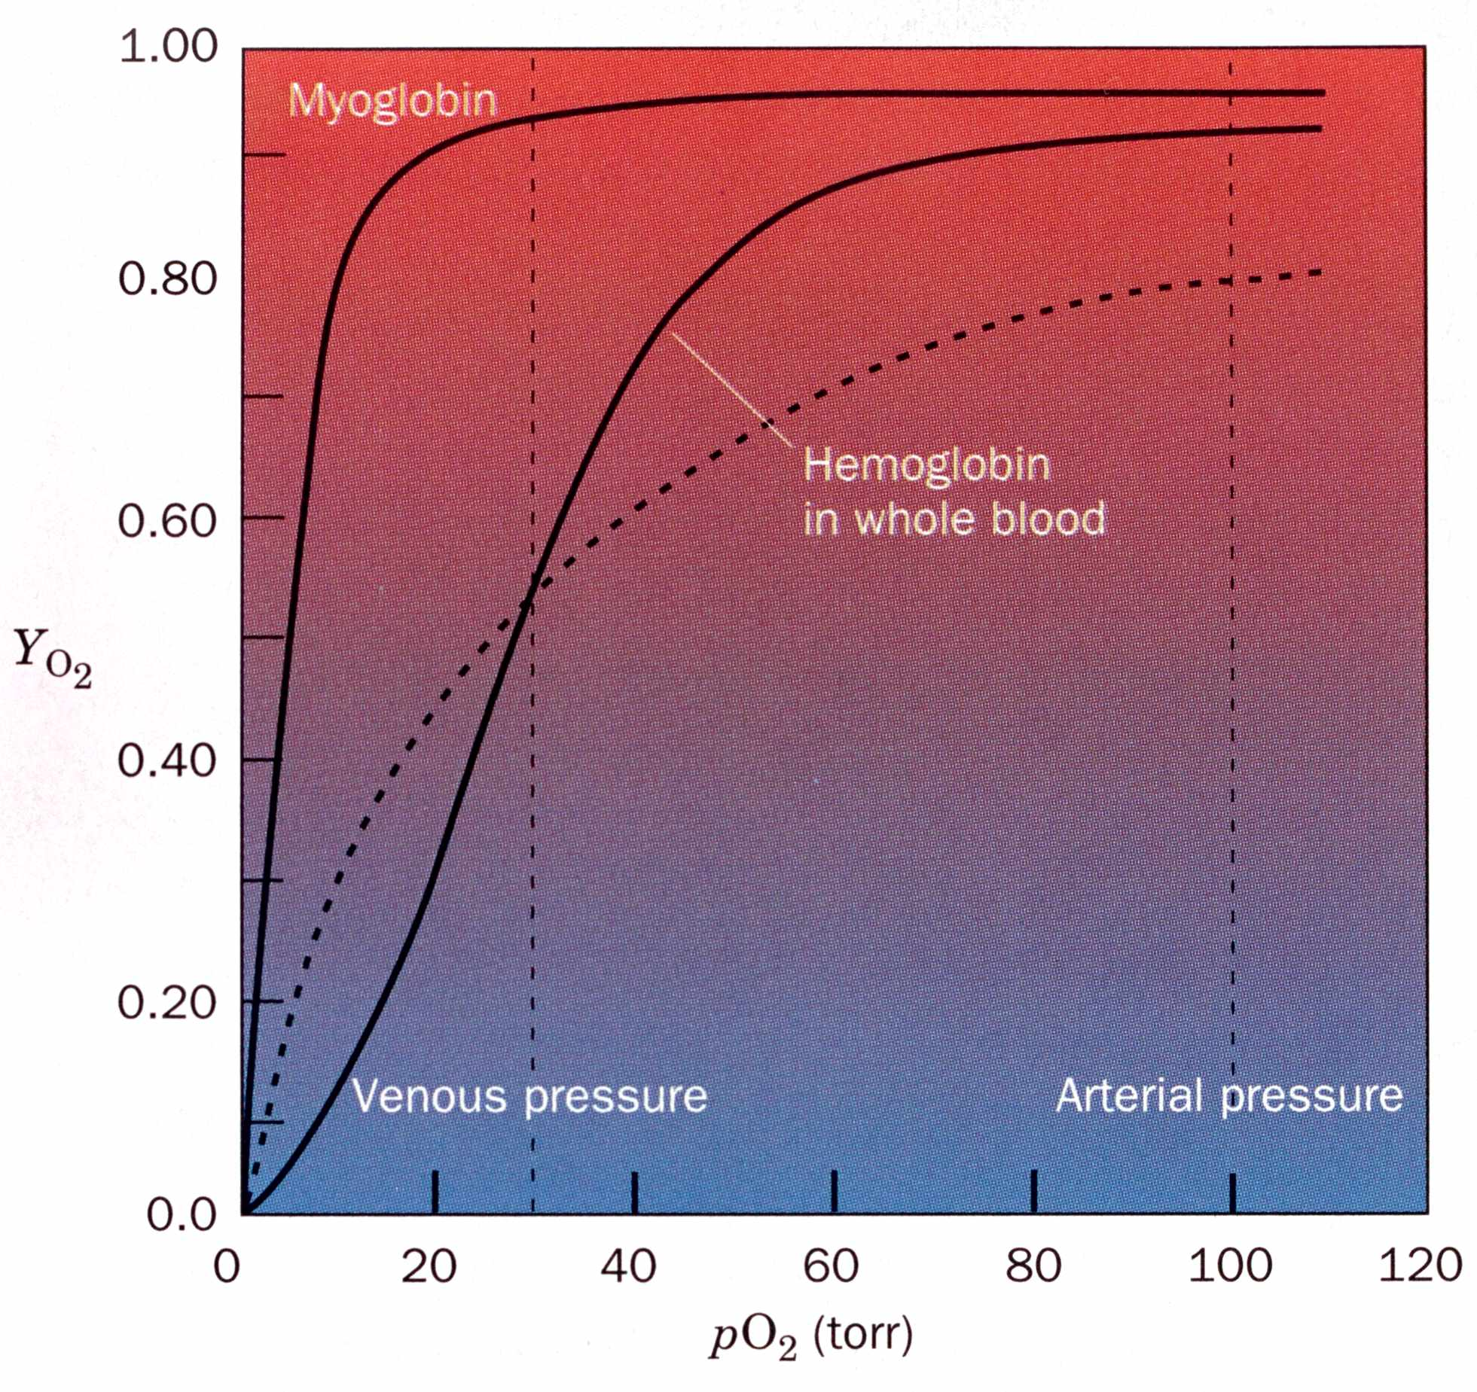
O₂ binding to Myoglobin
Normal Artery pO₂=100 Torr
Normal Vein pO₂ = 30 Torr
We see that the curve for Mb is very straightforward
Mb p50 is 2.8 Torr, so it takes very little O₂ to fill all Mb molecules
Mb doesn’t release the bound O₂ very readily over physiological pH
This means that Mb can scavenge O₂

Slide 32
O₂ binding to Myoglobin
For Myoglobin,
When pO₂ falls to very low levels, O₂ is released

Slide 33
O₂ binding to Hemoglobin
Huh?!
A simple Y_{O2} equation cannot describe this sigmoidal curve
Hb’s oxygen binding behaviour changes significantly over physiological pO₂
Dashed line is the theoretical curve if Hb had a single p50 value of 26 Torr

Slide 34
O₂ binding to Hemoglobin
Y_{O2} for Hb:
0.95 @ pO₂ = 100 Torr
0.55 @ pO₂ = 30 Torr
Hb releases O₂ at the same pressure that Mb becomes saturated
The sigmoidal curve is indicative of Cooperativity
The ligand binding sites of Hb are somehow “talking” to one another and the binding of a ligand in one site affects the binding in the other sites.
Dashed line is the theoretical curve if Hb had a single p50 of 26 Torr

Slide 35
Oxygen Binding Markedly Changes the Quaternary Structure of Hemoglobin
The quaternary structure of deoxyhemoglobin is referred to as the T state, while that of oxyhemoglobin is the R state.
The hemoglobin tetramer can be thought of as two αβ dimers. The α₁β₁ dimer rotates 15 degrees relative to the α₂β₂ dimer on oxygen binding.
This structure alteration, conversion from the T state to the R state, facilitates oxygen binding.

Slide 36
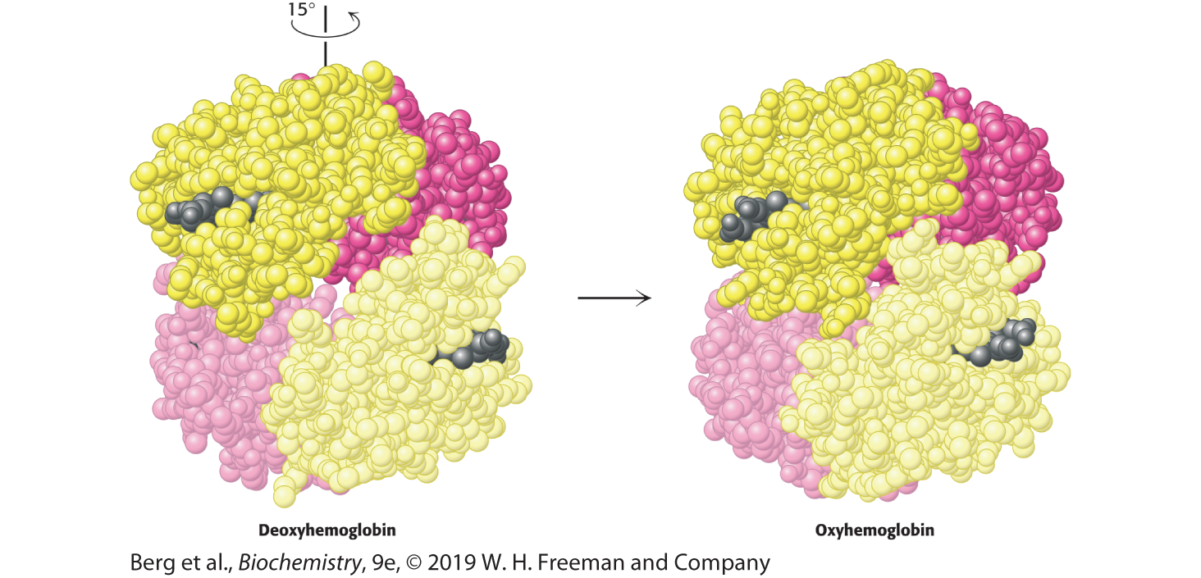
Quaternary Structural Changes on Oxygen Binding by Hemoglobin
Notes:
FIGURE 7.11 Quaternary structural changes on oxygen binding by hemoglobin. Notice that, on oxygenation, one αβ dimer shifts with respect to the other by a rotation of 15 degrees. [Drawn from 1A3N.pdb and 1LFQ.pdb.]

Slide 37
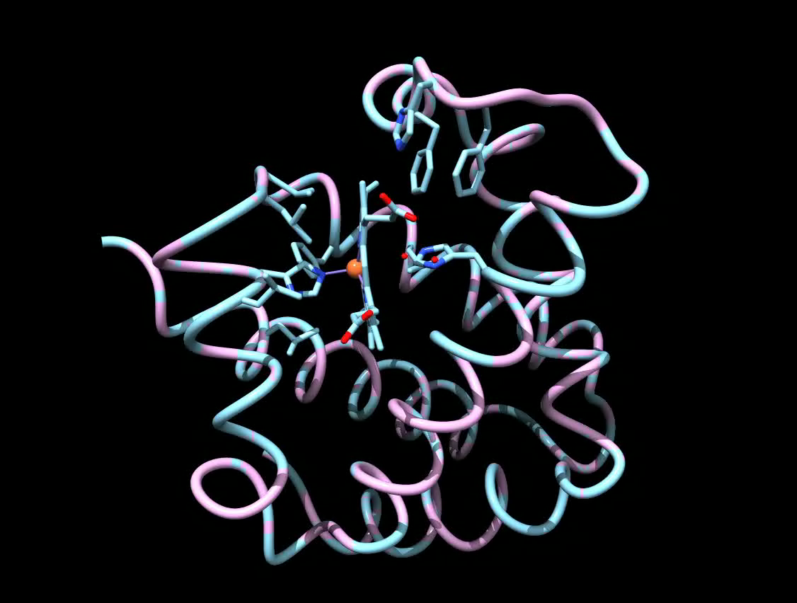
Notes:
FIGURE 7.11 Quaternary structural changes on oxygen binding by hemoglobin. Notice that, on oxygenation, one αβ dimer shifts with respect to the other by a rotation of 15 degrees. [Drawn from 1A3N.pdb and 1LFQ.pdb.]

Slide 38
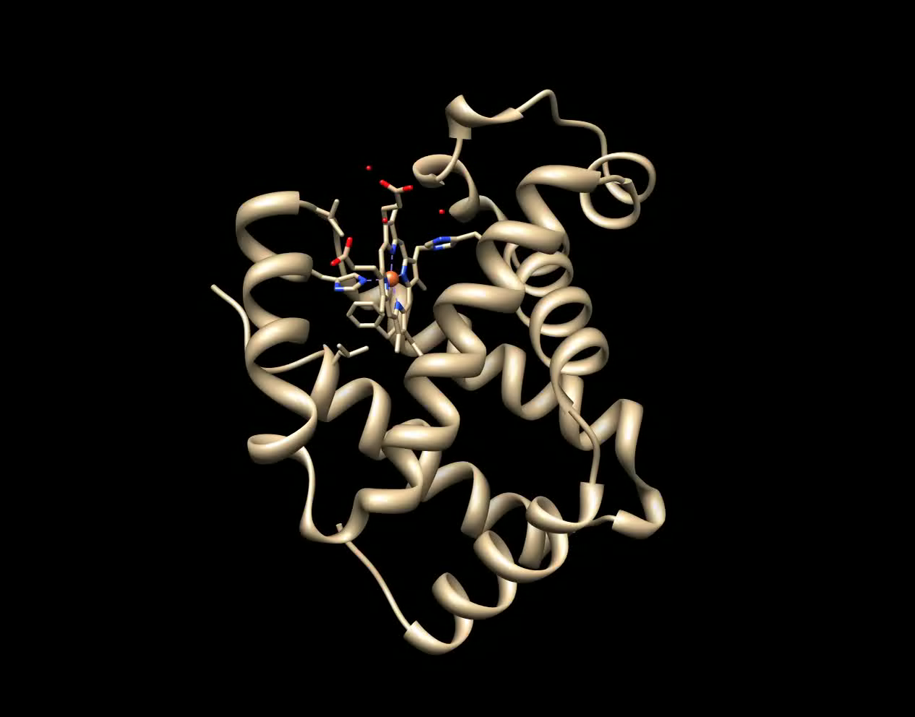
Notes:
FIGURE 7.11 Quaternary structural changes on oxygen binding by hemoglobin. Notice that, on oxygenation, one αβ dimer shifts with respect to the other by a rotation of 15 degrees. [Drawn from 1A3N.pdb and 1LFQ.pdb.]

Slide 39
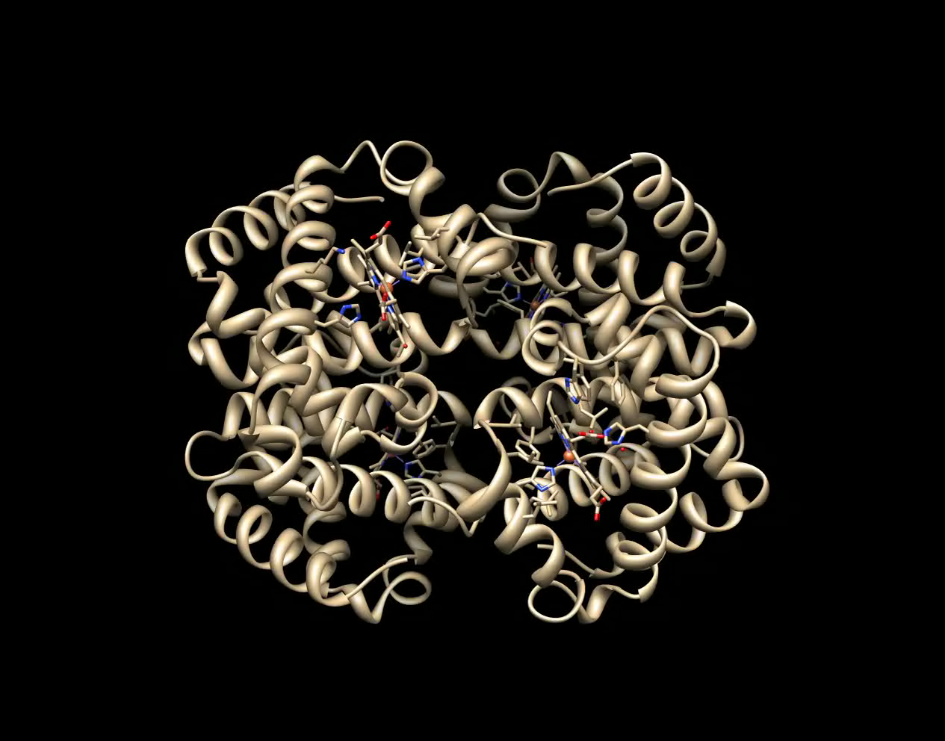
Notes:
FIGURE 7.11 Quaternary structural changes on oxygen binding by hemoglobin. Notice that, on oxygenation, one αβ dimer shifts with respect to the other by a rotation of 15 degrees. [Drawn from 1A3N.pdb and 1LFQ.pdb.]

Slide 40
Hemoglobin Cooperativity can be Potentially Explained by Several Models
Hemoglobin cooperativity incorporates aspects of both the concerted and sequential models of allostery.
  It is concerted in that in hemoglobin with three O₂ bound, the remaining subunit is in the R state.
  It is sequential in that in hemoglobin with one O₂ bound, the remaining subunits are in the T state.

Slide 41
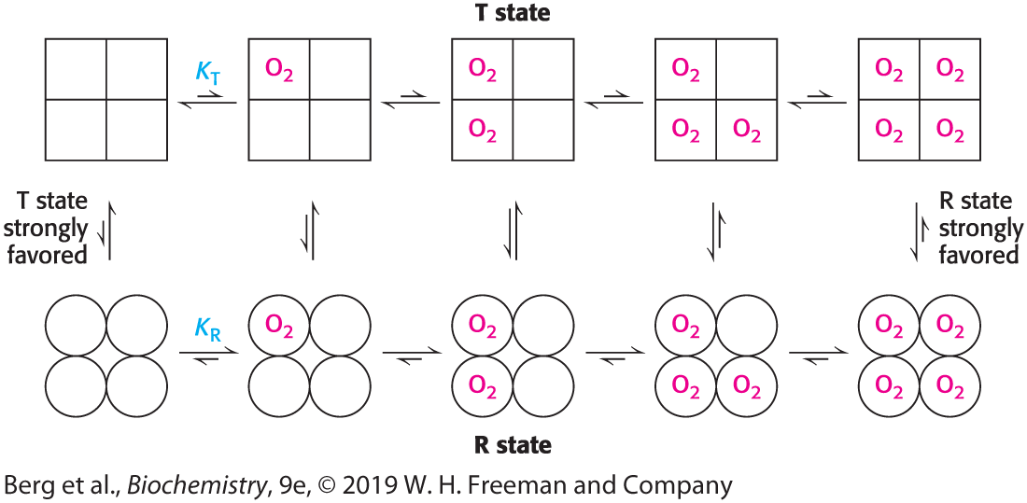
Concerted Model
Notes:
FIGURE 7.12 Concerted model. All molecules exist either in the T state or in the R state. At each level of oxygen loading, an equilibrium exists between the T and R states. The equilibrium shifts from strongly favoring the T state with no oxygen bound to strongly favoring the R state when the molecule is fully loaded with oxygen. The R state has a greater affinity for oxygen than does the T state.

Slide 42
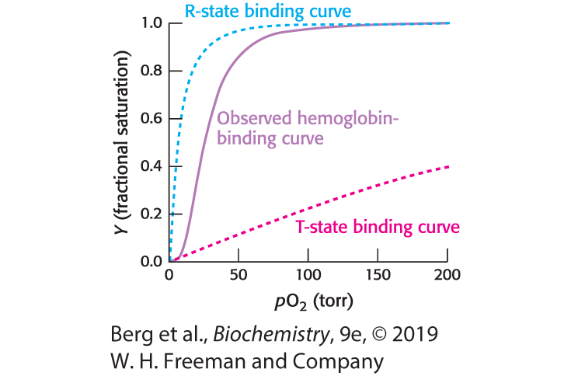
T-to-R Transition
Notes:
FIGURE 7.13 T-to-R transition. The binding curve for hemoglobin can be seen as a combination of the binding curves that would be observed if all molecules remained in the T state or if all of the molecules were in the R state. The sigmoidal curve is observed because molecules convert from the T state into the R state as oxygen molecules bind.

Slide 43
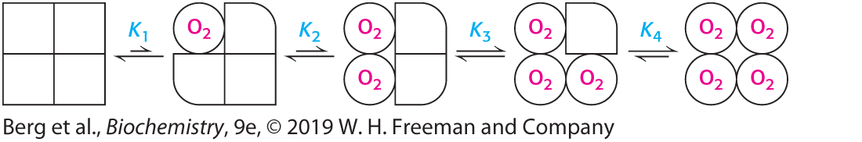
Sequential Model
Notes:
FIGURE 7.14 Sequential model. The binding of a ligand changes the conformation of the subunit to which it binds. This conformational change induces changes in neighboring subunits that increase their affinity for the ligand.

Slide 44
Structural Changes at the Heme Groups are Transmitted to the 𝛂₁𝛃₁-𝛂₂𝛃₂ Interface
The transition from deoxyhemoglobin (T state) to oxyhemoglobin (R state) occurs upon oxygen binding.
The iron ion moves into the plane of the heme when oxygen binds. The proximal histidine, which is a member of an α-helix, moves with the iron.
The resulting structural change is communicated to the other subunits so that the two αβ dimers rotate with respect to one another, resulting in the formation of the R state.

Slide 45
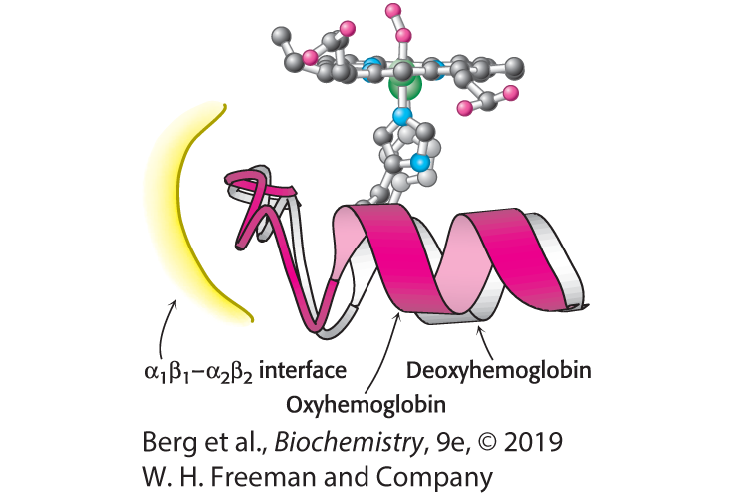
Conformational Changes in Hemoglobin
Notes:
FIGURE 7.15 Conformational changes in hemoglobin. The movement of the iron ion on oxygenation brings the iron-associated histidine residue toward the porphyrin ring. The associated movement of the histidine-containing α helix alters the interface between the αβ dimers, instigating other structural changes. For comparison, the deoxyhemoglobin structure is shown in gray behind the oxyhemoglobin structure in red.

Slide 46
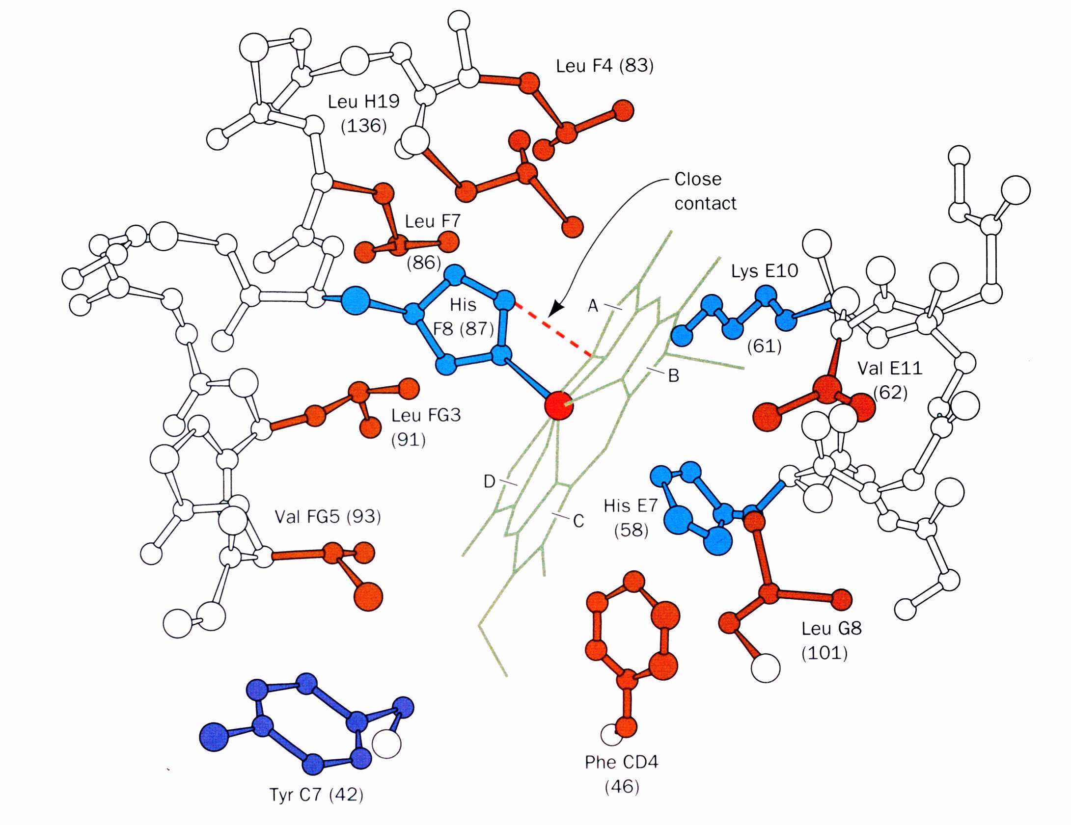
Conformational Changes in Hemoglobin
The proximal His in Hb (His87) is tightly packed in a pocket
This restricts its motion until it is pulled and even then, it has to move with its neighbors
Notes:
FIGURE 7.15 Conformational changes in hemoglobin. The movement of the iron ion on oxygenation brings the iron-associated histidine residue toward the porphyrin ring. The associated movement of the histidine-containing α helix alters the interface between the αβ dimers, instigating other structural changes. For comparison, the deoxyhemoglobin structure is shown in gray behind the oxyhemoglobin structure in red.

Slide 47
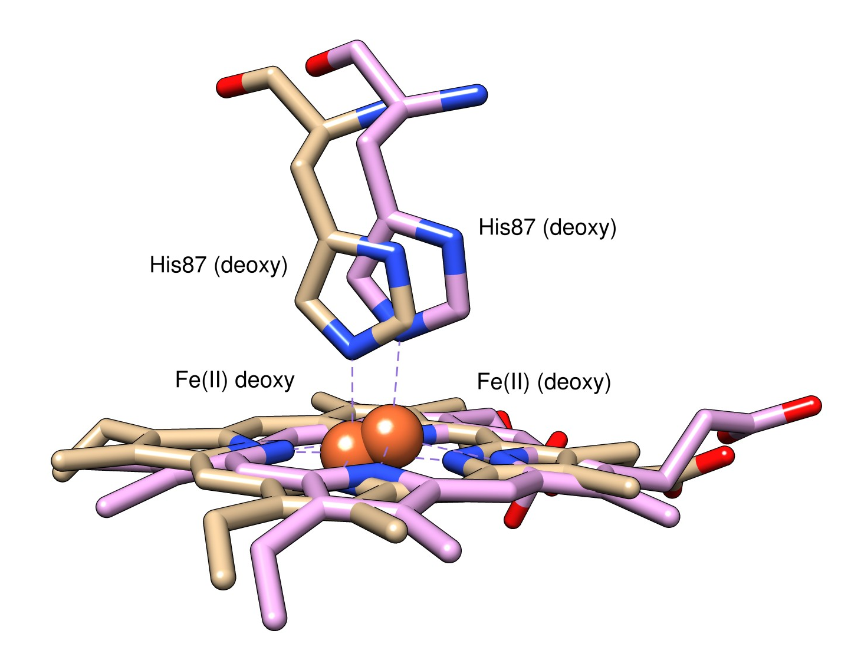
Conformational Changes in Hemoglobin
The movement of the Fe(II) into the plane of the heme ring upon oxygen binding triggers the T-state to R-state transition
His87 (F8) is pulled by the by the Fe(II) a distance of 0.6Å (compared to only 0.3Å in Mb)
This tilts the F-Helix and translates it 1Å across the plane of the helix
Notes:
FIGURE 7.15 Conformational changes in hemoglobin. The movement of the iron ion on oxygenation brings the iron-associated histidine residue toward the porphyrin ring. The associated movement of the histidine-containing α helix alters the interface between the αβ dimers, instigating other structural changes. For comparison, the deoxyhemoglobin structure is shown in gray behind the oxyhemoglobin structure in red.

Slide 48
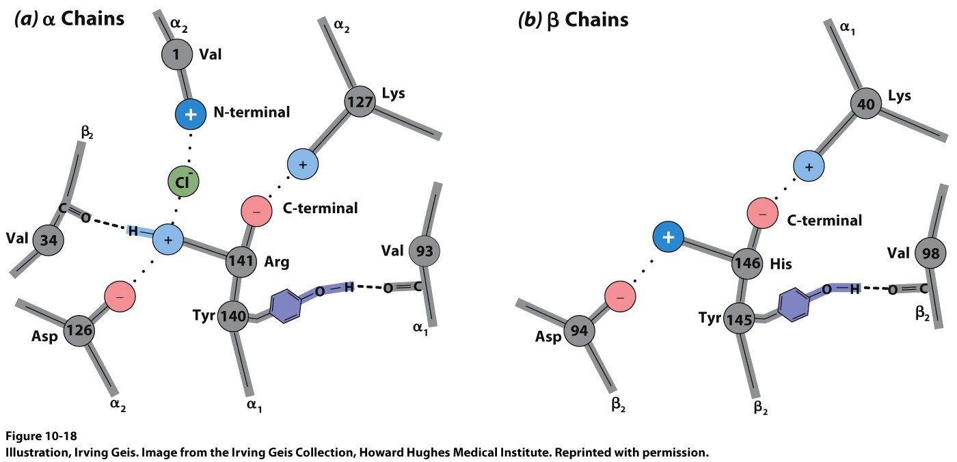
Conformational Changes in Hemoglobin
The T-state is stabilized by Salt Bridges
This helps stabilize the state since the protein is actually more stable in the R-state
The C-termini of the subunits (R141α and H146β) are free to move in the R-state but in the T-state they are secured by these bridges
Notes:
FIGURE 7.15 Conformational changes in hemoglobin. The movement of the iron ion on oxygenation brings the iron-associated histidine residue toward the porphyrin ring. The associated movement of the histidine-containing α helix alters the interface between the αβ dimers, instigating other structural changes. For comparison, the deoxyhemoglobin structure is shown in gray behind the oxyhemoglobin structure in red.

Slide 49

2,3-Bisphosphoglycerate in Red Cells is Crucial in Determining the Oxygen Affinity of Hemoglobin
2, 3-Bisphosphoglycerate (2,3-BPG) stabilizes the T state of hemoglobin and thus facilitates the release of oxygen.
2, 3-BPG binds to a pocket in the hemoglobin tetramer that exists only when hemoglobin is in the T state.

Slide 50
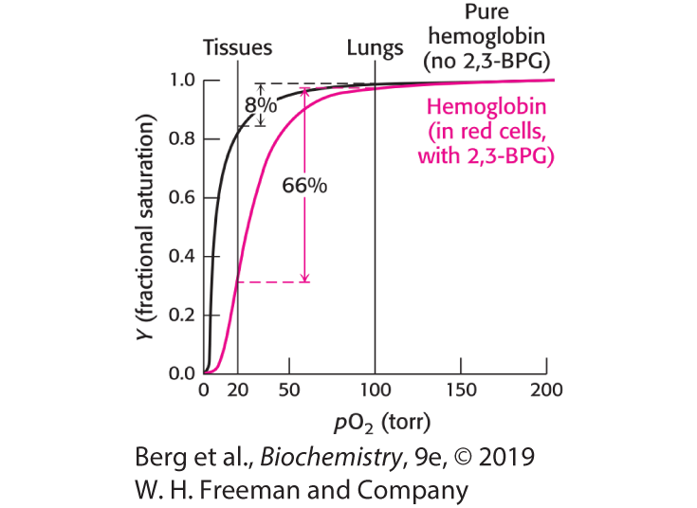
Oxygen Binding by Pure Hemoglobin Compared with Hemoglobin in Red Blood Cells
Notes:
FIGURE 7.16 Oxygen binding by pure hemoglobin compared with hemoglobin in red blood cells. Pure hemoglobin binds oxygen more tightly than does hemoglobin in red blood cells. This difference is due to the presence of 2,3-bisphosphoglycerate (2,3-BPG) in red blood cells.

Slide 51
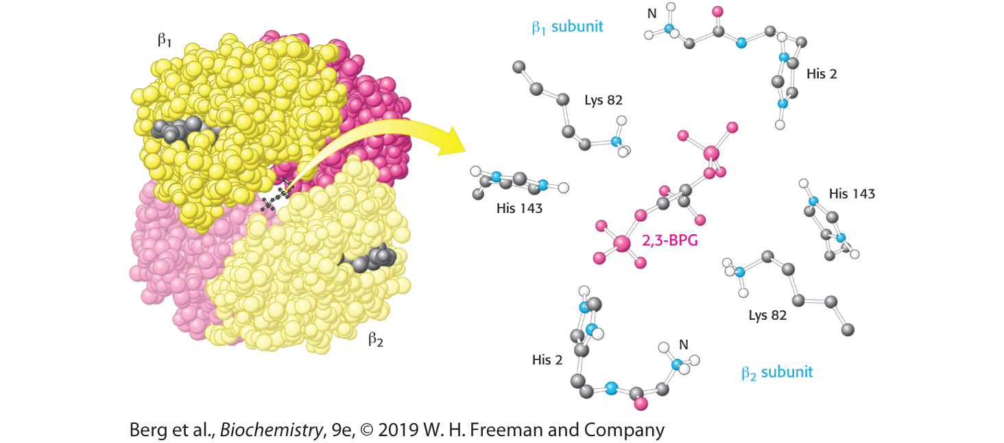
Mode of Binding of 2,3-BPG to Human Deoxyhemoglobin
Notes:
FIGURE 7.17 Mode of binding of 2,3-BPG to human deoxyhemoglobin. 2,3-Bisphosphoglycerate binds to the central cavity of deoxyhemoglobin (left). There, it interacts with three positively charged groups on each β chain (right). [Drawn from 1B86.pdb.]

Slide 52
Fetal Hemoglobin
Fetal hemoglobin must bind oxygen at the same pO₂ at which the mother’s hemoglobin is releasing oxygen.
In fetal hemoglobin, the β chain is replaced with a γ chain.
The fetal α₂γ₂ hemoglobin does not bind 2,3-BPG as well as adult hemoglobin does. The reduced affinity for 2,3-BPG results in fetal hemoglobin having a higher affinity for oxygen, binding oxygen when the mother’s hemoglobin is releasing oxygen.

Slide 53
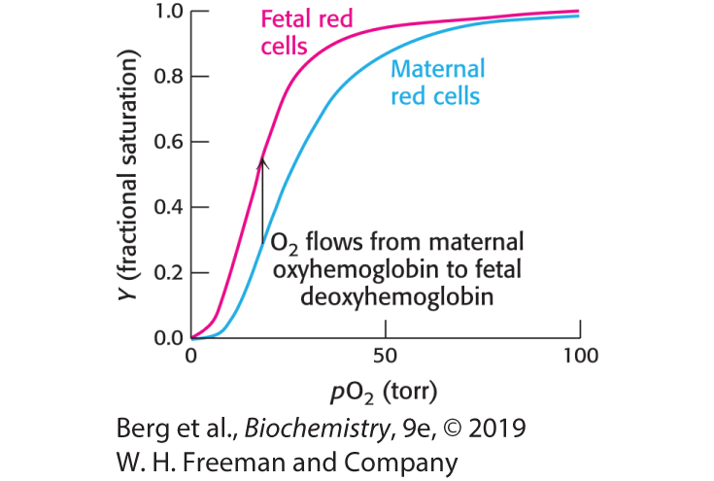
Oxygen Affinity of Fetal Red Blood Cells
Notes:
FIGURE 7.18 Oxygen affinity of fetal red blood cells. Fetal red blood cells have a higher oxygen affinity than do maternal red blood cells because fetal hemoglobin does not bind 2,3-BPG as well as maternal hemoglobin does.

Slide 54
Carbon Monoxide can Disrupt Oxygen Transport by Hemoglobin
Carbon monoxide is extremely harmful for two reasons:
  Carbon monoxide binds to hemoglobin about 200-fold more tightly than does oxygen, so even at low partial pressures in the blood, carbon monoxide will displace oxygen from hemoglobin, preventing its delivery.
  Carbon monoxide bound to one site in hemoglobin will shift the oxygen saturation curve of the remaining sites to the left, forcing the tetramer into the R state. The increased affinity for oxygen prevents its delivery to tissues.
Peripheral tissues are thus deprived of oxygen.

Slide 55
Section 7.3 Hydrogen Ions and Carbon Dioxide Promote the Release of Oxygen: The Bohr Effect
Carbon dioxide and H⁺, produced by actively respiring tissues, enhance oxygen release by hemoglobin. Carbon dioxide and H⁺ are thus allosteric effectors of hemoglobin.
At lower pH, ionic bonds form that stabilize the T state.
The stimulation of oxygen release by carbon dioxide and H⁺ is called the Bohr effect.

Slide 56
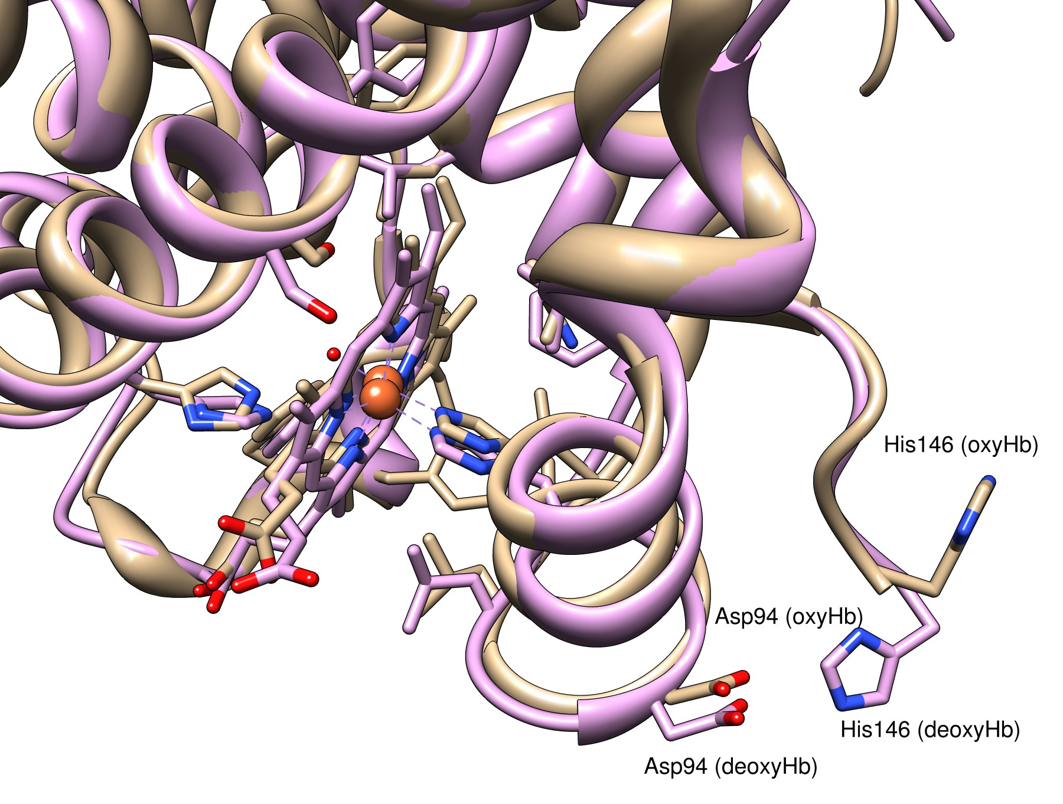
Section 7.3 The Bohr Effect
Hb also has a role to play in regulating CO₂ levels in the blood
When Hb binds to O₂, it undergoes a conformational change that exposes some amino acid side chains to solvent, specifically His146.
The His146 residue is normally involved in a salt-bridge with Asp94
His146 swings out and deprotonates
deoxyHb = 2DHB oxyHb = 2MHB
His146 (oxyHb) pKa=6.27 His146 (deoxyHb) pKa=7.40

Slide 57
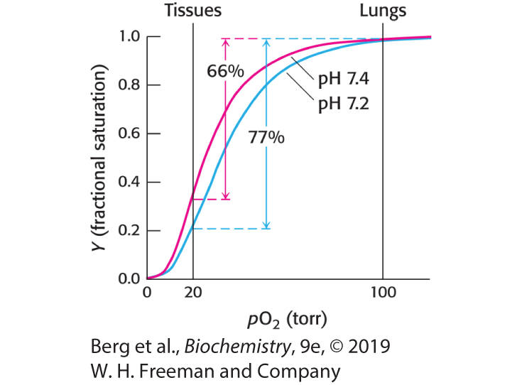
Effect of pH on the Oxygen Affinity of Hemoglobin
Notes:
FIGURE 7.19 Effect of pH on the oxygen affinity of hemoglobin. Lowering the pH from 7.4 (red curve) to 7.2 (blue curve) results in the release of O₂ from oxyhemoglobin.

Slide 58
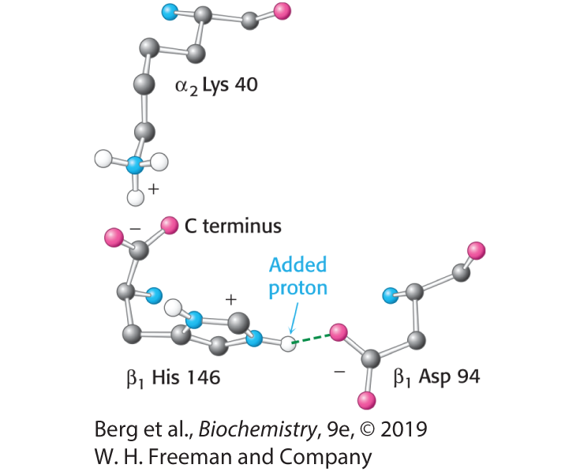
Chemical Basis of the Bohr Effect
Notes:
FIGURE 7.20 Chemical basis of the Bohr effect. In deoxyhemoglobin, three amino acid residues form two salt bridges that stabilize the T quaternary structure. The formation of one of the salt bridges depends on the presence of an added proton on histidine β146. The proximity of the negative charge on aspartate β94 in deoxyhemoglobin favors protonation of this histidine. Notice that the salt bridge between histidine β146 and aspartate β94 is stabilized by a hydrogen bond (green dashed line).

Slide 59
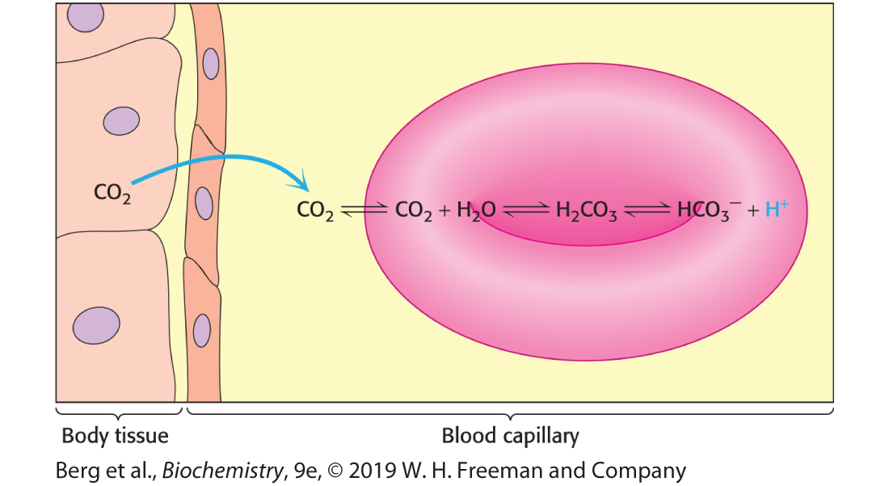
Carbon Dioxide and pH
Notes:
FIGURE 7.21 Carbon dioxide and pH. Carbon dioxide in the tissues diffuses into red blood cells. Inside a red blood cell, carbon dioxide reacts with water to form carbonic acid, in a reaction catalyzed by the enzyme carbonic anhydrase. Carbonic acid dissociates to form HCO⁻₃ and H⁺, resulting in a drop in pH inside the red cell.

Slide 60

Some Carbon Dioxide Reacts to Form Carbamate
Some carbon dioxide reacts with amino terminal groups on hemoglobin, forming carbamate.
The carbamate forms salt bridges that stabilize the T state.
However, most carbon dioxide is carried to the lungs in the blood as bicarbonate ion.

Slide 61
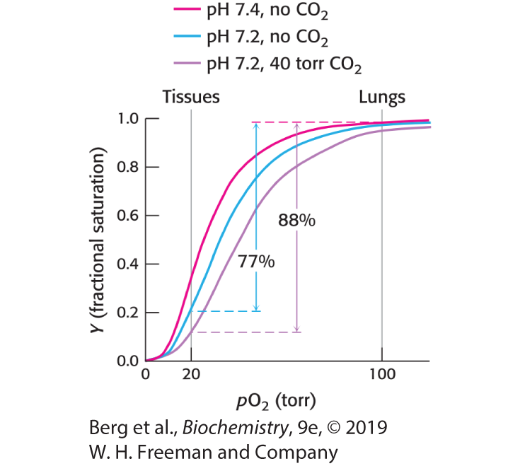
Carbon Dioxide Effects
Notes:
FIGURE 7.22 Carbon dioxide effects. The presence of carbon dioxide decreases the affinity of hemoglobin for oxygen even beyond the effect due to a decrease in pH, resulting in even more efficient oxygen transport from the tissues to the lungs.

Slide 62
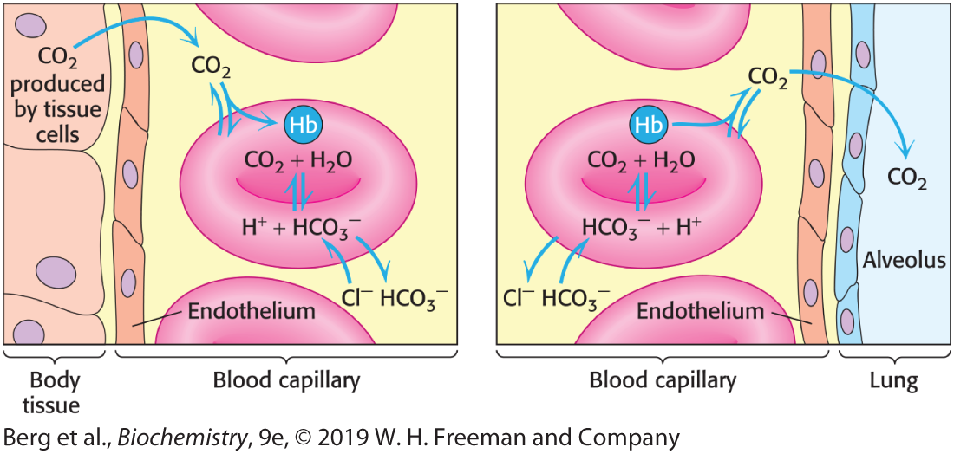
Transport of CO₂ from Tissues to Lungs
Notes:
FIGURE 7.23 Transport of CO₂ from tissues to lungs. Most carbon dioxide is transported to the lungs in the form of HCO⁻₃ produced in red blood cells and then released into the blood plasma. A lesser amount is transported by hemoglobin in the form of an attached carbamate.

