Slide 1
All Cellular RNA is Synthesized by RNA Polymerases
Synthesis of RNA from a DNA template (transcription) is catalyzed by RNA polymerase, which has the following requirements:
A DNA template. The sequence of the newly synthesized RNA is complementary to the DNA template. The DNA strand that has the same sequence as the RNA product (with T instead of U) is called the coding strand.
Activated precursors in the form of the four ribonucleoside triphosphates
Divalent metal ions, usually Mg²⁺ or Mn²⁺
RNA polymerase catalyzes the following reaction:

Slide 2
RNA Polymerase
RNA polymerase initiates and elongates the RNA product, with the chain growing in the 5’-to-3’ direction.
No primer is needed. The 3’ OH of the growing chain attacks the innermost phosphoryl (α) group of the incoming ribonucleoside triphosphate.
Notes:
FIGURE 4.27 RNA Polymerase. This large enzyme comprises many subunits, including β (red) and β’ (yellow), which form a “claw” that holds the DNA to be transcribed. Notice that the active site includes a Mg²⁺ion (green) at the center of the structure. The curved tubes making up the protein in the image represent the backbone of the polypeptide chain. [Drawn from 1L9Z. pdb.]

Slide 3
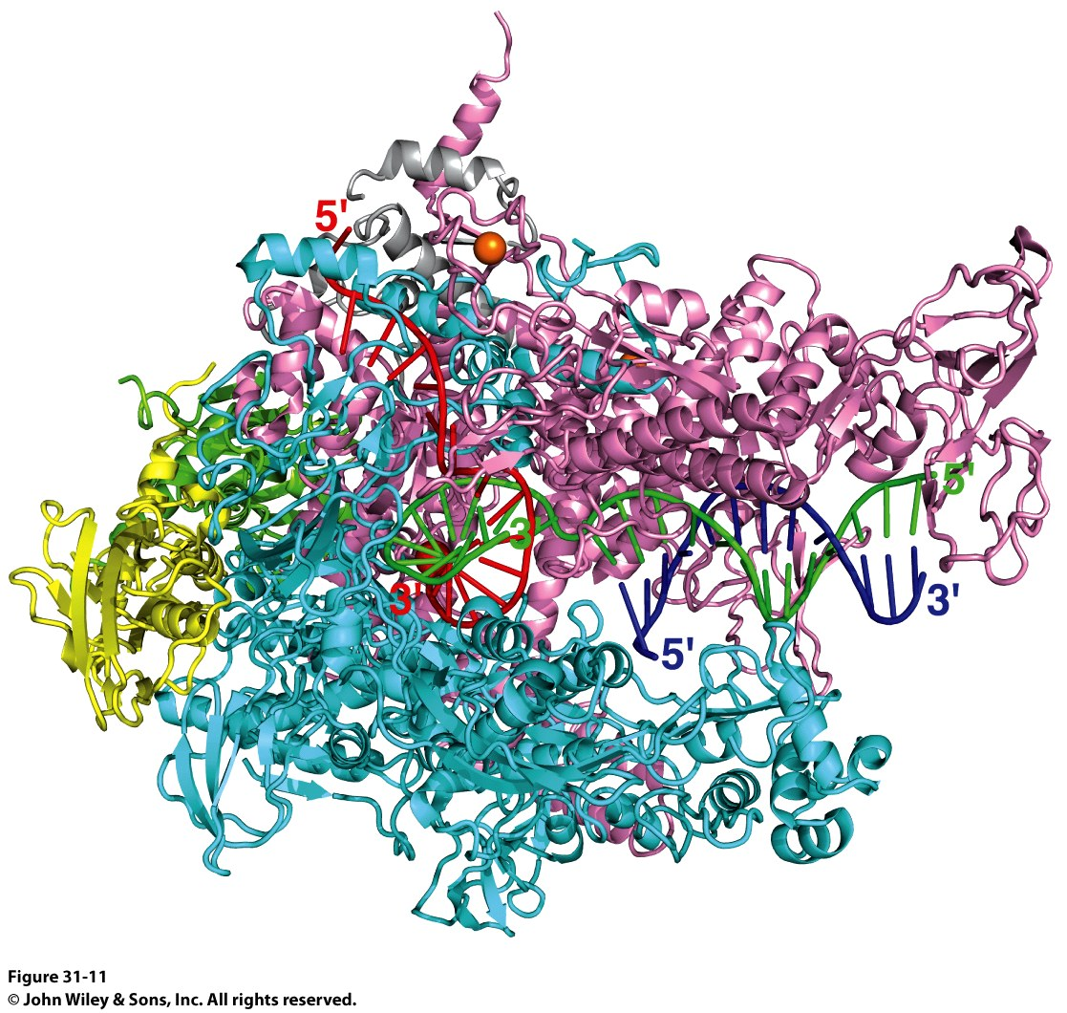
RNA Polymerase
RNA Polymerase (RNAP)
PDB ID Codes:
2O5I: Crystal structure of the Thermus thermophilus RNA polymerase elongation complex
1L9Z: Thermus aquaticus RNA Polymerase Holoenzyme/Fork-Junction Promoter DNA Complex at 6.5 A Resolution
2A69: Crystal structure of the Thermus Thermophilus RNA polymerase holoenzyme in complex with antibiotic rifapentin
2O5I

Slide 4
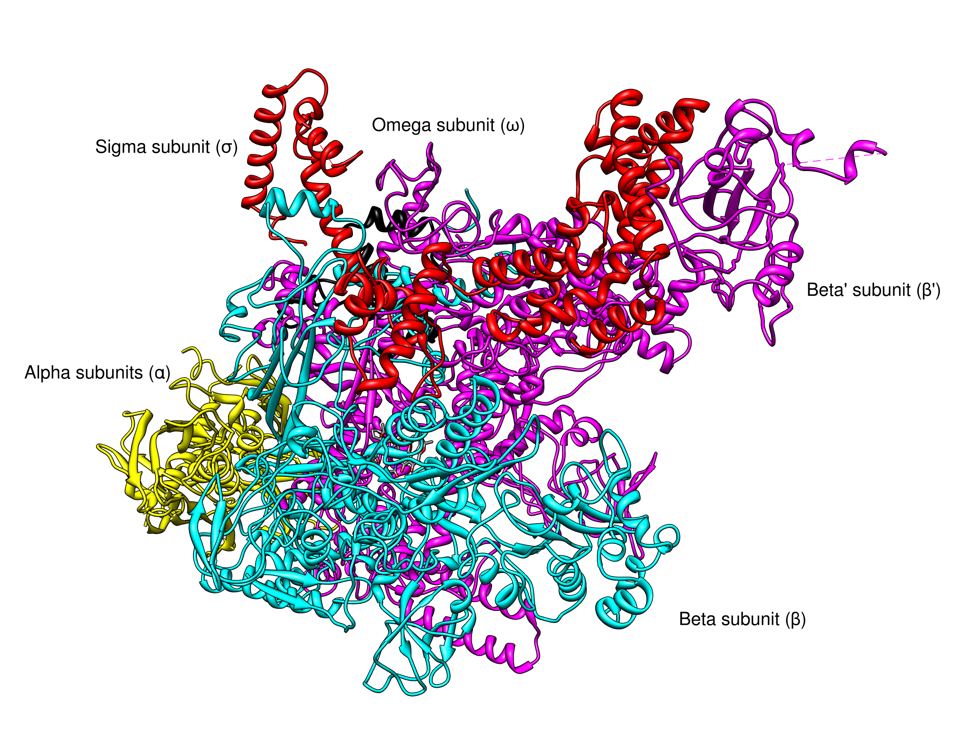
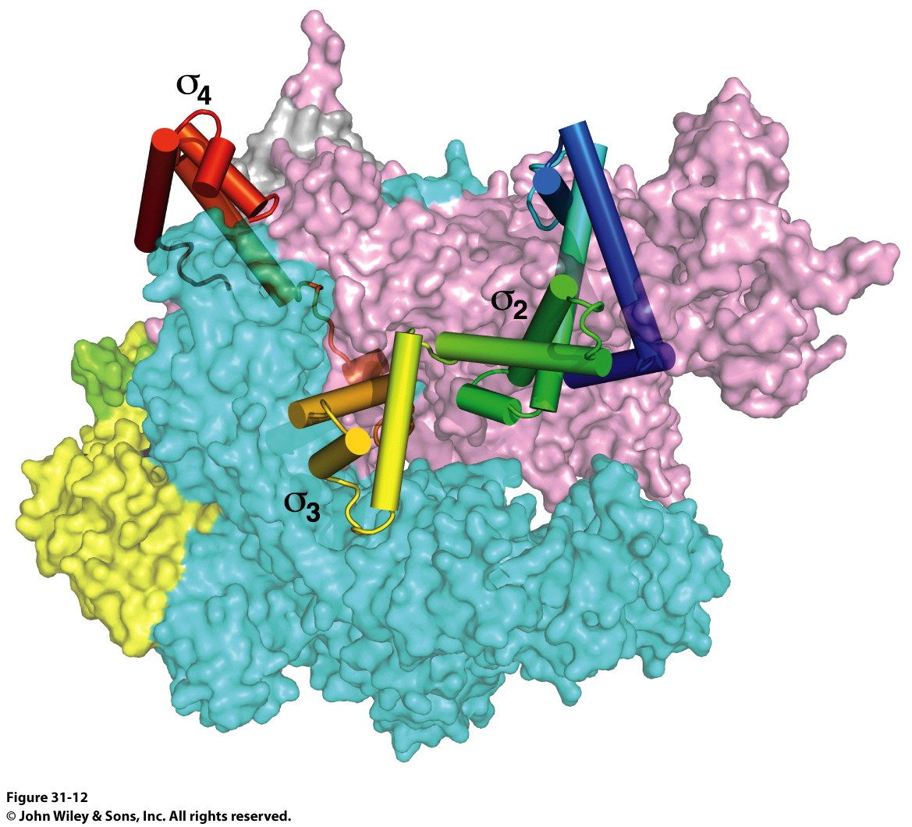
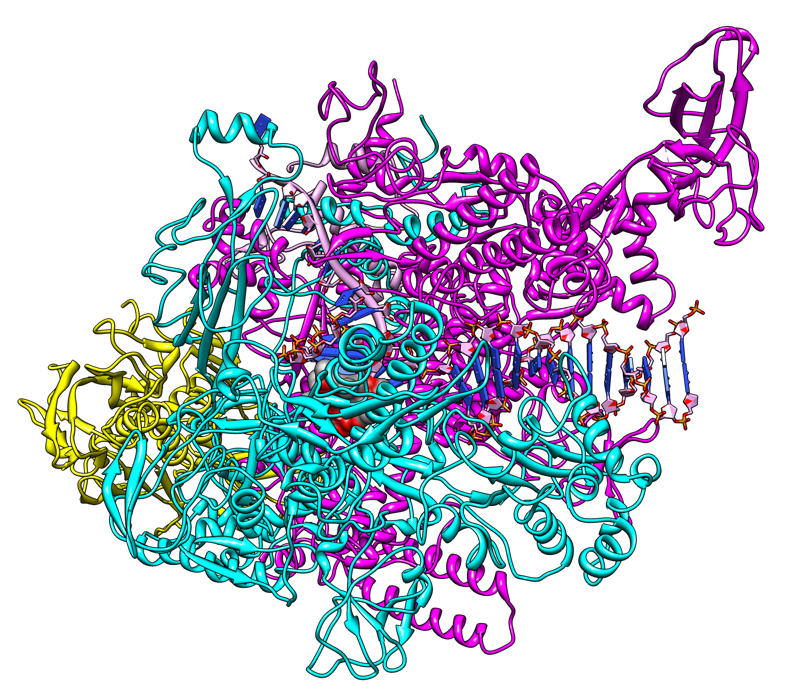
RNA Polymerase
Sigma subunits are critical to start transcription
1IW7
2A69
2O5I
The Holoenzyme (1IW7)
(The initial assembly on the promoter)
459 kDa
α₂ββ’ωσ subunits
The Core Enzyme (2A69)
(The functional assembly)
389 kDa
α₂ββ’ω subunits
Note no sigma!

Slide 5
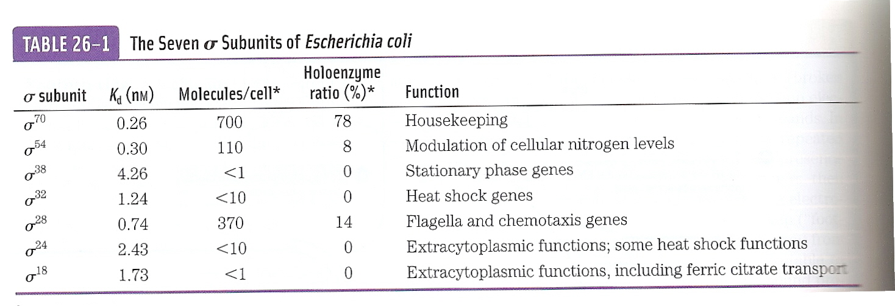
Sigma Subunits are Promoter Specific
The most prevalent is σ⁷⁰

Slide 6
Transcription Begins Near Promoter Sites and Ends at Terminator Sites
Promoters are specific DNA sequences that direct RNA polymerase to the proper initiation site.
There are often variations in the sequence of a promoter for different genes. The average of such variation is called the consensus sequence.

Slide 7
Promoter Sites for Transcription in Prokaryotes and Eukaryotes
Notes:
FIGURE 4.30 Promoter sites for transcription in (A) prokaryotes and (B) eukaryotes. Consensus sequences are shown. The first nucleotide to be transcribed is numbered +1. The adjacent nucleotide on the 5′ side is numbered −1. The sequences shown are those of the coding strand of DNA.

Slide 8
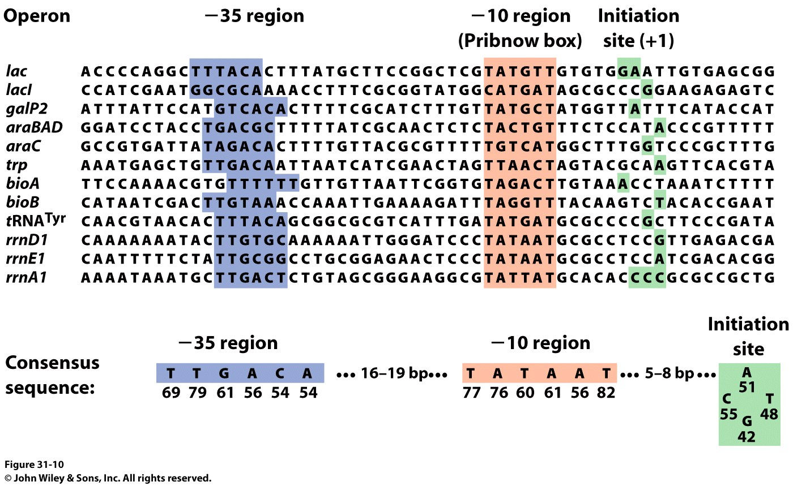
Promoters:
RNAP Binds to Specific Sites on the DNA
DNA is a duplex:
Antisense Strand: Strand that is transcribed
Sense Strand: The coding strand, has the same sequence as the transcribed mRNA

Slide 9
Promoters:
RNAP Binds to Specific Sites on the DNA
Promoters are 40bp sequences BEFORE the transcriptional start site (+1 site)
There is some variation in the -35 region, and almost none in the Pribnow box
The distance between the -35 and -10 regions is ABSOLUTELY CRITICAL
Mutation changes the affinity of RNAP for the DNA
Normally 1x10⁻¹⁴ M
Binding of RNAP to the promoter “melts” the DNA through the Pribnow box

Slide 10
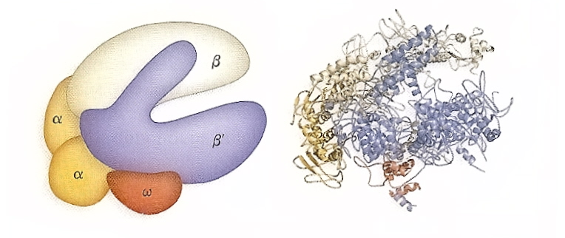
Structure of E. coli RNAP and Mechanism

Slide 11
Transcription Mechanism of the Chain-Elongation Reaction Catalyzed by RNA Polymerase
The reaction is driven thermodynamically by the hydrolysis of pyrophosphate.
Notes:
FIGURE 4.28 Transcription mechanism of the chain-elongation reaction catalyzed by RNA polymerase. [Source: J. L. Tymoczko, J. Berg, and L. Stryer, Biochemistry: A Short Course, 2nd ed. (W. H. Freeman and Company, 2013), Fig. 36.3.]

Slide 12
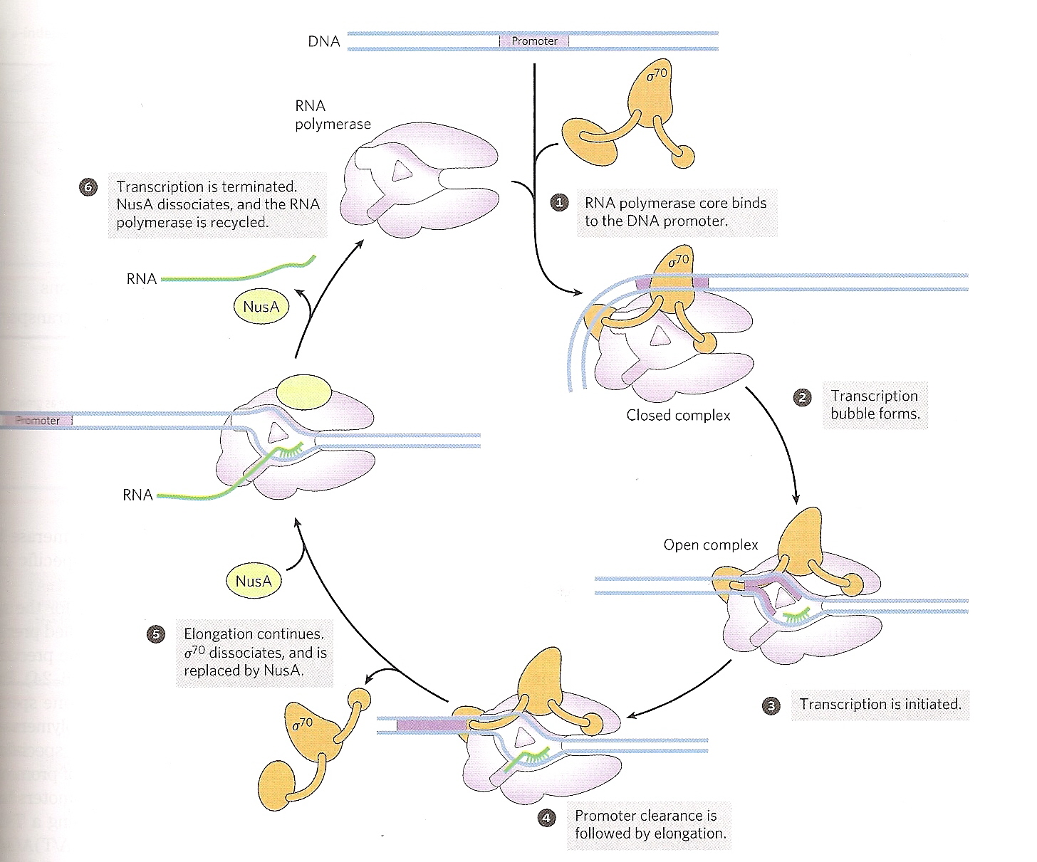
Structure of E. coli RNAP and Mode of Action
See? The sense strand going over the surface of the protein

Slide 13
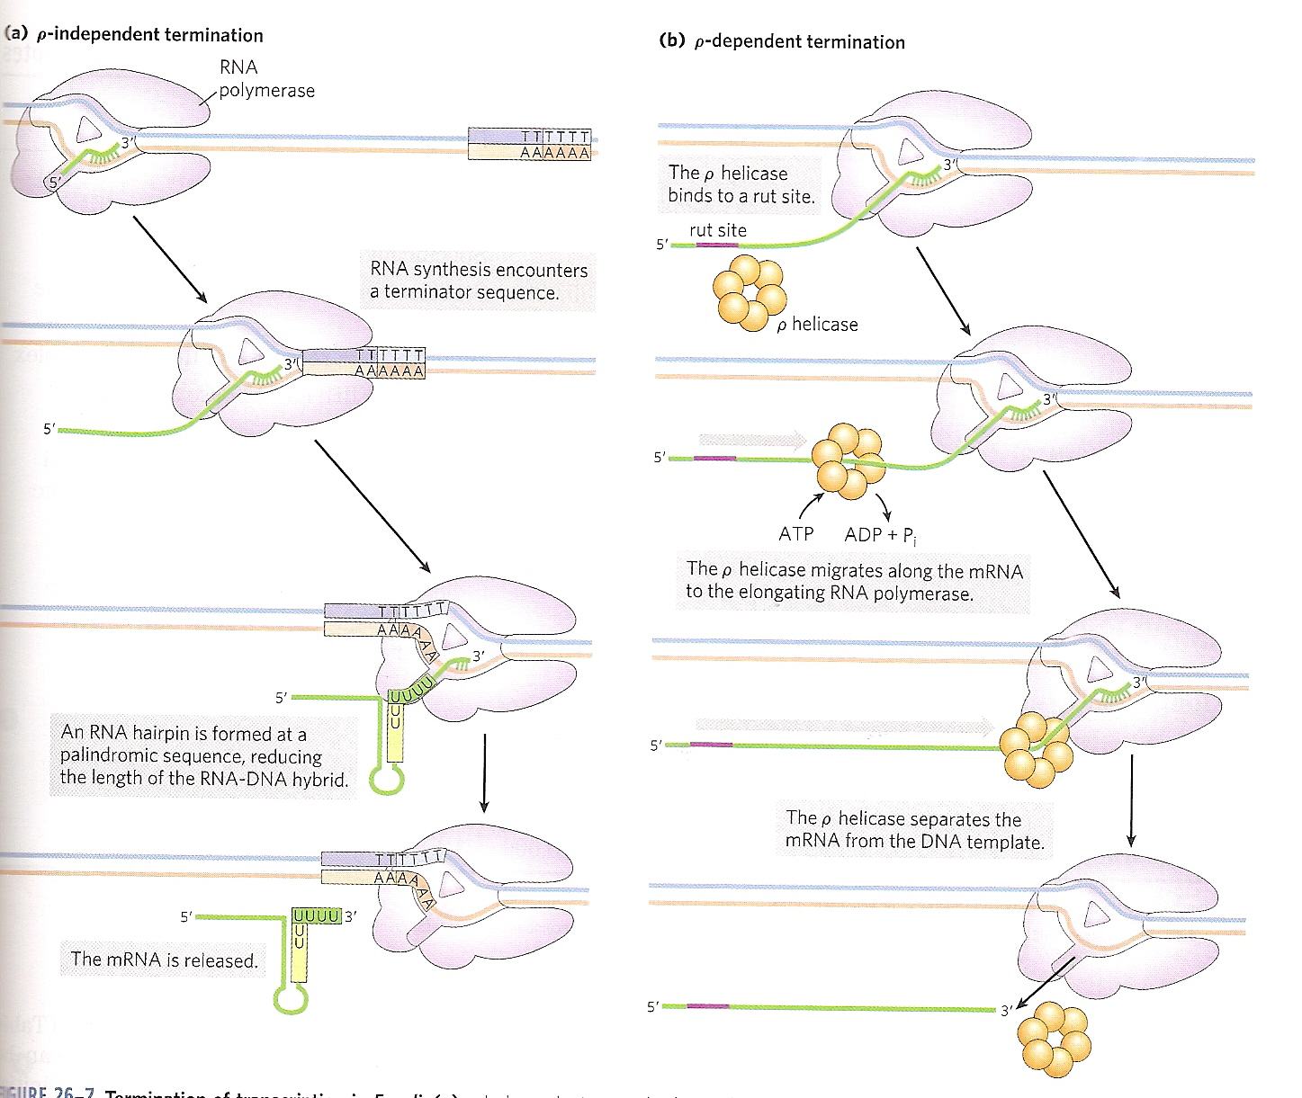
Termination of Transcription
Two methods: Rho independent and Rho-dependent

Slide 14
A Hairpin Structure at the 3’ End of an E. coli mRNA Transcript
Notes:
FIGURE 4.31 Base sequence of the 3’ end of an mRNA transcript in E. coli. A stable hairpin structure is followed by a sequence of uridine (U) residues.

Slide 15
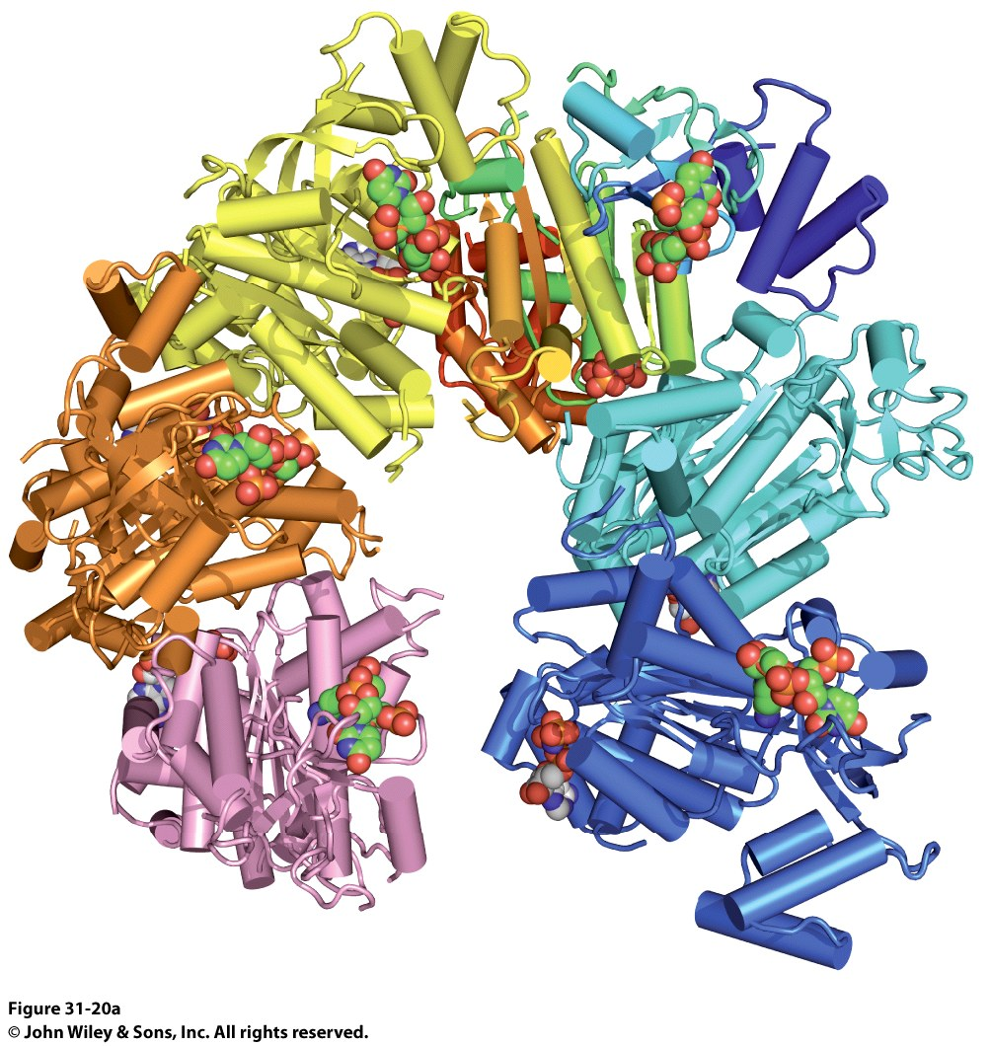
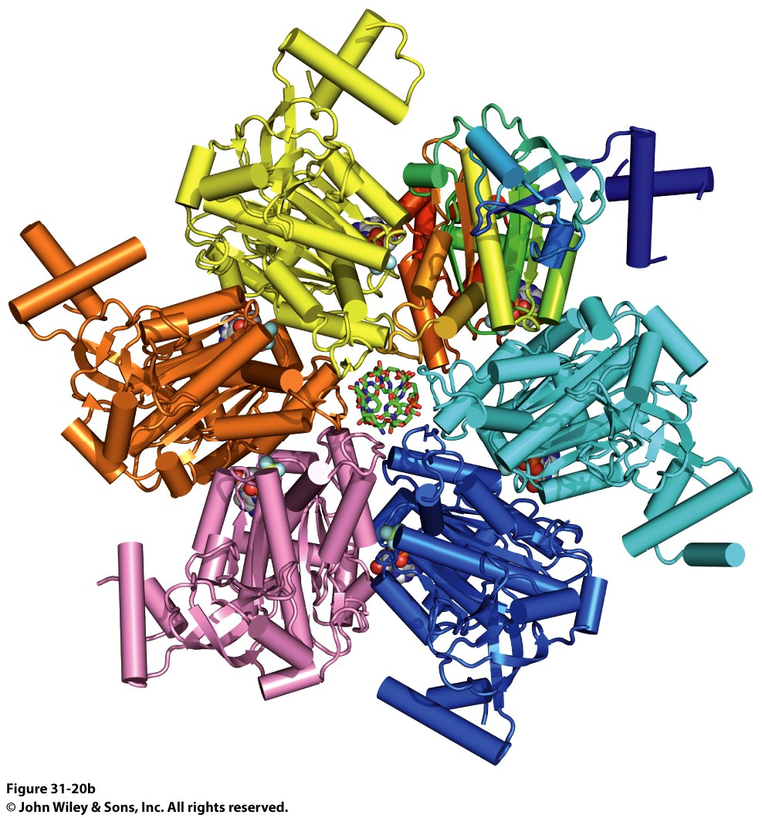
Rho-Dependent Termination of Transcription
The Rho protein is a helicase that loads onto DNA at specific sites (Rho Utilization Sites, RUT)

