Slide 1
Overall Requirements of DNA Replication
Forms of DNA Helices
All the background experiments helped give a set of rules for DNA replication
DNA replication is semi-conservative
DNA replication begins and proceeds Bidirectionally
DNA synthesis proceeds in a 5’→3’ direction and is semidiscontinuous
If replication is bidirectional (see #2) and always happens in a 5’→3’ direction, how is this possible?
One strand is synthesized in short pieces called Okazaki fragments
Leading strand: Continuous 5’→3’ synthesis
Lagging strand: Opposite direction of replication fork, where Okazaki fragments are found
4) DNA is synthesized by DNA polymerases

Slide 2
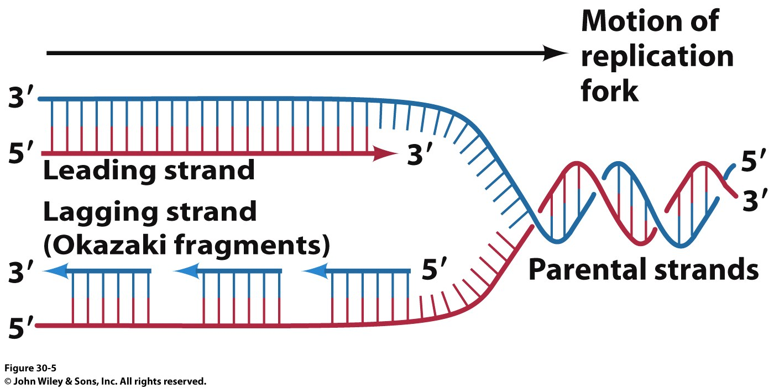
Semi-discontinuous Replication
Forms of DNA Helices
DNA’s 2 strands are replicated at the same time
DNA Polymerase synthesizes DNA in the
5’ → 3’ direction
5’
3’
5’
So how does the other strand elongate?
The ‘Lagging Strand’ is synthesized as small fragments (1000 – 2000 nuclotides in bacteria or 100-200 nt in eukaryotes) called Okazaki fragments.
Okazaki fragments are combined by a DNA Ligase after the RNA primers are cut out by the 5’-3’ exonuclease activity of DNA PolI

Slide 3
Adding Bases to the Growing Strand
Forms of DNA Helices
Same general chemistry for all polymerases
DNA Pol I

Slide 4
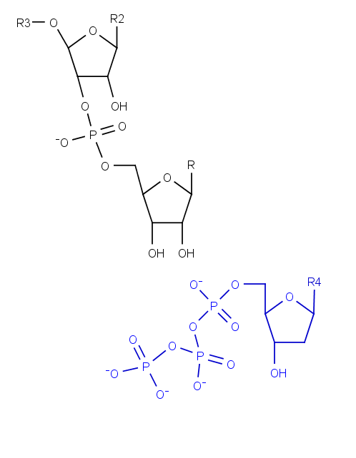
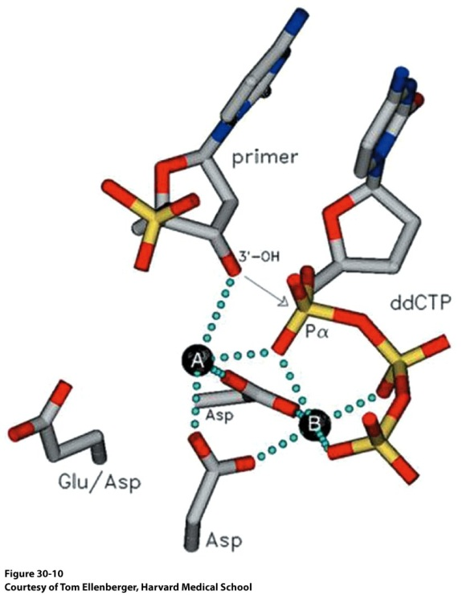
Adding Bases to the Growing Strand
Forms of DNA Helices
How will a dNTP be added to the existing chain?
How might the reaction be activated?
Metal ions! (A and B below)

Slide 5
Requirement for Priming
Forms of DNA Helices
This model of DNA replication requires a 3’ OH for strand elongation
5’
3’
5’
Analysis of Okazaki fragments indicated that the 5’ end was always composed of RNA 1→60 nucleotides in length
These will have to be replaced at some point
Nucleophile

Slide 6
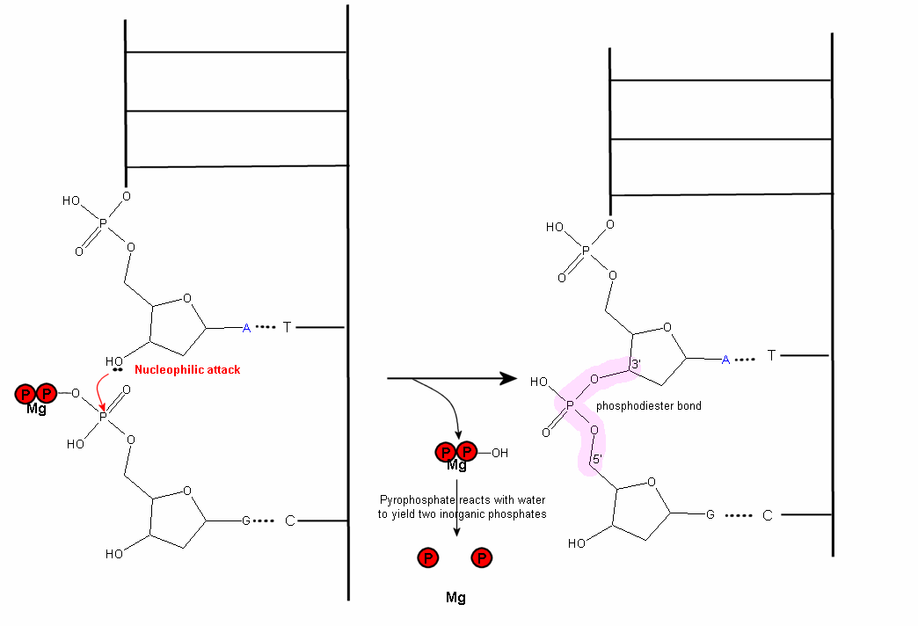
Polymerization Reaction
Forms of DNA Helices
http://wiki.cstl.semo.edu/agathman/GetFile.aspx?File=DNA%20polymerase/nucleophilic.gif

Slide 7
Strand Elongation is Driven by Pyrophosphate Hydrolysis
Notes:
FIGURE 4.25 Strand-elongation reaction. DNA polymerases catalyze the formation of a phosphodiester bridge. [Source: J. L. Tymoczko, J. Berg, and L. Stryer, Biochemistry: A Short Course, 2nd ed. (W. H. Freeman and Company, 2013), Fig. 34.2.]

Slide 8
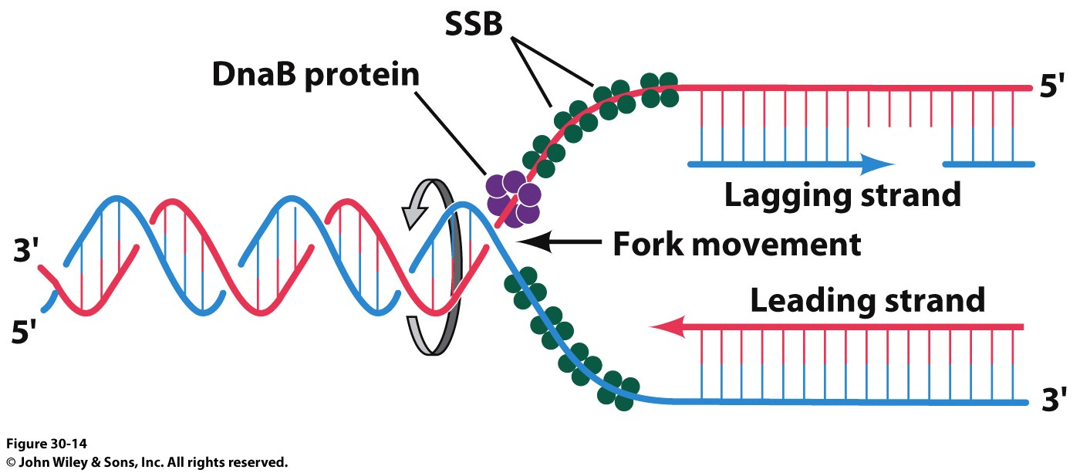
Formation of the Replication Fork
Forms of DNA Helices
DNA Gyrase (Topoisomerase II)
Crucial to deal with the supercoiling and twisting that the strands would do as they are unwound

Slide 9
Formation of the Replisome
Forms of DNA Helices

Slide 10
DNA Replication
DNA Replication is a very complex process
Must unwind helix and energy is normally required (pyrophosphatase driven)
ssDNA tends to form intra-strand base pairs that can halt the process (cruciform structures)
A single enzyme can realistically only catalyze a limited number of different types of reactions (replication complexes are typically among the most complex enzymatic associations that exist in any organism)
Safeguards have evolved to recognize and prevent errors and to repair most of those that do occur
Circularity in prokaryotes and largely linear molecules in eukaryotes in concert with the great size of the genomes of many organisms add physical constraints to replication systems
No particular mode of replication is suitable for all organisms (or viruses)
Replication is always, invariably a double-stranded event

Slide 11
What do we need in a DNA Polymerase?
Forms of DNA Helices
DNA Polymerases require a template
Template DNA binding site
Single Strand or Double Strand?
DNA Polymerases require an existing 3’-OH to join NTPs
Must have room for growing dsDNA
dNTP binding site
Mechanism to differentiate between the 4 possible dNTPs
Processivity vs Fidelity (Speed vs. Accuracy)
Self Correcting?
Viral Polymerase vs. Human Polymerase

Slide 12
What do we need in a DNA Polymerase?
Forms of DNA Helices
With respect to the template and 3’-OH requirement:
DNA Polymerases cannot simply start making new DNA strands! Why is this important?
ii) RNA polymerases don’t have the 3’-OH requirement, so they make the RNA primers that DNA Polymerases build upon
RNA Polymerases don’t have as much fidelity but it can start with just template and some nucleotides
DNA Polymerase HAS Fidelity AND Processivity
The polymerase binds to the template strand, adds nucleotides to the growing strand and proceeds
Faster polymerase have higher rates of Processivity or they add more nucleotides before they dissociate from the template strand (yes, they just fall off!)
Given the importance of DNA to the organism, it isn’t surprising that DNA polymerases must have fidelity
Your average DNA Polymerase makes a mistake every 1,000-10,000 bases added
The active site of a DNA Polymerase ensures that even though the wrong nucleotide might be added, it won’t fit into the active site and the growing strand swings down to a nuclease domain (in some polymerases)

Slide 13
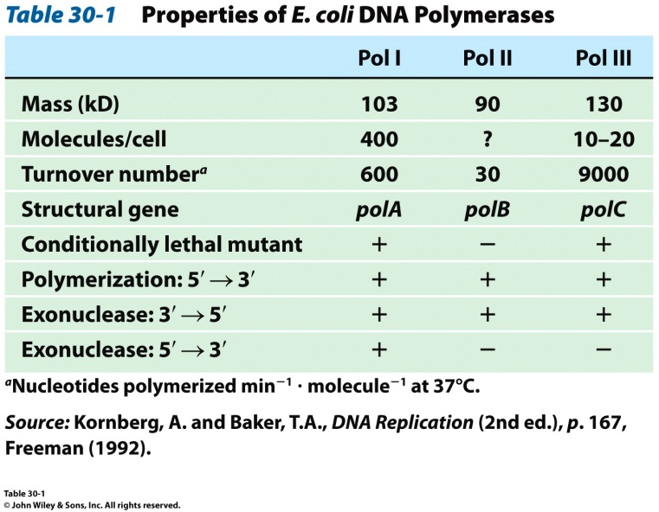
DNA Polymerases
E. coli has three major DNA polymerases
DNA Pol III is the principal replicative polymerase in E. coli. Why?

Slide 14
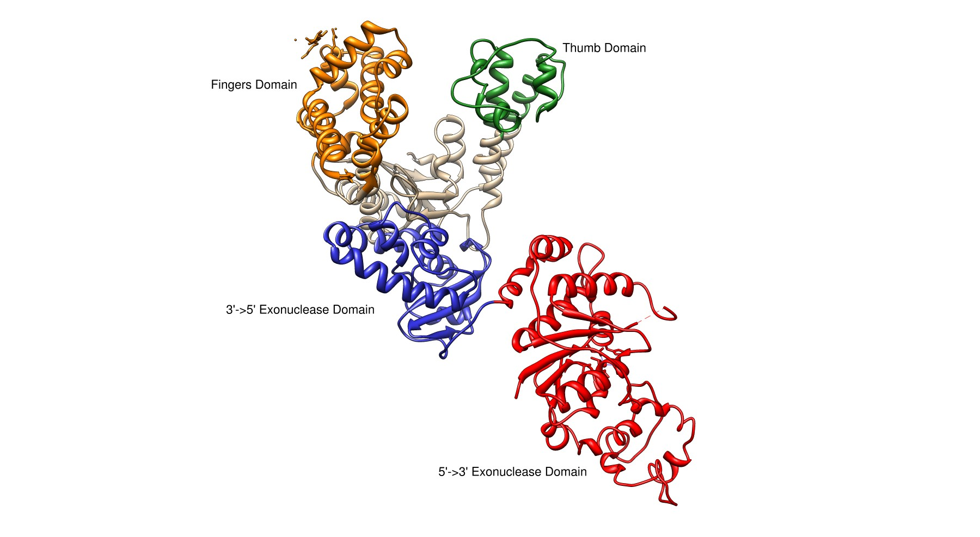
E. coli DNA Polymerase I
Forms of DNA Helices
Pol I
3’→ 5’ and 5’ → 3’ exonuclease activity
Small N-terminal domain contains the 5’→3’ exonuclease activity
Completely independent from active site or 3’ → 5 site
Thumb
Guides newly formed DNA
Responsible for processivity
Fingers
Contains dNTP binding site
Close in on dNTP/Growing Strand once successful Watson-Crick base pairing made
Palm Domain
~22 Å x 30 Å
Ideal shape to bind B-DNA
Lined with basic amino acids

Slide 15
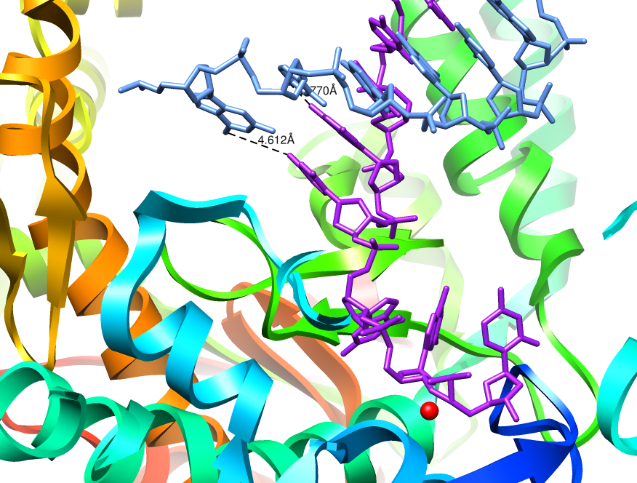
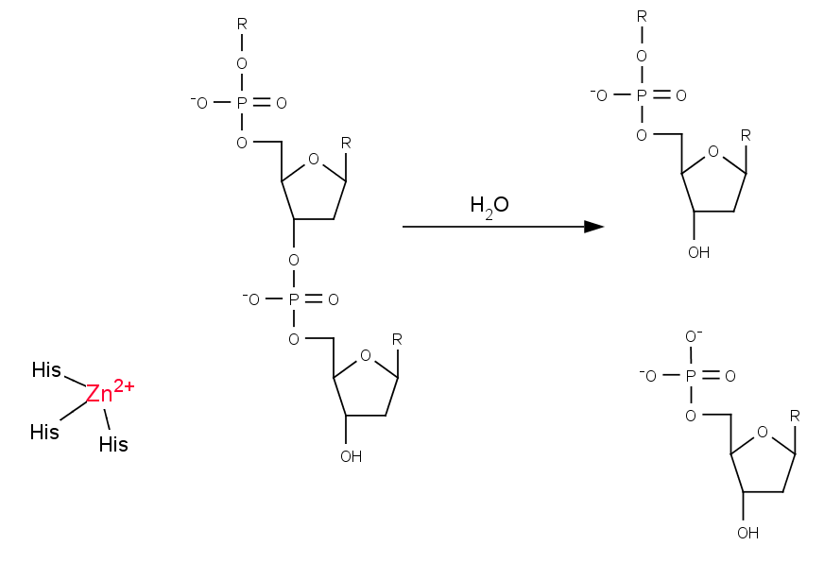
3’ → 5’ Exonuclease
Forms of DNA Helices
The structure of E. coli Pol I has been solved with DNA bound in the 3’→5’ exonuclease active site
Growing strand peels away from active site
The base pair closest to the polymerization active site is significantly weakened
Exonuclease site (Zn²⁺ activated mechanism)
Which bond will be cleaved?
NEED 3’-hydroxyl for elongation

Slide 16
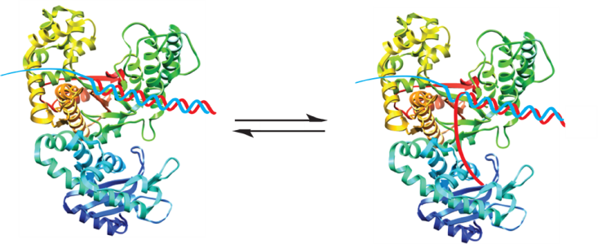
Model for Proofreading in DNA Polymerases
Forms of DNA Helices
dNTPs are in rapid equilibrium at active site
When reaction occurs, proper base pair will form a strong tight bonding pair
When an error occurs, the base pair is not as tight, resulting in increased favorability for the growing chain to be positioned at the 3’→5’ exonuclease site

Slide 17
Model for Proofreading in DNA Polymerases
Forms of DNA Helices
Incorrect pairing causes a clash and the chains separate. The growing chain swings out and into the exonuclease site

Slide 18
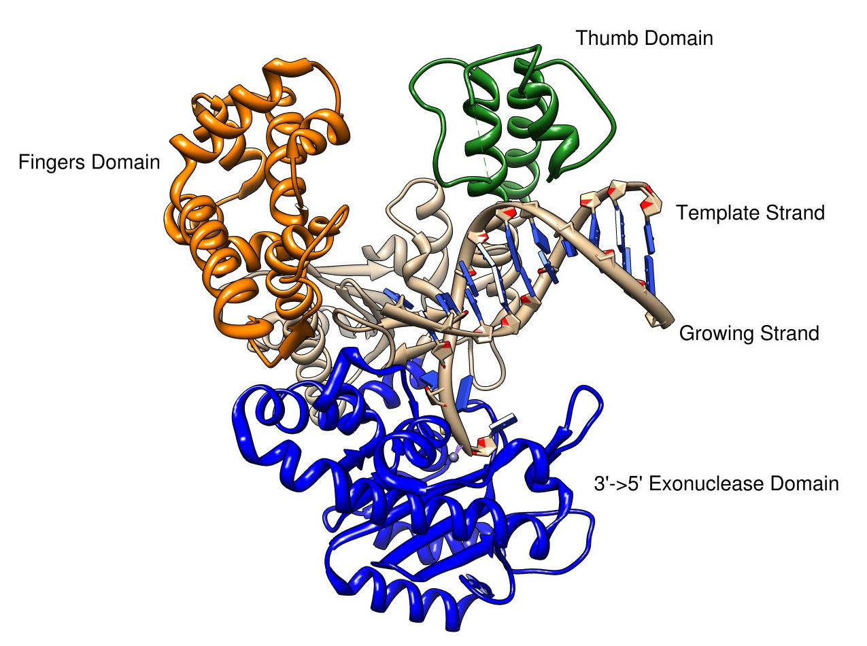
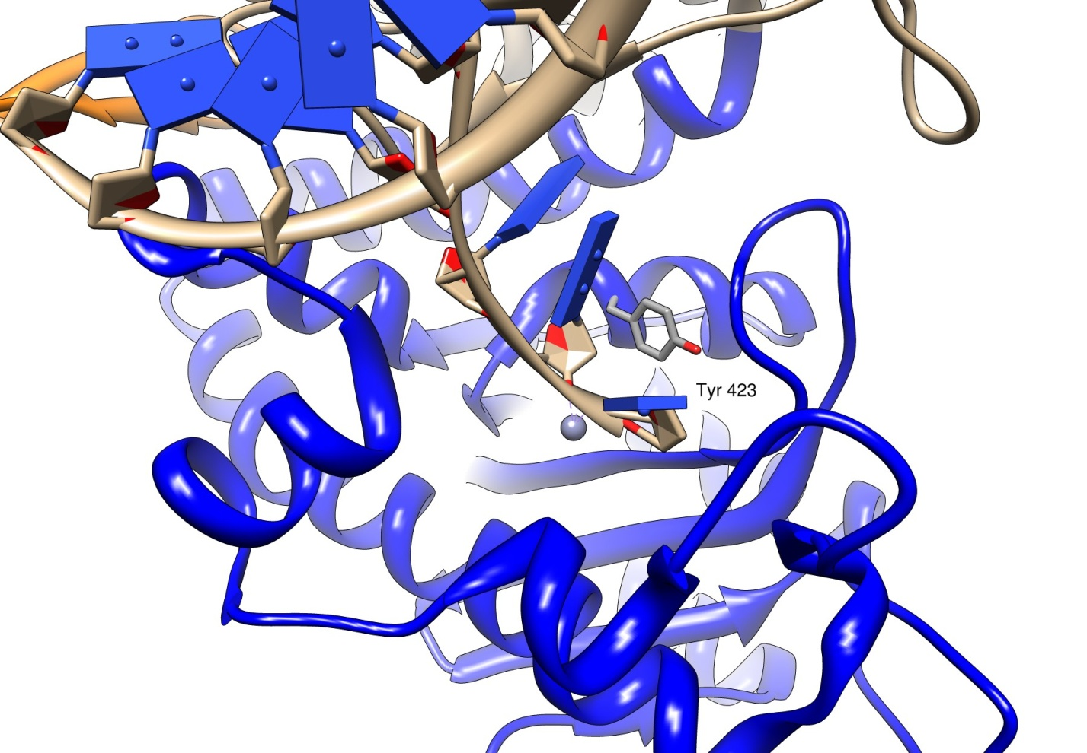
3’->5’ Exonuclease Mechanism
Forms of DNA Helices
The structure of E. coli Pol I has been solved with DNA bound in the 3’→5’ exonuclease site
Growing strand peels away from active site
Tyr 423 activates a water molecule which then serves as a nucleophile to begin the cleavage of the base from the strand

Slide 19
3’->5’ Exonuclease Mechanism
Forms of DNA Helices
Tyr 423 activates a water molecule which then serves as a nucleophile to begin the cleavage of the base from the strand
Freemont et al. (1988). Cocrystal structure of an editing complex of Klenow fragment with DNA. PNAS 85: 8924-8928.

Slide 20
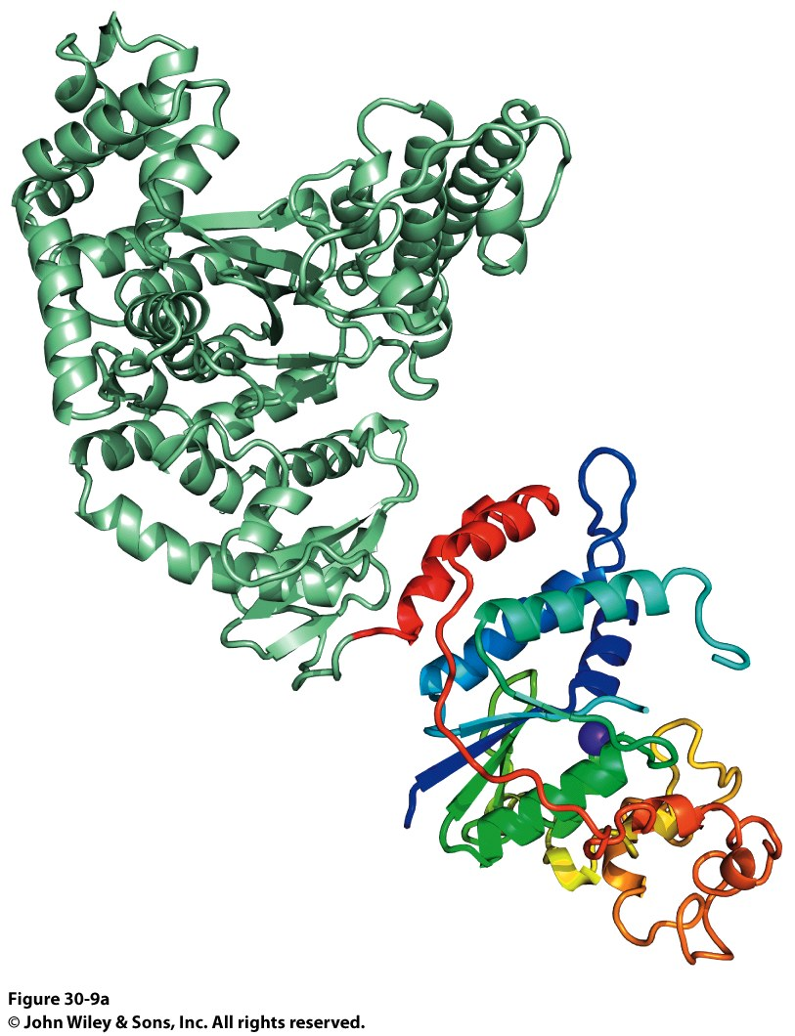
Taq DNA Polymerase
Forms of DNA Helices
Two domains were identified:
Polymerase Domain
5’→3’ Exonuclease Domain
N-terminal domain contains 5’ → 3’ exonuclease
C-terminal domain contains polymerase activity

Slide 21
Taq DNA Polymerase
Forms of DNA Helices
Notice the same Finger and Thumb domains as E. coli DNA PolI
Same function, same domains
Evidence of evolutionary conservation of function
Taq DNA Pol has no 3’->5’ exonuclease activity though…

Slide 22
E. coli and Taq DNA Polymerase Superposition
Forms of DNA Helices
Notice the same Finger and Thumb domains as E. coli DNA PolI
Same function, same domains
Evidence of evolutionary conservation of function
Taq DNA Pol has no 3’->5’ exonuclease activity though…

Slide 23
DNA Pol III
Forms of DNA Helices
Many subunits and protomers required for function

Slide 24
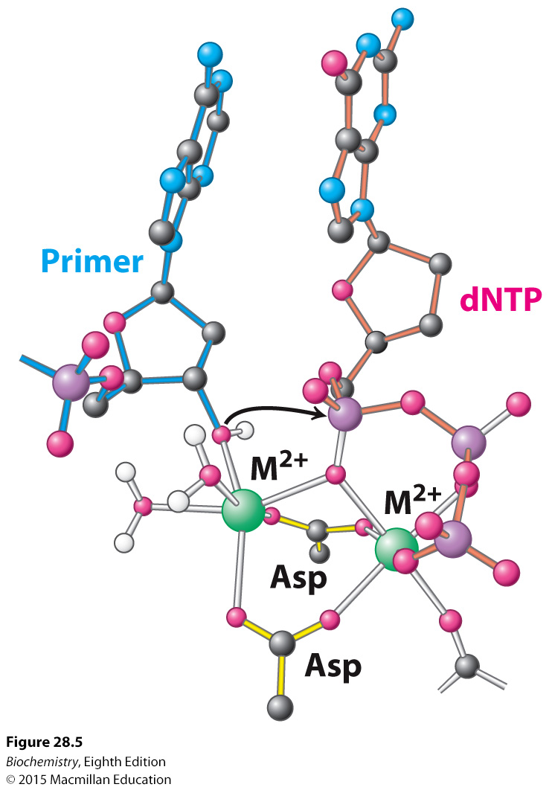
Metal Ions in Addition Reaction

Slide 25
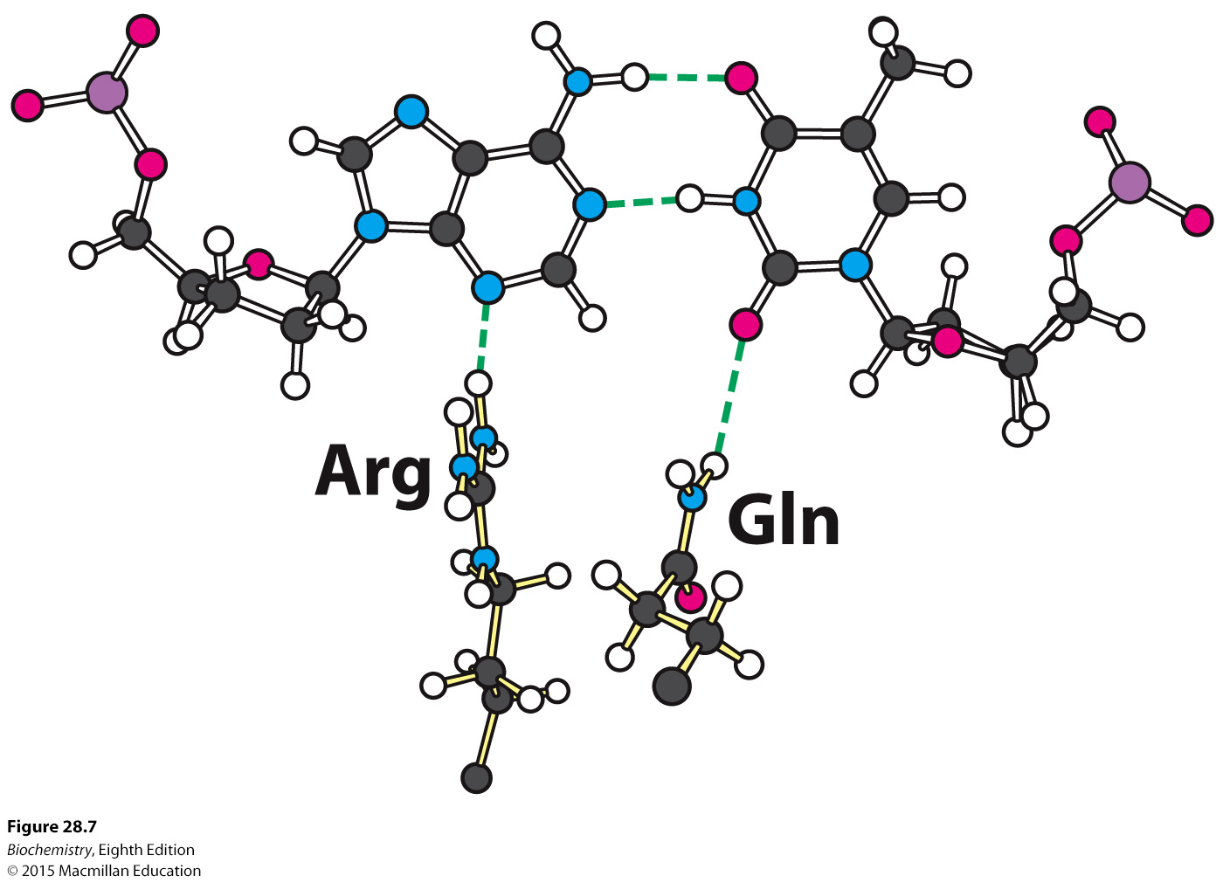
Fidelity, Minor groove hydrogen bonding

Slide 26
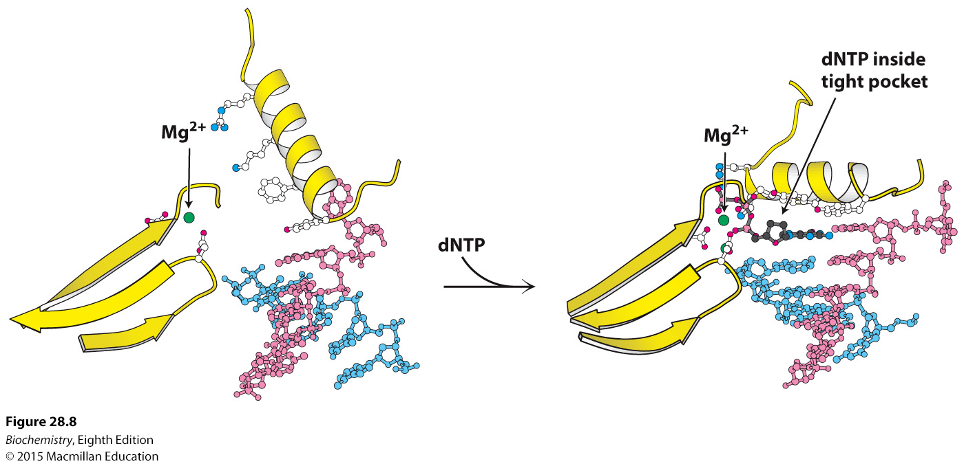
Fidelity, O-Helix

Slide 27
Fidelity, O-Helix

Slide 28
You absolutely MUST know the next slide in order to understand all subsequent slides. The next slide would make a very easy and straightforward test/final exam question All nucleic acid biosynthesis is the same chemical reaction mechanism, just different enzymatic machinery
Notes:
FIGURE 4.25 Strand-elongation reaction. DNA polymerases catalyze the formation of a phosphodiester bridge. [Source: J. L. Tymoczko, J. Berg, and L. Stryer, Biochemistry: A Short Course, 2nd ed. (W. H. Freeman and Company, 2013), Fig. 34.2.]

Slide 29
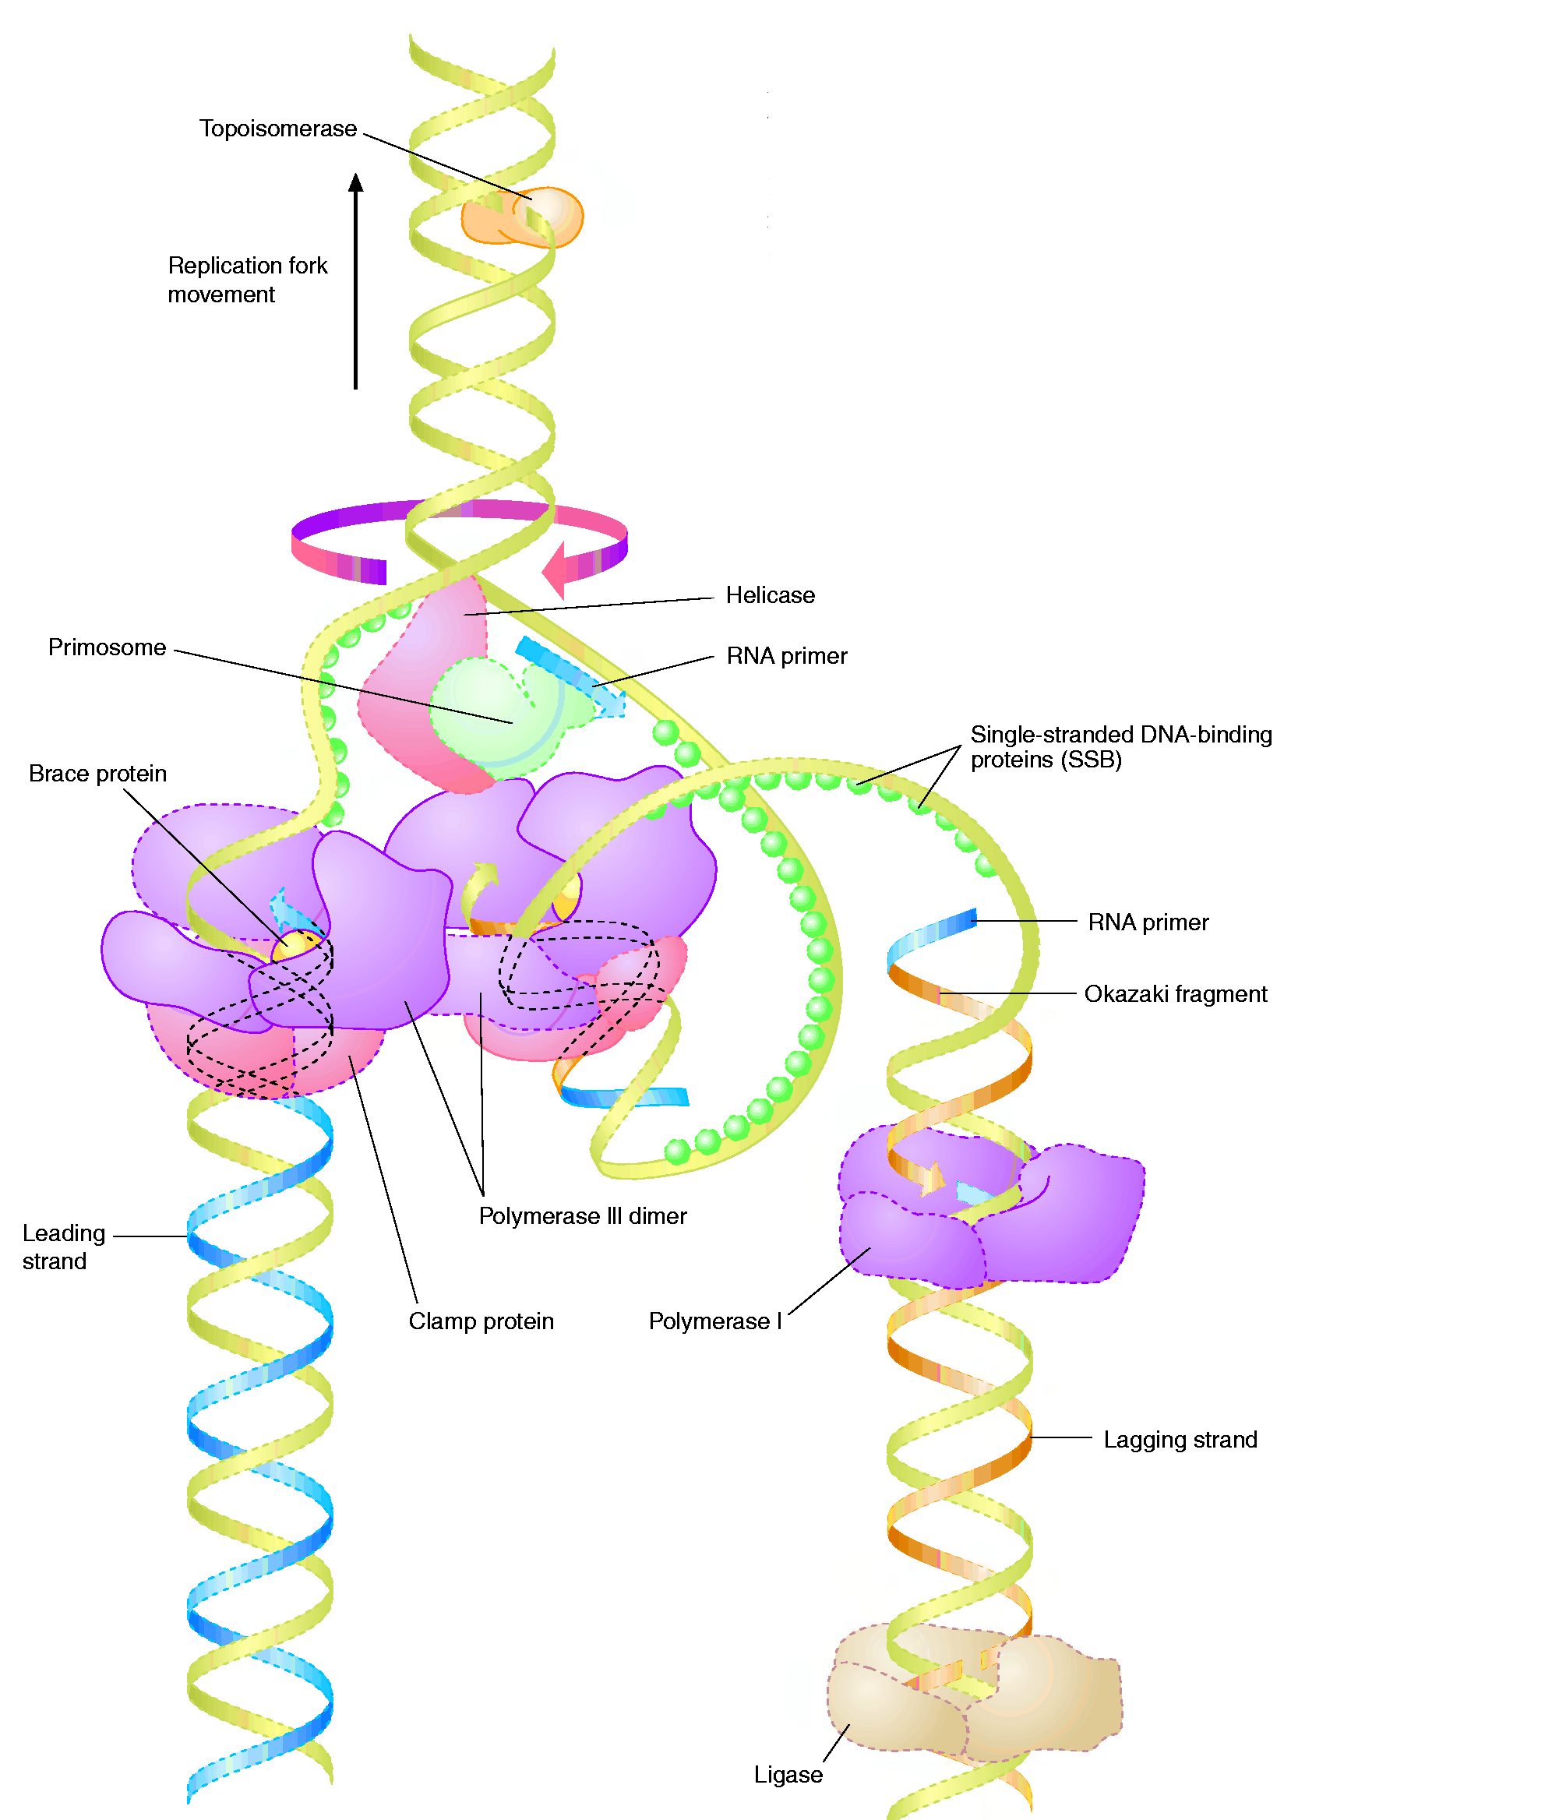
The Big Picture (in E.coli)
Forms of DNA Helices
Topoisomerase: relieves topological strain
Helicase - unwinds dsDNA at replication fork
SSB: keeps ssDNA from reannealing
Primase: synthesizes RNA primers for lagging strand
Pol III elongates lagging strand until strained. It then releases the template and rebinds at a new primed location.
DNA Polymerase III : elongate primed DNA from 5’→3’
3’→5’ exonuclease activity limits errors
Pol I: closes any gaps in lagging strand and replaces RNA primer; 5’→3’ exonuclease activity
Ligase: seals off backbone nicks

Slide 30
Formation of the Replisome
Forms of DNA Helices
It all comes down to a sequence (or a set of them!)
We call this the Origin of Replication, oriC.

Slide 31
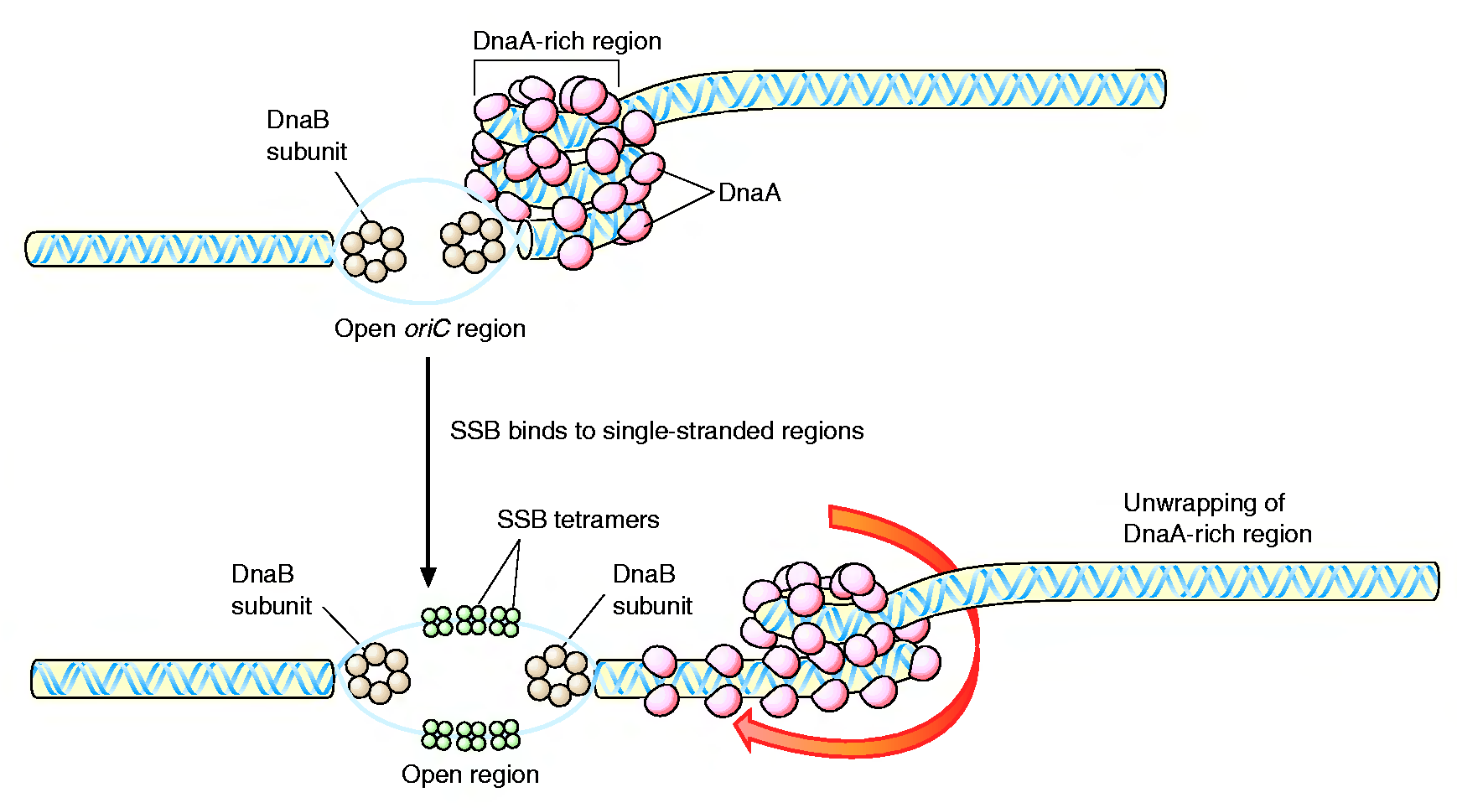
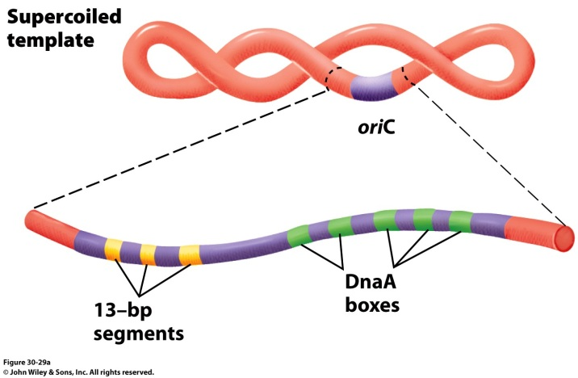
Formation of the Replication Fork
Forms of DNA Helices
4 DnaA proteins bind to the oriC region (recognizes 9 nucleotide segments)
Additional DnaA monomers bind forming a histone like complex of tightly wound DNA
Localized melting of a 13bp repeats
DnaB (6 subunit helicase) binds and unwinds the DNA
Topoisomerase functions downstream to relieve stress
Single Strand DNA binding proteins prevent the ssDNA from reannealing

Slide 32
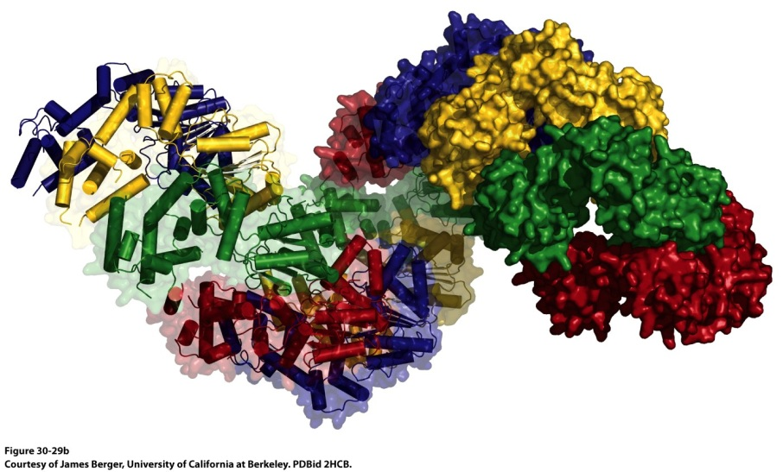
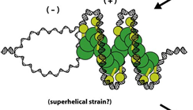
Formation of the Replication Fork
Forms of DNA Helices
178 Å
DnaA helical filament – 8 monomers per turn
ATP-bound DnaA molecules sit on 3 of the 5 DnaA boxes of the origin.
They recruit additional DnaA molecules to occupy the remaining boxes
This introduces positive supercoiling into the DNA, causing the DNA to unwind
The ATPase domain of DnaA may actively unwind DNA as a function of ATP hydrolysis
4) The oriC-DnaA complex recruits DnaB-DnaC hexamers to actively separate the DNA helix (DnaB is a helicase, DnaC is a loading protein that places DnaB onto the strand)

Slide 33
Formation of the Replication Fork
Forms of DNA Helices
DNA Gyrase (Topoisomerase II)
Crucial to deal with the supercoiling and twisting that the strands would do as they are unwound

Slide 34
Formation of the Replisome
Forms of DNA Helices

Slide 35
We’re loaded and primed, let’s replicate!
Forms of DNA Helices

Slide 36
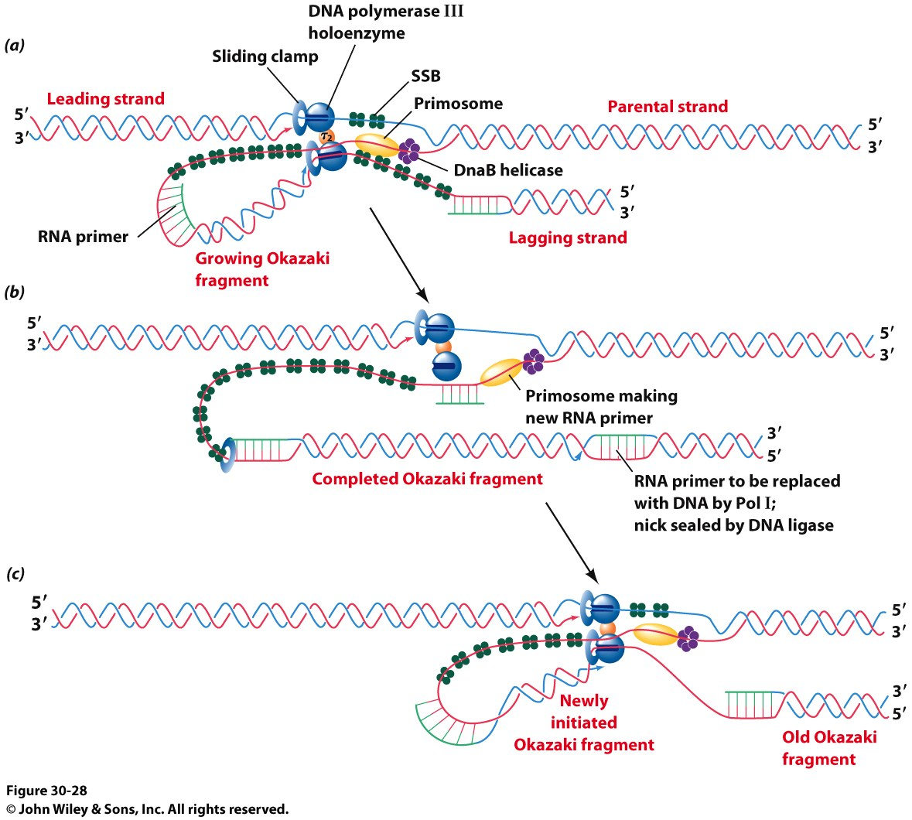
We’re loaded and primed, let’s replicate!
Forms of DNA Helices
Another look…

Slide 37
Sealing the Nicks in the Lagging Strand
Forms of DNA Helices
Reaction Catalyzed by DNA ligase

Slide 38
Finishing the Job: Termination
Forms of DNA Helices
The Ter sequences serve as binding sites for the Terminus Utilization Substance (Tus)
A Tus/Ter complex halts a polymerase in its tracks and replication stops.
No, we don’t really know how the Ter sequences are replicated!
It is assumed that some DNA polymerase finishes the job and seals the DNA strands after they split.

Slide 39
Trombone Model of DNA Replication by DNA PolIII
https://www.youtube.com/watch?v=I9ArIJWYZHI

