Slide 1
Chapter 14: Biosignaling
How does the cell recognize and respond to the environment around it?
To answer this, we need to understand Signal Transduction: The conversion of information into a chemical signal that can elicit an effect.
We will use all of the vocabulary, chemical principles and concepts we have covered to date to help us understand.

Slide 2
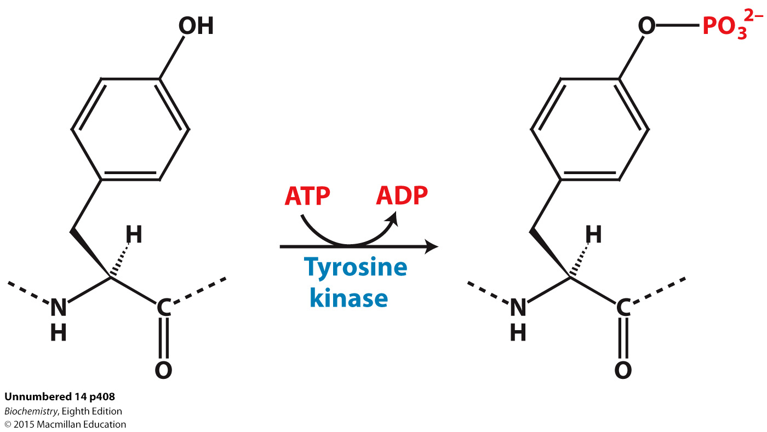
Some growth factors and hormones, such as insulin, bind to receptors that are tyrosine kinases, called receptor tyrosine kinases (RTK). Upon growth factor or hormone binding, some of these receptors form dimers. The insulin receptor exists as a dimer even in the absence of insulin.
The insulin receptor hormone binding site is composed of two α subunits that are outside the cell while the kinase activity resides in two β subunits inside the cell.

Slide 3
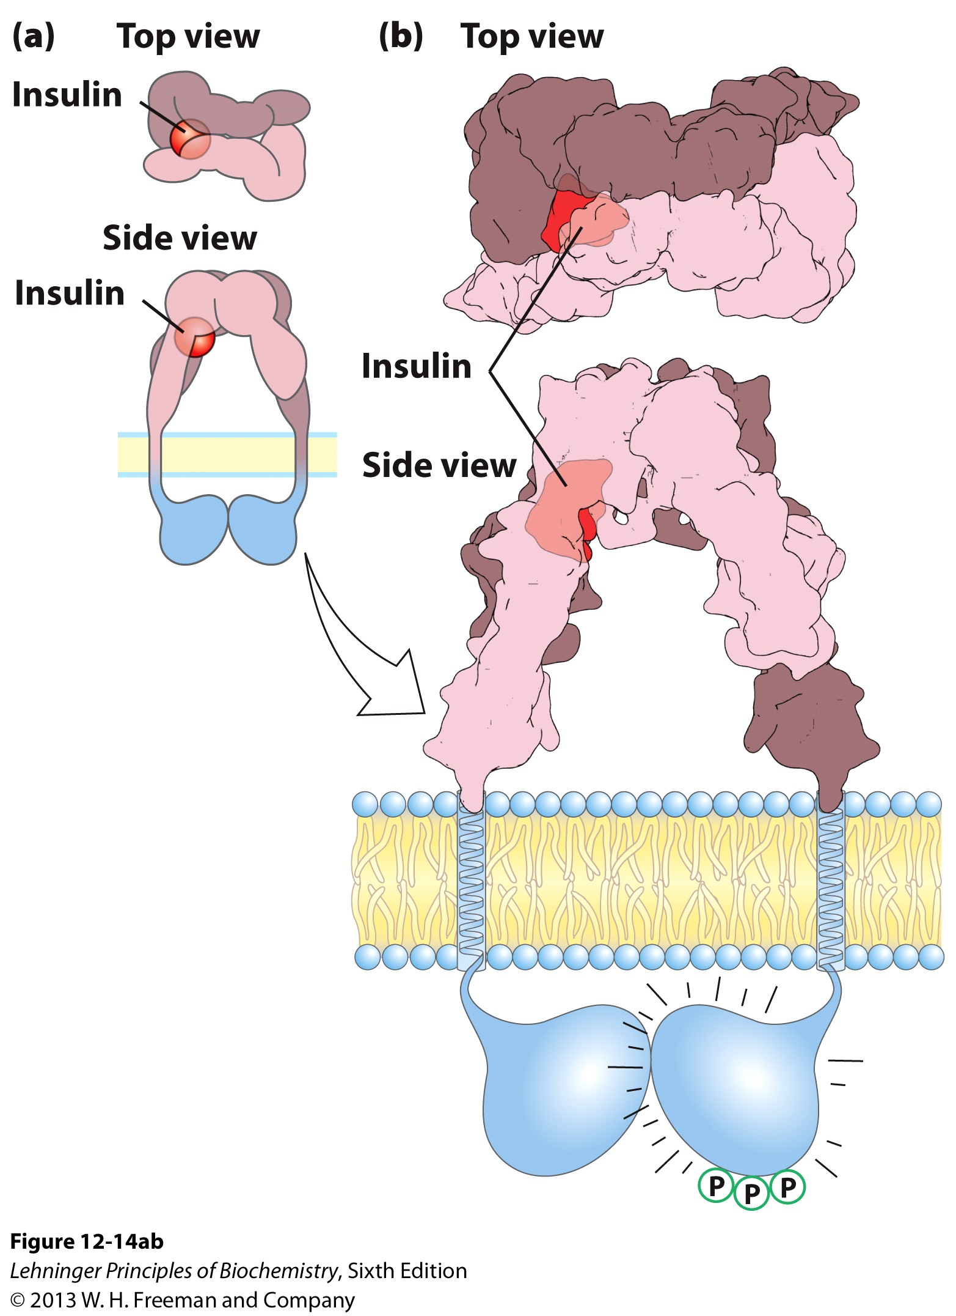
Receptor Tyrosine Kinases
Large family of Proteins
Fundamentally different from GPCRs b/c they not only _____ on the _____ side, but also possess a _______ domain on the ________ side that ___________ in target proteins
Large family of Proteins
Fundamentally different from GPCRs b/c they not only Bind Ligands on the Extracellular side, but also possess a Kinase domain on the Cytosolic side that phosphorylates tyrosines in target proteins
α-subunit
Insulin binding domain
β-subunit
Transmembrane helix and kinase domain

Slide 4
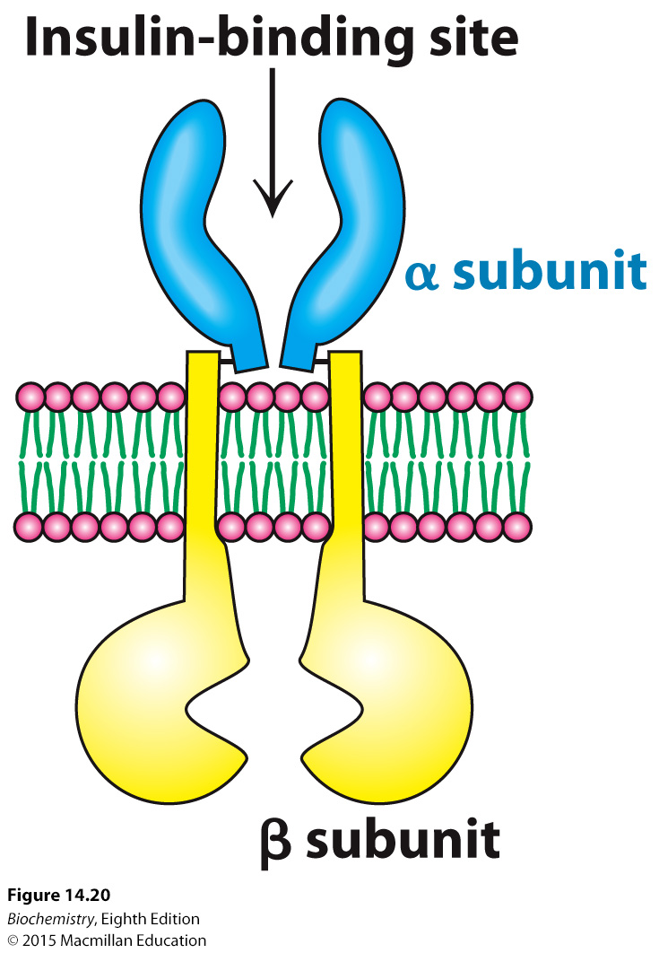
The extracellular alpha subunit is joined to the transmembrane beta-subunit by a single disulfide bond
Notes:
FIGURE 14.20 The insulin receptor. The receptor consists of two units, each of which consists of an α subunit and a β subunit linked by a disulfide bond. Two α subunits, which lie outside the cell, come together to form a binding site for insulin. Each β subunit lies primarily inside the cell and includes a protein kinase domain.

Slide 5
Large Negative Charge Cloud Associated with Phosphate group
The key to the function of the receptor lies in the addition of phosphates to tyrosines in a specific part of the beta-subunit of the protein, the Activation Loop
Notes:
FIGURE 14.20 The insulin receptor. The receptor consists of two units, each of which consists of an α subunit and a β subunit linked by a disulfide bond. Two α subunits, which lie outside the cell, come together to form a binding site for insulin. Each β subunit lies primarily inside the cell and includes a protein kinase domain.

Slide 6
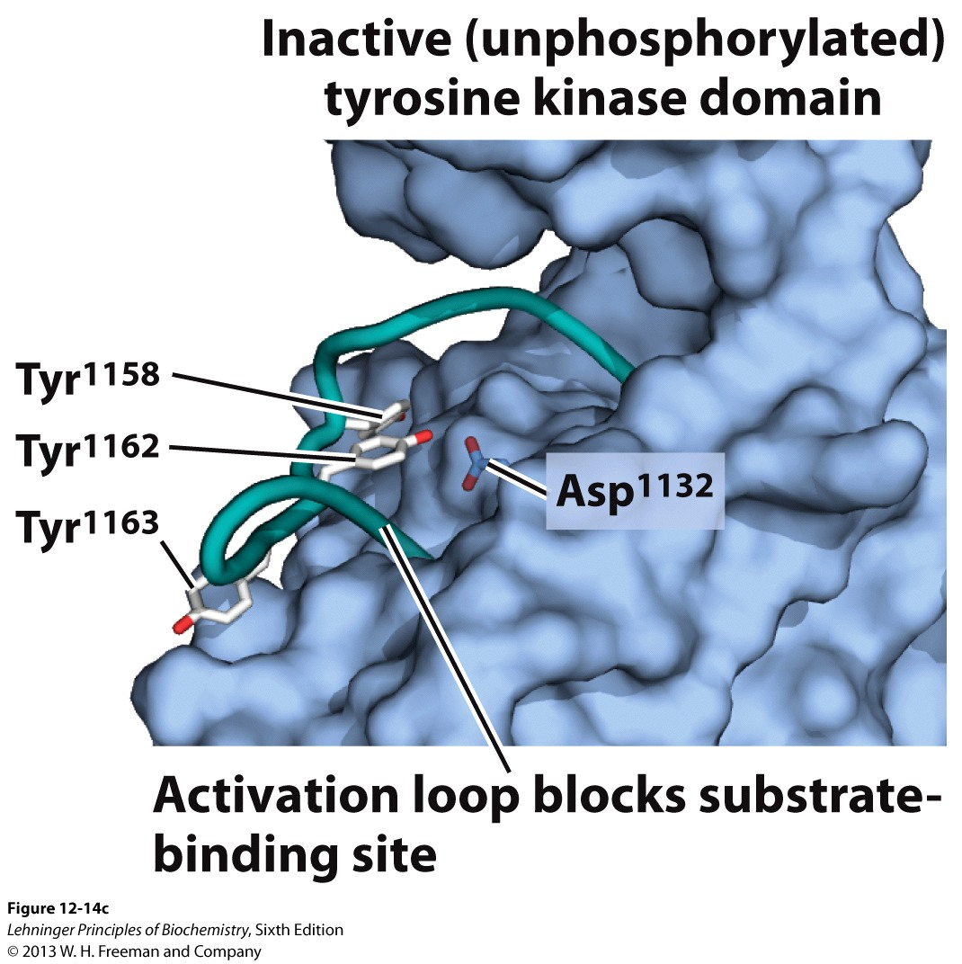
Receptor Tyrosine Kinases: How do They Work?
Example Protein: Insulin Receptor Tyrosine Kinase (INSR) (αβ heterotetramer)
1) Insulin binding to the receptor causes a conformational shift that promotes triple autophosphorylation of the other β-subunit

Slide 7
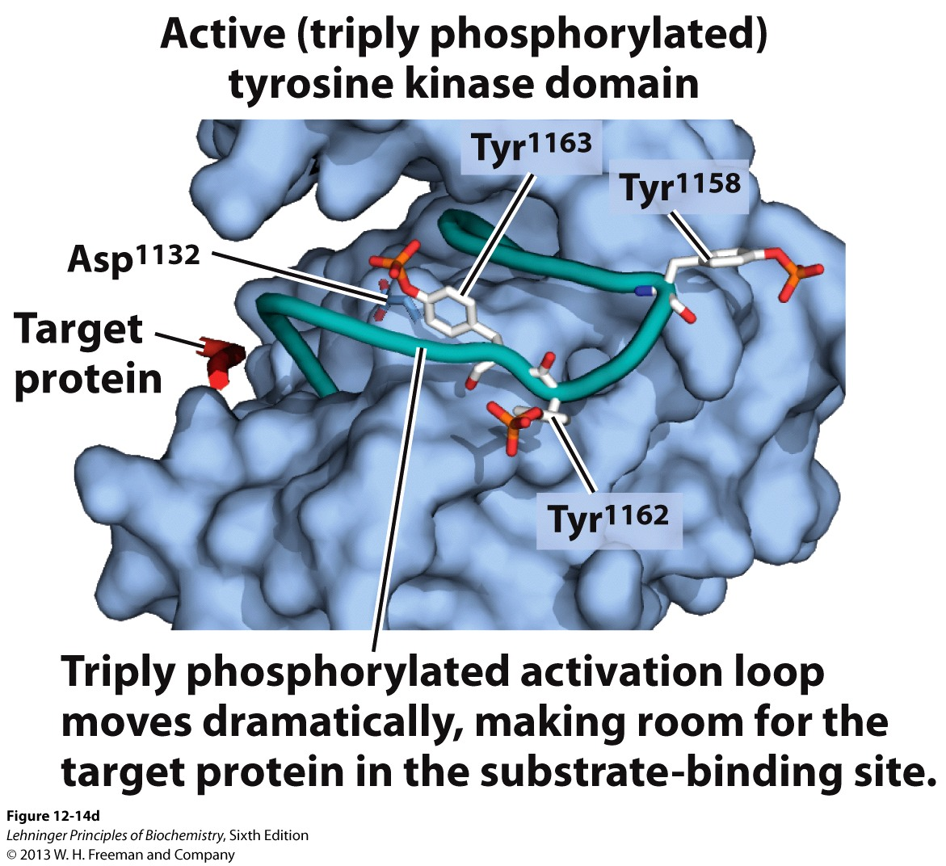
Receptor Tyrosine Kinases: How do They Work?
This Autophosphorylation triggers movement of the Activation Loop which exposes the substrate binding site of the β-subunits
Once activated, INSR binds and phosphorylates Insulin Receptor Subtrate-1 (IRS-1), which then serves as the core for a multiprotein complex

Slide 8
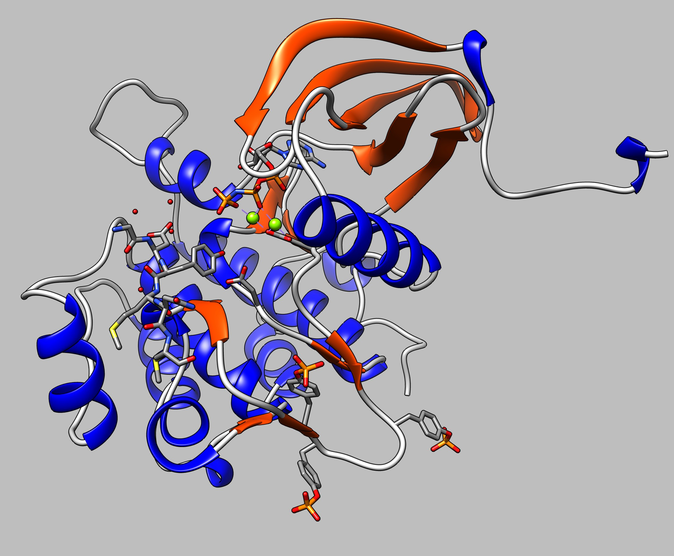
Receptor Tyrosine Kinases: How do They Work?
Activation Loop w/ Tyr1158, Tyr1162 and Tyr1163

Slide 10
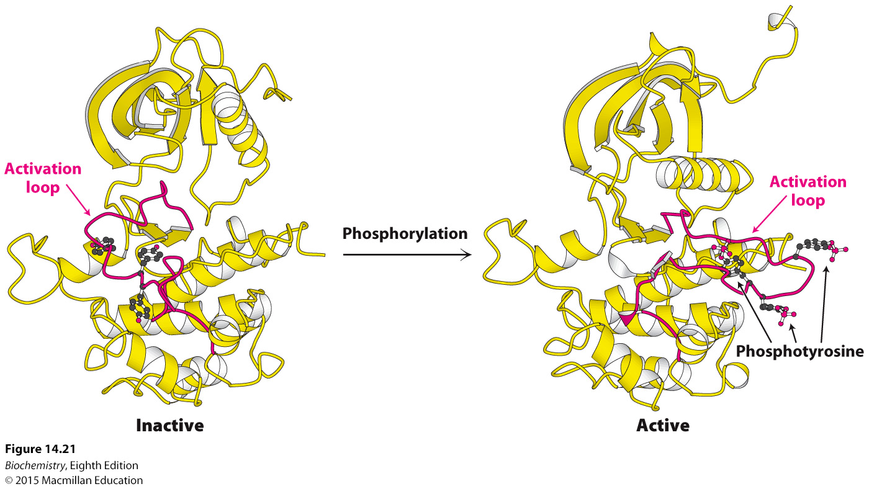
Here’s a static view of the motion of the activation loop
Notes:
FIGURE 14.21 Activation of the insulin receptor by phosphorylation. The activation loop is shown in red in this model of the protein kinase domain of the β subunit of the insulin receptor. The unphosphorylated structure on the left is not catalytically active. Notice that, when three tyrosine residues in the activation loop are phosphorylated, the activation loop swings across the structure and the kinase structure adopts a more compact conformation. This conformation is catalytically active. [Drawn from 1IRK.pdb and 1IR3.pdb.]

Slide 11
The activated kinase of the insulin receptor phosphorylates insulin-receptor substrates (IRSs), which starts a signal transduction pathway that increases glucose uptake by cells, and stimulates enzymes that convert glucose into glycogen.
The textbook describes what happens in somatic cells other than adipocytes and hepatocytes: They take in glucose
Hepatocytes and Adipocytes are different because they need to store energy, so they don’t just take in glucose, they need to upregulate the enzymes necessary to change their proteomes, not just activate GLUT transporters

Slide 12
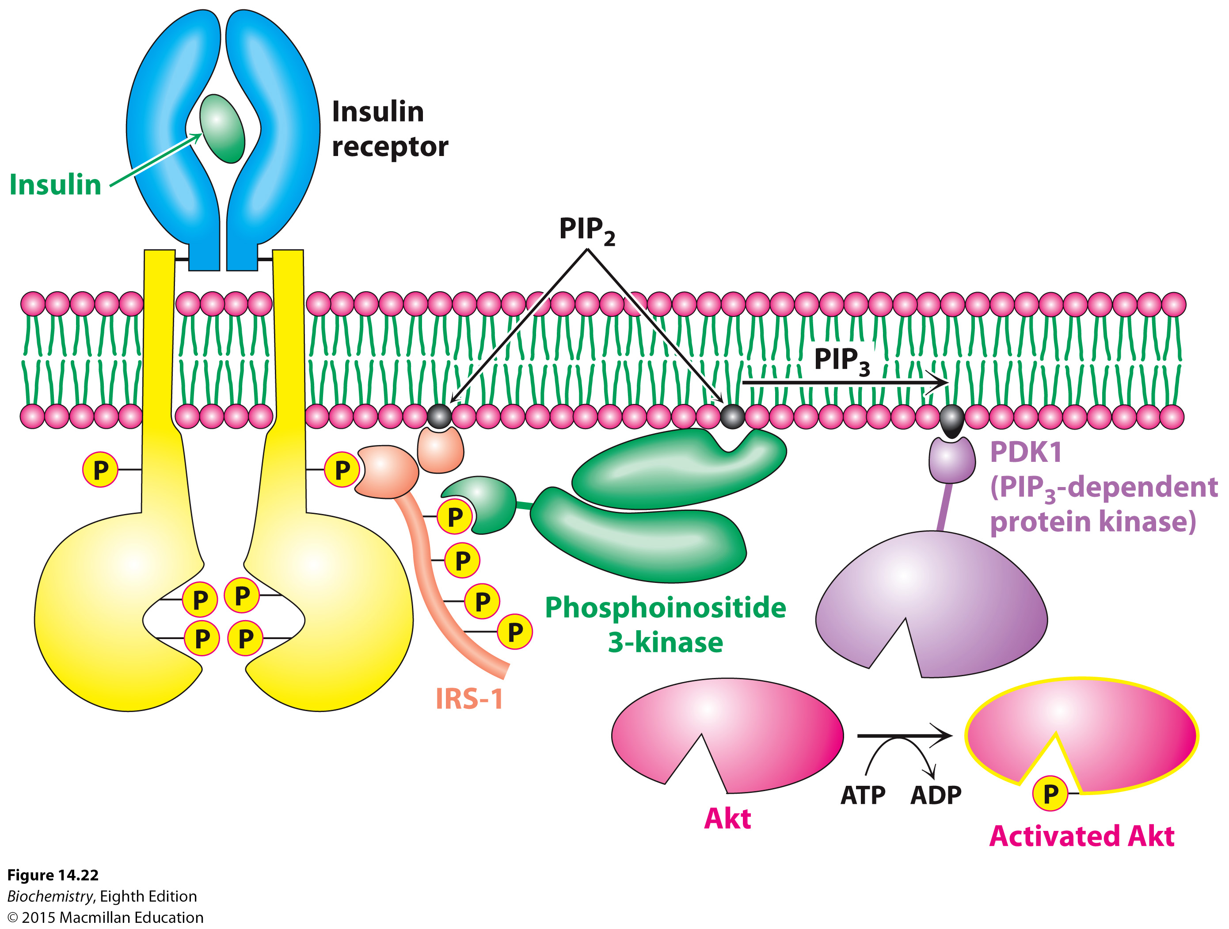
In somatic cells (other than hepatocytes and adipocytes)
Notes:
FIGURE 14.22 Insulin signaling. The binding of insulin results in the cross-phosphorylation and activation of the insulin receptor. Phosphorylated sites on the receptor act as binding sites for insulin receptor substrates such as IRS-1. The lipid kinase phosphoinositide 3-kinase binds to phosphorylated sites on IRS-1 through its regulatory domain, then converts PIP₂ into PIP₃. Binding to PIP₃ activates PIP₃-dependent protein kinase (PDK1), which phosphorylates and activates kinases such as Akt1. Activated Akt1 can then diffuse throughout the cell to continue the signal-transduction pathway.

Slide 13
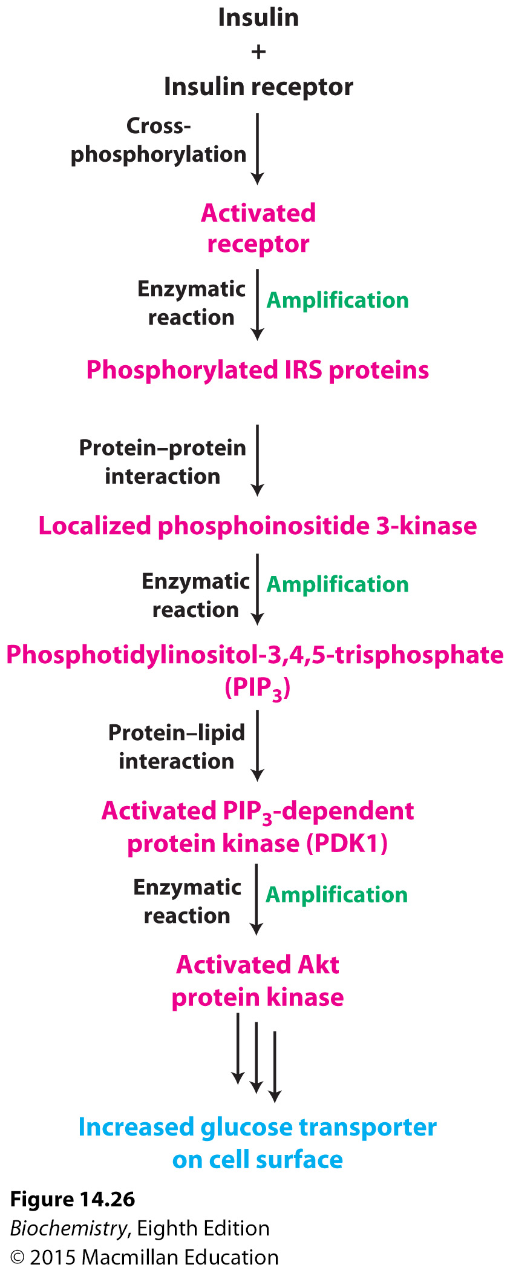
In somatic cells (other than hepatocytes and adipocytes)
Notes:
FIGURE 14.26 Insulin signaling pathway. Key steps in the signal transduction pathway initiated by the binding of insulin to the insulin receptor.

Slide 14
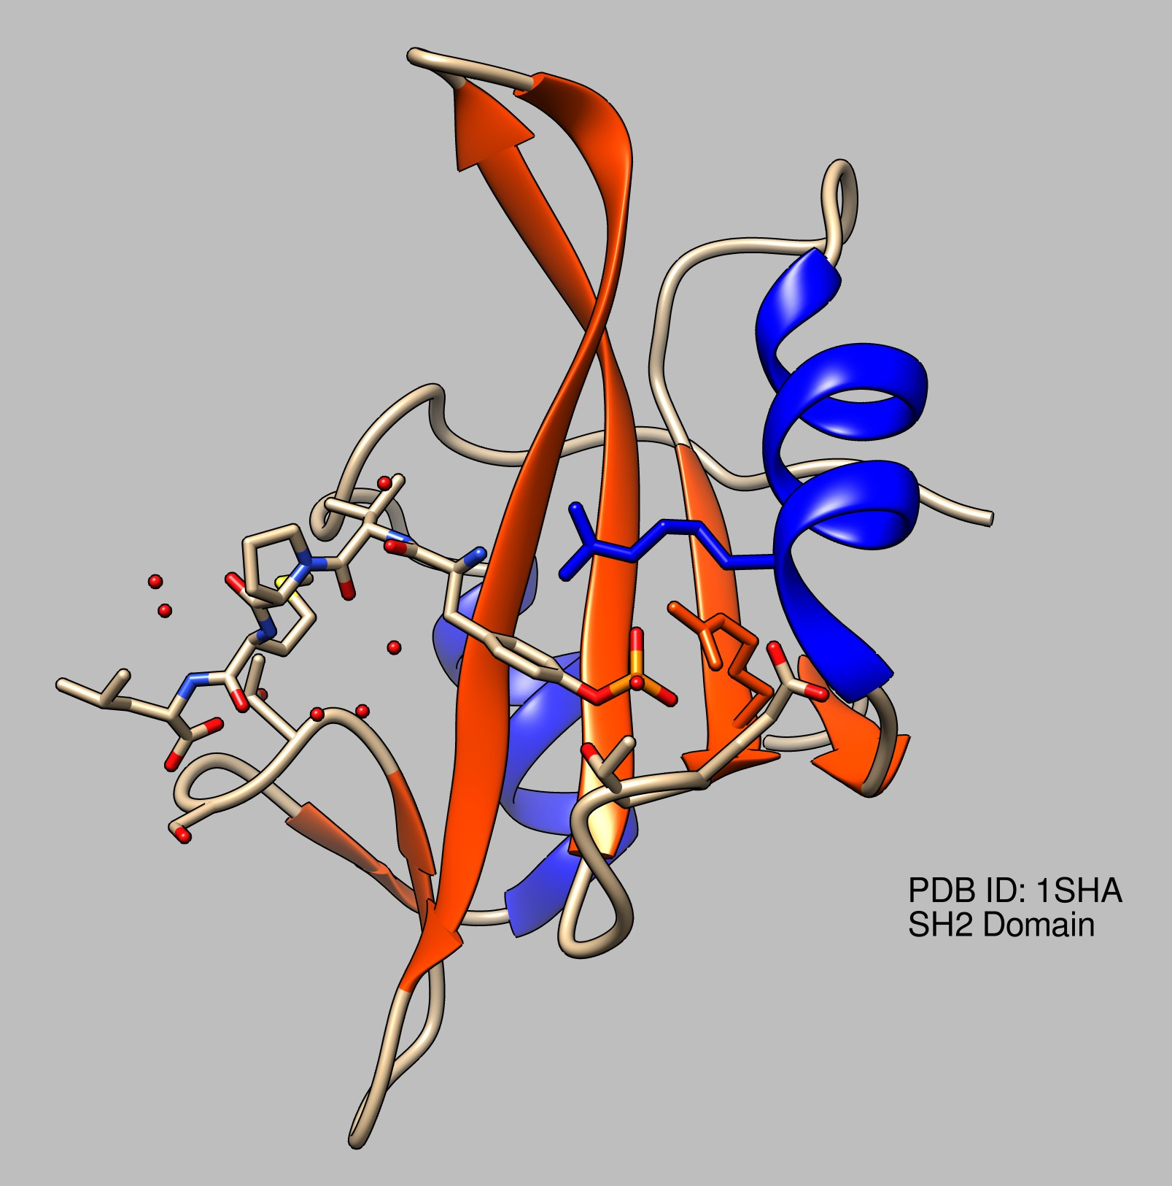
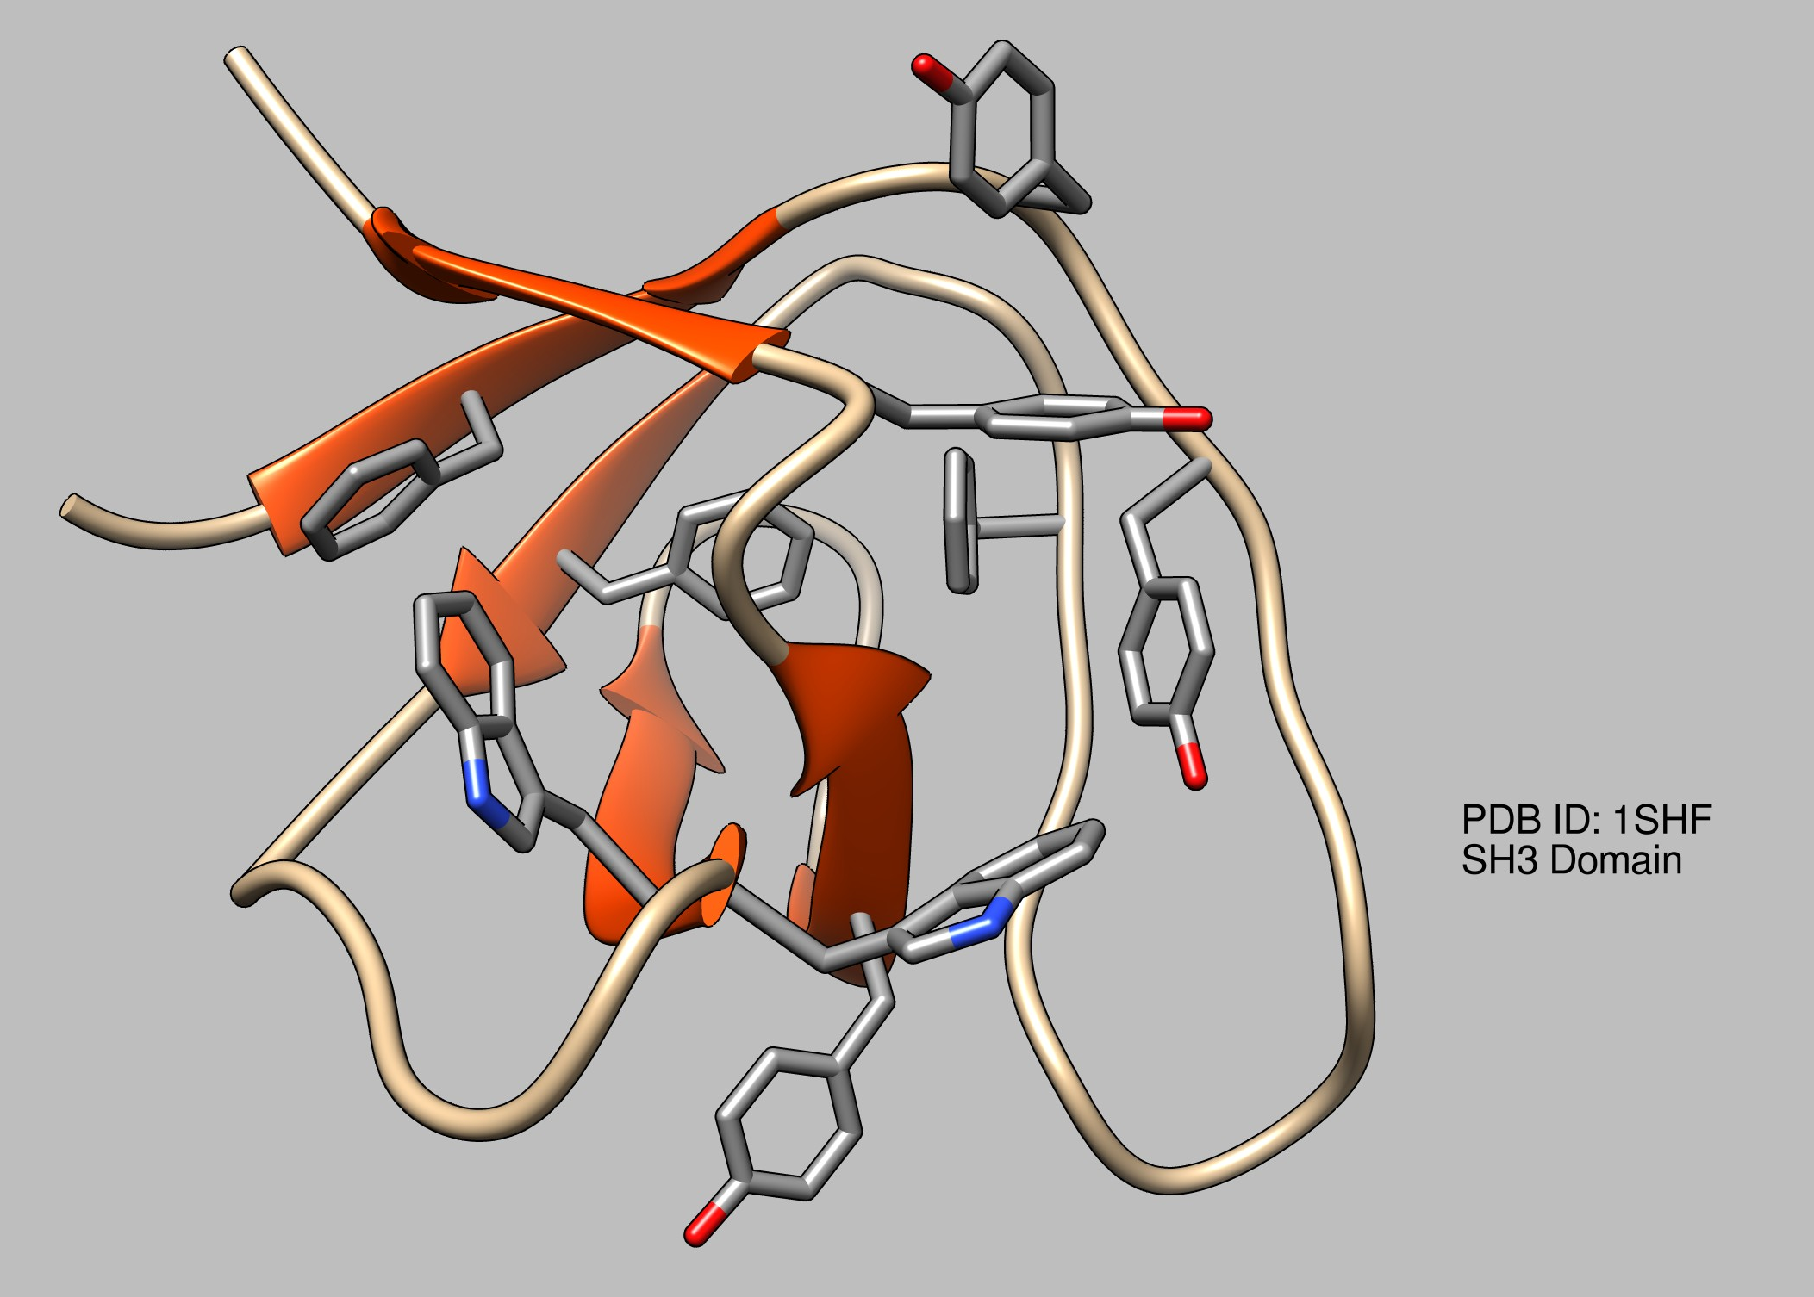
What Happens when INSR Activates IRS-1 In Hepatocytes and Adipocytes?
IRS-1 binds to Grb2
Grb2 has an important structural domain: the SH2 domain
Src Homology Domain 2
Binds to Tyr-PO₃ residues
Large β-sheet flanked by α-helices
Grb2 is an adapter protein that also has a unique structural domain: the SH3 domain
Src Homology Domain 3
Binds Proline-rich sequences in Tyr-PO₃ proteins
X-P-p-X-P motif in substrate where X is a hydrophobic residue in the binding pockets

Slide 15
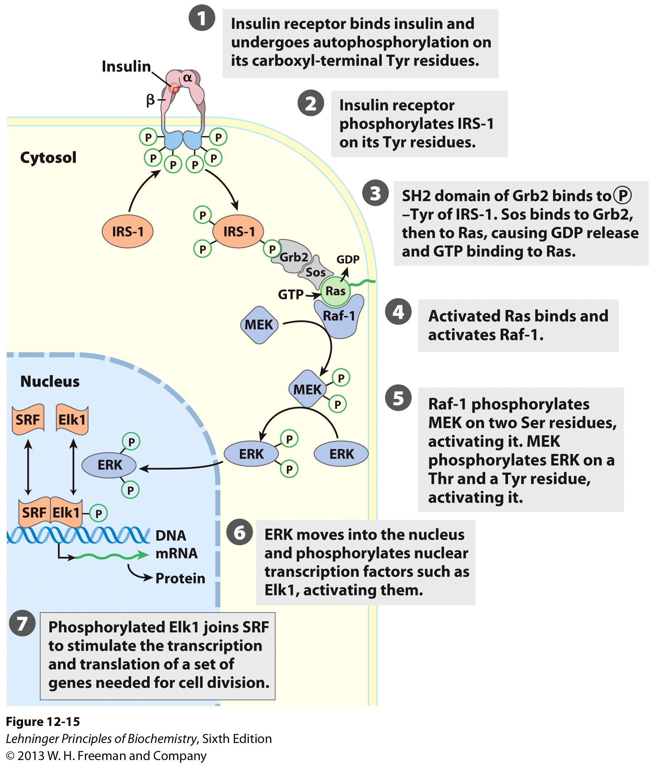
What Happens when INSR Activates IRS-1?
Grb2 binds to Sos via its SH3 domain and Sos binds to the Ras protein which causes it to bind GTP and release GDP
Ras is a G-Protein that is activated by binding GTP. It then binds and actiavtes Raf-1
Raf-1 is a kinase

Slide 16
What Happens when INSR Activates IRS-1?
Raf-1 phosphorylates MEK
MEK or MAP Kinase Kinase, phosphorylates ERK which then enters the nucleus and phosphorylates transcription factors responsible for cell division.
Insulin has just stimulated cell division!

Slide 17
What Happens when INSR Activates IRS-1?
NOTE: See all the multiple phosphorylation events in the cytoplasmic proteins involved in the pathway?
Why?

Slide 18
Insulin Signaling is Terminated by the Action of Phosphatases
In insulin signaling, three classes of enzymes are of particular importance in shutting off the signaling pathway:
Protein tyrosine phosphatases that remove phosphoryl groups from tyrosine residues on the insulin receptor and the IRS adaptor proteins
Lipid phosphatases that hydrolyze PIP₃ to PIP₂
Protein serine phosphatases that remove phosphoryl groups from activated protein kinases such as Akt
Many of these phosphatases are activated or recruited as part of the response to insulin so that binding of the initial signal also creates the conditions necessary for eventually terminating the response.

