Slide 1
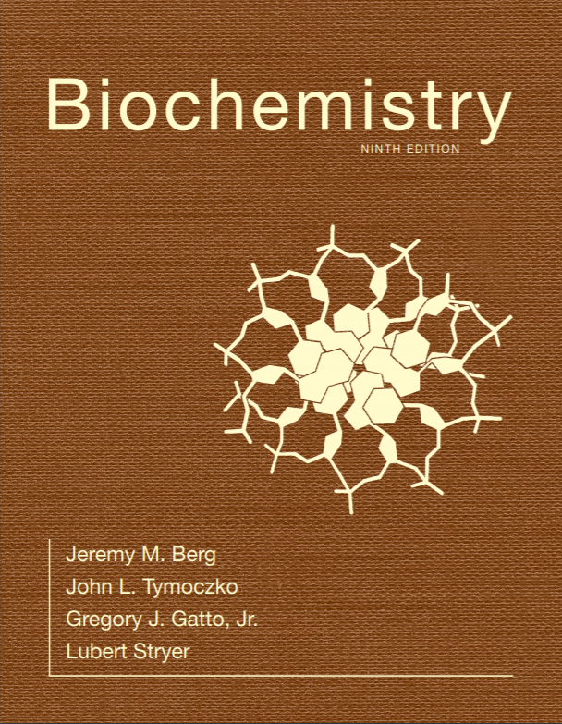
Chapter 30
RNA Synthesis and Processing
© 2019 W. H. Freeman and Company
Notes:
Corresponding Chapters: 1, 2, 8, 9, 10

Slide 2
CHAPTER 30 RNA Synthesis and Processing
Notes:
RNA synthesis is a key step in the expression of genetic information. For eukaryotic cells, the initial RNA transcript (the mRNA precursor) is often spliced, removing introns that do not encode protein sequences. Often, the same pre-mRNA is spliced differently in different cell types or at different developmental stages. In the image at the left, proteins associated with RNA splicing (stained with a fluorescent antibody) highlight regions of the newt genome that are being actively transcribed. [(Left) SPL/Science Source.]

Slide 3
Ch.30 Learning Objectives
By the end of this chapter, you should be able to:
Discuss the primary function of RNA polymerases, the reaction that they catalyze and its chemical mechanism.
Describe transcription, including the processes of initiation, elongation, and termination.
Discuss the regulation of transcription in eukaryotes, including the roles of transcription factors and enhancers.
Discuss the roles of RNA polymerases I, II, and III in producing ribosomal, transfer, and messenger RNAs.
Describe the process of RNA splicing, including the roles of the spliceosome and self-splicing RNA molecules.

Slide 4
Ch.30 Outline
30.1 RNA Polymerases Catalyze Transcription
30.2 Transcription in Eukaryotes Is Highly Regulated
30.3 The Transcription Products of Eukaryotic Polymerases Are Processed
30.4 The Discovery of Catalytic RNA Was Revealing in Regard to Both Mechanism and Evolution

Slide 5
RNA Synthesis Comprises Three Stages: Initiation, Elongation, and Termination
RNA polymerase is the enzyme that catalyzes the synthesis of RNA (i.e., transcription).
During transcription, RNA polymerases perform the following functions:
Search for and bind to promoter sequences, initiation sites for RNA synthesis
Unwind a short stretch of the double helix DNA to reveal the bases to be transcribed
Select the ribonucleoside triphosphate that corresponds to the DNA template and catalyze the formation of a phosphodiester linkage
Detect termination signals that halt transcription
Interact with other proteins that regulate the process of transcription

Slide 6
RNA Polymerase Structures
Notes:
FIGURE 30.1 RNA polymerase structures. The three-dimensional structures of RNA polymerases from a prokaryote (Thermus aquaticus) and a eukaryote (Saccharomyces cerevisiae). The two largest subunits for each structure are shown in dark red and dark blue. Notice that both structures contain a central metal ion (green) in their active sites, near a large cleft on the right. The similarity of these structures reveals that these enzymes have the same evolutionary origin and have many mechanistic features in common. [Drawn from 1I6V.pdb and 1I6H.pdb.]

Slide 7
Section 30.1 RNA Polymerases Catalyze Transcription
RNA polymerases catalyze the nucleophilic attack of the 3′-hydroxyl group of the last nucleotide in the chain on the α phosphoryl group of the incoming nucleoside triphosphate.
RNA polymerases, which consist of five subunits in E. coli, require two Mg²⁺ at the active site.
RNA synthesis occurs in a complex called the transcription bubble, where approximately 17 bases of the DNA are unwound.

Slide 8
Subunits of RNA Polymerase from E. coli

Slide 9
RNA Polymerase Active Site
Notes:
FIGURE 30.2 RNA polymerase active site. A model of the transition state for phosphodiester-bond formation in the active site of RNA polymerase. The 3´-hydroxyl group of the growing RNA chain attacks the α-phosphoryl group of the incoming nucleoside triphosphate, resulting in the release of pyrophosphate. This transition state is structurally similar to that in the active site of DNA polymerase (Figure 29.5).

Slide 10
Transcription Bubble (1/2)
Notes:
FIGURE 30.3 Transcription bubble. RNA polymerase separates a region of the double helix to form a structure called the “transcription bubble.” The red (template) and blue (nontemplate) strands of DNA are shown along with the RNA molecule being synthesized (shown in green). The position of the active site magnesium is indicated. The DNA enters from the left and exits at the bottom.

Slide 11
RNA Chains are Formed de novo and Grow in the 5′-to-3′ Direction (1/2)
The template or antisense (−) strand is complementary to the sequence of the RNA transcript. The coding or sense (+) strand of DNA has the same sequence as the transcript, with T in place of U.
The first nucleotide to be transcribed is denoted as +1. The nucleotide immediately preceding it is denoted as –1.
The 5′ end of the transcript is usually pppG or pppA.

Slide 12
Template and Coding Strands
Notes:
FIGURE 30.4 Template and coding strands. The template, or antisense (−), strand is complementary in sequence to the RNA transcript.

Slide 13
RNA Chains are Formed de novo and Grow in the 5′-to-3′ Direction (2/2)
Elongation occurs when a ribonucleoside triphosphate base-pairs with a nucleotide on the DNA template. The 3′-hydroxyl group of the last nucleotide in the chain attacks the α-phosphoryl group of the incoming nucleoside triphosphate, reforming a phosphodiester linkage and releasing PP_{i}.
For another nucleotide to become incorporated into the transcript, translocation must occur. The transcription bubble must move to allow the next nucleotide to base-pair with the DNA template.
As the bubble moves, the RNA product exits the enzyme and the transcribed DNA rejoins its partner.

Slide 14
Elongation Mechanism
Notes:
FIGURE 30.5 Elongation mechanism. A ribonucleoside triphosphate binds adjacent to the growing RNA chain and forms a Watson–Crick base pair with a base on the DNA template strand. The 3´-hydroxyl group at the end of the RNA chain attacks the newly bound nucleotide and forms a new phosphodiester bond, releasing pyrophosphate.

Slide 15
Translocation
Notes:
FIGURE 30.6 Translocation. After nucleotide addition, the RNA–DNA hybrid can translocate through the RNA polymerase, bringing a new DNA base into position to base-pair with an incoming nucleoside triphosphate.

Slide 16
RNA–DNA Hybrid Separation
Notes:
FIGURE 30.7 RNA–DNA hybrid separation. A structure within RNA polymerase forces the separation of the RNA–DNA hybrid. Notice that the DNA strand exits in one direction and the RNA product exits in another. [Drawn from 1I6H.pdb.]

Slide 17
RNA Polymerases Backtrack and Correct Errors
RNA polymerase can backtrack, especially if the incorporated nucleotide does not base-pair with the template.
When the enzyme backtracks, the misincorporated nucleotide is hydrolyzed.
In essence, the RNA polymerase proofreads its product.

Slide 18
Backtracking
Notes:
FIGURE 30.8 Backtracking. The RNA–DNA hybrid can occasionally backtrack within the RNA polymerase. In the backtracked position, hydrolysis can take place, producing a configuration equivalent to that after translocation. Backtracking is more likely if a mismatched base is added, facilitating proofreading.

Slide 19
RNA Polymerase Binds to Promoter Sites on the DNA Template to Initiate Transcription (1/2)
In E. coli, the core RNA polymerase has the subunit composition of α₂ββ′ω.
The holoenzyme is formed when the σ subunit joins the core enzyme. The role of the σ subunit is to identify promoters.
Common promoters in E. coli are the −10 sequence and the –35 sequence, together called the core promoter.

Slide 20
RNA Polymerase Binds to Promoter Sites on the DNA Template to Initiate Transcription (2/2)
Promoter sequences may vary from the average or consensus sequence. Generally, the more similar a promoter sequence is to the consensus, the more effective the promoter is.
Another promoter is the upstream (UP) element, located 40 to 60 nucleotides upstream of the core promoter.

Slide 21
Bacterial Promoter Sequences
Notes:
FIGURE 30.9 Bacterial promoter sequences. A comparison of five sequences from prokaryotic promoters reveals a recurring sequence of TATAAT centered on position −10. The −10 consensus sequence (in red) was deduced from a large number of promoter sequences. The sequences are from the (A) uvrD, (B) uncI, and (C) trp operons of E. coli, from (D) λ phage, and from (E) ϕX174 phage.

Slide 22
Sigma Subunits of RNA Polymerase Recognize Promoter Sites
The σ subunit of the holoenzyme is responsible for recognizing the promoter sequence.
Once the promoter is located, transcription begins. When the nascent chain is 9 or 10 nucleotides long, σ is released. After release, it will assist another enzyme to find the promoter.
E. coli has seven distinct σ subunits that recognize different promoters.

Slide 23
RNA Polymerase Holoenzyme Complex
Notes:
FIGURE 30.10 RNA polymerase holoenzyme complex. Notice that the σ subunit (blue) of the bacterial RNA polymerase holoenzyme makes sequence-specific contacts with the −10 (green) and −35 promoter elements (yellow). The active site of the polymerase is revealed by bound metal ion (purple). [Drawn from 1L9Z.pdb].

Slide 24
Alternative Promoter Sequences
Notes:
FIGURE 30.11 Alternative promoter sequences. A comparison of the consensus sequences of standard, heat-shock, and nitrogen-starvation promoters of E. coli. These promoters are recognized by σ⁷⁰, σ³², and σ⁵⁴, respectively.

Slide 25
RNA Polymerases Must Unwind the Template Double Helix for Transcription to Take Place
RNA polymerase can identify promoter sites on double helical DNA, but the DNA must be unwound for transcription to occur.
Transition from the closed promoter to the open promoter requires unwinding of approximately 17 base pairs of DNA.
The free energy necessary to break the bonds between these ~17 bp is derived from additional favorable contacts when DNA distorts to wrap around the RNA polymerase and from interactions between the single-stranded DNA regions and other parts of the polymerase.
These interactions stabilize the open promoter complex and help to pull the template strand into the enzyme’s active site.
The −10 element is unwound, whereas the −35 element remains in double-helical form.

Slide 26
DNA Unwinding
Notes:
FIGURE 30.12 DNA unwinding. The transition from the closed promoter complex to the open promoter complex requires the unwinding of approximately 17 base pairs of DNA.

Slide 27
Elongation Takes Place at Transcription Bubbles that Move Along the DNA Template
Once the DNA is unwound, elongation can take place.
The region containing the RNA polymerase, the DNA, and the RNA product is called the transcription bubble.
The transcription bubble moves along the DNA as DNA is unwound and then rewound, while the RNA product is extruded from the complex.
A RNA–DNA hybrid helix of approximately 8 nucleotides is an intermediate in RNA synthesis.
Transcription occurs at the rate of about 50 nucleotides per second.

Slide 28
Transcription Bubble (2/2)
Notes:
FIGURE 30.13 Transcription bubble. A schematic representation of a transcription bubble in the elongation of an RNA transcript. Duplex DNA is unwound at the forward end of RNA polymerase and rewound at its rear end. The RNA–DNA hybrid rotates during elongation.

Slide 29
Sequences within the Newly Transcribed RNA Signal Termination
Elongation continues until a termination signal is detected.
The simplest stop signal is the transcribed product of a segment of palindromic DNA.
The RNA complement of the DNA stop signal forms a hairpin structure, followed by several uracil residues.
Upon synthesis of the hairpin, the polymerase stalls, the RNA product is released, and the DNA double helix reforms.

Slide 30
Termination Signal
Notes:
FIGURE 30.14 Termination signal. A termination signal found at the 3´-end of an mRNA transcript consists of a series of bases that form a stable stem-loop structure and a series of U residues.

Slide 31
Some Messenger RNAs Directly Sense Metabolite Concentrations
Some mRNA molecules can form special secondary structures, called riboswitches, that bind to small molecules.
Such binding can lead to the termination of RNA synthesis.
For example: when abundant, flavin mononucleotide (FMN) binds to a riboswitch on an mRNA encoding an enzyme required for de novo FMN synthesis. Binding of FMN to the mRNA terminates synthesis of the mRNA.

Slide 32
Riboswitch
Notes:
FIGURE 30.15 Riboswitch. (A) The 5´-end of an mRNA that encodes proteins engaged in the production of flavin mononucleotide (FMN) folds to form a structure that is stabilized by binding FMN. This structure includes a terminator that leads to premature termination of the mRNA. At lower concentrations of FMN, an alternative structure that lacks the terminator is formed, leading to the production of full-length mRNA. (B) The three-dimensional structure of a related FMN-binding riboswitch bound to FMN. The blue and yellow stretches correspond to regions highlighted in the same colors in part A. Notice how the yellow strand contacts the bound FMN, stabilizing the structure. [Drawn from 3F2Q.pdb].

Slide 33
The rho Protein Helps to Terminate the Transcription of Some Genes
Another type of termination signal requires the protein rho (ρ).
Rho binds to a particular sequence on the RNA product and uses the energy of ATP hydrolysis to chase down the polymerase in the transcription bubble.
Contact with rho causes the transcription bubble to dissociate.

Slide 34
Effect of ρ Protein on the Size of RNA Transcripts
Notes:
FIGURE 30.16 Effect of ρ protein on the size of RNA transcripts.

Slide 35
Mechanism for the Termination of Transcription by ρ Protein
Notes:
FIGURE 30.17 Mechanism for the termination of transcription by ρ protein. This protein is an ATP-dependent helicase that binds the nascent RNA chain and pulls it away from RNA polymerase and the DNA template.

