Slide 1
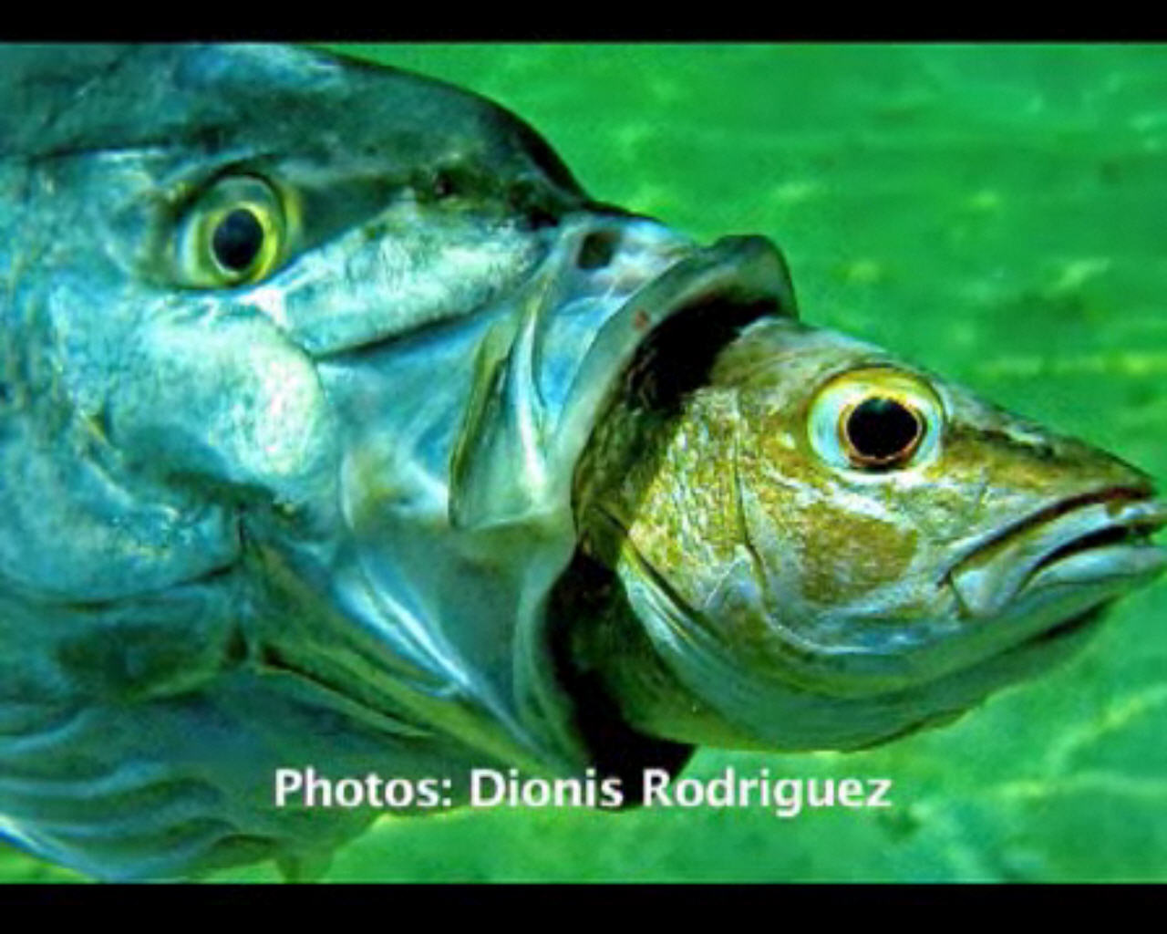
Welcome to Virtual Office Hours CHEM523: Biochemistry I Sunday, 16 February, 2014
There’s no real plan here, you just ask me questions…if no one has any questions, I’ll leave you to your studies.
If you aren’t actively speaking, Please Press the MUTE BUTTON next to your name in the Listeners Window on the left
This will stop some dreadful feedback for all of us
If you have a question, press the “Raise Hand” button on the lower right of the Users window
If you have no microphone, type a question in the chat window

