Slide 1
What do we need in a DNA Polymerase?
Forms of DNA Helices
With respect to the template and 3’-OH requirement:
DNA Polymerases cannot simply start making new DNA strands! Why is this important?
ii) RNA polymerases don’t have the 3’-OH requirement, so they make the RNA primers that DNA Polymerases build upon
RNA Polymerases don’t have as much fidelity but it can start with just template and some nucleotides
DNA Polymerase HAS Fidelity AND Processivity
The polymerase binds to the template strand, adds nucleotides to the growing strand and proceeds
Faster polymerase have higher rates of Processivity or they add more nucleotides before they dissociate from the template strand (yes, they just fall off!)
Given the importance of DNA to the organism, it isn’t surprising that DNA polymerases must have fidelity
Your average DNA Polymerase makes a mistake every 1,000-10,000 bases added
The active site of a DNA Polymerase ensures that even though the wrong nucleotide might be added, it won’t fit into the active site and the growing strand swings down to a nuclease domain (in some polymerases)

Slide 2
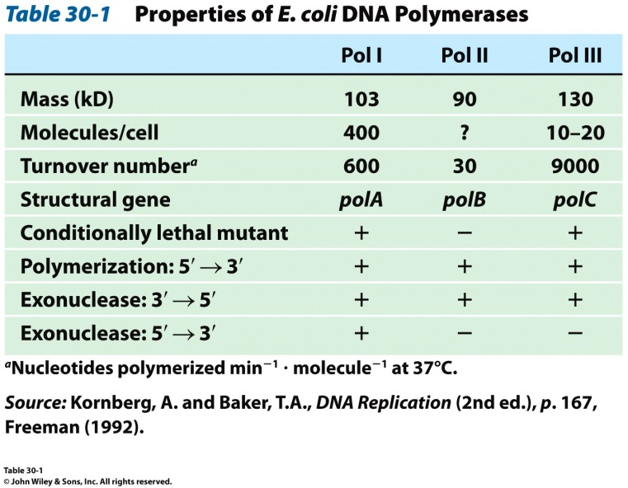
What do we need in a DNA Polymerase?
Forms of DNA Helices
End result:
Eschericha coli DNA Pol III leaves behind only 1 error for every 10⁶-10⁸ bases added!
Speaking of E. coli, it has three major DNA polymerases
DNA Pol III is the principal replicative polymerase in E. coli. Why?

Slide 3
DNA Polymerase Structures
Forms of DNA Helices
Arthur Kornberg discovered the first DNA polymerase isolated from Escherichia coli in 1956
This was called DNA Polymerase I (DNA PolI)
The structure of this enzyme was solved by Tom Steitz in 1987 (at least part of it was…)
PDB ID Code: 1DPI
The structure of the Thermus aquaticus DNA PolI was also discovered by Steitz in 1996
PDB ID Code: 1TAQ
For today’s lectures, we’ll use the following structures:
1QSS: ddGTP-trapped Closed Ternary Complex of the Large Fragment of DNA PolI from T. aquaticus
1KLN: DNA PolI Klenow Fragment Mutant/DNA Complex

Slide 4
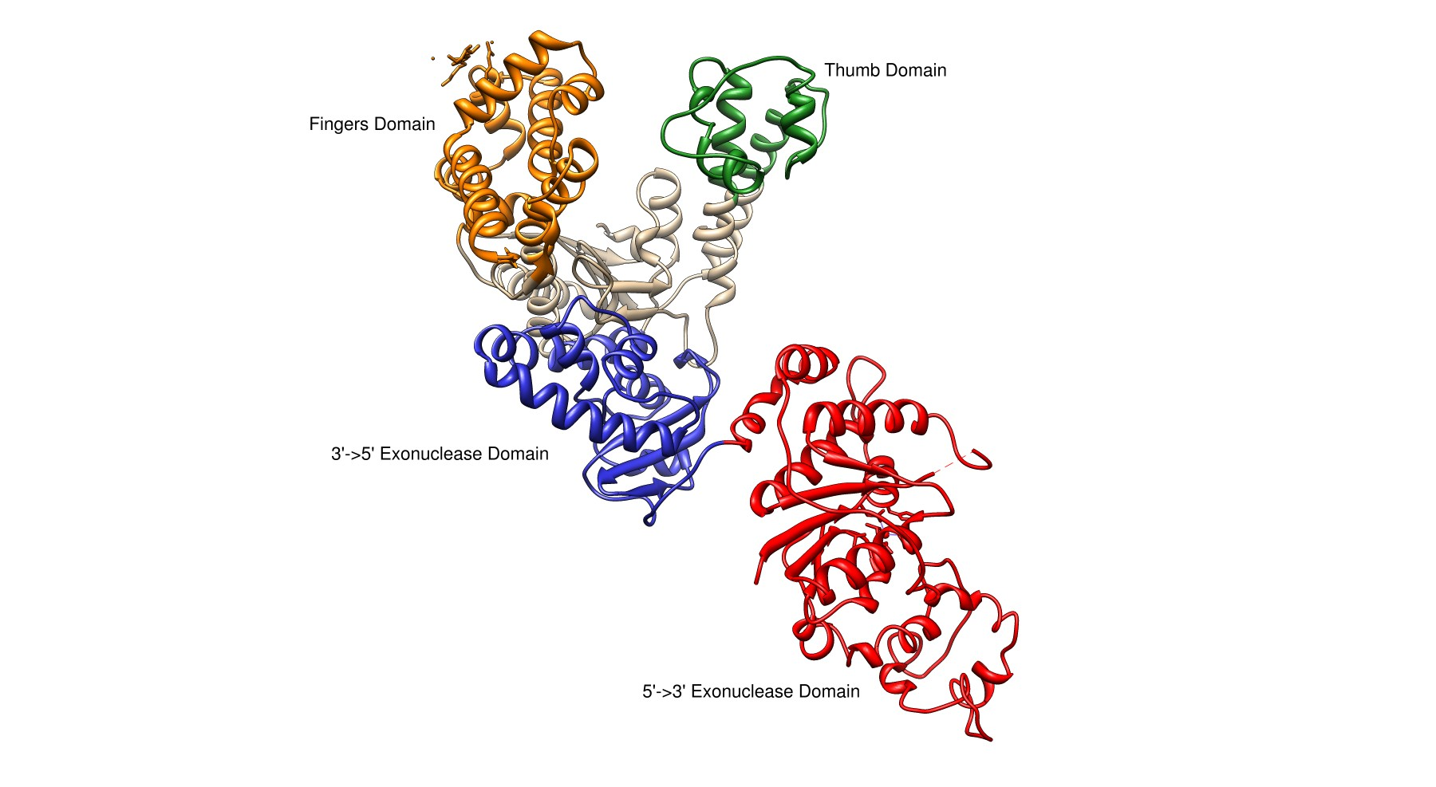
E. coli DNA Polymerase I
Forms of DNA Helices
Pol I
3’→ 5’ and 5’ → 3’ exonuclease activity
Small N-terminal domain contains the 5’→3’ exonuclease activity
Completely independent from active site or 3’ → 5 site
Thumb
Guides newly formed DNA
Responsible for processivity
Fingers
Contains dNTP binding site
Close in on dNTP/Growing Strand once successful Watson-Crick base pairing made
Palm Domain
~22 Å x 30 Å
Ideal shape to bind B-DNA
Lined with basic amino acids

Slide 5
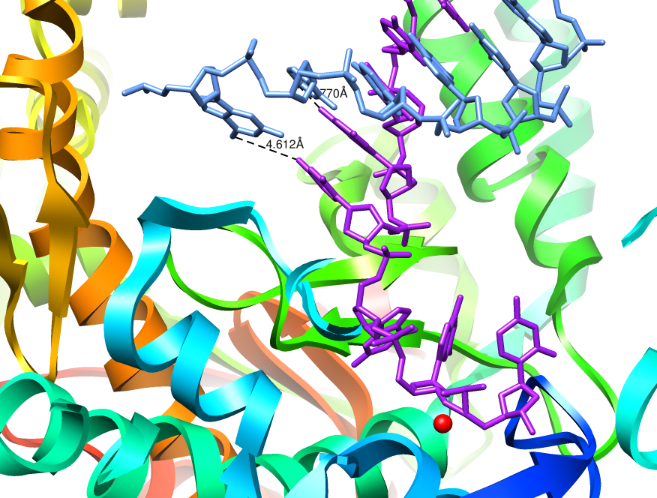
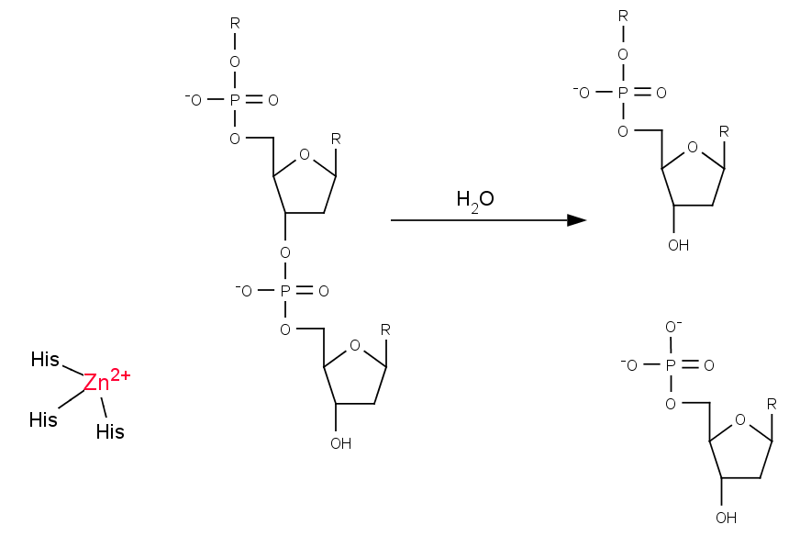
3’ → 5’ Exonuclease
Forms of DNA Helices
The structure of E. coli Pol I has been solved with DNA bound in the 3’→5’ exonuclease active site
Growing strand peels away from active site
The base pair closest to the polymerization active site is significantly weakened
Exonuclease site (Zn²⁺ activated mechanism)
Which bond will be cleaved?
NEED 3’-hydroxyl for elongation

Slide 6
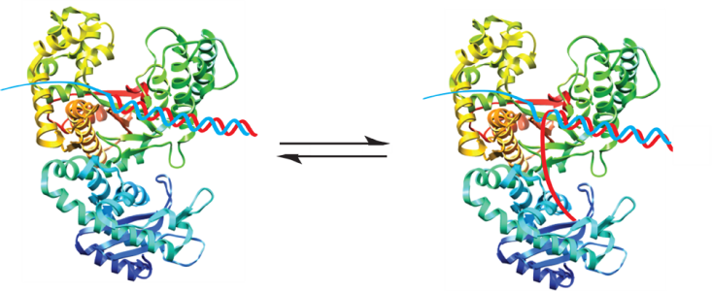
Model for Proofreading in DNA Polymerases
Forms of DNA Helices
dNTPs are in rapid equilibrium at active site
When reaction occurs, proper base pair will form a strong tight bonding pair
When an error occurs, the base pair is not as tight, resulting in increased favorability for the growing chain to be positioned at the 3’→5’ exonuclease site

Slide 7
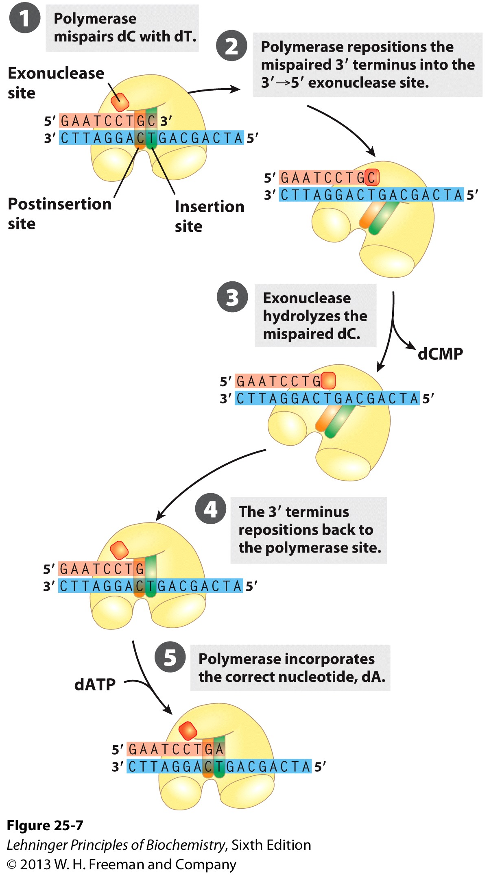
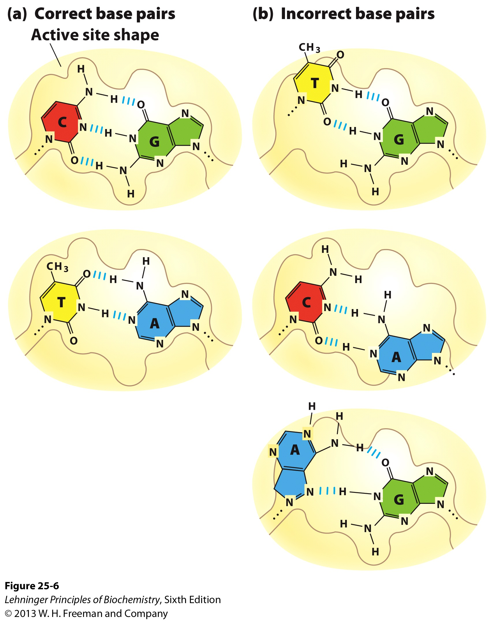
Model for Proofreading in DNA Polymerases
Forms of DNA Helices
Incorrect pairing causes a clash and the chains separate. The growing chain swings out and into the exonuclease site

Slide 8
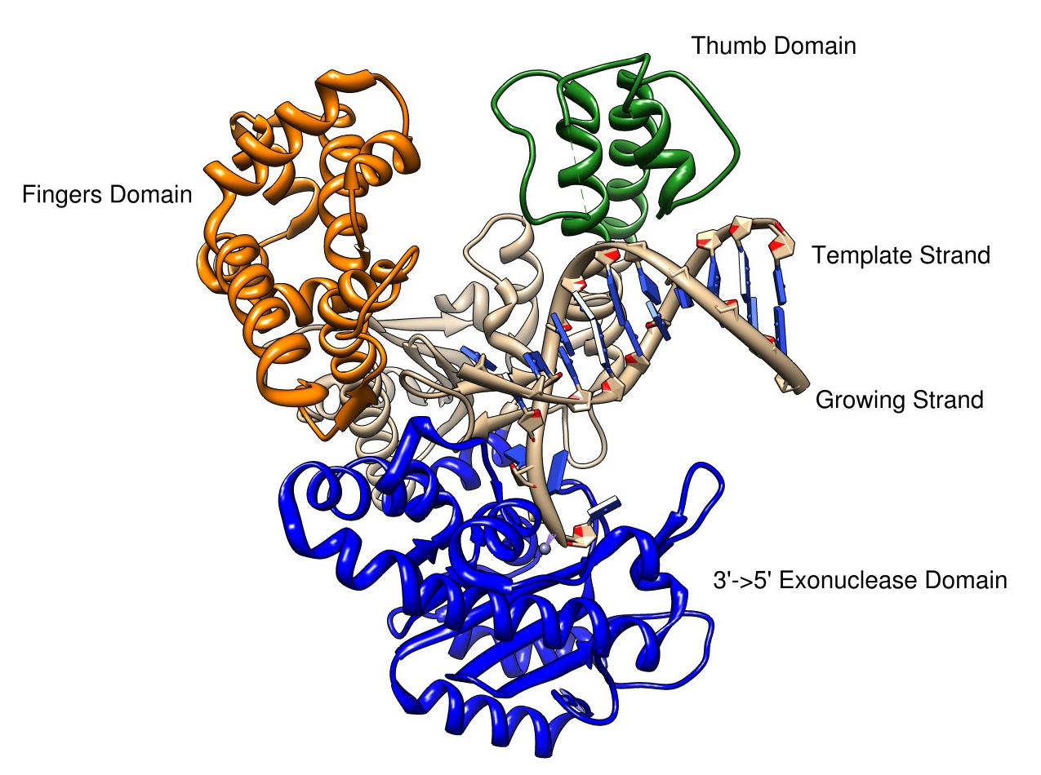
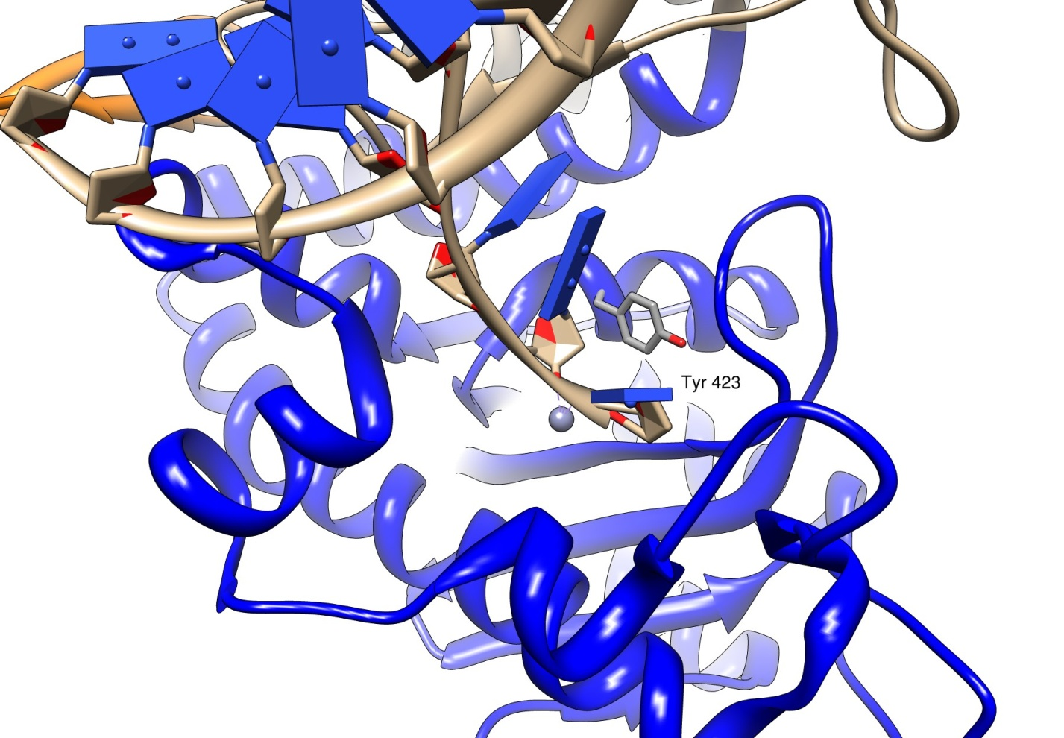
3’->5’ Exonuclease Mechanism
Forms of DNA Helices
The structure of E. coli Pol I has been solved with DNA bound in the 3’→5’ exonuclease site
Growing strand peels away from active site
Tyr 423 activates a water molecule which then serves as a nucleophile to begin the cleavage of the base from the strand

Slide 9
3’->5’ Exonuclease Mechanism
Forms of DNA Helices
Tyr 423 activates a water molecule which then serves as a nucleophile to begin the cleavage of the base from the strand
What other enzyme we’ve discussed this semester uses the same mechanism?
Freemont et al. (1988). Cocrystal structure of an editing complex of Klenow fragment with DNA. PNAS 85: 8924-8928.

Slide 10
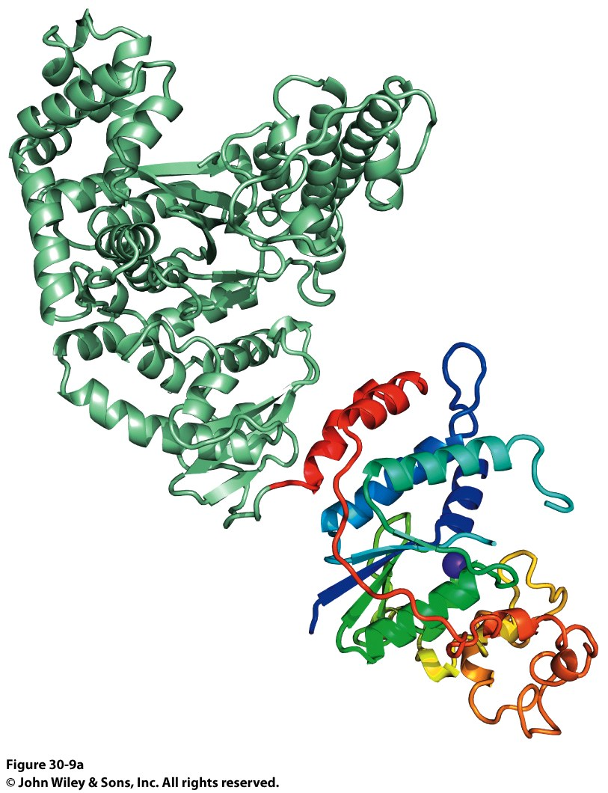
Taq DNA Polymerase
Forms of DNA Helices
Two domains were identified:
Polymerase Domain
5’→3’ Exonuclease Domain
N-terminal domain contains 5’ → 3’ exonuclease
C-terminal domain contains polymerase activity

Slide 11
Taq DNA Polymerase
Forms of DNA Helices
Notice the same Finger and Thumb domains as E. coli DNA PolI
Same function, same domains
Evidence of evolutionary conservation of function
Taq DNA Pol has no 3’->5’ exonuclease activity though…

Slide 12
E. coli and Taq DNA Polymerase Superposition
Forms of DNA Helices
Notice the same Finger and Thumb domains as E. coli DNA PolI
Same function, same domains
Evidence of evolutionary conservation of function
Taq DNA Pol has no 3’->5’ exonuclease activity though…

Slide 13
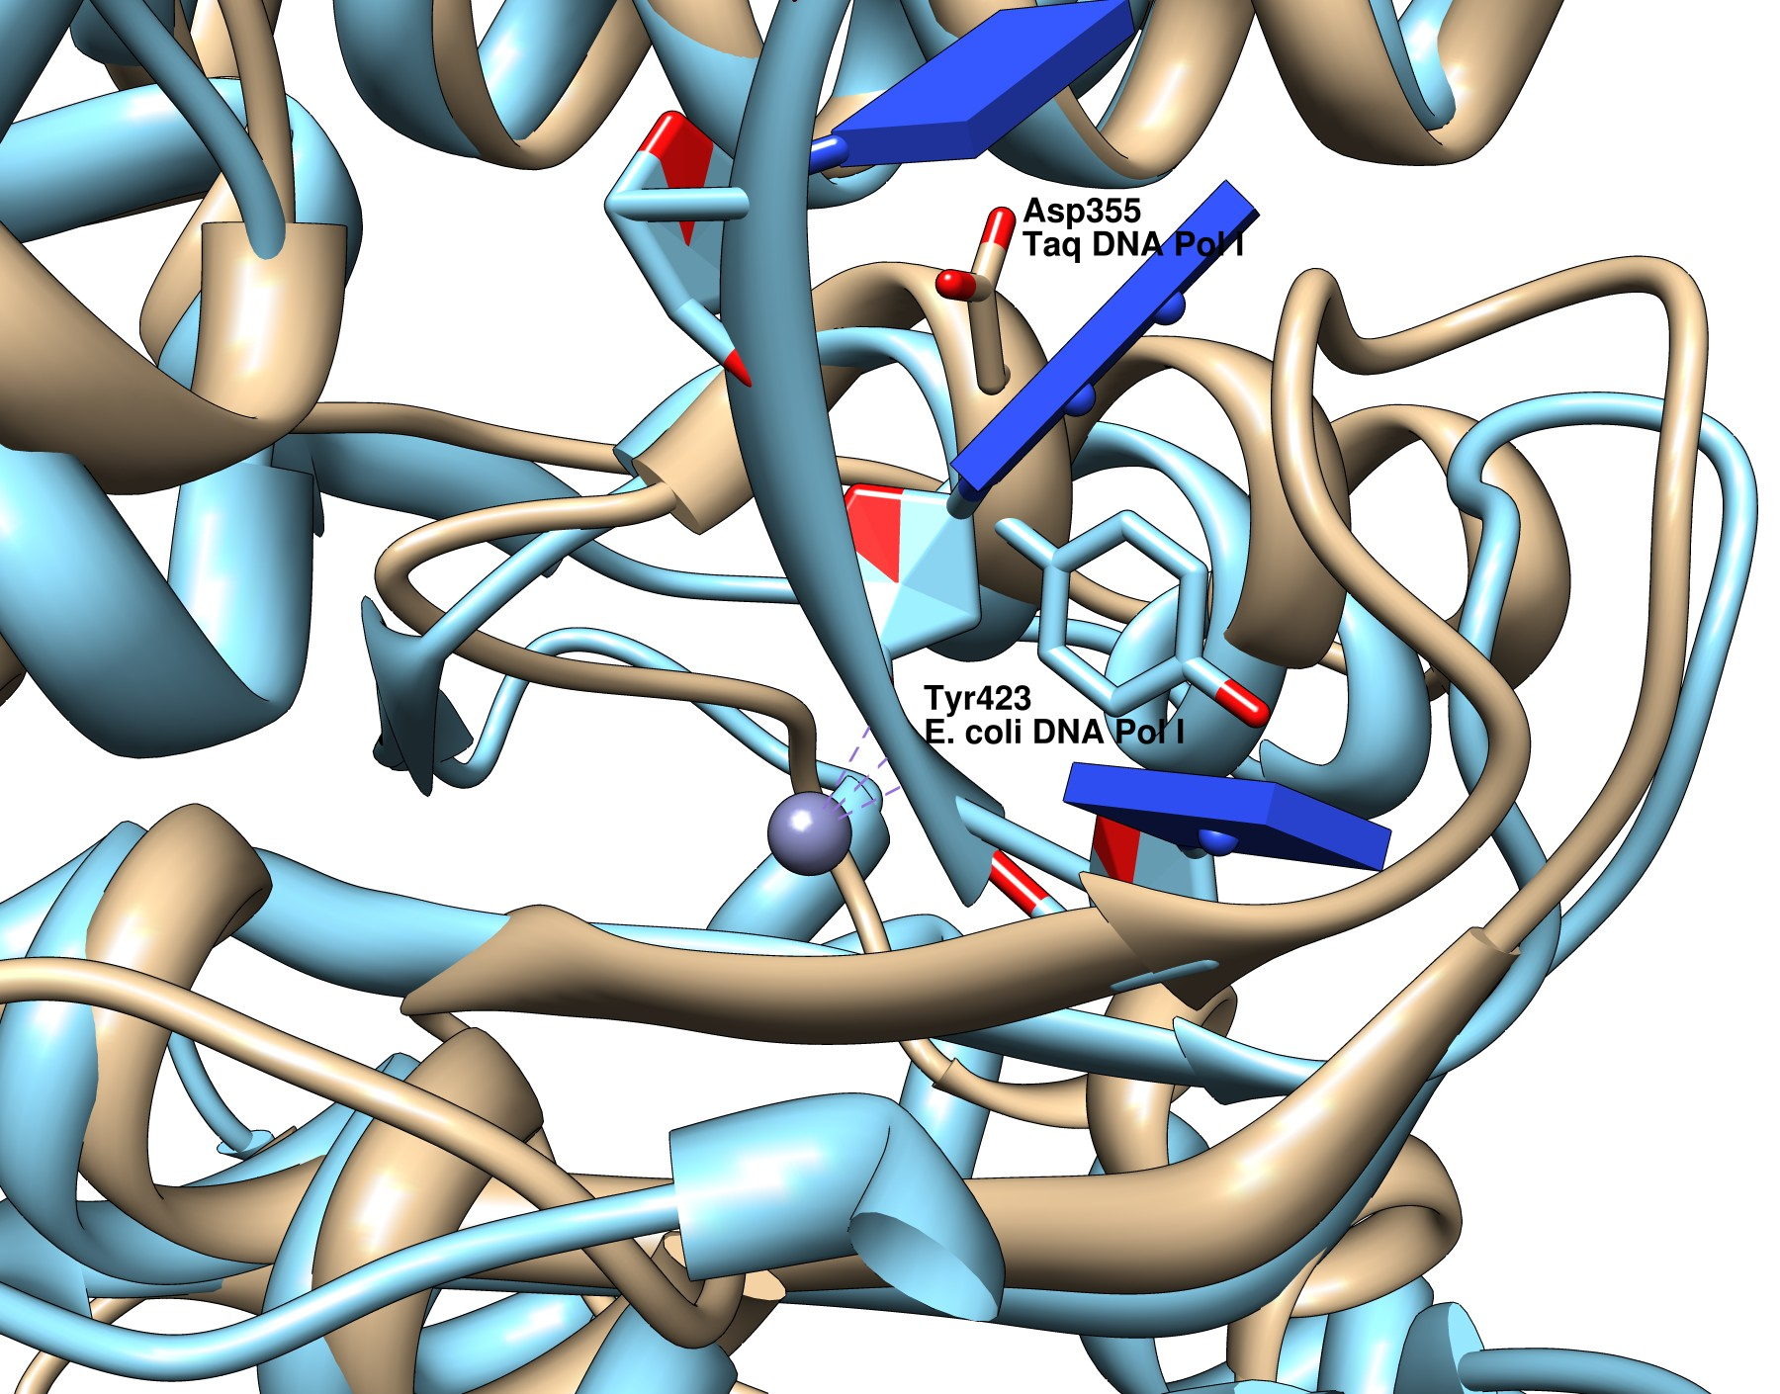
E. coli and Taq DNA Polymerase Superposition
Forms of DNA Helices
In E. coli DNA Pol I (Blue), Tyr423 activates a water
In Taq DNA Pol I (Tan), there is no Tyr and there is no Zinc ion!

Slide 14
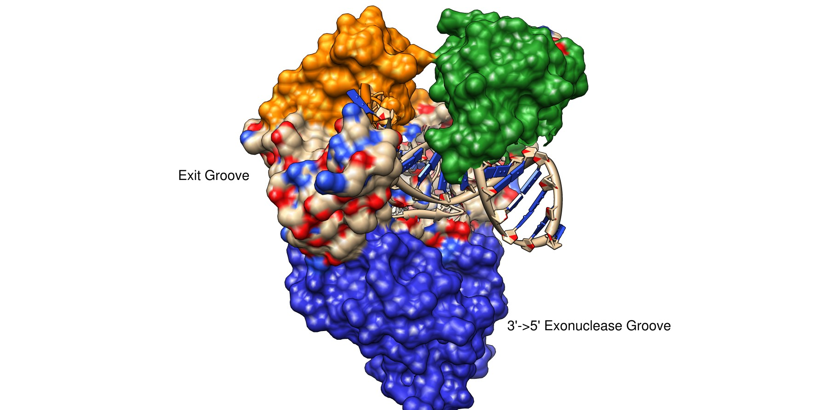
Taq DNA Polymerase
Forms of DNA Helices

Slide 15
Taq DNA Polymerase
Forms of DNA Helices
dNTP binding site

Slide 16
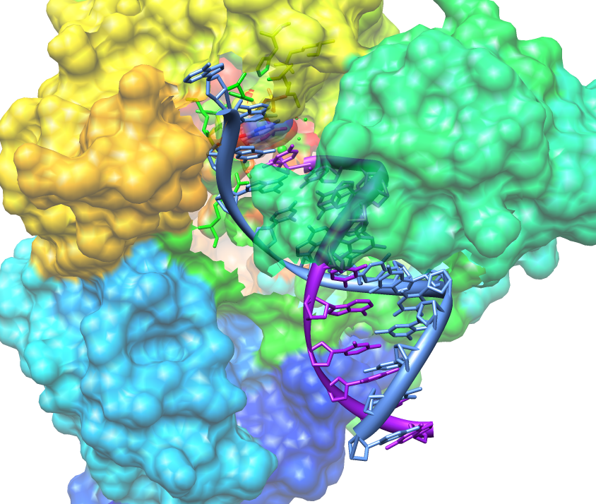
Taq DNA Polymerase
Forms of DNA Helices
Initial inspection of the groove between the thumb and fingers suggests the DNA would follow this cleft. This is NOT the case!
Active Site
Projected path of ssDNA template
5’
Template
Growing Strand
Thumb folds down over elongating dsDNA preventing it from escaping

Slide 17
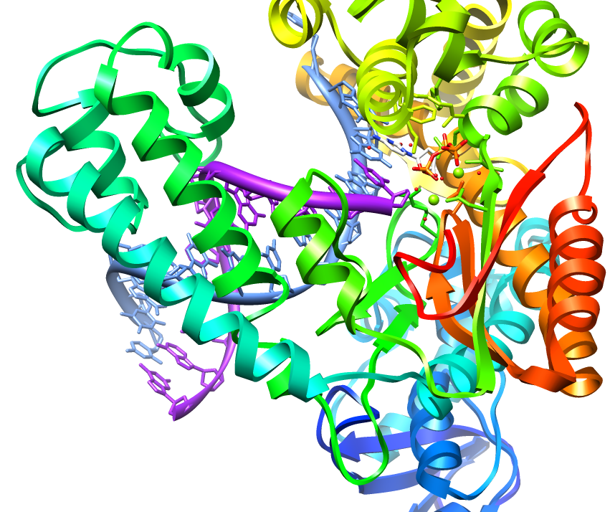
Taq DNA Polymerase
Forms of DNA Helices
dNTP Binding Site – allows for rapid sampling of the dNTPs
Projected path of ssDNA template
Thumb

Slide 18
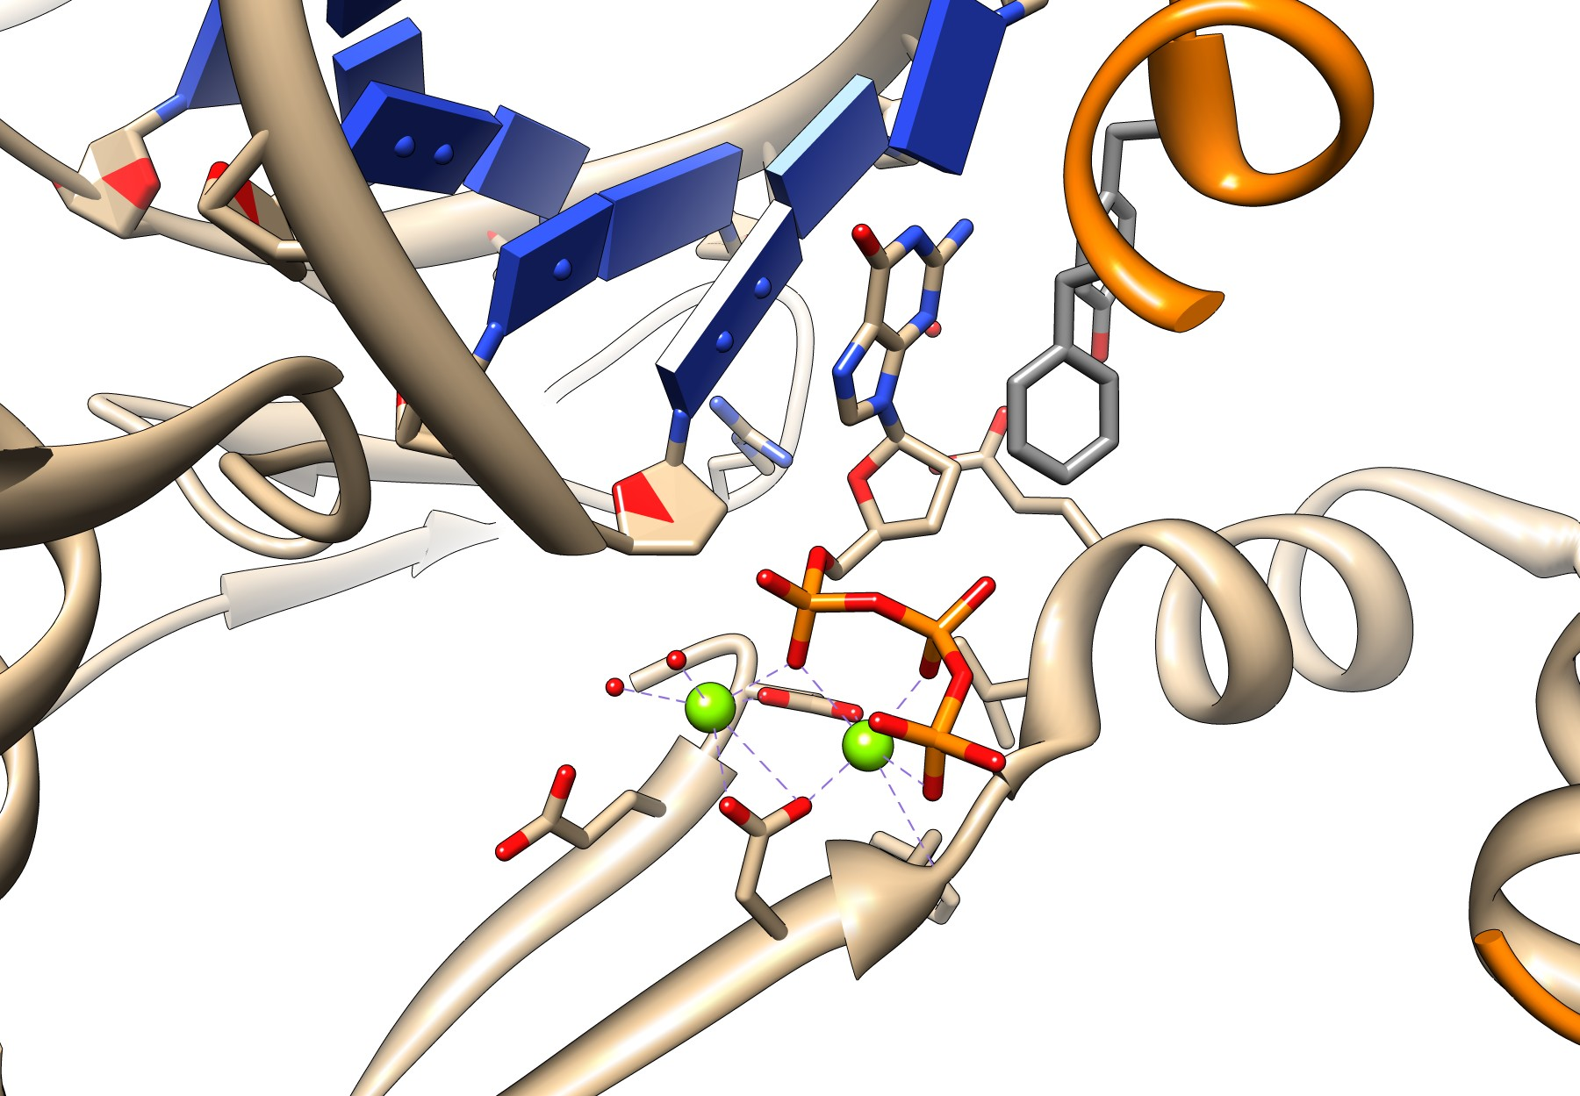
Taq DNA Polymerase
Forms of DNA Helices

Slide 19
The Role of the O Helix in the Finger Domain
Forms of DNA Helices
O-Helix

Slide 20
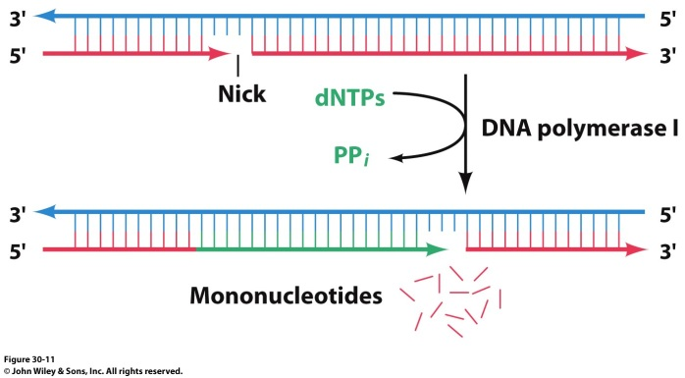
Taq DNA Polymerase 5’-3’ Exonuclease Activity
Forms of DNA Helices
Pol I from Thermus aquaticus lacks 3’→5’ exonuclease activity
What does this mean for fidelity?
N-terminal domain contains 5’ → 3’ exonuclease
Taq polymerase can translate a single nick in DNA by a mechanism that involves both the polymerase active site and the 5’→3’ exonuclease active site

Slide 21
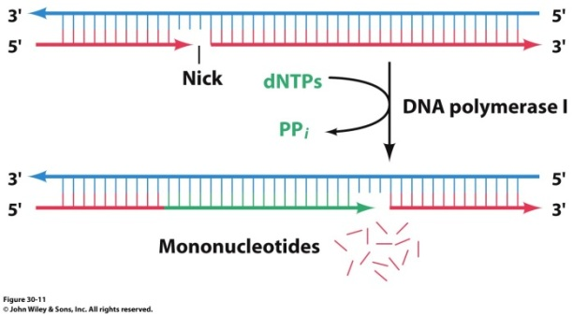
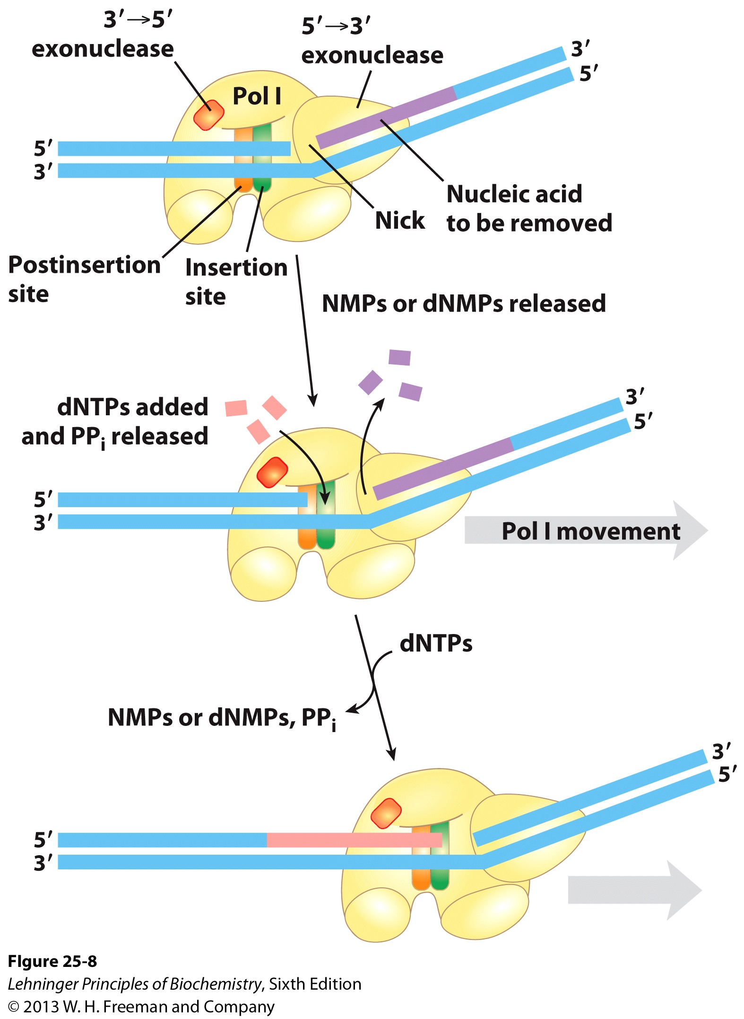
Nick Translation is Catalyzed by 5’->3’ Exonuclease Activity
What process in DNA replication requires a 5’→ 3’ exonuclease process?
Need to remove RNA primers from lagging strand!
Notes:
FIGURE 25–8 Nick translation. The bacterial DNA polymerase I has three domains, catalyzing its DNA polymerase, 5’3’ exonuclease, and 3’5’ exonuclease activities. The 5’3’ exonuclease domain is in front of the enzyme as it moves along the DNA and is not shown in Figure 25–5. By degrading the DNA strand ahead of the enzyme and synthesizing a new strand behind, DNA polymerase I can promote a reaction called nick translation, where a break or nick in the DNA is effectively moved along with the enzyme. This process has a role in DNA repair and in the removal of RNA primers during replication (both described later). The strand of nucleic acid to be removed (either DNA or RNA) is shown in purple, the replacement strand in red. DNA synthesis begins at a nick (a broken phosphodiester bond, leaving a free 3’ hydroxyl and a free 5’ phosphate). A
nick remains where DNA polymerase I eventually dissociates, and the nick is later sealed by another enzyme.

Slide 22
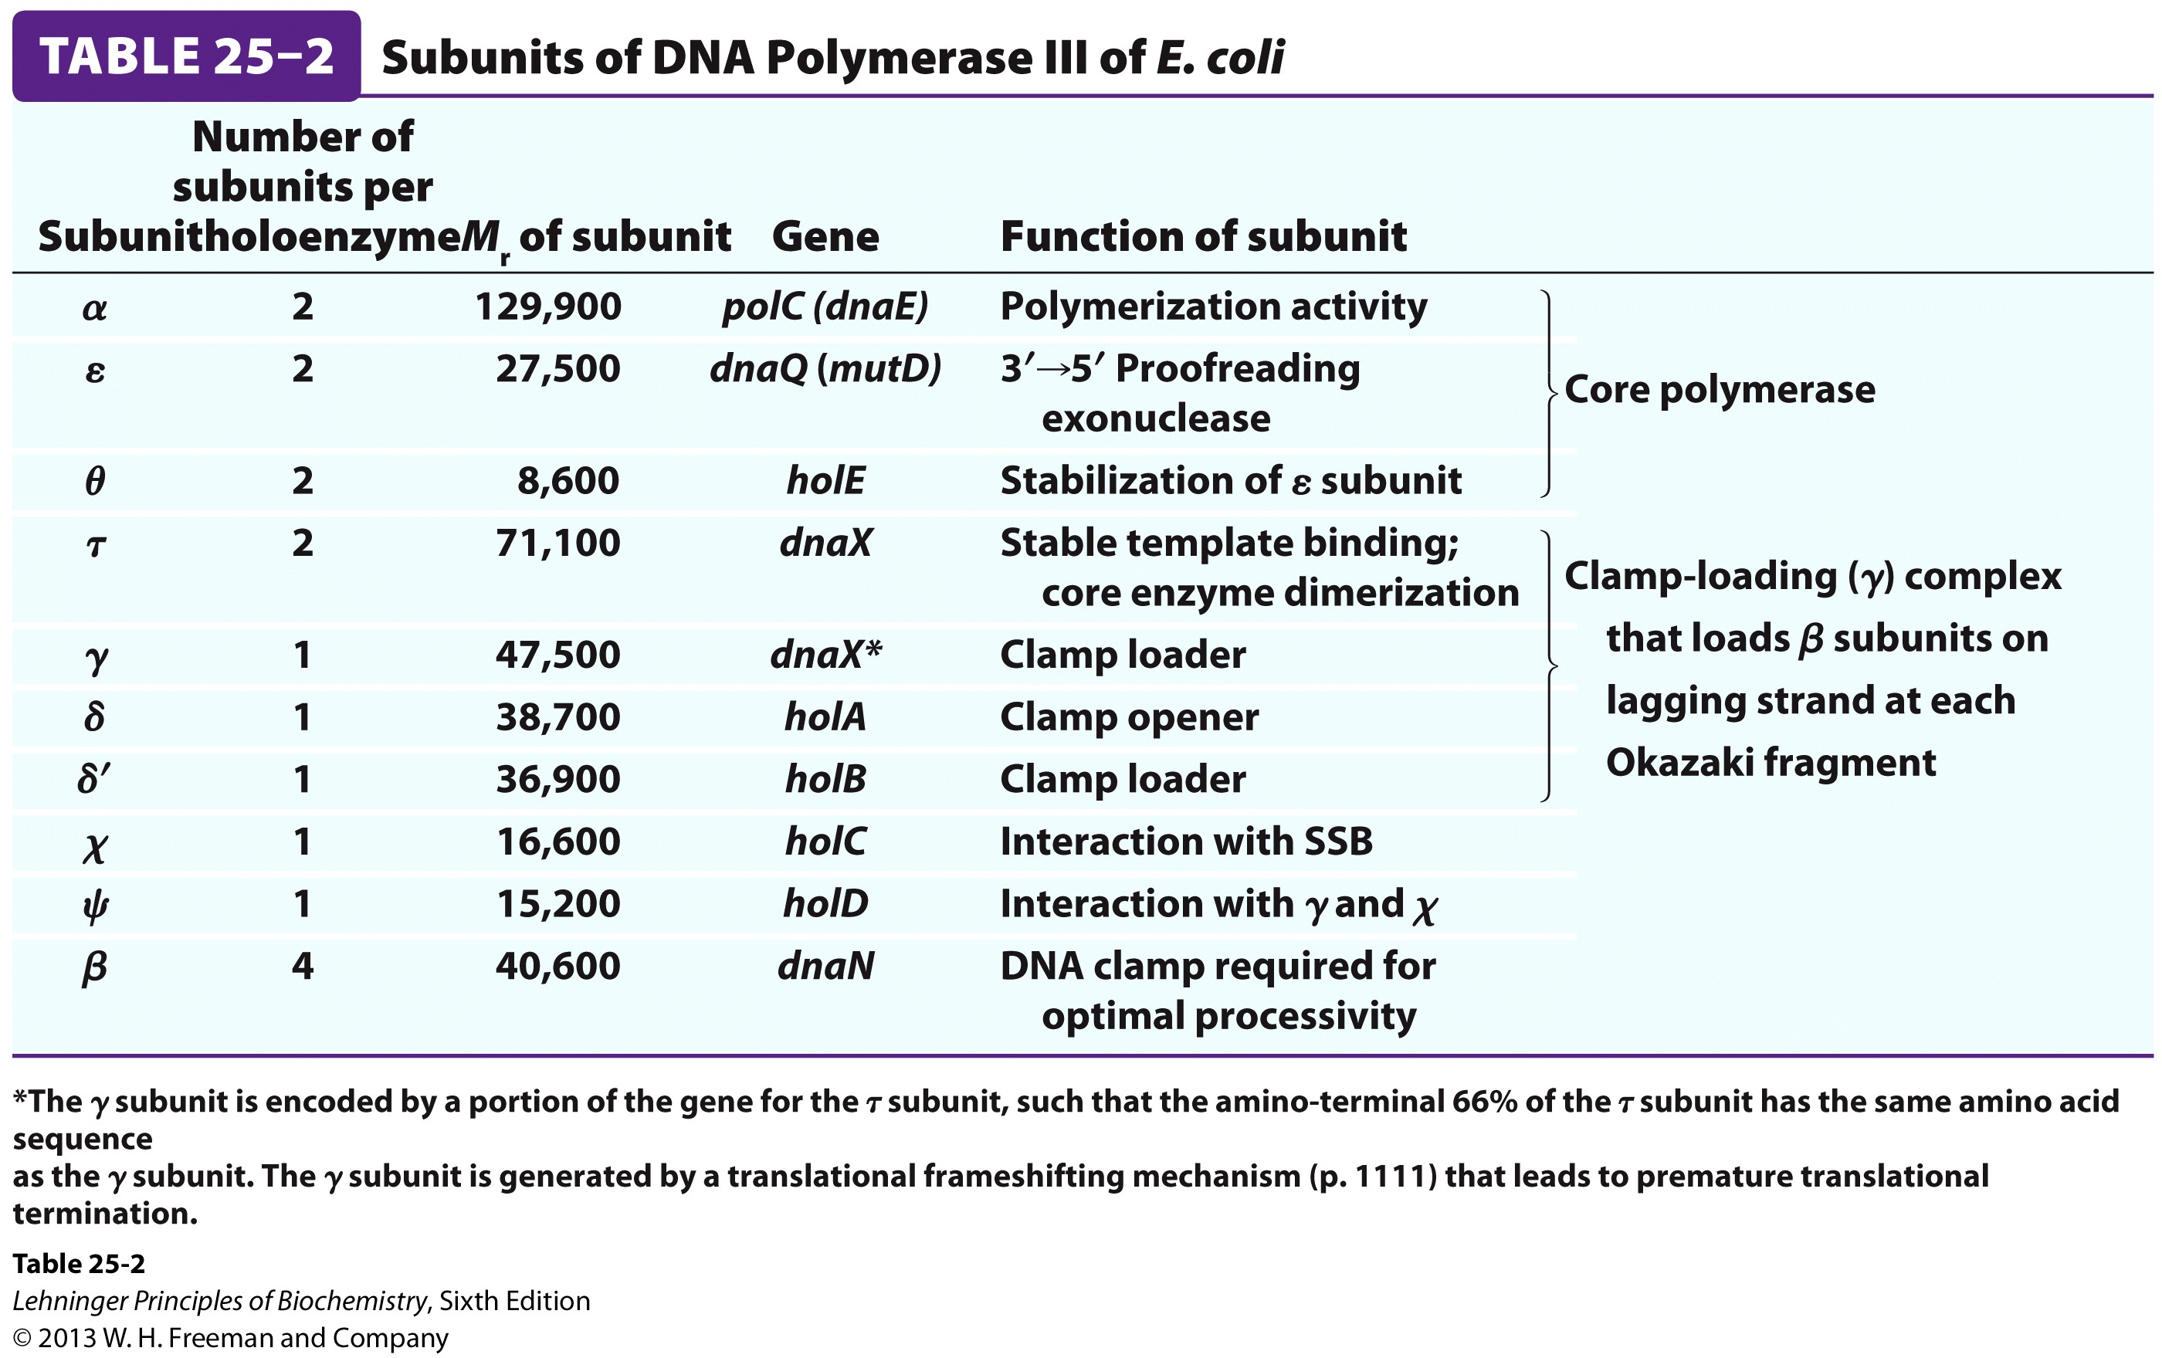
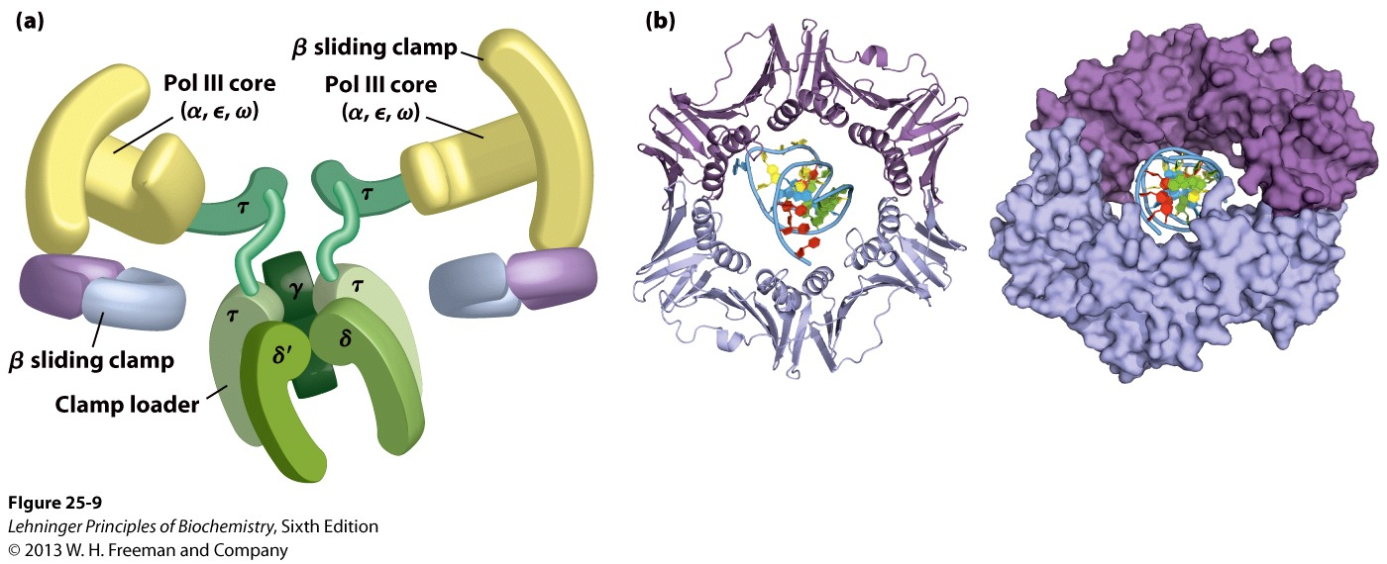
DNA Pol III
Forms of DNA Helices
Many subunits and protomers required for function

Slide 23
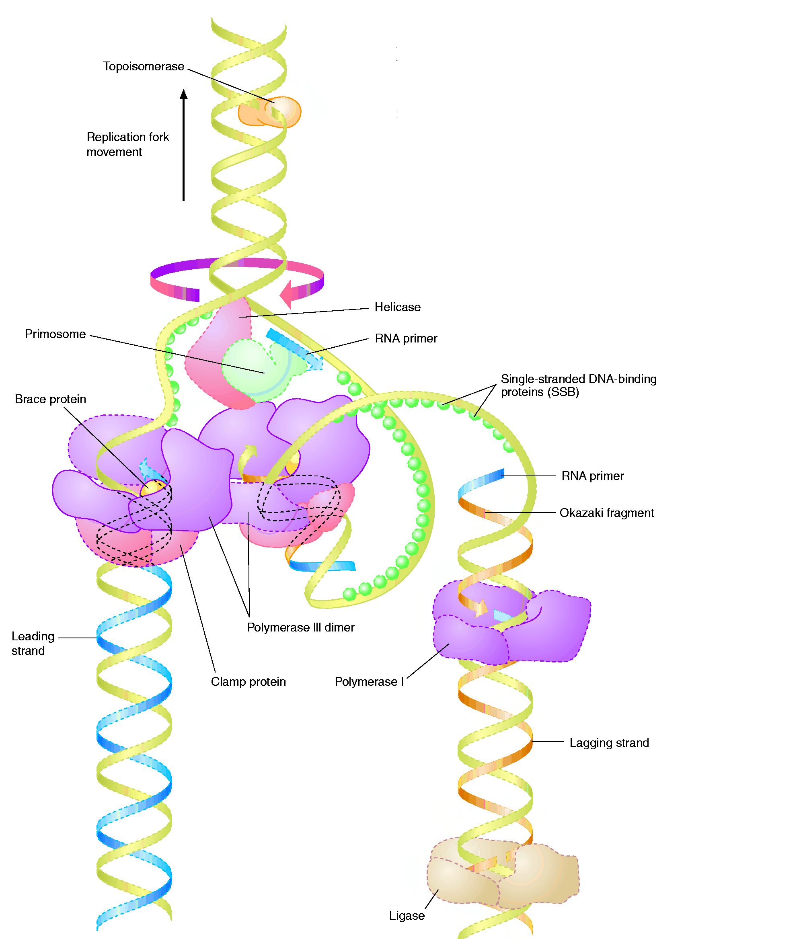
The Big Picture (in E.coli)
Forms of DNA Helices
Topoisomerase: relieves topological strain
Helicase - unwinds dsDNA at replication fork
SSB: keeps ssDNA from reannealing
Primase: synthesizes RNA primers for lagging strand
Pol III elongates lagging strand until strained. It then releases the template and rebinds at a new primed location.
DNA Polymerase III : elongate primed DNA from 5’→3’
3’→5’ exonuclease activity limits errors
Pol I: closes any gaps in lagging strand and replaces RNA primer; 5’→3’ exonuclease activity
Ligase: seals off backbone nicks

Slide 24
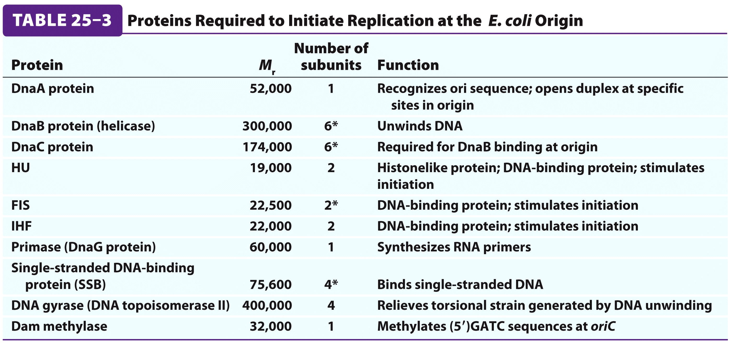
Formation of the Replisome
Forms of DNA Helices
DUE = DNA Unwinding Element
It all comes down to a sequence (or a set of them!)
We call this the Origin of Replication, oriC.
Goal of different Initiation Proteins:
Open the helix
Form prepriming complex
Important in timing DNA replication: DnaA binds to fully methylated DNA at oriC

Slide 25
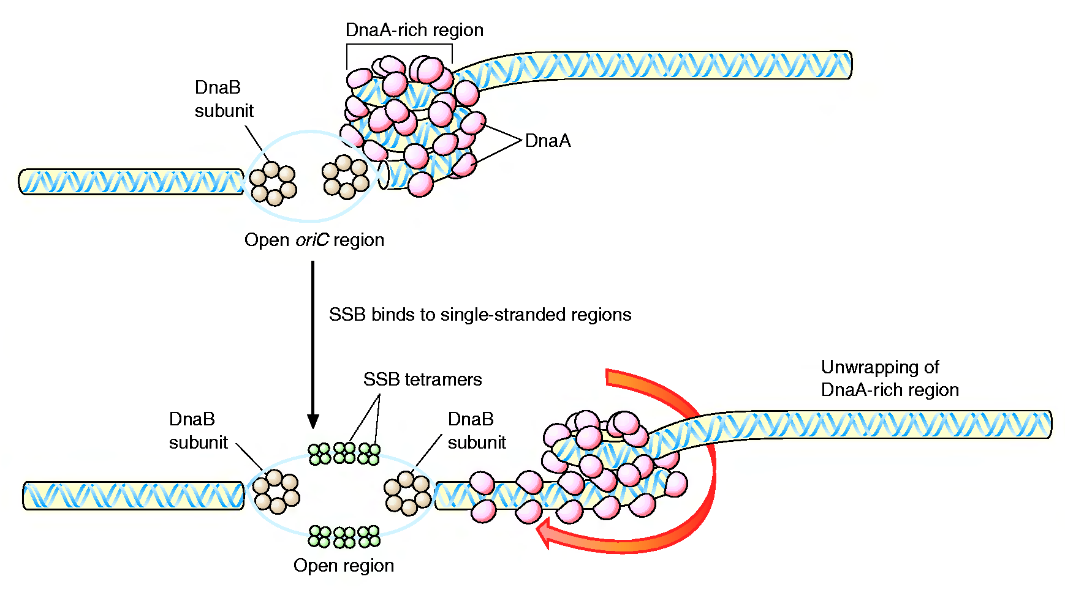
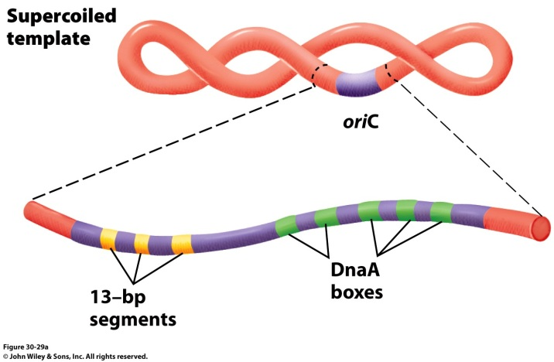
Formation of the Replication Fork
Forms of DNA Helices
4 DnaA proteins bind to the oriC region (recognizes 9 nucleotide segments)
Additional DnaA monomers bind forming a histone like complex of tightly wound DNA
Localized melting of a 13bp repeats
DnaB (6 subunit helicase) binds and unwinds the DNA
Topoisomerase functions downstream to relieve stress
Single Strand DNA binding proteins prevent the ssDNA from reannealing

Slide 26
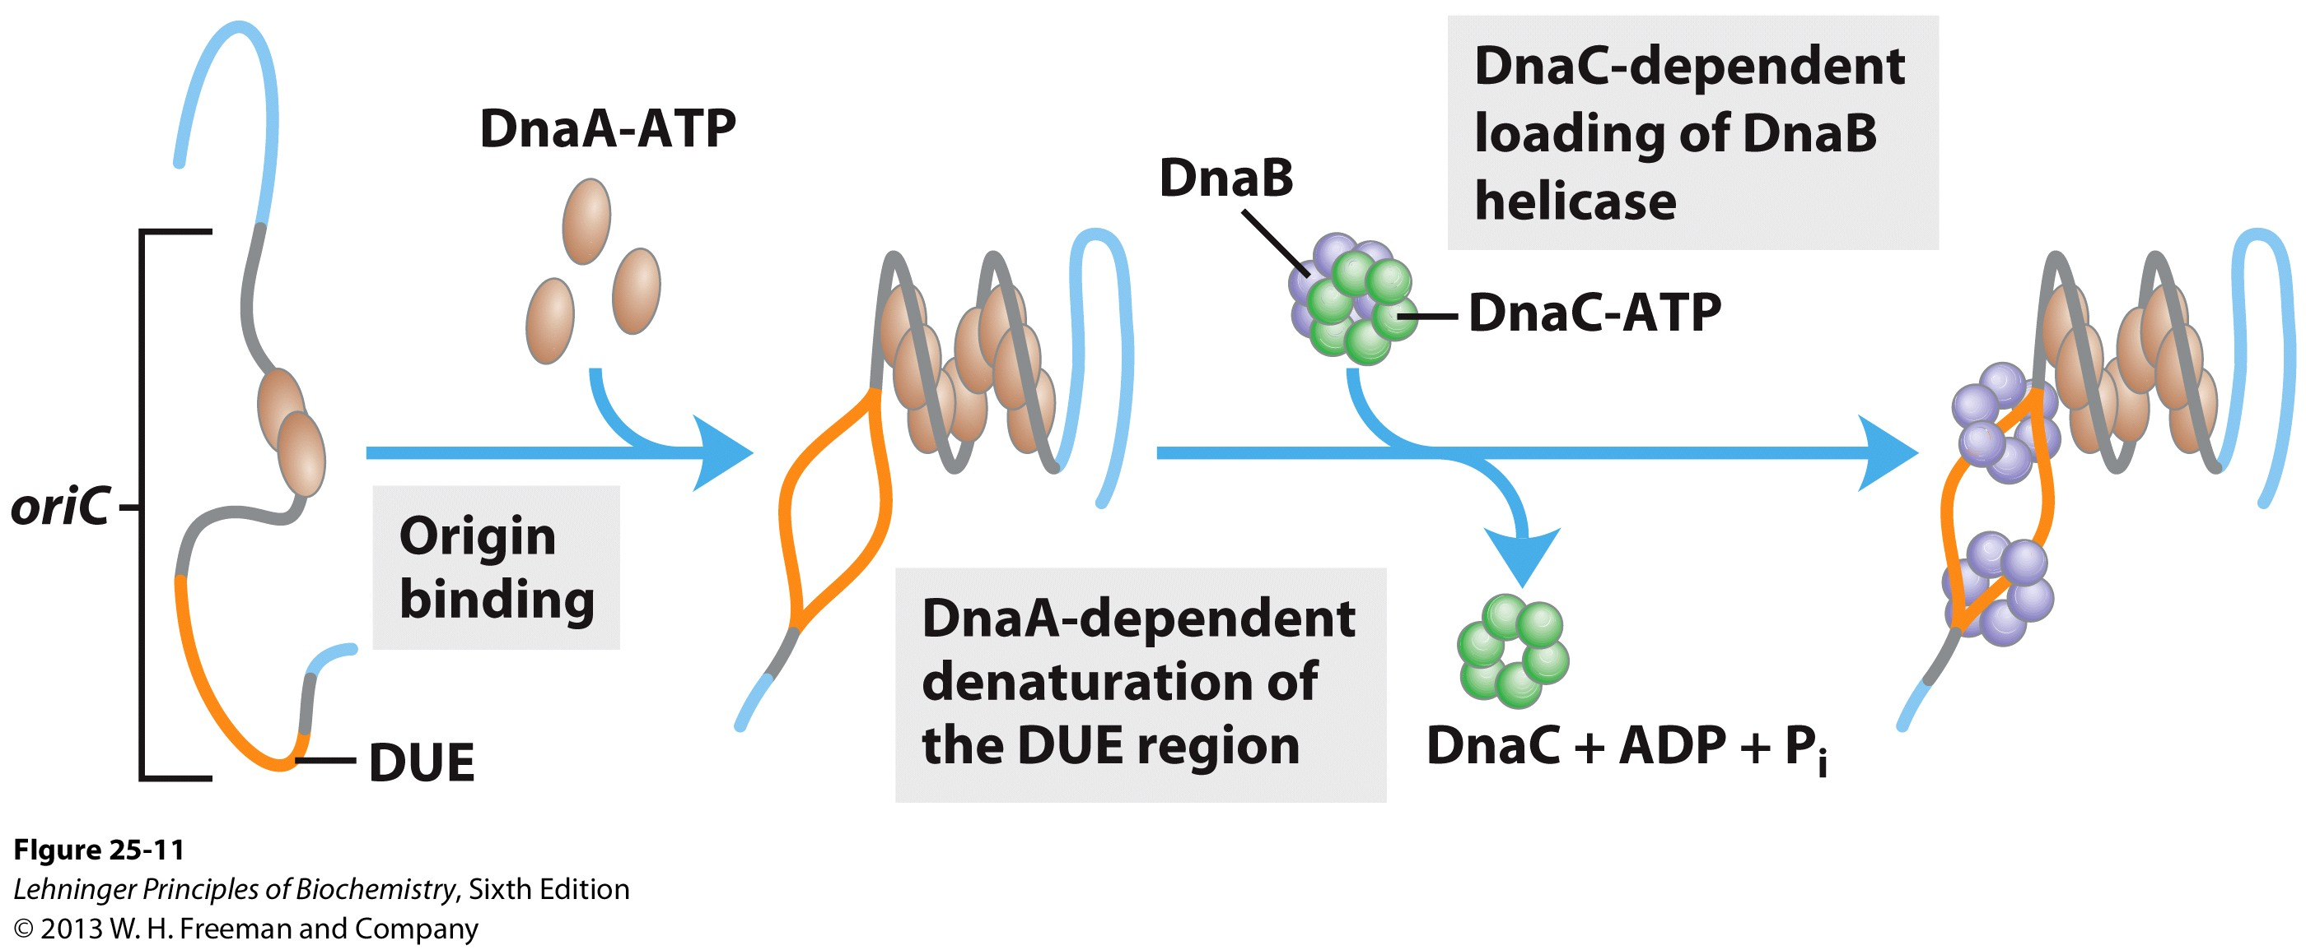
Formation of the Replication Fork
Forms of DNA Helices
ATP-bound DnaA molecules sit on 3 of the 5 DnaA boxes of the origin.
They recruit additional DnaA molecules to occupy the remaining boxes
This introduces positive supercoiling into the DNA, causing the DNA to unwind
The ATPase domain of DnaA may actively unwind DNA as a function of ATP hydrolysis
4) The oriC-DnaA complex recruits DnaB-DnaC hexamers to actively separate the DNA helix (DnaB is a helicase, DnaC is a loading protein that places DnaB onto the strand)
DnaA helical filament – 8 monomers per turn

Slide 27
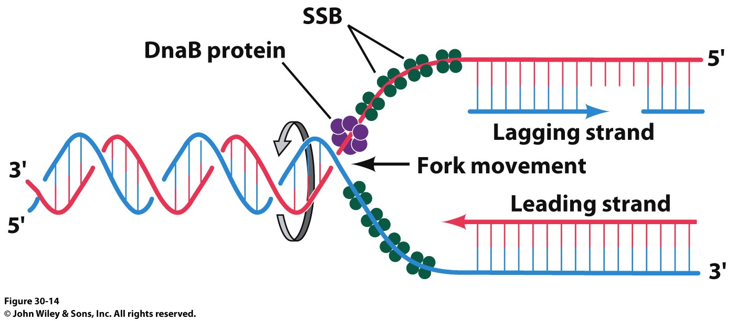
Formation of the Replication Fork
Forms of DNA Helices
DNA Gyrase (Topoisomerase II)
Crucial to deal with the supercoiling and twisting that the strands would do as they are unwound

Slide 28
DnaA proteins bind at R and I sites in oriC
DnaA proteins are ATPases
Eight DnaAs bind to R and I sites
DNA wraps around the complex forming a positive supercoil
Strain leads to denaturation of nearby DUE sites
Associated proteins facilitate DNA bending

Slide 29
DnaB helicase continues initiation
DnaB hexamer structure is opened by the binding of DnaC
DnaB then binds to separated strands
DnaB migrates along ssDNA 5’→3’ and unwinds the helix
Other proteins (DNA Pol III, etc.) link to DnaB
Single-stranded DNA-binding protein (SSB) stabilizes separated strands
DNA gyrase relieves topological stress ahead of the replication forks

Slide 30
Initiation is regulated to occur once per cell cycle
Hda binds to β subunits of DNA Pol III, stimulates hydrolysis of DnaA’s ATP
Hda is Homologous to DnaA
DnaA complex then dissociates
ADP dissociates
ATP rebinds to DnaA to stimulate all over again
Time scale: 20–40 mins
Length of Proklaryotic Cell Cycle depends upon the time it takes for DnaA to complete a trip down the length of the bacterial chromosome

Slide 31
Regulation of Replication Initiation via Methylation
After replication, oriC is hemimethylated by Dam methylase
Dam = DNA adenine methylase
Methylates N⁶ of A in GATC sequences
Hemimethylated oriC sequences interact with plasma membrane (uses protein SeqA)
After a period, SeqA dissociates, oriC sequences are released from membrane
Dam methylase fully methylates DNA to allow new DnaA to bind

Slide 32
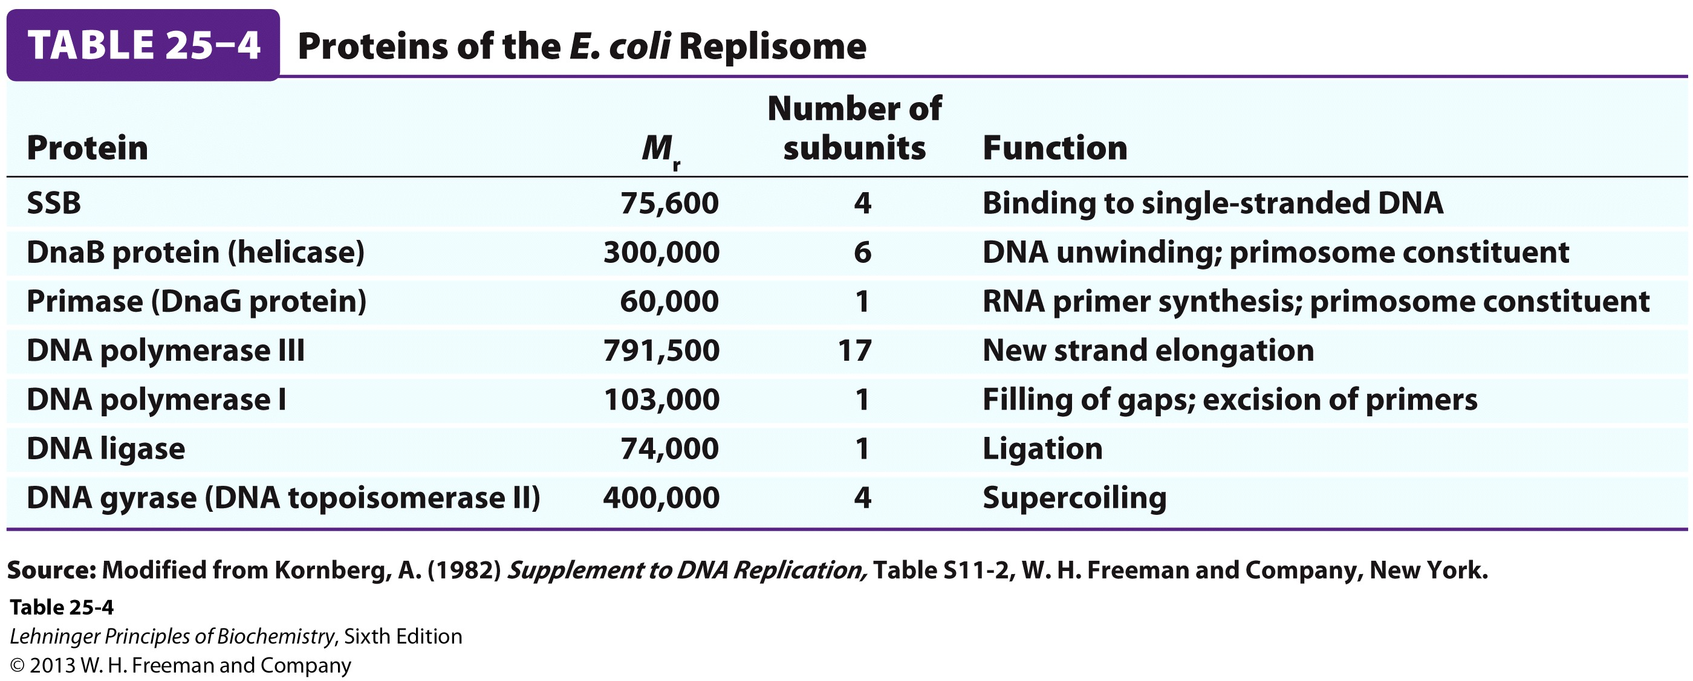
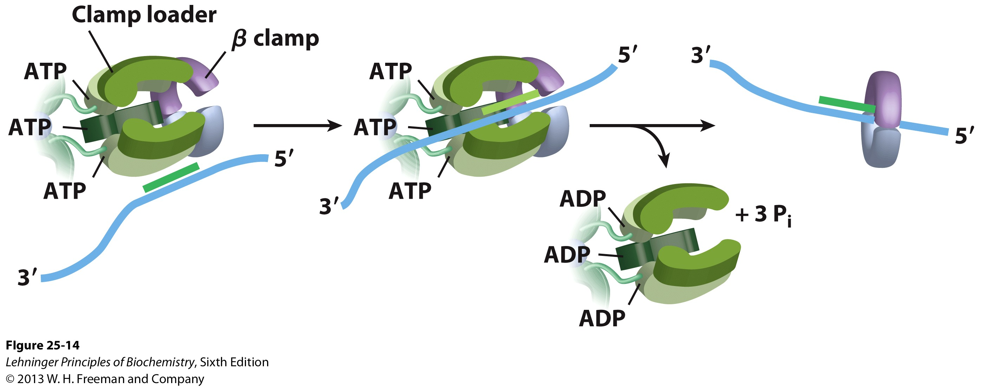
Formation of the Replisome
Forms of DNA Helices
(1° Replication Apparatus)

Slide 33
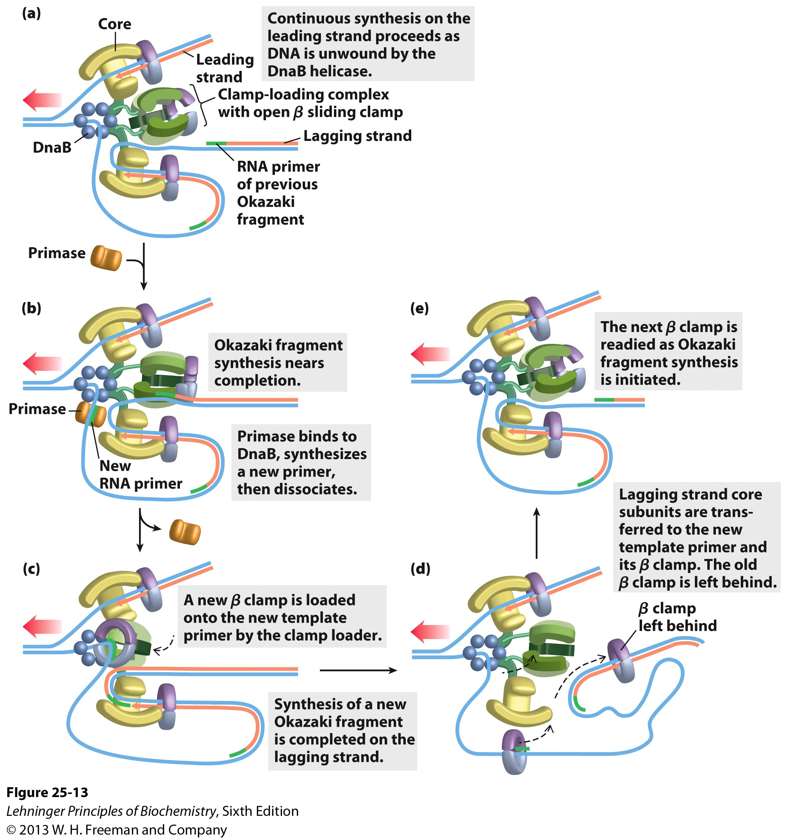
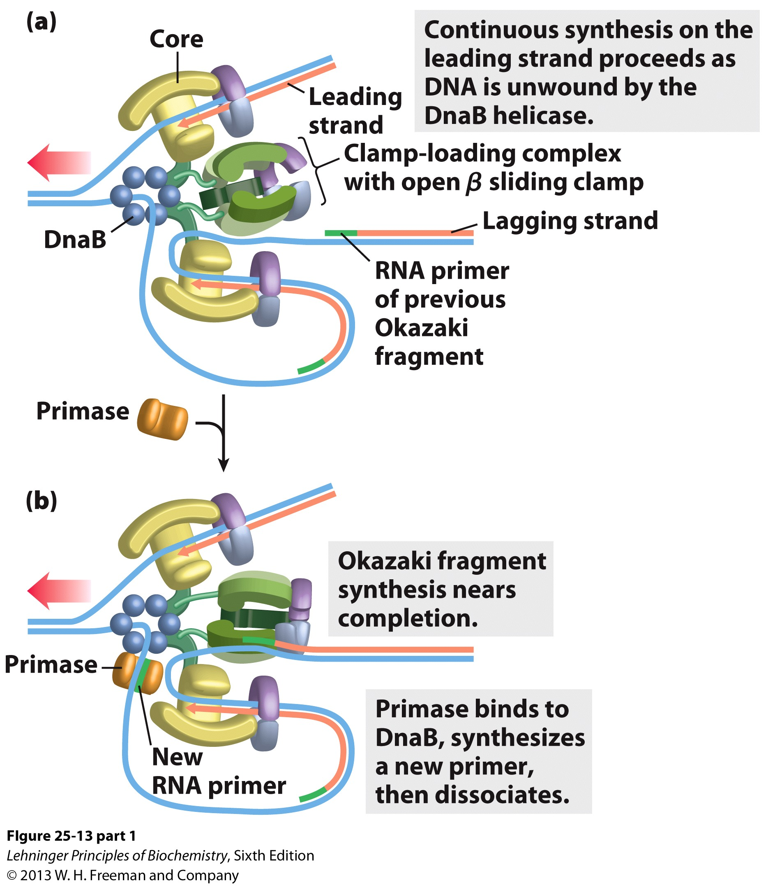
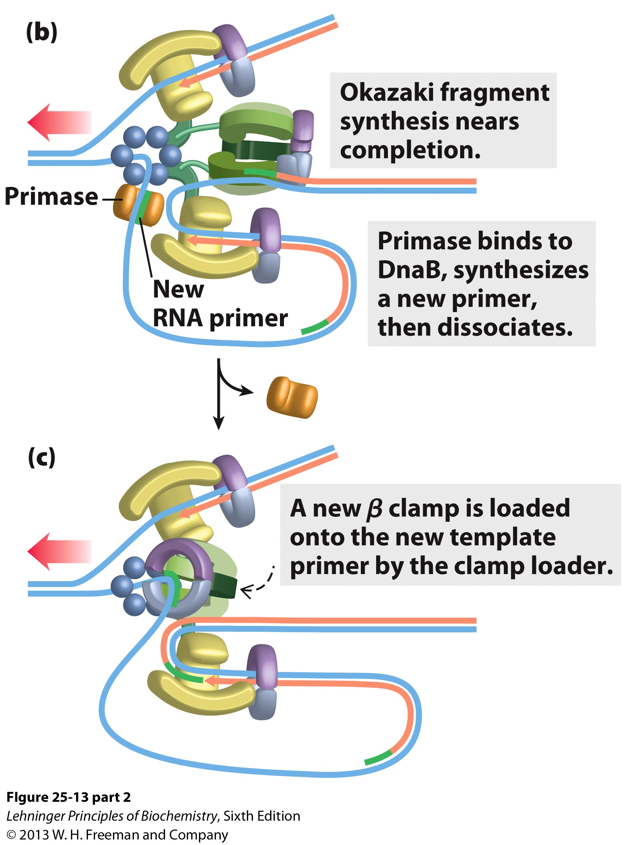
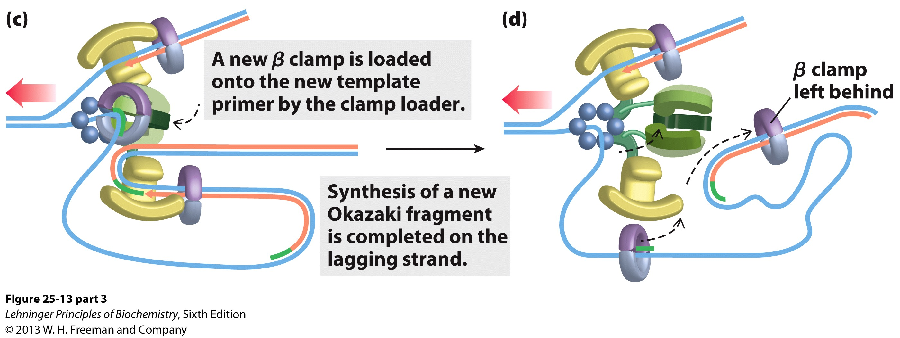
We’re loaded and primed, let’s replicate!
Forms of DNA Helices

Slide 34
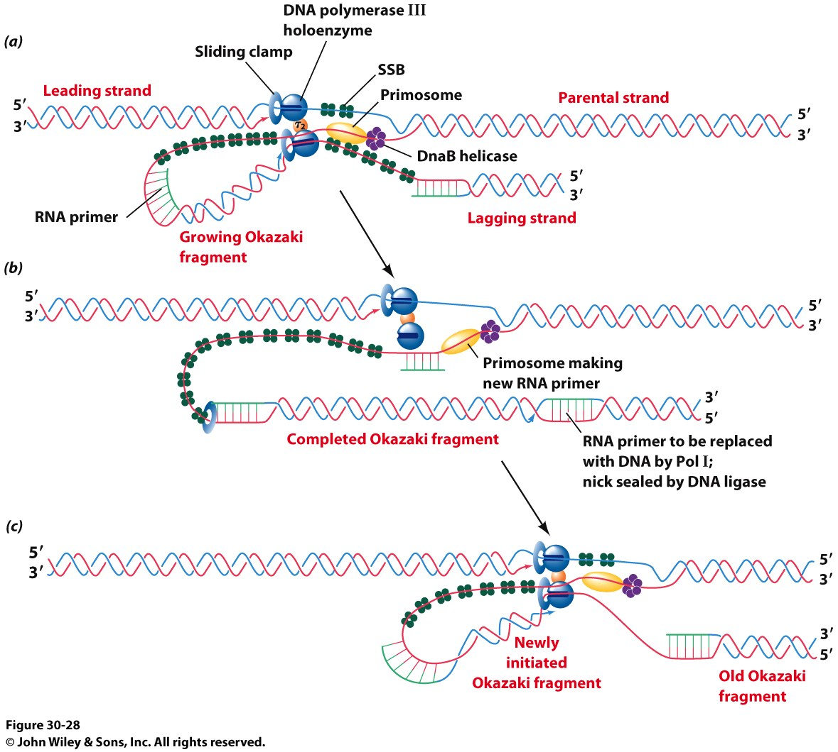
We’re loaded and primed, let’s replicate!
Forms of DNA Helices
Another look…

Slide 35
The β Clamp Release and Rebinding
Notes:
FIGURE 25–14 The DNA polymerase III clamp loader. The five subunits of the clamp-loading complex are the γ, δ, and δ’ subunits and the amino-terminal domain of each τ subunit (see Fig. 25–9). The complex binds to three molecules of ATP and to a dimeric β clamp. This binding forces the β clamp open at one of its two subunit interfaces. Hydrolysis of the bound ATP allows the β clamp to close again around the DNA.

Slide 36
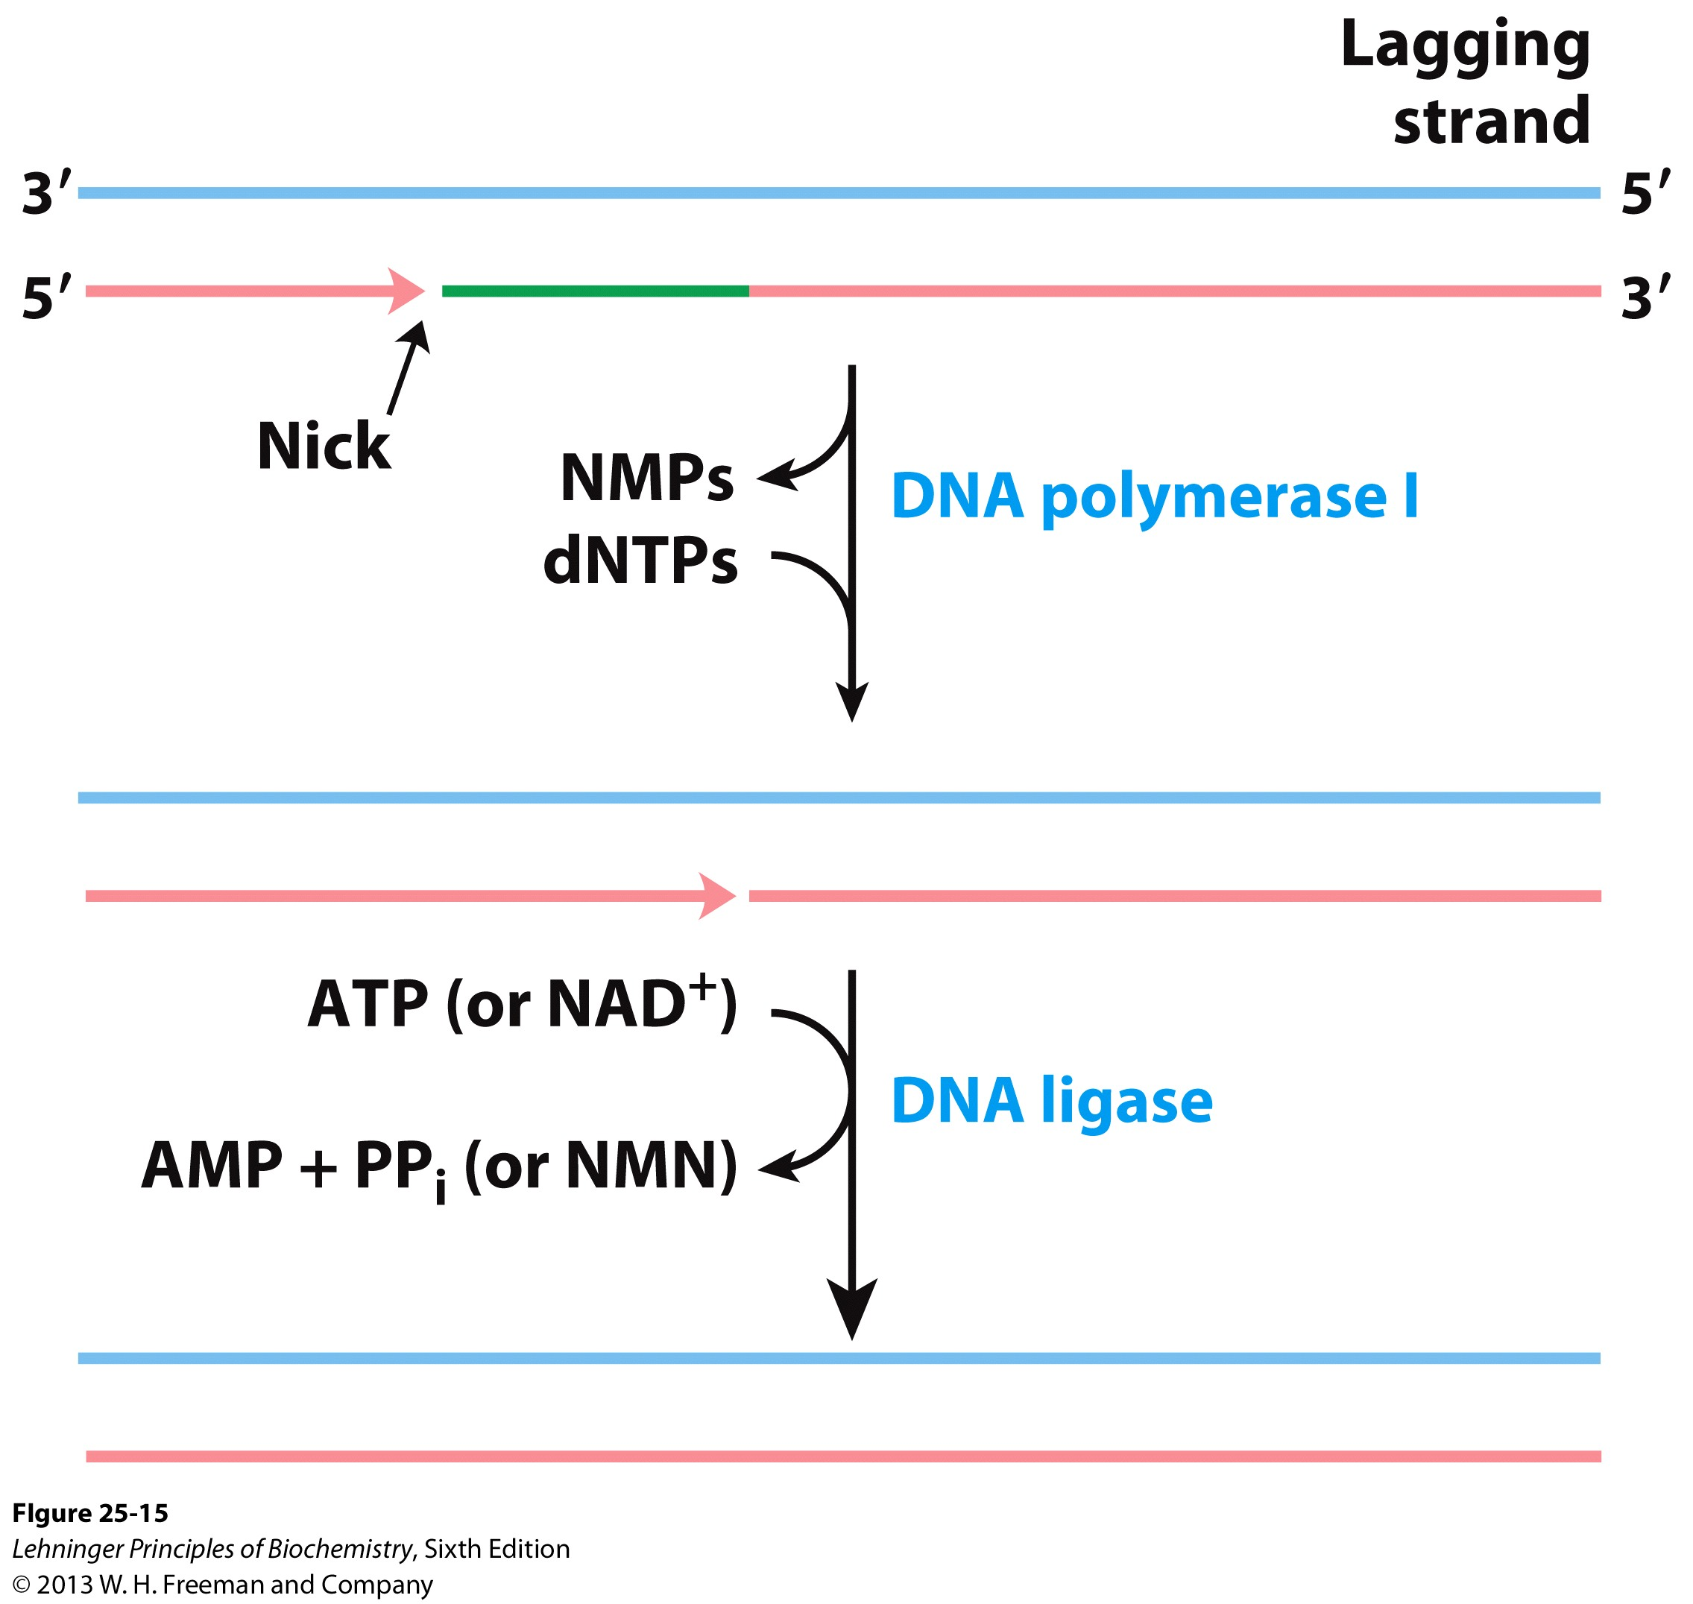
The Lagging Strand Still Has RNA Primers…
Forms of DNA Helices

Slide 37
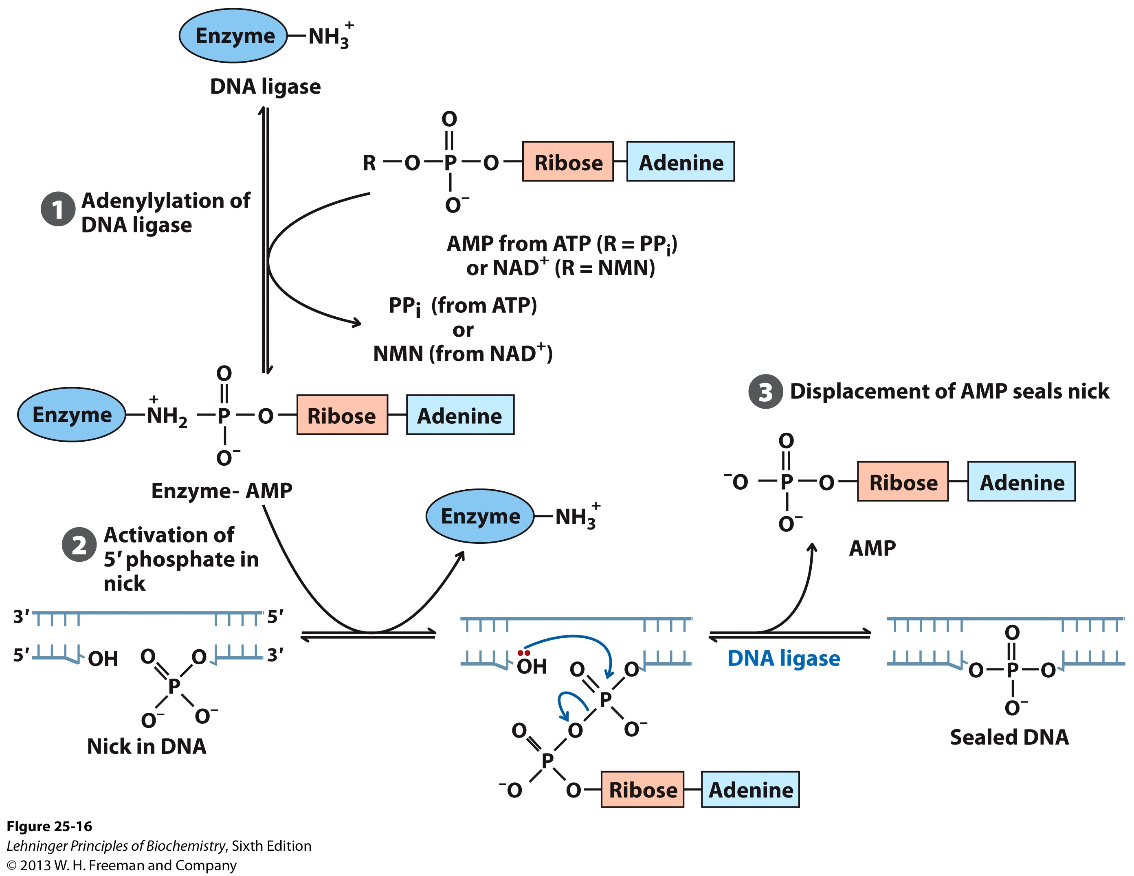
Sealing the Nicks in the Lagging Strand
Forms of DNA Helices
What is the point of this step? Why attach AMP to the 5’ PO₄?
Reaction Catalyzed by DNA ligase

Slide 38
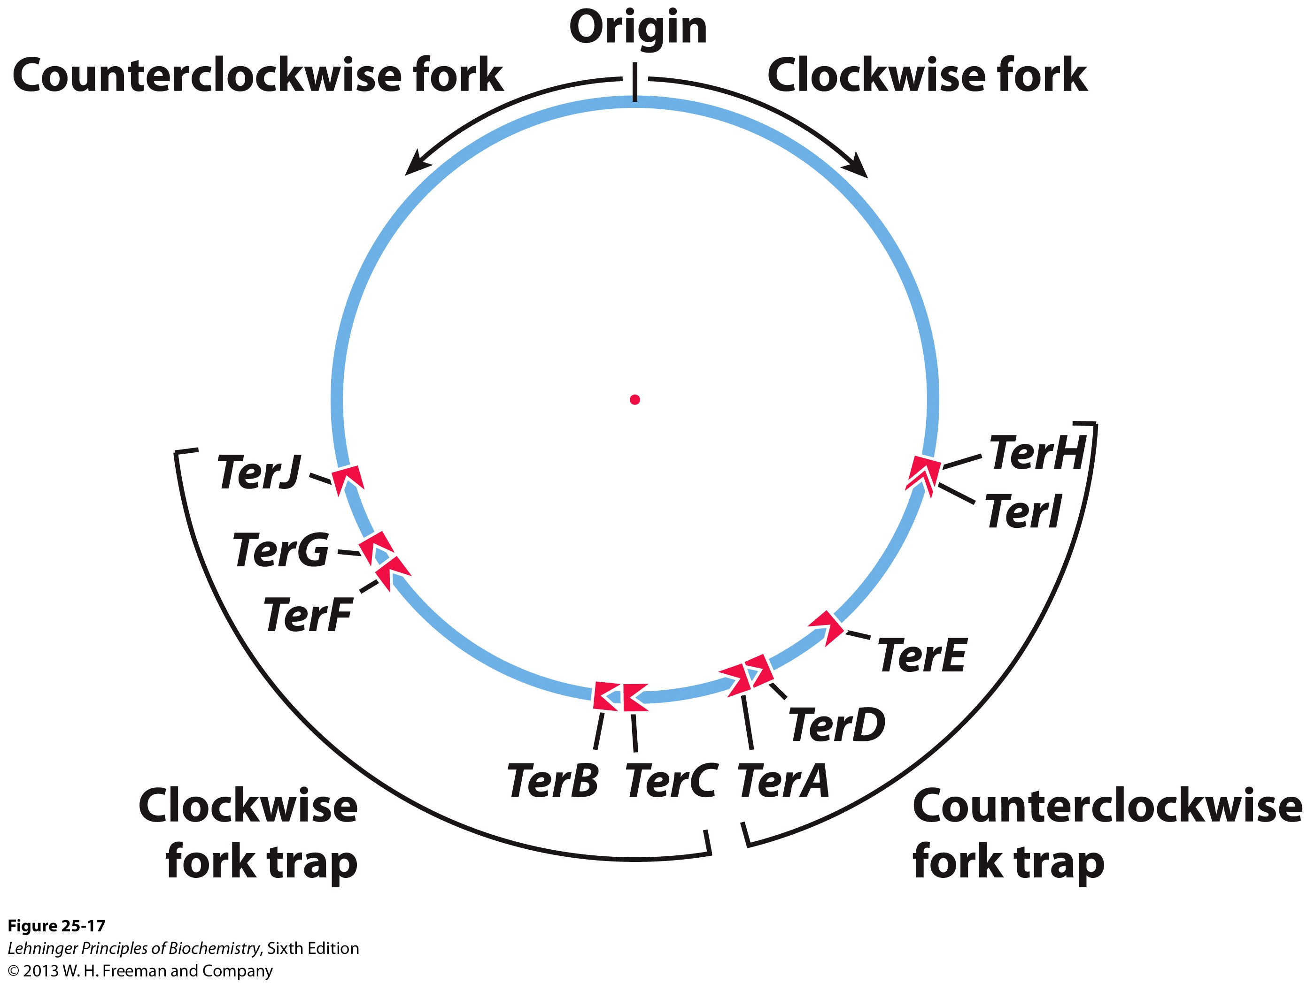
Finishing the Job: Termination
Forms of DNA Helices
The Ter sequences serve as binding sites for the Terminus Utilization Substance (Tus)
A Tus/Ter complex halts a polymerase in its tracks and replication stops.
No, we don’t really know how the Ter sequences are replicated!
It is assumed that some DNA polymerase finishes the job and seals the DNA strands after they split.

Slide 39
Questions to Ask Yourself
Forms of DNA Helices
Why is DNA PolI not the primary replicative DNA polymerase in E. coli?
Compare and contrast DNA PolI and DNA PolIII
What are all the components necessary to for the replisome and actively replicate DNA?
What is the mode and mechanism of DNA Replication?
What is the mechanism of DNA ligation?
What are the differences between DNA synthesis on the leading and lagging strand?
How is the fidelity of DNA replication maintained?
What are the domains of DNA Polymerases?

